Slide 1
2026 MCAS and Accountability Results
Presentation to the Board of Elementary and Secondary Education
September 22, 2026

Slide 2
Timeline of Release
Districts started receiving their results in May on a rolling basis
Earliest delivery of results to parents and guardians in history of the MCAS program
  New family portal was made available to districts to share with parents and guardians on August 14th
  Portal contained 2026 MCAS results and results from the last three school years
Public release on September 22nd

Slide 3
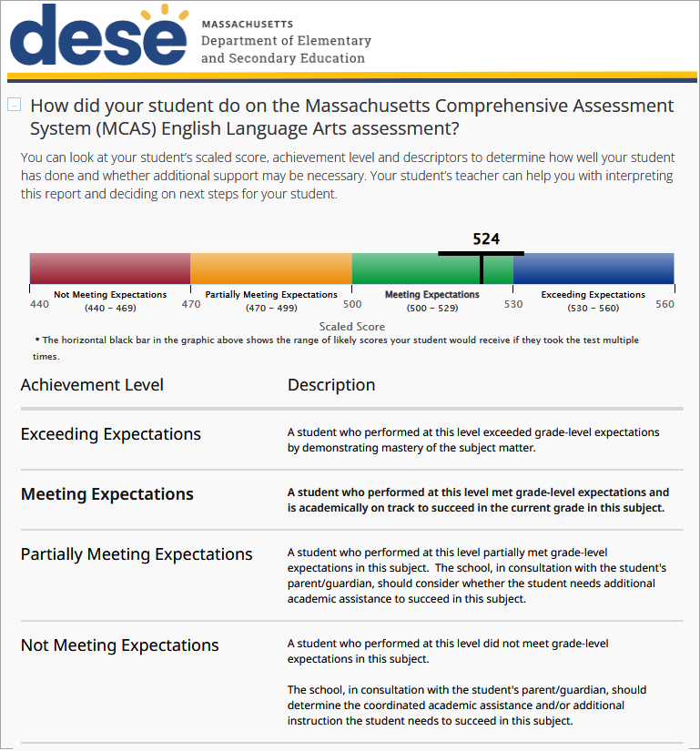
MCAS Family Portal
Here you can see your student’s score and achievement level, which show you how well they did on the test. In this example, the student’s score was 524, which is in the Meeting Expectations level.
Print pages from the MCAS Family Portal directly from your browser.

Slide 4
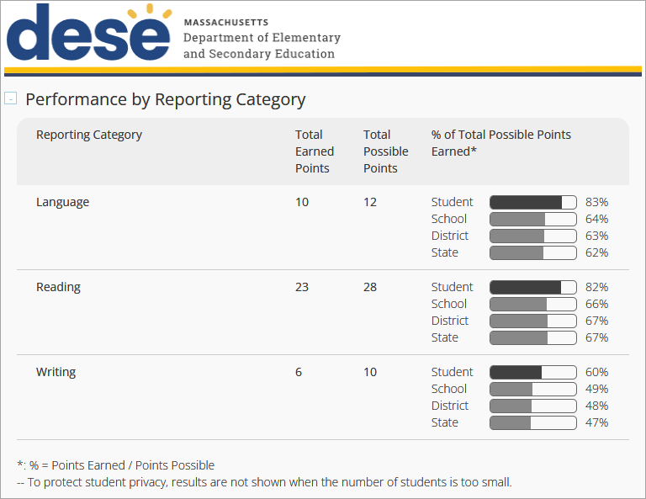
MCAS Family Portal
See how your student performed on specific reporting categories, or areas of learning within a subject.
Compare the percentage of points your student earned with the percentage of points other students in their school, district, and state earned.

Slide 5
MCAS Results
For grades 3-8 and 10, ELA results decreased from 2025.
For grades 3-8 and 10, Math results were mostly flat.
Results in Science reflected an increase in grade 8 and a decrease in grades 5 and 10 when compared to 2025.
Results in grade 8 Civics were flat.
A majority of schools have stabilized across the last two years

Slide 6
2026 ELA Results for Grades 3-8
Due to rounding, the sum of the achievement level categories may not equal 100.
Grades | 2026 NM % | 2026 PM % | 2026 M % | 2026 E % | 2026 M/E % | M/E Change Compared to 2025 | M/E Change Compared to 2019
Grade 3 | 19 | 38 | 35 | 8 | 43 | +1 | -13
Grade 4 | 18 | 45 | 33 | 5 | 37 | -3 | -15
Grade 5 | 18 | 44 | 34 | 4 | 38 | 0 | -14
Grade 6 | 24 | 36 | 32 | 9 | 40 | -2 | -13
Grade 7 | 22 | 39 | 32 | 8 | 40 | -2 | -8
Grade 8 | 25 | 34 | 32 | 10 | 42 | -2 | -10
Grades 3-8 | 21 | 39 | 33 | 7 | 40 | -2 | -12

Slide 7
2026 ELA Results by Student Group for Grades 3-8
Due to rounding, the sum of the achievement level categories may not equal 100.
Student Groups | 2026 NM % | 2026 PM % | 2026 M % | 2026 E % | 2026 M/E % | M/E Change Compared to 2025 | M/E Change Compared to 2019
Black or African American | 32 | 43 | 22 | 3 | 25 | -1 | -8
Asian | 10 | 28 | 45 | 17 | 62 | -2 | -10
Hispanic or Latino | 35 | 43 | 19 | 2 | 22 | 0 | -11
Multi-Race, Not Hispanic or Latino | 16 | 35 | 38 | 11 | 49 | 0 | -7
American Indian or Alaska Native | 29 | 46 | 23 | 3 | 26 | -2 | -14
Native Hawaiian or Other Pacific Islander | 25 | 40 | 30 | 5 | 34 | -4 | -17
White | 14 | 38 | 39 | 9 | 48 | -2 | -11
English Learners | 60 | 36 | 4 | 0 | 4 | -1 | -11
Low Income | 34 | 44 | 19 | 2 | 22 | -1 | N/A
Students with Disabilities | 51 | 39 | 10 | 1 | 11 | -1 | -5

Slide 8
2026 Math Results for Grades 3-8
Due to rounding, the sum of the achievement level categories may not equal 100.
Grades | 2026 NM % | 2026 PM % | 2026 M % | 2026 E % | 2026 M/E % | M/E Change Compared to 2025 | M/E Change Compared to 2019
Grade 3 | 21 | 37 | 33 | 9 | 42 | -2 | -7
Grade 4 | 19 | 38 | 36 | 7 | 43 | 0 | -7
Grade 5 | 14 | 46 | 34 | 6 | 39 | -1 | -9
Grade 6 | 16 | 42 | 35 | 7 | 43 | +2 | -9
Grade 7 | 19 | 43 | 28 | 10 | 37 | -2 | -11
Grade 8 | 20 | 38 | 34 | 8 | 42 | +4 | -4
Grades 3-8 | 18 | 41 | 33 | 8 | 41 | 0 | -8

Slide 9
2026 Math Results by Student Group for Grades 3-8
Due to rounding, the sum of the achievement level categories may not equal 100.
Student Groups | 2026 NM % | 2026 PM % | 2026 M % | 2026 E % | 2026 M/E % | M/E Change Compared to 2025 | M/E Change Compared to 2019
Black or African American | 31 | 47 | 20 | 2 | 22 | 0 | -6
Asian | 6 | 22 | 44 | 27 | 71 | 0 | -5
Hispanic or Latino | 31 | 48 | 19 | 2 | 21 | +1 | -8
Multi-Race, Not Hispanic or Latino | 15 | 37 | 36 | 12 | 48 | 0 | -3
American Indian or Alaska Native | 26 | 47 | 23 | 4 | 27 | 0 | -10
Native Hawaiian or Other Pacific Islander | 23 | 44 | 27 | 6 | 33 | -3 | -11
White | 11 | 39 | 41 | 8 | 50 | +1 | -6
English Learners | 48 | 43 | 8 | 0 | 8 | -1 | -9
Low Income | 31 | 48 | 19 | 2 | 21 | 0 | N/A
Students with Disabilities | 46 | 42 | 11 | 1 | 13 | 0 | -2

Slide 10
2026 ELA Results for Grade 10
Due to rounding, the sum of the achievement level categories may not equal 100.
Student Groups | 2026 NM % | 2026 PM % | 2026 M % | 2026 E % | 2026 M/E % | M/E Change Compared to 2025 | M/E Change Compared to 2019
All Students | 17 | 37 | 34 | 12 | 45 | -6 | -16
Black or African American | 26 | 45 | 25 | 4 | 29 | -6 | -9
Asian | 7 | 22 | 44 | 28 | 72 | -4 | -6
Hispanic or Latino | 29 | 44 | 22 | 4 | 27 | -4 | -10
Multi-Race, Not Hispanic or Latino | 14 | 33 | 36 | 17 | 53 | -3 | -12
American Indian or Alaska Native | 17 | 52 | 25 | 6 | 31 | -7 | -22
Native Hawaiian or Other Pacific Islander | 19 | 35 | 30 | 16 | 46 | +3 | -6
White | 11 | 35 | 39 | 14 | 54 | -5 | -15
English Learners | 68 | 31 | 1 | 0 | 1 | -1 | -2
Low Income | 29 | 44 | 23 | 4 | 27 | -4 | N/A
Students with Disabilities | 43 | 44 | 11 | 1 | 13 | -4 | -9

Slide 11
2026 Math Results for Grade 10
Due to rounding, the sum of the achievement level categories may not equal 100.
Student Groups | 2026 NM % | 2026 PM % | 2026 M % | 2026 E % | 2026 M/E % | M/E Change Compared to 2025 | M/E Change Compared to 2019
All Students | 15 | 41 | 33 | 11 | 44 | -1 | -15
Black or African American | 24 | 51 | 22 | 3 | 25 | -1 | -10
Asian | 4 | 18 | 39 | 39 | 77 | -1 | -5
Hispanic or Latino | 26 | 51 | 20 | 3 | 22 | -1 | -11
Multi-Race, Not Hispanic or Latino | 13 | 38 | 33 | 17 | 49 | +2 | -11
American Indian or Alaska Native | 17 | 54 | 24 | 5 | 29 | -9 | -15
Native Hawaiian or Other Pacific Islander | 21 | 28 | 36 | 16 | 52 | +14 | -11
White | 10 | 38 | 41 | 12 | 52 | -1 | -15
English Learners | 50 | 45 | 4 | 0 | 5 | 0 | -4
Low Income | 26 | 51 | 20 | 3 | 23 | -1 | N/A
Students with Disabilities | 39 | 49 | 10 | 1 | 11 | -1 | -7

Slide 12
2026 STE Results by Grade
Due to rounding, the sum of the achievement level categories may not equal 100.
Grades | 2026 NM % | 2026 PM % | 2026 M % | 2026 E % | 2026 M/E % | M/E Change Compared to 2025 | M/E Change Compared to 2019
Grade 5 | 21 | 36 | 35 | 8 | 43 | -3 | -6
Grade 8 | 21 | 41 | 33 | 6 | 39 | +2 | -7
Grades 5 & 8 | 21 | 38 | 34 | 7 | 41 | -1 | -7
Grade 10 | 21 | 39 | 31 | 10 | 41 | -5 | N/A

Slide 13
2026 Civics Results
Due to rounding, the sum of the achievement level categories may not equal 100.
Grade | 2026 NM % | 2026 PM % | 2026 M % | 2026 E % | 2026 M/E % | M/E Change Compared to 2025
Grade 8 | 17 | 44 | 31 | 9 | 40 | +1

Slide 14
2026 MCAS Results for
Chronically Absent Students
ELA
Grades | Average Scaled Score (Not Chronically Absent) | Average Scaled Score (Chronically Absent) | 2026 Average Scaled Score Difference | 2025 Average Scaled Score Difference | Percent M/E (Not Chronically Absent) | Percent M/E (Chronically Absent) | 2026 M/E Difference | 2025 M/E Difference
Grades 3-8 | 495 | 481 | -14 | -14 | 43 | 22 | -21 | -20
Grade 10 | 501 | 483 | -18 | -19 | 51 | 23 | -28 | -29
Math
Grades | Average Scaled Score (Not Chronically Absent) | Average Scaled Score (Chronically Absent) | 2026 Average Scaled Score Difference | 2025 Average Scaled Score Difference | Percent M/E (Not Chronically Absent) | Percent M/E (Chronically Absent) | 2026 M/E Difference | 2025 M/E Difference
Grades 3-8 | 497 | 480 | -17 | -16 | 44 | 18 | -26 | -25
Grade 10 | 500 | 481 | -19 | -20 | 49 | 17 | -32 | -33

Slide 15
A majority of schools have stabilized
Description | #: ELA | %: ELA | #: Math | %: Math
Declining in Both Years | 72 | 5% | 143 | 11%
Stable/Declining | 227 | 17% | 257 | 20%
Stable | 613 | 47% | 521 | 40%
Stable/Improving | 272 | 21% | 255 | 19%
Improving in Both Years | 132 | 10% | 137 | 10%
Total | 1,316 | 100% | 1,313 | 100%

Slide 16
56 Districts Met or Exceeded 2019 Levels of Achievement in Grades 3-8
 | ELA Only | Math Only | ELA and Math
Grades 3-8 | 5 | 37 | 14
14 districts have met or exceeded their 2019 achievement levels in both ELA and Math for grades 3-8.
Arlington **
Benjamin Banneker Charter Public School **
Central Berkshire **
Excel Academy Charter School **
Farmington River Regional **
Greater Commonwealth Virtual District *
Hawlemont *
Libertas Academy Charter School **
New Heights Charter School of Brockton *
Petersham *
Shutesbury *
Southbridge *
Wakefield **
Williamsburg **
* New in 2026
** Recognized in 2025

Slide 17
2026 Accountability Results

Slide 18
Massachusetts’ Accountability System
The Massachusetts accountability system consists of two components…
1
2
…that measure performance of groups, schools, and districts on specific indicators…
Achievement
Normative Component
(Accountability Percentile)
English Learner Proficiency
Student Growth
Additional Indicators
measures the performance of all students in a school compared to other schools in the state that serve similar grades, and is reported as a percentile from 1 to 99
High School Completion
3
…and are used to categorize schools and districts as requiring assistance/intervention or not.
Criterion-Referenced Component (Targets)
Not requiring assistance or intervention
Requiring assistance or intervention
measures a district’s or school’s progress towards improvement targets, and is reported as a percentage from 0 to 100
Schools of recognition Recognized for high achievement, high growth, or exceeding targets | Meeting or exceeding targets Cumulative criterion-referenced target percentage 75-100 | Substantial progress toward targets Cumulative criterion-referenced target percentage 50-74 | Moderate progress toward targets Cumulative criterion- referenced target percentage 25-49 | Limited or no progress toward targets Cumulative criterion- referenced target percentage 0-24 | Focused/ targeted support Percentiles 1-10 Low graduation rate Low performing group(s) Low participation | Broad/ comprehensive support Underperforming schools Chronically underperforming schools

Slide 19
Overall Accountability Classification
Schools are classified as “Requiring assistance or intervention” if they meet one or more of the following criteria:
  Designated as a Chronically Underperforming School
  Designated as an Underperforming School
  Among the lowest performing 10% of schools in the state
  High school with a graduation rate below 66.7%
  Among the lowest performing student groups in the state
  Not meeting assessment participation requirements

Slide 20
2026 School Accountability Results
All schools receive an overall accountability classification that describes the need for assistance or intervention
Total of 1,803 schools in the 2025-26 school year
  224 received a classification of “Insufficient data” primarily because the school did not serve any tested grades (e.g., PK-2 school)
Of the remaining 1,579 schools:
  1,264 (80%) were classified as “Not requiring assistance or intervention”
  315 (20%) were classified as “Requiring assistance or intervention” for one or more reasons
DESE is not announcing any decisions about schools entering or exiting underperforming status at this time

Slide 21
Progress Towards Targets
53% of schools in MA made substantial progress towards, met,
or exceeded their accountability targets in 2026 as compared to 54% in 2025
Grade Span​ | 2026 Number of Schools​ | 2025 Limited or No Progress Towards Targets​ (0-24%) | 2025 Moderate Progress Towards Targets​ (25-49%) | 2025 Substantial Progress Towards Targets​ (50-74%) | 2025 Meeting or Exceeding Targets ​(75-100%) | 2026 Limited or No Progress Towards Targets​ (0-24%) | 2026 Moderate Progress Towards Targets​ (25-49%) | 2026 Substantial Progress Towards Targets​ (50-74%) | 2026 Meeting or Exceeding Targets ​(75-100%)
ES/MS​ | 1,205 | 3.2% | 35.7% | 46.0% | 15.1% | 4.3% | 35.1% | 45.7% | 14.9%
MS/HS​ | 118 | 5.8% | 59.2% | 28.3% | 6.7% | 5.1% | 57.6% | 30.5% | 6.8%
HS only​ | 234 | 9.3% | 60.2% | 23.3% | 7.2% | 18.4% | 56.8% | 18.4% | 6.4%
Total​ | 1,557 | 4.3% | 41.2% | 41.2% | 13.2% | 6.5% | 40.1% | 40.5% | 13.0%
Due to rounding, the sum of the progress categories may not equal 100.

Slide 22
Schools of Recognition
DESE has identified 56 Schools of Recognition
Identified based on official accountability results, with an emphasis on improvement in ELA and Math achievement
Notation displayed on the school’s official accountability report and on DESE’s website

