Slide 1
State Student Advisory Council 2026-2027
Sara Khan, SSAC Chair & Student BESE Member
October 27, 2026

Slide 2
Agenda
Summer Leadership Retreat/Data Party
2026-2027 Council Year’s Focus
All Council Meeting
Looking Ahead

Slide 3
Summer Leadership Retreat
Elected SSAC Leadership
DESE Commissioner spoke to council
Held Data Party to identify council focus for the year
Identified benchmarks for the year
Notes:
*Some of the high-level activities the council did over the summer.
*A Data Party is an opportunity for the council to learn about Massachusetts educational and education-related youth data; gain data analysis and interpretation skills; and take a deeper dive into the data to identify areas of strength and concerns.

Slide 4
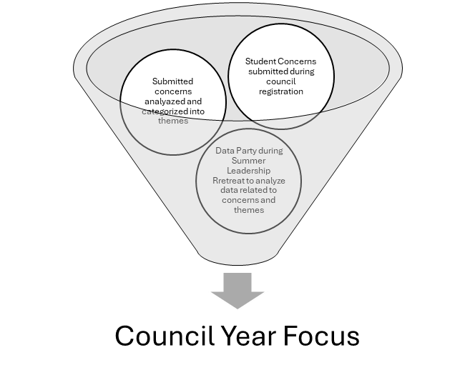
Process for Determining the Focus for the Council Year
Priority concerns of the students are submitted during the council’s registration and voting processes.
Submitted concerns are reviewed and contextualize into themes
Data centered around concerns/themes are analyzed and students come to consensus on the focus for the year through the Data Party held during the summer leadership retreat

Slide 5
Academic Climate
Academic climate refers to students’ perceptions of the extent to which their school’s instructional environment is student-centered, inclusive, relevant, and supportive of learning. This includes opportunities for student voice and autonomy, culturally responsive instruction and materials, and an emphasis on understanding rather than performance pressure.

Slide 6
Academic Climate Data
Views on Climate and Learning (VOCAL): 2026
Relevance & Representation : | 8th | 10th
What I'm learning is relevant to me | 59% | 56%
Read books that include people similar to me | 54% | 50%
Textbooks/materials reflect my race, background, and identity |  | 62%
Student Voice & Autonomy: | 4th | 5th | 8th | 10th
Voice in deciding school rules | 40% | 28% | 39%
OK to suggest other ways to do my work |  |  | 86% | 84%
Teachers ask students for feedback on instruction |  |  |  | 63%
Support & Pressure : | 8th | 10th
Teachers use my interests to help me learn | 73% | 66%
Teachers use my interests to help me learn |  | 65%
Pressure to perform well is unhealthy |  | 42%

Slide 7
September All Council Kick-Off Meeting Highlight
Council met all together for 1 hour then broke into regions for 2 hours
Collectively reviewed council structure, goals and focus for the year
Commissioner presented the new graduation framework
Every region held their data parties

Slide 8
Looking Ahead
Council remains in the gather and analyze phase till October/November then we'll transition to the share and connect phase
Each region will start preparing for their Stakeholder Engagement Events
  the council will work with the DESE team to let the Board members know when these events are being held.

Slide 9
Thank you
Questions?

