Slide 1
Graduation Framework: Foundational Coursework + Postsecondary Planning
Presentation to Massachusetts Board of Elementary and Secondary Education
Tuesday, October 27, 2026

Slide 2
Presenters
Lauren Woo, Deputy Commissioner
Adam Seidel, Senior Associate Commissioner of Secondary Schools and Beyond
Dr. John Papay, Walter and Leonore Annenberg Professor of Education Policy and Director of the Annenberg Institute, Brown University
Dr. Mandy Savitz-Romer, Nancy Pforzheimer Aronson Senior Lecturer in Human Development and Education at Harvard Graduate School of Education

Slide 3
Agenda
Purpose and alignment to the Strategic Plan
Graduation Framework at a glance
Foundational Coursework through MassCore
  Research presentation
Postsecondary Planning through MyCAP
  Research presentation
Board Discussion

Slide 4
Today's Purpose
To build shared understanding of MassCore and Postsecondary Planning – what each is, existing implementation and the impact
To prepare board members for informed decision-making as the implementation of proposed graduation requirements progresses
To prepare board members for proposed regulations requiring all high schools to offer MassCore and postsecondary planning through MyCAP

Slide 5
Strategic Plan Alignment
Future Focused brings together a portfolio of interconnected strategies and initiatives to deliver on our vision for high school success
The implementation of the recommended graduation framework is one initiative within Future Focused
Foundational coursework through MassCore and postsecondary planning through MyCAP are two primary components of the graduation framework

Slide 6
Graduation Framework
at a Glance

Slide 7
Statewide Graduation Council
Governor Healey issued an executive order in January 2025 establishing a K-12 Statewide Graduation Council. The Council was co-chaired by the DESE Commissioner and the Secretary of Education and charged with making recommendations for new statewide graduation requirements.
Recommendations
Published in June 2026 in the Final Report of the Statewide Graduation Council
The recommended framework is aligned to the Vision of a Massachusetts Graduate
Include primary and embedded components that holistically support student success in college, career, and civic life

Slide 8





Proposed Graduation Framework
Primary Components
Embedded Components
Foundational Coursework through MassCore
End-of-Course Assessments
Postsecondary Planning through MyCAP
Culminating Experiences
Financial Literacy
Work-Based Learning
FAFSA / MASFA Completion or Opt Out
AI & Digital Literacy
Civic Readiness

Slide 9
Implementation
Student-level graduation requirements aligned to the proposed framework will require legislation. In the meantime, districts are eager to start building capacity now, and DESE is supporting implementation by:
  Releasing a readiness workbook that districts and schools can use to assess where they stand
  Administering a data collection to inform future guidance and targeted supports
  Planning to propose regulations requiring high schools to offer MassCore and MyCAP, setting expectations for schools without changing student requirements

Slide 10
Foundational Coursework through MassCore

Slide 11
Recommendation
Recommendation: Students will complete MassCore, a rigorous program of study that aligns with the admissions requirements for higher education and keeps all postsecondary options available to students.
Why MassCore Matters:
  MassCore aligns with the admissions requirements of Massachusetts public four-year colleges and universities.
  National research literature indicates that high school coursework and academic performance is correlated with postsecondary success, including high school graduation, wages, and college enrollment, persistence, and academic performance.
  High school graduates who complete MassCore course recommendations are more likely to enroll in and complete postsecondary education across the MCAS score distribution.

Slide 12
MassCore: History + Overview
Background
MassCore was developed by a cross-sector advisory group (K–12, higher ed, nonprofits, private sector)
It was adopted by the Board as a recommended program of studies in 2007; amended 2018
MassCore Framework*
4 units of English Language Arts
4 units of Math
3 units of lab-based Science
3 units of History and Social Science
2 units of World Language
Physical Education, as required by law
1 unit of Arts
5 units of additional courses
*A unit represents a full academic year of study or its equivalent to a subject that covers all the standards contained in a specific Curriculum Framework.
Offering the MassCore sequence of courses is just the start - the level and rigor of the course matters. Our current guidance encourages schools to leverage DESE's curriculum frameworks to ensure each of their course offerings meet our standards.

Slide 13
MassCore: Current Implementation and Support
District-Reported Implementation
70% of high schools that submitted their local graduation requirements for review either require MassCore in its totality or are one subject away from requiring MassCore
82% of Massachusetts public high school graduates in 2025 completed MassCore, as reported by districts
Support for Districts and Schools
Posted updated guidance, summer 2026
Developing guidance to support high schools to make research-informed decisions when designing, refining and evaluating secondary mathematics course sequences
Targeted technical assistance and grants to support districts with strategic review of program of study, student trajectories, scheduling, staffing and implementation challenges

Slide 14
Evidence on MassCore Completion
John Papay, Ann Mantil, James LoPresti and the
Educational Opportunity in Massachusetts Project
Oct 27, 2026

Slide 15
Postsecondary Planning through MyCAP

Slide 16
Recommendation
Recommendation: Students will develop a postsecondary plan that meets required year-by-year milestones defined in the state’s My Career and Academic Plan (MyCAP) framework, along with locally determined activities.
Why Postsecondary Planning through MyCAP Matters:
Research indicates that when students continuously work with teachers, parents/caregivers, and counselors to develop and revise individual college and career plans, they are more likely to:
  Graduate from high school
  Apply to college
  Enroll in college

Slide 17
MyCAP: History + Overview
Background
My Career and Academic Plan (MyCAP) is a structured, student-driven, college, career, and civic readiness framework that was established in 2013 through a collaboration between the Massachusetts Department of Elementary and Secondary Education (DESE) and the Massachusetts Department of Higher Education (DHE). This built on the work of a BESE task force on Integration of College and Career Readiness that charged DESE to develop a plan to move the recommendations of the Task Force forward.
Originally recommended for Grades 9-12, DESE recently expanded the recommended scope and sequence to Pre-K.
MyCAP Overview
The MyCAP process engages students in a continuum of learning grounded in the discovery of individual interests, skills, and talents.
The process allows students to be the drivers of their education as they navigate career exploration aligned with personal interests, skills, and talents, choose courses that are aligned with both their personal attributes and career interests, and identify the personal, social, emotional, and behavioral skills needed to create and implement their individual plan for postsecondary success.

Slide 18
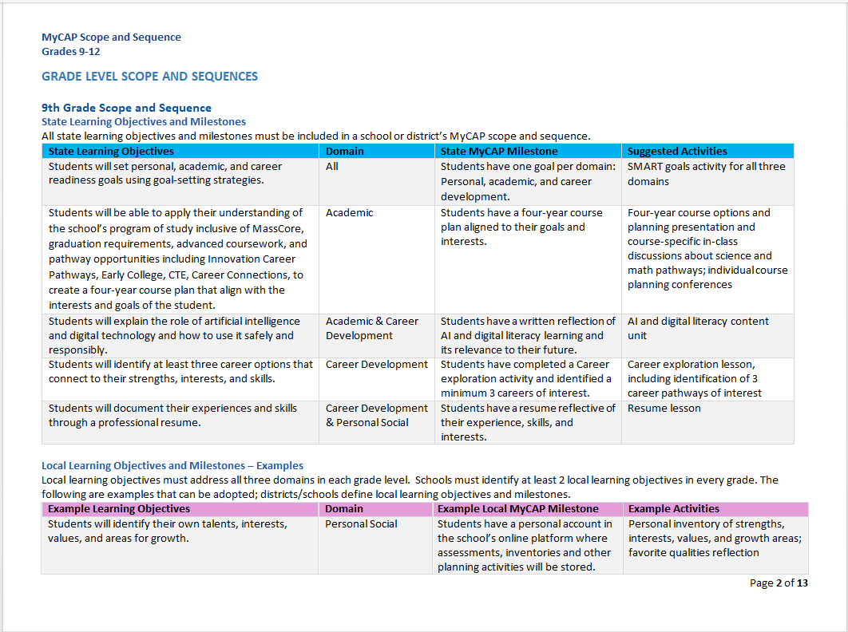
MyCAP Framework
Framework includes:
State Learning Objectives
Domains
State Milestones
Suggested Activities
Locally developed objectives, milestones and activities

Slide 19
MyCAP Framework, continued
The proposed graduation framework also recommends that the following components be embedded into the MyCAP scope and sequence:
Development of financial literacy knowledge and skills;
Development of artificial intelligence and digital literacy knowledge and skills;
Engagement in work-based learning; and
Complete the Free Application for Federal Student Aid (FAFSA), Massachusetts Application for State Financial Aid (MASFA) or opt-out.

Slide 20
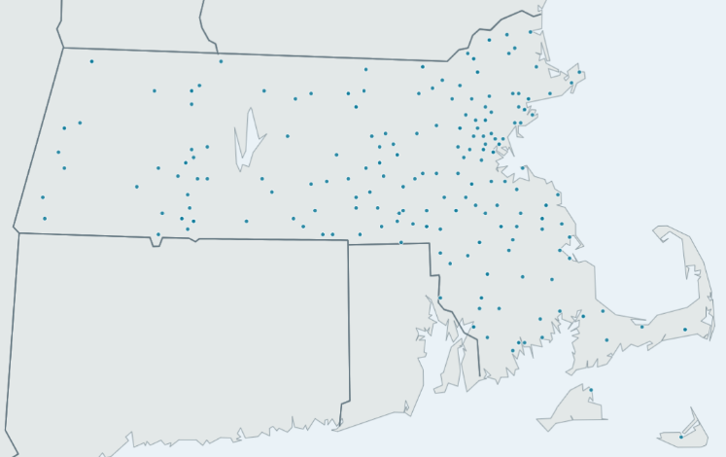
MyCAP: Current Implementation and Support
District Implementation
As of SY25-26, 40% of districts are engaged with MyCAP through professional learning and grant offerings
Planning and Implementation grants have been awarded to 237 districts, many with multiple school teams participating.
Participating schools and districts represent public, public charter, regional vocational and collaboratives

Slide 21
MyCAP: Current Implementation and Support Continued
Support for Districts and Schools
The Department provides several ways in which school teams can access support and training as they create their MyCAP process:
  Grant opportunities
    DESE has awarded over $4.5M in planning and implementation grants since 2022
  Two-day workshop series for districts/schools new to MyCAP (offered in Fall and Spring)
    Over 250 participants from over 100 districts attended our kick-off on 10/22
  Two workshops for those districts/schools in year 2 or year 3 of MyCAP implementation
    These sessions launch tomorrow at Westfield State University
  MyCAP "Coaching" opportunity for districts/schools in need of more intense support
    Currently 11 districts are slated to receive coaching through a vendor
  Office Hours to troubleshoot specific challenges

Slide 22
Postsecondary Planning Through Individualized Learning Plans
A key component of Future Readiness
Mandy Savitz-Romer, PhD
Harvard Graduate School of Education
Presentation to MA DESE Board, October 2026

Slide 23
Next Steps
We will soon propose new regulations requiring all high schools to offer foundational coursework through MassCore and postsecondary planning through MyCAP
If approved, regulations will go out for a public comment period and we will continue stakeholder engagement
Continued work with the Legislature on student-level graduation requirements
Ongoing district readiness support and grants

Slide 24
Discussion

