Slide 1
MassCore
A state-recommended program of study intended to align high school coursework with college and workforce expectations
July 2022

Slide 2
CONTENTS
01
State Definition of College and Career Readiness and Civic Preparation
02
MassCore Framework
03
Additional Core Courses and Learning Opportunities
04
What the Data Say
05
Critical Statewide Issues
06
Guiding Questions for Further Discussion

Slide 3
State Definition of College and Career Readiness and Civic Preparation
01

Slide 4
College and Career Readiness and Civic Preparation
Massachusetts students who are college and career ready and prepared for civic life will demonstrate the knowledge, skills and abilities that are necessary to successfully complete entry-level, credit-bearing college courses, participate in certificate or workplace training programs, enter economically viable career pathways, and engage as active and responsible citizens in our democracy.

Slide 5
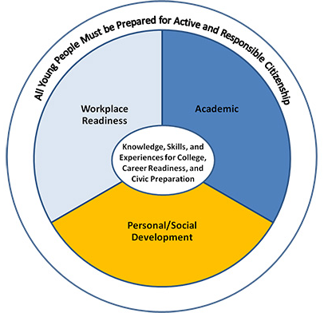
College and Career Readiness and Civic Preparation
The Commonwealth has defined a set of learning competencies, intellectual capacities and experiences essential for all students to become lifelong learners; positive contributors to their families, workplaces and communities; and successfully engaged citizens of a global 21st century.
Massachusetts Definition of College & Career Readiness & Civic Preparation

Slide 6
College and Career Readiness and Civic Preparation
Beyond achieving college and career ready levels of competence in English Language Arts / Literacy and Mathematics, all high school students should:
Develop a foundation in the academic disciplines identified in the MassCore course of study;
Build competencies for workplace readiness as articulated in the Integrating College and Career Task Force Report; and
focus on applying academic strategies to problem solving in diverse professional and life contexts, appropriate to individual student goals.

Slide 7
MassCore Framework
02

Slide 8
MassCore
Adopted by the Board of Elementary and Secondary Education in 2007 and amended in 2018, MassCore is a state-recommended program of study intended to align high school coursework with college and workforce expectations.

Slide 9
Program of Studies
The program of studies includes successful completion of four units of English, four units of mathematics, three units of a lab-based science, three units of history, two units of the same world language, one unit of the arts, and five additional "core" courses.
Certain computer science courses can substitute for either a laboratory science course or a mathematics course.

Slide 10
MassCore Framework
MassCore Framework Massachusetts High School Program of Studies
SUBJECT | UNITS | NOTES
English Language Arts | 4 Units
Mathematics | 4 Units | Including completion of Algebra II or the Integrated Mathematics equivalent. A mathematics course during senior year is recommended for all students. Students may substitute one unit of Computer Science that includes rigorous mathematical concepts and aligns with the Digital Literacy and Computer Science standards for a mathematics course.
Science | 3 Units of lab-based science | Coursework in technology/engineering courses may also count for MassCore science credit. Students may substitute one unit of Computer Science that includes rigorous scientific concepts and aligns with the Digital Literacy and Computer Science standards for a laboratory science course.
History and Social Science | 3 Units | Including U.S. History and World History.
world Language | 2 Units | Of the same language. Districts may designate students with demonstrated fluency and literacy in language(s) other than English as meeting the MassCore recommendations for world language
Physical Education | As required by law | “Physical education shall be taught as a required subject in all grades for all students” (M.G.L. c.71 §3).
Arts | 1 Unit
Additional Core Courses | 5 Units | Other additional coursework (including Career and Technical Education) or any of the above.
*A unit represents a full academic year of study or its equivalent in a subject that covers all the standards contained in a specific Curriculum Framework.
** Students enrolled in a state-approved Career and Technical Education program of studies have the option of opting out of world Language and Art and still fulfill MassCore.
MassCore is a recommended program of study Massachusetts high school students need to excel in college, career, and civic life. Developed by an advisory group from elementary and secondary education, higher education, nonprofits, and the private sector, MassCore maintains flexibility for students while letting districts set additional graduation requirements. Courses included in MassCore should be rigorous, engaging, and based on appropriate learning standards for high school or beyond. Fulfilling MassCore is just a start. Students should also engage in a full range of additional learning opportunities, such as: accelerated/advanced coursework; capstones or senior projects; dual enrollment courses; online courses; service learning; work-based learning; clubs and student organizations; varsity and intramural athletics; and part-time employment.

Slide 11
Additional Core Courses and Learning Opportunities
03

Slide 12
Additional Core Courses
Additional core courses provide flexibility to students seeking to take multiple electives and/or additional coursework to fill specific interests or follow specific career pathways:
Students can take 5 or more elective courses in science, technology/engineering or mathematics (STEM); arts and humanities; career and technical education; or other areas of interest.
Students can take more rigorous coursework including honors and Advanced Placement® classes, advanced classes that exceed the grade level standards in the Massachusetts Curriculum Frameworks, early college or dual enrollment classes, or participate in an International Baccalaureate (IB) program.

Slide 13
Additional Learning Opportunities
Additional learning opportunities help students to learn about careers and contribute to the community they live in. Examples of additional learning opportunities include:
Advanced Placement ®, which lets students take college-level courses while still in high school; 37 AP courses exist in 22 subject areas.
Capstones or senior projects are student-directed learning experiences that help them develop, design or create a product, service, system or event to better them for further studies or employment after high school. Strong projects demonstrate skills such as critical thinking, reading comprehension, and effective communication.
Dual enrollment courses let high school students simultaneously earn credits toward a high school diploma and a postsecondary degree or certificate. Including Early College

Slide 14
Additional Learning Opportunities (Continued)
Online courses for high school or college credit help prepare students for success in 21st century work and life. In addition to building important digital literacy skills, online courses provide greater flexibility in what, where, and how students learn, and at what pace.
Service learning integrates meaningful community service with instruction and reflection to enrich the learning experience, teach civic responsibility, and strengthen communities.
Work-based learning, work experience that connects classroom learning to work. At the highest level, academic and vocational/occupational curriculum are fully integrated with work site experience.

Slide 15
Additional Learning Opportunities (Continued)
Clubs and other student organizations that line up with students’ interests and provide opportunities to develop leadership and communication skills.
Varsity and intramural athletics build fitness, teamwork, perseverance, responsibility, commitment, time management, and social and emotional health.
Part-time employment, in which students form good work habits and acquire new skills, including communication, interpersonal, and job application and interview skills.

Slide 16
What the Data Say
04

Slide 17
What are the benefits of MassCore?
“The more you learn, the more you earn. Median weekly earnings in 2017 for those with the highest levels of educational attainment—doctoral and professional degrees—were more than triple those with the lowest level, less than a high school diploma. And workers with at least a bachelor’s degree earned more than the $907 median weekly earnings for all workers.” (U.S. Bureau of Labor Statistics, 2017)
“A major obstacle to the timely completion of an academic degree program is lack of preparedness of students, particularly in the area of math education.” (Massachusetts Department of Higher Education, 2018)
“The admissions standards for the state universities and University of Massachusetts emphasize strong academic preparation while in high school.” (Massachusetts Department of Higher Education, 2018)

Slide 18
Where do we stand with MassCore completion?

Slide 19
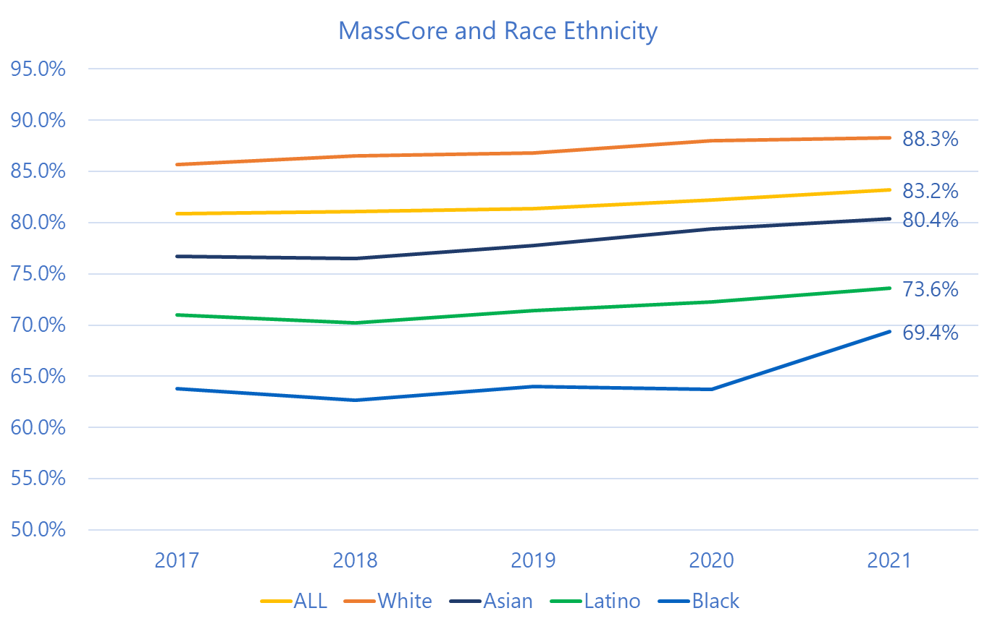
Opportunity Gaps Continue to exist
Notes:
This chart shows the percentage of students completing MassCore in suburban, rural, and urban schools over the last five years. A student completes MassCore if, at a minimum, they completed all of the recommended coursework laid out in the framework.
I wanted to point out two takeaways from this graph:
First, more students are completing MassCore now than they were five years ago.
The second takeaway is that on average, suburban and rural communities have much higher rates of MassCore completion than urban communities.

Slide 20
Critical Statewide Issues
05

Slide 21
Critical Statewide Issue #1: Access
Students should be able to access to appropriately rigorous, standards aligned coursework and other learning experiences that accommodate the full range of academic, advanced, elective, early college, and career and technical courses they need to excel in college, career, and civic life.
A wide range of quality courses (face-to-face, blended, and fully online) expands curricular options for students, includes a range of instructional approaches, and offers students flexibility in meeting their diverse learning needs.
Districts should identify opportunities beyond traditional coursework like jobs, internships, and volunteer opportunities that build workplace and interpersonal skills.

Slide 22
Critical Statewide Issue #2: Participation
Districts should set ambitious goals for increasing student participation in rigorous coursework, especially for historically underserved groups: students who are English language learners, those receiving special education services, economically disadvantaged students, and/or members of racial and ethnic minority groups.
Guidance counselors can help students and teachers understand that all students can benefit from challenging coursework, and address implicit bias, stereotypes, or misconceptions about who takes advanced coursework.

Slide 23
Critical Statewide Issue #3: Performance
Success in ninth grade is highly predictive of later outcomes in high school and beyond: districts should be proactive with students and families in keeping them on track to earn credit in core subjects like English Language Arts, Mathematics, Science, and History and Social Science.
Tutoring, counseling, and advising – among other supports –helps ensure all students get the academic help they need, and be known well by the adults in their school.

Slide 24
Guiding Questions for Further Discussion
06

Slide 25
Guiding Questions for Further Discussion
Do all students have access to appropriately rigorous, standards aligned coursework and other learning experiences that accommodate the full range of academic, advanced, elective, early college, and career and technical courses they need to excel in college, career, and civic life?
Does the district offer a wide range of quality courses (face-to-face, blended, and fully online) that expand curricular options for students, include a range of instructional approaches, and offer students flexibility in meeting their diverse learning needs?
Does the districts identify opportunities for students beyond traditional coursework like jobs, internships, and volunteer opportunities that build workplace and interpersonal skills?
Does the district set ambitious goals for increasing student participation in rigorous coursework, especially for historically underserved groups (students who are English language learners, those receiving special education services, economically disadvantaged students, and/or members of racial and ethnic minority groups)?

Slide 26
Guiding Questions for Further Discussion (Continued)
Do guidance counselors help students and teachers understand that all students can benefit from challenging coursework, and address implicit bias, stereotypes, or misconceptions about who takes advanced coursework?
Is the district proactive with students and families in keeping them on track to earn credit in core subjects like English Language Arts, Mathematics, Science, and History and Social Science in students’ freshman year of high school?
Does the district offer tutoring, counseling, and advising – among other supports – to help ensure all students get the academic help they need, and are known well by the adults in their school?

Slide 27
Potential risks for not completing MassCore
Generally….
Students failing coursework early in their high school careers
Resources for staff to teach and to develop appropriate coursework to meet MassCore requirements
Students who are unprepared for a rigorous course of study (pipeline and new arrivals)
Lack of incentives for students to complete MassCore
Collection of accurate data for decision making
Course Specific…
Appropriate math pathways for students (esp. year 4)
World Language
The Arts
Access to appropriate Science, Technology and Engineering courses
Maintenance of a course balance for all students, i.e. “my students have too many/not enough <insert course here>”
Meeting state law around the physical education requirement

Slide 28
Developing an Individual Plan for Success
My Career and Academic Plan (MyCAP)
A student-directed, multiyear process for the development of academic plans, personal/social skills, and career development activities that take into account the student’s unique, self-defined interests, needs, and goals for the attainment of post-secondary success.
Engages students in individual college and career planning
Uses an online platform (Naviance, MEFA Pathways, MassCIS, etc.) to capture the learning and document the achievement of learning objectives at each grade level
Provides opportunity for students to connect current learning with future goals
Leads students to choose a more rigorous course of study

