Slide 1
Postsecondary Perkins Enrollment & Outcomes Report 2022
Office for College, Career, and Technical Education
March 2022

Slide 2
Welcome!
In the chat...
include your Name, School & Role
In the Zoom poll, please share your experience with and understanding of the annual Perkins Report.

Slide 3
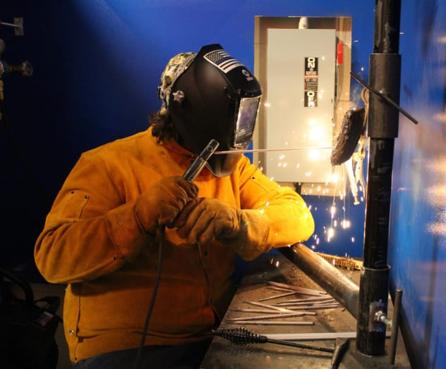
Perkins V Purpose
Perkins V is focused on increasing learner access to high-quality Career Technical Education (CTE) programs, paying particular attention to:
Alignment to employment options
Continual program improvement
Equitable access to programs
Photo courtesy of Minuteman Technical Institute (https://www.minutemanti.org/programs/metal-fabrication-welding)

Slide 4
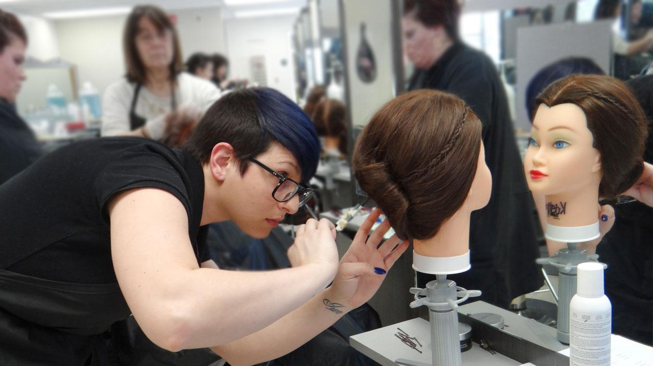
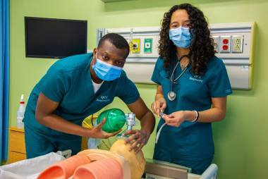
Perkins V Purpose
Based upon your own work with Perkins V, what would you share with prospective students about the benefits of CTE programs?
Photo courtesy of North Shore Community College and Quinsigamond Community College

Slide 5
Agenda
Report 2022 Overview
Core Indicator Definitions
Student Examples
Resources

Slide 6
Report 2022 Overview
What is Report 2022?
Annual Perkins V collection
Student-level data related to Enrollment and Core Indicators
Who should report?
Two-year postsecondary institutions
Schools in Postsecondary Consortium
When is it due?
Last Friday in June

Slide 7
Report 2022 Overview
Where to find this report?
Will be posted on CVTE Reporting & Data page
How to complete this report?

Slide 8
How Postsecondary Core Indicators are Calculated
3P1: Nontraditional Program Enrollment
2P1: Postsecondary Credential, Certificate or Diploma*
1P1: Postsecondary Retention & Placement
# of concentrators who received a recognized postsecondary credential during participation in or within 1 year of program completion
# of concentrators in a program nontraditional for their gender
# of concentrators who completed program & are positively placed
# of concentrators in programs that lead to nontraditional occupations
# of concentrators
# of concentrators who completed program
From Postsecondary Indicators at a Glance on Perkins V website:
https://www.doe.mass.edu/ccte/cvte/perkins-v/

Slide 9
Who is reported in Enrollment?*
Participating in Architecture program during Fall 2021 semester | Podiatry student during Spring 2022 semester | Concentrator in Rehabilitation Science during Fall 2021 semester | Concentrator in Business Machine Repair during Spring 2022 semester | Graduated from Practical Nursing during Summer 2020
Include student on Enrollment page?
YES – enrolled during School Year 2022 | YES – enrolled during School Year 2022 | YES – enrolled during School Year 2022 | YES – enrolled during School Year 2022 | NO – Out of reporting timeframe for Enrollment
*Note: these are instructional examples, student cases may vary

Slide 10
Now, let’s focus on a subset of enrolled students…

Slide 11
Who is reported in Indicator 3P1(Nontraditional Program Enrollment)?*
Female concentrator in Architecture during Fall 2021 semester | Female concentrator in Early Childhood Education during Spring 2021 semester | Male student in Rehabilitation Science during Fall 2021 semester | Nonbinary concentrator in Business Machine Repair during Spring 2021 semester | Graduated from Practical Nursing during Summer 2020
Include student on Indicator 3P1 page?
YES – As a concentrator in a nontrad program, this student is included in the Total concentrator count and as a nontrad student based on her gender. | YES - As a concentrator in a nontrad program, this student is included in the Total concentrator count but not as a nontrad student based on her gender. | NO – not a concentrator | YES - This student is included in the Total concentrator count. This student is not a nontrad student. | NO – Out of reporting timeframe for 3P1
*Note: these are instructional examples, student cases may vary

Slide 12
Who is reported in Indicator 2P1(Postsec Credential, Certificate or Diploma)?*
Multilingual Education concentrator end of Spring 2018, graduated from institution in Spring 2019 | Pharmacy Technician concentrator in Fall 2017, became Certified Pharmacy Technician in Summer 2018 | Became a concentrator in Practical Nursing in SY 2018, not enrolled in Fall 2021 & did not complete program | Became a concentrator in Practical Nursing in SY 2018, enrolled in coursework in Fall 2021 | Completed Cosmetology program in Spring 2017, obtained license in Fall 2017
Include student on Indicator 2P1 page?
YES | YES | YES – As a concentrator in SY 2018, this student is included in the Total concentrator count but not towards credentials earned. | NO – Still enrolled in program | NO – Out of reporting timeframe for 2P1
*Note: these are instructional examples, student cases may vary

Slide 13
Who is reported in Indicator 1P1(Postsec Retention & Placement)?*
Completed Medical Transcription program in January 2021, has been working in field since program completion | Completed Maritime Law Enforcement program in October 2020, enlisted in the U.S. Navy | Completed Construction program in May 2021, follow-up was not conducted | Studied Hospitality Management, graduated from institution in May 2020, working in field | Studied Business Management and earned 10 credits, enrolled at a four-year institution
Include student on Indicator 1P1 page?
YES | YES | YES – Student is still reported. | NO – Out of reporting timeframe for 1P1 | NO – Not a concentrator
*Note: these are instructional examples, student cases may vary

Slide 14
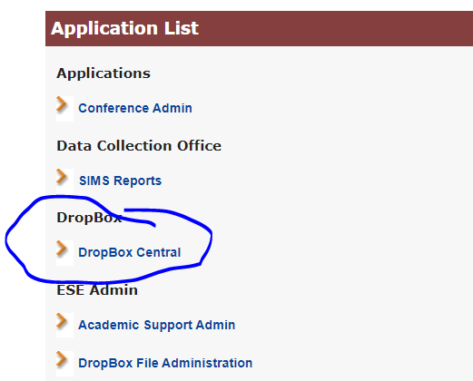
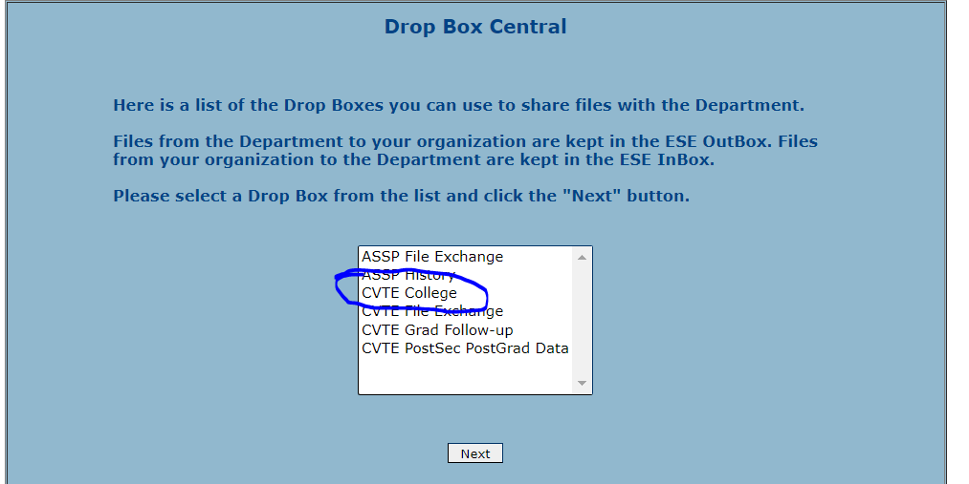
Submitting Report 2022
Security Portal – Drop Box Central – CVTE College
For access: email CCTE@mass.gov
Subject: CVTE Colleges drop box access

Slide 15
Report 2022 Resources
File specs
Core Indicator Measurement Approach
Office Hours
Friday, April 29th
Friday, May 6th

Slide 16
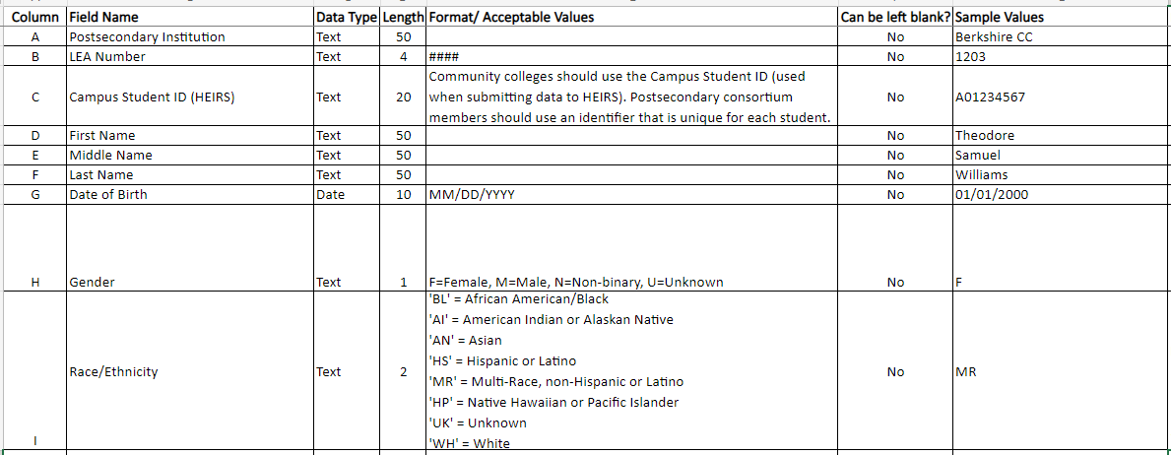
Report 2022 File Specs

Slide 17
From Postsecondary definition on Perkins V website:
https://www.doe.mass.edu/ccte/cvte/perkins-v/
Core Indicator Measurement Approach

Slide 18
THANK YOU
Office for College, Career, and Technical Education
781.338.3907
Nicole.Ventrone@mass.gov
www.doe.mass.edu/cte/
75 Pleasant Street, Malden, MA 02148

