Slide 1
CVTE Data Collection
September 2020

Slide 2
CVTE / Perkins V – Data Webinars
Welcome & Introductions
In the chat, please let us know –
  Your Name & Role
Webinars –
  Using new Perkins Reports – part 1 9/23
  Data Collection 9/30
  Using new Perkins Reports – part 2 10/7
Notes:
In this workshop, we’ll cover logging into the Security Portal, reviewing the Indicator reports (including Perkins V changes), and using them in program development. This workshop is suitable for anyone new to Perkins, or would like a refresher, and is curious how to use Indicator trends in program development: CVTE Directors, Data/Instruction contacts or other leaders.

Slide 3
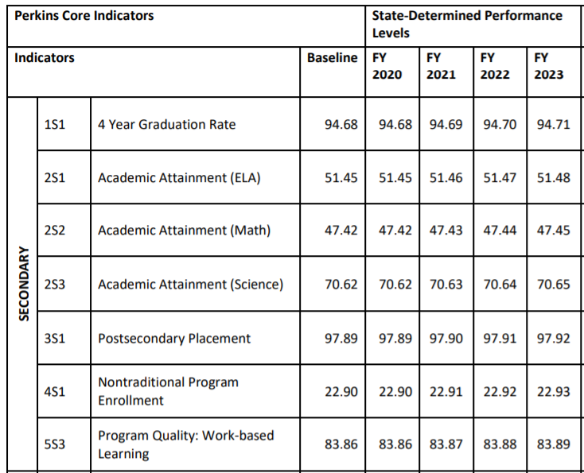
Why?
Perkins V
Notes:
Perkins V Accountability

Slide 4
Data Collection Webinar
Overview of state public education data reporting systems
Reporting Expectations
New Elements in 2020-2021
Q&A
For more:
http://www.doe.mass.edu/ccte/cvte/data/
Instructions for School Districts in Reporting Student-Level Data in CVTE
http://www.doe.mass.edu/infoservices/data/
SIMS Handbook, Schedule, Data Collection Support Liaison

Slide 5
Overview of state public education data reporting systems
01

Slide 6
Areas for Data Collection
Student attributes
Student participation in CVTE programs
  The type: CH74 and Perkins-only/Non-CH74
  The CVTE program itself
Student participation in required courses and experiences
Student credential attainment

Slide 7
What are SIMS and SCS?
The Student Information Management System (SIMS) is a student-level data collection system that allows the Department to collect and analyze more accurate and comprehensive information, to meet federal and state reporting requirements, and to inform policy and programmatic decisions.
The Student Course Schedule (SCS) collects student course, course completion, and mark/grade information to meet federal and state reporting requirements in a timely manner, and to provide districts and DESE with useful data that will contribute to enhanced student performance.
These two data sets are existing processes that CCTE uses in administering secondary programs.

Slide 8
Reporting Expectations
02

Slide 9
The Importance of Accurate Reporting
SIMS elements enable programs and state to analyze for scale, quality, and equity.
  Students Participating in Program
  Special Populations
Care is recommended to ensure that enrollment is accurate.
This is linked to performance, accountability and other areas of program development.
Notes:
DOE035: Career/Vocational Technical Education – Type of Program
DOE042: Career/Vocational Technical Education - Special Populations [SINGLE PARENTS]
DOE043: Career/Vocational Technical Education - Chapter 74-Approved Vocational Technical Education Program Participation
DOE044: Career/Vocational Technical Education - Non-Chapter 74 Career and Technical Education Program Participation
DOE047 Industry Recognized Credentials
DOE048 Industry Recognized Credentials
DOE049 Industry Recognized Credentials

Slide 10
Example: EL students
Perkins V
http://www.doe.mass.edu/ele/resources/id-assess-place-reclass.html
  The EDWIN Analytics system contains a mechanism for requesting historical MCAS and ACCESS data about a recently enrolled student who transferred from another district in Massachusetts.

Slide 11
Reporting Timelines
Student Information Management System (SIMS) – Student-level
  October
  March
  End-of-Year
Student Course Scheduling (SCS) – Course-taking
  October
  End-of-Year
http://www.doe.mass.edu/infoservices/data/schedule.html

Slide 12
Which Students Should be Reported?
Districts with Chapter 74-approved programs should report students consistent with state-approved Admissions policies.
Districts with non-Chapter74 programs should report students consistent with program policies.
  The Department encourages districts to have a clear process of determining which students are enrolled in non-Chapter74 Perkins programs for the purpose of accurate data reporting.
Students should only be enrolled in a CVTE program in SIMS if they can be provided with all required elements of the program before graduation.
Notes:
Collab – offline/other circumstances
N74:
Students might not be aware of available programs or how they may signal their intention to participate. Districts should inform students of programs available and have a method in place for identifying students wishing to participate.

Slide 13
SIMS DOE035: CVTE Type of Program
Enrollment in a CVTE Program
Four values:
      00= Not enrolled in a career/vocational technical education program
      02= Chapter 74–approved vocational technical education program secondary cooperative education
      04= Chapter 74–approved vocational technical education program secondary regular
      14= Non-Chapter 74 career and technical education program — secondary regular
Notes:
PLTW – 14

Slide 14
SIMS DOE043 and DOE044: CVTE Programs
Select from the list of CH74 programs
  DOE043: Career/Vocational Technical Education - Chapter 74-Approved Vocational Technical Education Program Participation
Select from the list of Non-CH74 programs
  DOE044: Career/Vocational Technical Education - Non-Chapter 74 Career and Technical Education Program Participation
Those values are captured in the SIMS handbook, available at the DESE website: http://www.doe.mass.edu/infoservices/data/sims/

Slide 15
Examples
Students enrolled in a Chapter 74-approved Culinary program
  Reported as enrolled in Chapter-74 Program (DOE035=04)
  Reported program is Culinary Arts (DOE 043=120500)
Students enrolled in a non-Chapter 74 (Perkins) Culinary program
  Reported as enrolled in non-Chapter 74 Program (DOE035=14)
  Reported program is Culinary Arts (DOE 044=1205)
Districts with five or more Chapter74-approved programs offer Exploratory, where 9th grade students explore the available programs.
  Reported as enrolled in Chapter-74 Program (DOE 035=04)
  Reported program is Exploratory (DOE 043=990100)
Students not enrolled in a program
  Reported as not enrolled in a career/vocational technical education program. (DOE 035=00).
Instructions for School Districts in Reporting Student-Level Data in CVTE

Slide 16
SIMS DOE047, 048, 049: Industry Recognized Credentials
There are three identical fields, allowing for up to 3 credentials to be reported per student.
These fields will be applicable to any student in grades 9 through 12.
There are approximately 200 reportable values for these fields, representing certifications from many industries (agriculture, business, construction, health, education, manufacturing, technology etc.)
Those values are captured in the SIMS handbook, available at the DESE website: http://www.doe.mass.edu/infoservices/data/sims/
Students’ attainment of these valuable credentials is part of the success story of CTE education; let’s capture all the data to tell that story!

Slide 17
Student Attributes
Various SIMS fields
  Gender
  Race/Ethnicity
  Single Parents
  English Learner
  Students with Disabilities
  Military connected
See SIMS Handbook for full instructions
Foster/Homeless Application for students in these groups

Slide 18
2020-21 Data Collection Changes
03

Slide 19
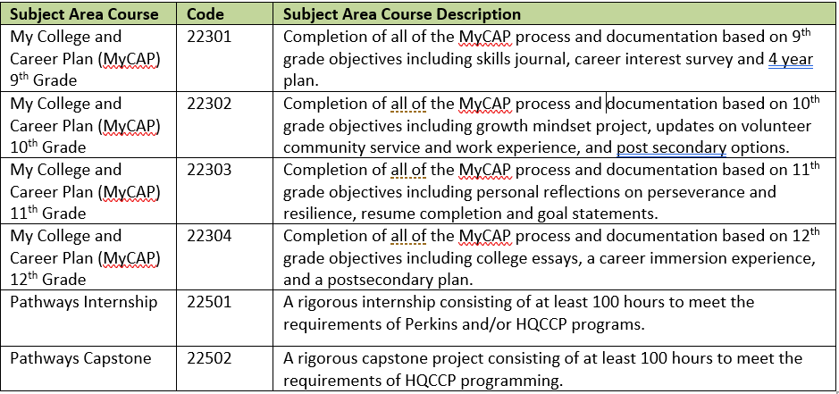
SCS: new subject area course codes reportable in SCS05
This is the addition of four MyCAP course codes, as these plans are required by both Early College and Innovation Pathway programs. Also the addition of course codes for Pathways Internship and Pathways Capstone coursework.

Slide 20
SCS: SCS14 Pathways Course
This is the addition of a new data element in the studentsectionenrollment SIF object
SCS14 Pathways Course will be a binary element with acceptable values:
00 Non Pathways Course
01 Pathways Course
This variable will be to indicate that a particular course is being used to meet the technical course taking requirement.

Slide 21
Q&A
03

Slide 22
THANK YOU
Please be in touch with further questions.
Jen Appleyard, CVTE Data & Development, jennifer.e.appleyard@mass.gov

