Slide 1
CVTE / Perkins V – Data Webinars
Welcome & Introductions
In the chat, please let us know –
Your Name & Role
Webinars –
Using new Perkins Reports – part 1 9/23
Data Collection 9/30
Using new Perkins Reports – part 2 10/7

Slide 2
Using new Perkins Reports – Part 1: Enrollment
Basics about Enrollment
Where to find CVTE Reports & other Enrollment trends
How to use these
Q&A
For more:
http://www.doe.mass.edu/ccte/cvte/data/
CVTE Reporting/Data Resources
https://gateway.edu.state.ma.us/
Security Portal

Slide 3
Chat:
Do you have a ‘burning question’ which might be answered with Enrollment data?

Slide 4
Why?
There are reporting, performance, accountability and monitoring requirements associated with Perkins.
Notes:
Districts, collaboratives and institutions progress toward implementation of equal access to high-quality career and technical education courses and programs of study for all students.
Districts and institutions are required to disaggregate data for each of the indicators of performance for the subpopulations of interest and identify and quantify any disparities or gaps in performance.

Slide 5
Enrollment is like … an octopus?

Slide 6
Enrollment is like … an octopus?
Preparing Students for Careers & College
Program Development
Enrollment
Access to Programs
Disaggregate by Race, Gender, other populations*
SIMS

Slide 7
Here’s where this can take us –
“How can we have more _____ students in the ____ program?”
“How can we have more _____ students improving on _______?”

Slide 8
Find the Security Portal from any DESE web page.

Slide 9
Once there, find CVTE Reports.

Slide 10
Don’t have access? Check with the DA for your district.
http://www.doe.mass.edu/infoservices/data/diradmin/

Slide 11
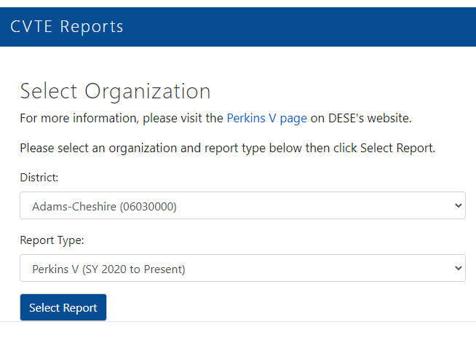
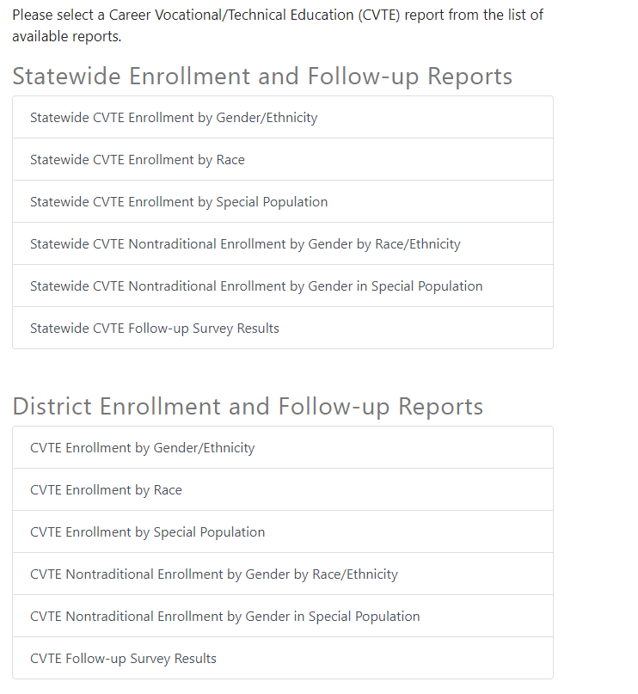
Once in CVTE Reports, use the menus to select specifics.

Slide 12
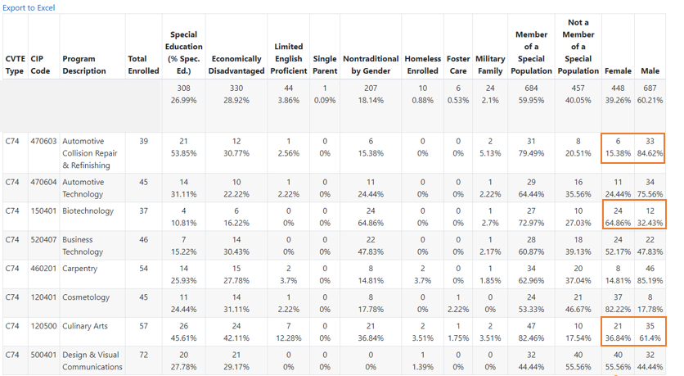
Examine the Enrollment overall & by program
10%
Notes:
A few examples –

Slide 13
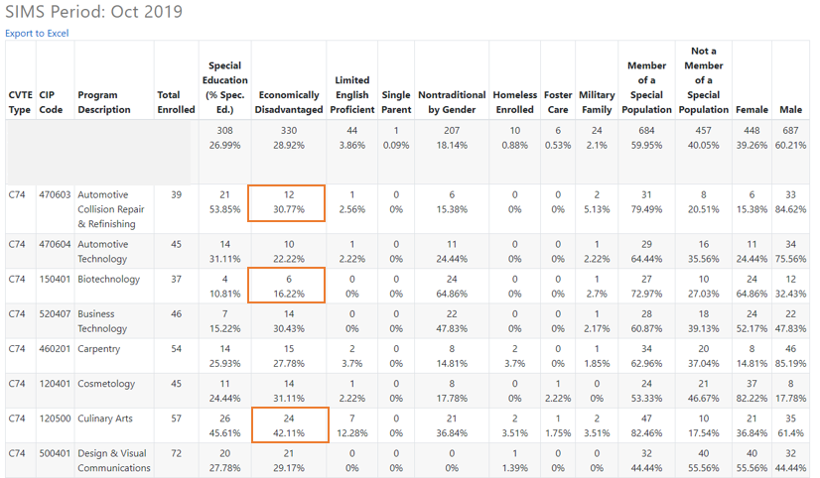
Examine the Enrollment overall & by program
10%

Slide 14
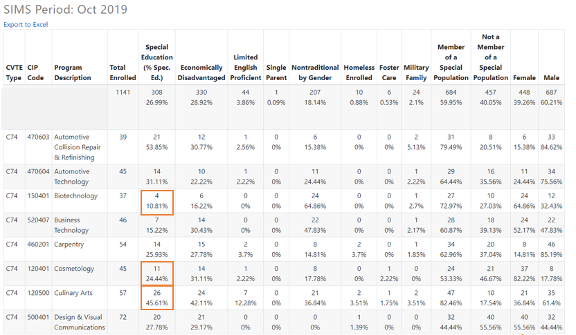
Examine the Enrollment overall & by program
10%

Slide 15
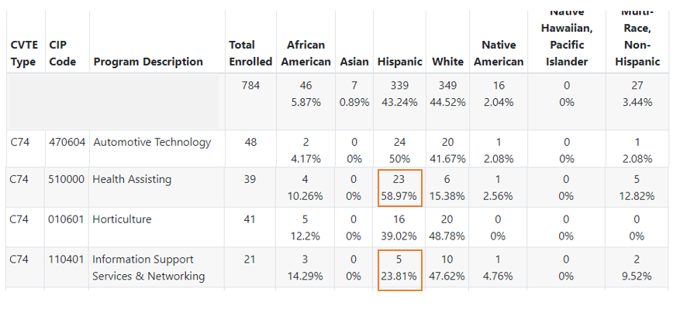
Examine the Enrollment overall & by program
10%

Slide 16
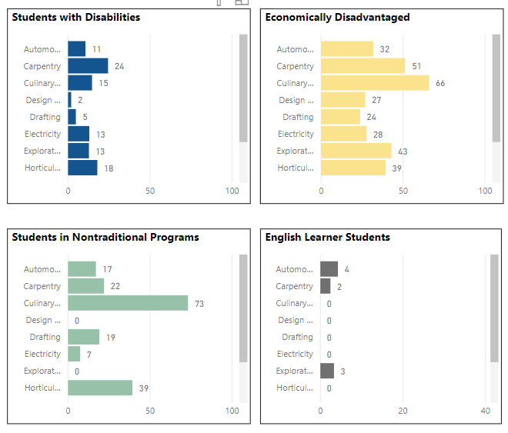
Enrollment visuals –
Notes:
https://app.powerbigov.us/view?r=eyJrIjoiN2YwN2EzMWEtZmFhNy00MWU5LWJiZTAtNWU0YWNhM2ZjZjRkIiwidCI6IjNlODYxZDE2LTQ4YjctNGEwZS05ODA2LThjMDRkODFiN2IyYSJ9

Slide 17
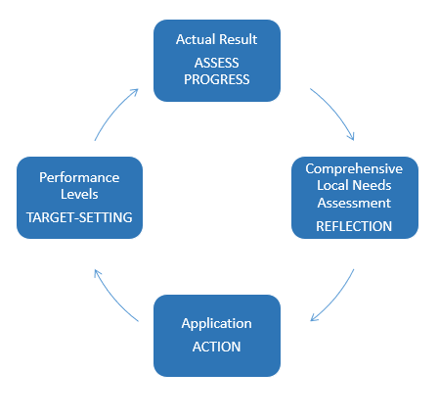
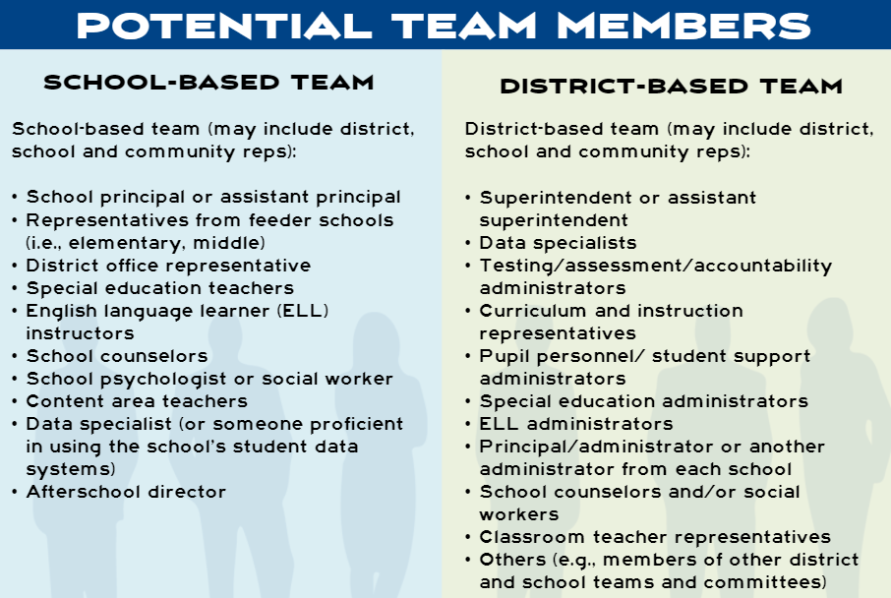
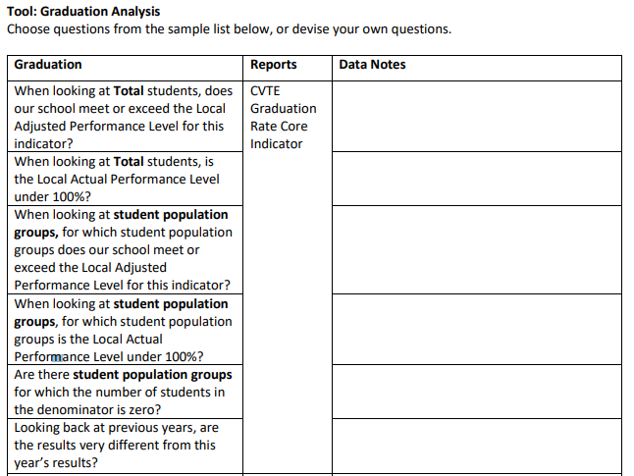
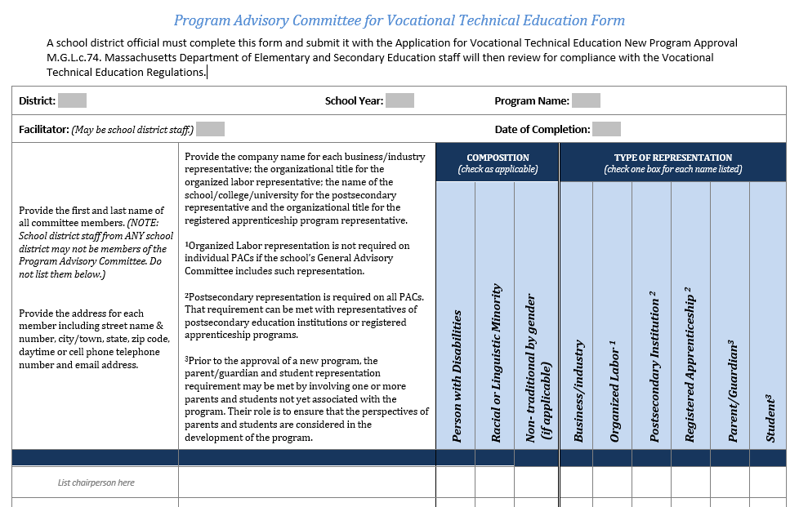
Connections…
Perkins Accountability Cycle CLNA, Application & more
CVTE Analysis Tools
Data Review Teams
Advisory Committees

Slide 18
Using new Perkins Reports – Part 1: Enrollment
Questions?

