Slide 1
Competency Determination Guidance and Policy Submission Process
August 6, 2025

Slide 2
Agenda
Background
Key Information
Updated Competency Determination Requirements
Coursework Requirements
Policy Requirements
Policy Submission
Questions

Slide 3
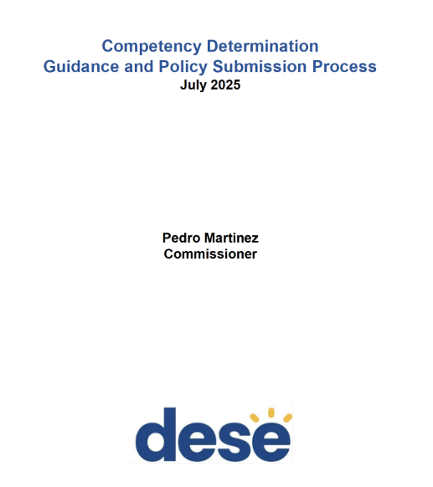
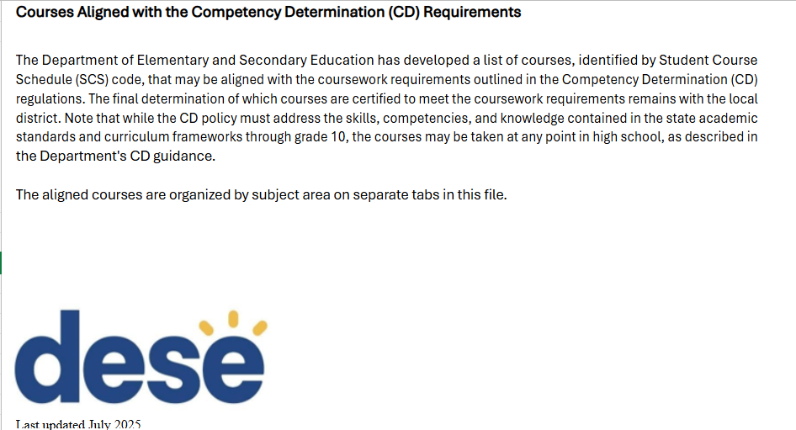
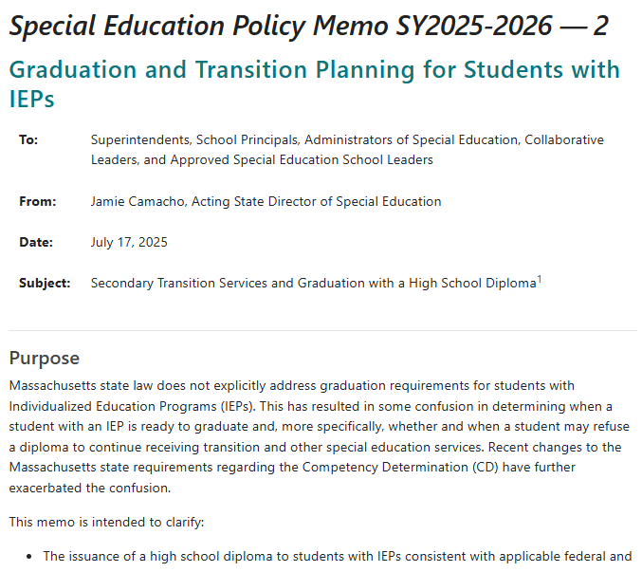
Guidance Released on July 17, 2025
Competency Determination Guidance and Policy Submission Process
Courses Aligned with the Competency Determination (CD) Requirements
Special Education Policy Memo SY2025-2026 – 2
Guidance and related resources will soon be posted to a new Competency Determination page on DESE’s website!

Slide 4
Background
In November 2024, Massachusetts voters approved a ballot question that removed the use of MCAS as the sole basis for meeting the requirements of the state’s Competency Determination (CD).
In May 2025, the Board of Elementary and Secondary Education voted to amend its regulations on the Competency Determination (603 CMR 30.00).

Slide 5
Key Information
Each district that graduates students must develop a CD policy that details how students will meet the new requirements.
The district’s CD policy must be approved by the district’s governing body by and submitted to the Department in GEM$ upon approval (no later than December 31, 2025).
Upon approval by the district's governing body, the CD policy must be publicly posted on the district’s website along with translated versions to ensure meaningful access for all parents and families.
Districts must also submit their local graduation requirements to DESE at the same time they submit their CD policy.

Slide 6
Updated Competency Determination Requirements
As described in the new regulations, the CD represents two accomplishments: showing a mastery of skills in English language arts, mathematics, and science; and the satisfactory completion of relevant coursework aligned to the standards measured by the high school English language arts, mathematics, and science MCAS assessments administered in 2023.
Show Mastery
Satisfactorily Complete Coursework

Slide 7
Show Mastery
To show mastery, a student must successfully complete in accordance with the district’s grading policy:
  The final assessment for a course; or
  A capstone or portfolio project; or
  An equivalent measure identified in the district’s CD policy.
In the policy submission template, districts will explain how a student shows mastery in accordance with the district’s grading policy.

Slide 8
Satisfactorily Complete Coursework
To satisfactorily complete coursework, a student must earn full credit in accordance with the district’s grading policy in the courses listed in the table on the next slide.
In the policy submission template, districts will explain how a student earns full credit in accordance with the district’s grading policy.

Slide 9
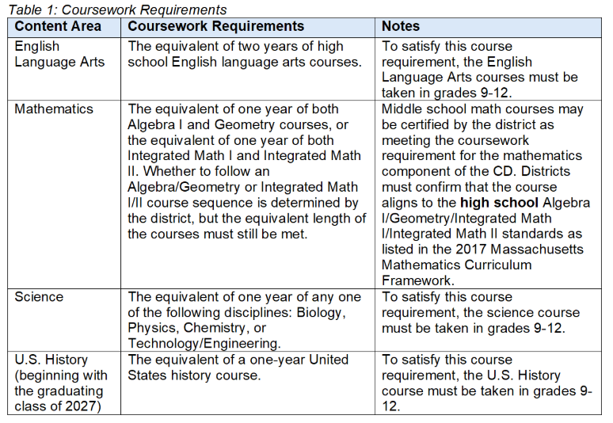
Coursework Requirements
The requirements refer to “the equivalent of” a specified number of years of coursework to accommodate the different instructional schedules that exist across Massachusetts’ high schools.

Slide 10
Courses Aligned with the Competency Determination (CD) Requirements
DESE has developed a list of courses, identified by Student Course Schedule (SCS) code, that may be aligned with the coursework requirements.
The list of courses is available on our website.
The final determination of which courses are certified to meet the coursework requirements remains with the district.

Slide 11
Policy Requirements
As described in the regulations, each district is required to develop a CD policy. The policy must include all of the following components:
The coursework requirements in each of the required subject areas, including the specific courses the district considers applicable for the purposes of the CD
The measure(s) the districts will use to determine whether the student has demonstrated mastery in each of the named subject areas
Considerations for students with disabilities and English learners
Considerations for late-enrolling students

Slide 12
Policy Requirements (continued)
As described in the regulations, each district is required to develop a CD policy. The policy must include all of the following components:
A description of the limited instances in which the district may use MCAS scores to determine competency
The process by which a student can appeal the district’s decision to award or deny a CD
The process by which a current or former student may request a transcript review (see Appendix C of the guidance document)

Slide 13
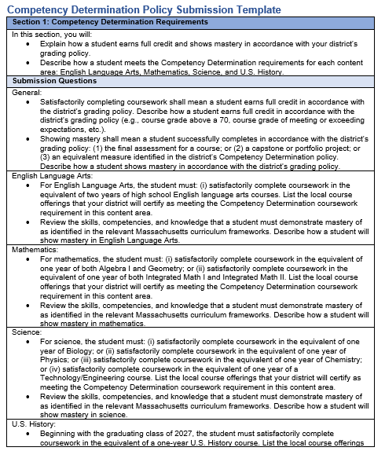
Policy Submission
Submission templates are outlined in pages 9-12 of the guidance document. This includes the questions that districts will respond to in GEM$.

Slide 14
Questions?

