Slide 1
Innovation Career Pathways
Spring 2023

Slide 2
Outline
What are Innovation Career Pathways?
Introduction to the Guiding Principles and Designation Criteria
Designation Process
  Application
  Timeline
  Expectations
Post-Designation Implementation
Funding and Other Considerations
Resources

Slide 3

What are Innovation Career Pathways?
Innovation Pathways connect student learning to a broadly-defined industry sector that is in demand in the regional and state economy, and guide students to relevant post-secondary education and training.
All pathways are designed to increase equitable access by eliminating barriers to student participation.
Notes:
Participation in this kind of pathway contextualizes student learning, engages students in their high school experience, and can lead students to opportunities for meaningful careers in the relevant industry sector upon their completion of needed postsecondary education and training.

Slide 4
About Innovation Career Pathways
Launched in 2017, as part of the “High Quality College and Career Pathways” Initiative
Goals:
  Contextualize student learning
  Engage students in their high school experience
  Lead students to opportunities for meaningful careers in the relevant industry sector upon their completion of needed postsecondary education and training.
Two-part designation process, approved by DESE Commissioner
Rooted in Five Guiding Principles

Slide 5
About Innovation Career Pathways
Based on partnerships between high schools and local MassHire workforce boards & employers
Broad industry sector alignment, not occupation-specific
Wall-to-wall vocational schools are not eligible to apply
Technical coursework aligned to industry-recognized credential
Advanced courses (AP, IB, dual enrollment)
100-hour work-based learning experience (internship or capstone)

Slide 6
Guiding Principles and Components
5 Guiding Principles
6 Components
Equitable Access
Guided Academic Pathways
Enhanced Student Support
Connection to Career
Effective Partnerships
Advising/MyCAP
Labor Market Demand
Integrated Instruction
Work Based Learning
Credential Preparation
Post-secondary Linkages
Notes:
Equitable Access
Prioritizing students underrepresented in higher education
Eliminating barriers to student participation
Guided Academic Pathways
Experiences beyond the classroom, exposure to career opportunities
Credits toward postsecondary credential (12)
College-level rigor and experience
Enhanced Student Support
Wraparound services to promote success
and completion
Connection to Career
Exposure to targeted pathway
opportunities intended
to lead to careers
Effective Partnerships
At least one institution of
higher education and
one secondary school
and/or district

Slide 7
5 Guiding Principles
Equitable Access
  Prioritizing students underrepresented in higher education and high skill/high demand industries
  Eliminating barriers to student participation
Guided Academic Pathways
  At least 2 Technical courses and
  2 Advanced courses
  College-level rigor and experience
  Student-centered college and career
  planning
Enhanced Student Supports
  Wraparound services to promote success and completion
Notes:
Equitable Access
Aimed towards keeping entry into IP pathway as open as possible, particularly with regard to prior academic performance
The program is designed and funded such that it will be offered free for all student participants—including tuition, fees, and other related expenses.
Guided Academic Pathways
Must include a scope and sequence of a minimum of 4 courses with:
A minimum of 2 of the 4 courses must be technical courses related to the pathway’s industry sector concentration, and;
A minimum of 2 of the 4 courses must be college-level courses that provide the student an opportunity to gain dual-enrollment or AP/IB college credit.
The 2 technical courses may NOT overlap with the required 2 college-level courses; there must be a 4-course sequence.
Students must complete Mass Core requirements by graduation.
Enhanced Student Support
identify potential academic and nonacademic challenges for potential student participants.
Plan and contacts for supports for academic, nonacademic, and career purposes -- including but not limited to counseling/advising and tutoring, both at the high school and college levels.

Slide 8
5 Guiding Principles, cont.
Connection to Career
  Exposure to targeted pathway opportunities intended to lead to careers
  100-hour internship or capstone with related quality indicators
Effective Partnerships
  For ICP, must have one district/secondary school and Workforce Development Board as partners and at least once employer partner

Slide 9
Labor Market Demand
Align with career opportunities in a broad industry sector category with high employer demand identified by the Workforce Skills Cabinet Regional Blueprint process.
Eligible industry sectors:
  Manufacturing
  Information
  Environmental and Life Sciences
  Health Care and Social Assistance
  Business and Finance
Additional information on the Workforce Skills Cabinet Regional Blueprints and other Labor Market tools can be found at: https://www.mass.gov/regional-workforce-skills-planning-initiative

Slide 10
Integrated Instruction
The pathway consists of an integrated Scope and Sequence of courses and experiences aligned with the industry sector that is developed through an individual planning process.
Students must have a MyCAP (My Career and Academic Plan) individual plan, managed online
The MyCAP scope and sequence must include
  At least 2 Technical courses aligned with the Industry Sector
  At least 2 Advanced courses, which can include dual enrollment, AP, PLTW, or other college-level courses
  A 100-hour internship or capstone project, identified with a local course code that will be displayed on the student’s transcript, taken later in high school (most likely - 12th grade, or summer before 12th grade)

Slide 11
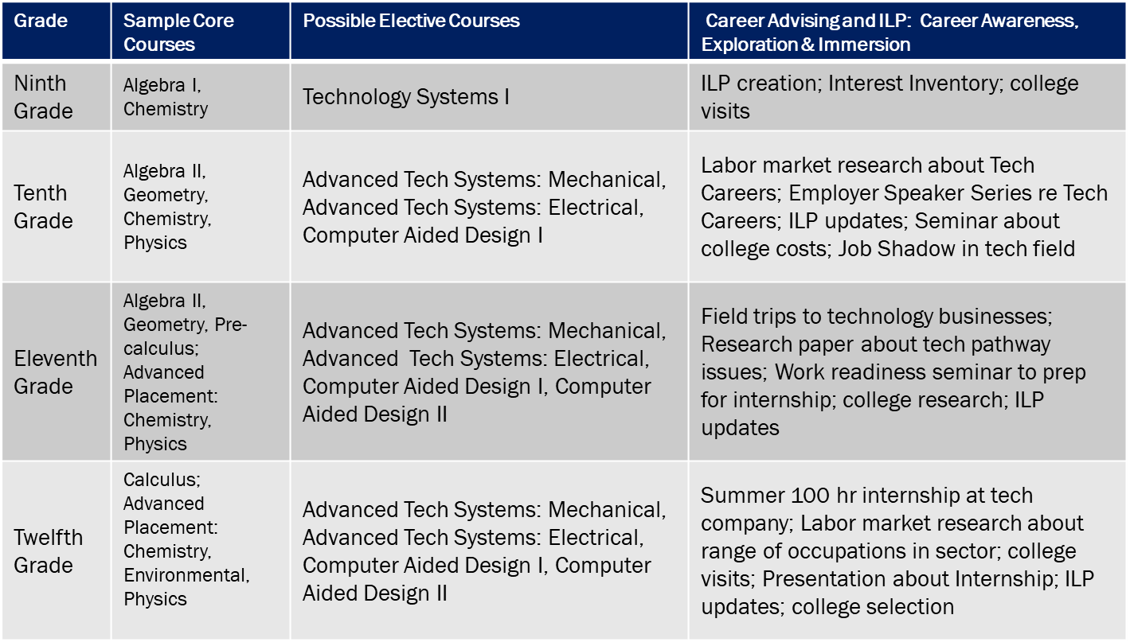
Sample Scope and Sequence – Technology Pathway

Slide 12
Student College and Career Advising
The pathway includes well-designed college and career advising:
Students must have an individual plan, referred to as MyCAP (My Career and Academic Plan) managed online, using an electronic platform designed for that purpose, such as MEFA Pathways, Naviance, MassCIS, Xello (formerly Career Cruising) or other systems
Career development education (CDE) is an aspect of advising, with career awareness, exploration and immersion activities built into the advising process
College access and awareness activities, and a postsecondary plan, are included

Slide 13
Work-based Learning
Career Development Education, with career awareness and exploration leading up to an immersive experience
Career immersion: 100 hours of an Internship or Capstone aligned with the industry sector and identified as a course in SCS
Quality elements for the immersive experience include:
  Staff liaison to interface with work site placement
  Work readiness training for students prior to start of internship (note that DESE will offer a set of lessons and training for districts that do not have their own, e.g., using the Signal Success curriculum by Commonwealth Corporation)
  Ongoing reflection opportunities such as journal writing, recorded in MyCAP
  Use of the MA Work-based Learning Plan, with data entry in its related database
  End of experience student product, such as oral presentation, written report, video

Slide 14
Credentials and Post-secondary Linkages
The Pathway leads to industry-recognized credentials (IRCs)
  Students know about credentials that are relevant to the industry sector
  They either attain them while in high school, or build skills for attaining them in post-secondary education
  The credential may be an Associate’s degree, a Bachelor’s degree, a Certificate, Registered Apprenticeship or other IRC
Explicit linkages with colleges or other institutions that provide IRCs are required

Slide 15
Innovation Pathways Designation Process and Criteria
Two-part application process structured around the five guiding principles
  Part A
  Part B
Guiding Principles are basis for Designation Criteria and application questions
Joint application/partnership between K-12 district and MassHire (local workforce development boards)
DESE Commissioner will make the final determinations for designations
Notes:
In order to ensure a measured and thoughtful process for applicants, the designation process will be in two stages: Preliminary Designation and Final Designation.
Structured similar to the (new) Chapter 74 approval process, this two-phase approach will enable staff to provide technical assistance.

Slide 16
Applicant Criteria for Innovation Pathways
Applications must include structured partnerships
  K-12 district as the applicant, with at least one identified high school where the pathway will exist
  Local MassHire, and at least one employer partner is also identified as a support partner, which should play an active role in the development of the application, and demonstrate its full engagement in the implementation of the IP
Both the district and MassHire will be actively involved in performance outcomes
A signed letter of agreement to partner is required as a component of the Part A application
Notes:
Must be a Massachusetts public high school

Slide 17
Two-Stage Process: Part A
Applicant must sufficiently address plans for each of the five guiding principles, according to specified criteria.
Key questions for consideration, based on Guiding Principles:
  Does the proposed program target and prioritize students underrepresented in post-secondary enrollment and completion and/or high skill/high demand industries, and is it structured to recruit these students and eliminate barriers to their participation?
  Does the program outline a clear academic pathway from secondary to
  post-secondary education and onto a career?
  Does the program identify academic and nonacademic challenges and supports for at-risk, under-represented and/or first-generation students?
  Are career awareness, exploration and immersion activities included as an integral part of the IP program?
  Does the program propose robust and viable partnerships?

Slide 18
Two-Stage Process: Part B
A successful Part A submission will allow the applicant to advance to the Part B stage
Part B is also structured around the five guiding principles, with additional requirements to demonstrate evidence of effective implementation. For example:
  Signed MOU(s) – note that samples are available
  Developed policies
  Calendars of activities and schedules
  Staffing plans
Final Designation indicates that a Program has completed all necessary requirements and is either already enrolled or is prepared to enroll students for the following academic year.

Slide 19
Example Part A Timeline
April/May
  Part A application posts to DESE site
June through August
  Prospective Applicant webinar in early June
  Intake Sessions – optional, informal, 1:1 meetings with DESE – July - August
Late October
  Preliminary Part A Designation Application due
November
  Review of Preliminary Part A applications
By November 30
  Applicants notified of advance to Final Part B Designation Phase

Slide 20
Example Part B Timeline
December – January
  Staff conduct Part B Designation information sessions/webinars
Early February
  Part B Designation Application due
February – mid-March
  Part B Application review by staff
  Applicant interviews (60 minutes)
Final Designations conferred by the DESE Commissioner by the end of March
See DESE Innovation Pathways webpage for the current Designation timeline.

Slide 21
Post-Designation
Schedule students in Spring for subsequent Fall launch of pathway
5 years term length for the designation
Designation is a performance contract
Oversight and Evaluation
  Annual reporting obligations (SIMS, SCS data collections)
  Annual Self-Reflection → DESE
  Performance metrics
  Site visits
  Review/check-in after the first three years
Ongoing support
  Convenings/Professional Learning Communities
  Technical assistance from DESE, EOE

Slide 22
Supports for Program Development and Implementation
Partnership with Boston-based Center for Collaborative Education, since late fall 2019
Technical assistance, professional development
Topics identified by the community
Webinars
Workshops
Professional Learning Communities
“Office Hours”
1:1 meetings
Peer Ambassadors
Community of Practice Site

Slide 23
Funding for Innovation Pathways
To date, grants from a variety of sources to support districts’ pursuit of the designation and subsequent program launch.
Planning Grants to support Designation
  Competitive RFP, maximum award: $25,000
  Alignment to Connecting Activities Planning Grants (MassHire Boards)
Implementation Grants for newly designated programs
  Staffing, instructional materials, career resources
Support Grants for designated programs in Year 2 and beyond
Sustainable Resources
  Technology & Equipment: Workforce Skills Cabinet Skills Capital grant program
  Per-student funding potential

Slide 24

The Current Landscape – As of May 2023
There are now 183 pathways designated in 78 schools across the Commonwealth
Over 6500 students will be enrolled in designated pathway programs statewide in fall ‘23!

Slide 25
Resources
DESE Innovation Pathways Webpage -
http://www.doe.mass.edu/ccte/innovation-pathways/
  Innovation Pathways Designation Criteria
  Timeline for Current Designation Cycle
  Application Materials
Massachusetts Connecting Activities - http://massconnecting.org/
Pathways Mapping Tool - http://massconnecting.org/pathwaymapping/

Slide 26
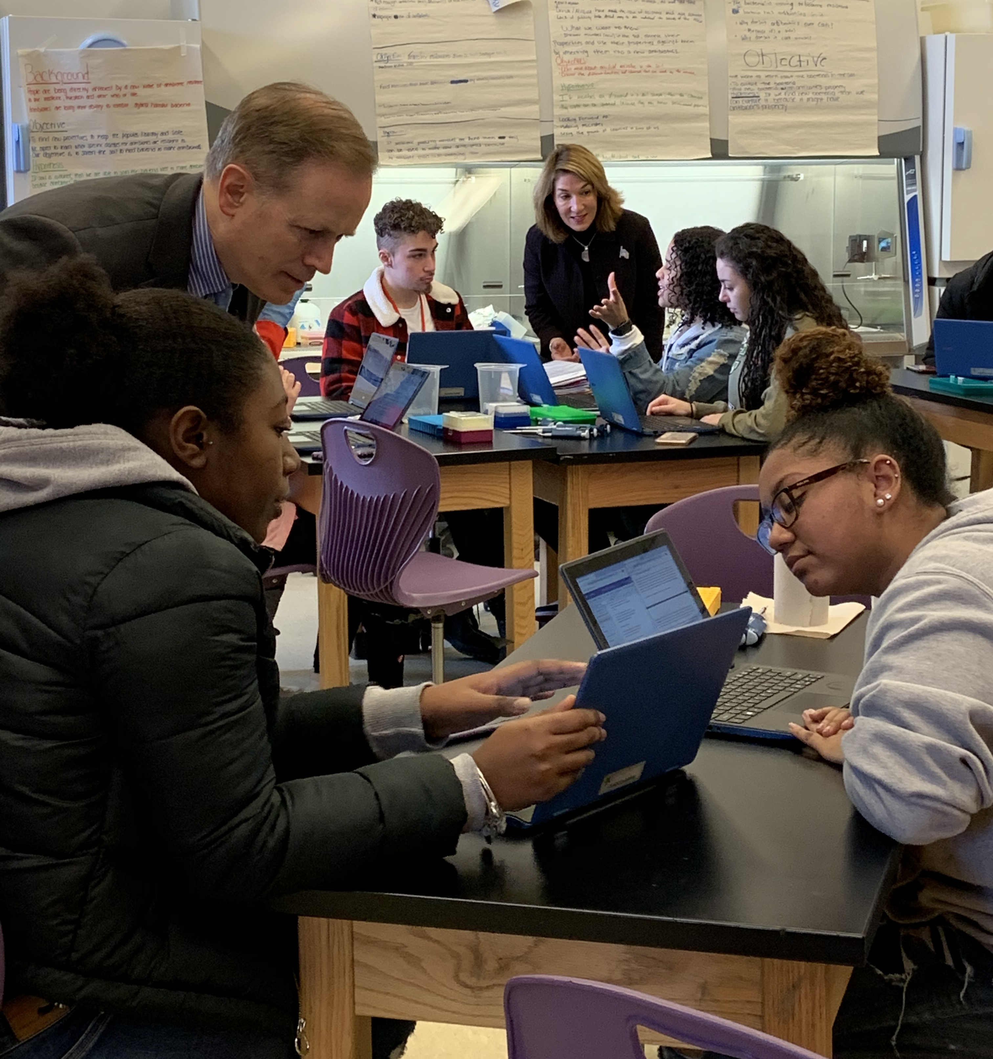
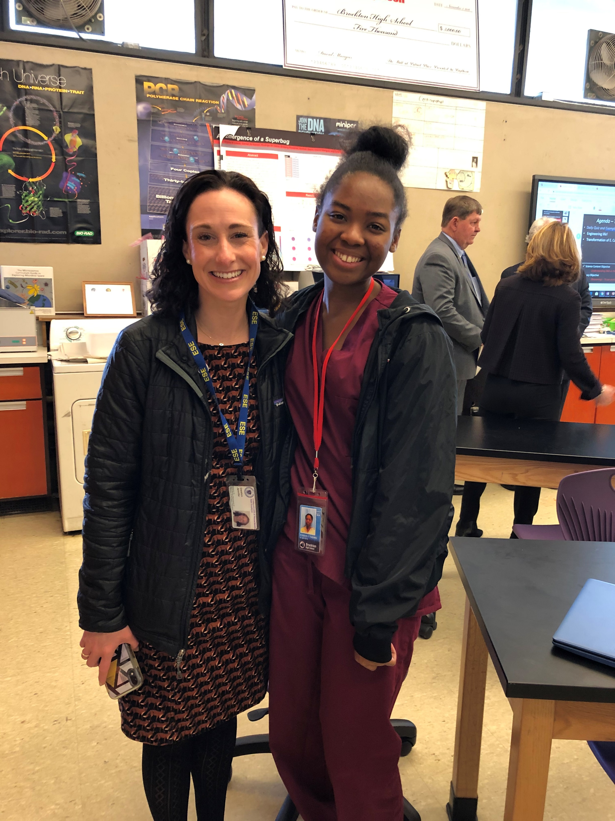
For further questions
Jennifer Gwatkin
Innovation Pathways Lead
Office for College, Career, and
Technical Education
jennifer.a.gwatkin@mass.gov
Innovation Pathways at Brockton High School, January 2020

