Slide 1
“Strengthening Career and Technical Education for the 21st Century Act
“Strengthening Career and Technical Education for the 21st Century Act”
Perkins V Implementation
February, 2020
Various Dates and Locations

Slide 2
Agenda
Welcome
Perkins V Highlights
Indicators
Assessing Local Needs
Perkins Application
Exploring Underlying Causes
Putting it All Together
Lunch / Team Time / Office Hours
Notes:
Share some highlights & basics – might feel like scratching the surface – for others it will be just enough.
Might not get to all the questions. Please share feedback or raise questions via sticky notes or put items in the ‘parking lot’. We’ll capture all of it and use to hone support & guidance.
STAFF INTRODUCTIONS

Slide 3
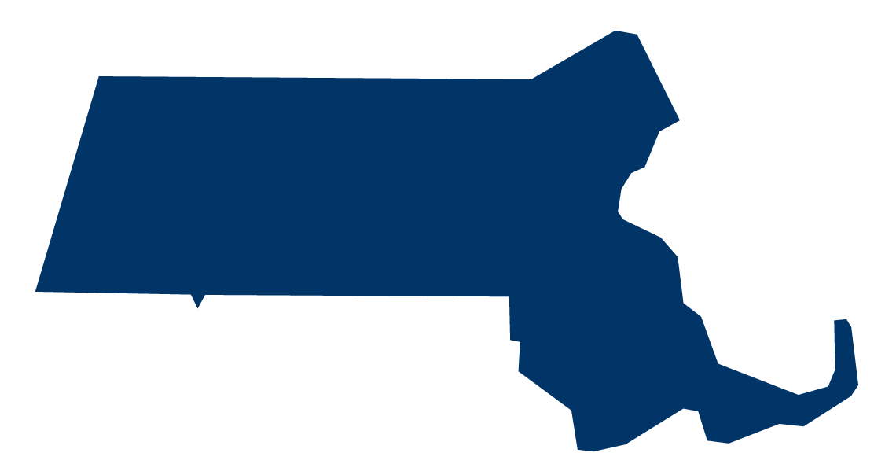
Success for Massachusetts
What does success look like for the Commonwealth of Massachusetts?
Transformed systems for college and career preparation
Increased Equitable Access to High-Quality College and Career Pathways
Improved College Persistence and Completion
Reduction in Workforce Skills Gap
Strong economy
STUDENT SUCCESS = OUR SUCCESS
Notes:
Access to Pathways
Need to increase access to high quality college and career pathways by:
Eliminating barriers for equitable access for all students and targeting high-need students (Ex: students with disabilities, students who are low-income).
Designating new pathways and increased capacity for all students to have access.
College Persistence and Completion
Waterfall Effect - Low-income students are less likely to persist and complete college
Workforce Skills Gap
There is a growing workforce skills gap and not enough students in the pipeline to meet the skill and education needs of high-demand industries

Slide 4
Steps to Expand Access
Steps to significantly expand access to high-quality college & career pathways with a focus on underserved populations/communities:
    Establish policies and build data systems to:
        set standards
        designate high-quality college and career pathways
        track participation
        measure performance
    Deepen partnerships with employers, focused on joint investment and workplace experience/learning
    Provide planning/start-up grants and on-going operating revenue

Slide 5
Perkins V in Massachusetts
Three areas of focus:
  Program quality, Access to programs and Alignment to workforce demands
There is alignment across state leadership levels:
  Education Secretariat, Governor, Workforce Skills Cabinet and DESE
Consider proportionality as you approach this work
  Some districts may have to weigh the costs and benefits, as Perkins V raises the bar
There are some important changes with Perkins V, which we’ll cover today –
  changes to Perkins Core Indicators (the accountability system for CVTE programs)
  a Needs Assessment process
  specific requirements in the Grant Application

Slide 6
Major Focus: Program Improvement
Alignment: Every Student Succeeds Act (ESSA) & Workforce Innovation and Opportunity Act (WIOA)
Increased focus - Labor Market needs
Rigorous Programs Of Study
Equity - Stronger focus - opportunities for special populations
Increase Reserve Fund - Innovation - programs of study
New National, Competitive Grant: Innovation & Modernization
Expands Career Exploration - grade 5-8
Comprehensive System
  Comprehensive Local Needs Assessment
  Local Application (Plan)
  Budget

Slide 7
What Does Perkins Do?
Perkins is:
  A federal education program that invests in secondary, postsecondary and adult Career Technical Education (CTE) programs in all 50 states, the District of Columbia and the territories
  Dedicated to the continuous improvement of and relevancy of CTE to meet the ever-changing needs of learners and employers
  Increases learner access to high-quality CTE programs of study (Secondary and Post-Secondary)
Funds support a variety of activities in MA, including:
Programs of Study
Professional development
Technical assistance
Career exploration, guidance and advisement
Data collection and analysis, including program and plan evaluation and monitoring

Slide 8
Career Technical Education is Applied Learning
Perkins Career and Technical Education Act Definition
Career Technical Education includes:
Career exploration
Rigorous academic content and technical knowledge
Technical skills and industry-recognized credentials
Competency-based, work-based, or other applied learning
Coordinated secondary and postsecondary programs, including early college
High-Quality College and Career Pathways
  Career Vocational Technical Education (Chapter 74)
  Innovation Pathways
  Early College
Notes:
HOLD / hand off to Jen [stay on this?]
[if need a warm up – ]
INTRODUCE STAFF?
Pause here for a bit – raise hands –
Secondary? Postsec? RVT? Ag? Comprehensive HS? New to Perkins? [IP?] Involved in Perk for IV? (III or earlier?)
Anyone from a district that is totally new to Perkins programming? IF so, see Lisa S before you leave. Some specific items that needs to be in place before going too far down this path so be sure to do that.
It might feel chaotic – [ex]

Slide 9
Perkins V Resources – and How They Fit Together
Comprehensive Local Needs Assessment
Grant Application
Size, Scope & Quality
Perkins Checklist
Perkins Core Indicators & Targets
Accountability system
Disaggregated for student population groups
Use for reflection & improvement
Essential components of programs
Refers to needs assessment
Budget
Guide & Worksheet
Six key areas
Consultation with stakeholders
Notes:
DRAFT – will propose to US ED – not yet accepted

Slide 10
Core Indicators of Performance
This is the accountability system for federally funded Perkins programs.
Disaggregated and used for program improvement.
  Indicators
  Targets
  Identification of population groups
Perkins Core Indicators & Targets
Notes:
… which includes Chapter 74 programs.
These are the MEASURES. We set TARGETS, which are to met across all POPULATION GROUPS.
All indicators are disaggregated by subpopulations and to be used for program improvement.
Both Sec & Postsec: some changes to populations [foster, military, homeless] / SIMS
Postsecondary: data collection changes underway
Secondary:
1S1: Four-Year Graduation Rate: no change (this was Perkins IV 4S1)
2S1: Academic Attainment in ELA: 11th grade concentrators and their 10th grade MCAS (next gen)
2S2: Academic Attainment in Mathematics: 11th grade concentrators and their 10th grade MCAS (next gen)
2S3: Academic Attainment in Science: 11th grade concentrators and their HS SCI MCAS (next gen) - incorporate as available
3S1: Postsecondary Placement: similar to Perkins IV 5S1; timing of survey & reporting to DESE moves in; slight changes to outcome categories
4S1: Nontraditional Program Enrollment: close to Perkins IV 6S1 & 6S2 (now 1 measure: was # enrolled & completed, now concentrators)
5S3: Program Quality – Participated in Work-Based Learning: new;
Postsecondary
1P1: Postsecondary Retention and Placement: similar to Perkins IV 5S1; timing of collection & reporting to DESE moves in; slight changes to outcome categories
2P1: Postsecondary Credential, Certificate or Diploma: Data collection changes underway; otherwise similar to previous indicator
3P1: Nontraditional Program Enrollment: Same as above

Slide 11
Core Indicators of Performance
This is the accountability system for federally funded Perkins programs.
Secondary Core Indicator | NOTES
1S1: Four-Year Graduation Rate | no change
2S1: Academic Attainment in ELA | 11th grade concentrators and their 10th grade MCAS (next gen)
2S2: Academic Attainment in Mathematics | 11th grade concentrators and their 10th grade MCAS (next gen)
2S3: Academic Attainment in Science | 11th grade concentrators and their HS SCI MCAS (incorporate next gen as available)
3S1: Postsecondary Placement | timing of survey & reporting to DESE moves in changes to outcome categories
4S1: Nontraditional Program Enrollment | Similar to Perkins IV
5S3: Program Quality – Participated in Work-Based Learning | NEW
Postsecondary Core Indicator
1P1: Postsecondary Retention and Placement | timing of survey & reporting to DESE moves in changes to outcome categories
2P1: Postsecondary Credential, Certificate or Diploma
3P1: Nontraditional Program Enrollment | Similar to Perkins IV
Perkins Core Indicators & Targets
Notes:
… which includes Chapter 74 programs.
These are the MEASURES. We set TARGETS, which are to met across all POPULATION GROUPS.
All indicators are disaggregated by subpopulations and to be used for program improvement.
Both Sec & Postsec: some changes to populations [foster, military, homeless] / SIMS
Postsecondary: data collection changes underway
Secondary:
1S1: Four-Year Graduation Rate: no change (this was Perkins IV 4S1)
2S1: Academic Attainment in ELA: 11th grade concentrators and their 10th grade MCAS (next gen)
2S2: Academic Attainment in Mathematics: 11th grade concentrators and their 10th grade MCAS (next gen)
2S3: Academic Attainment in Science: 11th grade concentrators and their HS SCI MCAS (next gen) - incorporate as available
3S1: Postsecondary Placement: similar to Perkins IV 5S1; timing of survey & reporting to DESE moves in; slight changes to outcome categories
4S1: Nontraditional Program Enrollment: close to Perkins IV 6S1 & 6S2 (now 1 measure: was # enrolled & completed, now concentrators)
5S3: Program Quality – Participated in Work-Based Learning: new;
Postsecondary
1P1: Postsecondary Retention and Placement: similar to Perkins IV 5S1; timing of collection & reporting to DESE moves in; slight changes to outcome categories
2P1: Postsecondary Credential, Certificate or Diploma: Data collection changes underway; otherwise similar to previous indicator
3P1: Nontraditional Program Enrollment: Same as above

Slide 12
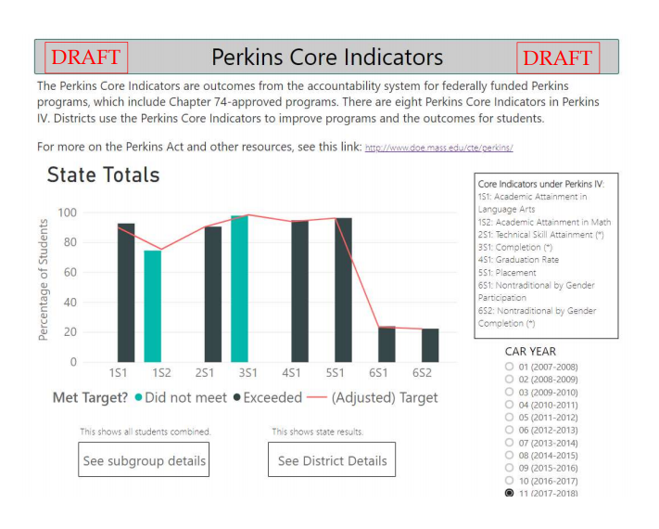
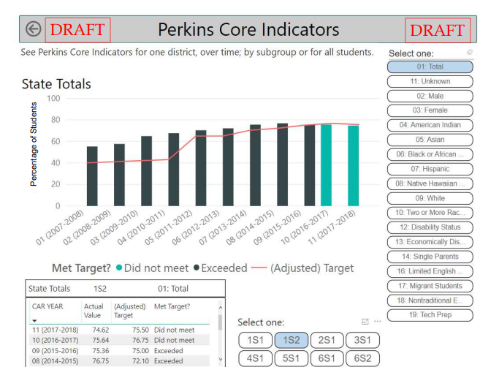
Core Indicators of Performance
Perkins Core Indicators & Targets

Slide 13
The Comprehensive Local Needs Assessment: Reflection and Consultation
Equity & access
Implementing Programs of Study
Recruitment, retention, training
Labor market
Core Indicators
Size, scope & quality
Initiatives
Comprehensive Local Needs Assessment
Budget
Notes:
US ED specifies six components needed in a CLNA:
Perf on core indicators
Alignment to Labor market
SSQ of programs offered
Progress toward implementing Programs/Programs of Study
Recruitment, Retention, Training of Faculty and Staff
Progress toward improving Equity and Access
Very aligned to what is in place already in districts
There’s a WORKSHEET and GUIDE to help do this part, which Larry will explain.
Another way to think about it - [expln]
PLUS: Stakeholder consultation
And PRIORITIZE what to focus on → THAT goes into application for budget purposes
20 min / 90 min / 14 days → CONSULTATION
Next to Larry for CLNA [5-10 min, then work time]

Slide 14
The Comprehensive Local Needs Assessment: Reflection and Consultation
Why complete a comprehensive local needs assessment?
  It allows for reflection and self-assessment.
  It ensures that program decision-making is data-driven.
  Completion can identify gaps – and aid in planning Perkins expenditures.
  It is aligned to Perkins V Application.
  Perkins V Act requires it.
Comprehensive Local Needs Assessment
Notes:
5-20 min
1-2 hours
14 days

Slide 15
The Perkins Grant Application:
Identify Initiatives and Budget
Equity & access
Implementing Programs of Study
Recruitment, retention, training
Labor market
Core Indicators
Size, scope & quality
Initiatives
Grant Application
Budget
Notes:
In the grant application – space to identify initiatives & budget.
Next to Ellie from RASP who will step through the Grant Application. [if haven’t yet: also introduce Ellie, Kathy and Alex from the RASP Office]

Slide 16
Perkins V Resources – and How They Fit Together
Comprehensive Local Needs Assessment
Grant Application
Size, Scope & Quality
Perkins Checklist
Perkins Core Indicators & Targets
Accountability system
Disaggregated for student population groups
Use for reflection & improvement
Essential components of programs
Refers to needs assessment
Budget
Guide & Worksheet
Six key areas
Consultation with stakeholders
Notes:
DRAFT – will propose to US ED – not yet accepted

Slide 17
Pulling the pieces together for YOUR district or institution
What’s next for you?
Notes:
Take back and continue
Consult with stakeholders and advisory groups
Contact Liaisons with questions

Slide 18
Perkins V
Thank you for participating!
Notes:
Take back and continue
Consult with stakeholders and advisory groups
Contact Liaisons with questions

Slide 19
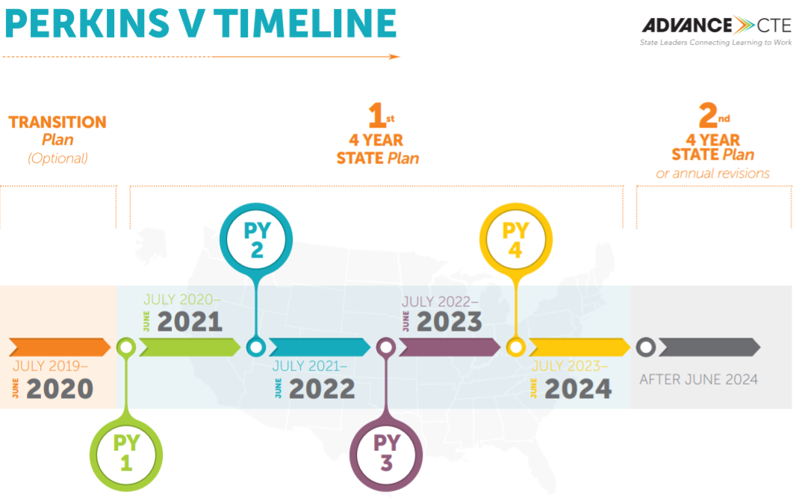
What does reauthorization mean for the state plan timeline?

Slide 20
State Plan Development
Draft 1
Oct 2019
Draft 2
Dec/
Jan
Draft 3
Feb 2020
Final Mar/Apr 2020
Collaborate
Submit to US ED
To date
Share highlights & plan
Share highlights & plan
Deliver to Gov.
This has been ongoing
October 2019
HQCCP SH meeting
MAVA General Meeting
Peer Review feedback
Governor
December/January
HQCCP SH meeting
Regional Hearings
Public Comment
February 2020
Meet with Governor, deliver final draft for 30 day review
March 2020
Modify as needed
April
Submit to US ED

Slide 21
State Plan Development
Status | Milestones | Date
Ongoing | Consultation | 2018-2019
Done | Project Kickoff | 8/21/2019
Done | State Plan Concepts/Priorities Outline | 9/10/2019
Done | Review w/ Commissioner | 9/16/2019
 | Complete State Plan Draft 1 | 10/15/2019
 | HQCCP SH meeting | 10/16/2019
 | Submit State Plan Draft 1 for Peer Review & Feedback | 10/18/2019
 | Governor’s Office Consultation on Draft Plan | Late Oct
 | Info Sessions for feedback/input | Oct/Nov
 | Complete State Plan Draft 2 | early Dec.
* | Hold Regional Hearings across the state | mid-Dec. through Jan.
* | Draft Plan 2: Public comment starts | Jan
* | HQCCP Stakeholder meeting | Jan
 | Draft Plan 2: Public comment ends | mid-Feb (latest)
 | Complete State Plan Draft 3 | 2/20/2020
 | Meet with Commissioner: Final Review with Final Draft (Draft 3) | 2/24/2020
 | Governor’s Office Consultation on Final Plan | Early Mar
 | Anticipated Approval from Governor | 3/26/2020
 | Submit to US ED | March/early April
Notes:
To be scheduled: hearings, Jan SH mtg, public comment

