Slide 1

Data Enhanced Grant
Data
Enhanced Grant
Beverly Public Schools May 31, 2019

Slide 2
Overview of Project
Formal Data Review Cycle
:Focus:
Establish and implement a data cycle of inquiry at the Beverly Middle School in two identified areas:
1.) Mathematics
2.) Attendance

Slide 3
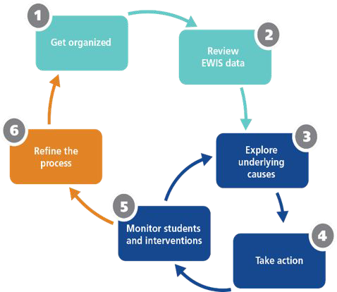
EWIS Strategies
Step 1. Get organized Step 2. Review EWIS data Step 3. Explore Causes Step 4. Take Action
Step 5. Monitor Students and Interve Step 6. Refine the Process
ntions

Slide 4
Two Focus Areas - Math
Math Focus: Inspired and built upon the data cycle established in the elementary schools to include:
Common diagnostic benchmark
Common formative and summative local assessments
Mid-year benchmark and end of year benchmark
Formal and informal data analysis meetings utilizing LinkIt (data dashboard) and data analysis protocol
Plan for personalization of teaching moving forward

Slide 5
Two Focus Areas - Attendance
Attendance Focus: Collaborative work to build upon existing practices in place at our school adjustment counselors weekly meetings.
Identify students with chronic absenteeism
Develop methods of including families and students
Weekly attendance reports share with administrative team
Identify barriers for school attendance
Social-Emotional/Therapeutic approach to provide student supports
Communication and action to interrupt chronic absence patterns and educate students and families

Slide 6
Examples of Strategies
Data Meetings held 3 times a year
Protocol for examining Data
Use of LinkIt - training provided for staff on data use
Tiered interventions for lowest performing students
(September, January, June)
Review of Chronic Attendance Data -
Google Sheet (EWIS data)
Implementation of Attendance Interventions

Slide 7
Trainings - Matt Wilson - LinkIt
8/30/2018 - on-site 9/11/2018 - on-site 9/20/2018 - web training 10/9/2018 - on-site 1/17/2019 - web training 2/7/2019 - on-site 5/20/2019 - on-site
On-going communication and training through email with a number of LinkIt staff members.
Very helpful!

Slide 8
Data Meetings Overview
Data Meetings Overview
Schedule:
Beginning-of-Year: September
Mid-Year: January
End-of-Year: June
Fall Data Meetings – Slides
Data Reflection Sheet

Slide 9
Data Meetings
EWIS Data
Grade 5 Spreadsheet Example
Agenda Examples
Grade 5
Grade 7

Slide 10

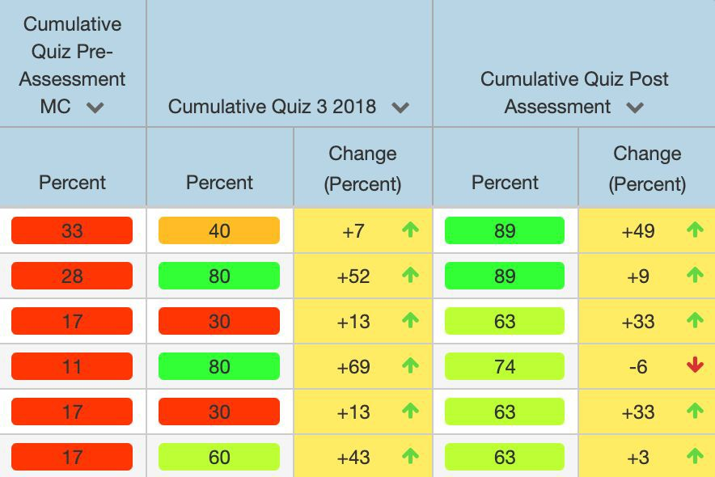
Grade 8 Data Stored in the Linkit Dashboard in Dashboard
Data Warehousing, Assessment Solutions and Analytics

Slide 11
Attendance Review Data
Middle School Chronic Attendance Data
High School Chronic Attendance Data

Slide 12
Tier 2 and Tier 3 Attendance Strategies
Tier 2 and Tier 3 Attendance Strategies
Attendance Review meetings: for students with over 14 absences. Includes student, parent/guardian, counselor, administrator.
- Reflection sheet: completed by student, with guidance from counselors
- Assigned mentors: cohort of teachers volunteer to be point person with 1 student
- Morning Class: 2 days per week during first period, scheduled as a Global Apps (elective, in lieu of STEM, Gym, or Fine Arts) - Opportunity for setting goals for the day - get started on the day on a positive note -included mindfulness activities.
- Outside Resources: connecting student with therapeutic supports, transportation, DCF or law
enforcement involvement depending on need.
- Attendance Tracking Sheets: tracks monthly attendance + tardy, grades, services (IEP, 504, ELL), and actions taken in one location

Slide 13
Next steps
Next Steps
Continue building upon the structures developed this year
Implement formal data meetings in ELA and/or Science
Embed attendance data as part of the content data analysis

