Slide 1

Data Cycles with EWIS
May 31st, 2019

Slide 2
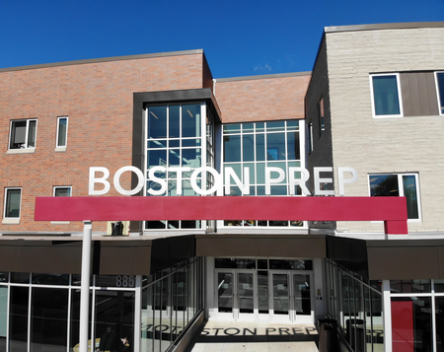
Agenda
Overview
Alumni data cycle
Student data cycle
Planning for SY20
Boston Prep overview
Data cycles
  Alumni data (annually)
  Student data (weekly)
Planning for SY20
Notes:
Narrate over session objective and agenda.

Slide 3
mission
Overview
Alumni data cycle
Student data cycle
Planning for SY20
Boston Prep
Mission
To prepare students to succeed in four-year colleges and embody, in thought and action, lifelong ethical growth.
Notes:
Standard Boston Prep overview, including:
Mission
Milestones (opened in 2004; added a grade each year; first HS graduates in 2011; Founder transition in 2012; first college graduates in 2015; approved for growth in 2017)
Summary data (400 students; 181 alumni)

Slide 4
Boston Prep History
Overview
Alumni data cycle
Student data cycle
Planning for SY20
Boston Prep History
Milestones
2017: State approves Boston Prep to open 300 new seats
2004: Boston Prep opens 6th grade
2014: First 4-year college graduate
2005-2010: Boston Prep adds a grade level each year
2011: First HS graduating class
2010: Persistence Project is launched
2004
2019

Slide 5
Boston Prep Overview
Overview
Alumni data cycle
Student data cycle
Planning for SY20
Boston Prep Overview
Key Design Elements
High expectations and a one-school, 6-16 model
Ethics
Student supports
Professional excellence
Alumni supports
Rigorous academics

Slide 6
Boston Prep Overview
Overview
Alumni data cycle
Student data cycle
Planning for SY20
By the Numbers:
527
Current students, across grades 6 through 12
271
Alumni
100%
Acceptance to 4-year colleges; 8 years in a row
98%
Matriculation to college the fall after graduation
76%
Persistence rate in college
52%
Graduation from 4-year college

Slide 7
Data Team
Overview
Alumni data cycle
Student data cycle
Planning for SY20
Data Team
Mindy Wright
Director of the Persistence Project
Carolina Brito
HS Principal
Cristina Lopez
MS Principal
Eileen Callahan
Chief Academic Officer
Sharon Liszanckie
Executive Director
Graham VanderZanden
Director of Strategic Projects
Katie Bernier
Data Analyst
Notes:
We each introduce ourselves.

Slide 8
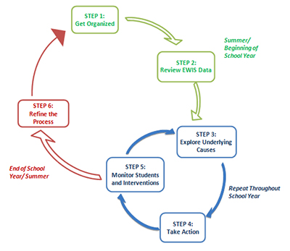
Annual Persistence data cycle
Overview
Alumni data cycle
Student data cycle
Planning for SY20
Annual Persistence data cycle
Step | Action
1 | Salesforce database tracks student progress to/through college
2 | Annual data update, including EWIS data, informs risk analysis
3 | College and alumni counselors plan supports and interventions
4 | Counselors conduct prioritized outreach
5 | NSC data and periodic check-ins help us track progress
6 | Targeted alumni interviews to understand drivers of college success for our alumni
Notes:
Caveat: Video was produced in 2015; data has been updated since then

Slide 9
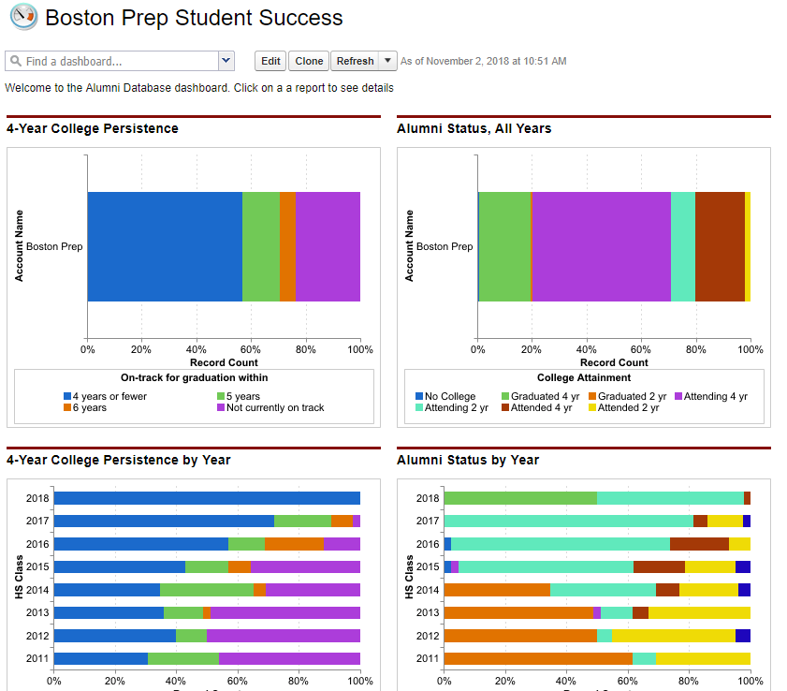
Get organized
Overview
Alumni data cycle
Student data cycle
Planning for SY20
Step 1: Get Organized
Salesforce database tracks student progress to/through college
Step | Action
1 | Salesforce database tracks student progress to/through college
2 | Annual data update, including EWIS data, informs risk analysis
3 | College and alumni counselors plan supports and interventions
4 | Counselors conduct prioritized outreach
5 | NSC data and periodic check-ins help us track progress
6 | Targeted alumni interviews to understand drivers of college success for our alumni
Notes:
Caveat: Video was produced in 2015; data has been updated since then

Slide 10
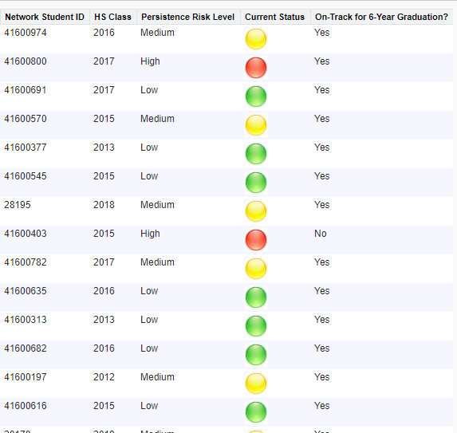
Step 2: Review EWIS Data
Overview
Alumni data cycle
Student data cycle
Planning for SY20
Step 2: Review EWIS Data
Annual data update, including EWIS data, informs risk analysis
Step | Action
1 | Salesforce database tracks student progress to/through college
2 | Annual data update, including EWIS data, informs risk analysis
3 | College and alumni counselors plan supports and interventions
4 | Counselors conduct prioritized outreach
5 | NSC data and periodic check-ins help us track progress
6 | Targeted alumni interviews to understand drivers of college success for our alumni
Notes:
Caveat: Video was produced in 2015; data has been updated since then

Slide 11
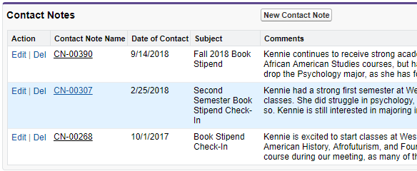
Step 3-4: Explore Underlying Causes; Take Action
College and alumni counselors plan supports and interventions. Counselors conduct prioritized outreach
Overview
Alumni data cycle
Student data cycle
Planning for SY20
Step 3-4: Explore Underlying Causes; Take Action
College and alumni counselors plan supports and interventions. Counselors conduct prioritized outreach
Step | Action
1 | Salesforce database tracks student progress to/through college
2 | Annual data update, including EWIS data, informs risk analysis
3 | College and alumni counselors plan supports and interventions
4 | Counselors conduct prioritized outreach
5 | NSC data and periodic check-ins help us track progress
6 | Targeted alumni interviews to understand drivers of college success for our alumni
Notes:
Caveat: Video was produced in 2015; data has been updated since then

Slide 12
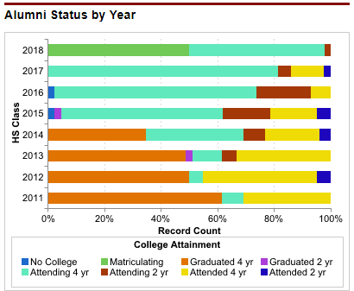
Step 5: Monitor Students and Interventions
NSC data and periodic check-ins help us track progress
Overview
Alumni data cycle
Student data cycle
Planning for SY20
Step 5: Monitor Students and Interventions
NSC data and periodic check-ins help us track progress
Step | Action
1 | Salesforce database tracks student progress to/through college
2 | Annual data update, including EWIS data, informs risk analysis
3 | College and alumni counselors plan supports and interventions
4 | Counselors conduct prioritized outreach
5 | NSC data and periodic check-ins help us track progress
6 | Targeted alumni interviews to understand drivers of college success for our alumni
Notes:
Caveat: Video was produced in 2015; data has been updated since then

Slide 13
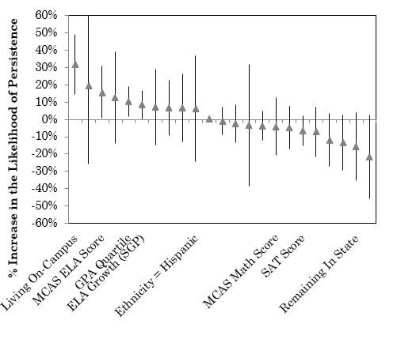
Step 6: Refine the Process
Targeted alumni interviews to understand drivers of college success for our alumni
Overview
Alumni data cycle
Student data cycle
Planning for SY20
Step 6: Refine the Process
Targeted alumni interviews to understand drivers of college success for our alumni
Step | Action
1 | Salesforce database tracks student progress to/through college
2 | Annual data update, including EWIS data, informs risk analysis
3 | College and alumni counselors plan supports and interventions
4 | Counselors conduct prioritized outreach
5 | NSC data and periodic check-ins help us track progress
6 | Targeted alumni interviews to understand drivers of college success for our alumni
Notes:
Caveat: Video was produced in 2015; data has been updated since then

Slide 14
Annual MS/HS data cycle
Overview
Alumni data cycle
Student data cycle
Planning for SY20
Step | Action
1 | Weekly GLM dashboard helps faculty members stay up-to-date on student progress
2 | EWIS data informs weekly GLMs
3 | Principals lead teachers in prioritizing students and interventions
4 | Teachers work with students (in class, in advisories, etc.)
5 | Weekly GLMs enable updates
6 | Ongoing review of dashboard tool between Principals and Data Analyst informs updates
Annual MS/HS data cycle
Notes:
Caveat: Video was produced in 2015; data has been updated since then

Slide 15
Weekly MS/HS data cycle
Overview
Alumni data cycle
Student data cycle
Planning for SY20
Weekly MS/HS data cycle
Step | Action
1 | Weekly GLM dashboard helps faculty members stay up-to-date on student progress
2 | EWIS data informs weekly GLMs
3 | Principals lead teachers in prioritizing students and interventions
4 | Teachers work with students (in class, in advisories, etc.)
5 | Weekly GLMs enable updates
6 | Ongoing review of dashboard tool between Principals and Data Analyst informs updates
Notes:
Caveat: Video was produced in 2015; data has been updated since then

Slide 16
EWIS Next Steps
Overview
Alumni data cycle
Student data cycle
Planning for SY20
Our Alumni and Student data cycles both draw on EWIS data to inform planning conversations about how best to support students. Moving forward, we hope to use EWIS data to:
Better support new students from day 1
Create bridges between our 6-12 and our Persistence programming

