Slide 1


Brockton public schools Student High Risk Indicator Tool
Brockton Public Schools
High Risk Indicator Tool (SHRIT)
Student

Slide 2



Student High Risk Indicator Tool (SHRiT):
Assessment Team Charge 2018-2019
Student High Risk Indicator Tool (SHRiT):
Assessment Team Charge 2018-2019
Our students struggle academically & behaviorally when they transition from the Elementary to Middle School.
Our academic and emotional data existed in silos - making it difficult for our staff to access it.

Slide 3





Student High Risk Indicator Tool (SHRiT):
Solution
Student High Risk Indicator Tool (SHRiT):
Solution

Slide 4










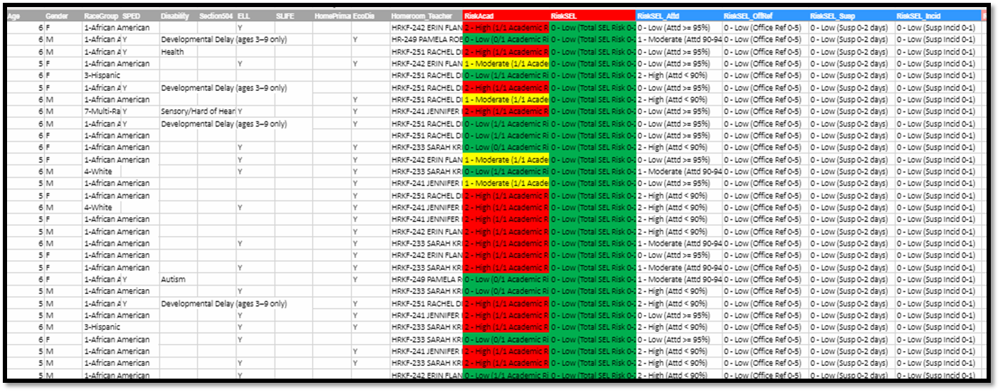













Student High Risk Indicator Tool (SHRiT):
The Tool
Student High Risk Indicator Tool (SHRiT):
The Tool
c

Slide 5


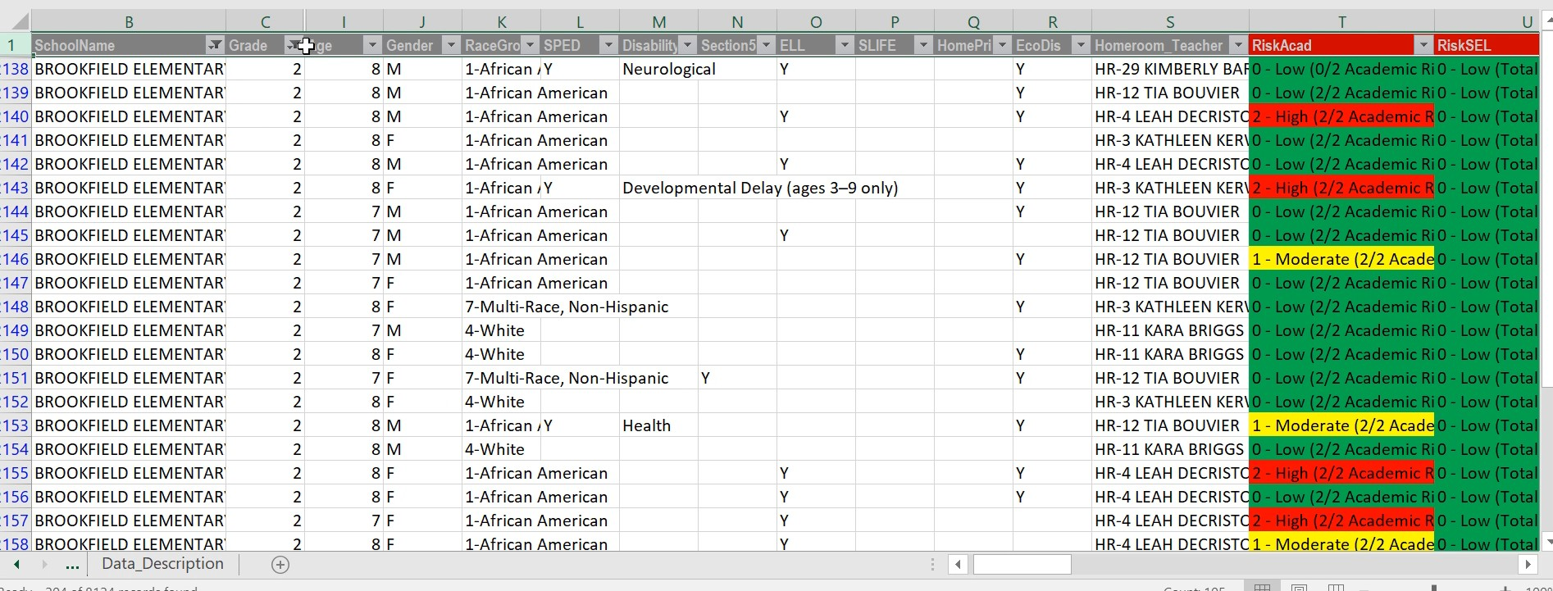
Student High Risk Indicator Tool (SHRiT):
The Tool
SHIRT: Compiles high risk indicators, both academic and behavioral, from our SIS and creates a custom RISK INDICATOR for each student

Slide 6






Student High Risk Indicator Tool (SHRiT): The Purpose
Change trajectory of students (safety net)
Track data from school to school and
grade level transition years
Use data to test assumptions Provide staff with all data in one tool Develop a more equitable process to
identify students

Slide 7




Student High Risk Indicator Tool (SHRiT):
Student High Risk Indicator Tool (SHRiT):
Strengths
Real time data
Academic and social/emotional can be viewed separately or combined
All data from multiple sources are
compiled in one data system.

Slide 8
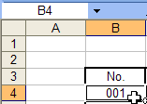



Student High Risk Indicator Tool (SHRiT):
Limitations
Student High Risk Indicator Tool (SHRiT):
Limitations
Lots of cells with descriptions to understand
Need to have some excel experience
Not consistent academic data for each grade level
Not able to keep edits since it is real time
data

Slide 9





Student High Risk Indicator Tool (SHRiT):
Implementation
Develop a plan for feedback
Continue to adjust SHIRT data fields to meet
the needs of the
Create a system that SHIRT is a pathway for
intervention
Find out: How are people using this? Do all of
these fields need to be included?

