Slide 1
Developing and Utilizing Early Warning Data Systems in Secondary Schools
Matthew R. DuBois, Ph.D, NCSP
Public Schools of Brookline

Slide 2
Goals
Identify the attendance and class performance thresholds that predict poor performance in core academic classes during 9th grade.
Create a tool that allows students to be identified, and subsequently provided support, as soon as the begin presenting with risk factors.
    Ensure that students most at need receive our most intensive supports.
Evaluate the effectiveness of our interventions, supports, and school-based practices (student and school level).

Slide 3
Step 1: Identifying Predictors and Creating Thresholds
Analyzed two 9th-grade cohorts (N = 1,024).
  Focused on attendance, grades, demographics
  Outcome variable: performance in core academic areas (Math, Science, History, English)
    Dichotomized as earning a D+ or lower or a C- or higher.

Slide 4
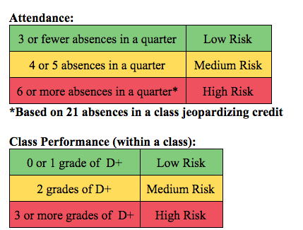
Attendance and class performance

Slide 5
Other Variables
School Connectedness/Mental Health
Academic Self-Efficacy
Behavior/Discipline
Middle school performance (grades, attendance, MCAS)

Slide 6
Step 2: Creating the EWIS Platform
Currently utilizing Google Sheets
Updated every week (mostly manual entry)
Focus on usability

Slide 7
Step 3: Exploring Additional Risk Factors
Surveying students directly at multiple times throughout the year.
  School connectedness/belonging
  Mental health
  Academic self-efficacy

Slide 8
Student Survey
Utilized Google Forms
Survey students at 5 time points
  First week of school
  End of 1st quarter
  End of 2nd quarter
  End of 3rd quarter
  End of school year

Slide 9
Step 4: Making the Data Actionable
Creation of an Early Warning Data Team (EWDT)
  Psychologist
  Director of Special Education
  Director of Guidance and Social Work
  Two general education teachers (including head of Advisory)
  A special education teacher
  BCBA
  Associate Dean
  Guidance Counselor
  9th grade social worker

Slide 10
EWDT
School Year 2018-2019
  Weekly hour-long meetings to:
    Review EWIS Data
    Email teams when students cross threshold (and begin problem solving process)
    Plan for presenting data to key stakeholders
    Prepare student surveys
    Develop additional supports

Slide 11
EWDT
Threshold emails are sent when:
  Student has 4th absence in a class in a quarter (and again after 6th absence)
  Student earns 2nd grade of D+ or lower on a report (and again after 3rd occasion).
Email is sent to student’s entire team
  Approximately a 50% response rate from teachers.
  Helpful for problem definition and understanding.

Slide 12
EWDT
After better understanding the problem, teachers and staff are directed to attempt other classroom-based, teacher-driven interventions.
More significant and complex challenges result in a referral to our Child Study Team.

Slide 13
EWDT
To share our work and begin shaping a culture around data we:
  Created a summary of BHS EWIS “paper” for faculty
  Hosted “Data Walkthroughs” and presented at department meetings.
  Presented EWIS data to Dean’s Team each month

Slide 14
Step 5: Using Data to Drive Intervention
“Lunch Lounge”
  10% of 9th graders reported to not having a close friend in 8th grade.
  Eating lunch in cafeteria was frequently described when students were asked, “What are you worried about in 9th grade.”
Safe place/Safe Person
  Guidance counselors, Deans, and/or Social Workers met with every 9th grader who reported that they did not have a safe person in 8th grade (40 students) and/or after 1st quarter (130 students).

Slide 15
Data Driven Intervention
Guidance counselors or a social worker met with all students who endorsed symptoms of depression (and did not already have access to on-going treatment; 32 students).
  Family provided contact information for community mental health center after initial screen.
  Focus on Building Relationships
    20 minutes in faculty meeting, followed up by a teacher training series (March and April)

Slide 16
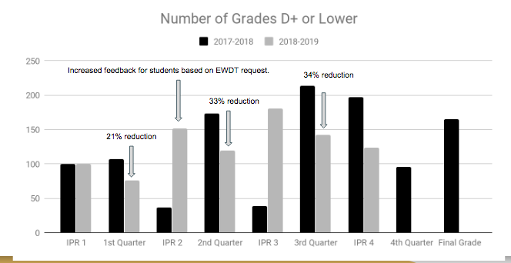
Current Impact

Slide 17
Next Steps and Future Directions
Currently analyzing 8th-grade data to identify variables that help predict 9th grade performance.
  Improving transition process.
Early stages in planning to extend work into elementary schools
Improvements in Data Entry
Embedding EWDT work into Dean’s Teams

