Slide 1
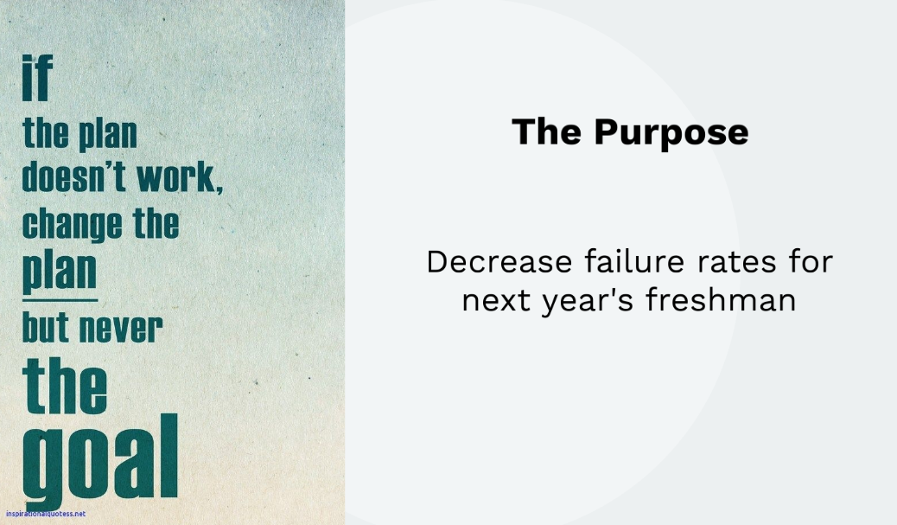
Gardner public school
Gardner Public Schools

Slide 2
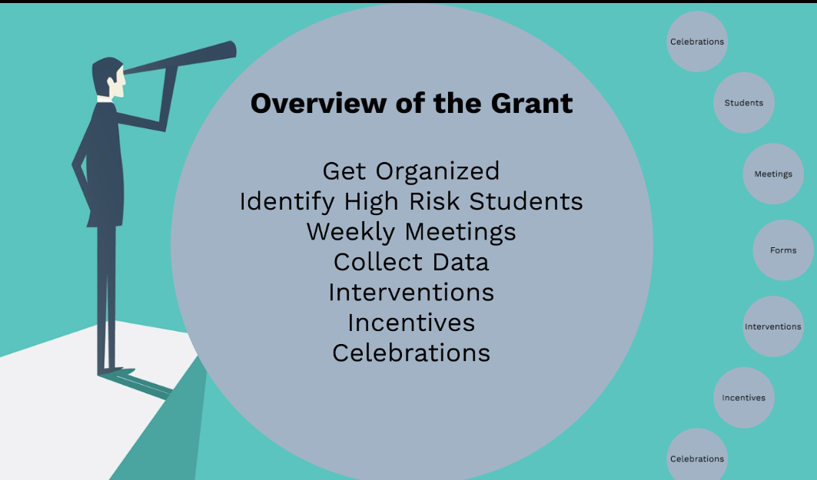
Overview of the grant

Slide 3
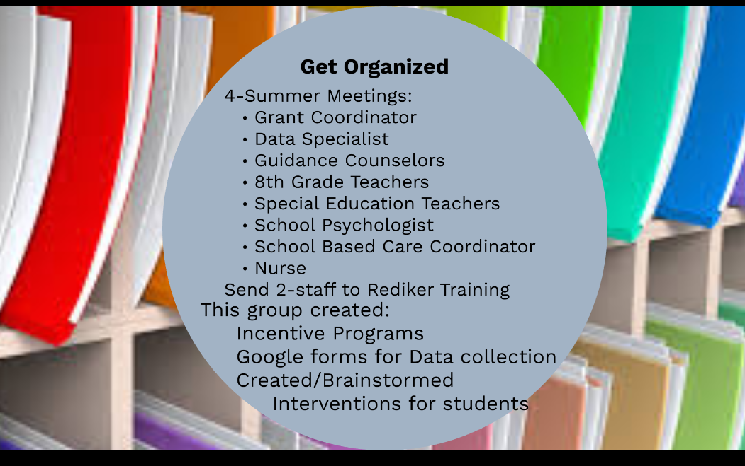
Get organized

Slide 4
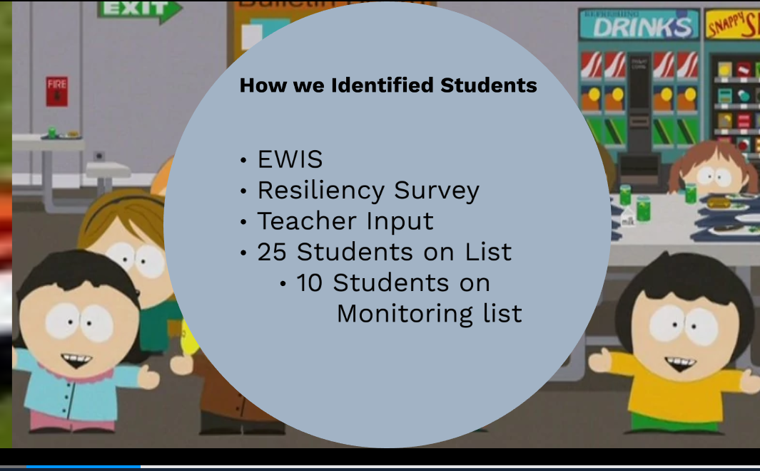
How we identified students

Slide 5
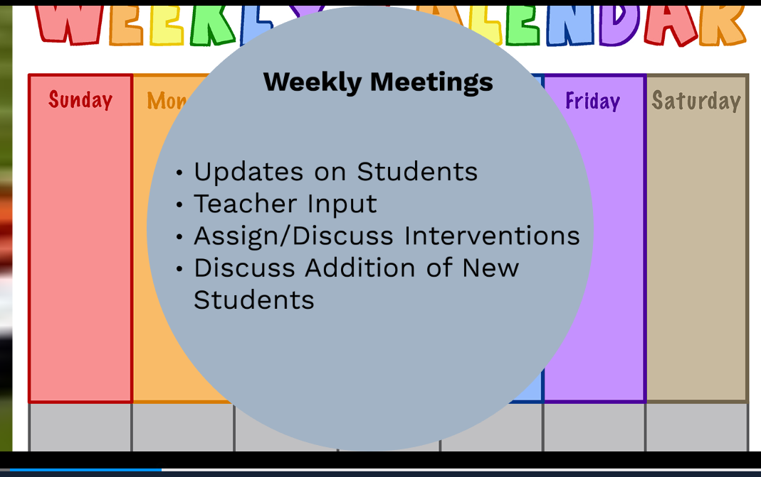
Weekly meetings

Slide 6
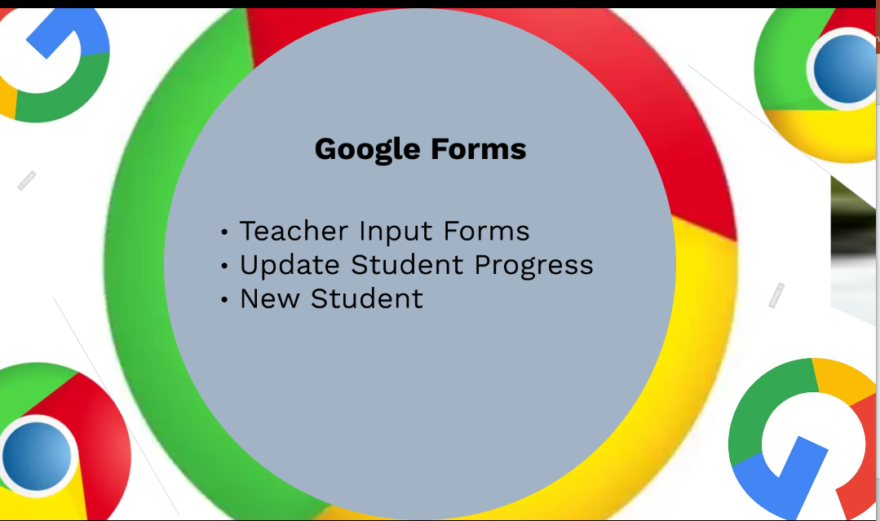
Google forms

Slide 7
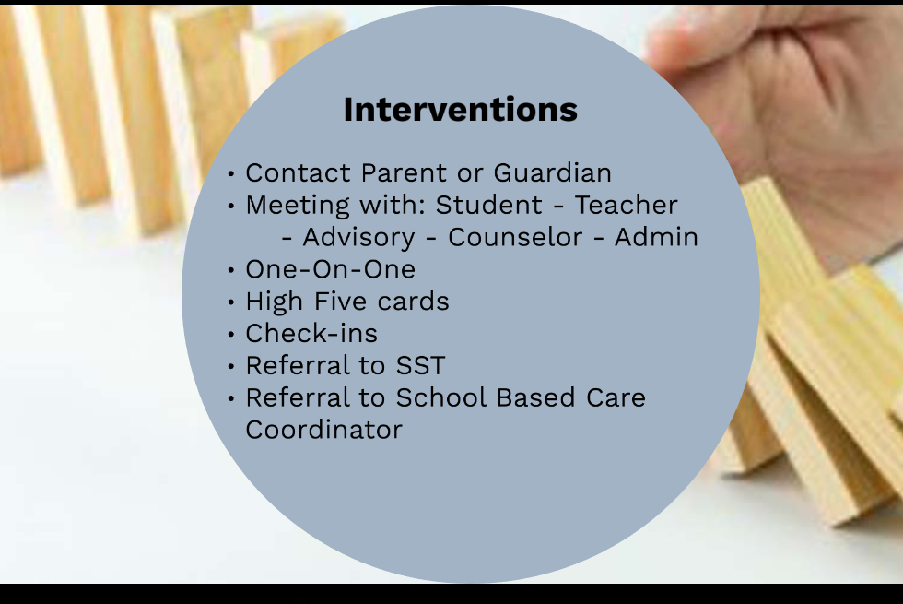
interventions

Slide 8
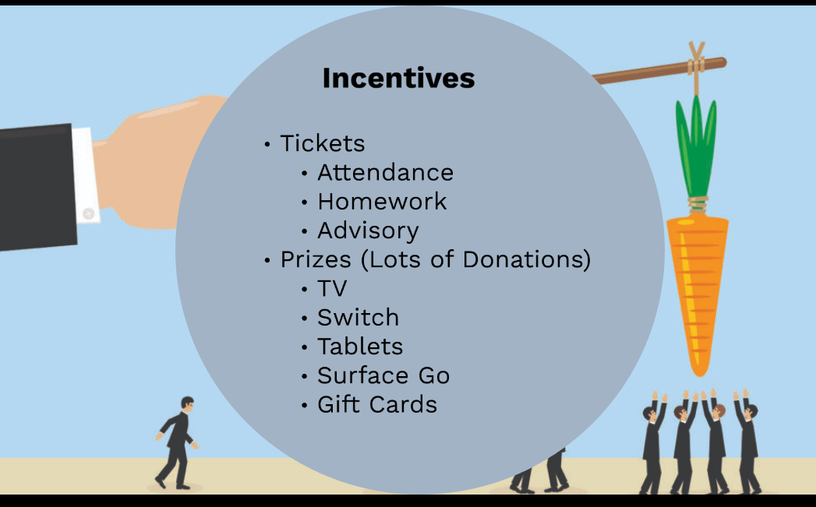
incentives

Slide 9
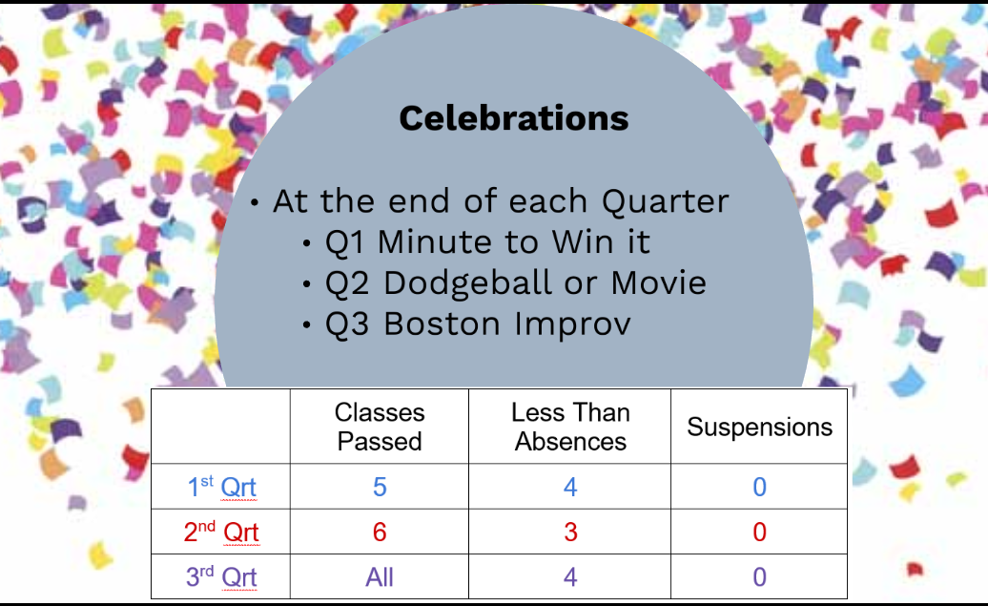
celebrations

Slide 10

Gardner hs 8th grade data grant

Slide 11
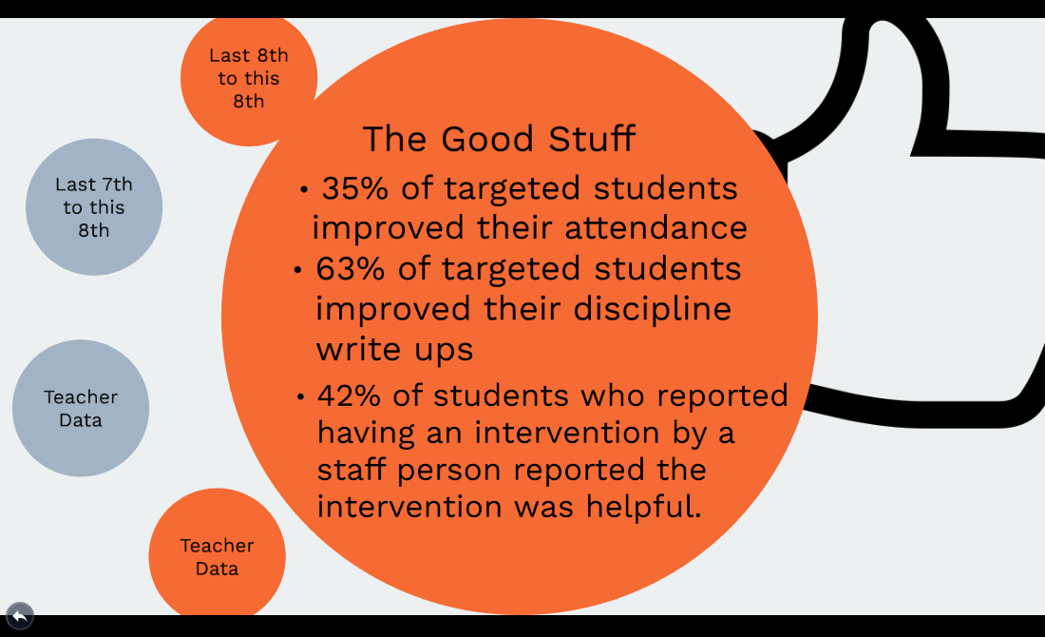
The good stuff

Slide 12
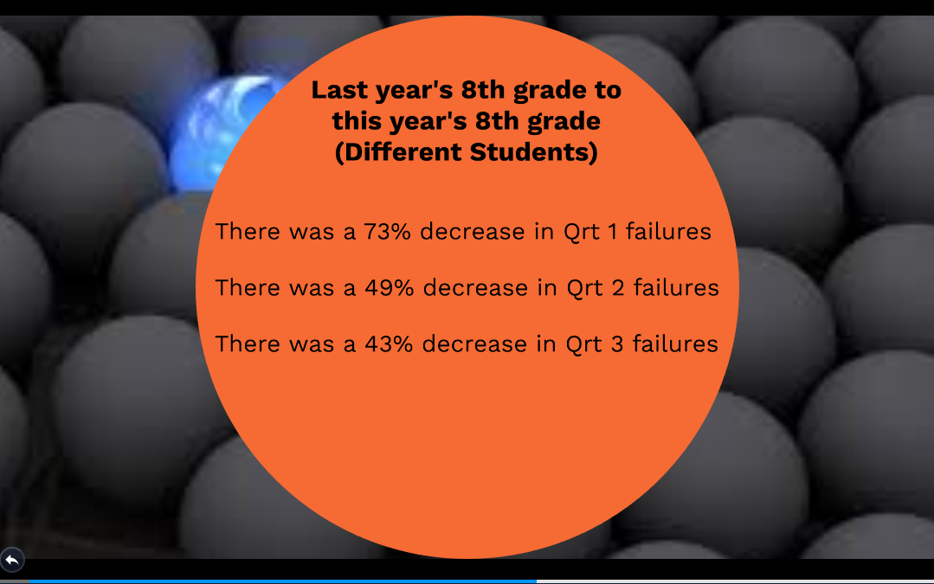
Last year’s 8th grade

Slide 13
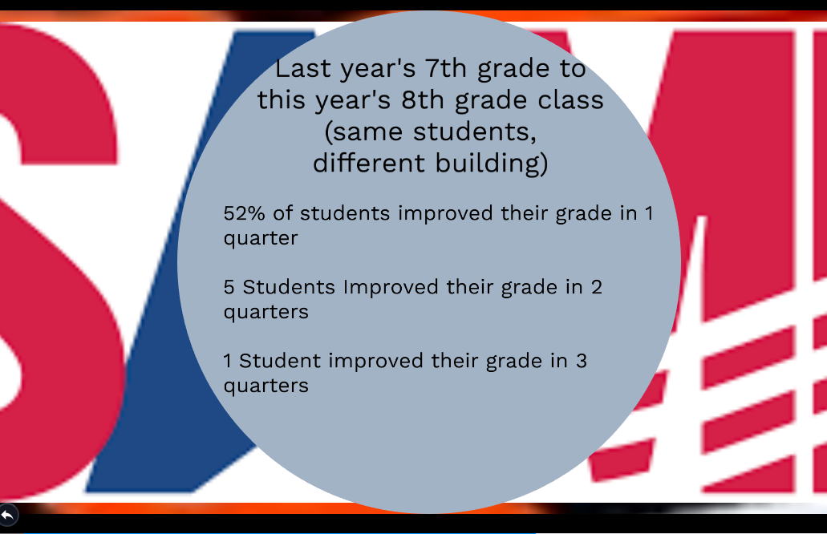
Last year’s 7th grade

Slide 14
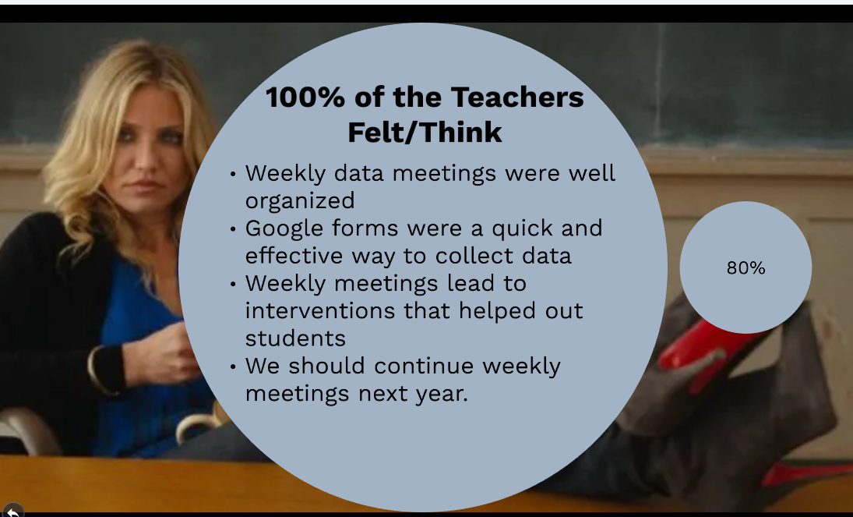
100% of the teachers felt/think

Slide 15
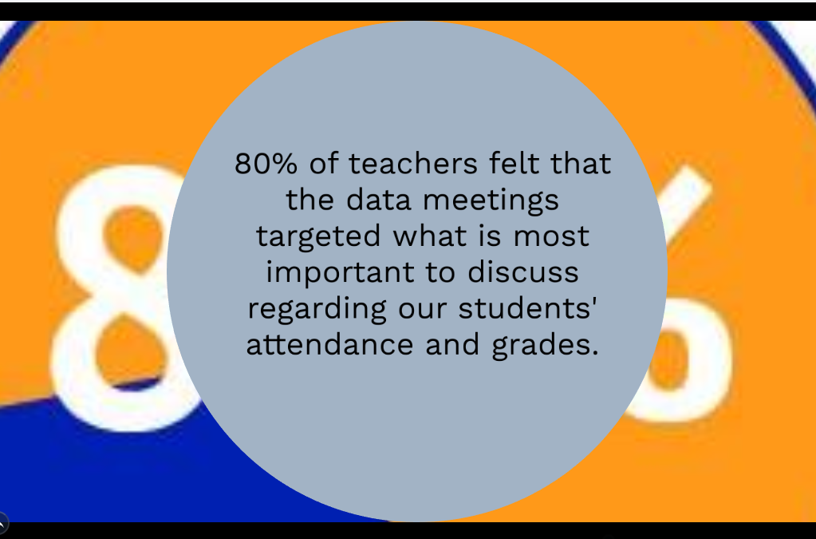
80% of teachers felt

Slide 16
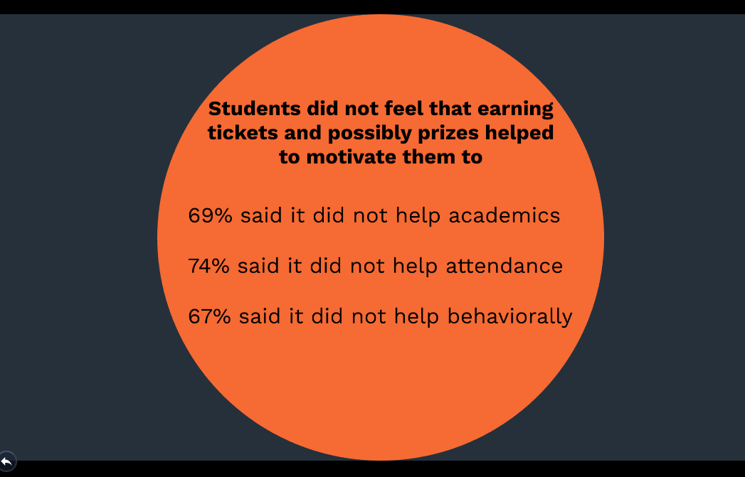
Students did not feel

Slide 17
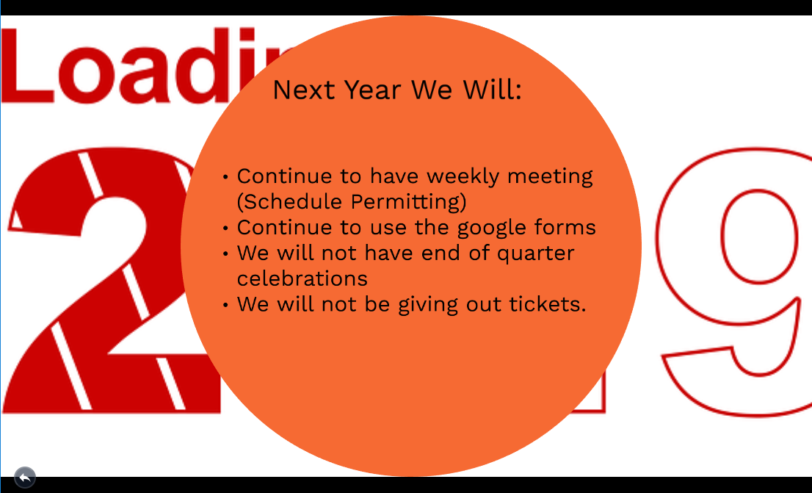
Next year we will

Slide 18
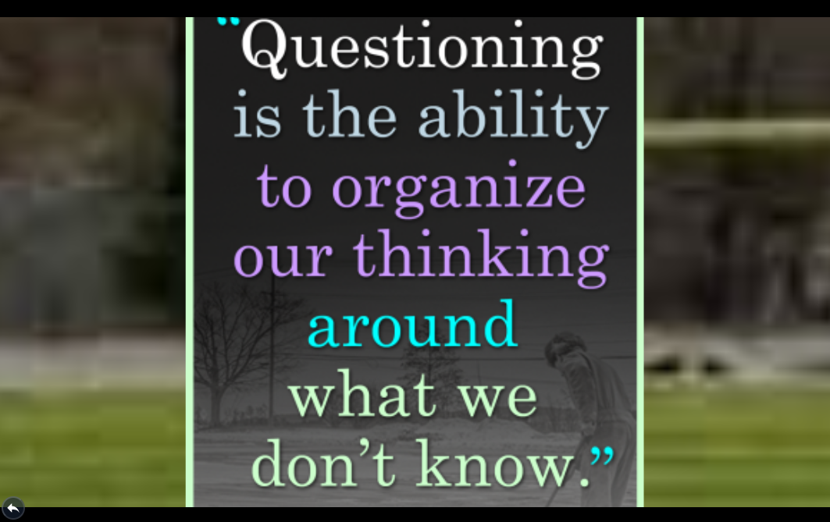
Questioning is the ability

