Slide 1
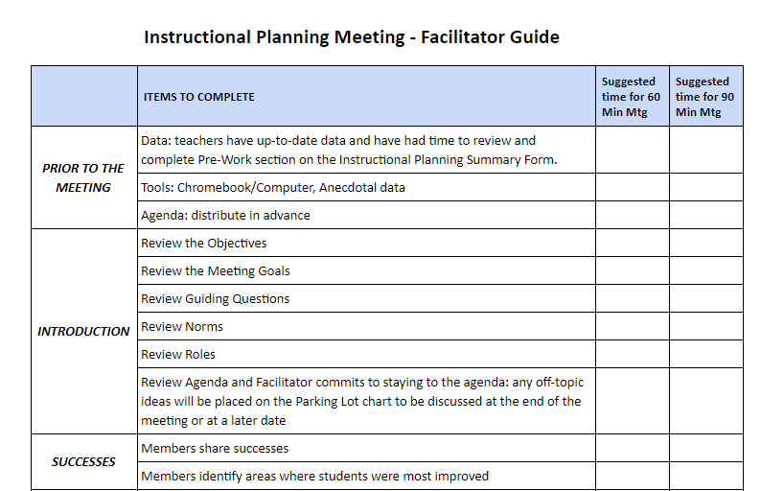
Instructional planning meeting

Slide 2
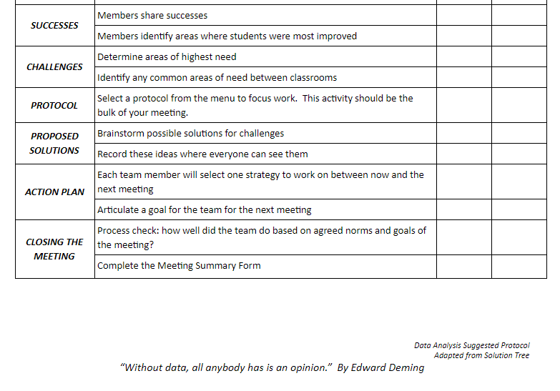
Instructional planning meeting

Slide 3
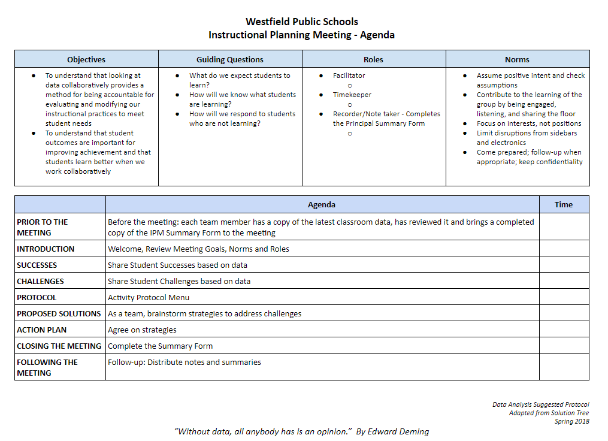
Instructional planning meeting

