Slide 1


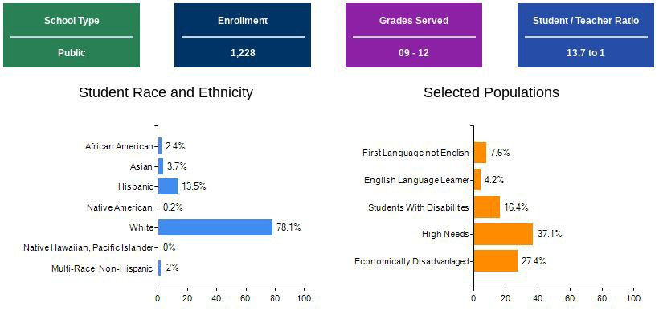
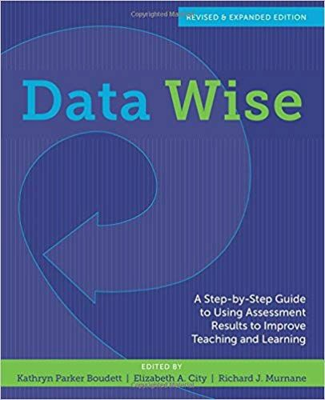

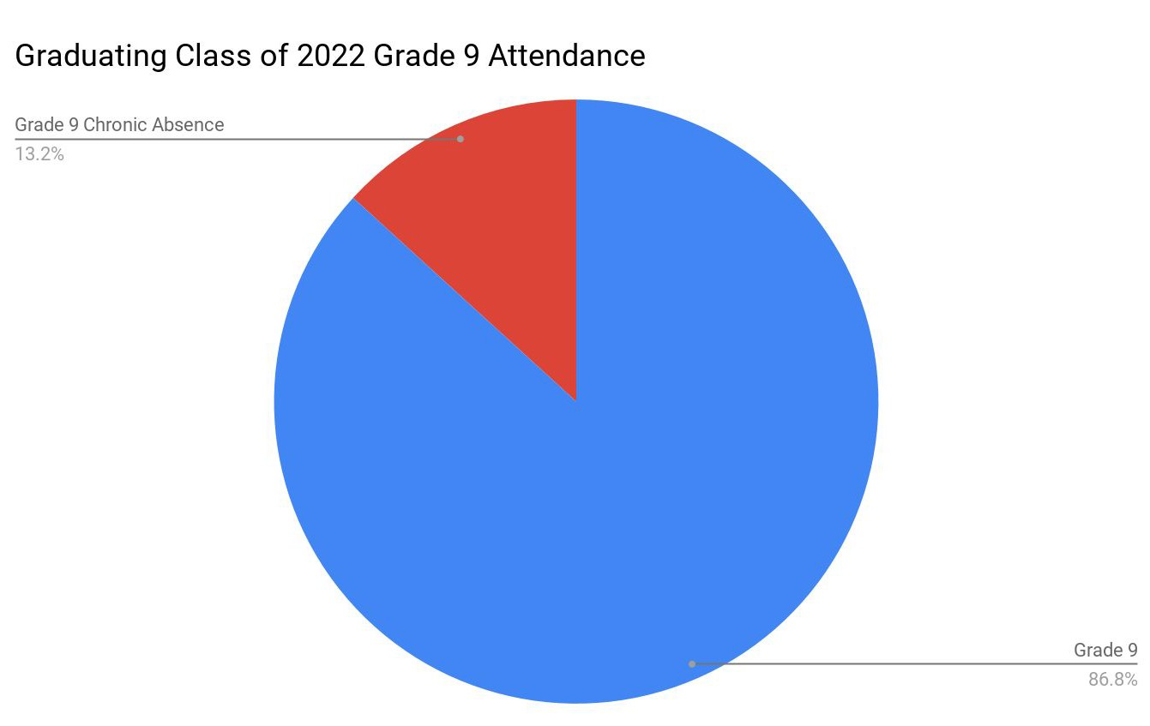
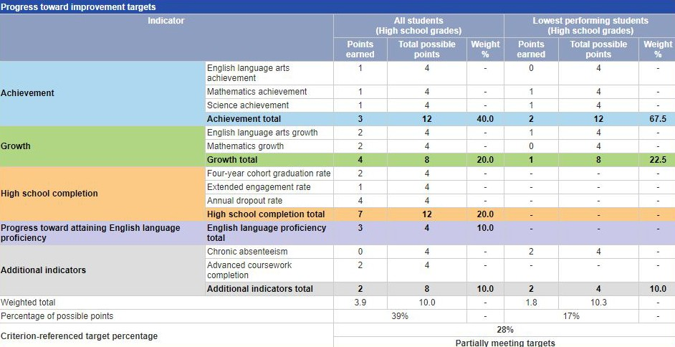


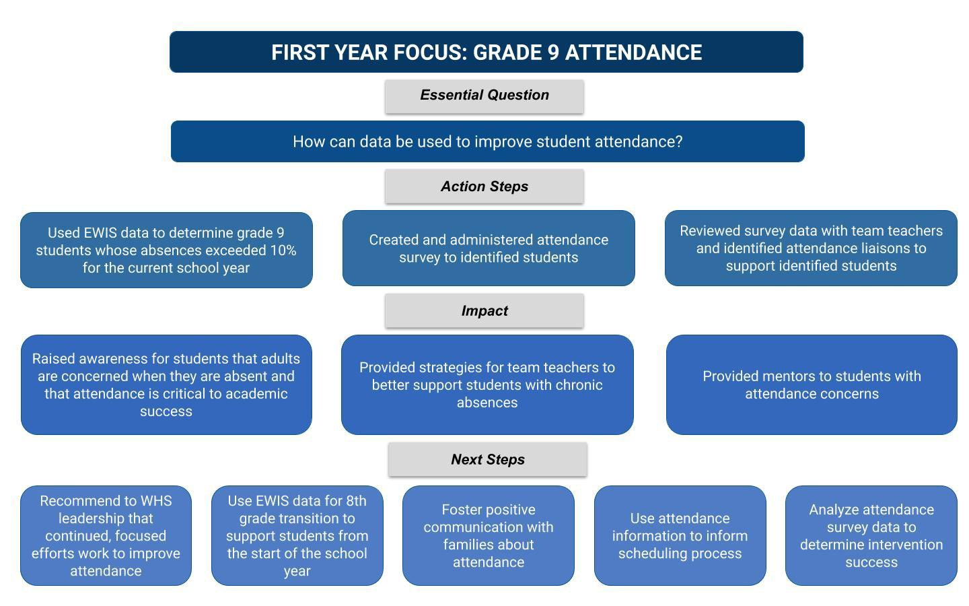
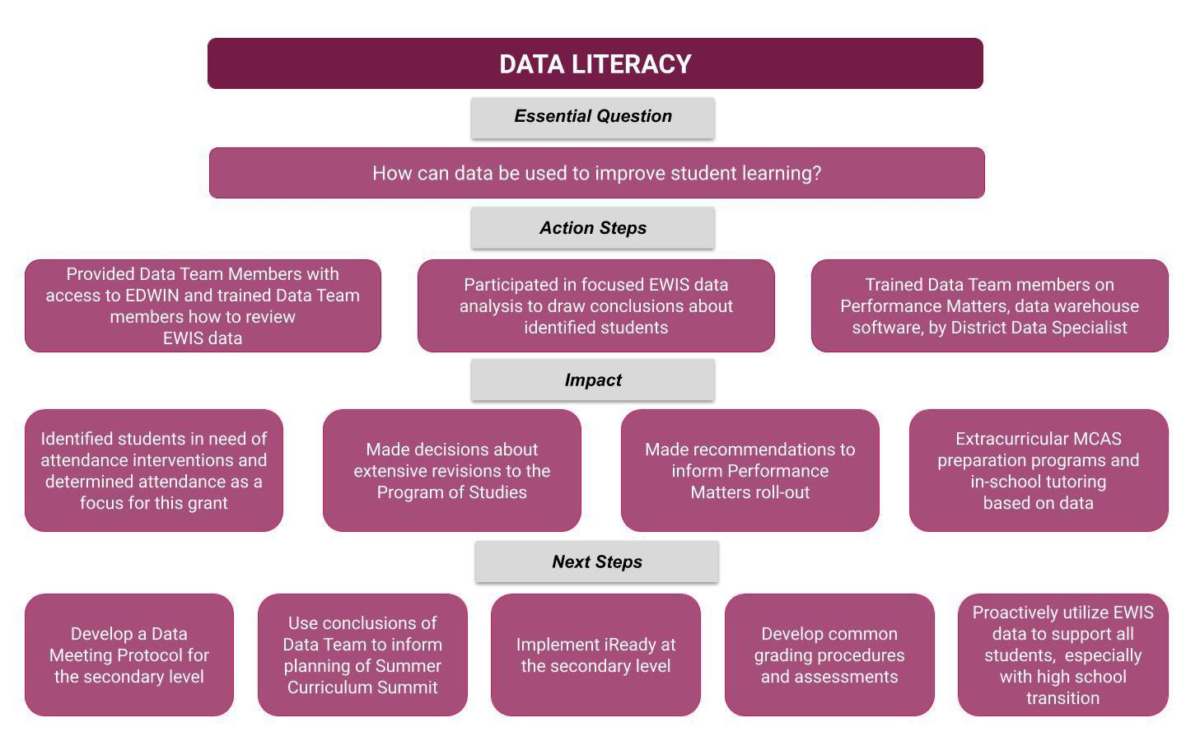
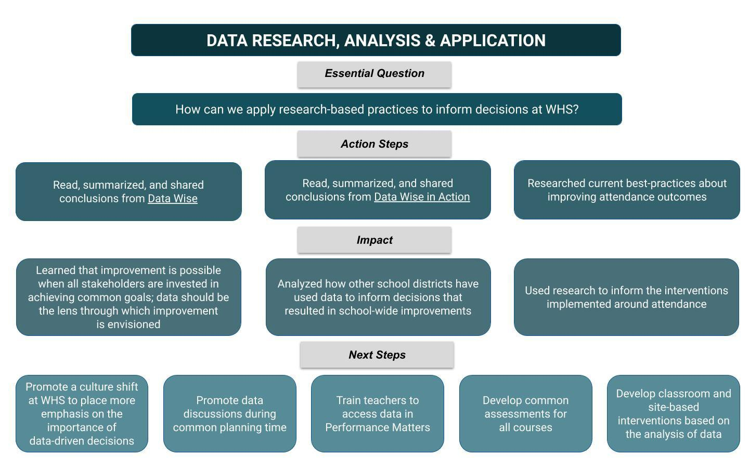
Westﬁeld High School Data Enhancement Project
Ena Arel, Jen Hall-Cotto, Ann Farnham, Andrew Joseph, Mary Keane, Erika Masciadrelli, Christal Murphy, Kristin Puleo and Denise Ruszala
School Demographics
Attendance Data
Resources
“Schools, communities, and advocates across the nation have successfully taken steps to ensure children are attending school more regularly. What works is to take a data-driven, comprehensive approach that begins with engaging students and families as well as preventing absences from adding up before students fall behind academically. The key is using chronic absence data as a diagnostic tool to identify where prevention and early intervention are needed.” ~Attendance Works
Data Enhancement Project Summary

