Slide 1

Westfield hs
Westﬁeld High School
Data Enhancement Grant Project
Westﬁeld, Massachusetts

Slide 2
Introduction to the Data Team
Introduction to the Data Team
Denise Ruszala, Director of Assessment and Accountability Christal Murphy, Assistant Principal
Erika Masciadrelli, District Technology Coach Mary Keane, Supervisor of English
Ena Arel, Science Teacher
Jen Hall-Cotto, Special Education Teacher Ann Farnham, Mathematics Teacher Andrew Joseph, Mathematics Teacher Kristin Puleo, School Counselor

Slide 3
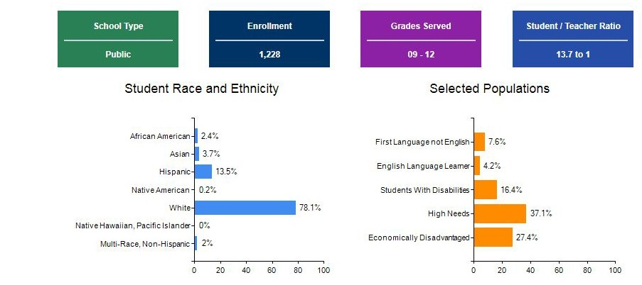
School Data Statistics

Slide 4
Data Enhancement Project Breakdown
Data Literacy
Data Research, Analysis & Application
First Year Focus: Grade 9 Attendance

Slide 5
Data Literacy
Essential Question
Essential Question: How can data be used to improve student learning?
Action Steps
Provided Data Team Members with access to EDWIN and trained Data Team members how to review EWIS data
Participated in focused EWIS data analysis to draw conclusions about identiﬁed students
Trained Data Team members on Performance Matters, data warehouse software, by District Data Specialist

Slide 6
Data Literacy
Impact
Identiﬁed students in need of attendance interventions and determined attendance as a focus for this grant
Made decisions about extensive revisions to the Program of Studies
Made recommendations to inform Performance Matters roll-out
Extracurricular Academic Student Support for literacy, math and science

Slide 7
Data Literacy
Next Steps
Develop a Data Meeting Protocol for the secondary level
Use conclusions of Data Team to inform planning of Summer Curriculum Summit
Implement iReady at the secondary level
Develop common grading procedures and assessments
Proactively utilize EWIS data to support all students, especially with high school transition

Slide 8
Data Research, Analysis & Application
Essential Question
Essential Question: How can we apply research-based practices to inform decisions at WHS?
Action Steps Action Steps
Read, summarized, and shared conclusions from DatawiseData Wise
●
●
Read, summarized, and shared conclusions from Datawise in ActionData Wise in Action
Researched current best-practices about improving attendance outcomes from www.attendanceworks.org

Slide 9
Data Research, Analysis & Application
Impact
Learned that improvement is possible when all stakeholders are invested in achieving common goals; data should be the lens through which improvement is envisioned
Analyzed how other school districts have used data to inform decisions that resulted in school-wide improvements
Used research to inform the interventions implemented around attendance

Slide 10
Data Research, Analysis & Application
Next Steps
Promote a culture shift at WHS to place more emphasis on the importance of data-driven decisions
Promote data discussions during common planning time
Train teachers to access data in Performance Matters
Develop common assessments for all courses
Develop classroom and site-based interventions based on the analysis of data

Slide 11
First Year Focus: Grade 9 Attendance
Essential Question
How can data be used to improve student attendance?
Action Steps
Used EWIS data to determine grade 9 students whose absences exceeded 10% for the current school year
Created and administered attendance survey to identiﬁed students
Reviewed survey data with team teachers and identiﬁed attendance liaisons to support identiﬁed students

Slide 12
First Year Focus: Grade 9 Attendance
Impact
Raised awareness for students that adults are concerned when they are absent and that attendance is critical to academic success
Provided strategies for team teachers to better support students with chronic absences
Provided mentors to students with attendance concerns
Percent Increase in Attendance
Team 2 Team 3
0.2% 9.7%
Team 1
Overall Average
3.7%
5%

Slide 13
First Year Focus: Grade 9 Attendance
Next Steps
Recommend to WHS leadership that continued, focused efforts work to improve attendance
Use EWIS data for 8th grade transition to support students from the start of the school year
Foster positive communication with families about attendance
Use attendance information to inform scheduling process
Analyze attendance data to determine intervention success

Slide 14
Additional Resources
Survey https://bit.ly/2MnYY26, Post-survey https://bit.ly/2McJLkA
Instructional Planning - Facilitator Guide, Agenda
Teacher Resource - The Importance of Attendance - How to talk to families

