Slide 1
Data Enhancement Grant
Weymouth Public Schools

Slide 2
Team Members
Pam Stazesky, Data & Assessment Strategy Manager
Melissa Humphrey, Supervisor of District Data Management
Angela White, Data Management Analyst
Matt Meehan, Principal of Adams Middle
Jack Flood, Principal of Chapman Middle
Liz Murray, Literacy Instructional Coach at Adams Middle
Chuck Hickey, 7th Grade Science Teacher and Data Coach at Chapman Middle

Slide 3
Grant Proposal
Existing Barriers
Proposed Improvements
Much effort to create and maintain color-coded school-level Data Workbooks in Excel
Scheduling Data Meetings at the middle school level is challenging due to existing structures (e.g., bell schedules)
Automate the Data Workbook linked to SIS (Aspen)
Create Data Routines to be used regularly at our two middle schools

Slide 4
Excel Data Workbooks

Slide 5
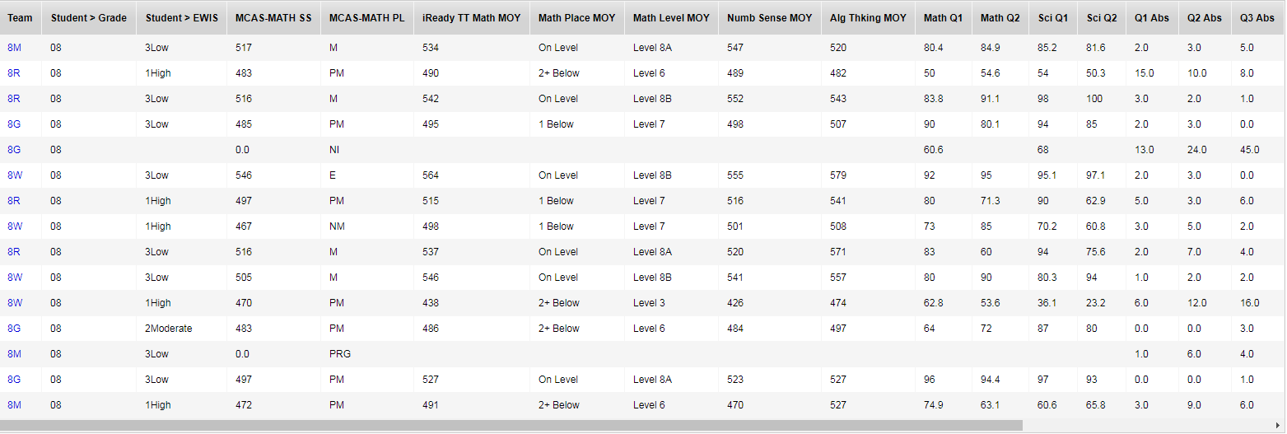
Data Workbook in Aspen

Slide 6
Successes and Roadblocks

Slide 7
Automate Data Workbooks
Successes
Roadblocks
Data Workbooks created in SIS (Aspen) by programmer for all schools
8 Primary Schools
2 Middle Schools
1 High School
Added new fields
(e.g., EWIS, daily attendance, course grades, sub-score placement level)
Real time updates and permits multiple users at one time
Limited color coding available
Can only color code specific text, not numbers
Cannot sort data on the same screen that you enter data
Lack of Buy-In
District leadership not committed to moving to automated Data Workbooks
Instructional Coaches and Data Coaches (K-6) prefer the former format for Data Workbooks (Excel or Google Sheets)
Additional information needed to improve the product

Slide 8
Data Routines at the Middle School Level
Successes
Roadblocks
ELA Data Meetings in one middle school up and running
Exposure and interest in EWIS by teachers has increased
School administration has utilized attendance data in order to monitor chronic absenteeism
Lack of Buy-In
Changes in Leadership
Three out of the four leaders within one middle school changed during the summer of 2018 thus no data meetings were held
Limited training opportunities
Unit A contract not ratified until early Spring thus no before school or after school training could occur
Substitute coverage is an ongoing challenge
PD calendar is booked a year in advance

Slide 9
What Now?
Lessons Learned
Next Steps
Not enough attention was dedicated to establishing buy-in across all stakeholders with a new product
Aspen’s limitations on sorting and color coding were unexpected
Further investigate reasons behind concerns with new product
Use 2019-20 to fine tune product and test with selected stakeholders
Introduce revised product in 2020-21
Train instructional coaches and Data Coaches in late Spring 2020

