Slide 1
FY25 Charter School Audit & Finance Webinar
Joanna Laghetto
Joanna.C.Laghetto@mass.gov
James DiMaio
James.DiMaio2@mass.gov

Slide 2
FY25 Audit & Finance Webinar Agenda
Slides will be posted (We will send the recording at your request.)
Due Date and CHAMP Upload
Document Links
FY25 Changes to the Audit Guide
Best Practice To Save All Submission Records
Q&A and Discussion

Slide 3
FY25 Due Date via CHAMP
CHAMP: Communication Hub and Application Monitoring Portal
Audited Financials due via upload to CHAMP* on October 31, 2025**
*The Security Portal will no longer be used for Audit or CSEOYFR submissions.
**Please do not email attachments or mail hard copies of the Audit to DESE.

Slide 4
FY25 CHAMP Submission Instructions
CHAMP is not live yet.
There will be many opportunities to learn CHAMP including log-in information.
The following slides are meant to show what the CHAMP System looks like and to provide an idea of the process and what to expect.

Slide 5
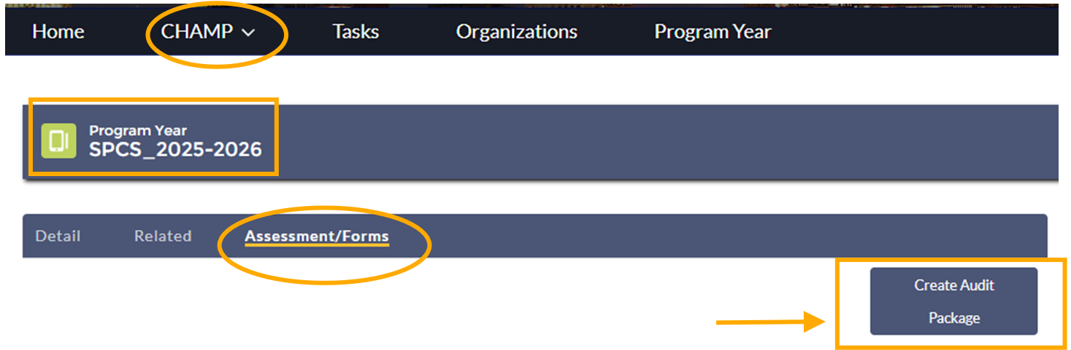
FY25 CHAMP Submission Instructions (1)

Slide 6
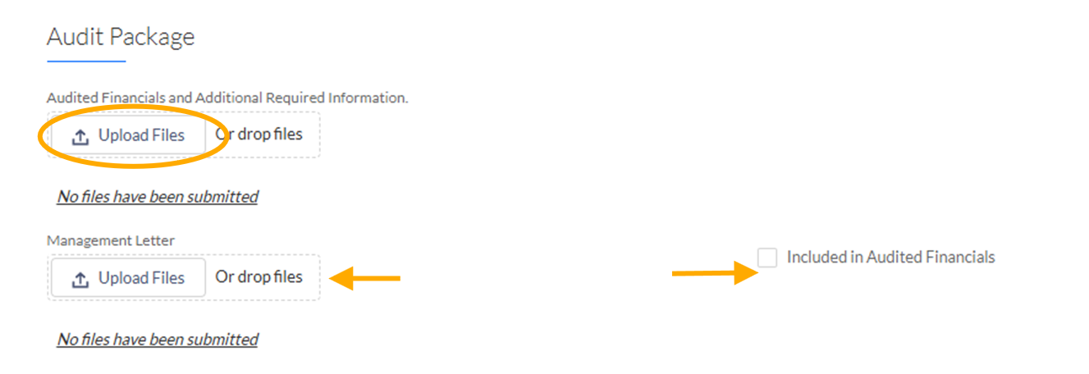
FY25 CHAMP Submission Instructions (2)

Slide 7
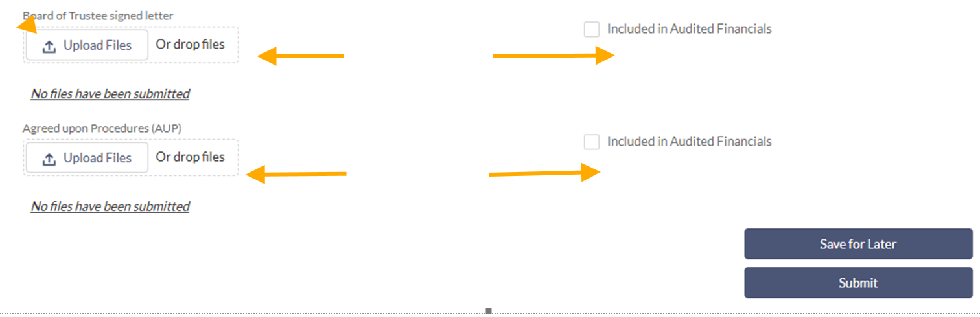
FY25 CHAMP Submission Instructions (3)

Slide 8
FY25 Audit Document Links
FY25 Audit Guide
  Please share both the Audit Guide and Audit Reference Guide with your auditor.
FY25 Audit Reference Guide
    Highlights revisions and important areas of the FY25 Audit Guide that should be clearly understood by charter schools, school business managers, and auditors.

Slide 9
FY25 Audit Guide Changes & Highlights
Appendix C Additional Required Information is a new requirement for schools to provide additional details of related party transactions, litigation, and employee compensation:
  For all Related Party Transactions, schools will provide the following information:
  Individuals or entities involved in transaction:
  Describe the relationship of the related parties and the specifics of the transaction beyond what is stated in the audit:
  If financial, what were the amount(s):

Slide 10
FY25 Audit Guide Changes & Highlights (1)
Appendix C Additional Required Information (continued):
  If the school is currently involved in any pending litigation or litigation that was resolved in FY25, schools will provide:
  Identify if school is defendant or plaintiff:
  Summary of alleged facts and claims made:
  Damages claimed:
  Estimated cost of litigation:

Slide 11
FY25 Audit Guide Changes & Highlights (2)
Appendix C Additional Required Information (continued):
  Compensation of Public Employees
  Please list the school’s five most highly compensated employees from the reporting fiscal year, including name, title, and total compensation. Total compensation includes but is not limited to salaries, bonuses, fees, stipends, housing, cars, sabbaticals, fringe benefits, severance pay and liability insurance premiums.

Slide 12
FY25 Audit Guide Changes & Highlights (3)
Late FY24 Report Submissions should be included as a finding in the FY25 Audit.
  Though not a change, we have noticed its omission in past submitted audits.
    Please see section 1004 Reporting of the Guide for a complete list of required reports. Because the reports are required by law, the school is out of compliance if submissions are late and non-compliance must be noted in FY25 audited financials.

Slide 13
FY25 Audit Guide Changes & Highlights (4)
Your Audit must contain both a Related Party Transactions and Findings Section*:
If there are no related party transactions or findings; this should be clearly stated.
*FY25 Audits without a Related Party Transactions Section and/or Findings section will not be considered complete.
Please see Guide and Audit Reference Guide for detailed information.

Slide 14
FY25 Audit Guide Changes & Highlights (6)
Grant Final Reports (FR1s & FERS):
In the Reporting Section 1004: Grant Final Reports – Each charter school must file final grant reports (FR1s) within 90 days of grant expiration date. This applies to any past year grants and any applicable FY25 grants.
The auditor is expected to test the DESE Grants Management systems to ensure there are no open grants that have been fully drawn and not closed out (Per EdGrants for FR1s and GEM$ for FERS).

Slide 15
FY25 Audit Guide Changes & Highlights (5)
Grant Final Reports:
For GEM$, one list can be generated by the school to show if the FER has been filed.
For EDGrants, only grants going back to FY18 grants should be tested as the FR1s were collected manually until FY17. Unlike GEM$, each grant must be looked at individually to ensure the FR1 was filed*.
*If a school is having technical difficulties closing out grants back to FY18 it is probably because the grants office has to re-open them. Please contact Jenn Ahern in the Grants Management Office and she will open the grant back up so the FR1 can be filed. Jennifer.M.Ahern@mass.gov
*If grants have not been closed out due to DESE/EdGrants technical difficulties, or because it is part of a consolidated grant that has not been fully expended, the school should not be issued a finding. Please have your auditor reach out to Joanna.C.Laghetto@mass.gov for confirmation or with additional questions.

Slide 16
FY25 Best Practice
Best Practice: Auditor presents complete Audit and findings to full BOT.
  Make sure the school’s Board of Trustee (BOT) meetings are scheduled so the audit can be approved and signed by October 31st.

Slide 17
FY25 Best Practice
Best Practice:
Throughout the year, store copies of the submissions and/or submission receipts and other documents the auditor will request, for example:
  Proof of Audit, CSEOYFR including Schedule B, and Pre-Enrollment Submission
  Annual Report (needed for CSEOYFR Surplus)
  Amendments to CSEOYFR
  Board Memos regarding renewal and conditions

Slide 18
Q&A and Thank You!
Please let us know if you have any questions on the FY25 Audit or any other finance related questions.
Joanna Laghetto Joanna.C.Laghetto@mass.gov
James DiMaio James.DiMaio2@mass.gov

