Slide 1
ORI & AG Presentation for K-12 Public Schools
Know Your Students' Rights
This presentation is for informational purposes only. For legal advice, please contact an attorney.
This presentation is for informational purposes only. For legal advice, please contact an attorney.

Slide 2
Today's Presenters
This presentation is for informational purposes only. For legal advice, please contact an attorney.

Slide 3
Overview of Department of Homeland Security
Immigration & Customs Enforcement
Customs & Border Protection
U.S. Citizenship & Immigration Services
Immigration Police / Enforcement, Detention & Deportation, representing the DHS in immigration proceedings
Enforcement at the border and within 100 miles of the border, checkpoints, and ports of entries
Adjudicates petitions for immigration benefits (asylum, green cards, citizenship, special visas)
This presentation is for informational purposes only. For legal advice, please contact an attorney.

Slide 4
How People May Come into Contact with Immigration Enforcement
Contact with the criminal system
Applying for a benefit at United States Citizenship and Immigration Services (USCIS), while having a removal order or criminal charge
Green card & Visa holders returning from travel:
CBP must show either Immigrant intent OR Fraud
A visa holder is subject to expedited removal
Raids & targeted enforcement
Attending an ICE appointment
Responding to an email/text/letter from ICE
This presentation is for informational purposes only. For legal advice, please contact an attorney.

Slide 5
Who is at Risk of Removal/Denial of Admission?
Not everyone who is not a citizen is subject to removal.
People must fall under a ground of deportation or grounds of inadmissibility.
Generally, this means:
Unauthorized / Undocumented immigrants
Lawful permanent residents with criminal charges (green card holders)
Expedited Removal at Border
Someone who did not go to an immigration court hearing or has final order of removal
Various grounds including drug trafficker, human trafficker, false claim to USC
Expedited Removal from Interior
(less than 2 years presence, lacking status & removal proceedings)
This presentation is for informational purposes only. For legal advice, please contact an attorney.

Slide 6
Reasons for Deportation
Lack of lawful status
Criminal grounds, including:
- Nearly all drug convictions
- Some domestic violence, violation of protection order
- Some theft, fraud, and many other offenses.
Sometimes, relatively minor and non-violent offenses can lead to mandatory deportation even for green card holders.
Immigration violations / Fraud
Security related grounds (gang involvement, terrorism)
This presentation is for informational purposes only. For legal advice, please contact an attorney.

Slide 7
Know Your Rights:
Interactions with Immigration Enforcement
This presentation is for informational purposes only. For legal advice, please contact an attorney.

Slide 8
Basic Background laws
It is not a crime to be in the United States without proper documentation:
The United States Supreme Court has explained that, “[a]s a general rule, it is not a crime for a removable alien to remain [present] in the United States,” Arizona v. United States, 567 U.S. 387 (2012)
This presentation is for informational purposes only. For legal advice, please contact an attorney.

Slide 9
Basic Search & Seizure Law
Controlled by U.S. & State Constitutions
Generally, law enforcement (including ICE) cannot conduct a search & seizure without a warrant signed by a Judge based on probable cause subject to limited legal exceptions.
Basis:
U.S. Constitution, 4th Amendment
Massachusetts Declaration of Rights, Article 14.
M.G.L. c. 276, Sec. 1
Lunn v. Commonwealth,
477 Mass. 517 (2017)
This presentation is for informational purposes only. For legal advice, please contact an attorney.

Slide 10
Withdrawal of Sensitive Locations Memo
What is the Sensitive Locations memo?
A memo that prohibited ICE from conducting enforcement at Churches, Schools, Courts, Weddings and other “sensitive locations”
What happened to the Sensitive Locations Memo?
DHS withdrew the memo on January 24, 2025
This presentation is for informational purposes only. For legal advice, please contact an attorney.

Slide 11
Policies for Responding to Immigration Enforcement
Review policies and designate an administrator to respond to any Immigration Enforcement requests
Consult
Consult with your organization's attorney to review your school’s privacy and visitors' policies
Designate
Designate an administrator or supervisor staff may contact
Consider
Consider student confidentiality and any notice requirements when responding to record requests
Consider
Consider your response to immigration efforts based upon the documentation provided
.
This presentation is for informational purposes only. For legal advice, please contact an attorney.

Slide 12
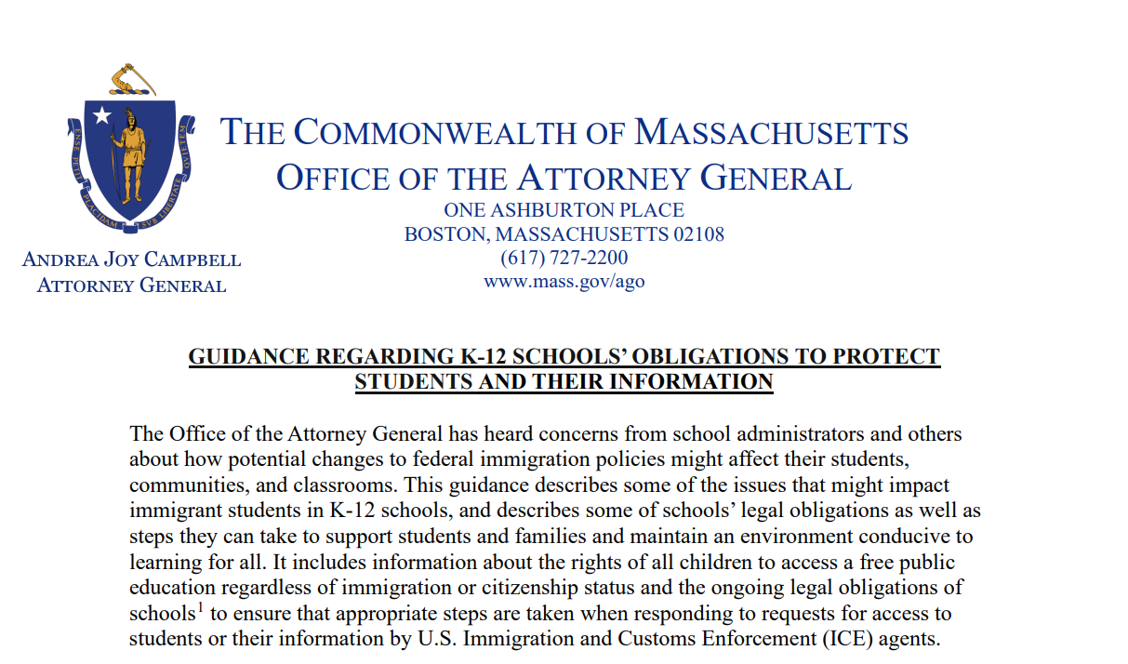
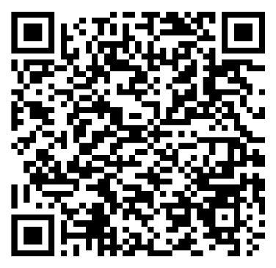
Guidance Regarding Public Schools’ Obligations to Protect Students and Their Information
Presented by Liza Hirsch, Director of the Children’s Justice Unit at the Massachusetts Attorney General’s Office
Flora Chang, Assistant Attorney General, Children’s Justice Unit
QR Code
This presentation is for informational purposes only. For legal advice, please contact an attorney.

Slide 13
Rights of All Students to Education Regardless of Immigration or Citizenship Status
Schools must provide equal access to education to all students regardless of immigration or citizenship status.
Schools must avoid policies that discourage or deny access to school on the basis of immigration status.
For more information:
Attorney General’s Advisory Regarding Equal Access to Public Education for All Students Irrespective of Immigration Status (updated April 2022).
Upholding the Rights of Immigrant Students to Enroll in School: Guidance for School Committees and Districts (December 2024)
This presentation is for informational purposes only. For legal advice, please contact an attorney.

Slide 14
Family Educational Rights and Privacy Act of 1974 (FERPA) and the Massachusetts Student Records Regulations
Schools cannot disclose, either orally or in writing, a student's personally identifiable information (e.g. student’s name, address, social security number, student number, date of birth, mother’s maiden name, etc.) to third parties (including ICE agents) without the student's parent or guardian’s specific informed consent, unless there is a specific exception permitting disclosure.
This presentation is for informational purposes only. For legal advice, please contact an attorney.

Slide 15
Exceptions to the General Rule
Judicial Order or Subpoena
But still need to first notify the parent (or student, if aged 18+) before complying unless there’s an exception to the notification rule.
Requests from Education officials
For the purpose of an audit, evaluation, or federal and state education law enforcement.
Data must be protected from third parties and should be destroyed once no longer needed.
Requests from Police, Prosecutors, DCF investigators, or Healthcare staff
For the health or safety of the student or others.
Requestors must agree to not disclose the information to a third party.
This presentation is for informational purposes only. For legal advice, please contact an attorney.

Slide 16
Exceptions to the General Rule
4. Requests for Directory Information
Designate information as directory only if not generally considered harmful or an invasion of privacy if disclosed.
Limit disclosure of directory information to specific parties, specific purposes, or both.
Notify parents/guardians of directory policies and allow parents to opt out at anytime, at least once a year. If a parent/guardian opts out of including their child’s information in the directory, the school cannot share the information.
Examples:
Schools may limit the directory information to a student’s name, phone number, grade level, dates of attendance, participation in activities and sports, or honors and awards received.
Schools may decide to limit disclosure of directory information to their school community, and not disclose the information to third parties.
This presentation is for informational purposes only. For legal advice, please contact an attorney.

Slide 17
Guidance on ICE Requests to Meet or Interview Students or Obtain Students’ Information
Schools may respond with statements such as “the school can neither confirm nor deny a student’s personally identifiable information.”
Refer ICE to the district’s central office to ensure proper protocol is followed.
Contact the district’s legal counsel to discuss the appropriate response before proceeding.
Immediately inform the student’s parent or guardian
Allows schools to obtain the specific, informed written consent of a parent/guardian (or eligible student)
Allows parent/guardian an opportunity to seek a protective order or other relief in court
If the agent presents a warrant, school legal counsel should confirm that it is a judicial rather than administrative warrant and to determine the scope of the search or arrest authority it provides.
Check to see if the warrant or order is signed by a federal or state judge or magistrate.
Determine the scope of the search or arrest authority that the judicial warrant, order, or subpoena provides.
This presentation is for informational purposes only. For legal advice, please contact an attorney.

Slide 18
Share Plan Ahead Resources with Parents/Guardians
Changes in federal immigration policy could increase arrest and detention, which impacts school communities. Schools should be prepared should a parent be arrested or detained by ICE and may consider taking the following proactive steps:
Provide regular opportunities to update emergency contact information, alternative caretaker contacts, and authorized pick-up contacts.
Share 'plan ahead' resources with families. See: Emergency Planning Guide for Parents with Uncertain Immigration Status.
Review your school’s policy or guidance to ensure it includes steps to take if a student cannot safely return home.
Support the needs of students who are facing increased anxiety as well as families who have been directly affected by changes to federal immigration policy.
This presentation is for informational purposes only. For legal advice, please contact an attorney.

Slide 19
Know Your Rights Presentations
For individual schools, non-profits or community organizations wishing to host a KYR presentation
MIRA:
PAIR Project:
Email Julia Ciachurski at jciachurski@pairproject.org for KYR Presentation Requests
Contacts:
Email training@miracoalition.org for KYR Presentation Requests
This presentation is for informational purposes only. For legal advice, please contact an attorney.

Slide 20
Immigration Legal Resources
It may take time to find a provider, please use trusted providers and check references.
Legal Services Directory in Massachusetts:
Massachusetts Legal Resource Finder: https://masslrf.org/en/home
Immigration court list of legal services: https://www.justice.gov/eoir/file/ProBonoMA/download
Legal Services Directory Outside of Massachusetts:
Immigration Advocates Network Legal Directory: https://www.immigrationadvocates.org/legaldirectory/
City of Boston free consultations:
https://www.boston.gov/departments/immigrant-advancement/free-immigration-consultations.
This presentation is for informational purposes only. For legal advice, please contact an attorney.

