Slide 1
Protect Act Guidance & Policy
Training (for district and school staff)
September 24 (12:00 PM) / October 9 (9:00 AM)
Please be advised that DESE does not authorize attendees to record or to use AI transcription tools during the meeting and DESE does not endorse any unauthorized transcripts created by third parties of its meetings.

Slide 2
Presenters
Susan Church, Chief Operating Officer and Legal Advisor, Office of Refugees and Immigrants (ORI)
Liza Hirsch, Director, Children's Justice Unit, Attorney General’s Office (AGO)
Lauren Woo, Deputy Commissioner, Department of Elementary and Secondary Education (DESE)
Kristen McKinnon, Assistant Director of Student and Family Support, Department of Elementary and Secondary Education (DESE)

Slide 3
Agenda
Protect Act Introduction
K-12 Guidance, Model Policy, and Model Procedures
Refresher: Know Your Rights
Scenarios
State and Community Resources for Staff and Families

Slide 4
Protect Act
Protect Act

Slide 5
Protect Act Introduction
**This presentation is for informational purposes only. For legal advice, please contact an attorney.​
On August 5, 2026, Governor Maura Healey signed the PROTECT Act into law in Massachusetts. The law prohibits civil arrests, including federal immigration enforcement, in nonpublic areas such as school grounds during operating hours, unless mandated by state or federal law, program administration requirements, or with a Judicial Warrant or Order.

Slide 6
Protect Act Guidance for K-12
The Act requires school districts, charter schools and collaborative schools to establish a policy and implement procedures for interaction with civil law enforcement on school grounds.
On August 21, DESE, in collaboration with the EOE and the Attorney General’s Office, released guidance for this law, a model policy, for school committee adoption, and model procedures, for superintendents and executive directors to enact.
Guidance for K-12 Schools Related to Interacting with Civil Law Enforcement
**This presentation is for informational purposes only. For legal advice, please contact an attorney.​

Slide 7
Protect Act Guidance for K-12: Designated Contact(s)
District-level and School-level contact(s) to be notified if law enforcement officers arrive on site or request information.
  Different people may be assigned at different times of day
  Consider naming at least one “back-up”
Recommended Primary Contacts
  District-level – superintendent/executive director or designee, or an attorney
  School-level – highest-ranking administrator or manager at the school
Include in written procedures: Name and Contact Information
**This presentation is for informational purposes only. For legal advice, please contact an attorney.​

Slide 8
Protect Act Guidance for K-12: Escalation Protocol – Employees/Staff
If law enforcement officers engaged in civil law enforcement arrive on site and there are no apparent emergency circumstances…
Employees and staff should
Inform the officers that the employee/staff will contact an administrator to assist them, and officers should wait where they are (ideally outside, away from students/children and their families)
Immediately contact the school-level contact person
Use approved language
**This presentation is for informational purposes only. For legal advice, please contact an attorney.​

Slide 9
Escalation Protocol – Designated Contacts
School-level contact person should:
Immediately call the district-level contact person and go to the location where the law enforcement officers are waiting
If the school has access to an attorney, call the attorney and keep them on the phone for advice
Speak to the law enforcement officers:
  Ask the law enforcement officers for identification and record their names, agencies, and badge numbers.
  Ask to view any warrant or other documentation.
    With assistance from an attorney, if able, and/or the district-level contact person—review the documents to determine whether the law enforcement officers have a valid Judicial Warrant or Judicial Order.
Document interaction
Provide notice to the school community
**This presentation is for informational purposes only. For legal advice, please contact an attorney.​

Slide 10
Protect Act Guidance for K-12: Additional Provisions*
Defines key terms such as school grounds, operating hours, etc.
Protocols for designated contacts with law enforcement officers with and without a judicial warrant, including approved language for employees
Guidance on documenting interactions, including specific details to record
Guidance on providing notice to the school community of the presence of law enforcement officers
Guidance on establishing clear protocol for a school's response in the event a child/student or their parent/guardian is detained by law enforcement officers, including developing a plan to make sure that emergency contact information, alternative caregiver contacts, and authorized pick-up contacts are up to date for all students/children
*see Appendix for additional provisions

Slide 11
Protect Act DESE Model Policy and Procedures
Interacting with Law Enforcement Officers Engaged in Civil Law Enforcement
  Model Policy: for school committee adoption
    Summarizes key elements to be outlined in written procedures; once enacted can serve as written emergency response plan required by the law
  Model Procedures: for school district/school implementation
    Aligned with guidance and model policy; can be easily adapted to include school-/district-specific information (e.g., contacts)
Both available in eight (8) languages:
  Arabic, Cape Verdean Creole, Chinese (Traditional), English, Haitian Creole, Portuguese, Spanish, Vietnamese
**This presentation is for informational purposes only. For legal advice, please contact an attorney.​

Slide 12
Know Your Rights
Know Your Rights

Slide 13
ICE Authority
OVERVIEW
ICE is subject to different, but similar, rules as other Law Enforcement
ICE is a federal law enforcement agency
ICE’s authority is generally limited to immigration related enforcement, unless acting in concert with federal or state law enforcement, or investigating crimes through ICE criminal investigative units
When carrying out its enforcement activities, ICE officers must follow different, but similar rules as other law enforcement agencies.
ICE officers must adhere to constitutional restrictions, as well as restrictions set by statutes, regulations and policies.
Individuals engaging with ICE have rights including (i) the right to remain silent; and (ii) the right to an attorney – though ICE is not required to provide one.

Slide 14
ICE Authority.
ICE is subject to different, but similar, rules as other Law Enforcement
OVERVIEW
ICE can demand identification:
Immigrants often must carry identification on them, including copies of a green card and/or proof of registration.
Depending on the facts and circumstances, ICE officers, when they have probable cause to believe a person is here unlawfully, can ask for identification.
ICE can interrogate:
ICE officers may interrogate a noncitizen or person believed to be a noncitizen as to their “right to be, or to remain in the United States” without a warrant. (NOTE: individuals have a right to remain silent and to a lawyer even if undocumented).
ICE cannot approach any individual based on race or nationality alone. However, ICE can approach a person based on factors unknown to the interrogated person.

Slide 15
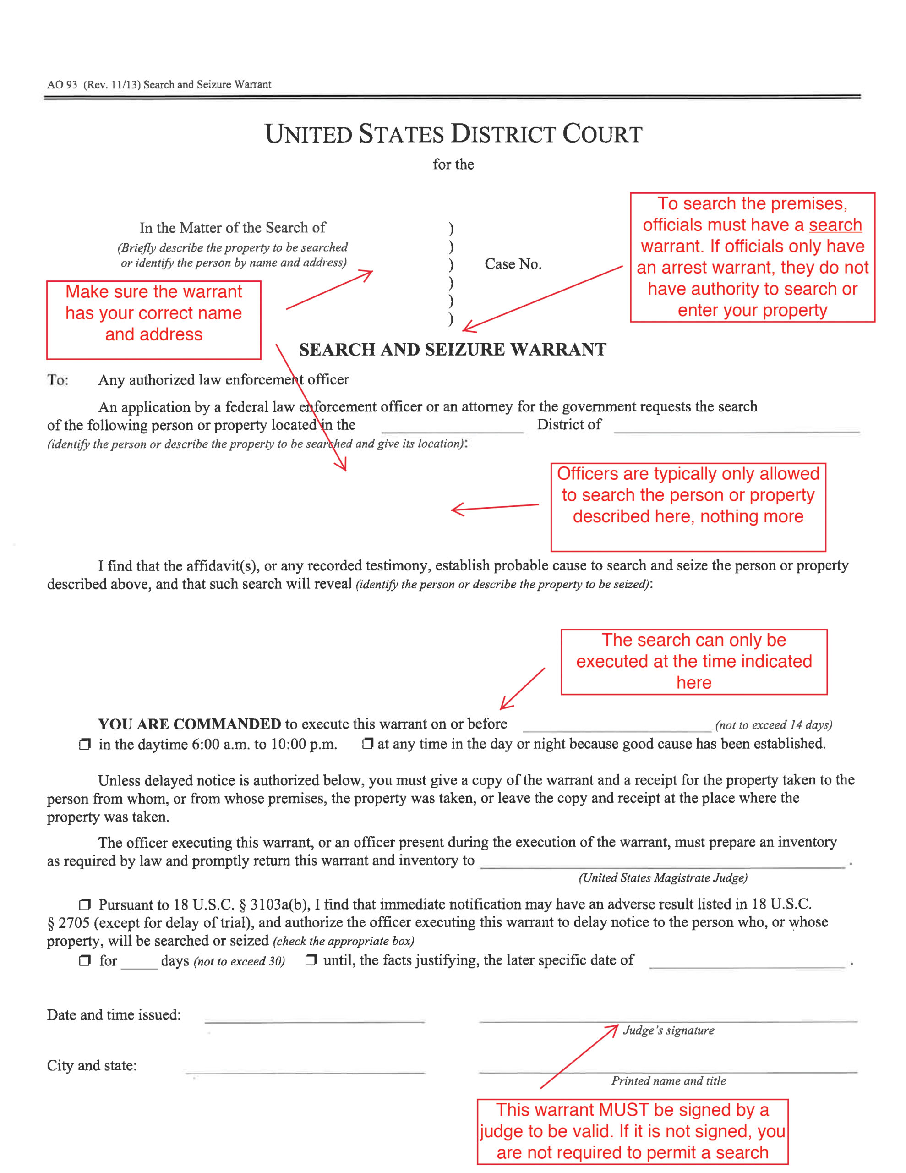
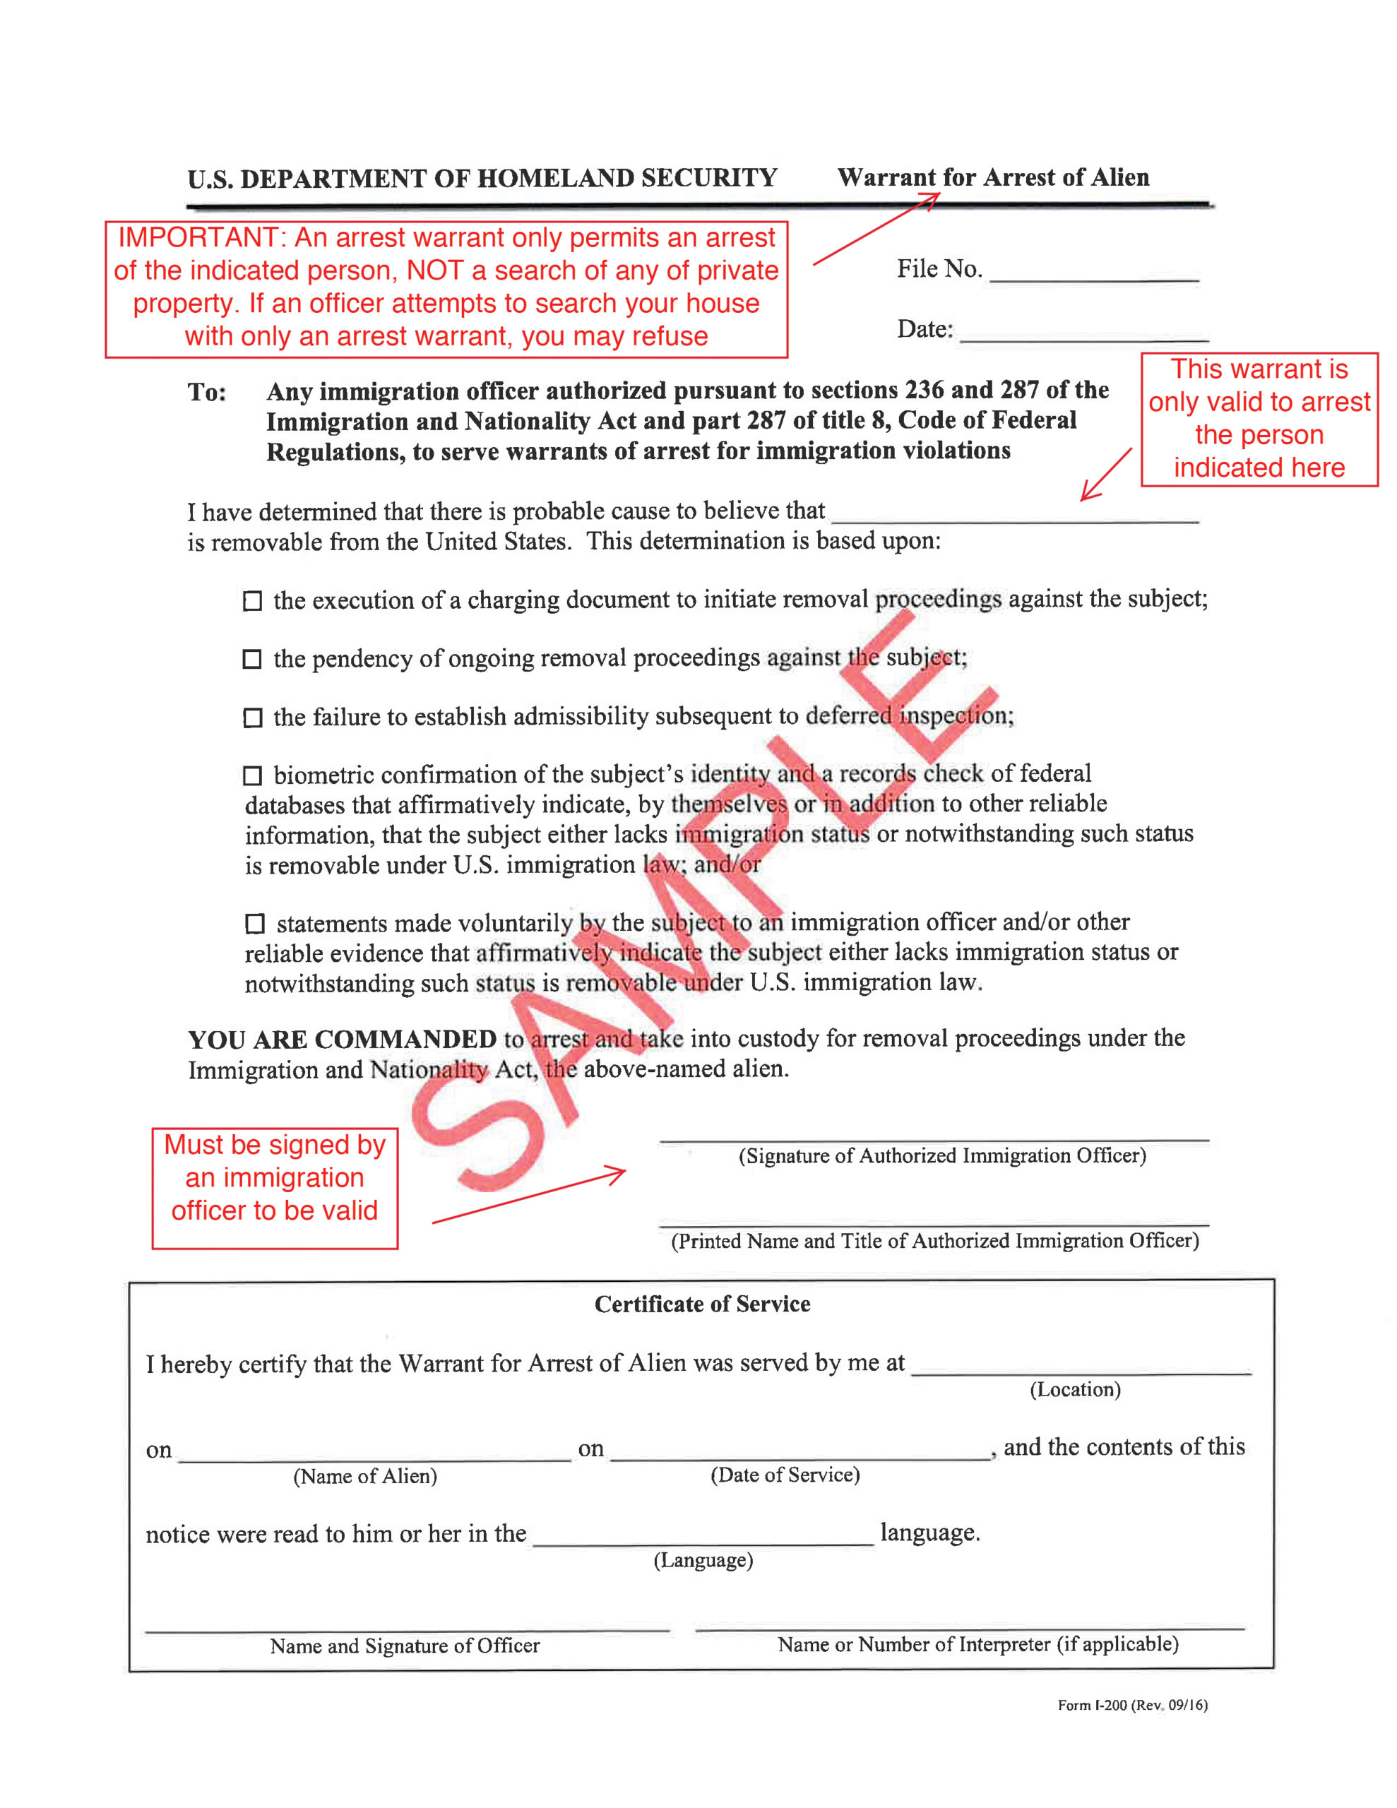
Judicial Warrants vs. Administrative Warrant
Judicial warrants must be signed by a judge and indicate the correct name, address, and time.
Administrative warrants do NOT permit ICE entry into any School

Slide 16
Rights and Responsibilities of Staff as Bystanders
You may bear witness to a public arrest
Physically interfering or verbally berating ICE could have adverse consequences for both you and the immigrant
You have the right to witness and document, including by video
You can help by promoting calm
You have the right to remain silent if ICE asks you any questions
You can ask the individual being arrested if they want you to call anyone for them

Slide 17
Federal Misconduct Portal: See Something, Say Something
Lawyers and media outlets need specific, verified information
What are we looking for?
  Random stops, non-targeted enforcement
  Violence against immigrant
  Harm, mistreatment to children
  Harm, mistreatment to pregnant women
  Long term residents, green card holders, those w/out any criminal record
  Demeaning or outrageous behavior
  Violence against bystanders
Reports:
Mass Gov and AG Federal Misconduct Portal

Slide 18
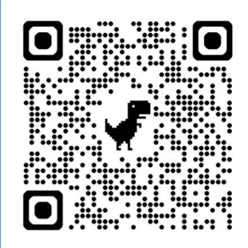
Community Support: Portal to report federal agent misconduct
Report misconduct by federal agents
Mass.gov/fedmisconduct
Use this form to report potentially unlawful actions or misconduct by ICE or other federal agents enforcing immigration laws.

Slide 19
Scenario Review
Scenario Review

Slide 20
General Principles
STAY CALM
Do not obstruct. Contact the school-level contact person (SLC)
1
VERBALLY LIMIT ACCESS
No private areas or confidential records unless required by valid judicial warrant or judicial order
2
DOCUMENT
Record details safely, report, and notify as appropriate
3
Staff should not physically interfere with officers

Slide 21
Escalation Protocol
When law enforcement arrives on site, school staff should initiate their escalation protocol:
Step 2
Staff immediately notify the school level contact person (SLC)
Step 3
SLC immediately calls the district level contact person (DLC) and goes to meet the officers. Either SLC or DLC calls legal counsel
Step 4
SLC speaks to the officers and requests their identifying information: names, agencies and badge numbers
Step 5
SLC asks to view the warrant and determine if it is judicial or administrative (with the attorney’s help, if applicable)
Step 1
Staff inform officers to wait where they are (ideally outside, away from students) while they contact an administra-tor
IF NO JUDICIAL WARRANT: SLC states that they have been advised not to permit entry without a valid judicial warrant
IF YES JUDICIAL WARRANT: review the terms of the warrant with an attorney if possible. Permit access only within scope of the warrant, and away from students, if possible.

Slide 22
Guiding Principles for School Staff
PRIOR to an incident … | AFTER an incident …
Develop/update policies and protocols Train all staff in policies and protocols – including escalation protocol and other applicable emergency protocols (e.g., lockdown, soft lockdown) Review Emergency Operations Plans with school bus companies re: protocols when law enforcement activity occurs at/near bus stops Determine what indoor and outdoor space constitutes “school grounds” at your location For every student, ensure that your school has emergency contacts and alternative caregivers listed Share “Plan Ahead” resources with parents to appoint alternative caregivers in case of an emergency making them unavailable Ensure staff maintain sensitivity to absences and behavioral challenges that may be related to these stressors Offer extra support to children/families as needed | All involved should write down what they remember of the incident; keep the record as you would other records (see Appendix B, Model Procedures, pp. 7, 14-15) Designated staff member to notify parents/guardians, teachers, administrators, and staff (See Appendix C, Model Procedures, pp. 8-9, 16) Report the incident to the AGO Civil Rights Division and Massachusetts Federal Misconduct Portal Debrief the incident and revisit policies and emergency protocol(s) based on any lessons learned

Slide 23
Scenario 1: On School Grounds
  On a day when school is in session, immigrant employees of a landscaping company subcontracted by the district are working outside on the grounds of the district's public high school building. ICE arrives on school grounds and proceeds to arrest one of the landscapers.
  What might school staff consider when faced with this situation?
**This presentation is for informational purposes only. For legal advice, please contact an attorney.​

Slide 24
Scenario 1: Arrest on School Grounds – How to respond
This is a violation of the PROTECT Act if the officers do not have a judicial warrant or judicial order.
If an arrest is not yet underway, contact the designated contact immediately. Ask the officers if they have a judicial warrant. If they do not, ask them to leave school property.
If the arrest is already in process, do not interfere. Instead, begin documenting.
Bystanders can openly (not secretly) videorecord the interaction
Consider implementing soft lockdown procedures to keep students indoors if there is an active safety threat (consistent with a lockdown policy that applies evenly to any active law enforcement activity on site). End the lockdown when the safety threat is no longer present.
If there is an imminent threat to safety, call 9-1-1 for assistance.
It is illegal to obstruct, impede, or assault an ICE agent.
**This presentation is for informational purposes only. For legal advice, please contact an attorney.​

Slide 25
Scenario 2: Parent Detained While Student is at School
During the school day, a member of school staff learns that the custodial parent of a student has just been detained by ICE. The student is currently at school and is unaware of the situation. ​
What might school staff consider when faced with this situation?​
**This presentation is for informational purposes only. For legal advice, please contact an attorney.​

Slide 26
Scenario 2: Parent Detained While Student is at School – How to Respond
Supporting Impacted Student
Community-Wide Considerations
Determine alternative caregiver:
Check student’s emergency contact information + authorized pick-up contacts
Is there a custodial chain on file? Check for alternative caregiver documents (e.g., caregiver authorization affidavit, temporary agent, guardian, standby guardian) → If no alternative caregiver plan in place: DCF
Notify student in a sensitive & supportive manner
If not already done: Share 'plan ahead' resources with families
Alert school and district leadership
Plan in advance
Refer to counseling, additional mental health services as appropriate
Be prepared for possible outreach by media contacts—consider privacy concerns
PROTECT Act requires you to have a plan now to update emergency contact information, alternative caretaker contacts, and authorized pick-up contacts for all students – including option for adding multiple contacts
Provide counseling and social work support to students indirectly impacted
For ALL students: Maintain sensitivity and awareness regarding student absences, lack of engagement, and behavioral challenges in school
Address mental health implications:
**This presentation is for informational purposes only. For legal advice, please contact an attorney.​

Slide 27
Scenario 3: Student Detained Outside of School Hours
On Monday morning, a teacher learns from a student that one of their students was detained by ICE over the weekend. ​
What might school staff consider when faced with this situation?​
**This presentation is for informational purposes only. For legal advice, please contact an attorney.​

Slide 28
Scenario 3: Student Detained Outside of School Hours – How to Respond
Supporting Impacted Family
Offer support to classmates
Community-Wide Considerations
Contact the AGO, ORI if your school learns of a student who was detained
Provide immigration attorney referral resources
For those wishing to hold community events for assisting families left behind, email: Request a Community Meeting with ORI
Check in with student’s sibling(s), offer additional support
For ALL students: Maintain sensitivity and awareness regarding absences, lack of engagement, and behavioral challenges​
Alert school leadership
Be prepared for possible outreach by media contacts—consider privacy concerns
Check in with family/caregiver
**This presentation is for informational purposes only. For legal advice, please contact an attorney.​

Slide 29
Scenario 3: Student Detained Outside of School Hours – How to Respond continued
Supporting Impacted Family
Community-Wide Considerations
Check in with family/caregiver
  Provide immigration attorney referral resources
Check in with student’s sibling(s), offer additional support
Alert school leadership
Offer support to classmates
Be prepared for possible outreach by media contacts—consider privacy concerns
Contact the AGO, ORI if your school learns of a student who was detained
For those wishing to hold community events for assisting families left behind, email: Request a Community Meeting with ORI
For ALL students: Maintain sensitivity and awareness regarding absences, lack of engagement, and behavioral challenges​

Slide 30
Scenario 4: Student Absenteeism Due to ICE Concerns
A principal is aware that one of their students has uncertain legal status. Following several publicized instances of ICE presence in the neighborhood surrounding the school, this student has been consistently absent from class.​
What might school staff consider when faced with this situation?​
**This presentation is for informational purposes only. For legal advice, please contact an attorney.​

Slide 31
Scenario 4: Student Absenteeism Due to ICE Concerns – How to Respond
Offer tutoring/educational services in short term​
Reach out to family to offer support and create a plan for safely transitioning the student back to school
Consider transportation needs
Schools Should:
Partner with families rather than filing a CRA for truancy or a 51A in connection with absences
  Students who are not physically present but are receiving academic instruction for at least half the school day should be counted as present.
**This presentation is for informational purposes only. For legal advice, please contact an attorney.​

Slide 32
SRO Involvement/School-Based Arrests – Further Considerations
SROs shall not become involved in routine disciplinary matters. Certain low-level offenses may be best handled by school administrators.
Strategies that can be effective in some circumstances to maintain safety: (1) Administrative search, (2) Ensure safety and contact parents; and (3) Involve community-based youth-serving organizations.​
Schools and SROs shall not disclose a student’s immigration status except as required by law.​
If an SRO or other police officer becomes involved and a student is taken to the police station and fingerprinted, their information is automatically shared with federal authorities including ICE.​
**This presentation is for informational purposes only. For legal advice, please contact an attorney.​

Slide 33
Resources
Resources

Slide 34
Community Legal Resources
ORI works closely with legal services providers, resettlement agencies and other legal organizations to expand capacity for immigration legal services in the state
The Habeas Project
The Legal Representation Fund (LRF)
The HelpDesk (For EA recipients, former TPS Recipients or using HomeBase):
The Massachusetts Access to Counsel Initiative (MACI)
Email: Immigrationhabeasproject@gmail.com
Detained Hotline: (617) 637-8195
Intake: 508-505-4588
https://forms.office.com/g/tYzYHCE0Yi OR email ORI-Helpdesk@mass.gov or Legal Helpdesk | Mass.gov
Family & Friends Hotline: (617) 396-7143

Slide 35
Immigration Attorney Referral Resources
Immigration Court list of legal services
City of Boston free immigration consultations
MIRA immigration Helpline
Massachusetts Legal Resource Finder
The American Immigration Lawyers Association’s online directory
The National Immigration Project of the National Lawyers Guild’s “Find an Attorney” website

Slide 36
Attorney General’s Office Resources
Resources for Immigrants in MassachusettsAttormey General's Office Resources LinksKNOW YOUR RIGHTS: ICE Enforcement A Guide for Immigrants, Families, and Communities
Flyer for K12 Schools on Protecting Students and Their Information
Guidance regarding K-12 Schools' obligations to protect students and their information
Immigrant Students’ Right to Attend School: A Guide for Families
Emergency Planning Guide for Parents with Uncertain Immigration Status (available in Spanish, Portuguese, Haitian Creole, Simplified Chinese)
Fact Sheet for Parents with Uncertain Immigration Status (available in Spanish, Portuguese, Haitian Creole, Simplified Chinese)

Slide 37
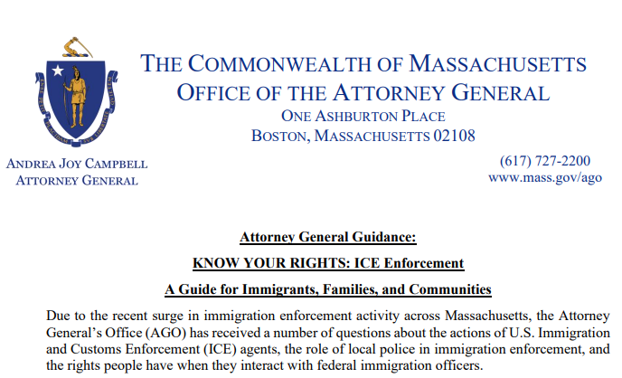
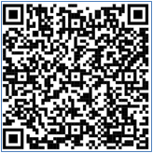
Know Your Rights Guidance Regarding ICE Enforcement for Immigrants, Families, and Communities
QR Code

Slide 38
Other helpful resources
Resources for Supporting Immigrant and Refugee Students
Community Resource Toolkit support immigrant families in crisis
Family Facing Resources

Slide 39
When to Reach Out / Who to Contact
AGO - To File a Civil Rights Complaint with the Attorney General’s Office, visit www.mass.gov/how-to/file-a-civil-rights-complaint, or for related civil rights questions, email civilrights@mass.gov, or call (617) 963-2917.
Immigration enforcement in or around schools or child care providers
ORI – Contact in unique emergency scenarios. This may include:
Immigration enforcement in or around EA shelters, schools, places of worship, or other sensitive locations
Detention of a parent/caregiver for a child with significant disabilities
Detention of a parent/caregiver for a child who is currently undergoing medical treatment for a serious medical condition (such as cancer)
Detention of a teenager, younger person, student
Detention of individual with no criminal record, United States Citizen children and significant long term US residence (more than 15 years approximately)
Other cases where a significant humanitarian concern is presented, including larger scale workplace raids or immigration enforcement events
Detention of young person under the age of 19

Slide 40
Appendix: Protect Act Additional Provisions Described

Slide 41
Escalation Protocol – Valid Judicial Warrant or Judicial Order
If officers have a valid Judicial Warrant or Judicial Order authorizing an arrest or entry to search (or both)
School-level contact should
  Inform officers they may enter school grounds
  Request that, where feasible, officers avoid any areas where students/children are present
**This presentation is for informational purposes only. For legal advice, please contact an attorney.​

Slide 42
Escalation Protocol – Valid Judicial Warrant or Judicial Order (continuation)
If officers DO NOT have a valid Judicial Warrant or Judicial Order authorizing an arrest or entry to search (or both)
School-level contact must
  Inform officers they are not authorized to conduct the arrest on school grounds and ask them to leave.
  If officers proceed to conduct a civil arrest in violation of the PROTECT Act, no one should attempt to physically interfere.
    Staff should follow guidance for bystanders to document an interaction.
  If there is an imminent threat to the safety of a child, staff member, family member, or other person, program staff should not hesitate to call 9-1-1 for assistance.
**This presentation is for informational purposes only. For legal advice, please contact an attorney.​

Slide 43
Documentation of Interactions
  All staff are encouraged to wait until they feel safe to write down what happened
  Use existing incident forms or create a new one and keep with other school records
  Bystanders can openly (not secretly) videorecord interactions, but must not interfere
**This presentation is for informational purposes only. For legal advice, please contact an attorney.​

Slide 44
Documentation of Interactions (continuation)
  Information to document:
    Date/time when law enforcement arrived/made request
    Names and badge numbers of officers and the agency they represented
    Number of vehicles and license plate numbers
    Names of witnesses
    Steps taken to notify designated contacts
    Actions of officers and whether officers complied with school instructions
    Whether officers had a valid Judicial Warrant or Judicial Order or some other documentation
    Whether a civil arrest was made on school grounds
    Impact on any students/children/employees/staff (after any immediate issues have been addressed) and any follow up actions needed to support them.
**This presentation is for informational purposes only. For legal advice, please contact an attorney.​

Slide 45
Notifications
Notice to School Community of the Presence of Law Enforcement Officers
  Required when school confirms presence of law enforcement conducting civil law enforcement.
  The school should notify students’ parents and guardians, teachers, administrators, and school personnel.
  The school should provide this notice in a manner that ensures the confidentiality and privacy of any potentially identifying information.

Slide 46
Caregiver Plans and Contact Information
Schools are encouraged to establish clear protocols for their response in the event a child/student or their parent/guardian is detained by law enforcement officers.
Develop a plan to make sure that emergency contact information, alternative caregiver contacts, and authorized pick-up contacts are up to date for all students/children.
Allow parents/guardians to list more than one person as an emergency contact.
Schools are also encouraged to keep any associated documentation on file, such as an authorization of another caregiver, temporary agent, or guardian.

