Slide 1
Begin Recording

Slide 2
Superintendent, Charter Leaders, and Collaborative Leaders Summer Webinar
Acting Commissioner Russell D. Johnston
Thursday, August 1, 2024

Slide 3
Welcoming Message from Secretary Tutwiler

Slide 4
Quote

Slide 5
Agenda
Educational Vision
Strategic Objective 1: Whole Student Supports
Chronic Absenteeism & Back to School Campaign
Strategic Objective 2: Deeper Learning
Comprehensive Health and PE Framework & SEL
PRISM & Locating Early Literacy Resources
DESE’s Core Functions
FY25 State Budget
Emergency Assistance (EA) Shelter Updates
Superintendent Checklist
Questions

Slide 6
Educational Vision

Slide 7
Educational Vision
Learning experiences
Individualized supports
Enable students to excel at grade level and beyond
Are relevant, real-world and interactive
Are known and valued
All students

Slide 8
Strategic Objectives
Strategic Objective 2 - "Deeper Learning"
Strategic Objective 3 - "Diverse and Effective Workforce"
Develop and sustain a workforce that is diverse, culturally responsive, well-prepared, and committed to continuous improvement, so that all students have equitable access to effective educators.
Promote deeper learning so that all students engage in grade-level work that is real-world, relevant, and interactive.
Cultivate systems to support the whole student and foster joyful, healthy, and supportive learning environments so that all students feel valued, connected, nourished, and ready to learn.
Strategic Objective 1 - "Whole Student"

Slide 9
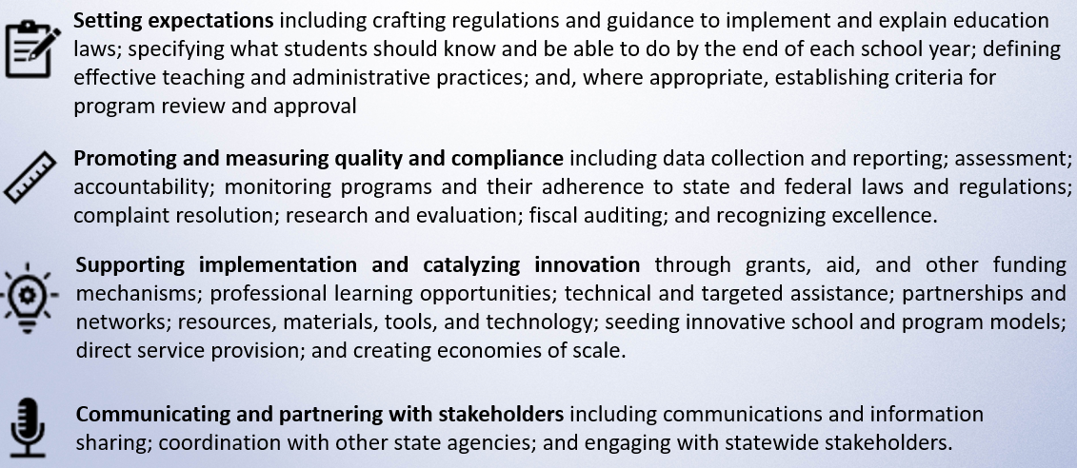
Core Functions

Slide 10
Catalog of Aligned Supports
Describes DESE's Educational Vision, strategic objectives, and core functions
Outlines DESE's priority strategies for each strategic objective and where to find aligned supports in the catalog

Slide 11
Strategic Objective 1: Whole Student Supports Chronic Absenteeism & Back to School Campaign

Slide 12
Rebecca Shor Senior Director Office of Effective Partnerships & Impact

Slide 13
The Headline: Pandemic, Progress, and Persistence
As of March 2024, 19.6% of our students were chronically absent,
compared to our pre-pandemic rate of 13%
Thank you! Your persistence brought chronic absenteeism rates down from our pandemic level high of 27.7%.
At the same time, high rates are persisting longer in Massachusetts and nationally, impacting all student groups.
As part of our Educational Vision, DESE is committed to providing every Massachusetts student a joyful, healthy, and supportive learning environment where they feel known, connected and valued.
Reducing chronic absenteeism is a key metric for success.

Slide 14
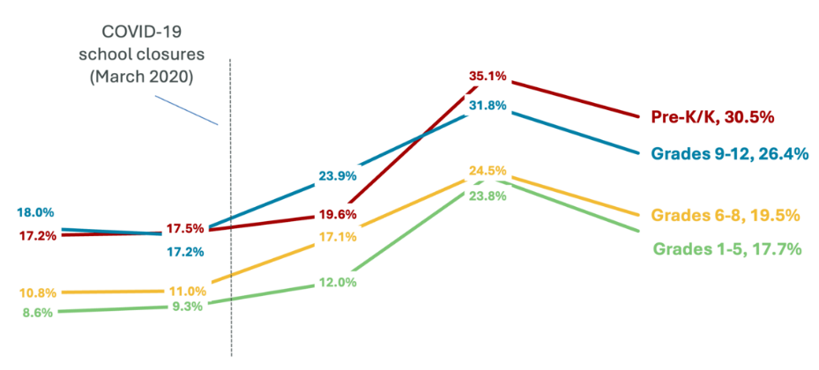
Massachusetts Trends by Grade Span
Chronic absenteeism is highest in PreK/K and high school
COVID 19
School closures
(March 2020)
Additional Insights
Chronically absent kindergarteners have lower attendance and lower achievement in future grades.
More than half of students who drop out were chronically absent 3 years prior.
Students in classrooms with high chronic absence feel a spillover effect; for example, lower test scores.
2018-19 2019-20 2020-21 2021-22 2022-23

Slide 15
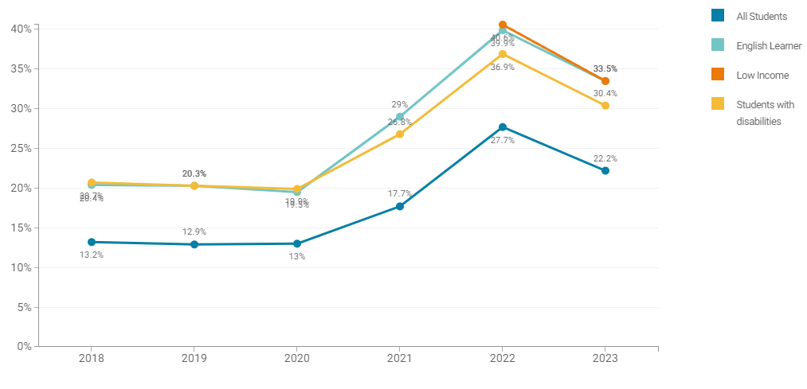
Massachusetts Trends by Specific Student Groups
Chronic absenteeism rates are higher for English learners,
low-income students, and students with disabilities
Additional Insights
National research shows the negative effects of school absences are larger for low-performing, low-income, and English learner students.
Almost half (47%) of high school English Learners missed 10% of school in 2022-2023.
Percent absent at least 10% of school year

Slide 16
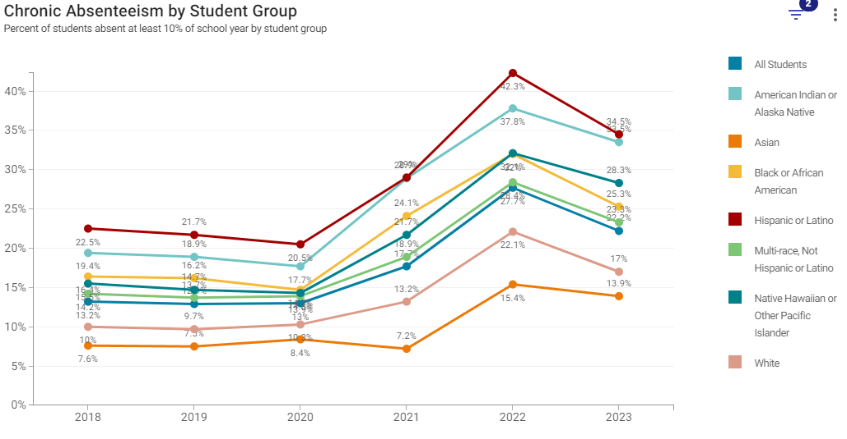
Massachusetts Trends by Race/Ethnicity
Chronic absenteeism varies by race/ethnicity
Additional Insights
Chronic absence can cause educators to view students more negatively, fueling a negative cycle.
2 out of 5 Hispanic high school students miss 10% of school or more
More MA districts impacted:
March 2024: 338 districts and 1486 schools (10%+)
2018-19: 198 districts and 913 schools (10%+)
Percent absent at least 10% of school year

Slide 17
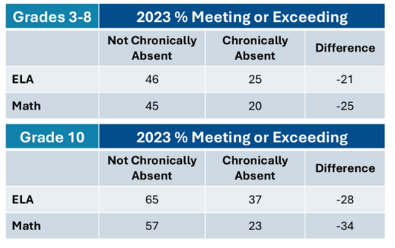
Correlation with MCAS Scores & Grad Rates
MCAS success rates nearly cut in half
Significantly lower graduation rate
4-Year Graduation Rate
62%
93%
Chronically absent in Grade 10
Not chronically absent in Grade 10

Slide 18
Factors Underlying Chronic Absenteeism
National research cites familiar root causes and risk factors, along with new or intensified post-pandemic variables
Post-Pandemic Variables
More widespread demographically
Rise in youth mental health challenges
Shifting caregiver/parent and student attitudes (lower threshold for missing school, more protective, etc.)
Economic stressors
Others you're seeing?
Health and Mental Health
Transportation Challenges
Absence and Attendance
Misconceptions
Economic and Housing
Instability
School Aversion / Student Experience

Slide 19
What We Can Do
Proactive Family Partnership and Outreach
Additional Insights
The strength of a school’s family engagement is more predictive of chronic absenteeism than rates of poverty – in fact, twice as predictive post-pandemic.
Some approaches that may have worked before may not address newer / shifting post-pandemic reasons or the scale of the challenge.
Most common district strategies nationally:
Positive / negative incentives (attendance recognition programs, detention/ suspension)
Basic needs, (e.g., free breakfast, late bus pick up, etc.)
Early, positive, and supportive communication and collaboration with families and students (policy clarity, pre-compliance); reframing attendance in context of engagement.
Holistic Student Support System
Assessing student’s holistic strengths and needs, deploying supports that include attendance barriers, actively tracking/adjusting interventions
Data Systems, Practices, and
Root Cause Analysis
School Culture and Belonging
Ensuring students feel safe and supported in school, and on the way to and from school. Connecting every student to supportive adults and activities during and after school.
Clear ownership of attendance data analysis and learning, including specific student group trends and insights from families and students
Engaging Instruction
Ensuring students are engaged in learning experiences that are real-world, relevant, and interactive, with individualized support to enable students to meet grade level standards and beyond.

Slide 20
What We Can Do: Examples from Districts
Data Systems & Root Cause Analysis | Proactive Family Partnership | Holistic Support | School Culture & Belonging | Engaging Instruction
Disaggregated data dives by student group, grade level, week / weekday, reason for absence, number absences Reviewing year-end data to plan new school strategies – early intervention and support Active use of early warning systems (e.g., EWIS) School-based attendance teams and district attendance lead or specialist Conversations and focus groups with students and families | Early and improved communication with parents/caregivers (getting ahead of compliance communications), e.g., texting to check in after 5 days, quarterly attendance update letter, attendance phone banking Equipping teachers with simple check-in scripts (“how are things going?”) Home visiting programs Family relationship building and more frequent check-ins Shifting focus of family-teacher conferences to hopes and dreams, student support, and listening to families Praise messages and calls to families as attendance improves Parent breakfasts and cafes to discuss barriers and supports | Helping families coordinate transportation and child care Working with community partners to remove barriers (rides, wake up calls or alarm clocks, medical care, food, laundry money, housing assistance, mental health services) Referring students with frequent absences to student support / school counselor Attendance recovery during school vacation weeks, Saturdays, or evenings Flexible scheduling / pathways, e.g., to support students with jobs, family member care responsibilities, parenting youth Leveraging telehealth Citywide attendance coalition School-based health clinics Mental health partnerships | In-school coach/mentor, teacher or adult supporter Purposeful relationship-building strategies, e.g., Check In/ Check Out, 2 x 10 (talk with a student 2 minutes per day for 10 days) High school Transition Team that works with Grade 8 and 9 students (welcome/ onboarding, early connections, regular feedback from students) “Near to peer” mentoring from older students Lunch group with trusted adult Strategy of engaging each 9th grader in at least two extracurricular activities (and generally developing robust portfolio of extracurricular and positive youth development activities) Positive/restorative behavior and discipline systems | Ensuring all students have access to grade level content CURATE Supporting educators to have the mindset, knowledge, and capacity to serve all students well, particularly students from historically underserved groups and communities DESE's resources on Culturally and Linguistically Sustaining Practices Make use of routines, protocols, and observation tools during professional development and common planning time to better leverage student identities and plan for engagement and inclusion Additional DESE resources to be posted soon!

Slide 21
What’s Next
What DESE is working on:
Gathering information about what’s working and not, particularly in a post-pandemic landscape
Learning about collective barriers we could help mitigate
Looking at ways we can align, and leverage DESE support to have an impact in this area
We would love to hear from you:
Complete the District Leader Survey about strategies you're using and challenges you're experiencing.

Slide 22
Resources
DESE Guidance for Attendance Policies
www.doe.mass.edu/sfs/attendance/attendance-guidance.docx
Reducing Chronic Absenteeism – Massachusetts Education to Career Data Hub (E2C)
https://educationtocareer.data.mass.gov/stories/s/Reducing-chronic-absenteeism-in-our-schools/vuut-f46x/
DESE Catalog of Aligned Supports
www.doe.mass.edu/commissioner/vision/catalog.xlsx
Chronic Absence and Student Attendance – Student and Family Support
www.doe.mass.edu/sfs/attendance/
Attendance Works
www.attendanceworks.org
October 2024
Learning Opportunity DESE Dropout Prevention and Reengagement Network Convening Focus: Chronic Absenteeism

Slide 23
Campaign

Slide 24
Strategic Objective 2: Deeper Learning Comprehensive Health and PE Framework & SEL

Slide 25
Dr. Erin Hashimoto-Martell Associate Commissioner Center for Instructional Support

Slide 26
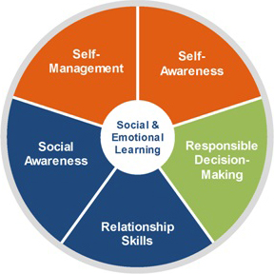
CHPE Curriculum Framework & Social and Emotional Learning
Practices for Comprehensive Health and Physical Education in MA
Practice 1: Decision-making and problem-solving.
Practice 2: Self-management and goal setting.
Practice 3: Social Awareness, Relationship, and Communication Skills.
Practice 4: Movement Skills.
Practice 5: Self-awareness and analyzing influences.
Practice 6: Information and Resource Seeking.
Practice 7: Self-Advocacy and Health Promotion. Promote personal, family, and community health.
The Collaborative for Academic Social and Emotional Learning (CASEL) Framework informed the development of the 2023 CHPE MA Curriculum Framework

Slide 27
CHPE Standards Sample
Practice 2: Self-management and Goal Setting.
Set goals, engage in health-promoting behaviors, and avoid risky behaviors.
Mental and Emotional Health [2.2.MH]
Demonstrate self-control (e.g., delay gratification, wait your turn) alone or with the support of adults in a variety of typical settings (e.g., on the playground, in the classroom, during physical education, at an assembly). [HPE; SE]
Define stress and demonstrate strategies for managing stress (e.g., positive self-talk, belly breathing, talking with a trusted adult, listening to calming music, play, physical activity) alone or with the support of adults. [HPE; SE]
Identify what it means to be responsible and list personal responsibilities. [HPE; SE]
Utilize simple positive self-talk for the purpose of self-motivation and behavior modification. [HPE; SE]
Identify simple goals for health, physical activity, academic success, and classroom behavior. [HPE; SE]

Slide 28
CHPE & SEL Implementation Resources
Available now:
Quick Reference Guide: Opting Out of Sex Education in MA Public Schools
Summer Institute Registration: August 5-8, 2024
CHPE Leader Network Registration: 2024-2025 School Year
Social, Emotional, Behavioral Academy Application for New Schools/Districts (SY24-25)
Coming soon:
CHPE Curriculum Guide: August 2024
Implementation Panel: Fall Webinar for M.A.S.S. planned.
Supporting Students' Social Emotional Learning, Behavioral & Mental Health, and Wellness Grant (SEL/MH Grant)
https://www.doe.mass.edu/stem/chpe/

Slide 29
Strategic Objective 2: Deeper Learning PRISM & Locating Early Literacy Resources

Slide 30
Literacy Launch
“to increase the number of public schools and licensed early education and care providers in the Commonwealth providing evidence-based, culturally and linguistically sustaining literacy instruction to students in preschool through grade 3”

Slide 31
Partnership for Reading Success – Massachusetts (PRISM)
Materials Purchase
Early Literacy screener
Vendors and Partners
Professional development from approved external providers
Staffing
Teacher stipends or substitute teacher costs
Instructional materials for tiers 2-3
Targeted consultant and coaching services from approved partner
Support for reading interventionists, coaches, specialists
Stipends for the PRISM Leadership Team
High dosage tutoring partner

Slide 32
Who Should Apply to PRISM I?
Eligibility
Size Considerations
Districts and charter schools using high-quality tier 1 core instructional materials in ELA/literacy in grades K-3*
LEAs willing and able to partner with at least two community-based preschool providers
*rated meets or partially meets on CURATE
For participating LEAs, all schools serving grades preschool-grade 3 must participate
Up to a cap of 15 participating schools per district
LEAs with only 1-2 schools that serves grades preschool-grade 3 must apply as a consortium with other LEAs to reach a minimum of three schools

Slide 33
Applying to PRISM I
RFP
PRISM Website
PRISM Overview
Application support videos
Sign up for office hours
FAQs
www. doe.mass.edu/instruction/prism
Apply on GEM$
Due date: October 1
www.doe.mass.edu/grants/2025/0592/

Slide 34
Additional Early Literacy Resources
Literacy Leaders Network: 2024-2025 School Year
Massachusetts Dyslexia Institute
ELA HQIM Communities of Practice (based on specific HQIM)
Mass Literacy Guide and online self-paced course
Resources to Support Early Literacy Universal Screening Assessments
Screeners for PreK and other languages being reviewed this year
Appleseeds Foundational Skills Curriculum
https://www.doe.mass.edu/instruction/ela

Slide 35
Core Functions: FY25 State Budget

Slide 36
Robert O’Donnell Director of School Finance Office of District and School Finance

Slide 37
Factors That Impact Chapter 70 Aid Distribution
October 1 enrollment drives foundation budgets
Review SIMS summary reports 1 and 2 for accuracy
Understand low-income counts based on 4-period match with EOHHS
Supplemental low-income data collection allows districts and charter schools to claim students who are not matched
Webinars scheduled for August 13th and September 19th
Live presentation at MASBO on September 25th
Student Opportunity Act fully implemented by FY27
Inflation based on the most recent Q3 to Q3 comparison Implicit Price Deflator for State and Local Government Services (row 26)

Slide 38
Core Functions: Emergency Assistance (EA) Shelter Updates

Slide 39
Anne Marie Stronach Operations Liaison Commissioner’s Office

Slide 40
Emergency Assistance (EA) Shelter Update July 2024 EA Policy Changes
Policy Goal to ensure that shelter is temporary, supportive, and non-recurring.​
Emergency Assistance (EA) shelter length of stay policy
Traditional Shelters including hotels implement a 9-month policy with qualifying 90-day extension.
Temporary Respite Centers (TRC) implement a 5-business day policy with a qualifying 5–30 day extension.
Impact on school enrollment
McKinney-Vento required
Family directs school enrollment
School of Origin Transportation
Potential increased enrollment homeless students doubling up with other families
Potential increased enrollment in over-aged students
DESE Supports
Webinars, technical assistance, and superintendent taskforce
Grant opportunities to support eligible districts
Contact Anne Marie Stronach for additional information at anne.marie.stronach@mass.gov

Slide 41
Core Functions: Superintendent Checklist

Slide 42
Superintendent Checklist
Superintendent Checklist released today
See “On The Desktop” email
Link: https://www.doe.mass.edu/commissioner/checklist.html

Slide 43
End Recording

Slide 44
Questions If you have additional questions that we did not answer during this webinar, please email the Commissioner’s Office at: commissioner0@MassMail.State.MA.US

Slide 45
Service Quote

Slide 46
Thank you and have a great school year!

Slide 47
Appendix

Slide 48
Sources for Chronic Absenteeism Slides
Massachusetts Trends by Grade Span Sources
https://educationtocareer.data.mass.gov/stories/s/vuut-f46x
https://www.gradpartnership.org/wp-content/uploads/2024/05/EGC-GP-NPSS-May-2024-Brief.pdf
https://annenberg.brown.edu/sites/default/files/EdResearch_for_Recovery_Brief_22.pdf
Massachusetts Trends by Race/Ethnicity Sources
https://www.edweek.org/leadership/teachers-view-chronically-absent-students-less-favorably/2024/06

Slide 49
Sources for Chronic Absenteeism Slides
Factors Underlying Chronic Absenteeism Sources
https://annenberg.brown.edu/sites/default/files/EdResearch_for_Recovery_Brief_22.pdf
https://www.gradpartnership.org/wp-content/uploads/2024/05/EGC-GP-NPSS-May-2024-Brief.pdf
https://acrobat.adobe.com/id/urn:aaid:sc:US:e6296128-208d-4b30-bbe7-ed40f79f50a8
https://www.edweek.org/leadership/3-steps-to-drive-down-chronic-absenteeism/2023/10
https://www.gse.harvard.edu/ideas/edcast/24/03/combatting-chronic-absenteeism-family-engagement
https://www.vox.com/2024/1/9/23904542/chronic-absenteeism-school-attendance
https://www.gse.harvard.edu/ideas/edcast/24/03/combatting-chronic-absenteeism-family-engagement

Slide 50
Sources for Chronic Absenteeism Slides
What We Can Do Sources
https://acrobat.adobe.com/id/urn:aaid:sc:US:e6296128-208d-4b30-bbe7-ed40f79f50a8
https://www.ecmcgroup.org/media/u3ta3xee/qtq-survey-5-digital-reportpdf.pdf
https://oag.ca.gov/sites/all/files/agweb/pdfs/tr/toolkit/QualitativeResearchReport.pdf
https://www.npr.org/2024/06/10/nx-s1-4954754/some-states-are-seeing-chronic-absenteeism-soar-to-more-than-40-of-students

Slide 51
Sources for Chronic Absenteeism Slides
What We Can Do: Examples from Districts Sources
Engage Massachusetts report July 2024 (high school)
https://educationtocareer.data.mass.gov/stories/s/vuut-f46x
https://annenberg.brown.edu/sites/default/files/EdResearch_for_Recovery_Brief_22.pdf
https://www.gradpartnership.org/wp-content/uploads/2024/05/EGC-GP-NPSS-May-2024-Brief.pdf
https://acrobat.adobe.com/id/urn:aaid:sc:US:e6296128-208d-4b30-bbe7-ed40f79f50a8
https://www.attendanceworks.org/chronic-absence/addressing-chronic-absence/
https://www.edsurge.com/news/2024-03-04-understanding-and-addressing-the-surge-of-chronic-absenteeism
https://www.future-ed.org/state-strategies-for-fighting-chronic-student-absenteeism/

Slide 52
Sources for Chronic Absenteeism Slides
What We Can Do: Examples from Districts Sources
https://www.edweek.org/leadership/3-steps-to-drive-down-chronic-absenteeism/2023/10
https://www.pbs.org/newshour/nation/chronic-absenteeism-is-up-across-the-country-school-leaders-are-trying-to-address-why
https://ies.ed.gov/ncee/edlabs/regions/southwest/pdf/training-coaching/SWCCR5115-HO2a-508.pdf
https://ies.ed.gov/ncee/pubs/2022001/pdf/2022001.pdf
https://www.cde.ca.gov/ls/ai/cw/attendstrategy.asp
https://www.seattletimes.com/education-lab/absent-students-schools-attendance-nudge-letters/
https://www.nassp.org/publication/principal-leadership/volume-17-2016-2017/principal-leadership-december-2016/10-high-yield-actions-to-improve-student-attendance/
https://www.gse.harvard.edu/ideas/edcast/24/03/combatting-chronic-absenteeism-family-engagement
https://www.gse.harvard.edu/ideas/edcast/24/03/combatting-chronic-absenteeism-family-engagement

