Slide 1
Superintendent, Charter Leaders, and Collaborative Leaders
Fall Webinar
Acting Commissioner Russell D. Johnston
Tuesday, November 12, 2024

Slide 2
Begin Recording

Slide 3

Agenda
Strategic Objective 1: Whole Student Supports
  1. Chronic Absenteeism & Student Attendance
    New Resource
    Power of Presence Campaign
    Student Learning Time Guidance
    Attendance Recovery
Strategic Objective 2: Deeper Learning
  2. Election Results
Core Functions
  3. 2024 VOCAL Updates
  4. Time-Out Rooms
  5. Budget (Circuit Breaker Claim System Updates)
  6. Licensure Updates
Q&A

Slide 4
Strategic Objective 1:
Whole Student Supports
Chronic Absenteeism & Student Attendance

Slide 5
New Resource

Slide 6
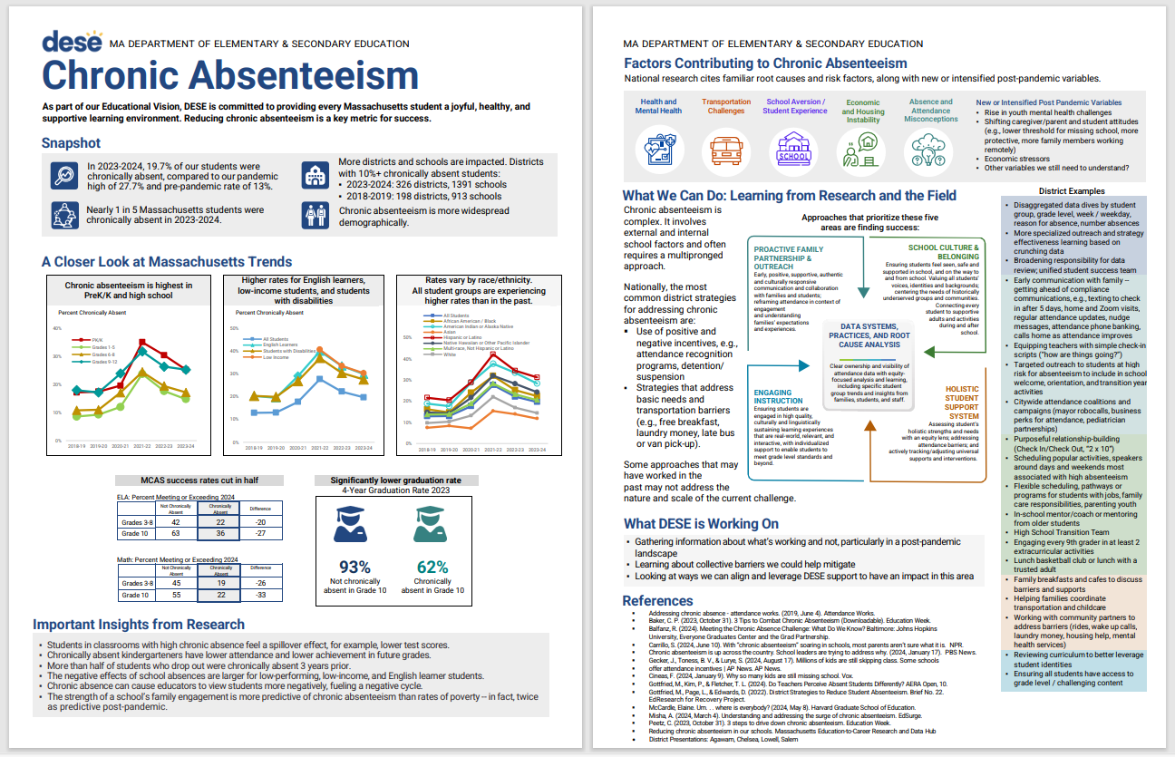
Chronic Absenteeism
https://www.doe.mass.edu/sfs/attendance/chronic-absenteeism.docx

Slide 7
Power of Presence Campaign

Slide 8

Power of Presence
Please encourage your school communities to participate!
In the Nov. 5 On The Desktop, you received templates and flyers for your schools.
Submissions close December 20.
Winners will be featured in 2025 PSA.
https://survey.alchemer.com/s3/7940961/The-Power-of-Presence-copy

Slide 9




Submissions: poems artwork videos

Slide 10
Student Learning Time Guidance

Slide 11
Student Learning Time Guidance
DESE is updating the 2011 Student Learning Time (SLT) guidance on making up days lost to health, weather, or safety emergencies.
The SLT regulations allow for districts to request a waiver from DESE to reduce the 180-day school requirement.
While waivers can be requested at any time, this new guidance will explain the criteria that will be used in consideration of any request.
Also includes a FAQ addressing:
  Use of half-days
  Scheduling vacations
  Graduation ceremony dates
  Start dates

Slide 12
Updated 180-Day Guidance
All days lost to health, weather, or safety emergencies from the first day of the school year through March 31st must be made up by rescheduling full school days to ensure a 180-day school year.
All days lost to health, weather, or safety emergencies after March 31st must be made up to ensure a 180-day school year or at least until the district has reached its previously scheduled 185th day, whichever comes first. If the district has previously closed for 5 days because of health, weather, or safety emergencies, and subsequently closes for additional days, then the Commissioner will consider a waiver in accordance with the Student Learning Time regulations on a case-by-case basis.

Slide 13
Attendance Recovery

Slide 14
Attendance Recovery Data Collection
DESE will not be collecting data related to student participation in attendance recovery programs for inclusion in 2024-25 accountability calculations.
Quality and consistency of data varied greatly.
Chronic absenteeism calculations will be based only on 180-day school year for all schools (or regular length of school year).
DESE encourages use of attendance or credit recovery programs for students at the local level.

Slide 15
Strategic Objective 2:
Deeper Learning
Election Results

Slide 16
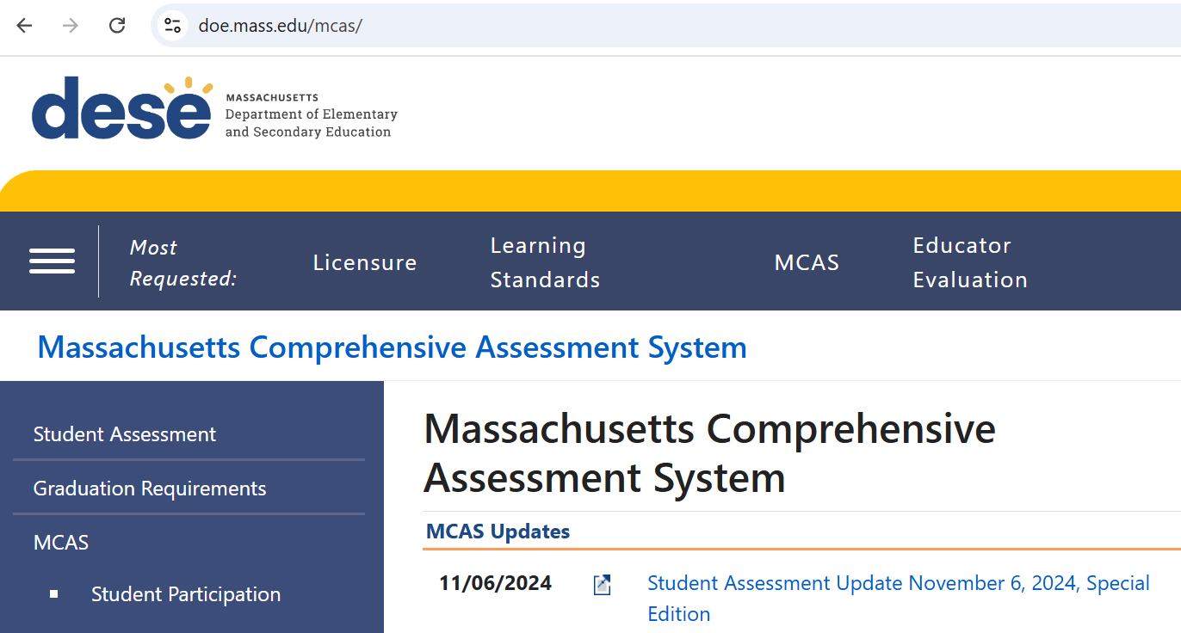
Election Follow-Up & Posted FAQ
https://www.doe.mass.edu/mcas/

Slide 17
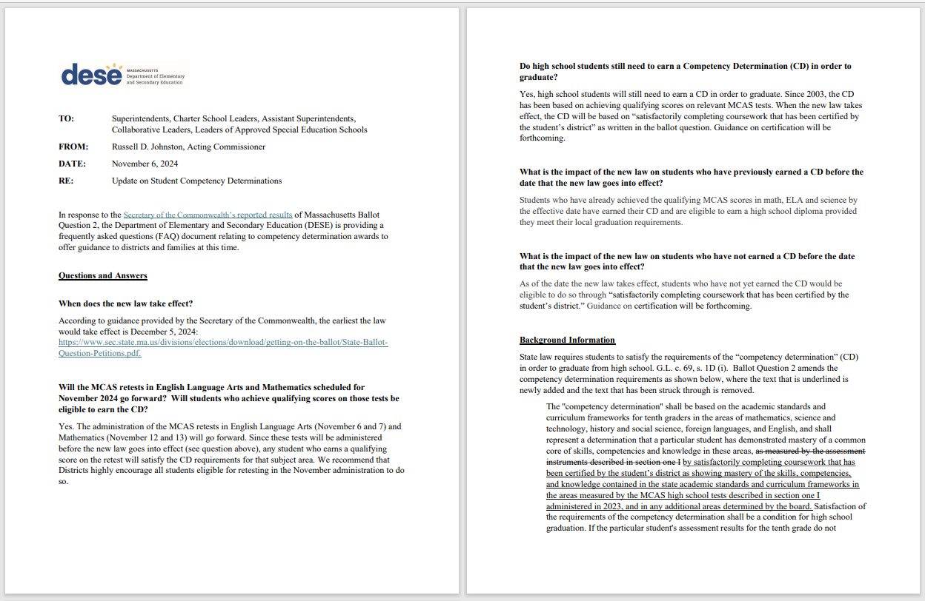
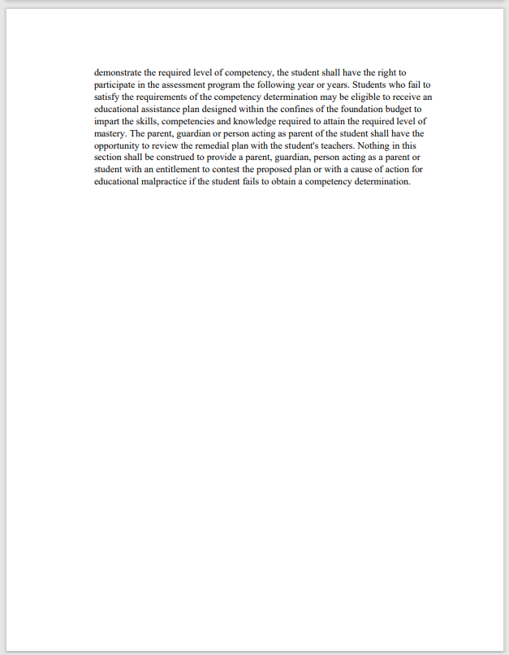
Continued
https://mcusercontent.com/d8f37d1a90dacd97f207f0b4a/files/2a1b587f-0b4d-c346-659d-6c34c580844a/DESE_Guidance_Document_on_CD_11.6.24_Final.02.pdf

Slide 18
Core Functions:
2024 VOCAL Updates

Slide 19
2024 VOCAL Results Released 10/14/24
District- and school-level VOCAL results are in the School Climate section of Edwin.
State-level dashboard and executive summary are publicly available on DESE’s VOCAL website.
Recording of release webinar on 10/24
  Contains updates, explanations, and high-level observations from results.
Contact: Brendan Longe, Psychometric Specialist in the Office of Planning and Research, brendan.w.longe@mass.gov

Slide 20
2024 VOCAL Access Permissions Update
Before 2024 | Now
Only district and school administrator Edwin accounts could access their own district or school results. | District, school administrator, and teacher accounts can access results for any school or district.
This aligns VOCAL reporting with all other aggregated data reporting in Edwin.
Easier access to support increased use.

Slide 21
Core Functions:
Time-Out Rooms

Slide 22
Guidance on Reducing and Eliminating the Use of Time-Out Rooms
Memo issued in September 2021 and remains in effect.
Wide stakeholder engagement.
Highlights of the guidance include:
  Encourages proactive implementation of strategies, interventions and supports that promote the social emotional well being of students.
  Strongly recommends that schools that use time-out rooms as a behavior support strategy actively consider and implement alternative approaches to reduce or eliminate the use of such rooms.
  Recommends for additional safeguards such as data collection and parental notification.

Slide 23
Time-Out Room Working Group Membership
American Federation of Teachers (AFT)
Department of Early Education & Care (EEC)
Disability Law Center (DLC)
EdLaw Project
Massachusetts Administrators for Special Education (ASE)
Massachusetts Advocates for Children (MAC)
Massachusetts Association of Approved Special Education Schools (MAAPS)
Massachusetts Association of School Superintendents (MASS)
Massachusetts Charter Public School Association (MCPSA)
Massachusetts Interscholastic Athletic Association (MIAA)
Massachusetts Organization of Educational Collaboratives (MOEC)
Massachusetts Teachers Association (MTA)

Slide 24
Core Functions:
Budget (Circuit Breaker Claim System Updates)

Slide 25
Circuit Breaker Claim System Update
New special education Circuit Breaker claim system in 2025.
Upgrade includes an online module through CHAMP.
Replaces Excel-based claim file.
Transition Timeline:
  In the next weeks - Updated list of services will be provided.
  Late winter – Training begins to support the Circuit Breaker Relief Cycle in March 2025.
More information to come from the Circuit Breaker Office.

Slide 26
Core Functions:
Licensure Updates

Slide 27
Potential Regulation Changes
    MTEL Alternative Assessment Pilot.
    Updates to the health/family and consumer science license based on new frameworks.
    Possession of a Bilingual Education Endorsement for the Sheltered English Immersion (SEI) Endorsement.
    Put a definitive end date on Emergency Extensions.

Slide 28
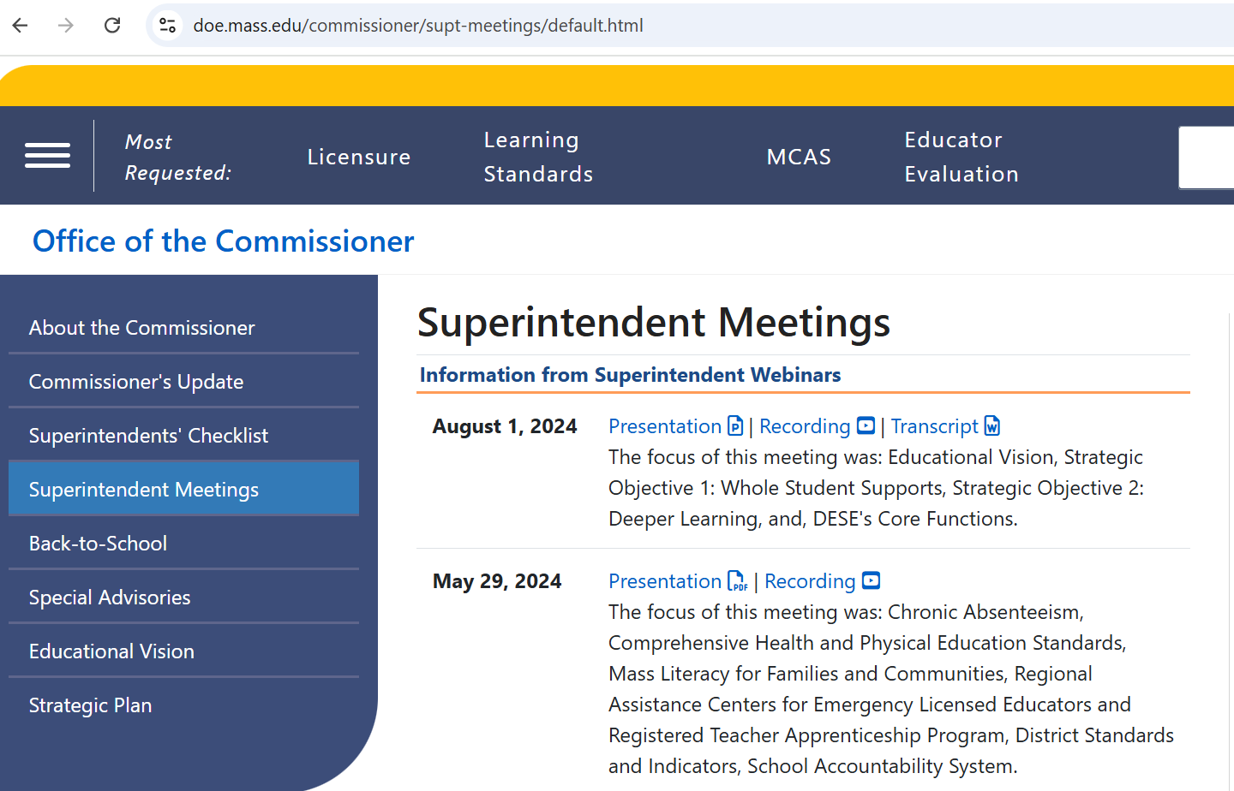
Reminder:
Webinars are recorded and posted on the Commissioner’s webpage.
https://www.doe.mass.edu/commissioner/supt-meetings/default.html

Slide 29
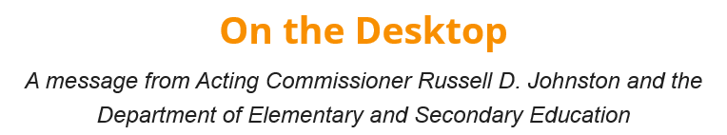
Coming Soon: On The Desktop (OTD)
Look for a follow-up “OTD” which will include:
  These webinar slides
  Other business items
    Example: Update on the superintendent’s checklist

Slide 30
End Recording

Slide 31
Questions
If you have additional questions that we did not answer during this webinar, please email the Commissioner’s Office at: commissioner0@MassMail.State.MA.US

Slide 32
Thank you!

