Slide 1
June 18, 2020
Planning and Adjusting your Instruction in Mathematics

Slide 2
Introductions
Ian Stith: Mathematics Content Support Lead, DESE (Ian.T.Stith@mass.gov)
Stephen Garschina-Bobrow: Mathematics Content Support Specialist, DESE (Stephen.Garschina-Bobrow@mass.gov)
Erin Hashimoto-Martell: Director of STEM, DESE
(Erin.A.Hashimoto-Martell@mass.gov)

Slide 3
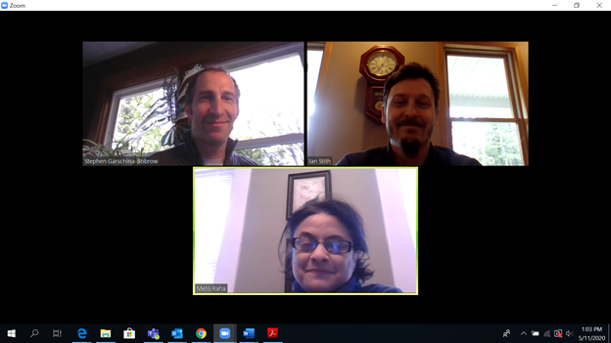
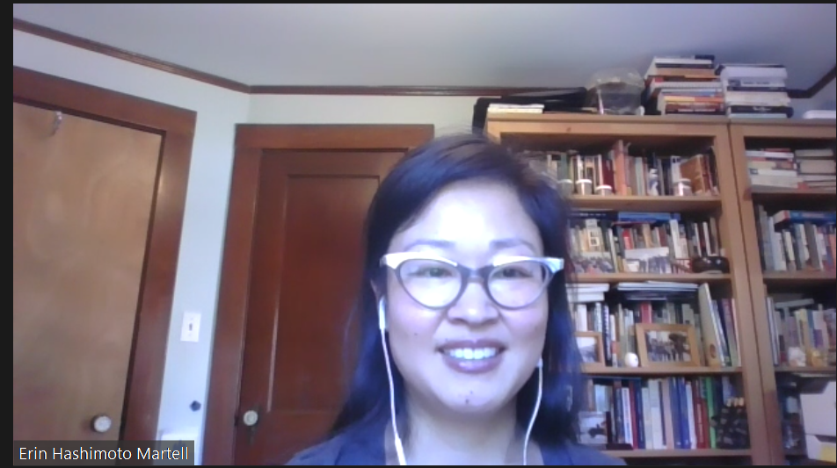

Zoom call
Closed Captioning?
To view closed caption during the meeting, click here.
If you don’t see this button, click on “More”
? Question?
To ask a question, click on the chat button and type into the chat box.

Slide 4

Thank You!
We are in a state of crisis management, and as such educators are working harder than ever before.
We appreciate all that you do
and will continue to do for
students.
We are here to support you.

Slide 5
Challenges and Unknowns for Fall Re-Entry
Remote learning has placed new strains and challenges on students and educators.
The closure of school buildings dramatically impacted teaching and learning.
Access to technology remains a challenge for educators and families.
We are all working with limited planning time and reacting to changing information as quickly as possible.
This crisis disproportionately affects our most vulnerable students in terms of their physical and mental health and also academically. Equity needs to be a top consideration.
Teaching and learning has taken place over a spectrum this spring that is making Fall planning and re-entry challenging.

Slide 6
Webinar goals
Provide strategies for structuring curriculum planning for fall re-entry and beyond
Provide strategies to adjust instruction and classroom assessment for fall re-entry and beyond, while maintaining grade level expectations
Ask and answer questions and offer support

Slide 7
agenda
1
Introductions and Welcome
2
Grade Level Planning Approach
3
Unit Level Planning
Agenda
4
Q+A
Please type questions into the Chat at any time.

Slide 8
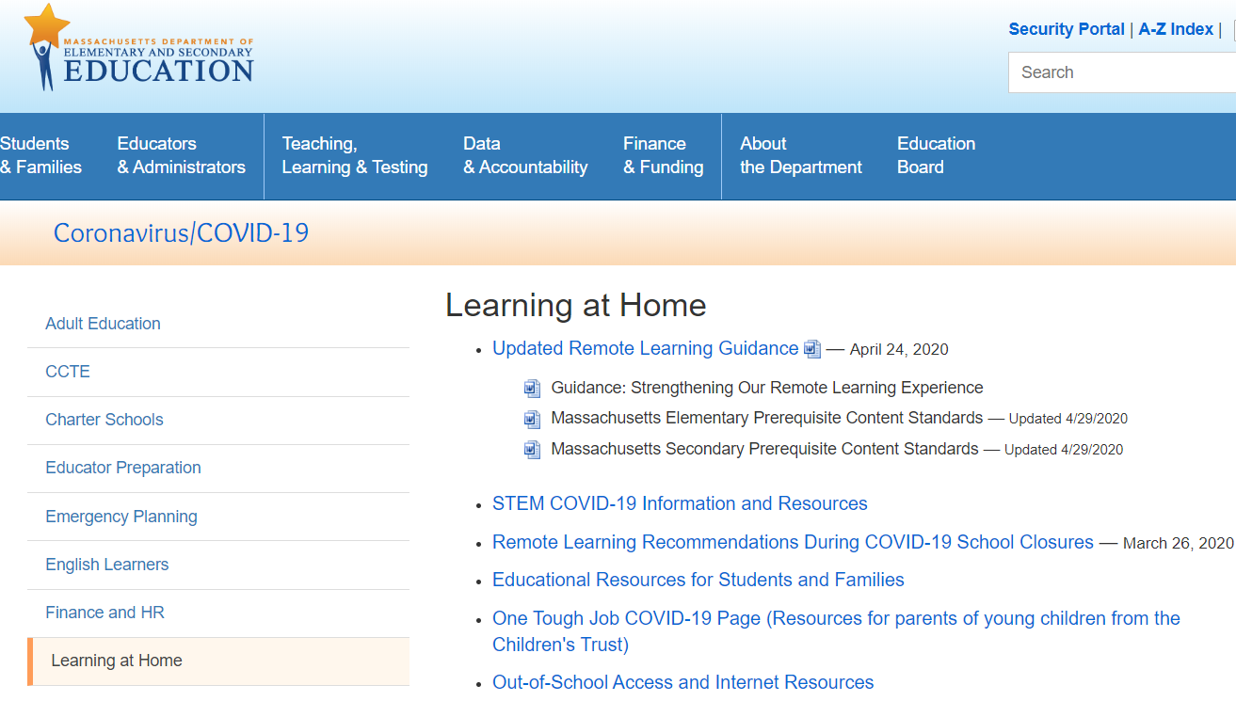
Remote Learning Recommendations
http://www.doe.mass.edu/covid19/learn-at-home.html

Slide 9

Guiding Principles For Our Work
The safety and well-being of students,
families, and staff must be our top
priority.
This crisis disproportionately affects
our most vulnerable students in terms
of their physical and mental health
and also academically. Equity needs
to be a top consideration.
Maintaining connections between school
staff, students, and families is paramount.

Slide 10
Importance of engagement
Teaching and learning has taken place over a spectrum this spring impacting student and families differently. There were many factors that impacted low or limited student participation. Reflect on the engagement of your students and their families in the spring, and consider how to build community and family engagement in the fall.
Low to no student participation
Limited student participation
Variable participation
Regular and ongoing communication between teacher and student
Majority of student likely have not engaged with on grade level material since school closures began
Intermittent and/or only initial student participation.
Some students regular participated and other did not
Near full coverage/learning of prerequisite standards and beyond

Slide 11
What does this mean for student learning
“The typical approach to remediation—providing work better suited for earlier grades—won’t come close to catching students up and will likely compound the problem….The students stuck in this vicious cycle are disproportionately the most vulnerable: students of color, from low-income families, with special needs, or learning English.” COVID-19 School Response Toolkit (2020) by TNTP, Inc.,
Notes:
https://tntp.org/covid-19-school-response-toolkit

Slide 12

Grade Level Planning Approach
Notes:
How can we use this information to adjust our instruction?

Slide 13

Why focus on grade level tasks?
An exploration of five diverse districts.
30,000 surveys
20,000 student work samples
5,000 assignments
1,000 classroom observations
TNTP’s Opportunity Myth (2018)
Notes:
https://tntp.org/assets/documents/TNTP_The-Opportunity-Myth_Web.pdf

Slide 14
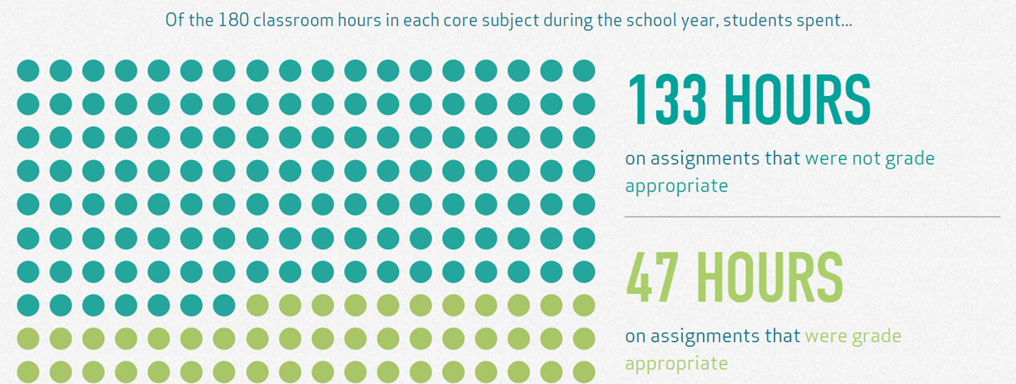
The importance of grade level instruction
Of the 180 classroom hours in each core subject during the school year, students spent...
TNTP’s Opportunity Myth (2018)

Slide 15
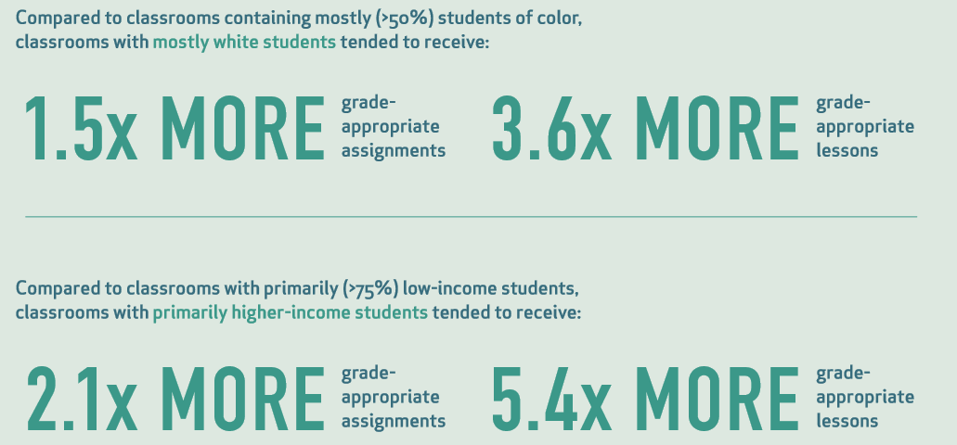
Access is Equity

Slide 16
Importance of access to grade-level instruction
Students starting the year below grade level benefit the most from on-grade level instruction:
“In classrooms where students had greater access to grade-appropriate assignments, they gained nearly two months of additional learning compared to their peers.”
“When students who started the year behind had greater access to grade-appropriate assignments, they closed the outcomes gap with their peers by more than seven months.”
(Opportunity Myth, 2018)
Notes:
link to opportunity myth https://opportunitymyth.tntp.org/

Slide 17
Key messages for planning and instruction
Focus on Equity.
  Instructional materials and instruction bring forward and value all students’ voices and surface all ideas & value the lived experiences of students as their prior knowledge
  Support diversity of learners and needs
  Prepare to support for the range of student engagement in the spring and beyond
Maintain & Support Grade Level Expectations.
  Align scope and sequence with grade level standards and look for gaps
  Most topics/standards span and build through multiple grade levels
  Support, scaffold and integrate prior content/skills as needed
  Check-in with curriculum publishers for any additional materials they have released
Utilize Purposeful Assessments Practices All Year Long.
  Gauge prior knowledge yearlong instead of frontloading in the beginning of the year
  Avoid assessments without a clear purpose and intended target
  Use actionable data to make decisions
  Start with curriculum embedded assessments from high quality instructional materials

Slide 18
Self Audit- How to maximize what you already have
Work in collaborative teams (grade level, span, course specific, etc.) to determine:
Quality of instructional materials- How aligned are your instructional materials to the standards? Do the materials have multiple entry points for students to access the content?
Range of Assessments- Does your curriculum include different types (formative, interim, summative, etc.) of assessments? How do the assessments assess the learning and have an explicit purpose? How are assessments embedded in your curriculum? How often are assessments delivered?
Student population- Where did students leave off from the previous year? Where might be the gaps in content? What type of supports or just in-time scaffolds are available?
Equity- How does the curriculum include materials that are responsive to students’ diverse cultures? How does the curriculum meet the needs of all learners?
Communication - How is feedback provided on assignments, progress or assessments to students and families? How timely, specific, consistent is it?
Collaboration structures- What routines, time, and expectations do you have for continued collaboration with your colleagues?

Slide 19
Importance of Engagement
Teaching and learning has taken place over a spectrum this spring impacting student and families differently. There were many factors that impacted low or limited student participation. Reflect on the engagement of your students and their families in the spring, and consider how to build community and family engagement in the fall.
Low to no student participation
Limited student participation
Variable participation
Regular and ongoing communication between teacher and student
Majority of student likely have not engaged with on grade level material since school closures began
Intermittent and/or only initial student participation.
Some students regular participated and other did not
Near full coverage/learning of prerequisite standards and beyond

Slide 20
Planning and Instruction Considerations
Build off of the knowledge of your colleagues, families, and students
Work from existing resources (instructional materials, pacing guides, curriculum maps, assessments, etc)
Integrate concepts/standards from unfinished learning into appropriate units throughout the school year, focusing on “just in time” supports
Recognize the emotional, safety, trauma students experienced this spring
This crisis disproportionately affects our most vulnerable students. Equity needs to be a top consideration.
Build consistency in classroom routines, norms and within the curriculum to set students up for success

Slide 21
What were the experiences of my students in 2019-2020?
What was the communication with students and families like?
How did you communicate with teachers (horizontally and vertically)?
What changes were made to your typical scope and sequence?
  What concepts/standards were unfinished?
What types of supports will be needed for the following grades?
Integrated, targeted remediation
Not sufficiently covered but fits well into the content of the next grade
Typical remediation will likely be sufficient
Many students struggled with a concept regardless of school closures
Immediate Need
Content vital to assess before regular instruction can begin

Slide 22
Categorization of Content - The Role of Assessment
Typical remediation will likely be sufficient
Integrated, targeted remediation
Assessment
Immediate Need

Slide 23
Review: The Role of Assessments
Purposeful:
How will the assessment help adapt instruction?
Is the assessment aligned to the specific content of interest?
Provides Actionable Data:
Is the data specific, clear, and practically actionable in the classroom?
Student and classroom level
Communication of Results to students, families, and other stakeholders:
Are the results communicated timely, specific, and understandable?
Are the results actionable for students and/or families?

Slide 24
2019-20 Scope and Sequence and Experience
Unit 1
Unit 2
Unit 3
Unit 4
Unit 5
Unit 6
Unit 7
Unit 8
Before Closures
Typical remediation likely sufficient
OR
Not Covered
Will likely need remediation
Targeted coverage needed
OR
During Closures
Must be covered before regular instruction begins
Typical remediation likely sufficient
OR
WIll likely need remediation

Slide 25
2020-21 Typical Scope and Sequence
Unit 1
Unit 2
Unit 3
Unit 4
Unit 5
Unit 6
Unit 7
Unit 8

Slide 26
2020-21: Modified Scope and Sequence
Must be covered before regular instruction begins
Unit 1
Unit 2
Unit 3
Unit 4
Unit 5
Unit 6
Unit 7
Unit 8
Targeted assessment, coverage, and remediation
Typical remediation likely sufficient
Where do these previous grade standards naturally align with our own grade scope and sequence?

Slide 27
Continuum of Experience
Low to no student participation
Limited student participation
Variable participation
Regular and ongoing communication between teacher and student
Majority of student likely have not engaged with on grade level material since school closures began
Intermittent and/or only initial student participation.
Some students regular participated and other did not
Near full coverage/learning of prerequisite standards and beyond
Notes:
not blaming students or families for lack of participation

Slide 28
3rd Grade Eureka Math
Already Covered
Prerequisite Standard | Eureka Module
3.OA.A.1 - 4 | Mod 1 & 3
3.OA.B.5, 6 | Mod 1 & 3
3.OA.C.7 | Mod 1 & 3
3.NBT.A.2 | Mod 2
3.NBT.A.3 | Mod 3
3.MD.C.7 | Mod 4
3.NF.A.1 - 3 | Mod 5
Remaining Units
Prerequisite Standard | Eureka Module
3.G.A.1 | Mod 7
Remaining Prerequisite Standards
NA

Slide 29
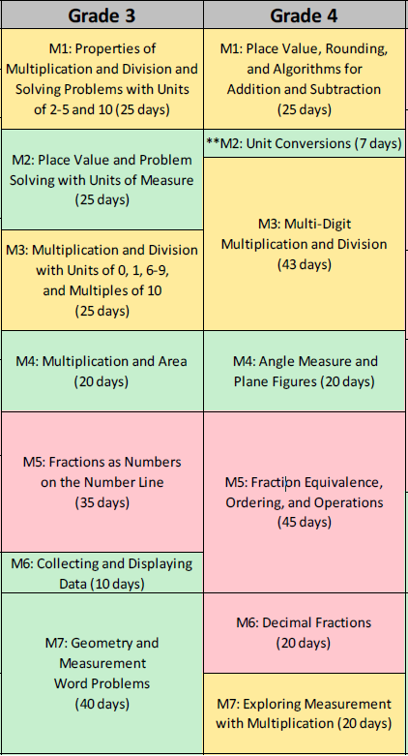
Documenting the work of the spring - Eureka Math Example #1
Before Closures
Multiplication and division
Place value
Addition and Subtraction
Typical remediation likely sufficient
OR
Not Covered
Will likely need remediation
Fractions
NA
During Closures
Typical remediation likely sufficient
Numbers on a number line
Data collection and displays
OR
WIll likely need remediation
Fractions
Measurement
Geometry
Notes:
This example is based on a teacher who was generally able to maintain connections with students and successfully cover material after the school closures.
Regular and ongoing communication between teacher and student
Near full coverage/learning of prerequisite standards and beyond

Slide 30
2020-21: Modified Scope and Sequence - Eureka Math Example #1
Must be covered before regular instruction begins
NA
Targeted assessment, coverage, and remediation
Typical remediation likely sufficient
Measurement
Geometry
Fractions
Multiplication and division
Place value
Addition and Subtraction
Numbers on a number line
Data collection and displays

Slide 31
Documenting the work of the spring - Eureka Math Example #2
Before Closures
Multiplication and division
Place value
Addition and Subtraction
Typical remediation likely sufficient
OR
Numbers on a number line
Fractions
Measurement
NA
Not Covered
Will likely need remediation
Fractions
Targeted coverage needed
During Closures
Typical remediation likely sufficient
NA
Must be covered before regular instruction begins
OR
WIll likely need remediation
Data collection and displays
Geometry
Notes:
This example is based on a more variable educational experience during the closures, with inconsistent or nonparticipation - likely because of lack of access.
Variable participation
Some students regular participated and other did not

Slide 32
2020-21: Modified Scope and Sequence - Eureka Math Example #2
Must be covered before regular instruction begins
NA
Targeted assessment, coverage, and remediation
Typical remediation likely sufficient
Measurement
Geometry
Fractions
Numbers on a number line
Data collection and displays
Multiplication and division
Place value
Addition and Subtraction

Slide 33
Documenting the work of the spring - Eureka Math Example #3
Before Closures
Multiplication and division
Place value
Addition and Subtraction
Typical remediation likely sufficient
Numbers on a number line
Fractions
Measurement
Data collection and displays
Geometry
NA
Not Covered
OR
Targeted coverage needed
Will likely need remediation
Fractions
During Closures
Typical remediation likely sufficient
NA
Must be covered before regular instruction begins
OR
WIll likely need remediation
NA
Notes:
This example is based on a more variable educational experience during the closures, with inconsistent or nonparticipation - likely because of lack of access.
Low to no student participation Majority of student likely have not engaged with on grade level material since school closures began

Slide 34
2020-21: Modified Scope and Sequence - Eureka Math Example #3
Must be covered before regular instruction begins
NA
Targeted assessment, coverage, and remediation
Typical remediation likely sufficient
Measurement
Geometry
Fractions
Numbers on a number line
Data collection and displays
Multiplication and division
Place value
Addition and Subtraction

Slide 35
Key messages for planning and instruction
Focus on Equity.
  Instructional materials and instruction bring forward and value all students’ voices and surface all ideas & value the lived experiences of students as their prior knowledge
  Support diversity of learners and needs
  Prepare to support for the range of student engagement in the spring and why
Maintain & Support Grade Level Expectations.
  Align scope and sequence with grade level standards and look for gaps
  Most topics/standards span and build through multiple grade levels
  Support, scaffold and integrate prior content/skills as needed
  Check-in with curriculum publishers for any additional materials they have released
Utilize Purposeful Assessments Practices All Year Long.
  Gauge prior knowledge yearlong instead of frontloading in the beginning of the year
  Avoid assessments without a clear purpose and intended target
  Use actionable data to make decisions
  Start with curriculum embedded assessments from high quality instructional materials
Notes:
As a reminder, we can learn lessons from other events,like Hurricane Katrina that have impacted learning.
https://www.crpe.org/thelens/what-post-katrina-new-orleans-can-teach-schools-about-addressing-covid-learning-losses
Assessment is a stressor for many students and will be heightened emotions with school re-entry and other factors

Slide 36
Review: The Role of Assessments
Purposeful:
How will the assessment help adapt instruction?
Is the assessment aligned to the specific content of interest?
Provides Actionable Data:
Is the data specific, clear, and practically actionable in the classroom?
Student and classroom level
Communication of Results to students, families, and other stakeholders:
Are the results communicated timely, specific, and understandable?
Are the results actionable for students and/or families?

Slide 37

Unit Level Planning

Slide 38

9th Grade Unit Example: Illustrative Math
As reported by 8th grade teachers
Targeted assessment, coverage, and remediation
Defining, evaluating, and comparing functions
8.F.A.1, 2, 3
Use functions to model relationships
8.F.B.4, 5
Notes:
https://www.illustrativemathematics.org/

Slide 39
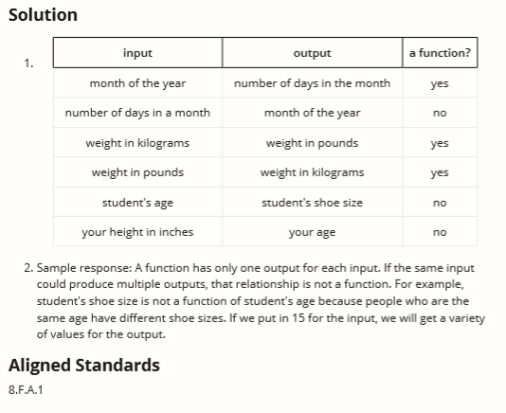
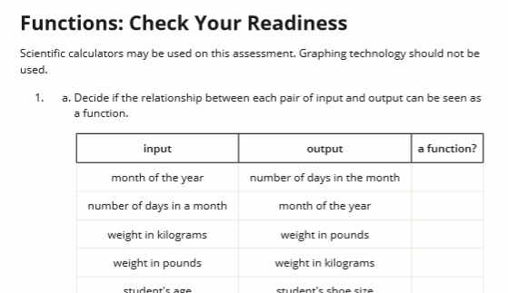
9th Grade Unit Example: Illustrative Math
As reported by 8th grade teachers
Defining, evaluating, and comparing functions
8.F.A.1, 2, 3
Use functions to model relationships
8.F.B.4, 5

Slide 40
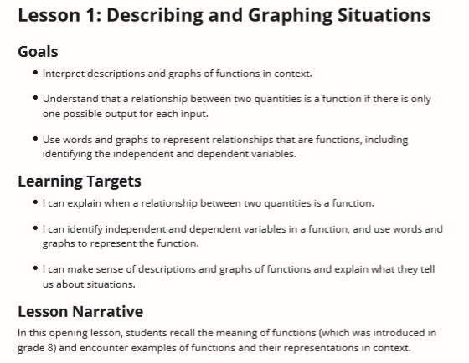
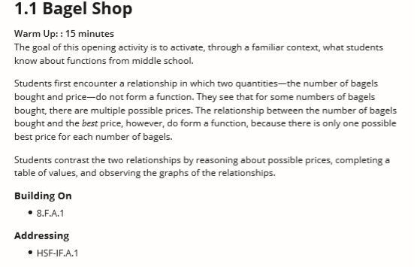
9th Grade Unit Example: Illustrative Math

Slide 41
Continuum of Experience
Low to no student participation
Limited student participation
Variable participation
Regular and ongoing communication between teacher and student
Majority of student likely have not engaged with on grade level material since school closures began
Intermittent and/or only initial student participation.
Some students regular participated and other did not
Near full coverage/learning of prerequisite standards and beyond

Slide 42
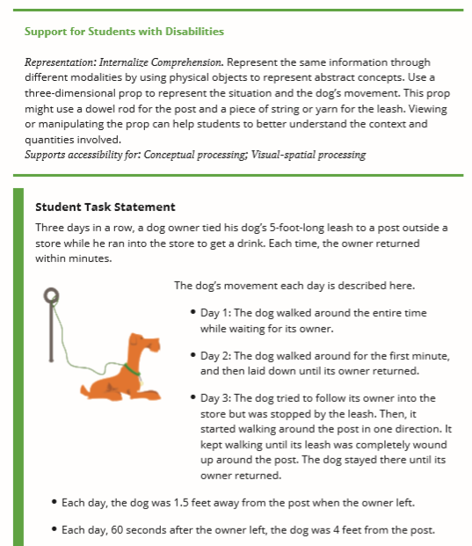
9th Grade Unit Example: Illustrative Math
Low to no student participation
Regular and ongoing communication between teacher and student
Majority of student likely have not engaged with on grade level material since school closures began
Near full coverage/learning of prerequisite standards and beyond

Slide 43
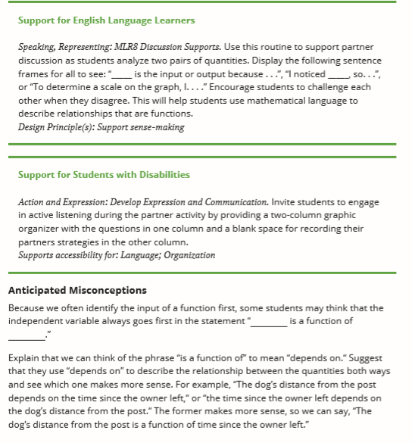
9th Grade Unit Example: Illustrative Math

Slide 44

The Standards Navigator
Standards based supports
  Terms
  Resources
  MCAS info
Visualize the trajectory of concepts and standards

Slide 45
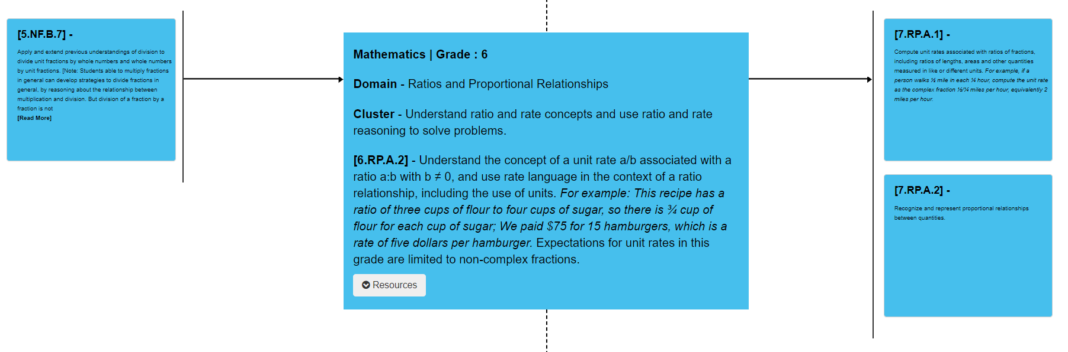
6th Grade: Ratios and Proportional Relationships

Slide 46
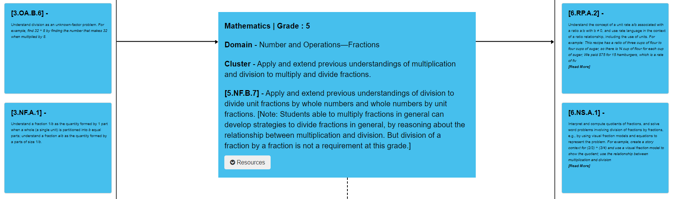
6th Grade: Ratios and Proportional Relationships

Slide 47
Resources
General Curriculum Planning
DESE- Standards Navigator
Rennie Center - Back-to-School Blueprint: Accessing Grade-Level Content
TNTP- COVID-19 SCHOOL RESPONSE TOOLKIT, and Opportunity Myth
Math Resources:
Great Minds (Eureka/EngageNY) - Updates
Illustrative Math (KendallHunt, McGraw-Hill, LearnZillion) -
Unfinished Learning Resources
Carnegie Math - At Home Resources
Ready Math - Updates
Open-up (6-8, Math Vision Project) - Updates
Zearn - Updates

Slide 48
Q & A

Slide 49


Submit Your STEM Highlights to the Newsletter!
Inviting educators and leaders to submit photos highlighting the wonderful STEM remote learning experiences your students are engaged in.
Students must have a signed photo release form on file with your district.
Email STEM Remote Learning Highlight to Alicia Wedderburn at alicia.wedderburn@mass.gov.
To subscribe to the STEM newsletter, visit:
www.doe.mass.edu/resources/newsletter-signup.aspx
Email: Alicia.Wedderburn@mass.gov

Slide 50
Exit Ticket
Please take a moment to answer this very brief anonymous survey.
This will help us provide useful information and support.

Slide 51



Thank you
THANK YOU
Ian Stith: Mathematics Content Support Lead, DESE
Ian.T.Stith@mass.gov
413-237-8537
http://www.doe.mass.edu/stem/
75 Pleasant Street, Malden, MA 02148

