Slide 1
May 12, 2020
Supporting Remote Learning in Elementary Science & Technology/Engineering (STE)

Slide 2
Introductions
Nicole Scola: Science Content Support Lead, DESE
(nicole.scola@mass.gov)
Alicia Wedderburn: Science Content Support Specialist, DESE
(alicia.wedderburn@mass.gov)
Hillary Paul Metcalf: Science Content Support Specialist, DESE
(hillary.paulmetcalf@mass.gov)

Slide 3
Thank You!
Remote learning is placing new strains and challenges on everyone, especially educators.
We are in a state of crisis management, and as such educators are working harder than ever before.
We appreciate all that you do and will continue to do for students.
We are here to support you.

Slide 4
Webinar Goals
Review key recommendations for remote learning
Discuss approaches to remote learning focused on the elementary science and technology/engineering standards
Ask and answer questions and offer support

Slide 5
Agenda
1
Introductions and Welcome (5 mins)
2
Remote Learning Recommendations (15 mins)
3
Remote Learning in Science (15 mins)
Agenda
4
Q+A (15 mins)
Please type questions into the Chat at any time.

Slide 6
Remote Learning Recommendations
Remote Learning Recommendations

Slide 7
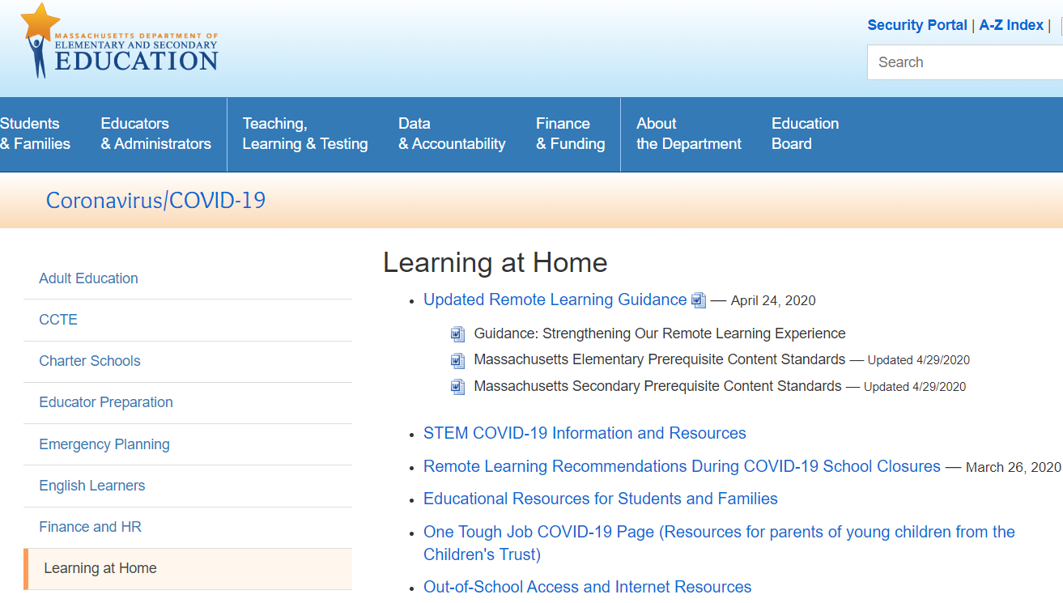
Remote Learning Recommendations
http://www.doe.mass.edu/covid19/learn-at-home.html

Slide 8
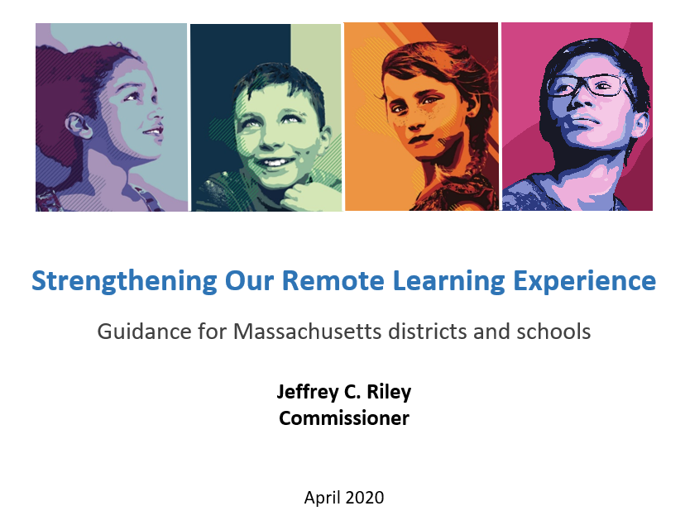
Guiding Principles For Our Work
The safety and well-being of students, families, and staff must be our top priority.
This crisis disproportionately affects our most vulnerable students in terms of their physical and mental health and also academically. Equity needs to be a top consideration.
Maintaining connections between school staff, students, and families is paramount.
Notes:
The picture snip there shows you what the current remote learning guidance document looks like. It is called “Strengthening our Remote Learning Experience.”
These guiding principles, from the document, have led DESE’s thinking about remote learning.

Slide 9
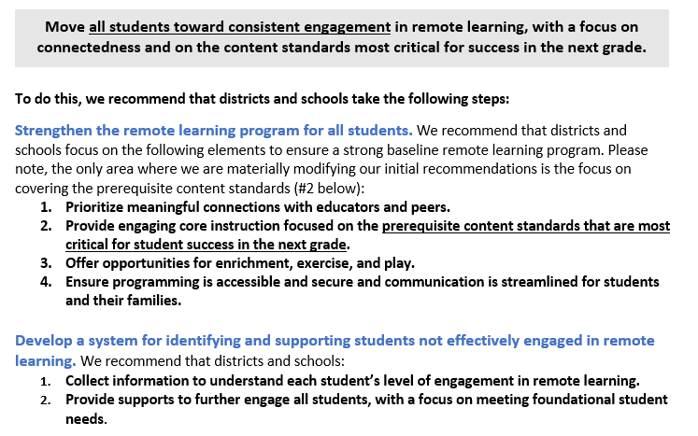
“Strengthening our Remote Learning Experience”
Notes:
The “Strengthening our Remote Learning Experience” document lays out a number of recommendations. They are summarized here.

Slide 10
Prerequisite Standards
We recommended that during remote learning, educators “focus on those standards that are the most critical pre- requisites for success in the next grade.”
They are recommendations (but not requirements) to help you prioritize standards for the remainder of this school year.

Slide 11
Using the Prerequisite Standards
Use your scope and sequence to identify the standards already taught and compare them with the prerequisite standards. If you are using high-quality instructional materials you will have likely already covered many of the prerequisite standards.
Make a plan for the remainder of the school year
Use remote learning resources posted by your publisher if possible
Cover any prerequisite standards not already taught. This may mean simply following you scope and sequence
Remediate prerequisite standards as needed

Slide 12
Prerequisite Standards: How were they selected?
In Science and Technology/Engineering, we focused on content standards that we think are important for students to know in order for them to be successful when they move to future grades
Note: The prequiste standards should not be used in connection with MCAS expectations or referenced in preparing students for the MCAS for any grade level. .

Slide 13
Prerequisite Standards: FAQ
Are these the standards that we should always be focused on beyond the 19-20 school year?
No. The Department does not typically promote “power standards.” We believe that every standard in each Curriculum Framework is important for college and career readiness. Every Framework was designed by experts in the field, including teachers. The prerequisite standards are ONLY applicable for use this year, during the pandemic, when teaching the entire curriculum is not possible.
Will these standards play a role in future years?
At this time, no. We do not expect to use these lists to inform curriculum, assessment, or other policy in the future. These are “pandemic-only” tools.
MCAS
MCAS is cancelled for this year.
Competency determination for students on track to graduate this year (or summer 2020) is district certification of earned credits and demonstrated competency with a tested Framework (Biology, Chemistry, Physics, Tech/Eng)
As of today, there has been no plan to change MCAS for next year

Slide 14
Remote Learning in Elementary Science
Remote Learning in Elementary Science
“Leveraging the assets of home-based learning,
rather than trying to recreate school, can
provide meaningful science learning experiences
that connect to students’ home lives, interests, and identities”
- Council of State Science Supervisors, Supporting Students' Science Learning in the Era of COVID-19

Slide 15
Remote Learning: Top Tips
Align learning to MA Curriculum Framework standards.
Keep it simple. Prioritize learning experiences that are simple to explain and to organize, and that students can complete with less adult support.
Make it engaging. Prioritize topics and tasks that will interest students. Consider how to build upon students’ home languages, experiences, and identities, within learning experiences and over time.
Attend to access and equity. Provide all academic, language, and social-emotional supports that students normally need or receive to the extent possible. Provide multiple modes of access and response to academic work, including for students who lack access to technology.
Provide pacing and structure. Each week, provide students a structure for the week and a plan for how much time they should spend on various activities and tasks.

Slide 16
Planning for Remote Learning in Elementary Science
Start by adapting activities in your curricular materials for engaging remote learning. Students should engage in the science and engineering practices to make sense of grade-appropriate content.
Select thematic (e.g., seasons, weather, habitats, shadows, states of matter) multi-day lessons and learning opportunities that may connect to the context of students’ home lives (e.g., connecting science and engineering projects to activities like cooking, fixing things, gardening or other outside activities).
Consider possible integration with other content areas… are there ways students might engage around a science and technology/engineering topic, and support their time on writing, reading, and math?
Prepare scaffolds, accommodations, modifications, and/or language supports for students who typically need these supports in science and technology/engineering.
Use technology as a supportive tool not a replacement for learning

Slide 17
Recommendations for Remote Learning
Prioritize meaningful connections with students (with
Consider both asynchronous and synchronous learning
Whole group
virtual meetups (i.e. Zoom, Google hangouts, etc.) for discussions
Student led discussions on a science topic
mail/deliver/pick up work packets to students (e.g., at local sites, meal pickup locations)
One-on-one check-ins
virtual
phone call, email
postcard
Self-paced or project-based learning - student choose topic of interest
Real world applications -explorations in the backyard/around the home

Slide 18
Facilitating Remote Learning
Plan coherent multi-day learning experiences for a week at a time vs unconnected daily assignments.
Support opportunities for students to:
Explore science that matters to them
Work independently and with others
Reflect on their own learning
Document and share what they learn
Highlight students’ efforts and successes
Give opportunity to share challenges, problem solve or come up with solutions as a group
Provide specific and frequent feedback on student work
Ensure supports and scaffolds for students with disabilities and English learners

Slide 19
Engaging Students in Coherent Multi-Day Remote Learning
Instruct students to make observations (via videos, live web-cameras, photographs, outdoor experiences, live demo, etc.) of the selected science topic or engineering problem through drawing and writing, and to ask questions about those observations. Have students submit and share their initial observations (noticings) and questions (wonderings) with you and other students.
Have students create an initial drawing (or model) about what they think is happening of the selected topic and share with you and other students. If working on an engineering problem, have students suggest a possible solution through drawing or writing.

Slide 20
Example: Notice and Wonder Chart
What do you notice?
(Observations - “I see…”)
Sense-Making: What do you think about what you are seeing?
What do you wonder?
(Questions - “ I wonder..”)

Slide 21
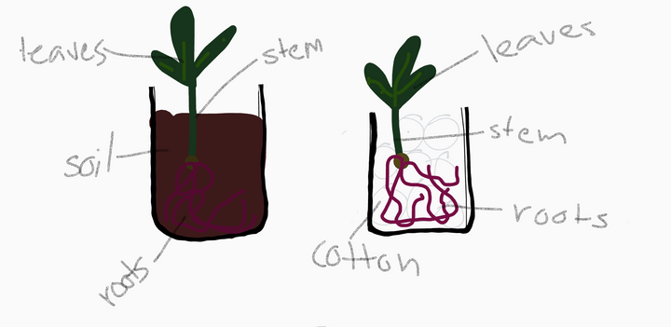
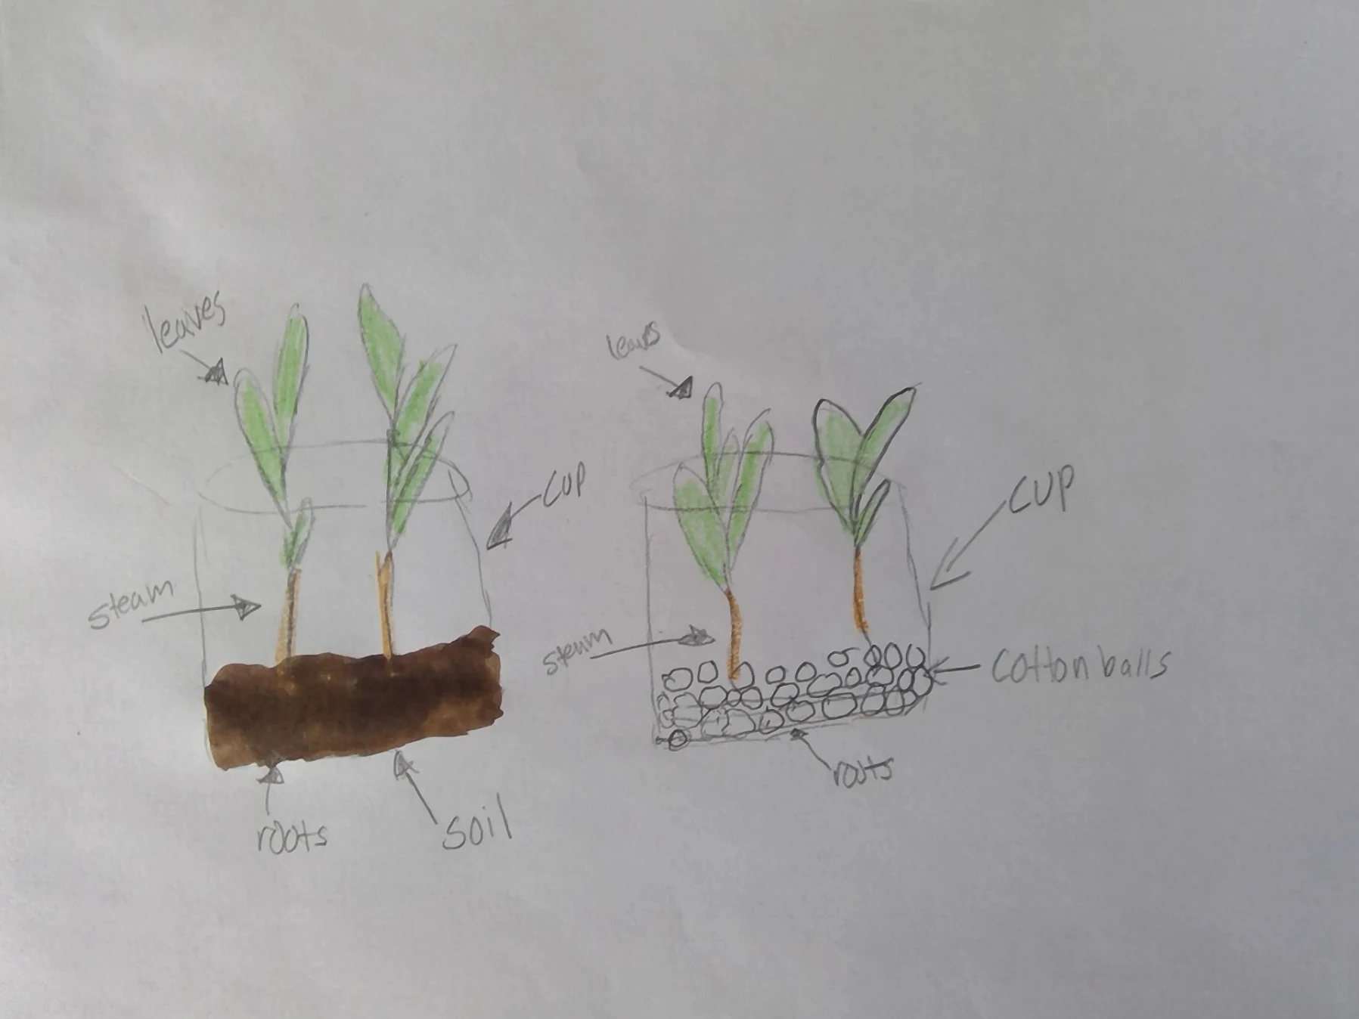
District Examples
Burlington Public Schools has developed K-5 wide "family oriented" investigations, For example,
How can we make a room as dark as possible?
How Do Nature’s Forces Affect Earth’s Surface Family Investigation
What do plants need to grow?
Reading Public Schools
5th graders made drawings (models) of corn plants growing in different substrates (soil or cotton balls). Their teacher grew the plants and showed them to students in various stages of growth.
Notes:
Link for Burlington: https://musselmanscience.wordpress.com/2020/05/08/designing-family-investigations-for-remote-science-learning/

Slide 22
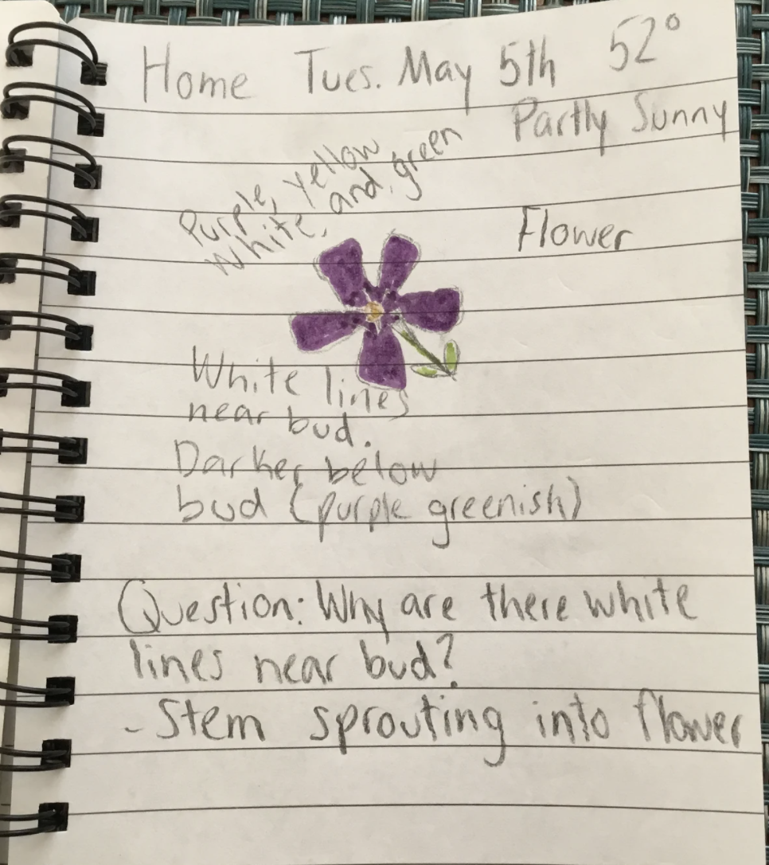
District Example - low tech
Winchester Public Schools elementary students exploring their backyards and “tiny” environments.
Notice & Wonder Walk- to get students exploring in and around their home (safely)

Slide 23
Facilitating Coherent Multi-Day Remote Learning Plan
Next Steps for engaging students:
Based on students’ questions and ideas, and existing curricular resources, support students to do further investigation to learn more about the topic or improve their design.
Have students communicate the new information they learned about the topic to you and the class. Engage students in a discussion (in synchronous or asynchronous ways) of how that additional information changes their initial models or initial designs.
Have students revise their drawings/models or engineering designs and communicate to you (orally or in writing) the science or engineering concepts they learned.

Slide 24
Resources for Thinking about Remote Learning
The following tools are helpful resources for ideas to transition your teaching to a remote setting
Resource | Description
National Science Teaching Association | NSTA/NGSS Classroom Resources can be sorted by standard. Each day, they share a sensemaking task, NSTA Daily Do , teachers and families can use to engage students in authentic, relevant science learning. and
Next Generation Science | Collection of open-source NGSS-aligned units reviewed by Achieve.
Concord Consortium | A library of simulations, models, and lessons. Educators can create a class and assign resources to students.
Council for State Science Supervisors and STEM Teaching Tools | Suite of resources, tools and ideas for teaching remotely.
Massachusetts STEM@Home List of Resources | This spreadsheet includes linked resources are intended for use by families, educators, and/or students to support enrichment and continuity of learning during the COVID-19 crisis. These resources are free and open to the public, and may or may not be aligned to a student's specific coursework. The State and the Department do not endorse any of the following curricula or resources.

Slide 25
Q and A
Q & A
Please see the Questions and Answers & Notes from Chat Document for questions and answers asked during webinar.

Slide 26
Submit Your STEM Highlights to the Newsletter!
Inviting educators and leaders to submit photos highlighting the wonderful STEM remote learning experiences your students are engaged in.
Students must have a signed photo release form on file with your district.
Email STEM Remote Learning Highlight to Alicia Wedderburn at alicia.wedderburn@mass.gov.
To subscribe to the STEM newsletter, visit:
www.doe.mass.edu/resources/newsletter-signup.aspx
Email: Alicia.Wedderburn@mass.gov

Slide 27
Thank you
THANK YOU
The Science & Technology/Engineering Team
Nicole, Hillary, Alicia
Nicole Scola, Science Content Support Lead, DESE, nicole.scola@mass.gov
Alicia Wedderburn, Science Content Support Specialist, DESE, alicia.wedderburn@mass.gov
Hillary Paul Metcalf, Science Content Support Specialist, DESE, hillary.paulmetcalf@mass.gov
http://www.doe.mass.edu/stem/

