Slide 1
Ian Stith, Mathematics Content Support Lead
Supporting Remote Learning in Secondary Math
DATE 5/13/2020 and 5/18/2020
Notes:
Thank you for joining
This meeting will be recorded and posted on our website for those who were not able to join, along with a link to the slides. We will begin recording NOW
The first PD will focus on the remote learning recommendations issued by the state on 4.24.20. However I want to emphasize (and I will be doing so throughout the course of this session) that these are recommendations and not state mandates. As you are aware districts have local control and autonomy to decide their own policy that works best for their districts.

Slide 2
Introductions
Ian Stith: Mathematics Content Support Lead, DESE (Ian.T.Stith@mass.gov)
Stephen Garschina-Bobrow: Mathematics Content Support Specialist, DESE (Stephen.Garschina-Bobrow@mass.gov)
Meto Raha: STEM EL Specialist, DESE
(Meto.Raha@mass.gov)

Slide 3
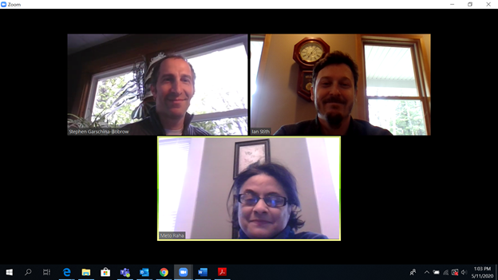
Math Team
? Question ?
To ask a question, click on the chat button and type into the chat box.

Slide 4
Thank You!
Remote learning is placing new strains and challenges on everyone, especially educators.
We are in a state of crisis management, and as such educators are working harder than ever before.
We appreciate all that you do and will continue to do for students.
We are here to support you and welcome your ideas and feedback.

Slide 5
Webinar Goals
Review key recommendations for remote learning
Discuss approaches to remote learning focused on the secondary math prerequisite standards
Ask and answer questions and offer support

Slide 6
agenda
1
Introductions and Welcome (5 mins)
2
Remote Learning Recommendations (15 mins)
3
Remote Learning in Secondary Math (15 mins)
Agenda
4
Q+A (15 mins)
Please type questions into the Chat at any time.

Slide 7
Remote Learning Recommendations

Slide 8
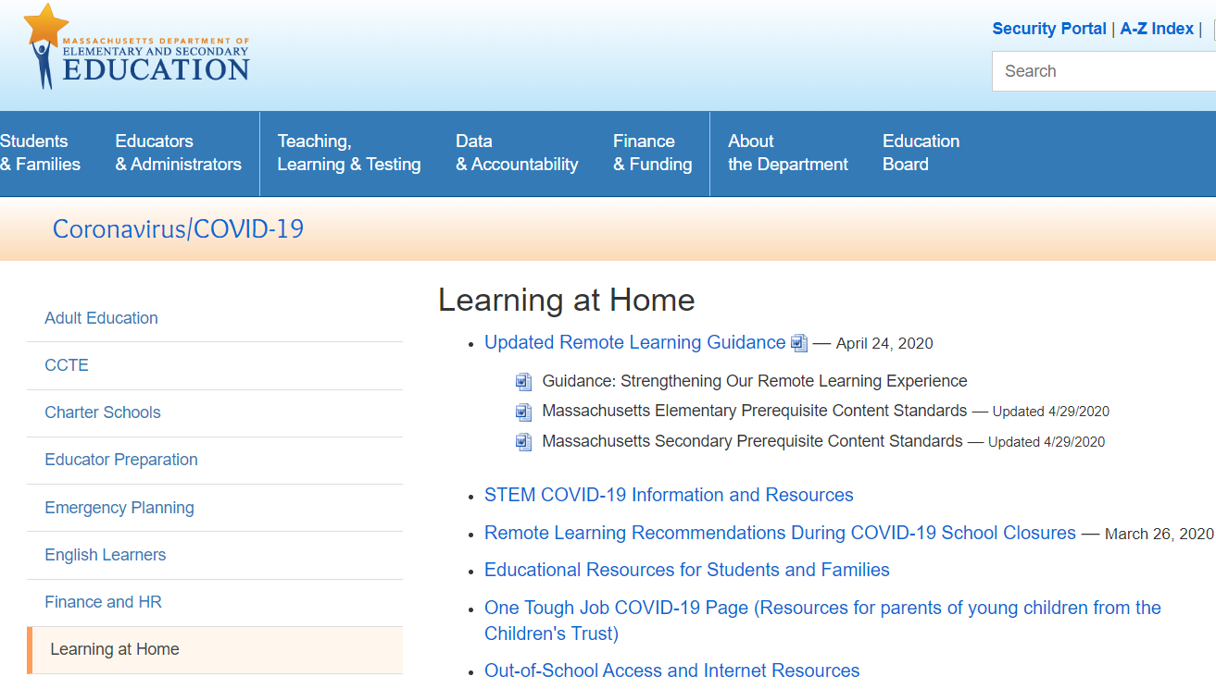
Remote Learning Recommendations
http://www.doe.mass.edu/covid19/learn-at-home.html
Notes:
When we talk about DESE’s remote learning recommendations today, we are referring to resources the Department issued over the last several weeks since school closures. Everything is available on this website which is linked at the top of this slide. This is a good page to visit and bookmark,
The image you see here is a snippet from DESE’s Learning at Home Page.
As you can see, the most recent remote learning guidance was issued on April 24. On that date, DESE provided a guidance document called Strengthening our Remote Learning Experience, as well as lists of prerequisite standards by grade and content area.
This webinar is focused on supporting remote learning for secondary math, but be aware that DESE has provided resources in other content areas, as well as guidance and resources for special populations including students with disabilities and English learners. Everything is on the DESE website.

Slide 9
Guiding Principles For Our Work
The safety and well-being of students, families, and staff must be our top priority.
This crisis disproportionately affects our most vulnerable students in terms of their physical and mental health and also academically. Equity needs to be a top consideration.
Maintaining connections between school staff, students, and families is paramount.
Notes:
The picture snip there shows you what the current remote learning guidance document looks like. It is called “Strengthening our Remote Learning Experience.”
These guiding principles, from the document, have led DESE’s thinking about remote learning.

Slide 10
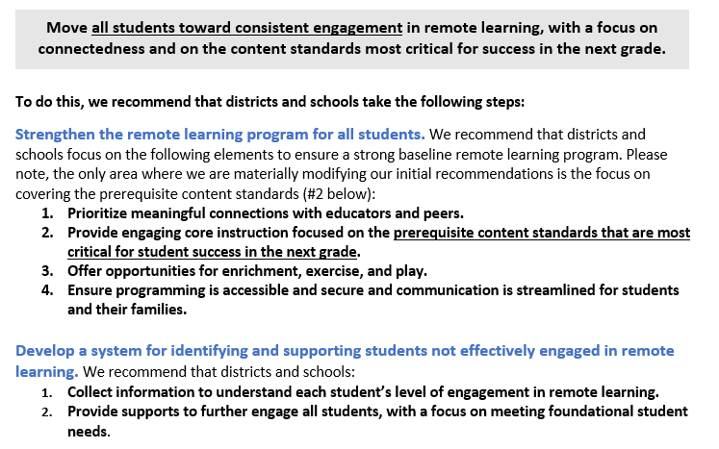
“Strengthening our Remote Learning Experience”
Notes:
The “Strengthening our Remote Learning Experience” document lays out a number of recommendations. They are summarized here, and you can read each one in detail in the document.
In that guidance, DESE recommends that districts and schools focus on the following goal through the end of the school year: (the gray box)
To do this, two sets of steps are recommended. This is in blue.
Strengthen the remote learning program for all students
Develop a system for identifying and supporting students not engaged in remote learning.
Today we are really focused on part 1, the content-specific remote learning, but if you have questions or would like support in the other areas, don’t hesitate to reach out and we will help however we can.

Slide 11
Prerequisite Standards
We recommended that during remote learning, educators “focus on those standards that are the most critical pre- requisites for success in the next grade.”
They are recommendations (but not requirements) to help you prioritize standards for the remainder of this school year.
Notes:
As part of the guidance, we recommended that during the pandemic, educators focus their limited teaching time on those standards that are the most critical prerequisites for success in the next grade.

Slide 12
Using the Prerequisite Standards
Use your scope and sequence to identify the standards already taught and compare them with the prerequisite standards. If you are using high-quality instructional materials you will have likely already covered many of the prerequisite standards.
Make a plan for the remainder of the school year
Use remote learning resources posted by your publisher if possible. For example: Carnegie Learning, Eureka Math
Cover any prerequisite standards not already taught. This may mean simply following you scope and sequence
Remediate prerequisite standards as needed

Slide 13
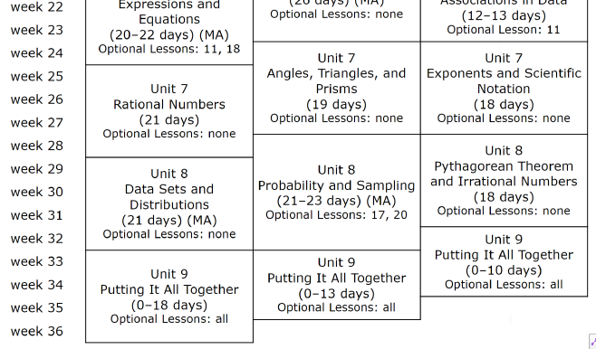
Using the Prerequisite Standards - Illustrative Math Example
Grade 8
Already covered
Proportions
Linear relationships and systems
Functions
SImilarity
Patterns in data
Planning for the remainder of the year
Scheduled to be covered
Exponents
Pythagorean theorem
Notes:
This is an examples based on one open source product

Slide 14
8th Grade Illustrative Math
Already Covered
Prerequisite Standard | IM Unit
8.G.A.2 8.G.A.4 | Unit 2
8.EE.B.5 | Unit 3
8.EE.C.7,8 | Unit 4
8.F.A.1, 2, 3 8.F.B.4, 5 | Unit 5
8.SP.A.3 | Unit 6
Remaining Units
Prerequisite Standard | IM Unit
8.EE.A.1 | Unit 7
8.EE.A.2 8.G.B.7 | Unit 8
Additional planning
Investigate and adapt Unit 9
Remediate prereq standards as needed
Remaining Prerequisite Standards
NA

Slide 15
Prerequisite Standards: How were they selected?
In Secondary Math, we identified content standards that we think are vital for students to know in order for them to be successful when they move to the next grade and beyond.
Focus on foundational conceptual understanding and modeling at the high school level.
Included a standard for each domain

Slide 16
Prerequisite Standards: FAQ
Are we required to teach these standards?
When planning future remote learning lessons, we recommend districts and schools focus on those standards that are the most critical prerequisites for student success in the next grade. These are recommendations, not requirements. Educators know their students and local context best and educators determine what and how to teach.
Are these the standards that we should focus on beyond the 19-20 school year?
No. The Department does not typically promote “power standards.” We believe that every standard in each Curriculum Framework is important for college and career readiness. Every Framework was designed by experts in the field, including teachers. The prerequisite standards are ONLY applicable for use this year, during the pandemic, when teaching the entire curriculum is not possible.
Will these standards play a role in future years?
At this time, no. We do not expect to use these lists to inform curriculum, assessment, or other policy in the future. These are “pandemic-only” tools. As of today, there has been no plan to change MCAS for next year
Notes:
If you have questions about next year’s MCAS, here is what we know.
MCAS is cancelled for this year
Competency determination for this year will be based on having passed a current course
As yet there has been no plan to change MCAS for next year, so at this time MCAS will be a typical MCAS next year.
If you have additional questions that we may be able to answer, please add them into the chat.

Slide 17
Remote Learning in Secondary Math
“Leveraging the assets of home-based learning, rather than trying to recreate school, can provide meaningful learning experiences that connect to students’ home lives, interests, and identities”

Slide 18
Remote Learning: Top Tips
Align learning to MA Curriculum Framework standards. Incorporate the Standards for Mathematical Practice
Keep it simple. Prioritize learning experiences that are simple to explain and to organize, and that students can complete with less adult support.
Make it engaging. Prioritize topics and tasks that will interest students. Consider how to build upon students’ home languages, experiences, and identities, within learning experiences and over time.
Attend to access and equity. Provide all academic, language, and social-emotional supports that students normally need or receive to the extent possible. Provide multiple modes of access and response to academic work, including for students who lack access to technology.
Provide pacing and structure. Each week, provide students a structure for the week and a plan for how much time they should spend on various activities and tasks.

Slide 19
Planning for Remote Learning in Secondary Math
Maintain the basics of standards-aligned math learning when moving to remote instruction.
Plan learning opportunities that connect to standards-aligned content and apply the Standards for Mathematical Practice (SMPs).
Include a diversity of contexts and situations, utilize home languages, student experiences, and identities, within learning experiences and over time
Inclusively support students on IEPs, multilingual learners, challenging home situations, and vulnerable populations.
Use technology as a supportive tool not a replacement for learning

Slide 20
Planning for Remote Learning in Secondary Math
Start by adapting activities in your curricular materials for engaging remote learning. Plan ways for students to apply the Standards for Mathematical Practice (SMPs).
Consider supplementing with a variety of types of tasks, including critical analysis (such as Which one doesn’t belong), inquiry based activities (such as 3-Act Math Task), or interactive technology (such as Desmos activities). For example: cooking → proportional reasoning; home improvement → measurement; exercise → data collection/analysis; making a math-based argument/recommendation (e.g. defend a recommendation to increase bus routes, longer hours at the library, or adding solar panels to the school).
Prepare scaffolds, accommodations, modifications, and/or language supports for students who typically need these supports in mathematics.
Students should have the opportunity to both turn in their work, receive feedback, and debate their thinking with other students. Plan for communication during and after student work.

Slide 21
Features of Remote Learning
Prioritize meaningful connections with students (with or w/o tech)
Use of remote learning tools and instructional materials to develop and provide students with appropriately structured and supported ways to keep learning while at home. It can be:
Synchronous - educators and learners, aided by technology, see, talk and learn together as a group
Virtual meetups (i.e. Zoom, Google hangouts, etc.) for discussions
One-on-one check-ins
Asynchronous -communications may not be delivered as a group or be aided by technology
Remote learning is NOT a replication of learning during the traditional school day
Engage students in meaningful productive learning for half the length of a regular school day, through a combination of educator-directed and student self-directed learning.
Structures of lessons need to reflect the features of remote learning
Notes:
On the Desktop, March 30

Slide 22
Recommendations for Remote Learning
Feedback and debriefing the learning
Online approaches
Host a real-time video chat
Provide feedback on shared online documents
Send follow-up questions/prompts to push student thinking and ask students to respond on a shared doc or in online chat features.
Offline approaches
Students record in journal/notebook.
Provide a call-in number for students to leave voice messages, questions, or feedback.

Slide 23
Google Quiz Example
Google Quizzes can be used for a number of asynchronous activities. Teachers can:
Include any picture, video, or task
Provide immediate feedback to students
Embed links and videos in your feedback
Try this example: bit.ly/6SPB5

Slide 24
Feedback Loop Example
When students send in evidence of work (through pictures or Google doc), use comments to give feedback to their work.
Comments can be given on almost any photo type, pdf, and google suite file.
Students can see and make comments back, revisions, or follow whatever directions to improve learning and grade.
Example 1: Teacher feedback on a picture of work
Example 2: Students give feedback to each other (ex used before live meet)
(created by Ramona Teodorescu)

Slide 25
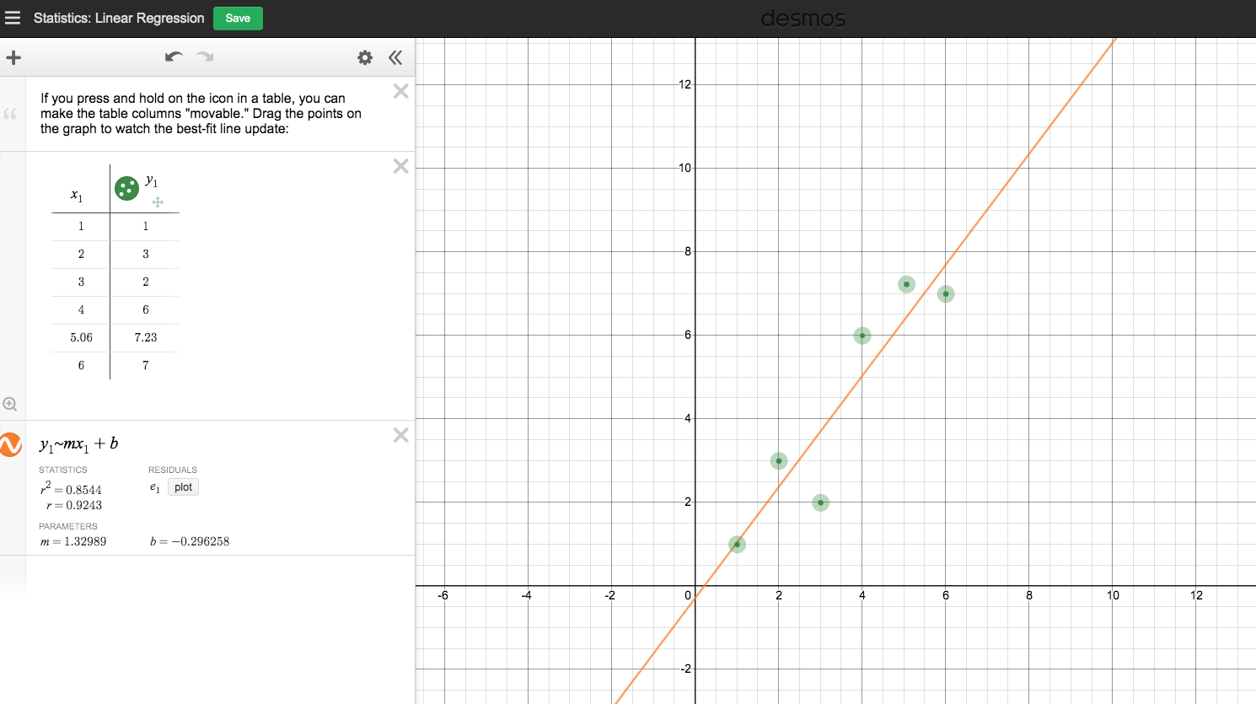
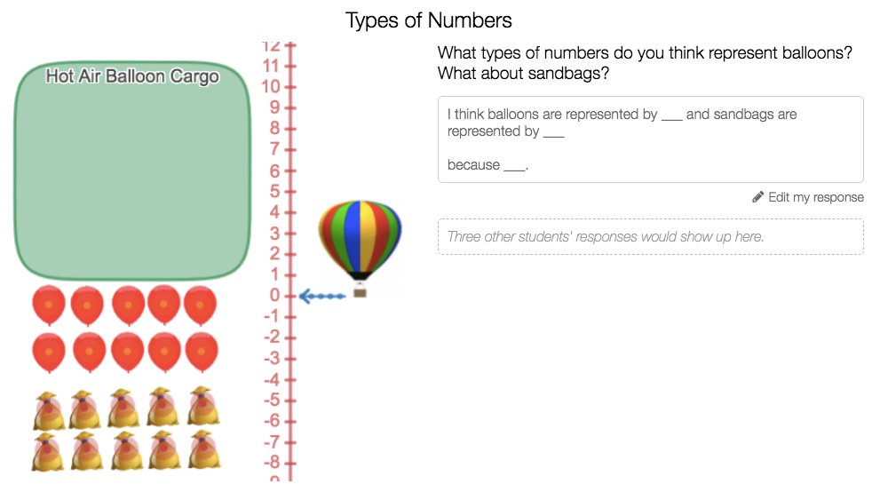
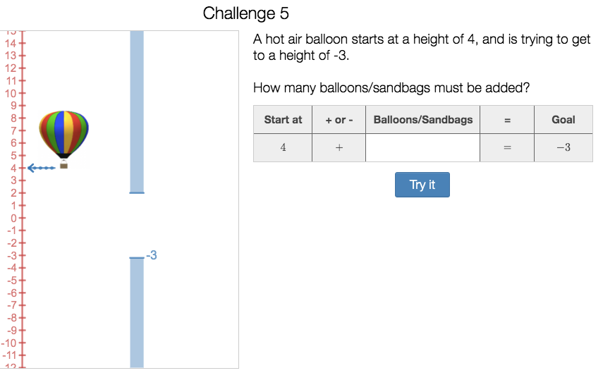
Desmos Activities
Desmos is a user-friendly, graphing calculator and host to hundreds of curated and teacher-developed activities.
Standards-aligned, interactive tasks
Teacher dashboard records all student progress
Builds conceptual understanding
Hot Air Balloon Model for Integer Operations Standard 6.NS.C.5
Notes:
Desmos does require some time to learn how to use the tools. The website provides tutorials and beginner activities, however we recommend these for classes where students are already familiar with it.
The Desmos graphing calculator is one of two tools that are embedded in the grade 8 and 10 MCAS.

Slide 26
Facilitating Remote Learning
Plan coherent multi-day learning experiences for a week at a time vs unconnected daily assignments.
Support opportunities for students to:
Explore math that matters to them
Work independently and with others
Reflect on their own learning
Document and share what they learn
Highlight students’ efforts and successes
Give opportunity to share challenges, problem solve or come up with solutions as a group
Provide specific and frequent feedback on student work
Ensure supports and scaffolds for students with disabilities and English learners

Slide 27
Great Resources for Thinking about Remote Learning
K-12 | Khan Academy | Free diagnostic tools, video tutorials, practice problems, and teacher monitoring dashboard facilitated through gamified platforms. Content is organized by grade level, course title, or specific curriculum programs: Eureka (grades 3-8), Illustrative Mathematics (grades 6-8), AP courses, and SAT prep. | Khan Academy
K-12 | Eureka Math (EngageNY) - Great Minds | Free access to the Eureka Math (EngageNY) curricular materials and daily video lessons delivered by Great Minds teachers. | Great Minds
K-8 | ST Math | Free access to ST Math, a visual instructional program that teaches concepts visually as students solve mathematical problems. Without language barriers, the problem is accessible to all students, regardless of skill level or language background. | ST Math
6-12 | Illustrative Math | Free access to Illustrative Math (IM) 6-8 and 9-12, including student and teacher materials (available with free registration). The materials can also be accessed through three IM certified partners LearnZillion (instructional videos), Kendall Hunt (Google Classroom interface; Spanish-language materials), and McGraw-Hill. | Kendall Hunt LearnZillion McGraw-Hill
6-12 | Carnegie Learning | Carnegie Learning provides free access to lesson videos, student practice, and MATHia software for adaptive, student-centered learning. | Carnegie Learning

Slide 28
COVID-19 Specific Resources
DESE COVID-19 Learning at Home
STEM Resources
CSSS Teaching at Home Teacher Guides
STEM teaching tools
Explorations- Outdoor Learning Walks and Notice & Wonder Walk

Slide 29
Exit Ticket
Please take a moment to answer this very brief anonymous survey.
This will help us provide useful information and support.
bit.ly/MAremote

Slide 30
Submit Your STEM Highlights to the Newsletter!
Inviting educators and leaders to submit photos highlighting the wonderful STEM remote learning experiences your students are engaged in.
Students must have a signed photo release form on file with your district. [DESE’s photograph release form]
Email STEM Remote Learning Highlight to Alicia Wedderburn at alicia.wedderburn@mass.gov.
To subscribe to the STEM newsletter, visit:
www.doe.mass.edu/resources/newsletter-signup.aspx
Email: Alicia.Wedderburn@mass.gov

Slide 31
Ian.T.Stith@mass.gov
THANK YOU
Ian Stith: Mathematics Content Support Lead, DESE
413-237-8537
http://www.doe.mass.edu/stem/
75 Pleasant Street, Malden, MA 02148

