Slide 1
Special Education Leaders' Meeting
June 11, 2021

Slide 2
CONTENTS
01
Welcome and Ignite
02
Recall
03
Chunk and Chew – New Information
04
04
Q&A

Slide 3
Welcome and Ignite
01

Slide 4
Operate from confidence, not from fear​
​
We're better together

Slide 5
Recall
02

Slide 6
IDEA Equitable Services Reminder Remember - June 15, 2021
Initial consultation for the expenditure of the resolution funds must be conducted by June 15, 2021.
Written affirmations for consultation on the resolution funds must be signed and submitted to the Department by June 15, 2021. Email: ideaequitableservices@mass.gov
In the case of districts with five or fewer eligible students, the initial consultation must discuss whether to receive the entire allocation in year one or spread it out over two or three years. This must be done by June 15, 2021.
Districts must notify the Department via email at ideaequitableservices@mass.gov if you are electing to have funds disbursed in their entirety in year one.
If the Department does not receive notification by June 15, 2021, the allocation will automatically default to two years for the 262 grant and three years for the 240 grant.

Slide 7
Use of Restraint Prevention RLO for staff trainings
Updated with a focus on
de-escalation

Slide 8
COVID-19 Protocols for Summer 2021
DESE will not issue separate guidance for summer school programs
For summer programs, districts and schools are encouraged to follow the health and safety guidance from DESE currently in place for in-person learning this spring

Slide 9
COVID-19 Protocols for School Year 2021-22
For the fall, all districts and schools will be required to be in-person, full-time, five days a week, and all DESE health and safety requirements will be lifted
This includes all physical distancing requirements
We will collaborate with the Department of Public Health (DPH) to issue any additional health and safety recommendations over the summer (e.g., masks for elementary school students)
We will provide any updates to districts and schools as we receive them
See Updates to DESE COVID-19 Guidance (5/27) for more information

Slide 10
SY22 Planning for Students with Unique Needs

Slide 11
Individual Student Accommodations 603 CMR 28.03 (3)(c) and 28.04 (4)
Individual Student Medical Requirement Home or Hospital Services 603 CMR 28.03(3)(c)
Students unable to attend school in person for a minimum of 14 days. More information about this regulation may be found in the Q&A guide.
Individual Student IEP Contingency (Unscheduled evaluations for medical reasons) 603 CMR 28.04(4)
Students with an IEP who are likely unable to attend school in person for more than sixty (60) school days in any school year, as documented by a physician. More information may be found in the Q&A guide.
Under these circumstances, districts may need to provide services, which may include live streaming and/or remote learning. These accommodations apply only to individual students with documented medical needs. School districts should work with families individually to accommodate the rare cases in which a sibling or family member is immunocompromised and additional precautions are required from the whole family. Remote or virtual learning may be an option for students in these families at a district’s discretion.

Slide 12
Implementing Education in Home or Hospital Settings 608 CMR 28.04(4) – New Form and Guidance
Updated information related to the implementation of educational services in the home or hospital settings
Question and Answer Guide on the Implementation of Educational Services in the Home or Hospital
Updated Question 4 to include “livestreaming and/or remote instruction”
Physician's Affirmation of Need for Temporary Home or Hospital Education for Medically Necessary Reasons (28.03(3)(c))
This form is unchanged
Physician's Affirmation of Medical Reasons That Student is Likely to Remain at Home, in a Hospital, or in a Pediatric Nursing Home for More than 60 School Days (28.04(4))
New form that can be used
All these materials have also been posted here: https://www.doe.mass.edu/news/news.aspx?id=26474
Translations are forthcoming!

Slide 13
Chunk and Chew
03

Slide 14
Acceleration Roadmap

Slide 15
Acceleration Roadmap Overview
Classroom Educator Roadmap
School Leader Roadmap

Slide 16
Overview of the Leader Edition of the Academic Excellence Roadmap
The Roadmap is organized around three overarching priorities that will guide your approach to acceleration and equity over the next several years:
Foster a sense of belonging and
partnership among students and families
Continuously monitor students’ understanding
Ensure strong grade-appropriate instruction with just-in-time scaffolds when they are needed
Page 6 of Leader Edition

Slide 17
Throughout the Roadmap, resources and tools are organized by priority and phase of the year.
Phase 1: Diagnostic and Planning | Phase 2: Launch | Phase 3: Progress Monitoring | Phase 4: Reflection and Planning
Before the 1st day of school 2021 | September- October 2021 | November 2021- April 2022 | May- June 2022
The priority-level guidance includes key guiding questions, suggested steps for success, and aligned resources.
Page 7 Leader Roadmap

Slide 18
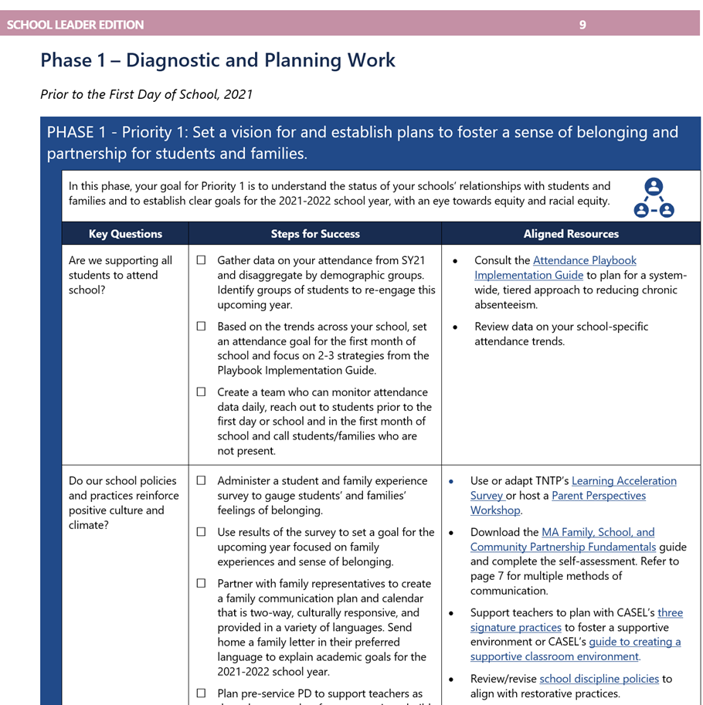
Components to look out for as you navigate the Roadmap
Components 1 and 2…
identifies the overarching action step of this phase/priority.
describes the overall aim and purpose of this phase/priority.
Components 3, 4, and 5…
Questions, steps, and resources tailored to support you with effectively executing on this phase with a lens on equity and meaningful inclusion.
1
2
3
4
5
Page 8 of the Leader Roadmap
6
7
8
9

Slide 19
Why are we accelerating rather than remediating student learning?

Slide 20
Accelerated Learning versus Remediation
Remediation often focuses on drilling students on isolated skills that bear little resemblance to current curriculum.
Activities connect to standards from years ago and aim to have students master content from years past.
Accelerated Learning strategically prepares students for success in current grade-level content.
Acceleration readies students for new learning. Past concepts and skills are addressed, but always in the purposeful context of current learning.
Rollins, Suzy Pepper. Learning in the Fast Lane: 8 Ways to Put All Students on the Road to Academic Success. ASCD Member Book. 2014.

Slide 21
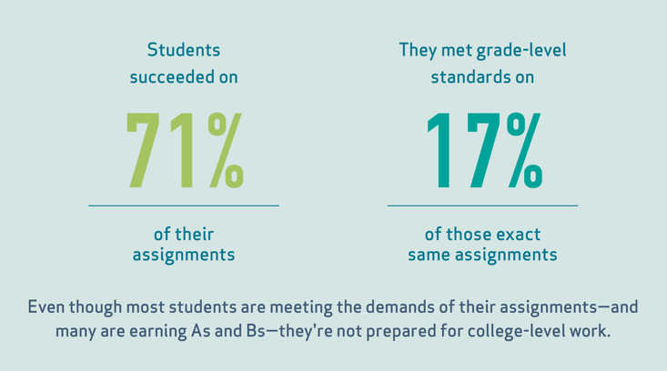
As a result, students were largely succeeding on their assignments but rarely able to meet state grade-level standards.

Slide 22
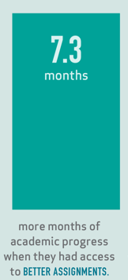
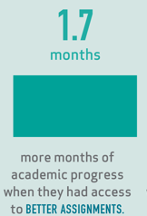
But students who received more frequent access to grade-level content made significantly larger gains than their peers who did not.
In The Opportunity Myth sample, all students made
But students who were furthest behind made
This tells us that we must accelerate—not remediate—student learning.

Slide 23
Why we are accelerating rather than remediating student learning:
 | ACCELERATION | REMEDIATION
Self-efficacy | Self-confidence and engagement increase. Academic progress is evident. | Students perceive they're in the "slow class," and self-confidence and engagement decrease. Backward movement leads to a sense of futility and lack of progress.
Basic skills | Skills are hand-picked just in time for new concepts. Students apply skills immediately. | Instruction attempts to reteach every missing skill. Skills are taught in isolation and not applied to current learning.
Connection to core class | Instruction is connected to core class; ongoing collaboration is emphasized. | Instruction is typically isolated from core class.
Pacing and direction | Active, fast-paced, hands-on. Forward movement; goal is for students to learn on time with peers. | Passive, with focus on worksheets or basic software programs. Backward movement; goal is for students to "catch up" to peers.
Page 28 Leader Roadmap
Why are we accelerating rather than remediating student learning?
Excerpt from Learning in the Fast Lane by Suzy Pepper Rollins4FRetrieved 3 June 2020 from: http://www.ascd.org/publications/books/114026/chapters/Acceleration@_Jump-Starting_Students_Who_Are_Behind.aspx

Slide 24
High Leverage Practices for Students with Disabilities
https://highleveragepractices.org/

Slide 25
Implementation Support
Upcoming Professional Learning Sessions
Educators:
Diagnosing and planning for unfinished learning
Supporting students with diverse learning needs
Leaders:
Change management
Building a sense of belonging for students and families

Slide 26
School Year 2021-2022 FAQ

Slide 27
New FAQ for SY 2021-2022
Q: Will schools continue to use “COVID-19 Special Education Learning Plans” during school year 2021-2022?
No. Schools are expected to provide full-time, in-person learning for students for school year 2021-2022. IEP teams must document all services in IEPs.
Q: Can districts continue to hold virtual IEPs meetings?
Yes. As students return to full-time, in-person learning, it is more important than ever to build strong relationships with families and continue meaningful family engagement initiatives that may facilitate family participation.
The Individuals with Disabilities Education Act (IDEA) contemplates that IEP meetings may be held via telephone and/or video conference. Districts can continue to hold IEP Team meetings using these alternatives means of meeting participation if the parent or guardian agrees to participate using these alternative means. The school or district should contact the parent or guardian to ask if the parent or guardian agrees to participate in a Team meeting virtually or telephonically. If the parent agrees, the school or district should issue the Team Meeting Invitation (N3 ) and Attendance Sheet (N3A ) by mail, email, or other electronic means (i.e., the parent's preferred method of communication) with the telephone or virtual platform’s dial-in information and proceed to plan to conduct the annual review Team meeting remotely. The school or district must provide interpreters for limited English proficient parents or guardians for these IEP Team meetings and translate documents that will be discussed, as appropriate. Attendance that is conducted virtually should be documented as such on the attendance sheet.

Slide 28
New FAQ for SY 2021-2022
Q: What if one of the required IEP Team members is unable to attend the IEP Team meeting?
If required members of the IEP Team are unable to attend, IDEA regulations provide that Team members can be excused with agreement from the family, if:
The district and the family agree, in writing, that the attendance of the Team member is not necessary because the member’s area of the curriculum or related services is not being modified or discussed; or
The district and the family agree, in writing, to excuse a required Team member’s participation and the excused member provides written input into the development of the IEP to the family and the IEP Team prior to the meeting.

Slide 29
Compensatory Services FAQ
Q: What are the factors that might lead to consideration of compensatory services for students as a result of unforeseen circumstances or inability to fully implement an IEP during the 2020-21 school year?
USED and DESE have stated that all students were entitled to receive FAPE during the 2020-2021 school year regardless of the instructional model used (remote, hybrid, or modified in-person). DESE’s COVID-19 Compensatory Services Guidance was intended to address any disruption or delay in instruction or service delivery during the spring and summer of 2020. However, if a student’s IEP was not fully implemented or if other extenuating circumstances arose during the 2020-2021 school year that impacted the student’s ability to access FAPE, the Team should seek to address any need for compensatory services as necessary and appropriate. In particular, IEP Teams should discuss the individual need for compensatory services for the following groups of students who are potentially more likely to need those services:
Students with disabilities in districts that were fully remote for three or more months during the 2020-21 school year;
All students with disabilities who were chronically absent during the 2020-21 school year; and
All students with disabilities who had significant difficulty accessing remote learning offered by the school district due to the nature or severity of the child’s disability, technology barriers, language access barriers, or barriers resulting from the pandemic.
A discussion about compensatory services related to issues stemming from the 2020-2021 school year can occur during the annual Team meeting, during a meeting that has been scheduled to discuss COVID-19 Compensatory Services stemming from the 2019-2020 school year or during any other Team meeting. Parents and guardians also have the procedural rights to pursue a due process hearing at the Bureau of Special Education Appeals or file a complaint with the Department’s Problem Resolution System Office.

Slide 30
New FAQ for SY 2021-2022
Q: Can an electronic or digital signature be accepted to indicate parental consent for an initial evaluation, reevaluation, or the provision of special education and related services?
Yes, electronic or digital signatures may be accepted as long as the school district ensures that there are appropriate safeguards in place to protect the integrity of the process. An electronic or digital signature can be used as long as the parent has been fully informed and the parent has received written notice of the activity for which the consent is being requested. Additionally, written notice must be in the parent’s primary language and in language that is understandable to the general public. The parent must agree in writing to the activity and the signature must authenticate a particular person as the source of the consent. For further explanation, see Q.1 of the United States Department of Education, Q&A on IDEA Part B, Procedural Safeguards (June 30, 2020) available at https://www2.ed.gov/policy/speced/guid/idea/memosdcltrs/qa-procedural-safeguards-idea-part-b-06-30-2020.pdf.

Slide 31
New FAQ for SY 2021-2022
Q. How can school districts apply for a compliance waiver for preschool inclusionary ratios?
Due to the return to full-time, in-person learning, districts will no longer be able to apply for a compliance waiver for preschool inclusionary ratios. Districts will be expected to follow the required preschool inclusionary ratios, as outlined in 603 CMR 28.06(7)(e)(2), in preschool inclusionary programs for children with disabilities, aged 3-5. Public preschool inclusionary class size shall not exceed 20 students with one teacher and one aide, and no more than 5 students with disabilities. If the number of children with disabilities is six or seven, then the class size may not exceed 15 with one teacher and one aide.

Slide 32
Additional Updates

Slide 33
Update on Technical Assistance Advisory SPED 2014-5
In August 2014, DESE released a technical assistance advisory SPED 2014-5: Charter School Responsibilities for Students with Disabilities Who May Need an Out-of-District Program 603 CMR 28.10(6)
DESE has received requests from charters and school districts of residence (SDOR) for clarifications of the guidance, including charter and SDOR responsibilities
Updated version is anticipated this summer
Questions or for more information, contact Melissa Gordon

Slide 34
Independent Evaluation Rates
Rates established in 2019 are still current
Revised rates and other regulatory changes are in the proposal stage
EOHHS held a public hearing about them in April 2021
The planned effective date for any of these amendments is September 1, 2021
Proposed new rates plus a variety of proposed changes to regulatory language can be found at
https://www.mass.gov/doc/proposed-regulation-date-filed-march-19-2021-0/download
Examples of changes include a proposed extension of maximum hours allowed (from 20 to 24) for a comprehensive neuropsychological assessment, and authorization for psychologists to conduct educational assessments.

Slide 35
IDEA Equitable Services Reminder Remember - June 15, 2021
Initial consultation for the expenditure of the resolution funds must be conducted by June 15, 2021.
Written affirmations for consultation on the resolution funds must be signed and submitted to the Department by June 15, 2021. Email: ideaequitableservices@mass.gov
In the case of districts with five or fewer eligible students, the initial consultation must discuss whether to receive the entire allocation in year one or spread it out over two or three years. This must be done by June 15, 2021.
Districts must notify the Department via email at ideaequitableservices@mass.gov if you are electing to have funds disbursed in their entirety in year one.
If the Department does not receive notification by June 15, 2021, the allocation will automatically default to two years for the 262 grant and three years for the 240 grant.

Slide 36
Upcoming Special Education Leadership Meetings
Thursday, July 15, 2021 11:30am to 12:30pm
Thursday, August 5, 2021 11:30am to 12:30pm
Notes:
Our next two calls will occur on July 15th and August 5th. Please make sure to save these times/dates and add them to your calendars.

Slide 37
Q&A
04

Slide 38
THANK YOU

