Slide 1
Special Education Leaders' Meeting
November 19, 2021

Slide 2
AG's Decision on SEPACs and Open Meeting Law
The Massachusetts Attorney General received four complaints, each alleging that a local Special Education Parent Advisory Council violated the Open Meeting Law, G.L. c. 30A, §§ 18-25.
The complaints were leveled against SEPACs in Brockton, Melrose, and Brookline.
The allegations of the complaints vary, but their resolution turns on a common question: whether the SEPAC, created pursuant to General Laws chapter 71B, section 3, is a “public body” subject to the Open Meeting Law.

Slide 3
Two Main Issues
Are the Brockton, Brookline, and Melrose SEPACs Public Bodies Subject to the Open Meeting Law?
Are the leadership groups in these SEPACs public bodies subject to the Open Meeting Law?

Slide 4
The Decision
The Attorney General’s Office concluded that:
  The Brockton, Brookline, and Melrose SEPACs are not public bodies subject to the Open Meeting Law.
  The Melrose and Brockton SEPAC officers are not public bodies subject to the Open Meeting Law.
    Limited authority granted to them
    Perform administrative functions
    Do not take collective action

Slide 5
The Decision
The Attorney General’s Office concluded that:
  The Brookline SEPAC Board is a public body subject to the Open Meeting for limited purposes only.
    Although the Board is structured in such a way that allows it to take collective action, the matters within its jurisdiction to take collective action—removal of a Board member—are extraordinarily narrow.
Also found the Brookline SEPAC board had not violated the Open Meeting Law.

Slide 6
IMPORTANT:
  The Attorney General’s Office strongly encourages SEPACs to:
    Advertise their meetings to the public,
    Allow all eligible members as well as other members of the public to attend meetings, and
    Provide opportunities for all interested members of the public to participate in the SEPAC’s activities.
  They also noted that individual SEPACs may, through their own bylaws, specify that all meetings shall be held in accordance with the provisions of the Open Meeting Law, even though they are not legally mandated to do so.

Slide 7
Child Find
OSEP issued an FAQ about child find under IDEA Part B (Aug. 24, 2021)
DESE will be issuing:
  Child find factsheet
  Sample child find poster
  Sample letter that can be used to reach out to parents if school-age children are not enrolled in school and are not homeschooled
    Forthcoming at: https://www.doe.mass.edu/sped/docs.html
      In English and translated

Slide 8
Technical Assistance Advisory SPED 2021-3
Shared Responsibility for Special Education Services in Institutional Settings

Slide 9
Special Education in Institutional Settings (SEIS)
The Department of Elementary and Secondary Education (DESE), through its Special Education in Institutional Settings (SEIS) unit, local school districts, and host agency facilities each play a role in providing special education services to youth with disabilities residing in state facilities operated by:
  Department of Youth Services – 36 Sites
  Department of Mental Health – 6 Sites
  Department of Mental Health Adult Services – 11 Sites
  County Houses of Correction – 15 Sites
  Department of Public Health – 1 Site
In school year 2020-21, SEIS served approximately 550 individual students across all host agencies statewide.

Slide 10
What you need to know:
DESE strongly recommends that the school district reconvene the student’s IEP team, as soon as practicable after they enter a host agency facility, to discuss IEP implementation at the host agency facility.
A reconvene meeting provides the opportunity for all team members to collaborate on:
  Implementing an IEP that will support the student’s meaningful educational progress during their stay;
  Identifying how best to serve the student in the host agency facility; and
  Proactively planning for the student’s return to their prior educational setting.

Slide 11
Updates to School Aged PL 1 and PL 2
Because of a change in the data requirements from OSEP, IEP teams should use new School-aged PL 1 and PL2 forms for 5-year-olds in Kindergarten.
Revised PL1 and PL2 forms will be posted soon.
  School-aged PL 1: Aged 5 (enrolled in kindergarten) and aged 6 through 21
  School-aged PL 2: Aged 5 (enrolled in kindergarten) and aged 6 through 2
IEP teams should use updated forms with each new IEP cycle.

Slide 12
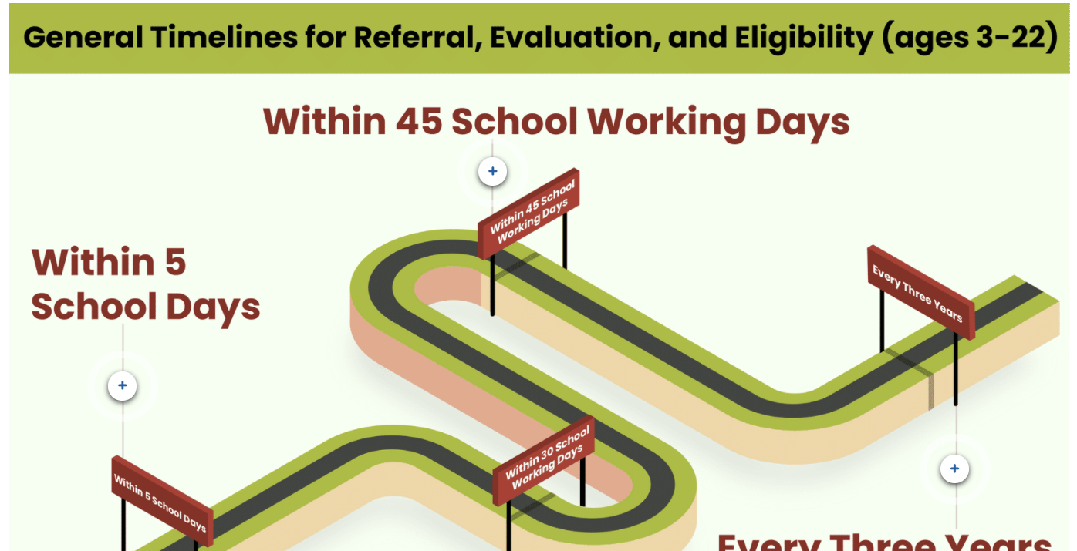
MA Referral, Evaluation, and Eligibility Determination Guidance
Referral Updates

Slide 13
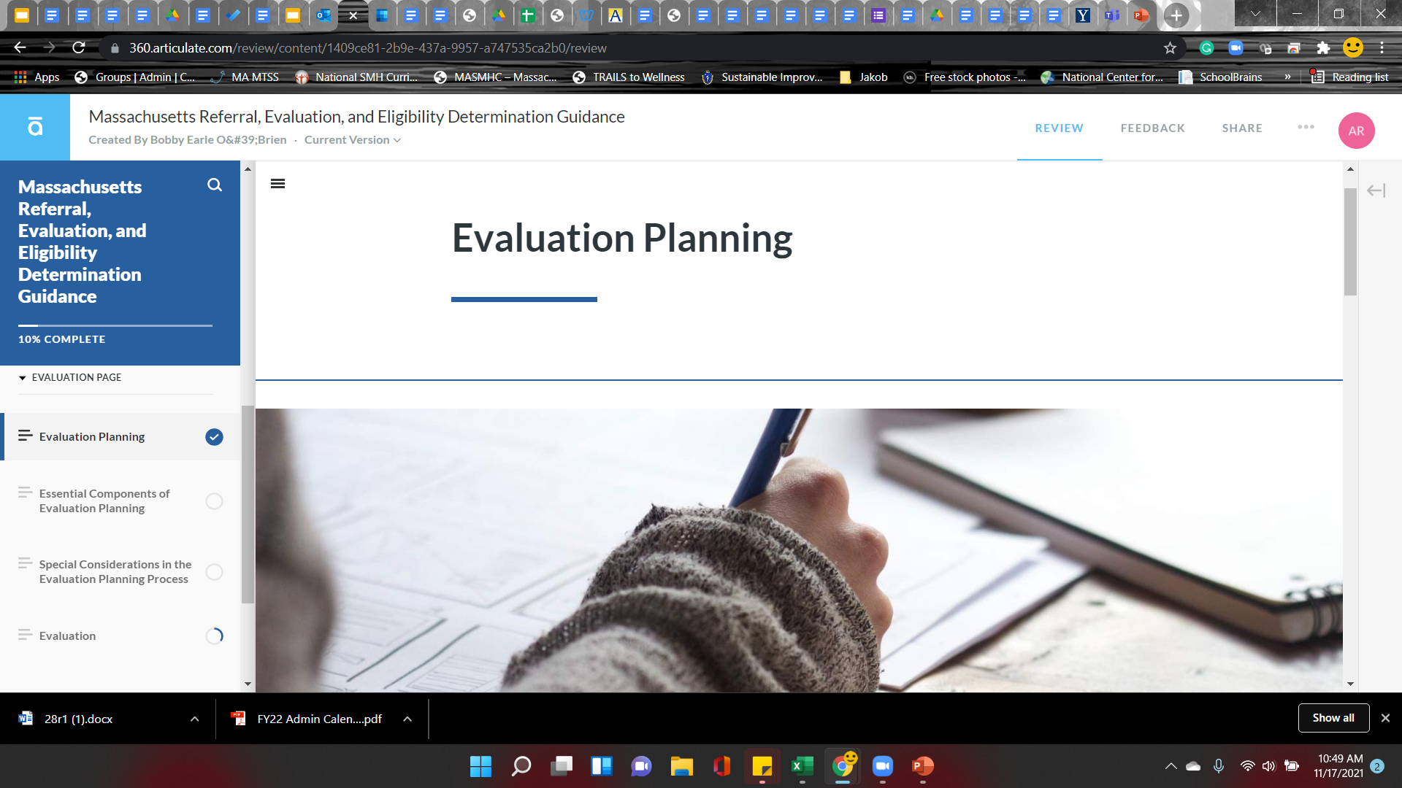
MA Referral, Evaluation, and Eligibility Determination Guidance
https://www.doe.mass.edu/sped/ImproveIEP/guidance-rlo/index.html#/lessons/25gSeNZzy21QuXWR7rjVY6i1DevlBv2U

Slide 14
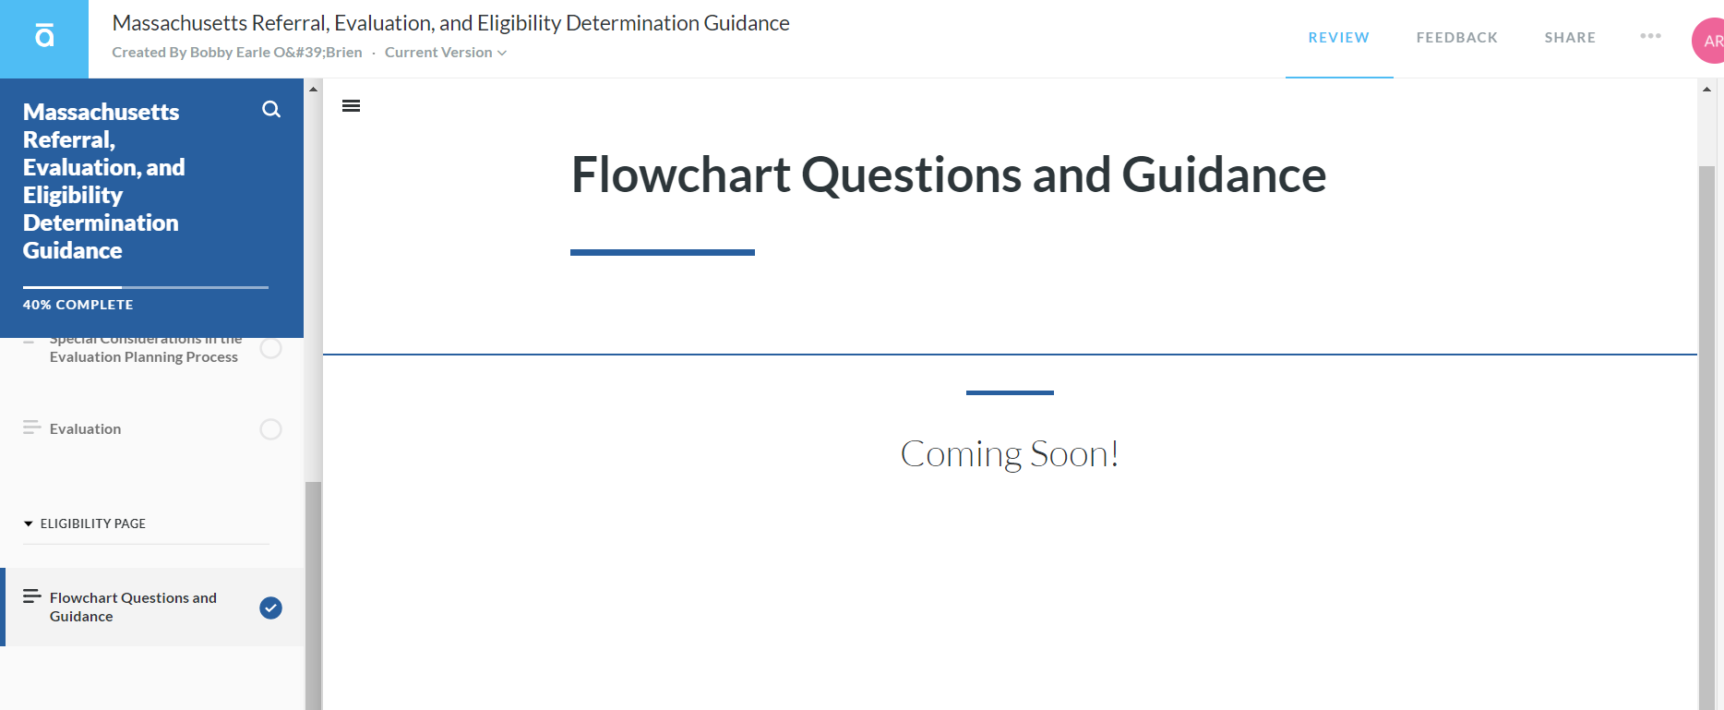
Coming January 2022!!

Slide 15
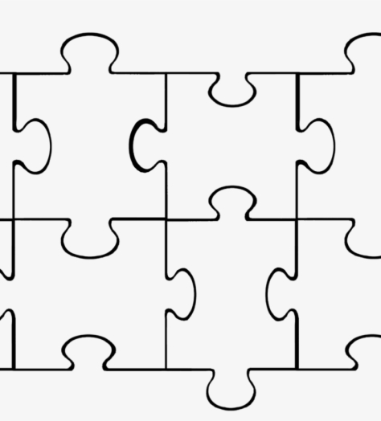
Improved Student Outcomes
Referral, Evaluation, Eligibility Guidance
Parent’s Guide
Process Guide
Early Adopters
Playbook for Improving Systems

Slide 16
Improved IEP guidance to support students with disabilities. The Department aims to improve outcomes for students with disabilities by revising the current IEP (Individualized Education Program) guidance, developing new data-driven, student-centered IEP forms, and identifying resources to support successful implementation of the IEP process.
Goals | Timeline
Developing new referral, evaluation, and eligibility (REE) guidance | Mostly completed; Eligibility section coming soon
Revising the IEP Process Guide | In progress
Revising “A Parent’s Guide to Special Education" | Coming soon
Creating an online learning tool that provides guidance and resources on the IEP process | In progress
Engaging the early adopters to identify best practices, strategies, and resources to support the IEP process – including IEP forms | In progress – beginning with draft IEP forms this winter and adding tips and strategies to REE
Convening stakeholder groups to create opportunities for families, school district staff, and community organizations to inform the development of guidance and resources, and updated IEP forms | Coming soon

Slide 17
Q&A
04

Slide 18
Save the date – Upcoming meetings
January 21, 2022 – 11:30-12:30
February 11, 2022 - 11:00-12:00
March 11, 2022 – 11:00-12:00

Slide 19
THANK YOU

