Slide 1
Special Education Leaders' Meeting
January 21, 2022

Slide 2

Supporting Head Start Children with IEPs

Slide 3
Federal Head Start Vaccine and Mask Requirements
Universal masking is required of all individuals two years of age and older with some noted exceptions.
Staff, volunteers, and contractors who have contact with or provide direct services to children must be fully vaccinated for COVID-19 by January 31, 2022.
Those granted exemption must undergo weekly testing for current SARS COV-2 infection.
More information: 86 FR 68052
Notes:
Please work with your local Head Start programs to ensure that children with disabilities continue to receive the services within the settings identified in the IEPs.
Note: Although an individual is not considered fully vaccinated until 14 days (2 weeks) after the final dose, staff, certain contractors and volunteers who have received the final dose of a primary vaccination series by January 31, 2022 are considered to have met the vaccination requirement, even if they have not yet completed the 14-day waiting period.

Slide 4
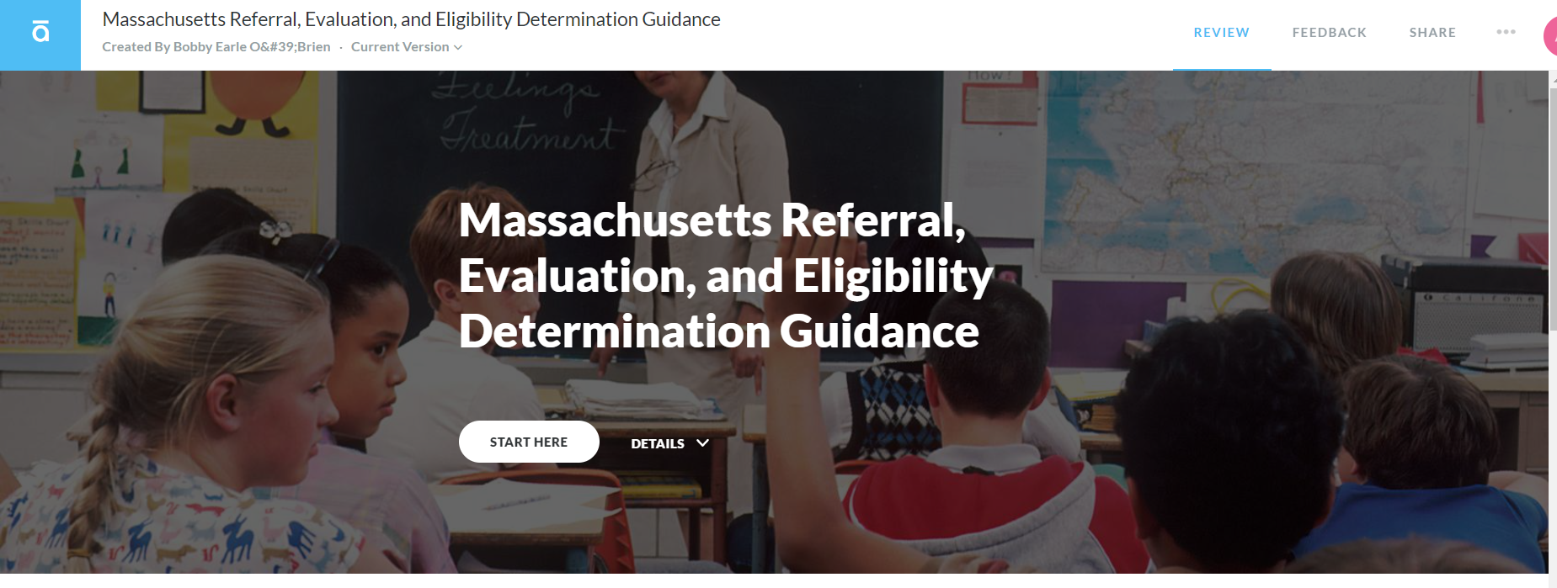
Referral, Evaluation, Eligibility Guidance
Live document: may update as needed

Slide 5
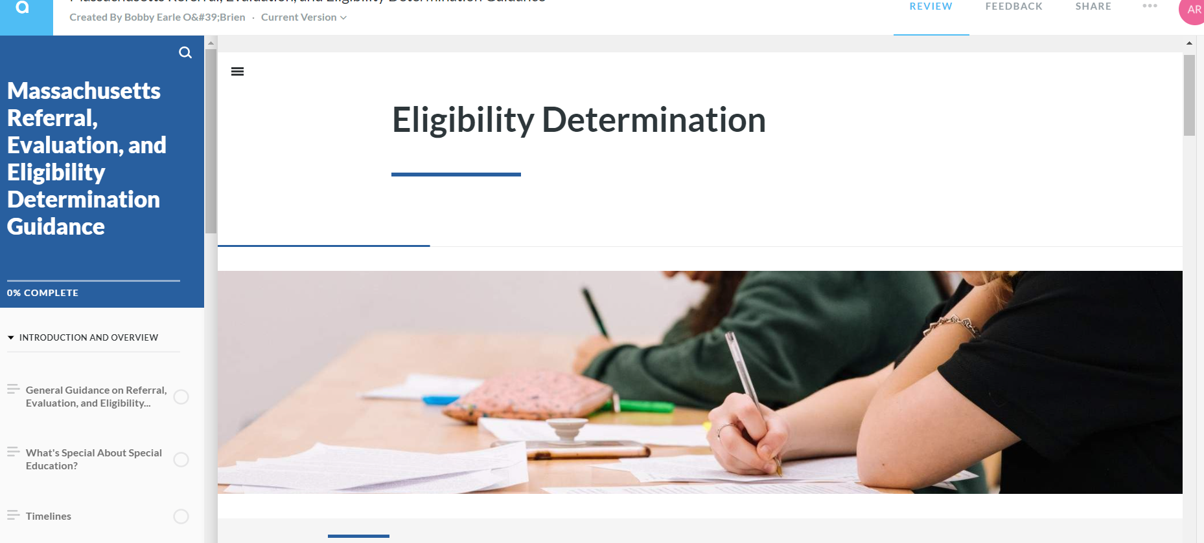
Eligibility

Slide 6
Special Education Updates
Use this link to subscribe and see past issues:
https://us14.campaign-archive.com/home/?u=d8f37d1a90dacd97f207f0b4a&id=41b37f7347

Slide 7
Upcoming Special Education Leaders’ Only Zoom Meetings
Friday February 11, 2022 11:00-12:00 Friday March 11, 2022 11:00-12:00

Slide 8
Q&A

Slide 9
THANK YOU

