Slide 1
Special Education Leaders' Meeting
April 14, 2022

Slide 2
CONTENTS
01
IEP Improvement Project
02
Problem Resolution System
03
Equitable Services
04
General Special Education Updates
05
Q&A
Notes:
Lauren

Slide 3


IEP Improvement Project
Spring 2022

Slide 4
The IEP Improvement Project
To improve outcomes for all students with disabilities by providing guidance, technical assistance, and tools on equitable processes to school and district professionals, families, and students so that all students with disabilities have meaningful access to the curriculum frameworks and life of the school.
If students with disabilities have meaningful access to the curriculum frameworks and the skills to engage in all aspects of the life of the school, then we will begin to close the opportunity and achievement gaps between students with disabilities and their age-appropriate non-disabled peers.
Project Goal
Improve Outcomes
Meaningful Access
Theory of Change
Close Opportunity & Achievement Gaps

Slide 5
MA DESE Special Education Forms
Referral, Evaluation, Eligibility Guide
Parent’s Guide to Special Education
MA DESE Special Education Forms
Systems Improvement Playbook
IEP Process Guide

Slide 6
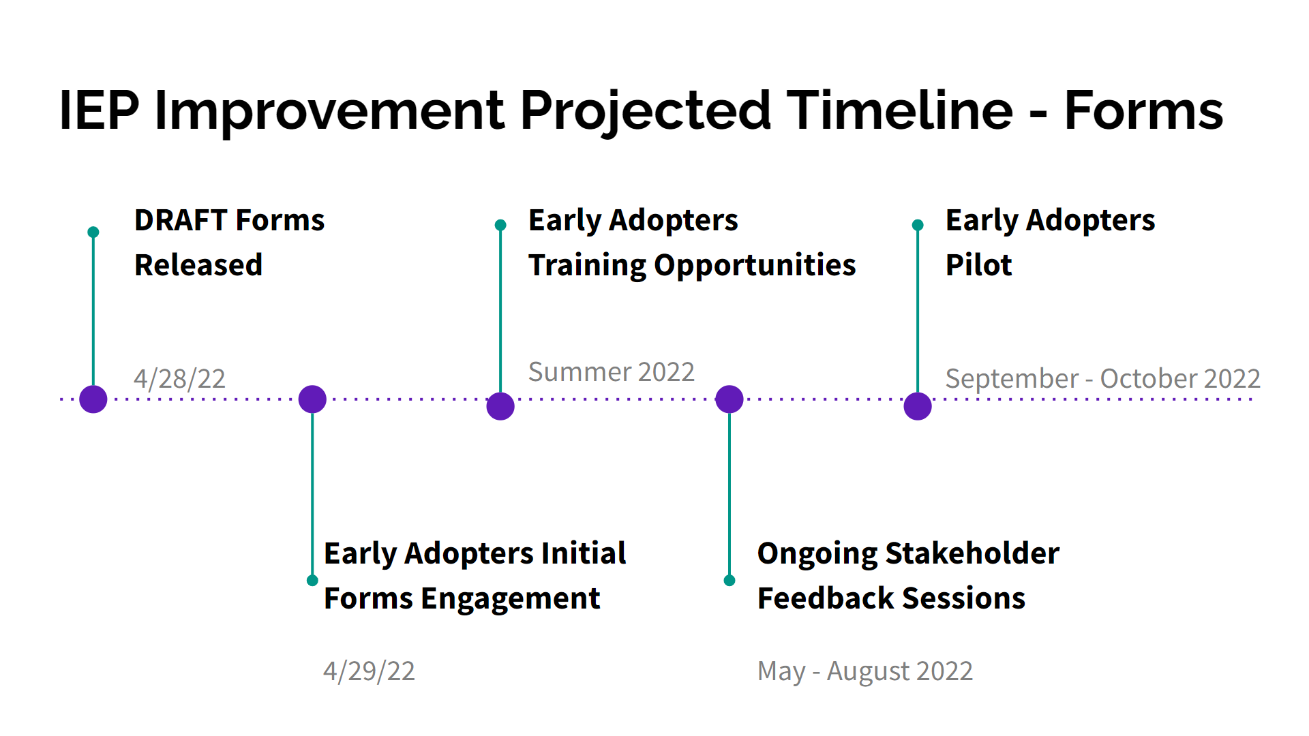
Projected Timeline for IEP Improvement Project

Slide 7
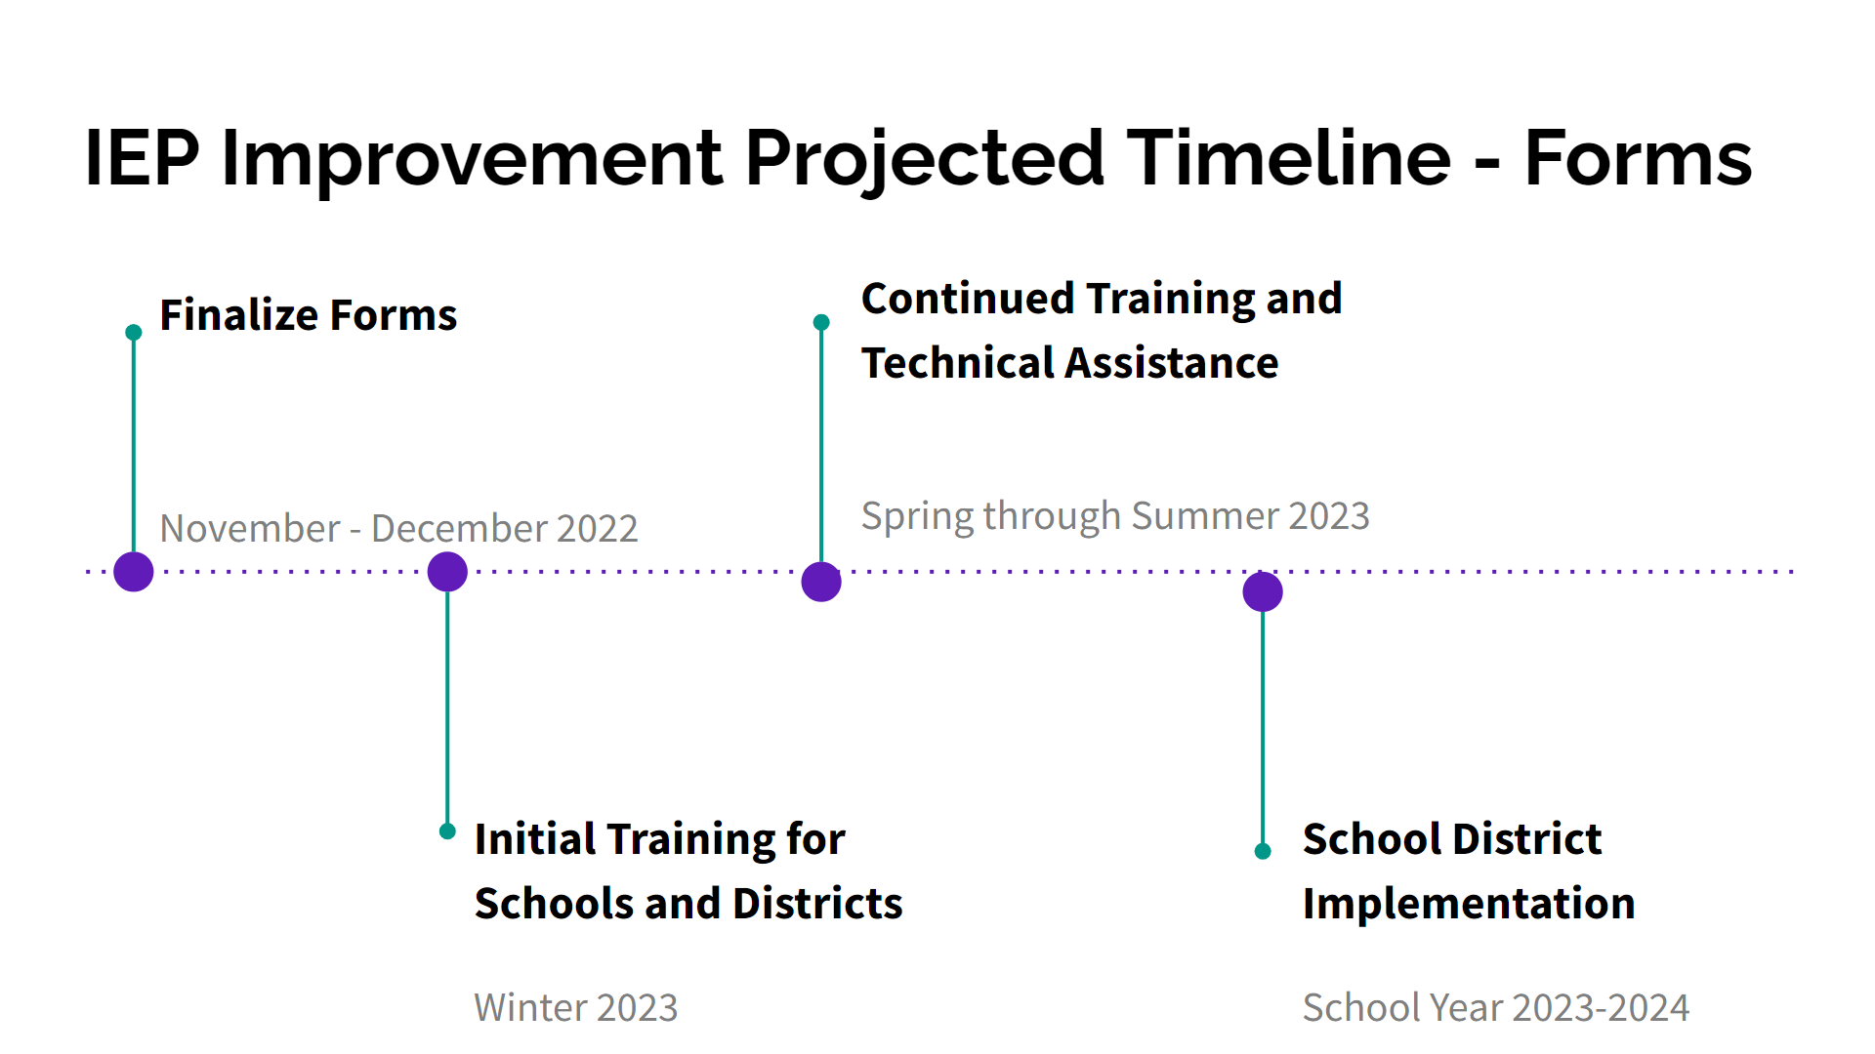
Projected Timeline for IEP Improvement Project

Slide 8
Problem Resolution System
02

Slide 9
State Regulations: Special Education and General Education
The Department maintains a Problem Resolution System that provides for the investigation of complaints and the enforcement of compliance with 603 CMR 28.00, as well as with other statutes and regulations relating to the provision of publicly funded education. The Department can make findings on procedural issues and issues related to implementation of requirements. Any party wishing to file a complaint may do so through the Department. Use of the Department Problem Resolution procedures shall not prevent a party from requesting alternative administrative remedies of mediation or hearing on any matter, at any time. Copies of the Problem Resolution System Guidelines and Procedures are available from the Department upon request. Findings and orders issued by the Department on complaints and the Department's processing of a complaint are not reviewable by the Bureau of Special Education Appeals. Additionally, the pendency of a complaint before the Department does not make the Department a necessary party to actions on related issues pending before the Bureau of Special Education Appeals.

Slide 10
Federal Regulations
34 C.F.R. § 300.151 Adoption of State complaint procedures.
(a) General. Each SEA must adopt written procedures for -
(1) Resolving any complaint, including a complaint filed by an organization or individual from another State, that meets the requirements of § 300.153 by -
(i) Providing for the filing of a complaint with the SEA; and
(ii) At the SEA's discretion, providing for the filing of a complaint with a public agency and the right to have the SEA review the public agency's decision on the complaint; and
(2) Widely disseminating to parents and other interested individuals, including parent training and information centers, protection and advocacy agencies, independent living centers, and other appropriate entities, the State procedures under §§ 300.151 through 300.153 . . (i) Providing for the filing of a complaint with the SEA; and
(ii) At the SEA's discretion, providing for the filing of a complaint with a public agency and the right to have the SEA review the public agency's decision on the complaint…
.

Slide 11
Regulations
34 C.F.R. § 300.152 Minimum State complaint procedures.
(a) Time limit; minimum procedures. Each SEA must include in its complaint procedures a time limit of 60 days after a complaint is filed under § 300.153 . . . .
34 C.F.R. § 300.153 Filing a complaint.
(a) An organization or individual may file a signed written complaint under the procedures described in §§ 300.151 through 300.152.
(b) The complaint must include -
(1) A statement that a public agency has violated a requirement of Part B of the Act or of this part;
(2) The facts on which the statement is based;
(3) The signature and contact information for the complainant; and
(4) If alleging violations with respect to a specific child -
(i) The name and address of the residence of the child;
(ii) The name of the school the child is attending;
(iii) In the case of a homeless child or youth (within the meaning of section 725(2) of the McKinney-Vento Homeless Assistance Act (42 U.S.C. 11434a(2)), available contact information for the child, and the name of the school the child is attending;
(iv) A description of the nature of the problem of the child, including facts relating to the problem; and
(v) A proposed resolution of the problem to the extent known and available to the party at the time the complaint is filed.
(c) The complaint must allege a violation that occurred not more than one year prior to the date that the complaint is received in accordance with § 300.151…

Slide 12
Tips
PRS tailors its investigations to the specific allegations raised
  Carefully read the request for a local report and provide requested materials
Contact the investigator if you have any questions about the scope of the investigation or the materials being requested
You may reach out to the complainant to attempt to resolve the issue

Slide 13
Equitable Services Update
03

Slide 14
IDEA Equitable Services Resolution
August 15, 2019
  United States Department of Education's Office of Special Education Programs (OSEP) issued a decision in response to private school officials' complaints regarding districts’ expenditure of IDEA proportionate share on eligible students from Federal Fiscal Years 2014-2018.
  The decision required the Department to instruct districts to redo their child count for those years and remedy any shortfall in IDEA proportionate share expenditures.
  In order to facilitate a more expedient resolution, the Department proposed a plan under which it would recalculate and allocate funds at the state level rather than require districts to revisit the calculations from those years and set aside additional funds.
January 11, 2021
  OSEP approved the Department’s plan. The Department conducted the calculations and determined a statewide amount to be allocated among the impacted districts.

Slide 15
Notice to Impacted Districts for Year 2 Resolution Funds
In April 2022, the Department will notify each impacted district with the specific allocation amount of Year 2 resolution funds for both Fund Codes 240 and 262.
The allocations are calculated based on the child count provided to the Department in each district’s FY2022 IDEA grant application.

Slide 16
Consultation Requirement for Resolution Funds
Timely and meaningful consultation between with private school representatives and representatives of parents of parentally-placed private school children with disabilities and parents of home-schooled children with disabilities regarding the resolution funds.
Initial consultation for the expenditure of resolution funds for FY2023 must be conducted by June 1, 2022.
Written affirmations following the initial consultation must be signed and submitted to the Department by June 1, 2022, at ideaequitableservices@mass.gov. Written Affirmations must note that the Resolution Funds were discussed during consultation.

Slide 17
Important Due Dates and Action Steps for Year 2 Resolution
Date | Actions and documentation due to the Department
April - May 2022 June 1, 2022 | LEAS s must conduct consultation meetings regarding Resolution Funds. LEAs must submit signed written affirmation to the Department.
Mid-July to early October 2022 | LEAs will complete FY2023 IDEA grant application. Budget and narrative descriptions submitted to the Department as part of the grant application process.
Winter 2022 | Mid-year fiscal review will be conducted by the Department. Fiscal self-assessments to be completed and submitted to the Department.
Fall 2023 | End of year annual financial reports submitted to the Department.

Slide 18
Special Education Updates
04

Slide 19
Safe, In-Person Learning for Students with Disabilities
On March 24, the U.S. Department of Education issued a letter to educators and parents about schools’ responsibilities to provide in-person learning for students with disabilities and the right of students with disabilities to receive a free appropriate public education in the least restrictive environment.
The letter summarizes strategies for keeping school communities healthy and for addressing the health needs of individual students with disabilities.

Slide 20
Powerful Learning Experiences for Students with Disabilities
LearnLaunch is excited to partner with the Special Education Leadership Fellowship to offer this free, 90-minute virtual workshop
This workshop will help school and district leaders design learning experiences that are meaningful for students at all ability levels, but especially for students with disabilities.
The workshop will be offered at 10:00 a.m. on Tuesday, April 26; again that day at 3:00 p.m.; and at 10:00 a.m. on Wednesday, April 27.
Register and find all of LearnLaunch’s upcoming workshops here!

Slide 21
Attorney General’s Advisory
On Monday, April 11, the Attorney General’s Office released an updated version of its advisory titled “Equal Access to Public Education for All Students Irrespective of Immigration Status.”
The updated advisory is available here.
The Department encourages school districts to share it with school personnel responsible for enrollment of new students.

Slide 22
COVID-19 Testing Program
DESE and the Executive Office of Health and Human Services are extending past April 22 the statewide COVID-19 testing options currently available to districts and schools.
The Department and EOHHS will continue to monitor factors related to COVID-19 and may make further adjustments to the statewide K-12 COVID-19 testing options this school year.
The Department anticipates following up later this spring with more information, including next steps for the summer and fall.

Slide 23
Transportation
Parents of students for whom transportation is provided for in their IEPs and who transport their students are eligible for reimbursement, as described in 603 CMR 28.07(6)
Mileage reimbursement increased on March 20, 2022 to $0.585 per mile
Planning for the summer
  Extended School Year: students with disabilities may need transportation to access and benefit from services

Slide 24

Special Education Updates
Special Education Updates Sign Up Link

Slide 25
Q&A
05

