Slide 1
Special Education Leaders' Meeting
May 14, 2022

Slide 2
CONTENTS
01
Emergency License Update
02
IEP Improvement Project
03
IDEA Equitable Services Resolution Funds
04
Special Education Updates, Including ESY
05
Q&A
Notes:
Lauren

Slide 3
Emergency License
Special Education Leaders – 5/13/22

Slide 4
Objectives
01
Emergency License Extension
02
Requirements for Provisional License
OBJECTIVES
03
Requirements for Initial License
04
Licensure Office Applicant Support
Notes:
In this presentation, we will cover:
Emergency License Extension - how do you apply and the steps to satisfy the requirements
Requirements for Provisional
Requirements for Initial License
Licensure Office Applicant Support- how this office can further support applicants.

Slide 5
Emergency License Extension
Emergency License Extension
01
Notes:
First, we will go over the extension of emergency licenses.

Slide 6
Emergency License
The emergency licenses were issued in the 2020-21 school year and expired June 30, 2021. The license is designed to assist candidates who were impacted by the COVID-19 state of emergency and the inability to satisfy certain aspects of the licensure requirements, such as a passing score on the Massachusetts Tests for Educator Licensure (MTEL).
Notes:
The emergency licenses were issued in the 2020-21 school year and expired June 30, 2021. The license is designed to assist candidates who were impacted by the COVID-19 state of emergency and the inability to satisfy certain aspects of the licensure requirements, such as a passing score on the Massachusetts Tests for Educator Licensure (MTEL).
Since, the original issuance of the Emergency License the Commissioner has issued an extension to June 30, 2022 and the current extension to June 30, 2023.

Slide 7
Emergency License Extension
Most emergency licenses were automatically extended to be valid until June 30, 2023.
The following licenses will not automatically extend and will expire on June 30, 2022.
      Teacher of Students with Moderate Disabilities
      Teacher of Students with Severe Disabilities
      Teacher of the Deaf and Hard of Hearing (ASL/TC)
      Teacher of the Deaf and Hard of Hearing (Oral/Aural)
      Teacher of the Visually Impaired
      English as a Second Language (ESL)
Notes:
In response to feedback from districts and due to continued challenges as a result of the ongoing impact of the coronavirus, Commissioner Riley has extended the validity period of some emergency licenses through June 30, 2023 (originally valid until June 30, 2021 and extended last year to June 30, 2022).Existing Emergency licenses for special education and ESL are valid until June 30, 2022. All other fields of Emergency license are valid until June 30, 2023.
All emergency licenses will automatically be extended and will be valid until June 30, 2023, except for the following licenses:
Teacher of Students with Moderate Disabilities
Teacher of Students with Severe Disabilities
Teacher of the Deaf and Hard of Hearing (ASL/TC)
Teacher of the Deaf and Hard of Hearing (Oral/Aural)
Teacher of the Visually Impaired
English as a Second Language (ESL)
Emergency licenses that have been granted in the above six license areas are valid through June 30, 2022 and are not subject to the automatic one-year extension; however, individuals with an emergency license in these fields will be eligible to apply for a no-cost extension of their emergency license, and an extension to June 30, 2023 will be given to those that demonstrate appropriate subject matter knowledge in the field.

Slide 8
Extending an Emergency License
Applicants who hold emergency licenses that will not automatically extend can apply for an extension of their emergency license, up until June 30, 2023.
To qualify for the extension applicants must be able to demonstrate appropriate subject matter knowledge in the field.
English as a Second Language Emergency Licenses | Pass the ESL MTEL test
Special Education Emergency Licenses | Either Demonstrate the subject matter knowledge through a competency review; OR Complete a performance-based assessment process through structured guidance and support (SG&S)
Notes:
Applicants who hold emergency licenses that will not automatically extend can apply for an extension of their emergency license, up until June 30, 2023.
To qualify for the extension, applicants must be able to demonstrate appropriate subject matter knowledge in the field.
For the ESL license, this means passing the subject matter MTEL.
For any of the special education licenses, this means covering the subject matter knowledge through a competency review or through structured Guidance and Supports

Slide 9
The Competency Review
A Competency Review is the process for determining whether the subject matter knowledge requirements for a license have been met in a field for which there is no MTEL subject test.
Competencies are also known as the "coverage of" requirements and can be satisfied through the completion of a professional learning experience(s) that provided at least 10 hours of instruction specific to and completely covering a subject matter knowledge requirement.
Competencies can be satisfied through completion of any one or combination of coursework, seminars, workshops, mentored employment, or peer coaching or Structured Guidance and Support (SGS).
Notes:
A Competency Review is the process for determining whether the subject matter knowledge requirements for a license have been met in a field for which there is no MTEL subject test.
Competencies are also known as the "coverage of" requirements and can be satisfied through the completion of a professional learning experience that provided at least 10 hours of instruction specific to and completely covering a subject matter knowledge requirement. Competencies can be satisfied through completion of any one or combination of coursework, seminars, workshops, mentored employment, or peer coaching.

Slide 10
Structured Guidance & Supports
SG&S
Classroom focused professional support
Supervision
Assessment
The Structured Guidance & Supports (SG&S) process is one path for completing the Competency Review. The SG&S process is a performance-based assessment for a teacher licensure candidate.
The SG&S process and assessment takes place over a supervised 150-hour field-based experience.
Notes:
The Structured Guidance & Supports (SG&S) process is one path for completing the Competency Review. The SG&S process is a performance-based assessment for a teacher licensure candidate.
Classroom focused professional support
Supervision - Intensive supervision and regular ongoing support
Assessment - An assessment of the candidate’s knowledge and skills against a performance rubric, aligned to the subject matter knowledge of the license
The SG&S process and assessment takes place over a supervised 150-hour field-based experience, which offers classroom focused professional support

Slide 11
Waivers
If an educator with an ESL or special education emergency license is unable to meet the requirements to obtain an emergency extension, employers may pursue a Hardship Waiver in order to employ them without a license in the 2022-23 school year.
School districts can begin applying for a Hardship Waiver for 2022-23 through ELAR as early as April 1, 2022.
Notes:
If an educator with an ESL or Special Education emergency license is unable to obtain an emergency extension, then a waiver may be an option. It is the district's responsibility to follow the instructions for logging the waiver request in ELAR and submitting the requested evidence that a good faith effort has been made to hire licensed personnel. It is at the district’s discretion to submit a waiver request on the educator’s behalf. As long as you have a pending application for your Provisional or Initial, an employer can pursue their options to employ you under a waiver. A waiver is valid for one year, and your obligation is to be working towards the license during that time.

Slide 12

Professional Teaching Status
Time spent working under an emergency license can count towards Professional Teaching Status (PTS) if the educator obtains a provisional or initial academic license or a preliminary vocational license within two years of the date of issuance of the emergency license in the field and continues to work for the same employer under the newly acquired license.
an educator who received an emergency license middle school math/science on July 1, 2020, has been teaching grade 8 science classes since the start of the 2020-21 school year, receives a provisional or initial license in middle school math/science by June 30, 2022, and continues to teach under that license for the same employer can count the two years taught under the emergency license toward PTS.

Slide 13

.
Emergency license
Initial
Provisional
Notes:
Educators with an Emergency license should be working towards meeting the requirements for a Provisional or Initial license.

Slide 14
Requirements for Provisional License
Requirements for Provisional License
02
Notes:
Your next step may be to work towards a Provisional license. Here we will go over those requirements.

Slide 15
Provisional Teacher License
A Provisional teacher license is valid for five years of employment in the role of the license in public schools or other settings where possession of the license is required by Massachusetts law.
A Provisional teacher license is generally for someone who has not yet completed an approved teacher preparation program.
Most licenses can be obtained with passing scores on the appropriate Massachusetts Tests for Educator Licensure (MTEL) and verification of a bachelor’s degree.
Beyond these basic requirements, earning a Provisional license may require completion of seminars or courses and/or a Competency Review.
Use the Licensure Requirements Tool for information & advice or go ahead and apply for it in ELAR to get started.

Slide 16
Provisional Licenses that Require Only a Bachelor’s Degree & MTEL:
Possess a bachelor’s degree
Achieve a passing score on the Communication & Literacy Skills test
Achieve a passing score on a corresponding subject matter test
Middle School: Mathematics/Science: 5-8
Music: Vocal/Instrumental/General: All
Physical Education: PreK-8; 5-12
Physics: 8-12
Social Science: 5-12
Speech: All
Technology/Engineering: 5-12
Theater: All
Visual Art: PreK-8; 5-12
Foreign Language: PreK-6; 5-12
  Chinese (Mandarin)
  French
  German
  Italian
  Portuguese
  Russian
  Spanish
Biology: 8-12
Business: 5-12
Chemistry: 8-12
Dance: All
Digital Literacy/Computer Science: 5-12
Earth and Space Science: 8-12
English: 5-12
English as a Second Language (ESL): PreK-6; 5-12
General Science : *1-6; 5-8
Health/Family and Consumer Sciences: All
History: *1-6; 5-12
Latin & Classical Humanities: 5-12
Mathematics: 1-6; 5-8; 8-12
Middle School Humanities: 5-8

Slide 17
Provisional Licenses that Require Seminars or Courses:
Early Childhood (PreK-2) & Elementary(1-6) Provisional Licenses: Common Requirements:
Possession of a bachelor’s degree
Passing score on the Communication & Literacy Skills test
Passing score on the Foundations of Reading test
Seminars or courses on ways to prepare and maintain students with disabilities for general classrooms
Additional Requirements:
Early Childhood: PreK-2
  Passing score on the Early Childhood subject matter test
Elementary: 1-6
  Passing score on the General Curriculum multi-subject subtest
  Passing score on General Curriculum mathematics subtest

Slide 18
Provisional Licenses that Require a Competency Review: Special Needs Fields
Requirements common among all special needs licenses:
Possession of a bachelor’s degree
Passing score on the Communication & Literacy Skills test
Passing score on the General Curriculum multi-subject subtest
Passing Score on the General Curriculum mathematics subtest
Seminars or courses on ways to prepare and maintain students with disabilities for general classrooms
Competency Review
Students with Severe Disabilities: All
All Common Requirements as noted above.
The Foundations of Reading test is also required for the following licenses:
Teacher of Students with Moderate Disabilities: PreK-8; 5-12
Teacher of the Deaf and Hard-of-Hearing (Oral/Aural): All
Teacher of the Visually Impaired: All
Teacher of the Deaf and Hard-of-Hearing (American Sign Language/Total Communication): All
Passing score on the Sign Language Proficiency Interview for American Sign Language test (SLPI).

Slide 19
Provisional Licenses that Require a Competency Review
A Competency Review – is the process for determining whether the subject matter knowledge requirements have been met for the specific license sought. Competency Review Guidelines can be found on our website.
Possess a bachelor’s degree
Achieve a passing score on the Communication & Literacy Skills test
Competency Review
Foreign Languages:
American Sign Language: PreK-6; 5-12
Arabic: PreK-6; 5-12
Armenian: PreK-6; 5-12
Cambodian: PreK-6; 5-12
Cape Verdean: PreK-6; 5-12
Creole Haitian: PreK-6; 5-12
Greek: PreK-6; 5-12
Hebrew: PreK-6; 5-12
Hmong: PreK-6; 5-12
Japanese: PreK-6; 5-12
Hungarian: PreK-6; 5-12
Khmer: PreK-6; 5-12
Korean: PreK-6; 5-12
Polish: PreK-6; 5-12
Ukrainian: PreK-6; 5-12
Vietnamese: PreK-6; 5-12
--------------------------------------------
Library: All

Slide 20
How to Satisfy the Requirements: Seminars or Courses
Seminars or Courses on Ways to Prepare and Maintain Students with Disabilities for General Classrooms
Satisfied through at least 10 hours of instruction specific to and completely covering the requirement.
  Documenting through a course(s) = Official Transcript
  Documenting through a seminar(s)= Letter/Certificate(s) of Completion
  Oftentimes, it is necessary for the applicant to submit a letter verifying the number of hours of instruction delivered specific to a requirement and the specific components of the requirement covered within a course or seminar.
  Letters verifying a course must be on official college/university letterhead and signed by the course instructor, licensure officer, appropriate department chair, registrar, dean, provost, chancellor, vice-president, or president.
  Letters verifying a seminar should be on official letterhead of the provider and signed by an appropriate representative.

Slide 21
Satisfying Competency Review Requirements
Competency Review requirements are satisfied through courses, seminars/workshops, or school-based mentored employment/peer coaching that provide as least 10 hours of instruction specific to and completely covering the Competency Review requirement.
Documenting through courses = Official Transcripts & Official Course Descriptions
Documenting through seminars/workshops = Letters/Certificates of Completion & Activity Descriptions
Documenting through school-based mentored employment/peer coaching = A letter on official letterhead signed by the Superintendent/or equivalent stating the hours of instruction delivered via the mentored employment or peer coaching specific to a requirement and the specific component(s) of the requirement that were covered. The name and license number of the person serving as the mentor for the mentored employment or peer coaching must be included. Template provided in Competency Review Guide.
Documentation through Structured Guidance and Support
For more information on how to document compliance, please refer to the Competency Review Guide found at https://www.doe.mass.edu/licensure/forms-guidelines.html .

Slide 22
Requirements for Initial License
Requirements for Initial License
03
Notes:
The stage after Provisional is Initial. Here, we will go over those requirements.

Slide 23
Initial Teacher License
In-state candidates must complete a Massachusetts approved educator preparation program (Initial licensure program) or the Performance Review Program for Initial Licensure (PRPIL).
Out-of-state candidates may verify that they completed a state approved educator preparation program or hold a comparable (field & type) license from another state.
Teachers obtaining their first Initial license in core academic subjects are required to obtain the Sheltered English Immersion (SEI) Teacher Endorsement.
Notes:
Initial licensure is for the applicant who has studied to become a teacher through an accredited program.
In-state candidates must complete a Massachusetts approved educator preparation program, also known as an Initial licensure program; or they may participate in the Performance Review Program for Initial Licensure or PRPIL.
Out-of-state candidates may verify that they completed a state approved educator preparation program or hold a comparable license from another state.
Teachers obtaining their first Initial license in core academic subjects are required to obtain the Sheltered English Immersion (SEI) Teacher Endorsement.

Slide 24
Requirements for In-state Traditional Route
Bachelor's degree
MTEL
  Passing score on the Communication & Literacy Skills
  Passing score on applicable subject matter knowledge test/s (MTEL). Where no test has been established, completion of an approved program will satisfy this requirement.
Successful completion of a Massachusetts approved teacher preparation program for the Initial license sought.
For core academic teachers, possession of the SEI Teacher Endorsement.
Notes:
In order to earn your initial license through a Massachusetts approved teacher preparation program, these are the requirements:
- Possession of a Bachelor's degree on an official transcript.
- Achieve passing scores on the relevant exams. This would generally include the MTELs for Communication & Literacy Skills – both Reading and Writing subtests – as well as an applicable subject matter knowledge test or tests. Where no test has been established, completion of an approved program will satisfy this requirement.
- Educators will choose to affiliate with the approved program of their choice to complete pedagogy and practicum requirements, including SEI for core teachers. Successful completion of each of these is verified in ELAR by the program sponsor.

Slide 25
Performance Review Program for Initial Licensure (PRPIL)
Possession of the Provisional license in the field and at the grade level of the Initial license sought.
  At least three years of experience under the Provisional license
Completion of the Performance Review Program for Initial Licensure (PRPIL).
For core academic teachers, possession of an SEI Teacher Endorsement.
Notes:
The Performance Review Program for Initial Licensure (PRPIL) is an alternative to the traditional approved program route. Experienced teachers who believe they can demonstrate the necessary pedagogical skills on the job may choose to forgo a college or university program in lieu of this option. PRPIL does not include an SEI component, so core academic teachers who chose this route will need to earn an SEI Teacher Endorsement on their own, by taking a RETELL course or passing an MTEL.

Slide 26
Prepared Outside of Massachusetts – Initial License
Individuals who completed an approved educator preparation program outside of Massachusetts submit a copy of an official transcript and a completed Out-of-State Approved Program Verification Form
Individuals who hold the equivalent of at least a Massachusetts Initial license issued by a state with which Massachusetts has signed the NASDTEC Interstate Agreement should submit a copy of their out-of-state license that is comparable to the Initial license.
Notes:
Educators who completed their teacher preparation out of state should upload official transcripts and the resulting teacher credential earned. Further clarity about the program may be sought as needed using the Out of State Approved Program Verification Form. Core teachers in this situation will need to earn an SEI Teacher Endorsement on their own, typically by taking a RETELL course or passing an MTEL.

Slide 27
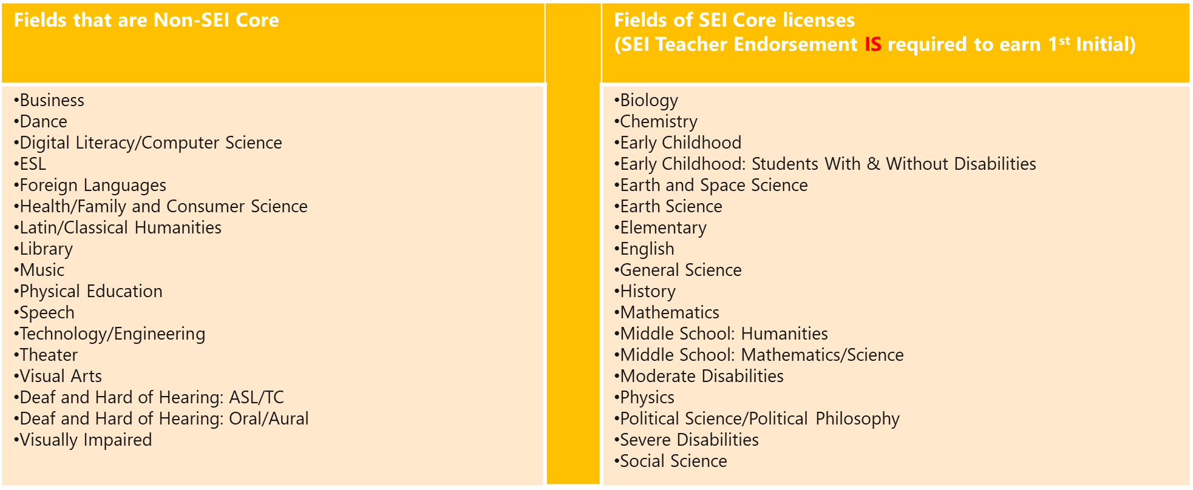
Non-SEI Core Fields vs. SEI Core Fields
Notes:
The following license areas are considered "Non-core" for the purposes of the SEI Endorsement:
Business, dance, digital literacy and computer science, ESL, Foreign languages, health/family and consumer sciences, latin/classical humanities, library, music, physical education, speech, technology/engineering, theater, visual arts, deaf and hard of hearing: ASL/TC and Oral/Aural, Visually impaired. Non-core in this case means you are not required to earn the SEI Endorsement.
This leaves the following Core license areas, where applicants will need an SEI Endorsement:
Biology, chemistry, early childhood, earth and space science, elementary, English, General science, history, math, middle school humanities, middle school math/science, moderate disabilities, physics, political science/political philosophy, severe disabilities, social science.

Slide 28
How to obtain a SEI Teacher Endorsement
One of the following:
Successful completion of a DESE-approved RETELL course
  Passing the Sheltered English Immersion test (MTEL)
  Possession of an ESL or ELL teacher license (Temporary, Emergency, Invalid and Professional are not applicable)
  Transcript review of a relevant degree (e.g. linguistics major)
Notes:
Most people will earn the SEI endorsement by taking a course or passing the MTEL for SEI. If you have a degree in ESL or linguistics, you may pursue a transcript review instead.
The question of when you need the SEI endorsement depends on your employment. While DESE does not require it until you are earning your first initial license in a core area, your employer is required to ensure that you have it within one year of being assigned an English language learner. Employers may be asking you to get this done faster than DESE is asking you to, and you should defer to your employer.

Slide 29
Licensure Office Applicant Support
Licensure Office Applicant Support
04
Notes:
Licensure Office Applicant Support

Slide 30
Office of Educator Licensure Applicant Support
Applicant Support
Call Center
(781)-338-6600
Monday -Friday
9:00 AM – 1:00 PM
2:00 PM – 5:00 PM
Walk-In Welcome Center
75 Pleasant Street, Malden
Monday-Friday
8:45 AM – 4:45 PM
ELAR Correspondence (Evaluation of your application)
Licensure Website
www.doe.mass.edu/licensure
Notes:
The licensure office utilizes the online ELAR system to communicate directly with you in writing about the evaluation of your application.
You can authorize a school district employer to view your ELAR Correspondence History and MTEL scores, and school districts can request to have your application expedited.
If you would like to talk with us by phone about the communication you are receiving in ELAR, our customer service specialists are available Monday through Friday, from 9am to 1pm, and from 2 to 5pm. To reach the first available specialist, call 781-338-6600, or visit our walk up counter at 75 Pleasant Street in Malden.
In addition, authorized school district administrators can contact us via the Commissioner’s Licensure Hotline.

Slide 31
Stages of License and Validity
Professional License Renewal
(Every 5 years)
Initial license an be extended for can additional 5 years
Professional License
(Valid for 5 calendar years)
Initial License
(Valid for 5 years of employment)
Provisional License
(Valid for 5 years of employment)
Notes:
Licensure is an ongoing part of your professional development. These are the stages of educator licensure that you can progress through as you continue your career.

Slide 32
Reminder of IEP Improvement Project Goals
02
Reminder of IEP Improvement Project Goals

Slide 33


IEP Improvement Project
Spring 2022

Slide 34

Iep
https://www.doe.mass.edu/sped/improveiep/
Notes:
If you have not heard of the project and are interested in learning more about the work that has been done and the history of the project, I encourage you to check out the IEP IP website
The project goes back several years and there has been a tremendous amount of work that has been done to lead us to where we are now in the project
By way of introduction to this work, I often ask groups “What IMMEDIATELY comes to mind when they think of the IEP Process?”
The following inevitably come up:
Paperwork
Forms
Documentation
Of course, other things come up as well, but I can pretty well count on these things making their way into the responses.
Those things are certainly part of the IEP process, but we want to shift the focus from the “FORMS” as the driver.

Slide 35
The IEP Improvement Project
To improve outcomes for all students with disabilities by providing guidance, technical assistance, and tools on equitable processes to school and district professionals, families, and students so that all students with disabilities have meaningful access to the curriculum frameworks and life of the school.
If students with disabilities have meaningful access to the curriculum frameworks and the skills to engage in all aspects of the life of the school, then we will begin to close the opportunity and achievement gaps between students with disabilities and their age-appropriate non-disabled peers.
Project Goal
Improve Outcomes
Meaningful Access
Close Opportunity & Achievement Gaps
Notes:
SO – WHAT EXACTLY DOES THAT MEAN?
When we talk about the IEP Improvement project in the special education office in DESE, we ground ourselves in the Project Goal and Theory of Action
I won’t ask you to read all the small print on the left, again this can be found on the IEP Improvement Project website (see https://www.doe.mass.edu/sped/improveiep/ )
On the left are the stated Project Goal and Theory of Action
These are summarized in the graphic on the right
Boiled down: The purpose is to implement a newly reimagined process that truly focuses on OUTCOMES, ACCESS, and CLOSING GAPS.
In other words:
The purpose of this project is not simply to create newer, prettier documents and FORMS
The goal is that the IEP process is viewed as a transition document from eligibility to “graduation”
Remember that there are various kinds of “graduating”
Graduation from an IEP
Traditional graduation from HS after completion of local requirements
AND, as you well know, some graduate when they turn 22 (or some time after they finish HS)

Slide 36
Forms
Referral, Evaluation, Eligibility Guide
Parent’s Guide to Special Education
MA DESE Special Education Forms
Systems Improvement Playbook
IEP Process Guide
Notes:
As you can imagine, a project that proclaims the desire IMPROVE OUTCOMES, INCREASE MEANINGFUL ACCESS, AND CLOSE GAPS for SWD involves the creation or updating of multiple documents that MAKE UP the process.
There are multiple parts in the Improvement Project and various groups are involved in the creation of materials, feedback on documents, designing and implementing training, and providing support.
This graphic represents the four major “products” that will be created OR updated as part of the IEP Improvement Project
TOP LEFT: Referral, Evaluation, Eligibility Guide
TOP RIGHT: Parent’s guide to special education
Has been recently updated by FCSN in collaboration with DESE
As the other documents are finalized and released, this will also go through another update to align with any changes
BOTTOM LEFT: IEP Process Guide
Again, as the other documents are finalized and released, this will also be aligned and updated
BOTTOM RIGHT: Systems Improvement Playbook
This does not currently exist, but is in development
THESE 4 documents represent the pieces that will transform the IEP PROCESS
You will note that the FORMS are in the center of this document
Forms are NOT the driving force for the IEP Process or the FOCUS of the entire IEP Improvement Process, but rather a PRODUCT of the process
Important points to make:
This is not a linear process. These documents are all in various phases of updating as we speak.
SO you might be wondering, WHY ARE WE HERE TODAY?

Slide 37
Early Adopter Schools and Districts
Carver Public Schools
Chelsea Public Schools
Clinton Public Schools
Groton-Dunstable Regional School District
The Guild for Human Services
League School of Greater Boston
Malden Public Schools
Marblehead Public Schools
Mashpee Public Schools
Medfield Public Schools
New Bedford Public Schools
Norton Public Schools
Perkins School for the Blind
Quabbin Regional School District
Waltham Public Schools
Worcester Public Schools

Slide 38
Design Elements for Draft IEP Form
Design Elements for Draft IEP Form

Slide 39
Key Design Elements
Simplified format (length, usability, language and redundancy)
Data-driven and student-centered process
Strength-based approach
Focus on Least Restrictive Environment
Transition planning more directly included in the IEP process
Purposeful inclusion of student and family/caregiver voice

Slide 40
What’s Not Included
The draft form addresses the IEP process itself, currently IEP 1- IEP 8.
Later, we will update other IEP-related forms, as necessary.
Examples might include the Placement Decision Form (PL 1 and PL 2) and/or the Notice of Proposed School District Action.

Slide 41
Review of the Draft Form
To access the draft form, please click here or go to https://www.doe.mass.edu/sped/ImproveIEP/draft-iep-form.xlsm.
The draft form is in an interactive Excel format.
  As you answer questions on the form, additional questions drop down when more information is needed.
  For example, if a student is identified with Autism, the seven additional considerations appear for team consideration.
  If the student is not identified with Autism, the additional considerations do not appear.

Slide 42
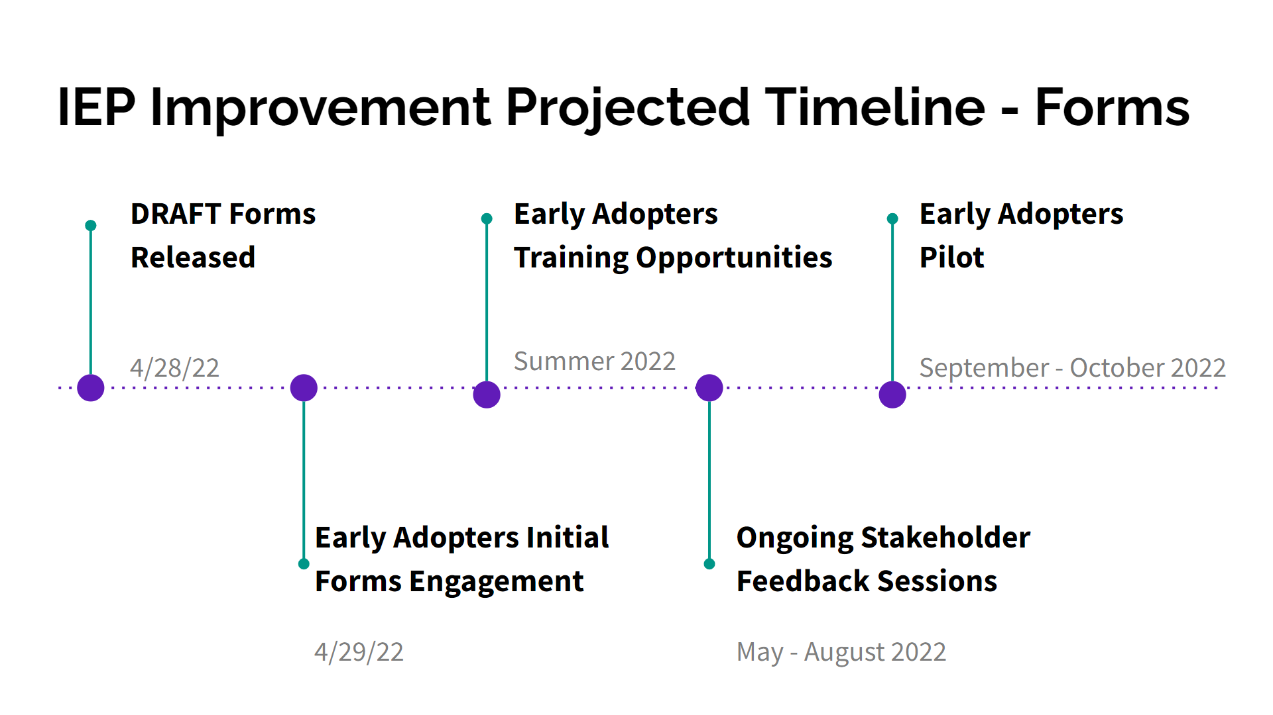
IEP projected timeline
Notes:
Added the timeline slides, as requested

Slide 43
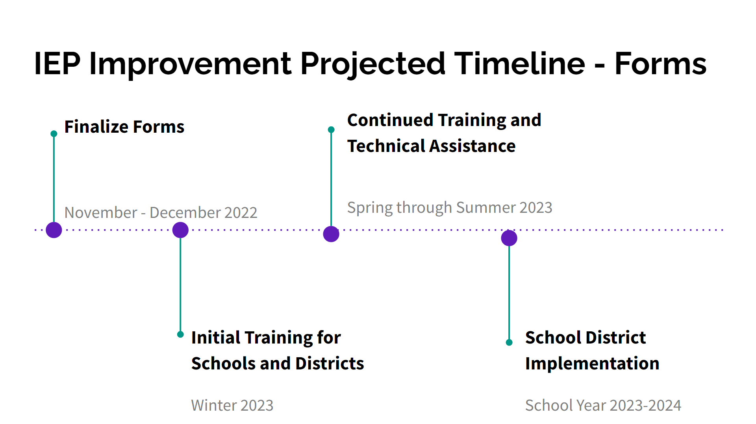
.iep forms

Slide 44


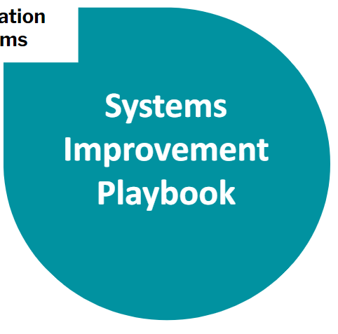


.students and families first
Students and Families First Coalition: Providing Training, Oversight, and Guidance to “Early Adopters”
Notes:
Another example of the process for gathering stakeholder feedback is the SYSTEMS IMPROVEMENT PLAYBOOK
What has stakeholder feedback for the Systems Improvement Playbook looked like?
This process is a little different bc the playbook does not yet exist
The playbook is being created by a group of organizations (Students and Families First Coalition) and teams of school-based staff (Early Adopters).
SFFC was formed in 2020 to lead the work of 30+ school-based teams in making structural improvements to their special education and IEP processes while piloting and implementing new guidance and forms from the MA Department of Elementary and Secondary Education
This is a multi-year process that engages these schools in a PDSA cycle around the IEP process. Lessons learned will be documented in a playbook for districts/schools for rebuilding systems
The organizations leading this work are:
CAST: Pioneers in the field of UDL
Rennie Center: Conduct educational research and make policy recommendations for education reform in MA
FCSN: advocacy organization for families of SWD
Black Print: Educational Consulting agency supporting development of policies, practices, and structures to support racial equity in education

Slide 45
Stakeholder Engagement to Improve Draft Forms
Early Adopters
Targeted Engagement
Universal Input

Slide 46
IDEA Equitable Services Resolution Funds
03

Slide 47
Resolution Funds Year 2
LEAs that were allocated Resolution Funds in FY2022 will be receiving allocations in FY2023 unless the LEA opted to take all funds in Year 1 of the Resolution (FY2022).
LEA allocation letters are forthcoming.
FY2023 allocations have been adjusted to reflect the updated child count.
Written affirmations that include documentation of consultation regarding the Resolution Funds are to be submitted to IDEAequitableservices@mass.gov by June 1, 2022.
A sample affirmation that includes the Resolution Funds can be found at https://www.doe.mass.edu/sped/proshare/ in the Sample Documents section.
Notes:
Resolution Funds for FY2022
--child counts from October 1-December 1, 2020 (most recent child count)
--submitted to the Department via the IDEA consolidated application in the summer/fall of 2021
Resolution Funds for FY2023
--child counts from October 1-December 1, 2021
--submitted to the Department via the IDEA consolidated application in the summer/fall of 2022
Resolution Funds will be allocated in
--FY2022, FY2023, and FY2024 for Fund Code 240
--FY2022 and FY2023 for Fund Code 262
unless the district opted to take all funds during the Year 1 (FY2022)
FY2023 allocations have been adjusted to reflect the most recent child count (see above for FY2023)
LEA allocation letters are forthcoming (we are working on this now so it should be next week)

Slide 48
Special Education Updates
04

Slide 49
Extended School Year
Transportation
Remote Services

Slide 50

Special Education Update
Special Education Updates Sign Up Link

Slide 51

Virtual Job Fair: Massachusetts Public Schools and
Approved Private Special Education Schools
Save the date:
Wednesday, June 15th from 10:00-2:00
Sponsored by DESE and MassHire
Employers (free of charge): If you have not done so, please complete this brief preregistration form to reserve a booth (closes 5/13/22)
Job Seekers: Please complete this two question survey (closes 5/20/22)
All: Please share with your professional network as well as family and friends.

Slide 52
.
Next Special Education Leaders’ Meeting
June 10, 2022
11:00-12:00

Slide 53
Q&A
05

