Slide 1

The Massachusetts Commission for the Blind
Presentation to
The Massachusetts Department of Elementary and Secondary Education’s Special Education Leaders Meeting
June 10, 2022

Slide 2
Welcome
Welcome
MCB Team Includes
Commissioner
David D’Arcangelo
Deputy Commissioner
John Oliveira
Pre-Employment Transition Services
Mayanne MacDonald Briggs
Nina Kagan
Greater Boston Region Children’s Services Worker
Carrie Brasier
Director of the AIM Library

Slide 3
Massachusetts Commission for the Blind (MCB)
Massachusetts Commission for the Blind (MCB)
“Alone we can do so little;
together we can do so much.”
Helen Keller
…Oh, BTW, All of our Services are FREE to Districts!

Slide 4
Persons with Disabilities &
Employment in Massachusetts
American Community Survey 1-Year Estimates
How many candidates of this Talent Pool could;
Meet the MERS?
Meet the PERS?
Need a RA?
Perform Essential Job Duties?
785,093 persons with disabilities in Massachusetts
Talent Pool
374,288 Working age persons with disabilities (PWDs) in Massachusetts**
172,742 in the labor force
201,546 not in the labor force
155,507 Employed
17,235 Unemployed
58.5% (218,781) of working age PWD in MA are
Not Employed
Significant “Societal Challenges” exist. We should endeavor to better understand our talent pool. (174,742)
90% of PWD labor force Employed
10% of PWD labor force Unemployed
* Of total civilian noninstitutionalized population
** 18-64 years
Source: UNH calculations using the U.S. Census Bureau, 2019 American
Community Survey, Tables s1810 and B18120
DRAFT For Policy Development Purposes ONLY

Slide 5
Persons with Disabilities &
Employment in Massachusetts (1)
Two Step Challenge
Step #1
How can we get more PWD into the Labor Force?
Step #2
How can we get more PWD employed?
201,546 of working-age PWD in Mass. are
not in the Labor Force!
This is 53.8% of working-age PWD
172,742 PWD’s in the
Labor Force
10% of PWD Unemployed
90% of PWD Employed
DRAFT For Policy Development Purposes ONLY

Slide 6
Overview of MCB Services
MCB provides social and vocational rehabilitation services to approximately ~25,000 consumers.
MCB currently has 2,177 individuals registered that are ages 4-21
Our mission is to provide quality services that enhance the lives of our consumers by promoting independence, dignity and self-determination.
We achieve this by partnering with local school districts, community agencies, healthcare providers, employers and, most importantly, our consumers and their families.

Slide 7
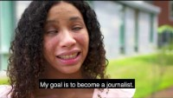
WHAT’S YOUR VISION?
At MCB, our vision is a world where individuals who are blind or visually impaired are empowered with opportunities to work and thrive.

Slide 8
Eligibility for Services
Massachusetts General Law mandates that MCB maintain a register of the blind. Chapter 6 – Sec. 136. All eyecare providers are required to report within 30 days all cases of legal blindness.
Legal Blindness Definition
All cases where vision with correction is 20/200 or less in the better eye.

Slide 9

Vocational Rehabilitation (VR)
VOCATIONAL REHABILITATION (VR)
VR services assist older students to prepare for, achieve, retain, or regain employment.
VR program is federally funded with a State match. ~950 consumers actively receiving services

Slide 10

Social Rehabilitation (SR)
SOCIAL REHABILITATION (SR)
Social Rehabilitation (SR) services assist in the adjustment to blindness and support maximum personal independence and living in community.
SR services are targeted to children 0-13, seniors and anyone not served by VR including consumers receiving DeafBlind Extended Supports. The SR program is state funded. (2,200 seniors and other non-vocational adults actively receiving services)

Slide 11

Social Rehabilitation (SR) continued
SOCIAL REHABILITATION (SR)
Children Services are part of our Social Rehabilitation program and are for children from birth to 13 years.
This includes case management, information and referral (I&R), funding for afterschool socialization and recreation programs, advocacy and technical assistance around Individualized Education Plans (IEP).
~770 children actively receiving services

Slide 12
AIM Library
AIM Library
The Massachusetts Accessible Instructional Materials (AIM) library acquires, maintains and distributes braille, large print, and specialized instructional materials from the American Printing House for the Blind to preschool thru 12th grade blind and visually impaired students.
AIM Library operates under The Massachusetts Commission for the Blind (MCB) through an interagency service agreement with the DESE as of July 2021
Local education agencies can access AIM Library materials, at no cost to district, through the districts certified teacher of the visually impaired (TVI).

Slide 13
AIM Library continued
District TVI’s are responsible for administrating appropriate assessments, facilitating APH’s Student Federal Quota Registration, AIM Library Assurance Form and Parental Consent, and coordinating material requests to assist LEA in providing equal access to the curriculum to support and improve the quality of education for blind and visually impaired students.
Braille requests should be placed by March and Large Print requests should be placed by June. All requests should be submitted with clean print copies of textbooks.
American Printing House for the Blind(APH) materials may be requested all year.

Slide 14
AIM Library (3)
AIM Library
AIM Library School Year 2021-2022
3,034 Total students reported with a documented visual impairment
1,815 Legally Blind students registered for APH Federal Quota
1,219 Students reported as visually impaired
138 TVI’s from 389 School districts submitted student registrations
The AIM Library provided 2,200 students with over 9,500 accessible materials including braille, large print and assistive technology devices at not charge to districts.

Slide 15
Questions regarding AIM Library
Questions for AIM Library
Carrie Brasier
AIM Library Director | APH EOT
3 Randolph Street Canton, MA 02021
Email carrie.brasier@mass.gov
Mobile 781-540-4418
Office: 781-562-0461
Fax: 781-562-0463
Website: www.aimlibrary.org

Slide 16

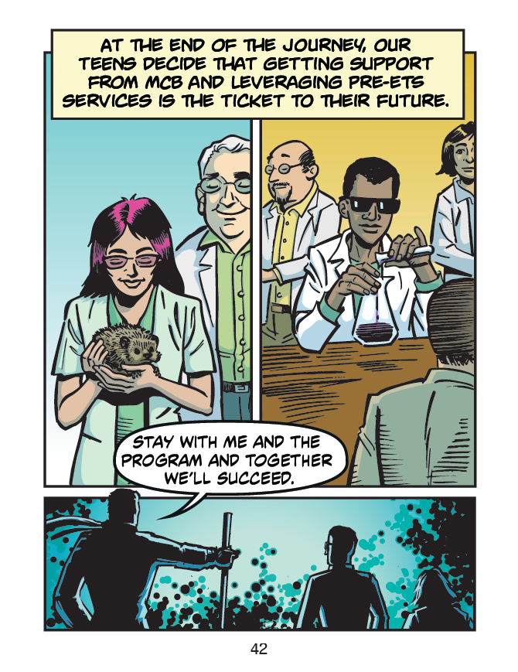
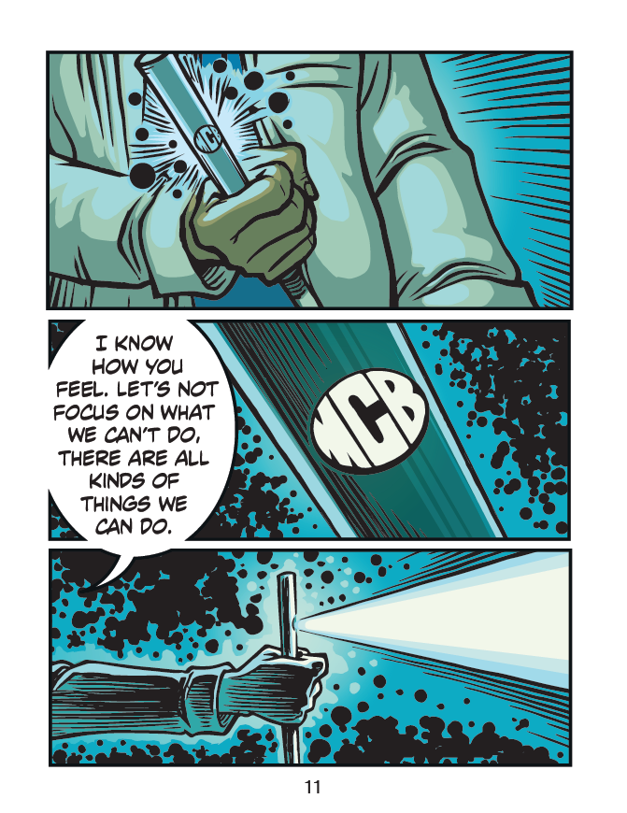
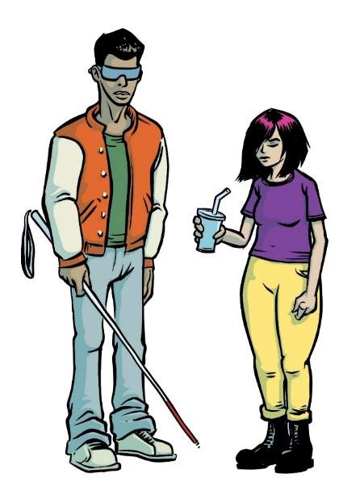
Graphic Novel

Slide 17

Project Goals/Desired Outcomes
Employment = Independence & Self-Determination
Engage visually impaired students early
Inform teens, parents, and counselors about Pre-ETS services and support
Help Youth understand that the actions they take now contribute to their future success in finding a job and living independently.
Notes:
MCB seeks a consultant to produce a “Pre-Ets Best Practices Guide for Consumers and State VR Agencies”. The Guide will include information contained within multiple publications, outlets and presentations. The consultant will provide corresponding marketing and outreach strategies and methods. The Guide will be designed to illustrate, highlight and explain the top approaches currently yielding the most favorable results for Pre-Ets consumers. The guide will be presented in a manner that is easy to use, accessible, and straightforward.
The Guide will include the following topics:
(1) job exploration counseling
(2) work-based learning
(3) transition counseling
(4) workplace readiness
(5) self-advocacy
(6) independent living and community inclusion
(7) How to retain competitive integrated employment
(8) VR counselors, school transition personnel, and other persons supporting students with disabilities.
(9) disseminating information about Pre-Ets services
(10) Service Coordination
(11) improving policies, procedures, and practices
(12) model transition demonstration projects
(13) establishing or supporting multistate or regional partnerships
(14) transition to postsecondary activities of traditionally unserved populations.

Slide 18
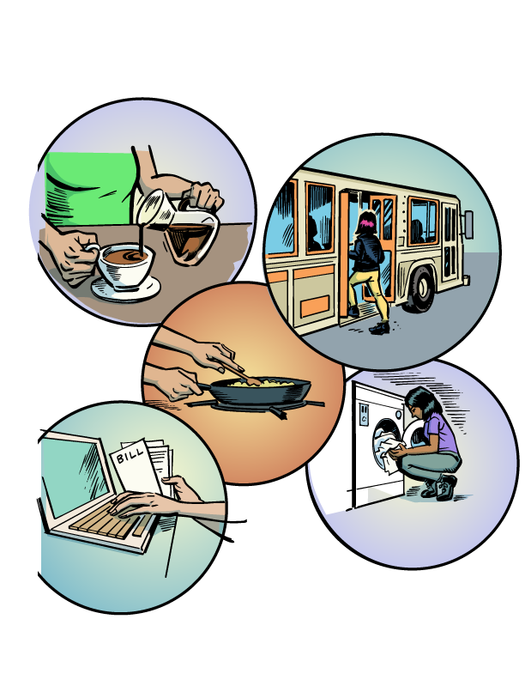
Target Audiences
Target Audiences
Primary Audience
Teens and Young Adults aged 14 – 22 who are blind and visually impaired
Secondary Audience(s)
Parents / Caregivers of primary audience
Vocational Rehab Counselors (VRCs), Teachers for Visually Impaired (TVIs), Educators, Guidance Counselors

Slide 19
Focus Areas
Focus Areas
Five chapters – Each one focused on the 5 required WIOA topics:
Dark Clouds – MCB paves the way (Job Exploration & Counseling)
Next Step – Explore your options (Work Based Learning)
The Path – Empower yourself (Career - Transition Counseling)
Balancing Act – Put your best foot forward (Workplace Readiness)
Rise Up – Showcase your superpowers (Self-Advocacy)

Slide 20

Components
Components
  Graphic Novel – Electronic Accessible PDF
  Book – Printed, high contrast book – 2021
  Narrated audio soundtrack – MP3, MP4, WAV files
  QR Code – Quickly links the reader to the website
  Website – www.mcb-thequestforindependence.com
  Poster – A map outlining the 5 key areas
  Infographic – Insert for parents or guardians
  Social Media – Hero header, images, and MP4)

Slide 21
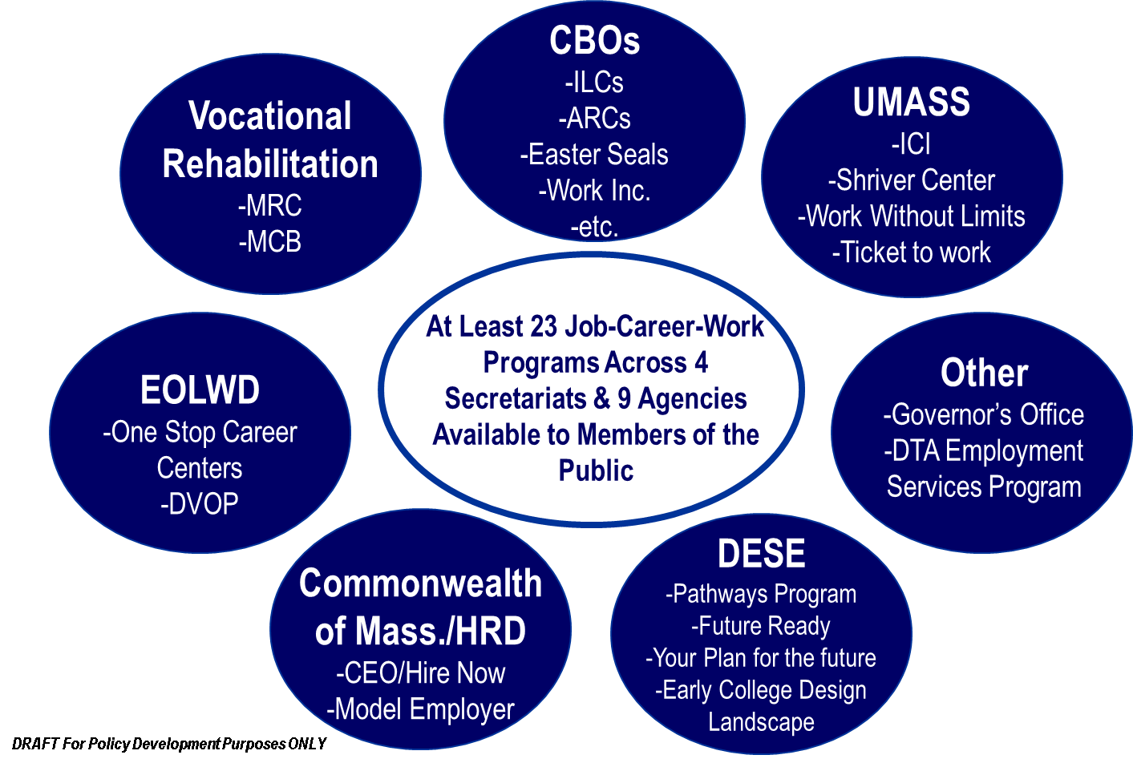
Public Employment Programs Within Massachusetts

Slide 22
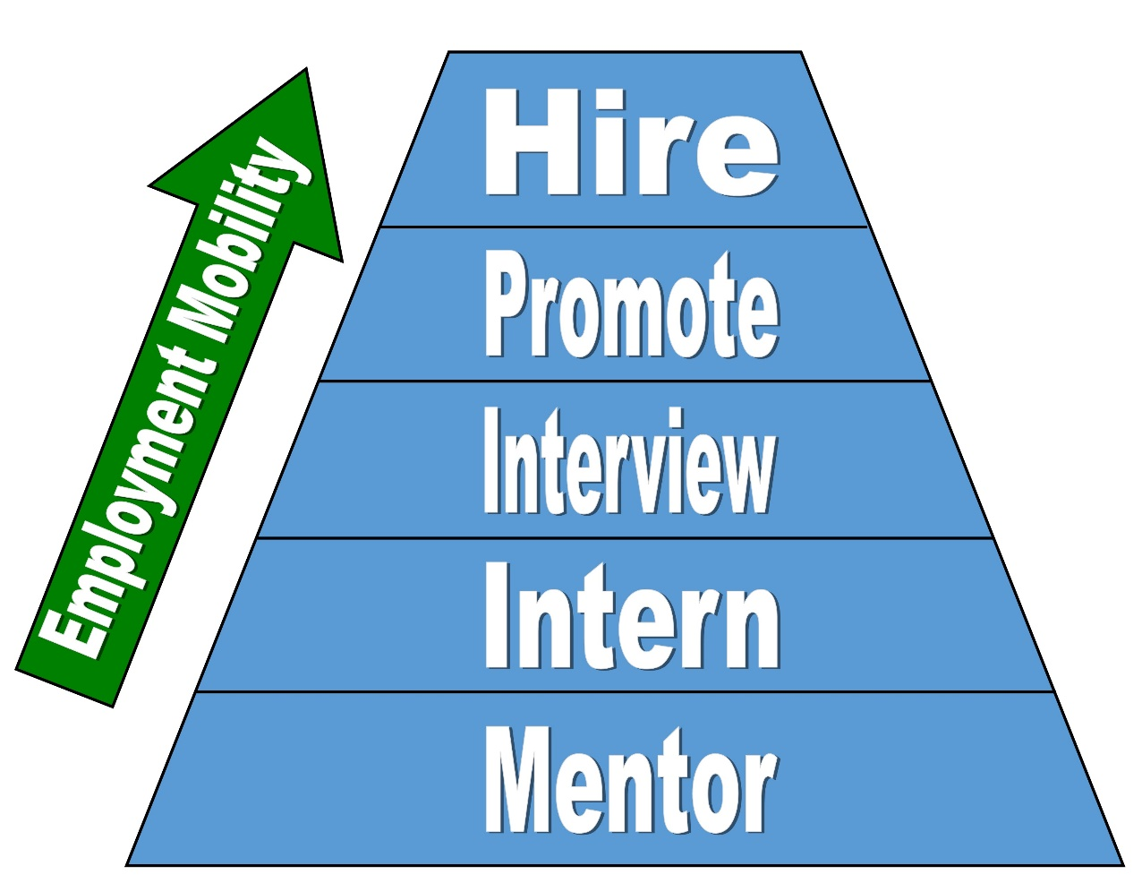
The Employer Challenge
Views Gaining Competitive Employment as a Process
Goal is to have businesses be “One-Better” than last year

Slide 23
Entrepreneurial Initiative e-Commerce Business
Entrepreneurial Initiative
e-Commerce Business
Steve Brice
Thomas Lehrich
Jonathan Lucus
Luis Interiano

Slide 24
Questions?
Questions?

Slide 25
Connect With MCB
Connect With MCB
1-800-392-6450
600 Washington Street, Boston, MA 02111
www.mass.gov/mcb
MCBinfo@mass.gov
Follow us:
Twitter:@massblind
Facebook: @masscommblind
Instagram: @massblind
LinkedIn: Massachusetts Commission for the Blind

