Slide 1
Special Education Leaders' Meeting
September 16, 2022

Slide 2
CONTENTS
01
Behavioral and Mental Health Resources
02
Special Education Surrogate Parent Program
03
Special Education Updates
04
Questions and Answers
Notes:
Lauren

Slide 3
Behavioral and Mental Health Resources
01

Slide 4
DESE Resources/Initiatives Related to Behavioral and Mental Health & Social Emotional Wellness
Special Education Leaders Meeting – September 16, 2022
Chris Pond, Behavioral and Mental Health Specialist Student & Family Support (SFS)

Slide 5
Major themes
DESE is supporting schools/collaboratives with funding, guidance, and professional development.
We’re seeing promising practices across the state.
Statewide advisory groups are informing the efforts.

Slide 6
DESE Grant Funding
Example includes:
Supporting Students’ SEL, Behavioral & Mental Health (MH), and Wellness through MTSS (SEL & MH Grant)
developing comprehensive, integrated multi-tiered systems for student, family, and educator social-emotional and/or mental health supports; and
building sustainable infrastructure to facilitate integrated coordination between school and community-based services and/or providers.
FY23 continuation SEL Mental Health Grant awardees https://www.doe.mass.edu/grants/2022/awards/613-311-332.docx

Slide 7
Guidance / Information/Professional Development
Examples include:
Holistic Support and Enrichment, SEL, Health and Safety Newsletter
Sign-up & See Past Issues
Mental & Behavioral Health and Wellness Supports
Multi-Tiered Systems of Support (MTSS) Academies
E.g., SEL/Mental Health, Systemic Student Support (S3), and Culturally Responsive Teaching

Slide 8
THANK YOU
781.338.3010
achievement@doe.mass.edu
www.doe.mass.edu/sfs
Office of Student & Family Support (SFS)

Slide 9
Special Education Surrogate Parents
04

Slide 10
Special Education Surrogate Parents
Megan Ronzio, Director
Special Education Surrogate Parent (SESP) Program
mronzio@sespprogram.org
Andrea Parker, Director
Recruitment, Training,
and Support Center (RTSC)
aparker@fcsn.org
Special Education Leaders Network Meeting
9/16/22

Slide 11
CES and FCSN
Massachusetts Department of Elementary and Secondary Education
Collaborative for
Educational Services (CES)
Contracts with DESE to manage the
SESP Program
Federation for Children with Special Needs (FCSN)
Contracts with DESE to manage the RTSC
Special Education
Surrogate Parent (SESP) Program
· All student referrals, investigations,
and eligibility determinations
· Matching of SESPs and students·
· Student case management and provider liaison
· Clarification on the rights and responsibilities of the SESP
· Provider Trainings on the SESP Program
· Mentor program for SESPs
Recruitment, Training,
and Support Center (RTSC)
· Volunteer recruitment and orientation training
· Individual support for SESPs
· Web-based resources
· On-going general trainings, webinars, newsletters, and support groups
· Yearly conference

Slide 12
The SESP Program
What Does the SESP Program Do?
Appoints special education decision-makers to eligible students
In state custody
Parents unknown or not able to be located
Classified as an Unaccompanied Homeless Youth (UHY)
Statewide
Volunteer based
Over 25 years

Slide 13
The SESP Program
Our Students
Approximately 700 students across MA are currently assigned to a SESP*
401 students were assigned to a SESP in SY2022-23
Majority are male and over 14 years old
Wide range of diagnoses and services
Living in congregate care: group homes, residential schools, DYS, hospitals, shelters, etc.
Students in foster homes or living with a parent are generally not eligible.
*September 2022

Slide 14
The SESP Program
So what exactly does a SESP do (a summary)?
Decision-making authority in special education matters.
Works as part of the special education Team to develop an IEP and educational placement, using educational records, observation, provider feedback, etc.
Monitors the student’s progress by communicating regularly with teachers, administrators, and service providers, and by reviewing progress reports.

Slide 15
Role of the SESP
SESP | DCF Social Worker or Designee | School District
Request copies of all evaluations and records from the school district. Sign consent for special education evaluations and review them. Observe the student in the classroom. Attend all special education Team meetings. Visit any proposed special educational placements. Review, accept/reject and sign the IEP. Request additional special education evaluations. Request (re)convening of Team. Request independent evaluation, if necessary. Pursue the complaint and/or appeals process, if necessary. | Enroll student in school. Request an initial special education evaluation. Sign school related consent forms (i.e. field trips, permission to be photographed, medical releases, etc. but not special education evaluation consent forms.) Approve any access to student records (other than for SESP), including if/when referrals are made to out of district settings. Provide Medicaid or MassHealth related authorization. Authorize a student to withdraw from school after the age of sixteen. Sign Chapter 688 referral form. (Requires the signature of the student 18 or over, or the student’s legal guardian.) All other signatures related to regular education and Section 504. | Recognize that the Special Education Surrogate Parent (SESP) has the same decision-making rights and responsibilities as any parent of a special education student. Schedule IEP meetings at a mutually agreed upon time and place. Send education records, progress reports and report cards to the SESP. Keep the SESP informed of any changes. Maintain communication with the SESP.

Slide 16
The SESP Program
Opportunities for Collaboration
Do you have a member of your school community (not current staff or parent) who might be a good student- or district-specific SESP? Let us know!
Consider students who may need an SESP but have not been referred (i.e. UHY).
Access to student records and progress reports: A big piece of the puzzle!
Make sure office staff (i.e. secretaries) are aware of the role of the SESP
Best district contact
DCF, SESP, and District integration
District Ideas and Feedback Welcome!

Slide 17
Special Education Leader Network Meeting
Special Education Leader Network
Meeting
Presented by:
Andrea Parker and Megan Ronzio
fcsn.org/rtsc
rtsc@fcsn.org
617-399-8342

Slide 18
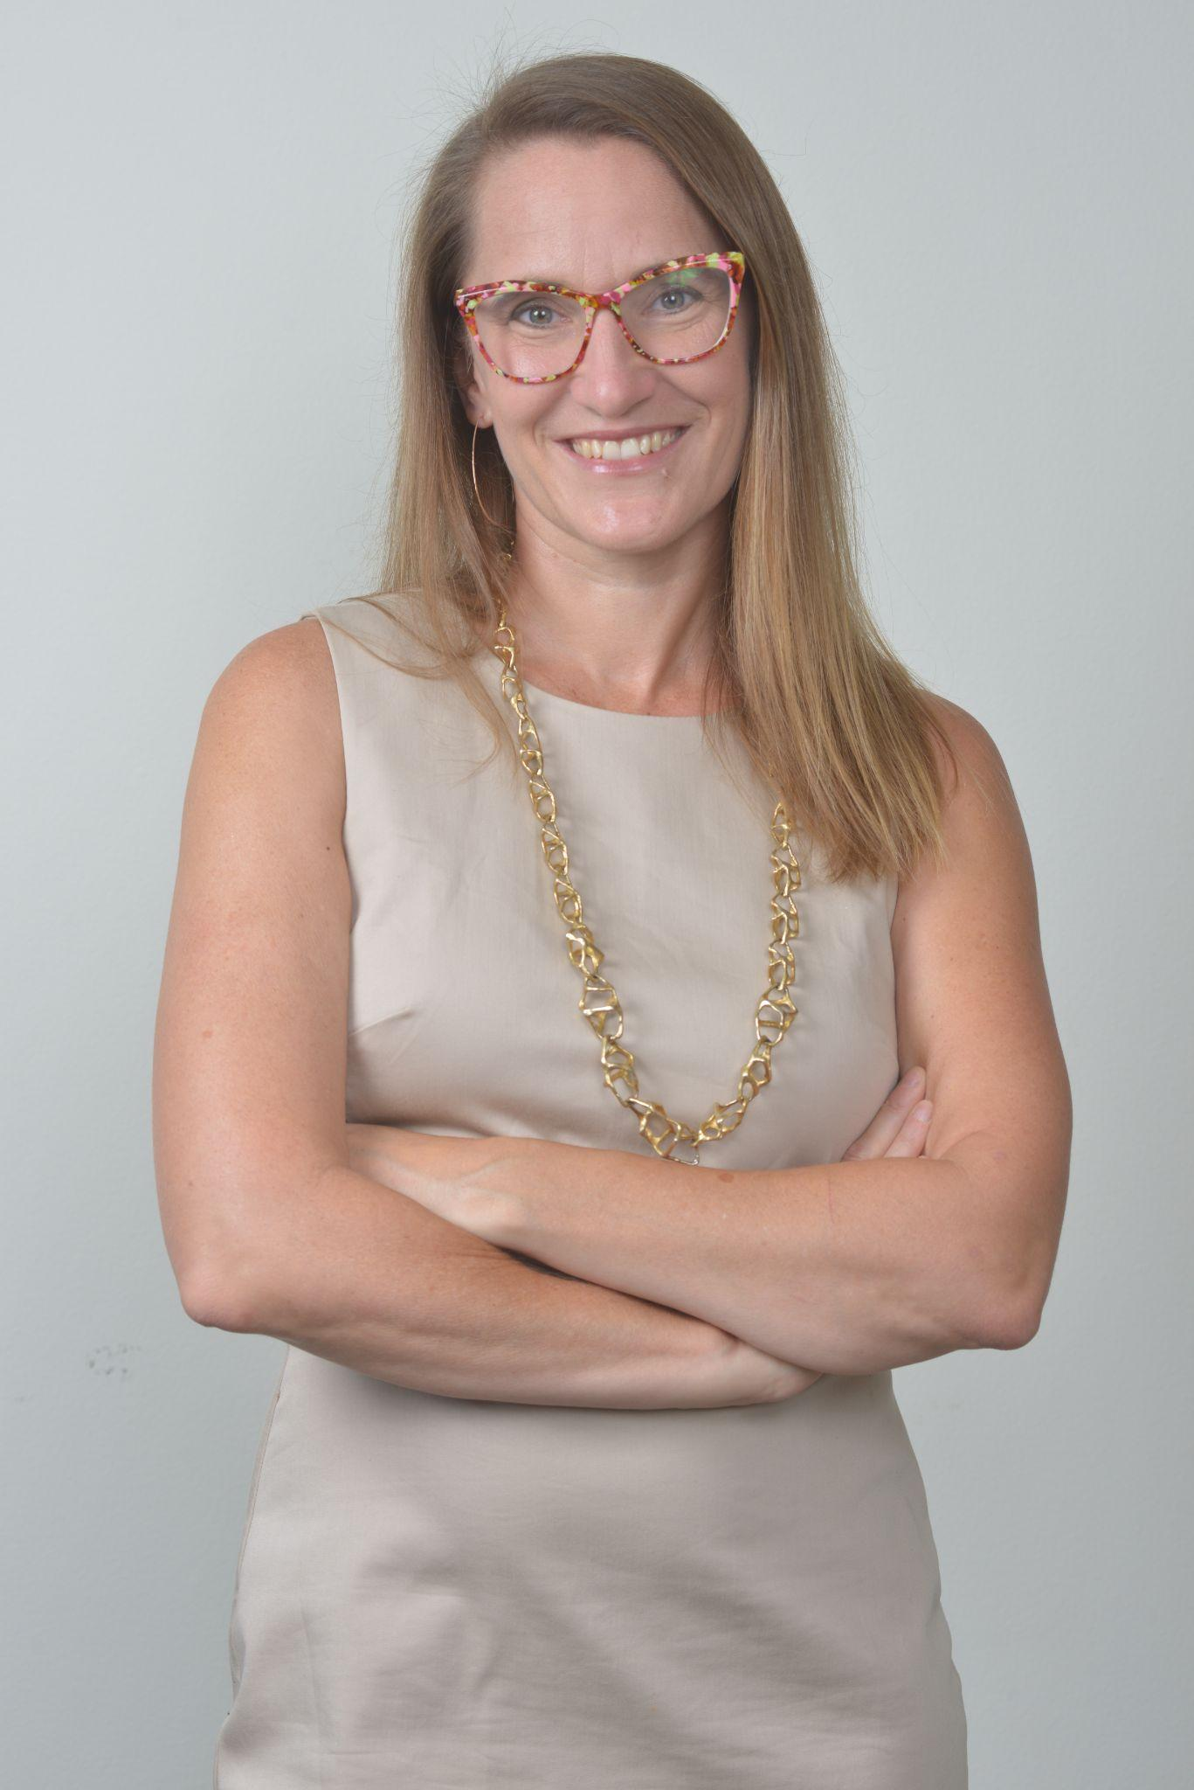
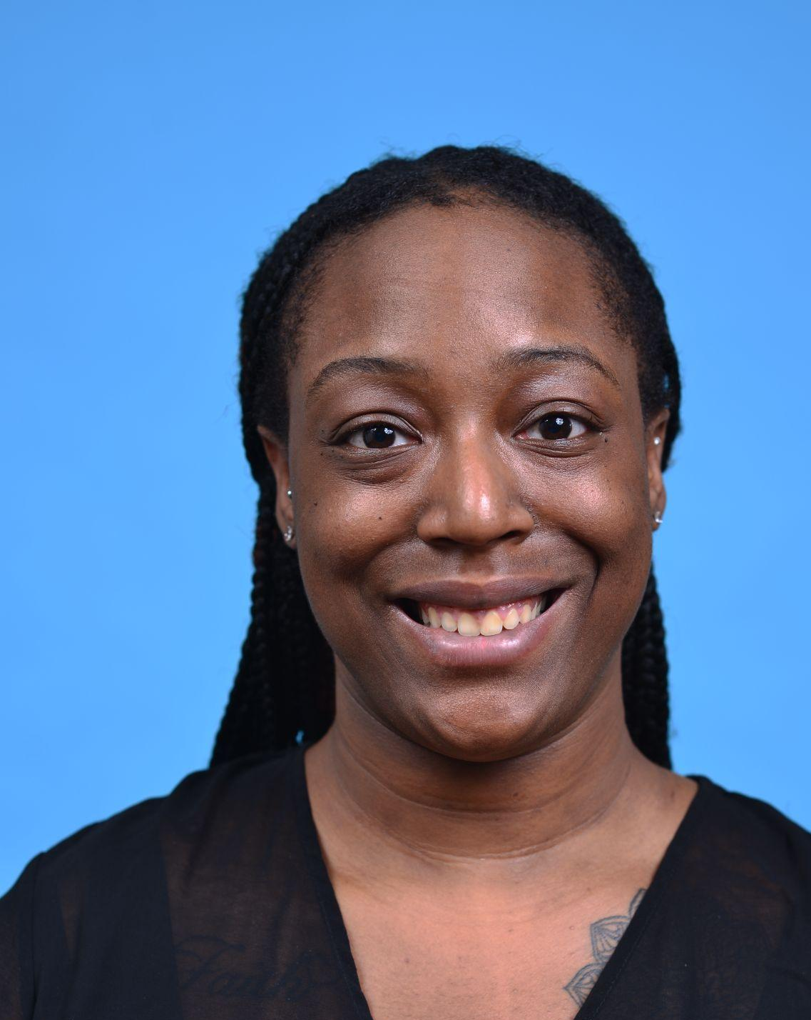
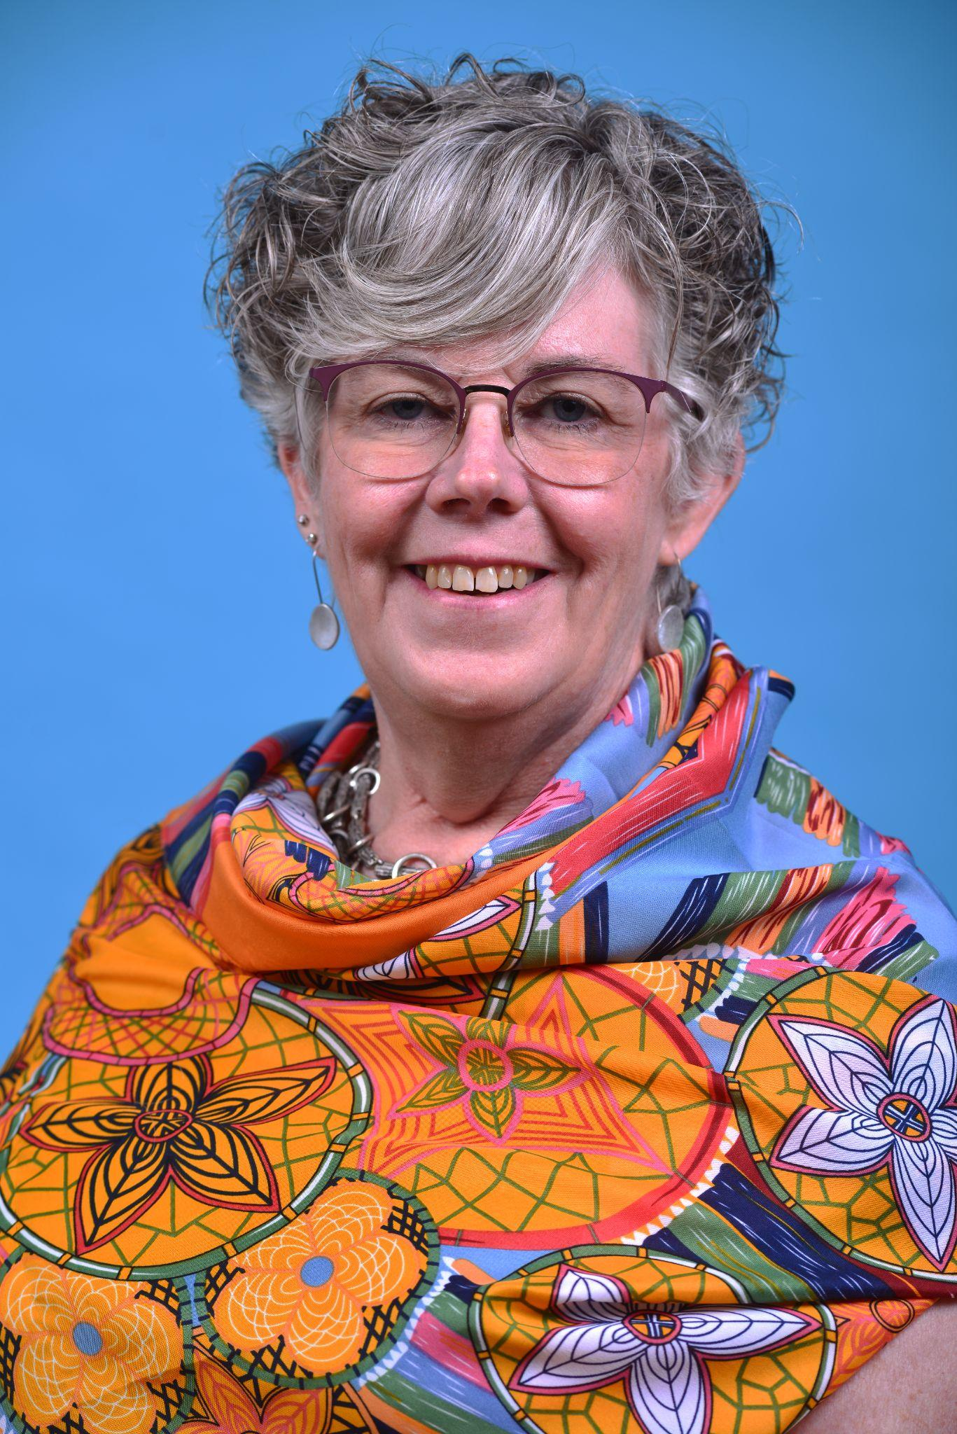
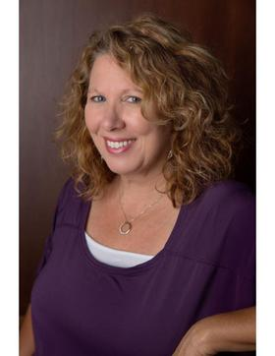
About RTSC: Meet our Team
The Recruitment, Training and Support Center (RTSC) for Special Education Surrogate Parents (SESPs) is a project of the Federation for Children with Special Needs. Federal education law (IDEA) requires a student’s parents or guardians be included in the special education decision-making process. However, children in state custody may not have anyone to fill that role. In Massachusetts, those children depend on SESPs to protect their legal right to a free and appropriate education.
The mission of the RTSC is to ensure that every child in state custody receives the educational supports they need to succeed. We strive to meet this goal by recruiting volunteers from across the state and providing them with the training and support they need to be effective Special Education Surrogate Parents (SESPs).
Andrea Parker, EdM
Project Director
Kendra Watkins
Project Associate
Mary-Beth Landy
Senior Trainer and Support Specialist
Elaine Arsenault
Trainer and Support Specialist

Slide 19
Recent Recordings and Upcoming Events:

Slide 20
LEA Recruitment Program
School Districts are our strongest partners!
We provide LEAs with the guidance, tools, and supports needed to initiate recruitment programs within their school districts.
Is your District interested in partnering to recruit retired teachers, professionals, as well as “aging-out” caregivers, to serve in this vital role for the most vulnerable children in the state? We will provide 15 minute info sessions for your SEPAC and/or School Committee.
In partnership, RTSC offers Developmental Childhood Trauma Training at a free/reduced cost to all participating LEAs (In-Service, Continuing Education, Professional Development.
Join us in ensuring that your students in state care and custody receive appropriate special education supports!
Developing and Sustaining Trauma-informed schools!

Slide 21
RTSC: Recruiting
Current or former Equity-minded special education teachers and administrators
Social Workers, counselors, psychologists
Caretakers/parents familiar with or motivated to learn about special education
Community members who are involved in a child/youth’s life
Attendees at resource fairs and conferences we attend (Youth at Risk, A View from all Sides, Fathers and Families)
Individuals with specific knowledge and experience (LGBTQ+, Inclusion and Trauma Specialists, specific disability knowledge)
SEPAC and School Committee Members
There are currently 322 potential individuals in the varying processes to become an SESP

Slide 22
Training
Required 2 hour Orientations (weekly)
2 hour Trauma Training (monthly)
2 hour Transition Training (bi-monthly)
2 hour Discipline and Suspension Training
Monthly Webinars such as:
Antiracism and Universal Design for Learning
Serving and Supporting LGBTQ+ students
Wellness and Self-Care for support professionals
Access to all Federation Trainings such as basic rights, the Parent Consultant Training Institute (PCTI) and Connecting Families
Networking monthly with SEPACs and PCTI Graduates
Annual Conference: Making a Difference
2 Keynotes, 2 sessions with 8 concurrent workshops
LICSW CEUs eligible
During the last year, over 3,000 individuals have been trained.

Slide 23
Supporting
SESPs who feel supported, keep doing the job!
1 and 3 month follow-up calls with SESPs, after appointment begins
Daily support calls and emails for issues that arise doing appointments (24-48 hour turn-around)
Quarterly updates and bi-annual needs assessment
SESP zoom support sessions
Monthly networking sessions with SEPACs and PCTI graduates
Private Facebook Group
At this point of the year, over 1,100 follow up calls have be made to newly appointed SESPs

Slide 24
Thank you!
Contact RTSC
fcsn.org/rtsc
rtsc@fcsn.org
617-399-8342
Become an SESP
RTSC Brochure
Online Application
Register for an Orientation
CORI Form
Trainings
SESP Orientation Training
Trauma
Discipline and Suspension
Monthly Webinars
Sign up on our Events Calendar
SESP Supports
Contact a Support Specialist
SESP Zoom Support Meeting
Consider This Newsletter
Networking Meetings
Other Support

Slide 25
Making a Difference Conference Registration is Now Open
Registration is now open!

Slide 26
Where can I get more information?
SESP Program Director
Megan Ronzio
508-792-7679 x5811
mronzio@sespprogram.org
www.sespprogram.org
RTSC Director
Andrea Parker
857-636-8030
aparker@fcsn.org
https://fcsn.org/rtsc/

Slide 27
Special Education Updates
02

Slide 28
ESY Transportation
As IEP teams meet throughout the year, it is important for them to determine transportation arrangements for students with disabilities who are entitled to extended school year (ESY) services.
Students who receive ESY services are entitled to transportation if they need it to benefit from special education ESY services.
A student may need transportation to benefit from special education ESY services even if they don't receive "special" or "specialized" transportation during the regular school year.

Slide 29
Indicator 14: Post-School Outcomes for Students with IEPs

Slide 30
Why is Indicator 14 important?
Indicator 14 is one of the 17 Indicators that the U.S. Department of Education’s Office of Special Education Programs (OSEP) uses to determine whether school districts are following the federal special education law and whether special education is improving outcomes for students with disabilities.
Indicator 14 reports whether our students with Individualized Education Programs (IEPs) are in school or have a job one year after they leave high school by graduating, aging out at age 22, or dropping out. It is one way to help us understand whether students’ education prepared them for adult life.

Slide 31
Data Collection Timeline
Districts in Cohort 3 are currently surveying “exiters” from the 2020/2021 school year. As a reminder, starting in 2023, Indicator 14 will move to statewide collection with all districts surveying “exiters” every year.
Data collection started on June 1, 2022 and will end on September 30, 2022.
As of last Friday (9/9) there were 496 completed surveys across 46 districts. There are still 29 districts who have not had a survey submitted. We are asking that districts in Cohort 3 continue to reach out to their “exiters” to ensure a high response rate.
For more information about Indicator 14 data collection please contact Greg Tobey, DESE’s Office of Special Education Planning and Policy, gregory.tobey@mass.gov or 781-338-3378.

Slide 32
The IEP Improvement Project
To improve outcomes for all students with disabilities by providing guidance, technical assistance, and tools on equitable processes to school and district professionals, families, and students so that all students with disabilities have meaningful access to the curriculum frameworks and life of the school.
If students with disabilities have meaningful access to the curriculum frameworks and the skills to engage in all aspects of the life of the school, then we will begin to close the opportunity and achievement gaps between students with disabilities and their age-appropriate non-disabled peers.
Project Goal
Improve Outcomes
Meaningful Access
Theory of Change
Close Opportunity & Achievement Gaps

Slide 33
MA DESE Special Education Forms
Referral, Evaluation, Eligibility Guide
Parent’s Guide to Special Education
Systems Improvement Playbook
IEP Process Guide

Slide 34
Early Adopters Systems Work

Slide 35
Time-Out Rooms: Observations and Discussions
Reducing or Eliminating the Use of Time-Out Rooms
All OASES and PSM Monitoring Reviews will include:
Observations of time-out rooms to assess whether they are “clean, safe, sanitary, and appropriate for the purposes of calming,” as required by 603 CMR 46.02.
For example, adequate size and ventilation
Free from hazards (exposed electrical outlets, exposed wiring, etc.)
Student is continuously observed
Review of logs utilized to collect, review, and analyze data regarding time-out room usage.

Slide 36
MCB Upcoming Activities
05

Slide 37
Massachusetts Commission for the Blind (MCB)
Upcoming Activities

Slide 38
MCB White Cane Awareness Day Virtual Celebration
Join MCB for our White Cane Awareness Day Virtual Celebration to learn about the history of the white cane, the “White Cane Law”, white cane benefits, different types of canes, traveling recommendations and more.
Hear from inspiring individuals who use white canes to travel to work, school and community engagements. Get information about support groups across the state and meet MCB's Orientation & Mobility (O&M) team.
For more information and to register go to: https://www.mass.gov/event/mcb-white-cane-awareness-day-virtual-celebration-2022-10-14t100000-0400-2022-10-14t113000-0400
Friday, October 14, 2022
10 a.m. - 11:30 a.m.

Slide 39
Meg Robertson Mobility Award
In recognition of former O&M Director Meg Robertson, MCB developed the Meg Robertson Mobility Award to be presented annually at the White Cane Awareness Day Celebration event every October. The award highlights Meg’s hard work, dedication, and advocacy to the blindness community with over 30 years of service.
The award celebrates the white cane and its impact in the lives of individuals who are blind and visually impaired.
Nominations are open to long cane users of all ages and abilities who demonstrate mobility skills at their level and incorporate the cane into their lives to increase independence.
Nominations should include the following:
How has an individual's travel ability with a cane improved since the beginning of O&M instruction to their current level?
Where does the person travel with a cane?
How has O&M made a difference in their life?
Submit a Nomination for the Meg Robertson Mobility Award
The nomination form must be completed by a Certified Orientation and Mobility Specialist (COMS) and will be presented at the annual White Cane Day event.

Slide 40
Special Education Leaders Meetings for SY2022-2023
2022
2023
Friday, October 21, 2022 - Noon to 1pm
Friday, November 18, 2022 - Noon to 1pm
No meeting in December 2022
Friday, January 20, 2023 – Noon to 1pm
Friday, February 10, 2023 – Noon to 1pm
Friday, March 24, 2023 – 11am to noon
Friday, April 28, 2023 – 11am to noon
Friday, May 26, 2023 – 11am to noon
Friday, June 23, 2023 – 11am to noon

Slide 41
Questions and Answers
05

