Slide 1
Special Education Leaders' Meeting
October 21, 2022

Slide 2
CONTENTS
01
MA Commission for the Blind
02
Early Literacy Regulations
03
Special Education Updates
04
Questions and Answers

Slide 3
MA Commission for the Blind
01

Slide 4

Massachusetts Commission for the Blind
Accessible Instructional Materials (AIM) Library
Carrie Brasier, Director
October 2022

Slide 5
AIM LIBRARY KEY POINTS
AIM Library/APH resources are FREE to districts
Eligibility = Assurance Forms are due every year in September
Braille and large print needs to be requested in the spring for the following school year
If a student is legally blind, braille must be considered
NIMAS is FREE = All districts should OPT IN to NIMAC and NIMAS. Language should be in every LEA purchasing contract.

Slide 6
A FREE RESOURCE FOR LEAs
The Massachusetts Accessible Instructional Materials (AIM) Library is a FREE resource for districts to help provide blind AND visually impaired students with an appropriate education.
We can coordinate braille and large print textbooks, assistive technology devices, and many other accessible instructional materials to support and improve quality education and the expanded core curriculum.
The library operates under the Massachusetts Commission for the Blind (MCB) through an interagency service agreement with the Massachusetts Department of Elementary and Secondary Education (DESE).

Slide 7
WHO IS ELIGIBLE FOR FREE MATERIALS?
Any student resident with special educational needs regarding vision, legally blind as well as visually impaired, as determined by TEAM decision, to age 22 (or to the age a high school diploma is attained, i.e., college students are not eligible) can be eligible for services.

Slide 8
$1.5 MILLION EACH YEAR
FOR FREE ACCESSIBLE MATERIALS TO DISTRICTS
The AIM Library provides on a first come first serve basis. Braille and large print should be requested in the spring to ensure timely delivery.
AIM Library materials may only be requested through certified teachers of the visually impaired (TVIs).
On any given year the Library supports more than 2,000 students. As student needs and curriculums fluctuate year to year, so does our provisional scope and the number of materials we are able to provide.
School districts are responsible for securing items the Library is unable provide.

Slide 9
STUDENT REGISTRATION – 2 FORMS
For the purposes of state and federal funding, two documents must be filed with the AIM Library as evidence of the student’s educational program and eligibility.
1. Assurances Form (AF)
To be signed by the Special Education Director or equivalent and are required every school year prior to materials requests. This form reflects the appropriate assessments, current medical records, and a written education plan are on file where the student attends school. The actual assessments, reports and plans are not to be submitted to the AIM Library.
2. Parent Consent Form (PC)
To be signed by parent or guardian to allow the AIM Library to exchange student information as required for funding purposes. This form in needed only once unless the student changes districts or until the student turns 18, then they must sign an Over 18 Consent Form (O18C).

Slide 10
ASSURNACES FORM
SIGNED BY SPED DIRECTOR
Written education plan
Medical eye report
Learning Media Assessment (LMA)
Functional Vision Assessments (FVA)
Low Vision Evaluation (LVE)
Assistive Technology Assessments (ATA)
Orientation & Mobility Assessment (OMA).
Transition Plan and Independent Living Skill Assessment (TILSA) (if age appropriate)

Slide 11
FREE MATERIALS FROM AMERICAN PRINTING HOUSE FOR THE BLIND THROUGH AIM LIBRARY
APH materials are FREE through the AIM Library. The Federal Quota Program was initiated in 1879 by the Federal Act to Promote the Education of the Blind.

Slide 12
APH FEDERAL QUOTA CENSUS
IS DONE YEARLY
APH Census is conducted every January and generates funding for October 1st through September 30th the following year.
The appropriation from Congress is divided by the total number of eligible students nationally, thus determining the per capita Federal Quota allocation.
We pool our funds in Massachusetts. We have a warehouse that enables us to collect, clean and recirculate APH materials.
Not reporting students by the due date will result in your district not being able to access FREE AIM APH materials.

Slide 13
FREE BRAILLE LITERACY MATERIALS
All Aboard! The Sight Word Activity Express | 1-03558-00
Alphabet Scramble | 5-01199-00
Best for a Nest | 5-12301-01
BOP Pre-K Teacher | 8-78534-00
Student | 6-78530-00
BOP K Teacher | 8-78451-00
Student | 6-78550-00
BOP First Grade (By Unit) | aphbop.org
BOP- Second (By Unit) | aphbop.org
Braille Beads | 1-08879-00
Braille Buzz | 1-03935-00
Braille Contraction Cards, | 1-03561-01
Expanded Dolch Word Cards | 1-03560-01
Fun with Braille (4th grade level+) Braille | 7-00110-01
Large Print | 5-00110-01
Holy Moly (first touch book, Birth to 3) | 6-77910-00
Hop-A-Dot | 1-08819-00
Illinois Braille Series Book 1 Print | 7-17230-01
I-M-ABLE Kit | 1-00351-00

Slide 14
FREE BRAILLE LITERACY MATERIALS
Laptime and Lullabies | 6-77701-00
Light Touch Brailler | 1-00815-00
Lots of Dots Learning My ABC’s | 1-10000-01
On the Way to Literacy: Early Experiences for Children with VI | 8-77520-00
Pop-A-Cell | 1-17002-00
Quick Pick Braille Contractions | 1-03576-01
Six Little Dots | 6-77954-00
Six Dots Game of Cards | 1-03569-00
Slates and styluses | www.aph.org
SMART Brailler | 1-00820-00
Swing Cell Compact, Big Cell | 6-78041-00
Teaching Touch | 1-08861-00
Touch and Tell | 6-44670-00
Word Associations Print/Braille Labels | 8-39050-00
Word PlayHouse | 1-03562-00

Slide 15
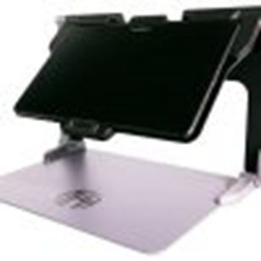
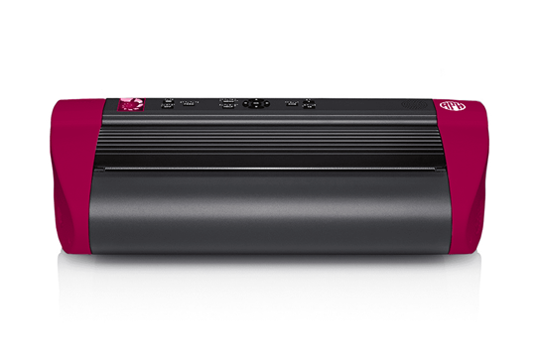
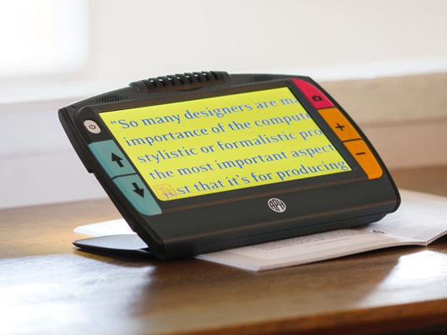

FREE APH AT DEVICES
MattConnect | 1-03941-00 | $3,220.00
Jupiter | 1-00370-00 | $3,599.00
Juno | 1-00380-00 | $1,392.00
Mantis Q40 | 1-08470-00 | $2,682.00
Chameleon 20 | 1-08471-00 | $1,715.00
PageBlaster | 1-08075-00 | $4,295.00
PixBlaster | 1-08070-00 | $4,295.00

Slide 16
NIMAC
NATIONAL INSTRUCTIONAL MATERIALS ACCESS CENTER
Created by IDEA 2004, the NIMAC is a FREE OSEP resource. Districts need to “opt in.” There is no fee to district for checking that box.
The NIMAC is a database where publishers send their textbook files, called NIMAS files.
NIMAS files are not for student distribution. NIMAS files are used by the AIM Library help expedite the production of accessible instructional materials.

Slide 17
NIMAS SAMPLE PURCHASE ORDER LANGUAGE
FOR LEAs TO REQUEST NIMAS FILES
By agreeing to deliver the materials marked with “NIMAS” on this contract or purchase order, the publisher agrees to prepare and submit on or before (30/60/90 days), a NIMAS file set to the NIMAC that complies with the terms and procedures set forth by the National Instructional Materials Access Center (NIMAC) (IDEA Title I, Part D, sec. 674(e)).
The publisher also agrees to mark up materials eligible for NIMAS submission that contain mathematical and scientific instructional content by using the MathML modular extension of the DAISY/NIMAS Structure Guidelines, as posted and maintained at the DAISY Consortium website DAISY3/part2-math
Files will be used to produce alternate formats as permitted under the law for students with print disabilities.
Should the vendor be a distributor of the materials and not the publisher, the distributor agrees to immediately notify the publisher of its obligation to submit NIMAS file sets of the purchased materials to the NIMAC.

Slide 18
MASSACHUSETTS BRAILLE LITERACY ACT OF 1996
Signed into law August 1996
https://www.mass.gov/service-details/massachusetts-braille-bills-signed-into-law
Whenever a student is blind, they must be assessed through a learning media assessment to determine the appropriateness of braille as their learning media.

Slide 19
WHAT IS CHAPTER 688/TURNING 22?
Massachusetts “Turning 22 law” enacted in 1984 to address transition planning needs of students with significant disabilities who will need adult services.
(At least) a two-year formalized planning process
Assigns Lead Transitional Agency
Development of an Individual Transition Plan (ITP)
Chapter 688 is NOT:
Continuation of Special Education
Adult Eligibility Determination
Entitlement to adult services

Slide 20

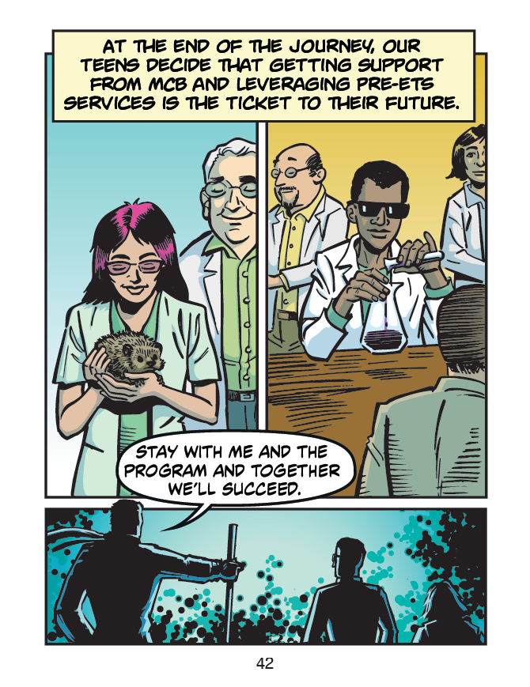
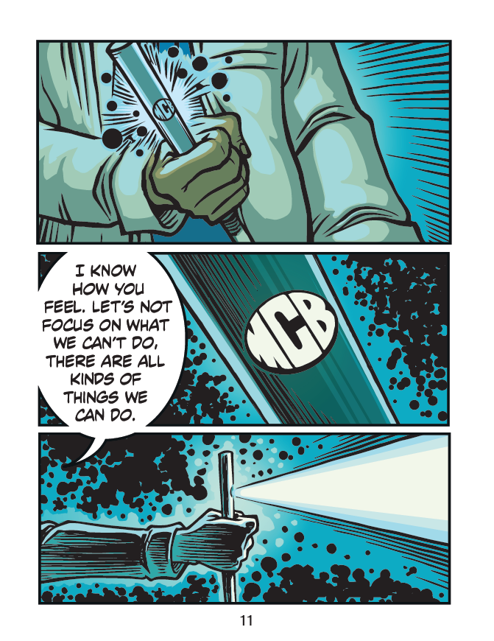
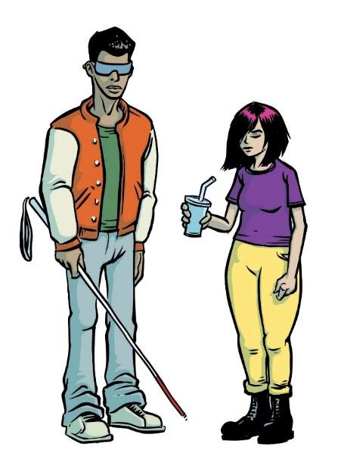
The Quest for Independence Graphic Novel

Slide 21
PROJECT GOALS/DESIRED OUTCOMES
Employment = Independence & Self-Determination
Engage visually impaired students early
Inform teens, parents, and counselors about Pre-ETS services and support
Help Youth understand that the actions they take now contribute to their future success in finding a job and living independently.

Slide 22
CONTACT AIM LIBRARY
Director
Carrie Brasier: Carrie.Brasier@mass.gov
Mobile: 781-540-4418
Registration Coordinator
Barbara Zbyszewski: Barbara.Zbyszewski@mass.gov
Mobile: 781-540-4432
Website: www.aimlibrary.org
All forms can be found on the website.
Office: 781-562-0461
Fax: 781-562-0463
Shipping address:
AIM Library
3 Randolph Street
Canton, MA 02021

Slide 23
Early Literacy Regulation Amendment
04

Slide 24
New Early Literacy Regulation
Each school district shall at least twice per year assess each student’s reading ability and progress in literacy skills, from kindergarten through at least third grade, using a valid, developmentally appropriate screening instrument approved by the Department;
If such screenings determine that a student is significantly below relevant benchmarks for age-typical development in specific literacy skills, the school shall determine which actions within the general education program will meet the student’s needs, including differentiated or supplementary evidence-based reading instruction and ongoing monitoring of progress;
Within 30 school days of a screening result that is significantly below the relevant benchmarks, the school shall inform the student’s parent or guardian of the screening results and the school’s response and shall offer them the opportunity for a follow-up discussion.
Read the new regulation here.

Slide 25
Implementation Supports
Information on the approved Early Literacy Universal Screening Assessments can be found here. The assessments are designed to be brief and easy to administer. The Department will offer grants during the current school year to help schools and districts implement an approved screener.
Further guidance on administering approved early screeners and family communication will be coming in spring 2023.

Slide 26
Special Education Updates
02

Slide 27
SY 2022-2023 Determinations of Need for Special Ed
IDEA requires DESE make annual LEA determinations of need for special education.
  Assessment of LEAs' performance and compliance
Please note the highlighted changes to the calculations for SY 2022-2023
LEA FAQ is forthcoming for SY 2022-2023
Annual Dropout Rate (2021) | 5-Year Cohort Graduation Rate (2020) Points x 1.5 | Public School Monitoring Compliance (SY 2021-2022) | Problem Resolution System Letters of Finding Issued per 1000 SWD (SY 2021-2022) | Special Education SPP/APR Compliance Indicators (4B, 9, & 10) (SY 2020-2021) | Special Education SPP/APR Compliance Indicators (5 &6) (SY 2021-2022) Points x2 | Significant Disproportionality Data (SY 2021-2022 & SY 2022-2023)

Slide 28
SY 2022-2023 Determinations of Need for Special Ed TA or Intervention
MA uses the following categories:
Meets Requirements (MR) | Needs Assistance (NA) | Needs Intervention (NI) | Needs Substantial Intervention (NSI)
Special Education Determination Percentage 75.0-100.0 | Special Education Determination Percentage 65.0-74.9 | Special Education Determination Percentage 0-64.9 | A substantial failure to comply with a condition of LEA eligibility under Part B of the IDEA (300.200 – 300.213)

Slide 29
SY 2022-2023 Technical Assistance and Intervention
Existing accountability and assistance liaisons from DESE offices will collaborate to ensure a coordinated approach:
  Special Education Planning and Policy office (SEPP)
  Office of Public School Monitoring (PSM)
  Statewide System of Support (SSOS)
  Office of School Turnaround (OST)
  Office of Charter Schools & School Redesign (CSSRD)
Communication will be provided directly to LEAs about tailored supports and the identification of a DESE liaison who will serve as the primary point of contact.

Slide 30
What is a Chapter 688 Referral?
A Chapter 688 referral is a way to help adult agencies, schools, and families to identify and plan ahead for needed adult services for students with severe disabilities. Schools send a Chapter 688 referral electronically to the adult agency that the IEP Team thinks might be able to meet a student’s needs when the student graduates from high school or turns 22.
“A 688 referral is not an application for agency eligibility. Schools submit the 688 referral, but families are responsible for submitting an application to the agency. Agencies must receive a complete application so they can decide whether the student will be eligible to receive adult services.

Slide 31
Who should have a Chapter 688 Referral?
To have a Chapter 688 referral, a student must:
  Have an Individualized Education Program (IEP)
  Need continuing services because of the severity of their disability
  Be unable to work 20 or more hours per week in competitive employment

Slide 32
Why is Chapter 688 Referral Important?
The Chapter 688 referral process is important for two reasons:
(1) It allows adult agencies to advocate for funding from the state legislature to serve students with disabilities when they exit from school.
(2) The Chapter 688 referral also alerts the adult agency to work with the student, family, and school to complete an Individualized Transition Plan (ITP) that will help to plan the supports the student may need after they exit school.

Slide 33
Tips for 688 Referrals
TIP 1: Learn the steps in the Chapter 688 referral process
TIP 2: Learn about the adult agencies
TIP 3: Learn what the family is responsible for after the school makes the Chapter 688 referral
TIP 4: Learn how to connect to other community resources

Slide 34
Chapter 688 Referral Resources
Advisory
Technical Assistance Advisory SPED 2021-2: Students with Autism and Application for Department of Developmental Services Adult Eligibility - Special Education (mass.edu)
Chapter 688
Chapter 688 Information and Referral Forms - Special Education (mass.edu)
688 Referral Form
referral-form.docx (live.com)
Brochure
Chapter 688 Referral Parent/Student Brochure (mass.edu)

Slide 35
Coordinated Pandemic-
Related Transition Services

Slide 36
What are Coordinated Pandemic-Related Transition Services?
“To address the needs of individuals with IEPs who reached or will reach age 22 during the COVID-19 pandemic, the Commonwealth has enacted Chapter 42 of the Acts of 2022 allocating $10 million for transition “services for individuals with disabilities that reached age 22 between March 10, 2020, and September 1, 2023, and were entitled to special education services up to age 22.”

Slide 37
Agencies Providing Services
The Department is currently collaborating with state agencies that provide adult services to qualifying individuals with disabilities.​
Department of Developmental Services (DDS)​
Massachusetts Rehabilitation Commission (MRC)​
Massachusetts Commission for the Blind (MCB)​
Massachusetts Inclusive Concurrent Enrollment Initiative (MAICEI) - starting in January 2023​
These agencies will expand their services to provide supports for eligible young adults.

Slide 38
Connecting Students and Families to Services
Each agency will look at the young adults that they already serve to see if they meet the criteria​.
Each agency will use social media to post information about available services​.
DESE is seeking assistance from districts to reach out to former students who meet the criteria to provide information.
DESE is seeking assistance from educator groups, community groups, and advocacy groups in providing information to eligible young adults.

Slide 39
The Federation for Children with Special Needs
The Federation may be the first point of contact for individuals and their families​
Ask what supports they are interested in, or describe what services are being offered ​
Ask where they are located (some services are only offered in specific locations)​
Provide the caller with the contact information of the agency providing the services that will best meet their needs.

Slide 40
Did you turn 22 during COVID?
If you:
  Turned 22 after March 10, 2020
  Remained enrolled in school until you
  turn 22 and have completed school
  Then you may be eligible for services now.
Participating state agencies: Massachusetts Commission for the Blind (MCB), Massachusetts Inclusive Concurrent Enrollment Initiative (MAICEI), Department of Developmental Services (DDS) and Massachusetts Rehabilitation Commission (MCB).
To find out more about extra services available to you call 1-800-331-0688 or go to www.fcsn.org/transition-support

Slide 41
Department of Developmental Services
  Family Support Centers will offer a variety of groups that appeal to the personal interests of the participants. The groups will be provided in the evenings and on the weekends and be offered in person. A group can consist of two or more eligible participants.
Support offered through Family Support Centers:
  Berkshire County ARC, Pittsfield
  Better Community Living, Dartmouth and New Bedford
  ARC of Greater Brockton, Brockton
  Communitas, Wakefield
  Plymouth County Family Support, Plymouth
  People Inc., Fall River
Groups could include:
  Healthcare management
  Nutritional information and healthy eating practice
  Emergency-situation practice
  Technology skills
  Computer and Phone use
  Social Media and Internet Safety
  Self-Advocacy Skills
  Civic Participation Groups
  Networking and Social Skills
  Travel Safety and Practice (Public Transit, Ubers)
  Social Skills

Slide 42
Massachusetts Commission for the Blind
MCB will identify individuals for engagement in available and appropriate MCB programs. MCB will offer a service voucher that will allow consumers to purchase the services that appeal to the consumer.
Services could include:
Assistive Technology skills
Computer and Smart Phone use
Social Media and Internet utilization
Self-Advocacy Skills
Civic Participation Groups
Networking and Social Skills
Orientation and Mobility Training (Public Transit, ride share)
Social Skills Groups

Slide 43
Massachusetts Rehabilitation Commission
MRC will identify individuals for engagement in available and appropriate MRC programs. This may include Vocational Rehabilitation Services or NextGen Services.
Vocational Services could include:
  Vocational Counseling and Guidance
  Training/Educational opportunities leading to employment
  Job Placement Assistance
  Benefits Counseling
  Participation in Youth Leadership Forum
NextGen Services could include:
  Learning, development, and mentoring in the areas of self-capacity, self-advocacy, self-realization, and self -sufficiency
  Access to an Integrated Resource Team to provide wraparound support for employment goals
  Development of a Career Focused Portfolio
  Peer mentorship and Family Partnership
  Internships and Apprenticeship opportunities in STEM fields
  Benefits Counseling and Job Placement Assistance

Slide 44
Massachusetts Inclusive Concurrent Enrollment Initiative
MAICEI Programs offer a fully inclusive college experience for students with documented intellectual, developmental disabilities and autism to learn alongside their non-disabled peers.
Services include
Fully inclusive college experience
Full use of all campus services
Academic Support (Education Coach to assist in the classroom)
Social Support – Student Peer Mentors (introduce students to campus activities)
Navigation Skills
Time Management Skills
Internships
Person Centered Planning
Independent Living Skills

Slide 45
Updated Sections of the Draft IEP Form
Stakeholder Feedback Analysis
  Identified Trends and Patterns
  Updated Sections for use with Early Adopter Schools and Districts
Early Adopters
  Piloting Select Sections September through November 2022
  Feedback to be collected and will inform updates for final version

Slide 46
The IEP Improvement Project
To improve outcomes for all students with disabilities by providing guidance, technical assistance, and tools on equitable processes to school and district professionals, families, and students so that all students with disabilities have meaningful access to the curriculum frameworks and life of the school.
If students with disabilities have meaningful access to the curriculum frameworks and the skills to engage in all aspects of the life of the school, then we will begin to close the opportunity and achievement gaps between students with disabilities and their age-appropriate non-disabled peers.
Project Goal
Improve Outcomes
Meaningful Access
Theory of Change
Close Opportunity & Achievement Gaps

Slide 47
IEP Improvement Project Resources
Referral, Evaluation, Eligibility Guide
Parent’s Guide to Special Education
MA DESE Special Education Forms
Systems Improvement Playbook
IEP Process Guide

Slide 48

IEP Improvement Process Timeline
Nov – Dec 2022
Spring/Summer 2023
Winter 2023
SY 23-24
Fall 2024
Finalize Forms
Initial Training for Schools and Districts
Continued Training and Technical Assistance
Schools and Districts May Begin Adopting the New Process and Form
Full Adoption Statewide

Slide 49

MCAS Alt. Training for Administrators
Upcoming training for administrators or anyone who oversees teachers compiling the alternate assessment
Two sessions are available:
October 26: 1:30-3:00
November 2: 1:30- 3:00
Link to register: Administrator’s Session for the MCAS-Alt

Slide 50
Special Education Leaders Meetings for SY2022-2023
2022
2023
Friday, October 21, 2022 - Noon to 1pm
Friday, November 18, 2022 - Noon to 1pm
No meeting in December 2022
Friday, January 20, 2023 – Noon to 1pm
Friday, February 10, 2023 – Noon to 1pm
Friday, March 24, 2023 – 11am to noon
Friday, April 28, 2023 – 11am to noon
Friday, May 26, 2023 – 11am to noon
Friday, June 23, 2023 – 11am to noon

Slide 51
Questions and Answers
05

