Slide 1
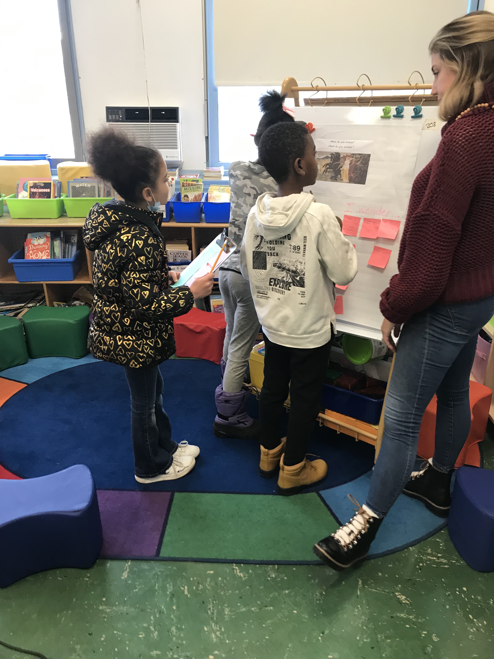
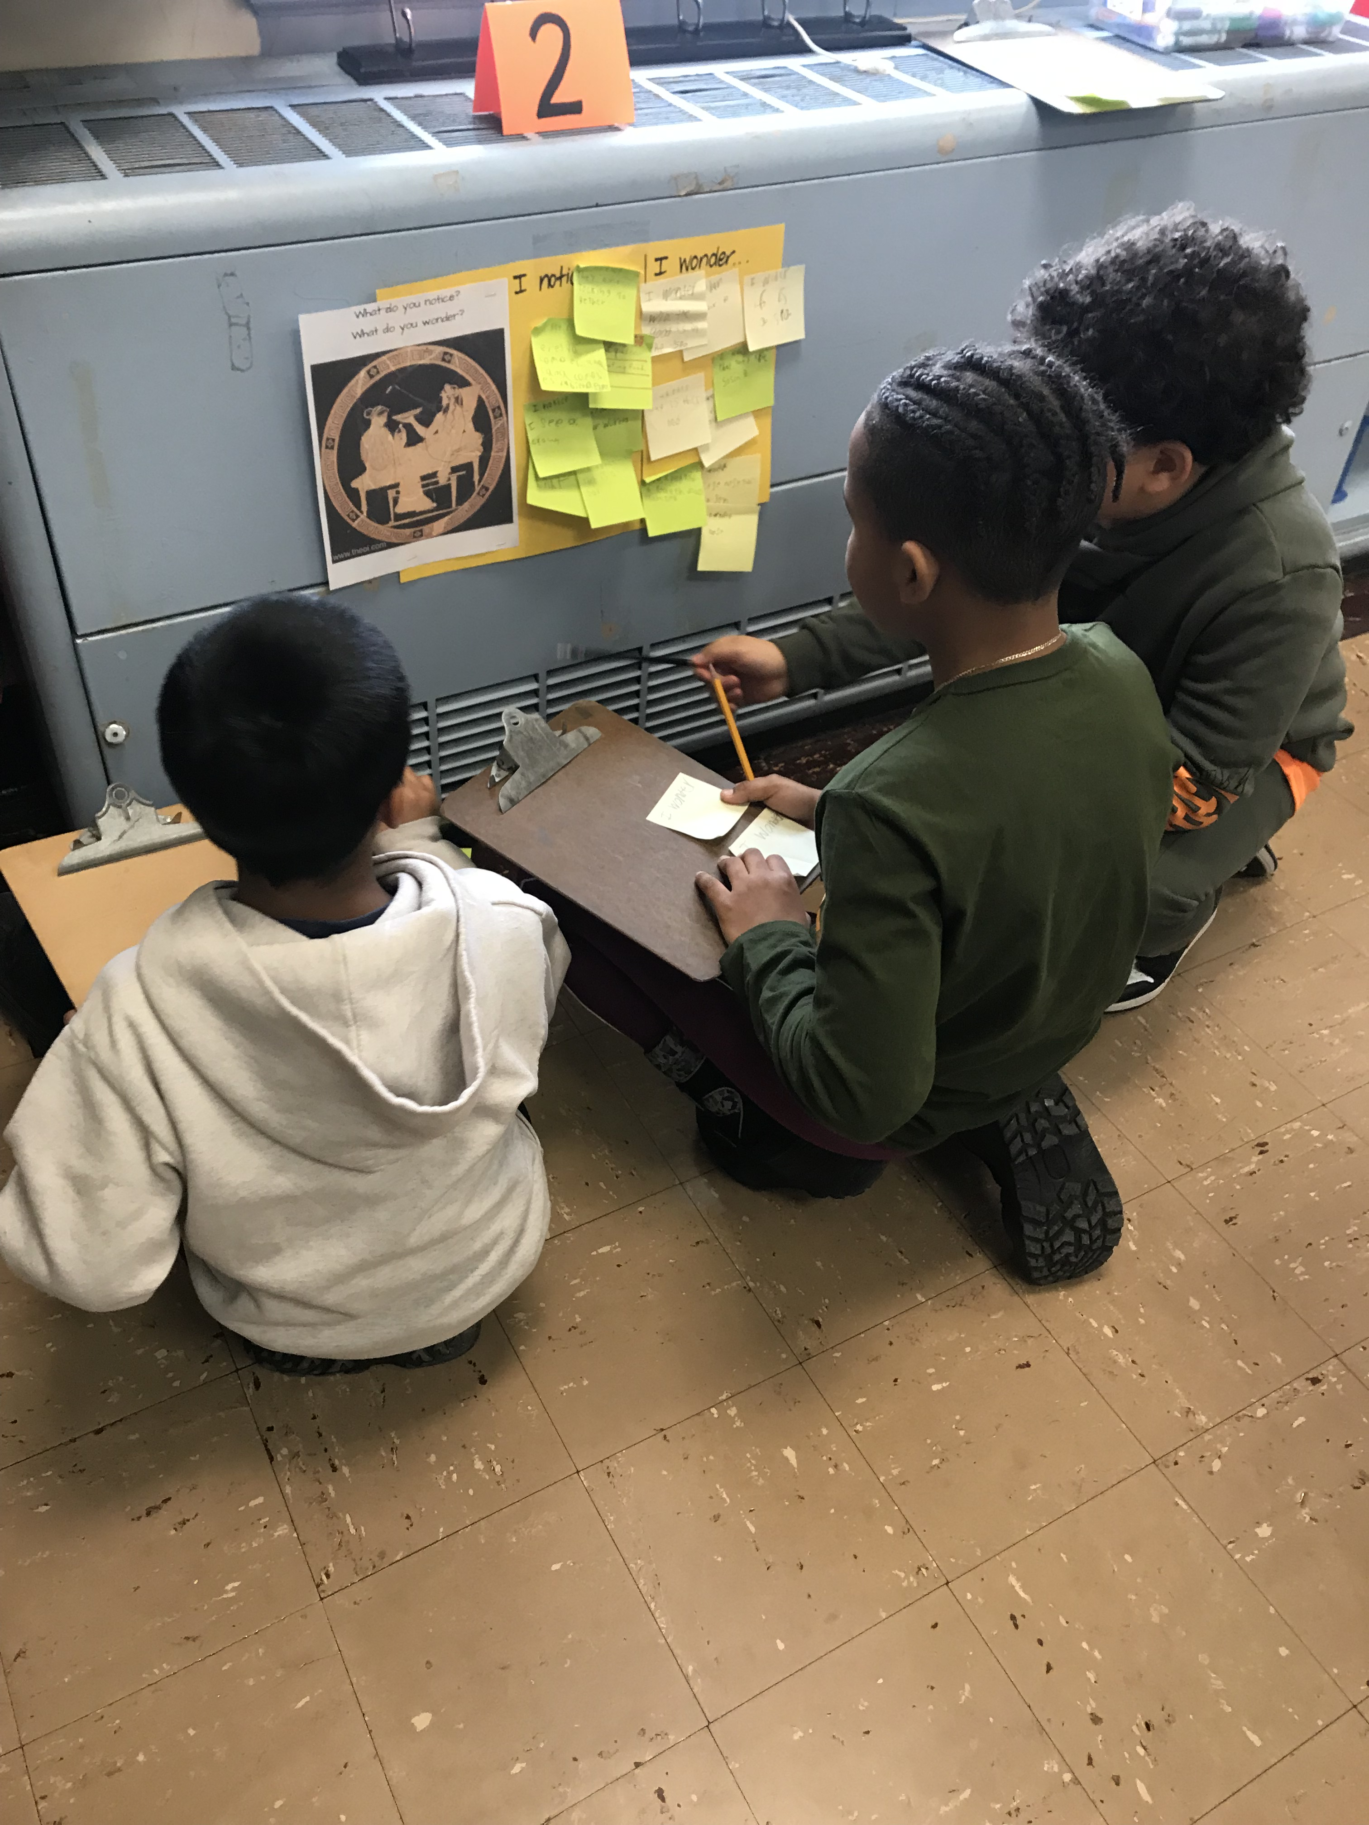
Paul A. Dever School, Boston

Slide 2
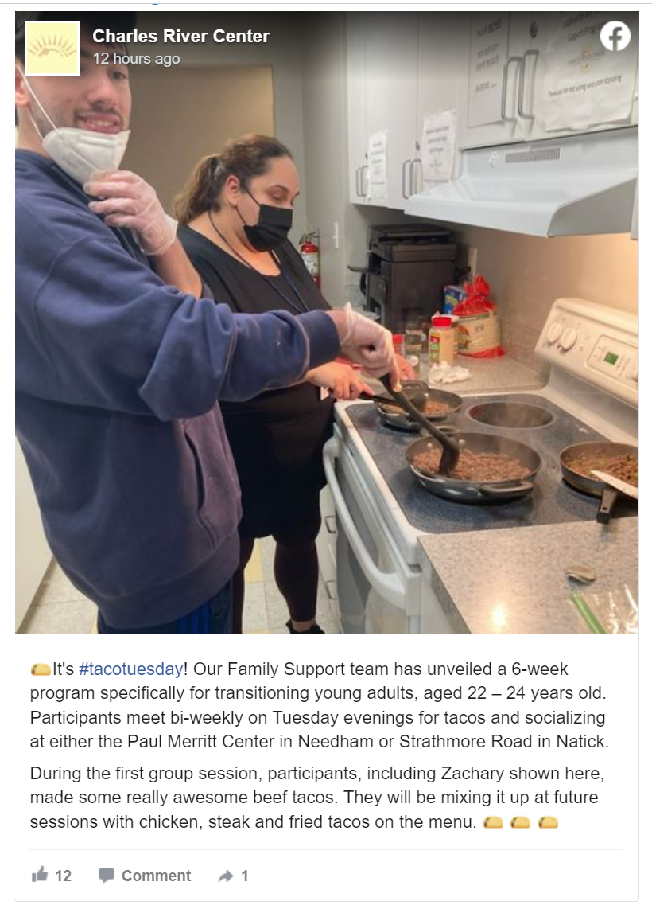
Coordinated Pandemic-Related Transition Services

Slide 3
Special Education Leaders Meeting
Friday, January 20, 2023

Slide 4
Agenda
Department of Developmental Services Information
Problem Resolution System Update
Special Education Updates

Slide 5
Department of Developmental Services (DDS)

Slide 6

DDS Supports: Across The Lifespan
January 20, 2023

Slide 7

DDS Supports Across the Lifespan
0-2
Primary service source: Early Intervention
3-17
22+
Primary service source: School
18-21
Primary service sources: School & Family Support Center
DDS Transition Coordinator will begin planning with TEAM for
life after school
If student will graduate before age 22, contact DDS Service
Coordinator
DDS funds Family Support programs to supplement
Primary service source: DDS
DDS offers Children’s Autism Waiver, DESE Program, IFFS
Array of day, employment, home services
Services, supports, school transition assistance
DDS Children’s Service
Coordinator
DDS Transition Service
Coordinator
DDS Service Coordinator

Slide 8
Services for Children & Families
Family Support Center Referrals
Intensive Flexible Family Supports
DESE/DDS Program
Medically Complex Program
Service Coordinator
Family Leadership Series
Autism Waiver Program

Slide 9
Autism Spectrum Disorder (ASD) Eligibility
New criteria in 2014 Autism Omnibus Bill
Diagnosis of Intellectual Disability not required
Primary diagnosis Autism Spectrum Disorder, Prader Willi or Smith Magenis Syndrome
Autism Spectrum Disorder manifests before age 22
Substantial functional impairments in 3 or more of 7 major life areas
Transition Funding Available for students with 504

Slide 10
Transition and DDS Adult Supports
Number of individuals Turning 22 is growing
Transition service coordinators in area offices act as liaisons for the student, family, school team and DDS services.
Chapter 688 Process
Employment Supports
Community Based Day Programs
Residential Support Options

Slide 11
Benefits of the Chapter 688 Process
Connects the student with the appropriate adult human service agency before leaving school
Formalized, shared planning process
Specifies support the student/family is requesting upon leaving special education
Allows for better understanding of the student’s needs
Specialized funding for students turning 22 within that fiscal year

Slide 12
Key Points Regarding the 688 Process
688 referral is not the same as the DDS adult eligibility
A 688 referral is still needed if known to DDS as a child or already determined adult eligible
DDS Transition Coordinator plays key role in planning
Not a continuation of special education services
Submit the Ch 688 referral form two years before student leaves school

Slide 13
DESE/DDS Residential Prevention Program
Open Interest now through March 31, 2023
Wraparound in-home programming focused on skill development and community integration
Dedicated Family Navigator works with family
The 55/45 Rule
Online interest submission
Notes:
43 Qualified family navigators
37 Active agencies
Families can choose any navigator that works within their region
links all components of the program (your own personal program concierge)
Participants work on 2-5 goals, on average
Evenings and weekends
Services and Supports: skills training, senior level therapists (BCBA, PsyD), therapies (music, aroma, arts, biofeedback), peer mentors, respite
Goods/Reimbursements: Community Activities, outing costs, family training, specialized nutrition, safety equipment, uncovered medical

Slide 14
Problem Resolution System (PRS) Update

Slide 15
PRS Update
New staff update
Update on liaison-district structure
Complaint management questions? Concerns? Contact the Supervisor
Procedure for districts that acknowledge non-compliance
  The District can acknowledge non-compliance and submit a Corrective Action Plan for approval.
Who is my PRS Specialist?
PRS Specialist Assignments - Problem Resolution System (mass.edu)

Slide 16
Special Education Updates

Slide 17
Important Dates and Action Steps for Year 3 of Resolution Funds
Date | Actions and documentation due to the Department
January 6, 2023 | Complete the self-assessment to include: A summary of the budget you proposed through the application, The total expenditures to date, A summary of the type of expenditures, and Date of the spring consultation meeting.
April 2023 | Department will notify affected LEAs of FY2024 allocations (Year 3).
May 2023 | The Department recommends making sure that the FY2024 Resolution Funds have been discussed in consultation meetings by May to appropriately plan for services for the fall.
June 1, 2023 | LEAs must submit signed written affirmation to the Department as evidence of the spring consultation regarding FY2024 Resolution Funds. A sample affirmation that includes Resolution Funds can be found at https://www.doe.mass.edu/sped/proshare/ in the Sample Documents section.

Slide 18

IEP Improvement Process Timeline
Winter 2023
Spring 2023
SY 23-24
Fall 2023
Fall 2024
Finalize Forms
Initial Training for Schools and Districts
Continued Training and Technical Assistance
Schools and Districts May Begin Adopting the New Process and Form
Full Adoption Statewide
Notes:
As you can see, the FORM will be finalized AFTER the work is completed with the EA’s on the pilot
Their feedback, along with the feedback gathered from thousands of stakeholders will help to update the forms
We anticipate the final form to be completed in the Winter of this year
We are currently working on the possibility of getting a vendor to develop professional development resources, modules, and training to begin in late winter 2023 and go through implementation
As it stands now, full implementation across the state is expected to happen during the 2023-2024 school year
Districts will have flexibility to begin implementing, so it is safe to say that you will have some districts using the OLD forms and some using the NEW forms as they begin to transition
The best thing you can do is be prepared, which is why we have been working on mini-training sessions such as this

Slide 19
Reducing or Eliminating Use of Time-Out Rooms
Continue to use guidance on Reducing or Eliminating the Use of Time-Out Rooms.
  Goal: maximize amount of time students spend learning with peers by using alternative strategies, interventions, and supports.
  Must be clean, safe, sanitary, and appropriate for the purpose of calming if used.
Ongoing procurement for “Effective Behavioral Intervention Programs” available at 23MASESMN1 on COMMBUYS.

Slide 20
Agreement of Interest
U.S. Department of Civil Rights Reached a Resolution Agreement with California’s Davis Joint Unified School District in Investigation Regarding the Use of Restraint and Seclusion (Dec. 7, 2022).

Slide 21
Welcoming Newcomer and Refugee Students
Memorandum from the Commissioner (March 8, 2022)
  Contains a list of resources for supporting students and families who have experienced trauma
Enrolling and Supporting Newcomer Students in Massachusetts Schools & Districts, Frequently Asked Questions (Oct. 14, 2022)

Slide 22
Q&A

