Slide 1
Special Education Leaders Meeting
Friday, March 3, 2023

Slide 2
Agenda
Special education updates
Panel presentation: Reducing or Eliminating the Use of Time-Out Rooms

Slide 3
Special Education Updates

Slide 4

The IEP Improvement Project
To improve outcomes for all students with disabilities by providing guidance, technical assistance, and tools on equitable processes to school and district professionals, families, and students so that all students with disabilities have meaningful access to the curriculum frameworks and life of the school.
If students with disabilities have meaningful access to the curriculum frameworks and the skills to engage in all aspects of the life of the school, then we will begin to close the opportunity and achievement gaps between students with disabilities and their age-appropriate non-disabled peers.
Project Goal
Improve Outcomes
Meaningful Access
Theory of Change
Close Opportunity & Achievement Gaps
Notes:
On the left are the stated Project Goal and Theory of Action (see https://www.doe.mass.edu/sped/improveiep/ )
These can are summarized in the graphic on the right
Points to make:
The purpose of this project is not simply to create newer, prettier documents.
The purpose is to implement an newly reimagined process that truly focuses on OUTCOMES, ACCESS, and CLOSING GAPS.
The goal is that the IEP process is viewed as a transition document from eligibility to “graduation” (from the IEP, from HS, or at age 22).
Another way to think of this is that transition planning should start the minute the student is found eligible. (INDEPENDENCE is the ultimate goal for every student.)

Slide 5
Areas of Focus For Improved IEP Form
Family and student voice
Form documents process
Least Restrictive Environment
Integrated transition planning
Accessibility of language
Notes:
The forms reflect the “new” process that we will expect schools and districts to implement
Student and family voice front and center in the IEP process
Transition planning will be a driver of the IEP process
Lastly, we intend to simplify the forms so that they are user-friendly for all Team participants

Slide 6

IEP Improvement Process Timeline
Winter 2023
Spring 2023
SY 23-24
Fall 2023
Fall 2024
Finalize Forms and Tech Specs
Initial Training for Schools and Districts
Continued Training and Technical Assistance
Schools and Districts May Begin Adopting the New Process and Form
Full Adoption Statewide
Notes:
- Updates to highlight:
(1) Vendor on board and currently working on finalizing the current draft, preparing for the creation of process guide materials as well as technical assistance professional development and resources. (You may want to remind them that we anticipate having a "train the trainer" model in place.)
(2) Working with EOE IT now to create business rules for the tech specifications that IEP vendors will need. These will be released publicly at the end of March.
(3) Anticipated public release date of updated forms is March 23. We will be meeting with early adopters on this date.
(4) Special Ed Directors meeting on March 24th will be a review of the updated form
(5) Recognition that IEPs will need to be transitioned to the new form as IEP Teams meet throughout the year, so the process will take a year. (Ensure they understand that the "content" of the current IEP will not be easily transferred to the updated form.

Slide 7
What are Coordinated Pandemic-Related Transition Services?
To address the needs of individuals with IEPs who reached or will reach age 22 during the COVID-19 pandemic, the Commonwealth has enacted Chapter 42 of the Acts of 2022 allocating $10 million for transition “services for individuals with disabilities that reached age 22 between March 10, 2020, and September 1, 2023, and were entitled to special education services up to age 22.”

Slide 8
Agencies Providing Services
The Department is currently collaborating with state agencies that provide adult services to qualifying individuals with disabilities.​
  Department of Developmental Services (DDS)​
  Massachusetts Rehabilitation Commission (MRC)​
  Massachusetts Commission for the Blind (MCB)​
  Massachusetts Inclusive Concurrent Enrollment Initiative (MAICEI)
These agencies will expand their services to provide supports for eligible young adults.

Slide 9
How can you help?
An email was sent to districts with individuals eligible for these supports
  Check the Security Portal - DropBox Central – Stater Performance Plan for a list of eligible young adults
Share information about the services with:
  The young adult and their family
    They can call the FCSN to get more information: (617) 236-7210, (800) 331-0688
  Local community organizations, such as….
    Your social media platforms
    Towns social media platforms
    Parks and Recreation department
    YMCA/YWCA
    Community Action
    Faith-based organizations
    Other organizations in your community
Questions: contact Martha at martha.s.daigle@mass.gov

Slide 10

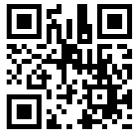
Model Educator Evaluation Rubric Update Project
What is effective teaching practice? Share your feedback!
The model educator evaluation rubric provides a statewide standard for what it means to be an effective teacher in Massachusetts.
DESE is seeking feedback from educators, students, and families on a draft updated rubric.
Learn more and share feedback by 3/30:
https://tinyurl.com/MArubric23

Slide 11
Important Dates and Action Steps for Year 3 of Resolution Funds
Date | Actions and documentation due to the Department
January 6, 2023 | Complete the self-assessment to include: A summary of the budget you proposed through the application, The total expenditures to date, A summary of the type of expenditures, and Date of the spring consultation meeting.
April 2023 | Department will notify affected LEAs of FY2024 allocations (Year 3).
May 2023 | The Department recommends making sure that the FY2024 Resolution Funds have been discussed in consultation meetings by May to appropriately plan for services for the fall.
June 1, 2023 | LEAs must submit signed written affirmation to the Department as evidence of the spring consultation regarding FY2024 Resolution Funds. A sample affirmation that includes Resolution Funds can be found at https://www.doe.mass.edu/sped/proshare/ in the Sample Documents section.

Slide 12
Panel Presentation: Reducing or Eliminating the Use of Time-Out Rooms

Slide 13
Panelist Contact Information
Corey Meurer, Building Communities of Care Director of Operations, Justice Resource Institute cmeurer@jri.org
Eliza Cassella, Director of Social Emotional Learning, Culture, & Climate, Salem Public Schools ecassella@salemk12.org
Alison Connelly, School Library Teacher, Stoneham High School, Stoneham Public Schools aconnelly@stonehamschools.org
Marla De La Cruz, District Coordinator of Behavioral and Mental Health, Groton Dunstable Regional School District mdelacruz@gdrsd.org
One more contact: Cyndy Taymore, Interim Special Education Director, Billerica Public Schools ctaymore@billericak12.com

Slide 14
Alternatives to Exclusion and Time Out
  DESE Advisory on Reducing or Eliminating the Use of Time Out Rooms
  Positive, Proactive Approaches to Supporting the Needs of Children with Disabilities: A Guide for Stakeholders
  Letter from Secretary Cardona
  Fact Sheet
Resources from IDEAs that Work
Notes:
SEE SCRIPT: Panel Plan & Outline.docx

Slide 15

Building Communities of Care
Corey Meurer – BCC Director of Operations
Justice Resource Institute

Slide 16
What We Know
We are biologically hardwired to respond to stress and threat in our environment.
We need to understand how stress/change impacts our students so we can explain it to them in a language they can understand, normalize their responses and help them feel safe.
We need to understand what is happening in our own bodies so we can recognize signs of burnout and identify self care strategies to match our need.

Slide 17
The Human Stress Response Continuum
STRESSOR
(PERCEIVED THREATS TO SURVIVAL)
STRESS RESPONSE
(Neurobiology-Neurophysiology)
(Body-Brain)
BEHAVIORAL REACTIONS
TO STRESS RESPONSE
ICDR All Rights Reserved Copyright 1995-2010

Slide 18
The Covid Lens
Lack of predictability
Change
Loss of connection
Sense that it will never end
Loss of safety
Loss of social learning

Slide 19
How might this show itself?
Increased anxiety/worry
Lack of interest in things they previously enjoyed
Age related regressions in sleep, independence, emotional control, language
Anger/Agitation/Irritability
Decreased frustration tolerance
Withdrawal

Slide 20
So, what do we do to reduce/eliminate exclusionary practices in schools?
We always keep in mind the impact of trauma when thinking about techniques/activities
We recognize behavior is a form of communication, often trying to communicate needs (Connection, Containment, Control)
We know attunement is a key factor in building successful relationships (Proactivity)
Strategies are presented as a menu, we individualize their usage

Slide 21
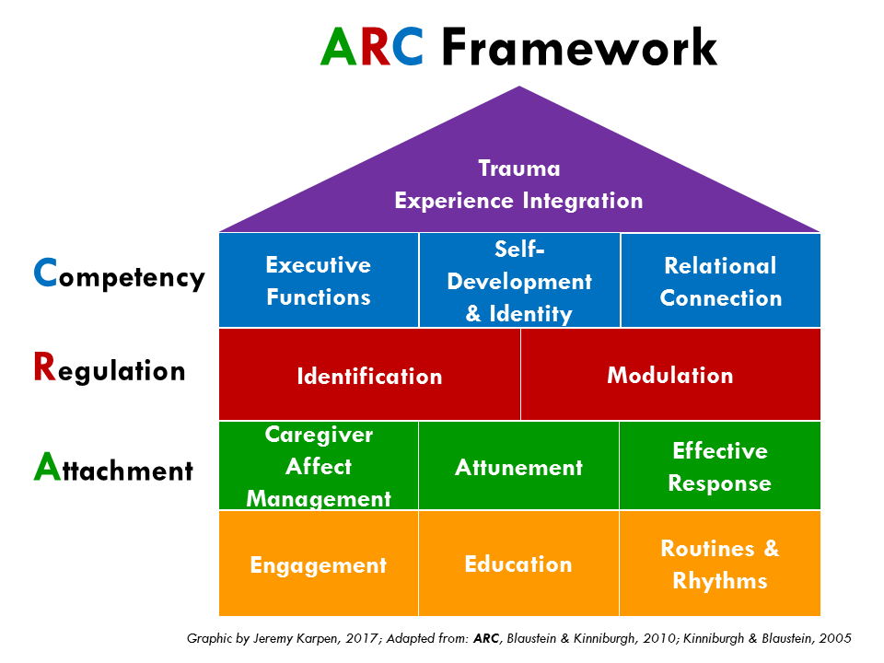
BCC Overview - Curriculum
Mission Statement: To teach participants to provide trauma-informed, individualized, and strengths-based interventions within a nurturing and supportive community of care.
ARC-informed Curriculum
Environment – Safe and Comfortable
Treatment – How everyone impacts treatment
Engagement – Building skills and tolerance

Slide 22
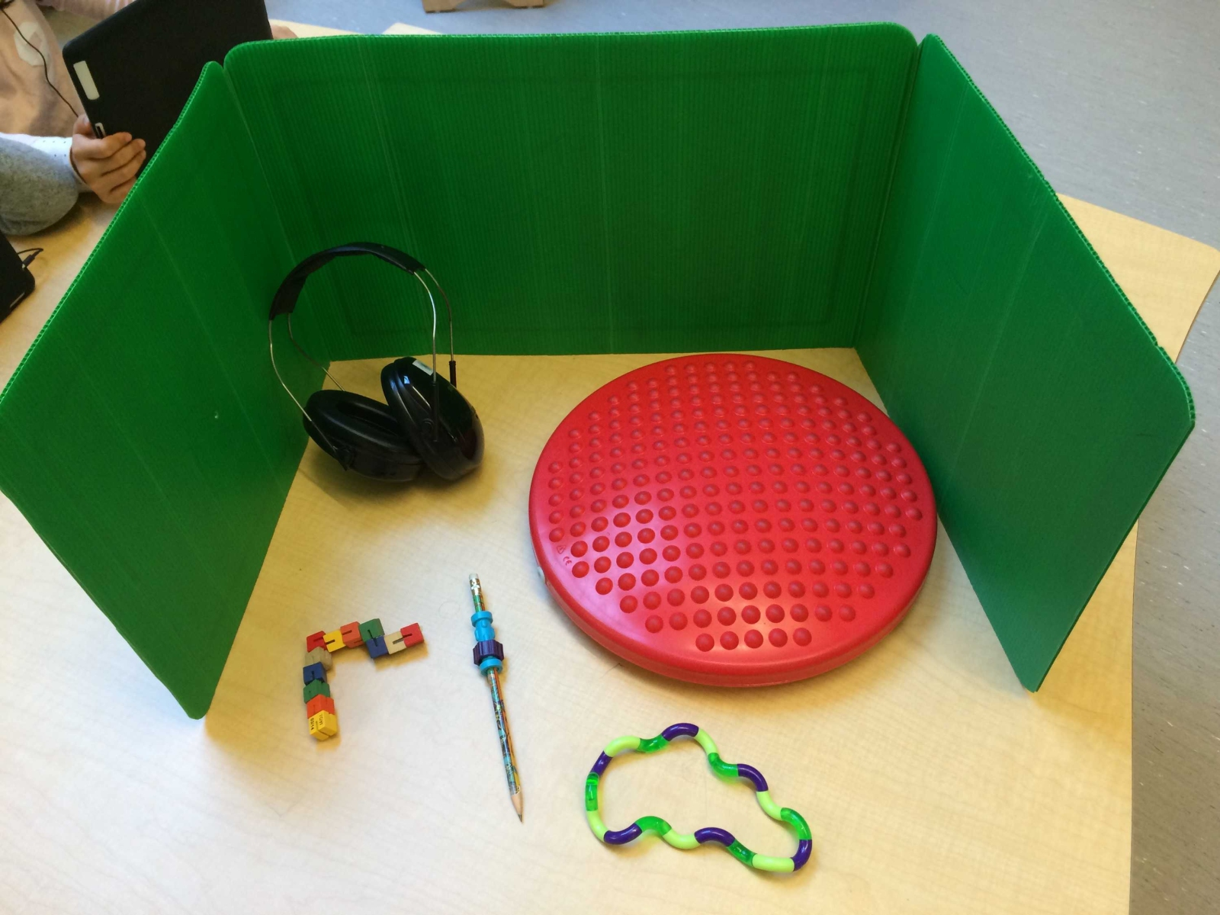
JRI Example #1

Slide 23
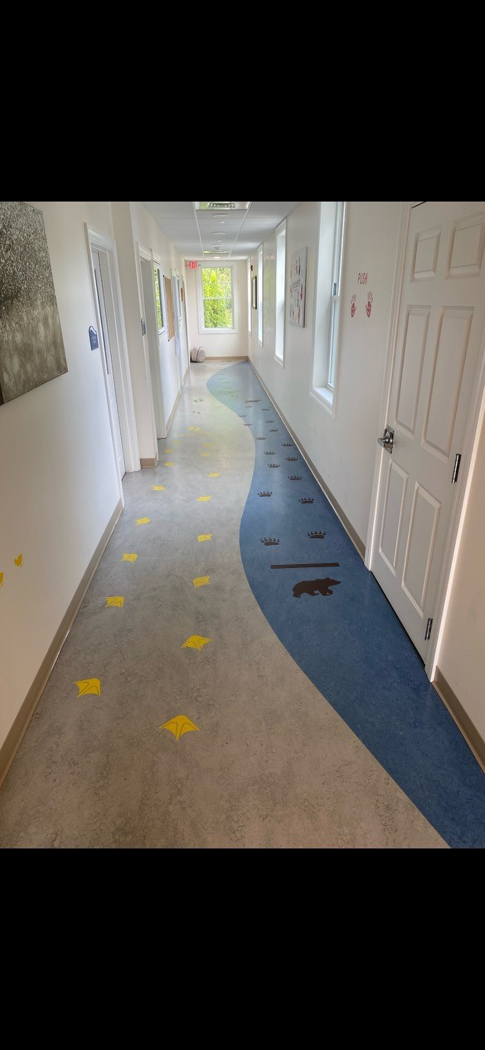
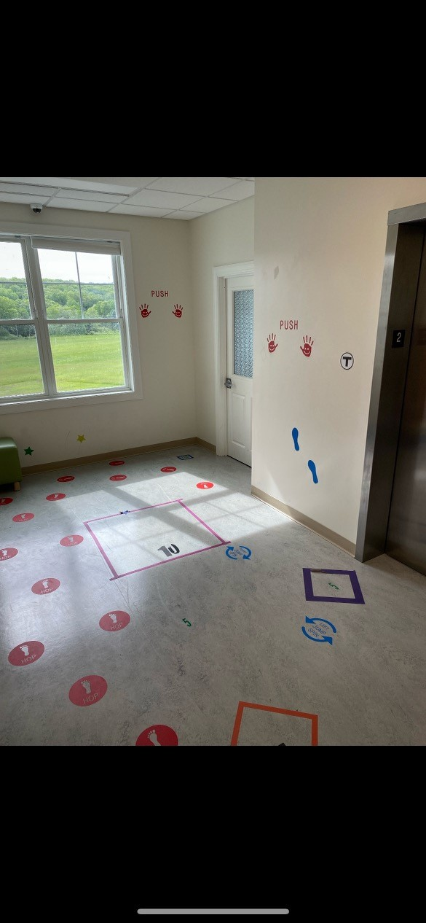
JRI Hallway and room

Slide 24
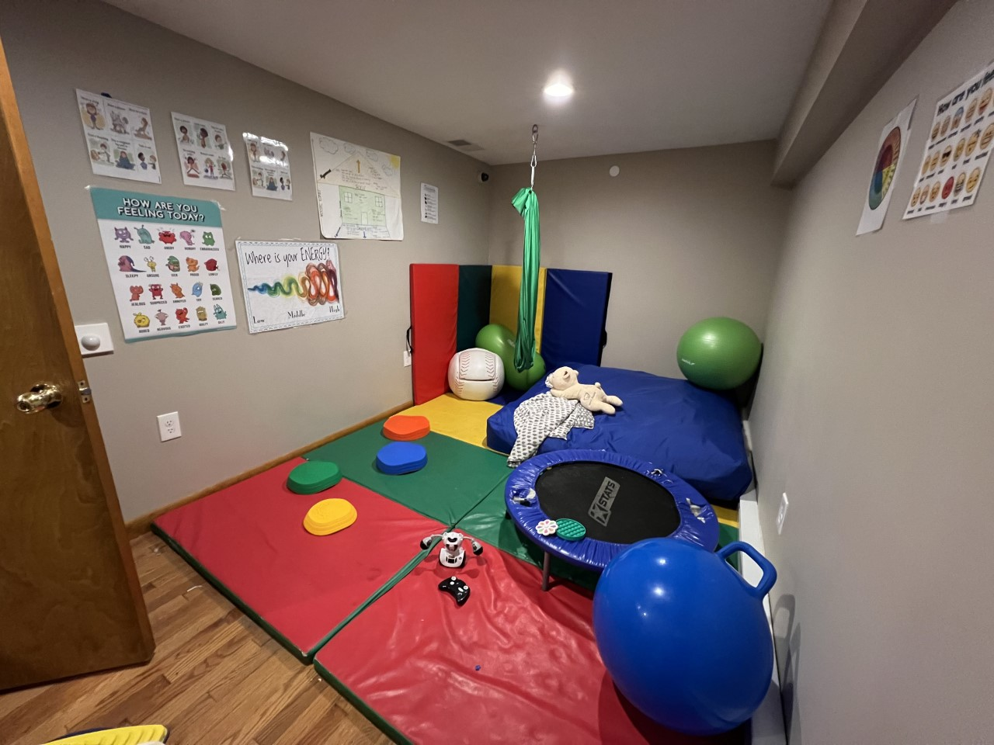
JRI Room

Slide 25
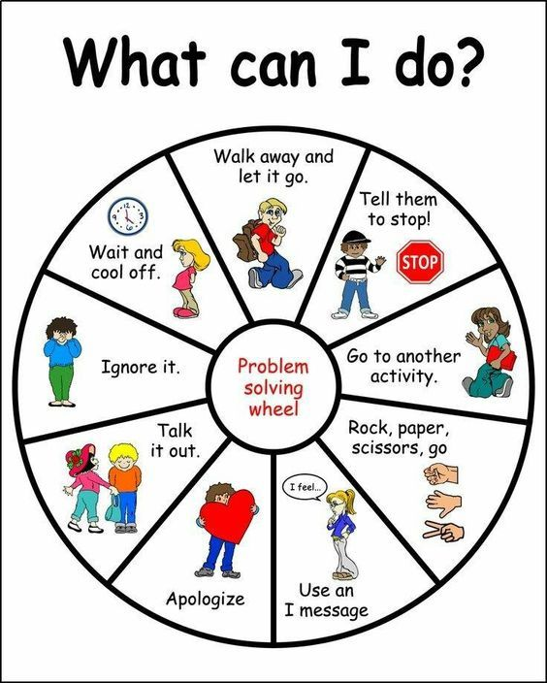
JRI-What can I do?

Slide 26
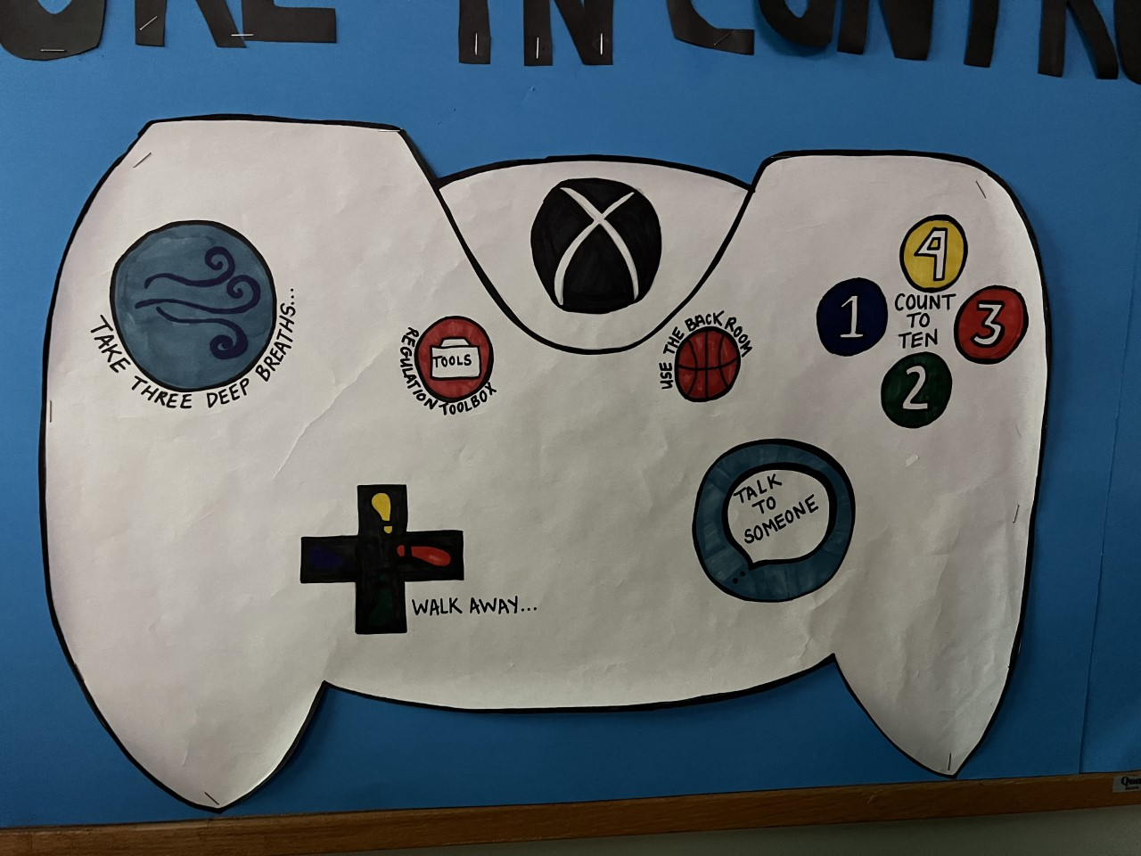
JRI image

Slide 27
Questions or Comments?
https://jri.org/services/educational-and-residential/day-schools/anchor
Corey Meurer
Building Communities of Care - Director of Operations
cmeurer@jri.org

Slide 28
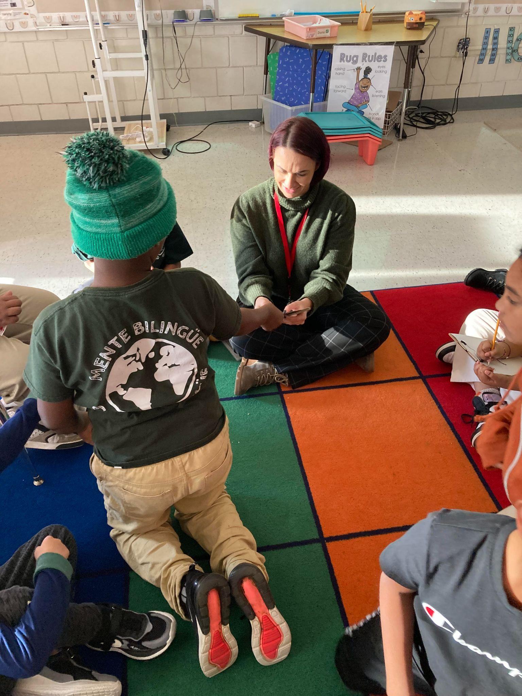
Introduction
Eliza Cassella M.Ed
Director of Social Emotional Learning, Culture, & Climate
Salem Public Schools
Notes:
Slide should take no more than 1 minute to present

Slide 29
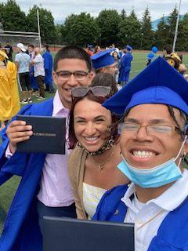
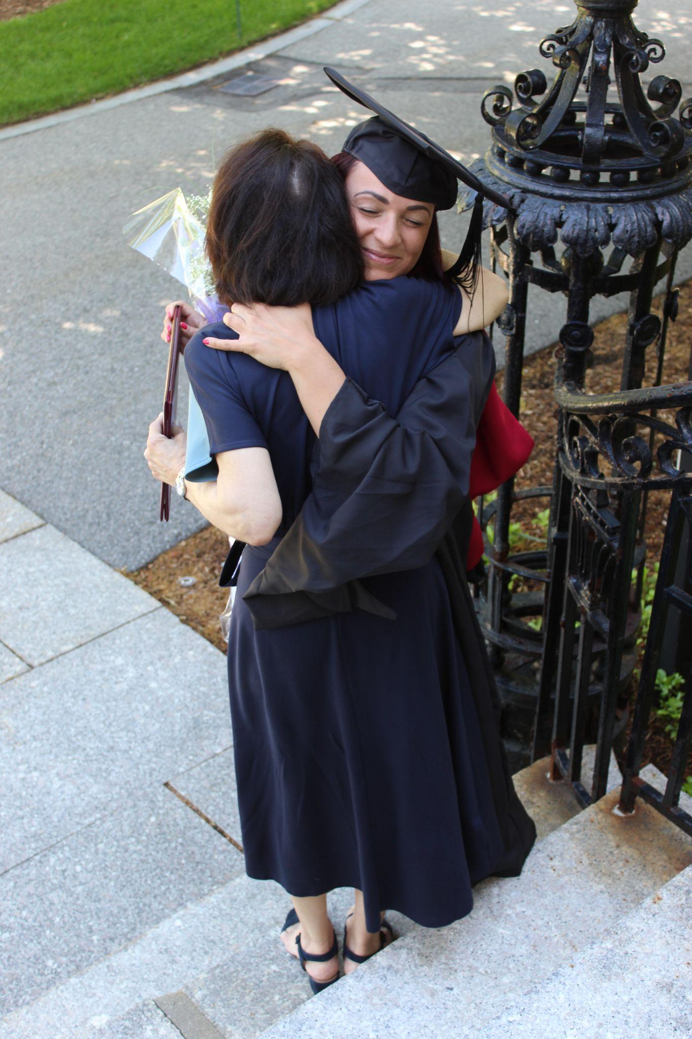
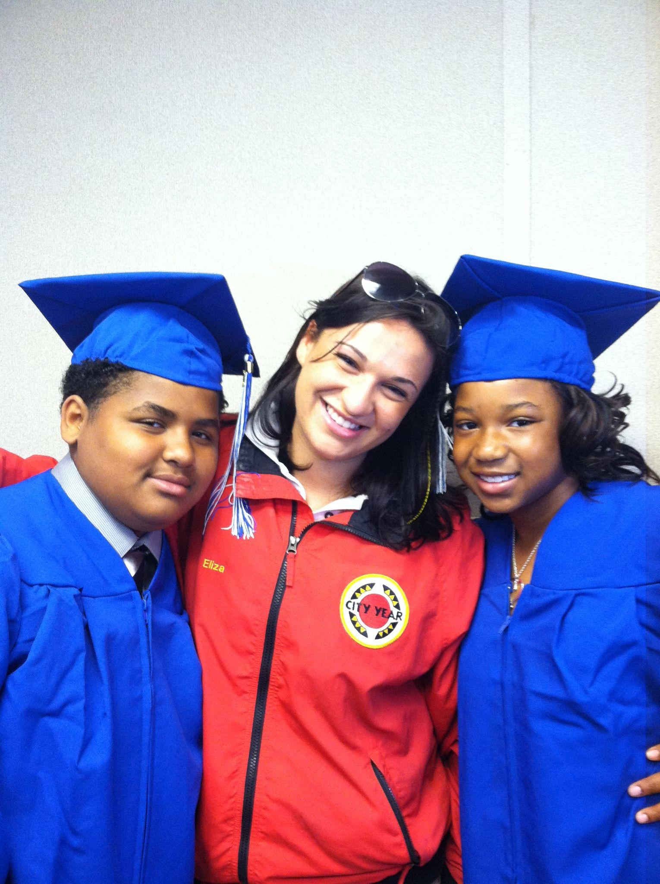

Who Am I?

Slide 30
Power of Storytelling
Stories have the power to connect, heal, and to empower us
Everyone has a story. Stories give us voice
Stories allow us to get to know ourselves and others better
Stories help us remember what we learn

Slide 31
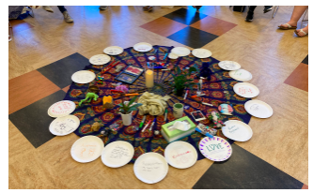
Highlights
Differentiated SEL School Based Inventories
Strengths Based Human Centered Design
Restorative Practices
Adult SEL
Notes:
~3 minutes

Slide 32


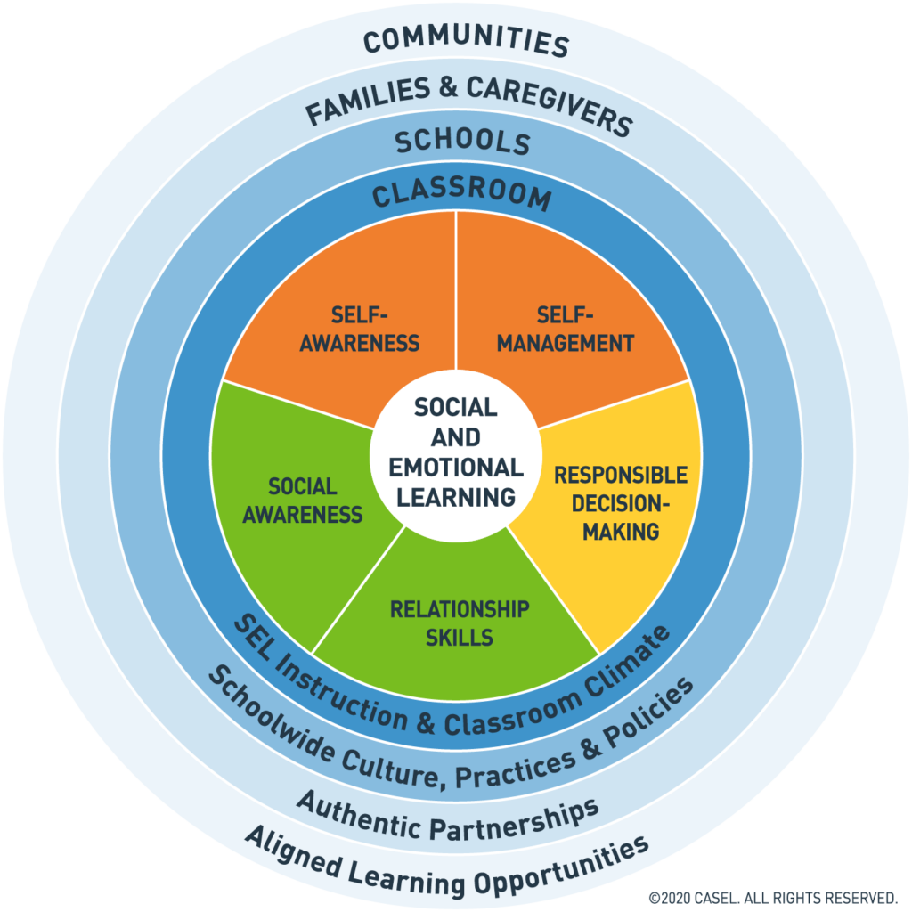









SEL in Salem
Notes:
CASEL Aligned
SEL Curriculums
Instructional Priorities
Culturally Responsive Teaching
Tiered supports
Family Engagement
Asset-based growth mindset
3 Signature Practices
Restorative Discipline
Trauma-informed care

Slide 33
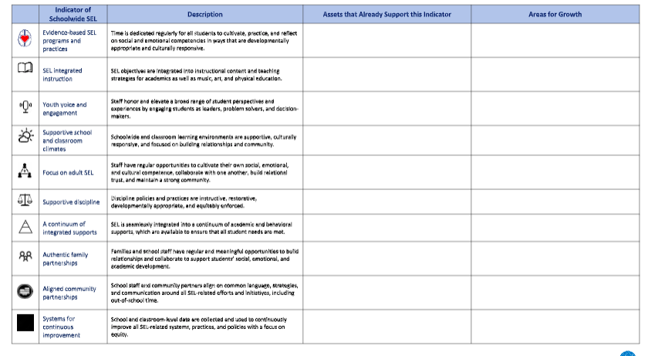
SEL in Salem Inventory

Slide 34
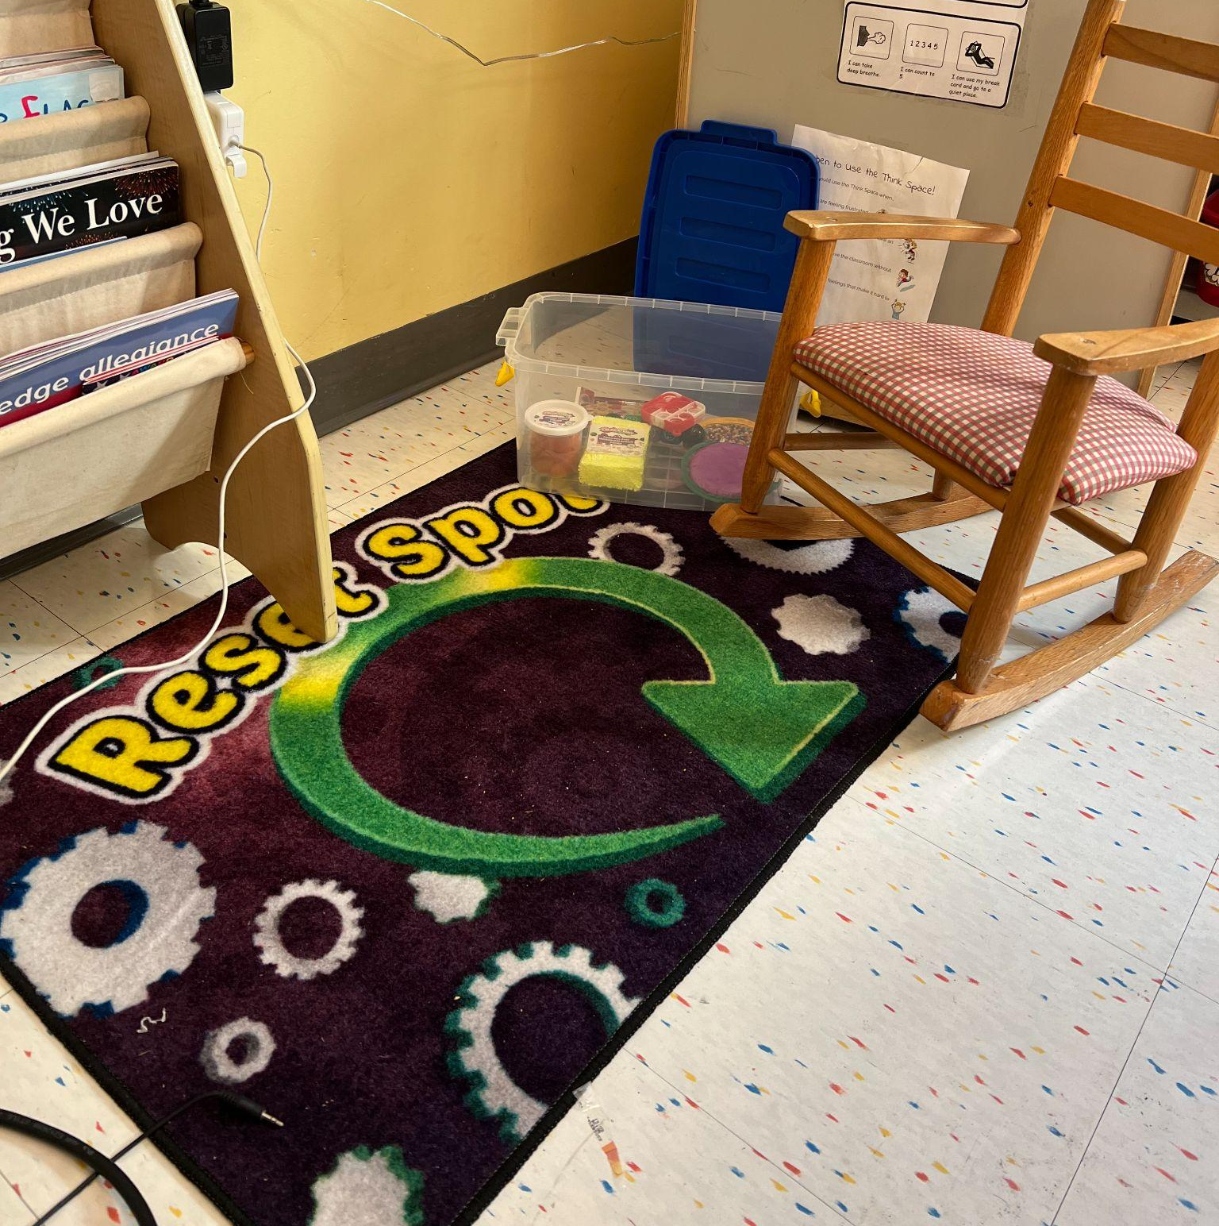
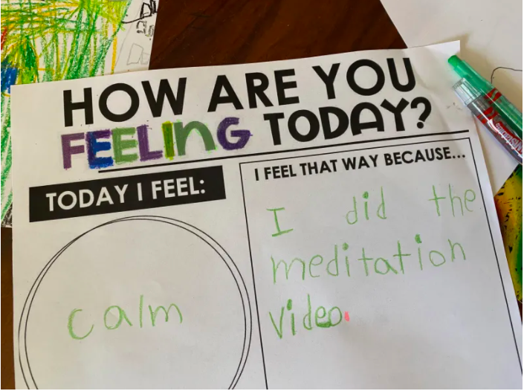
Principal Perspective:

Slide 35
Why “and adults”?
“To promote students’ social and emotional competence, it’s important for schools to simultaneously foster a supportive staff environment that cultivates the social and emotional competence and capacity of adults in the building.” (schoolguide.casel.org, 2020).
“(Adults) social-emotional competence and wellbeing strongly influence the learning context and the infusion of SEL into classrooms and schools…we need to optimize (adult) ability to promote SEL in their students by helping them build their own social-emotional competence” (Schonert-Reichl, 2017, p.139).
Notes:
Fist to 5 in the chat– to what extent does the research surprise you?

Slide 36

Time for Joy
A Space for Joy
Harvard Graduate School Of Education Spring/Summer 2022

Slide 37
Introduction
Alison Connelly
Stoneham High School
School Library Teacher
Notes:
Slide should take no more than 1 minue to present

Slide 38
Highlights
Redesign of the library at the Stoneham High School, creating a more inclusive space that meets both the academic and the social/emotional needs of all students. Make it the “Family Room” of the school.
The library now has a very relaxed and welcoming atmosphere that allows students a space to decompress from stress. It also is an alternative environment to the classroom, offering a more relaxed approach to learning for those students who need it.
Notes:
~3 minutes

Slide 39
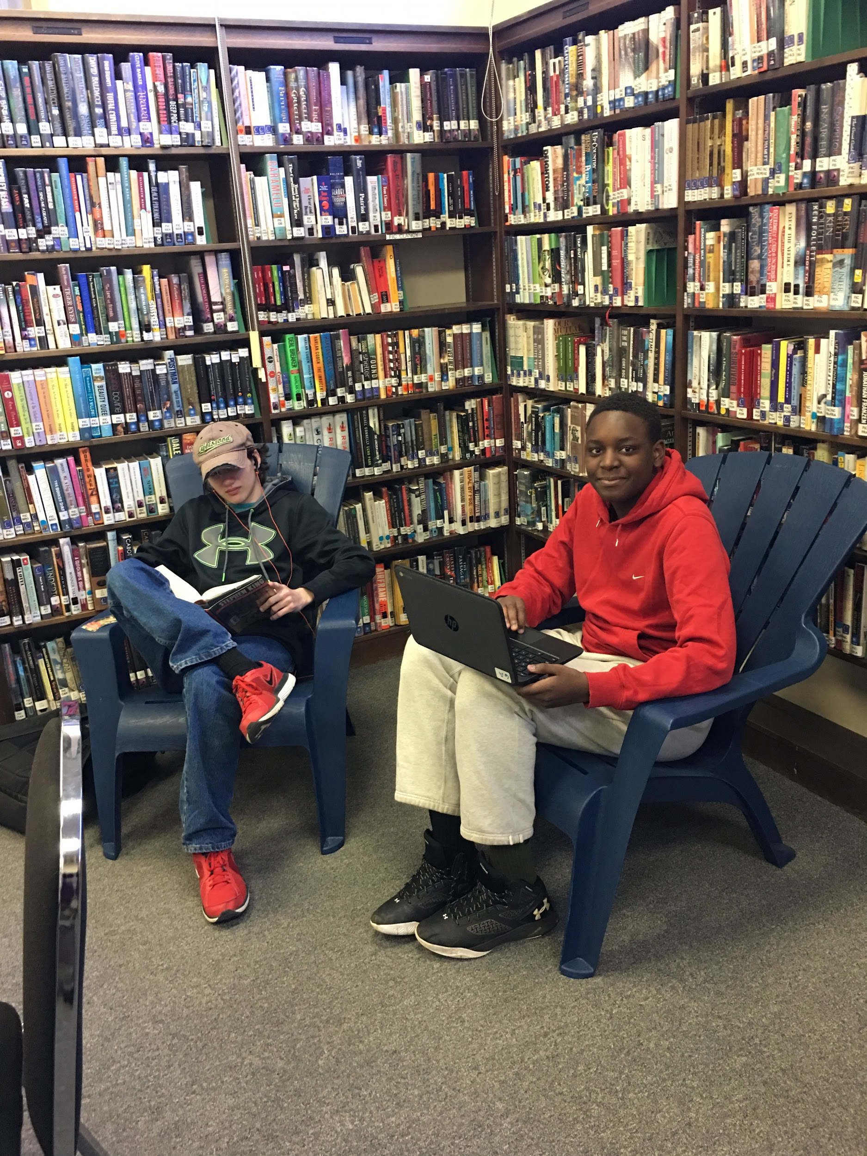
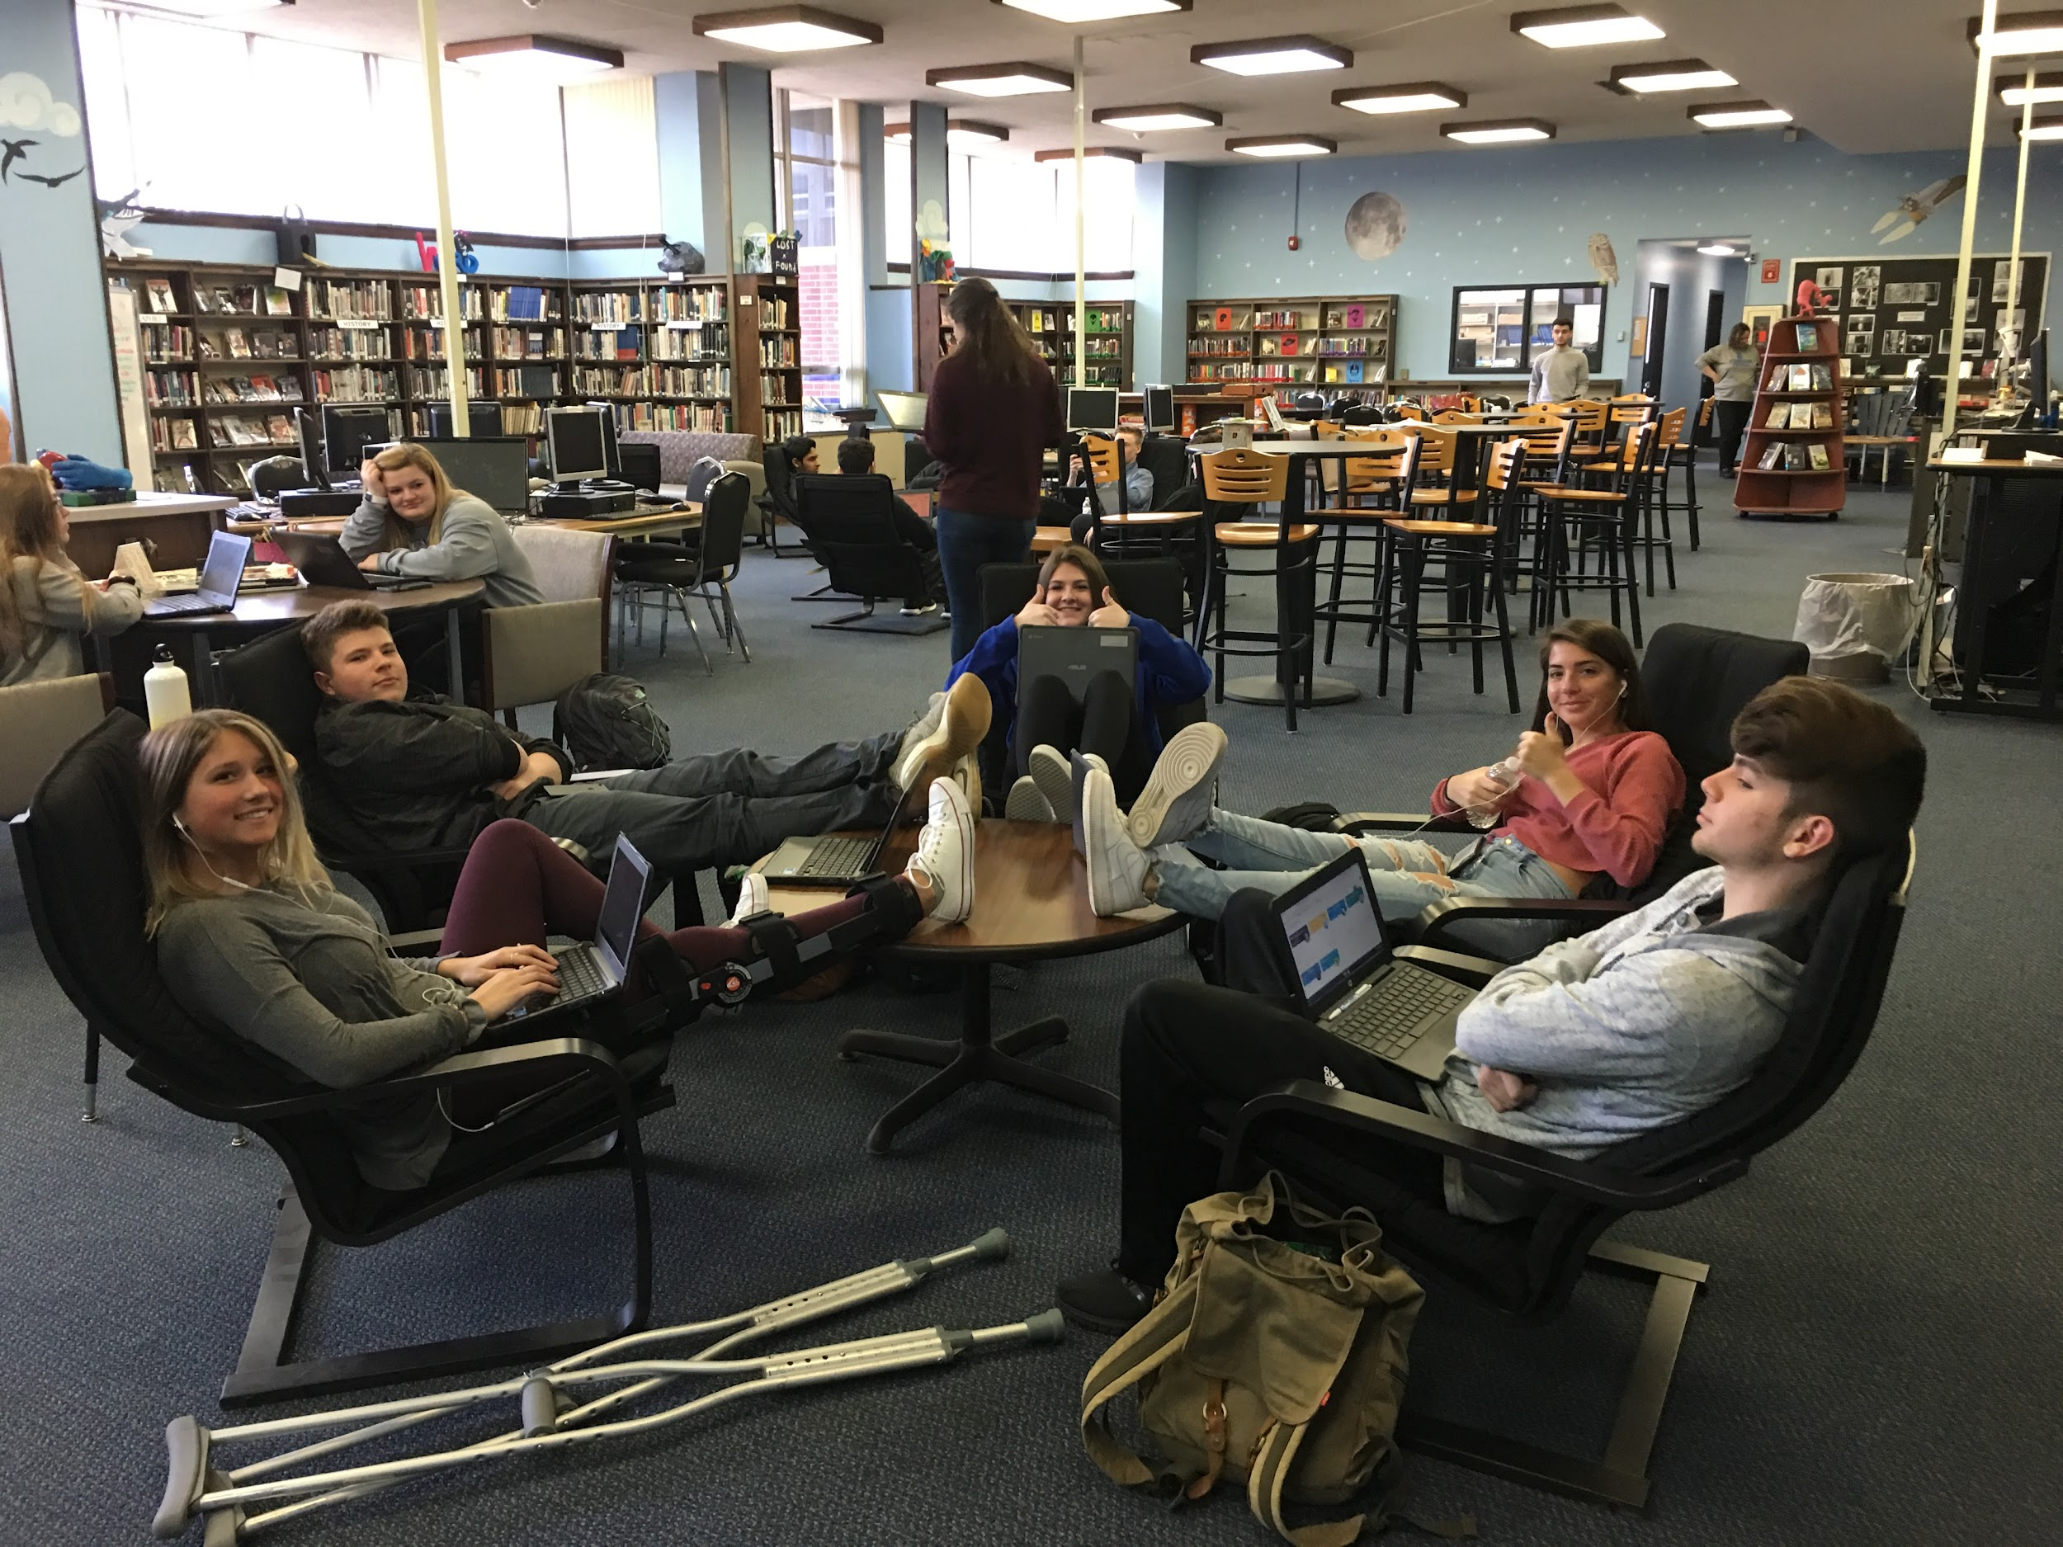
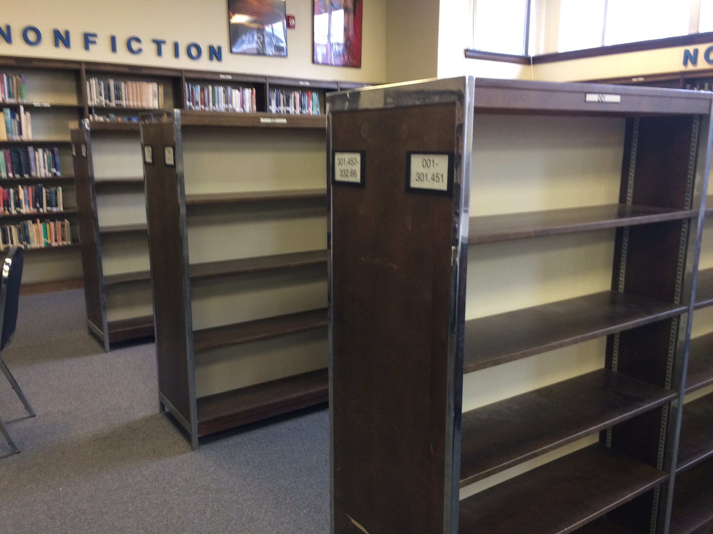
Make it Comfortable
Before
After
Notes:
~3 minutes
Weeding books allowed for a variety of seating option for collaboration ad for comfort.

Slide 40
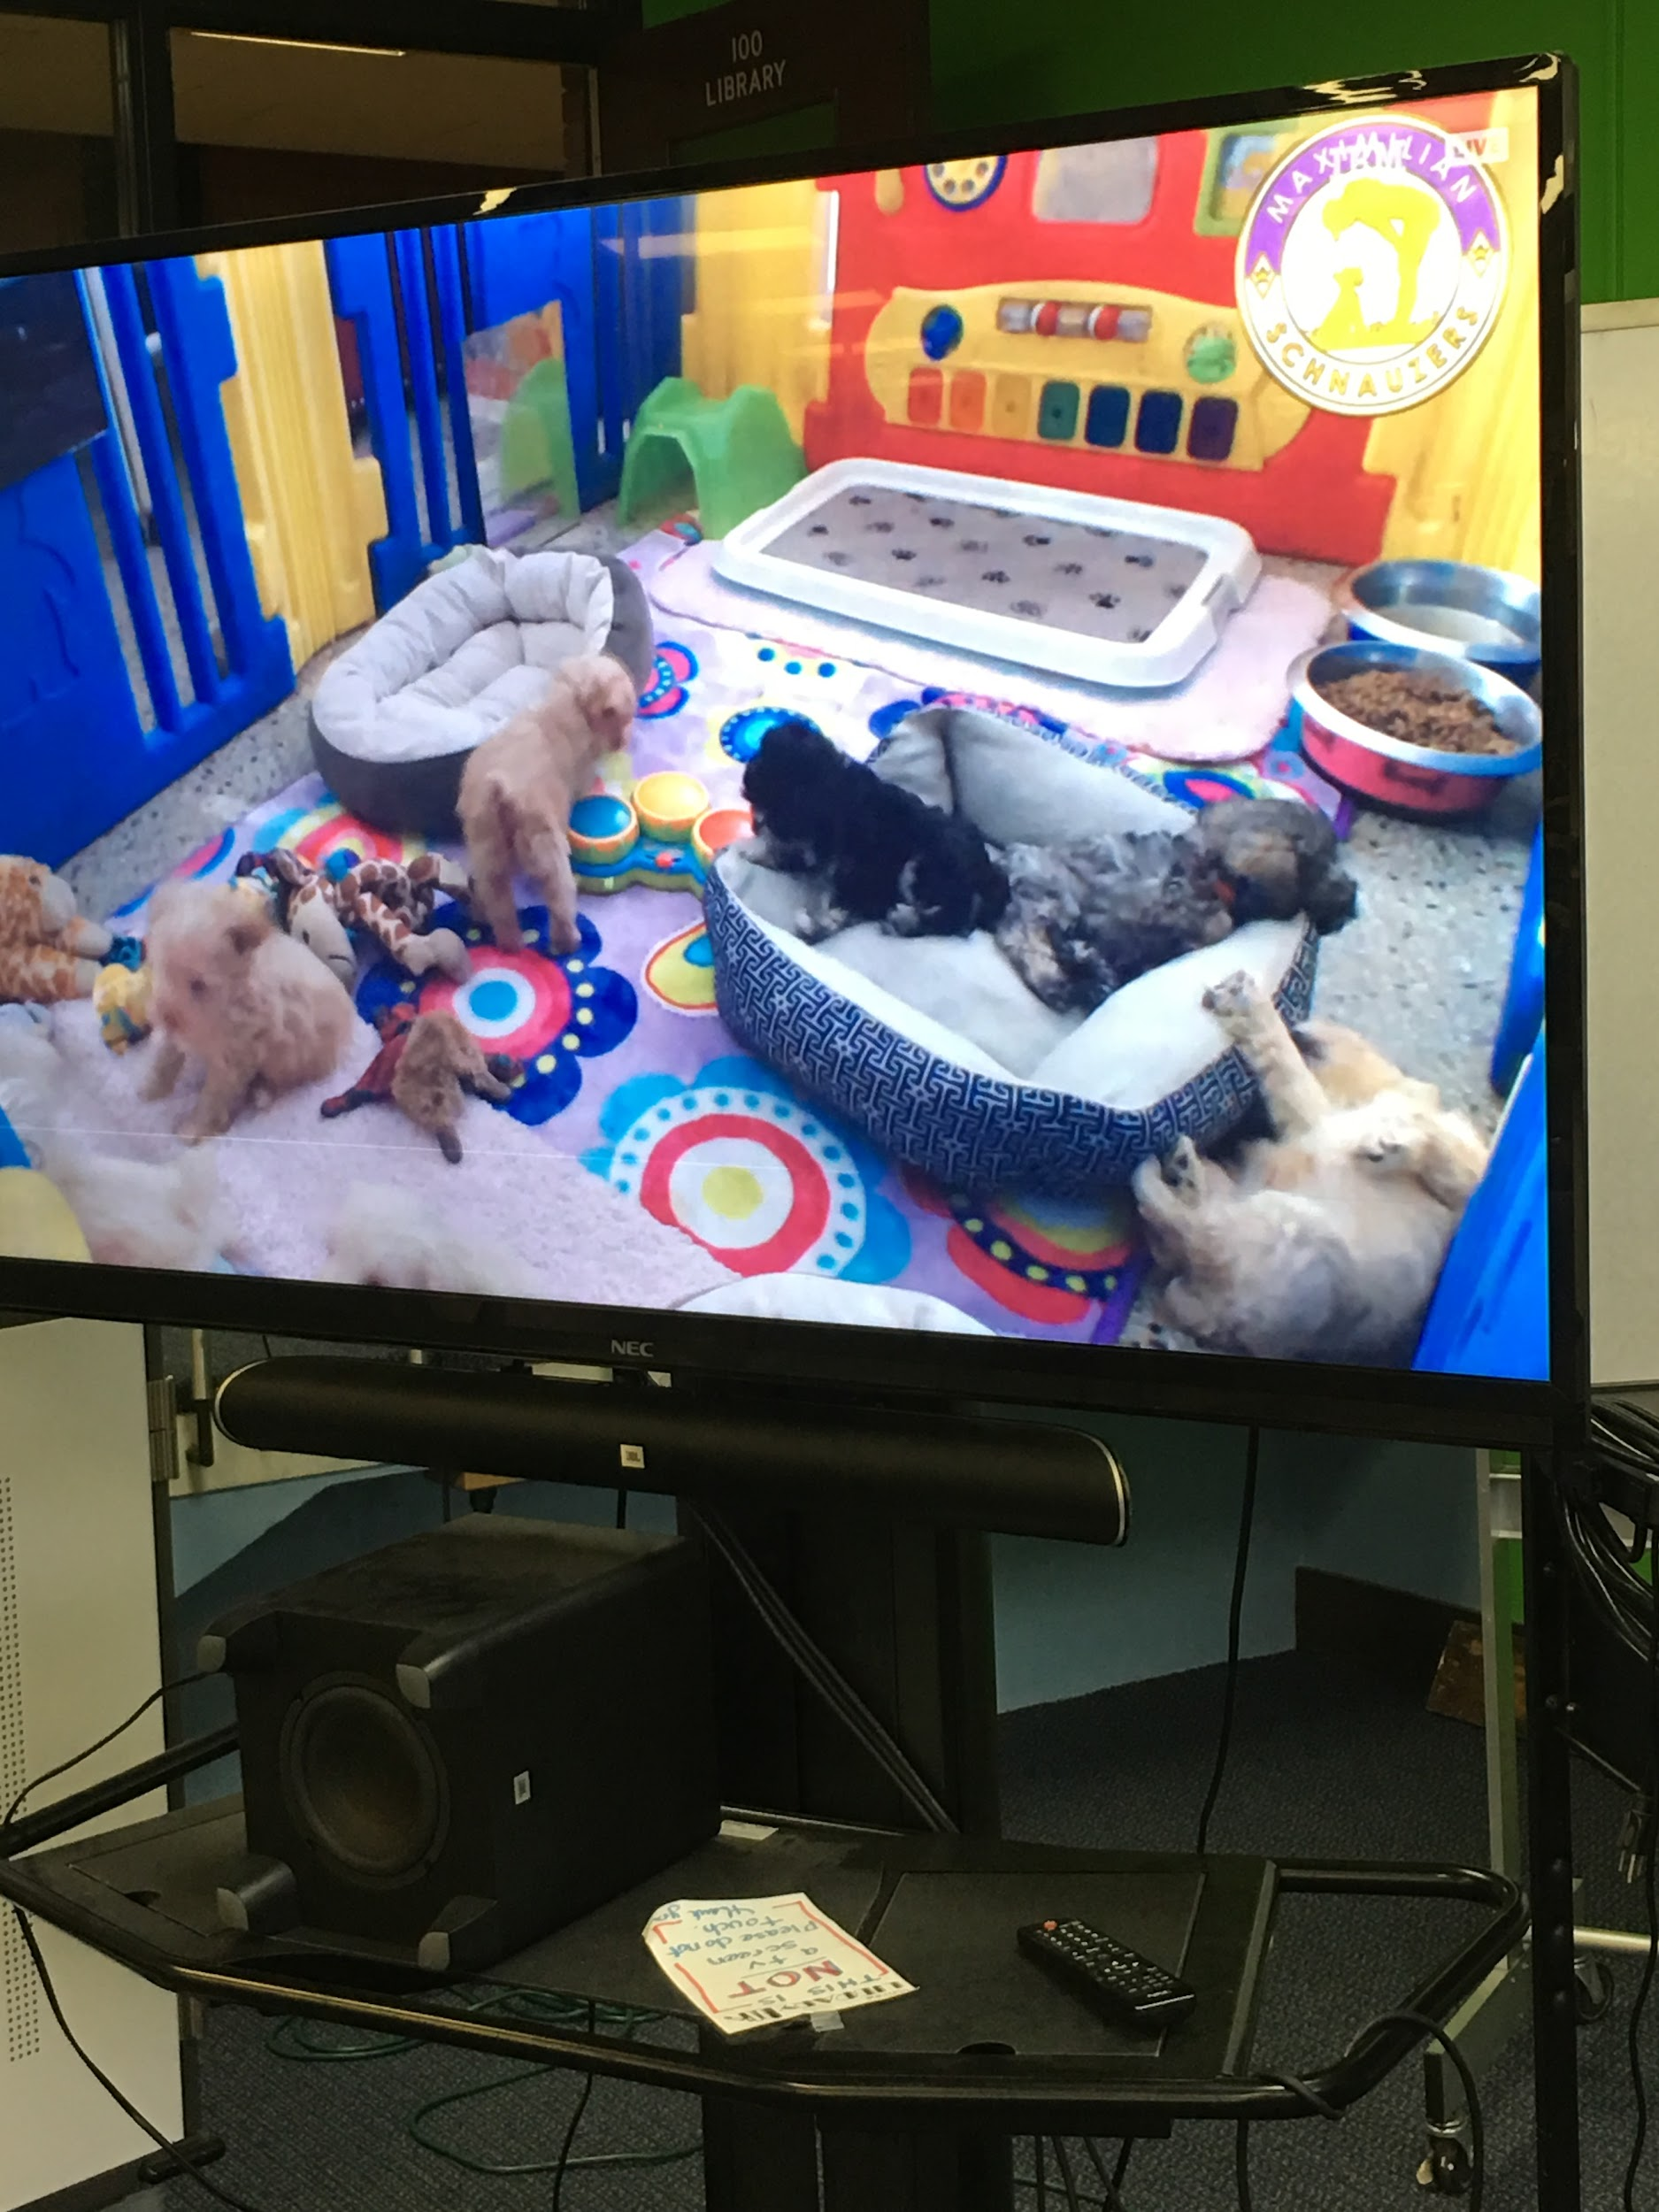
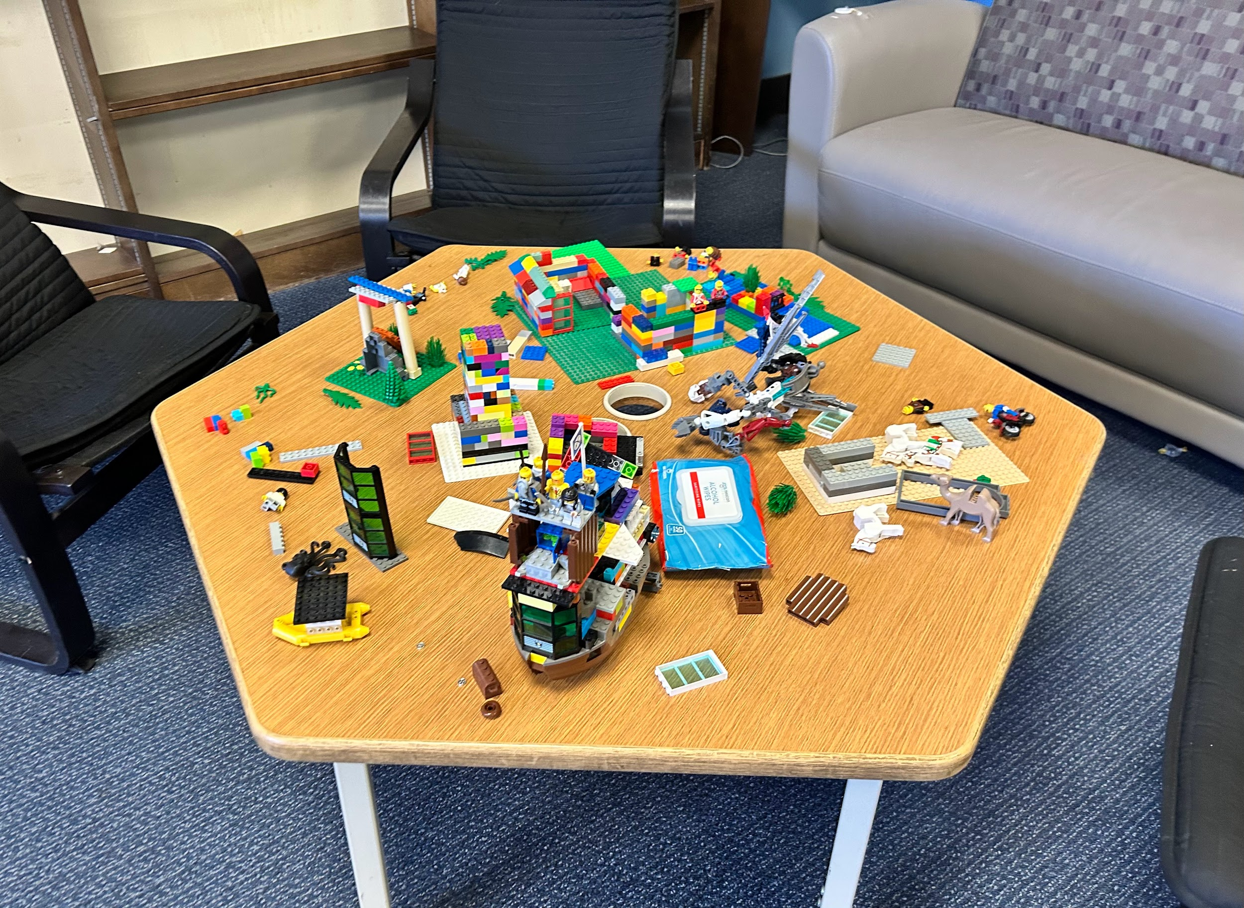
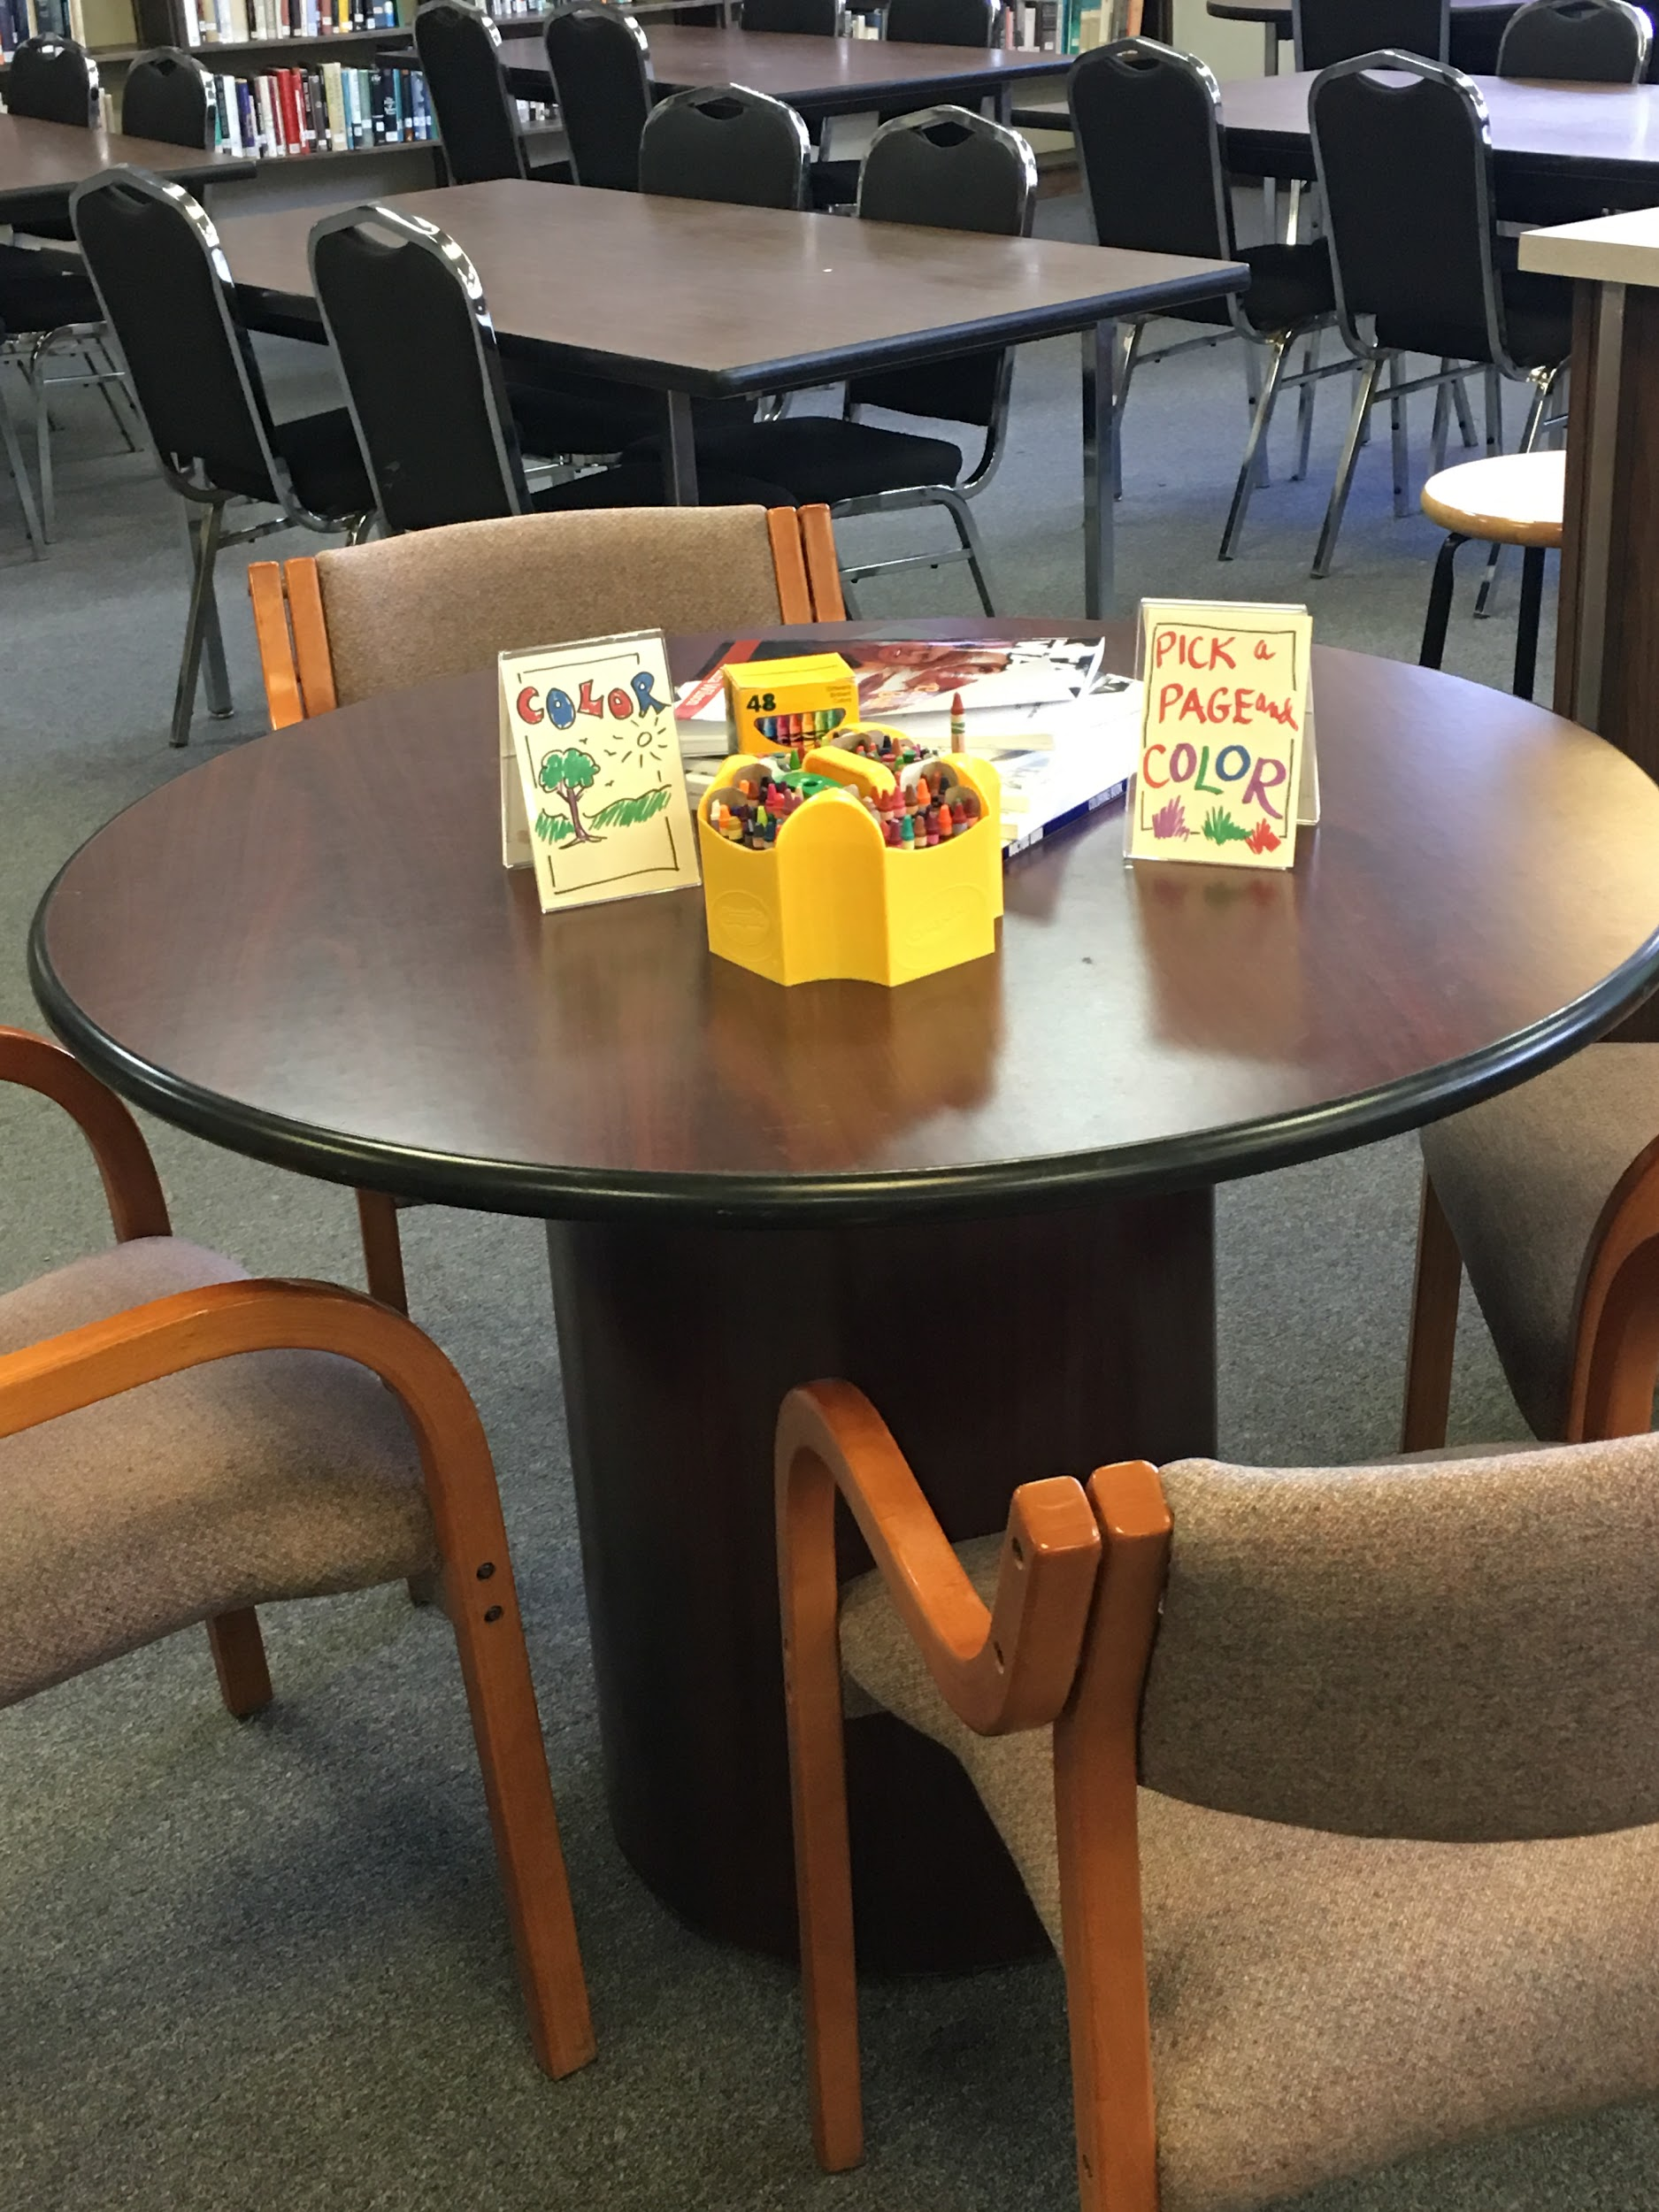
Make it Relaxing
We watch live webcams of puppies!
https://explore.org/livecams
Community Coloring and Puzzle Spot
Legos Space
Notes:
Lunch is OK too

Slide 41
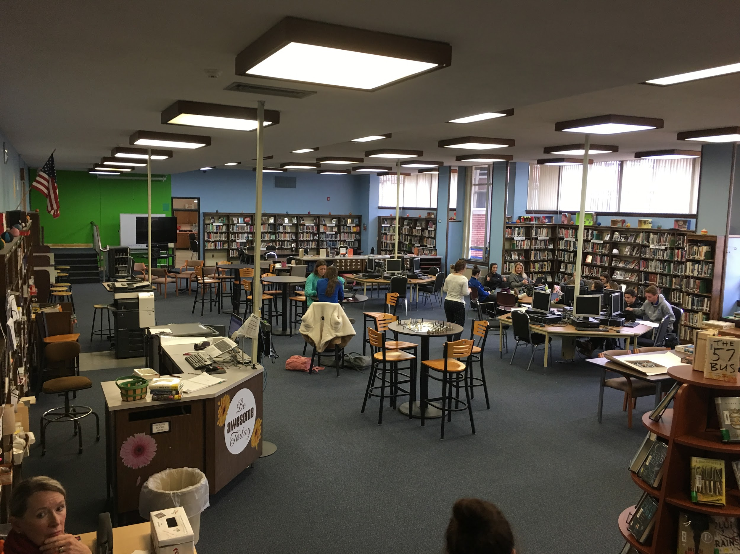
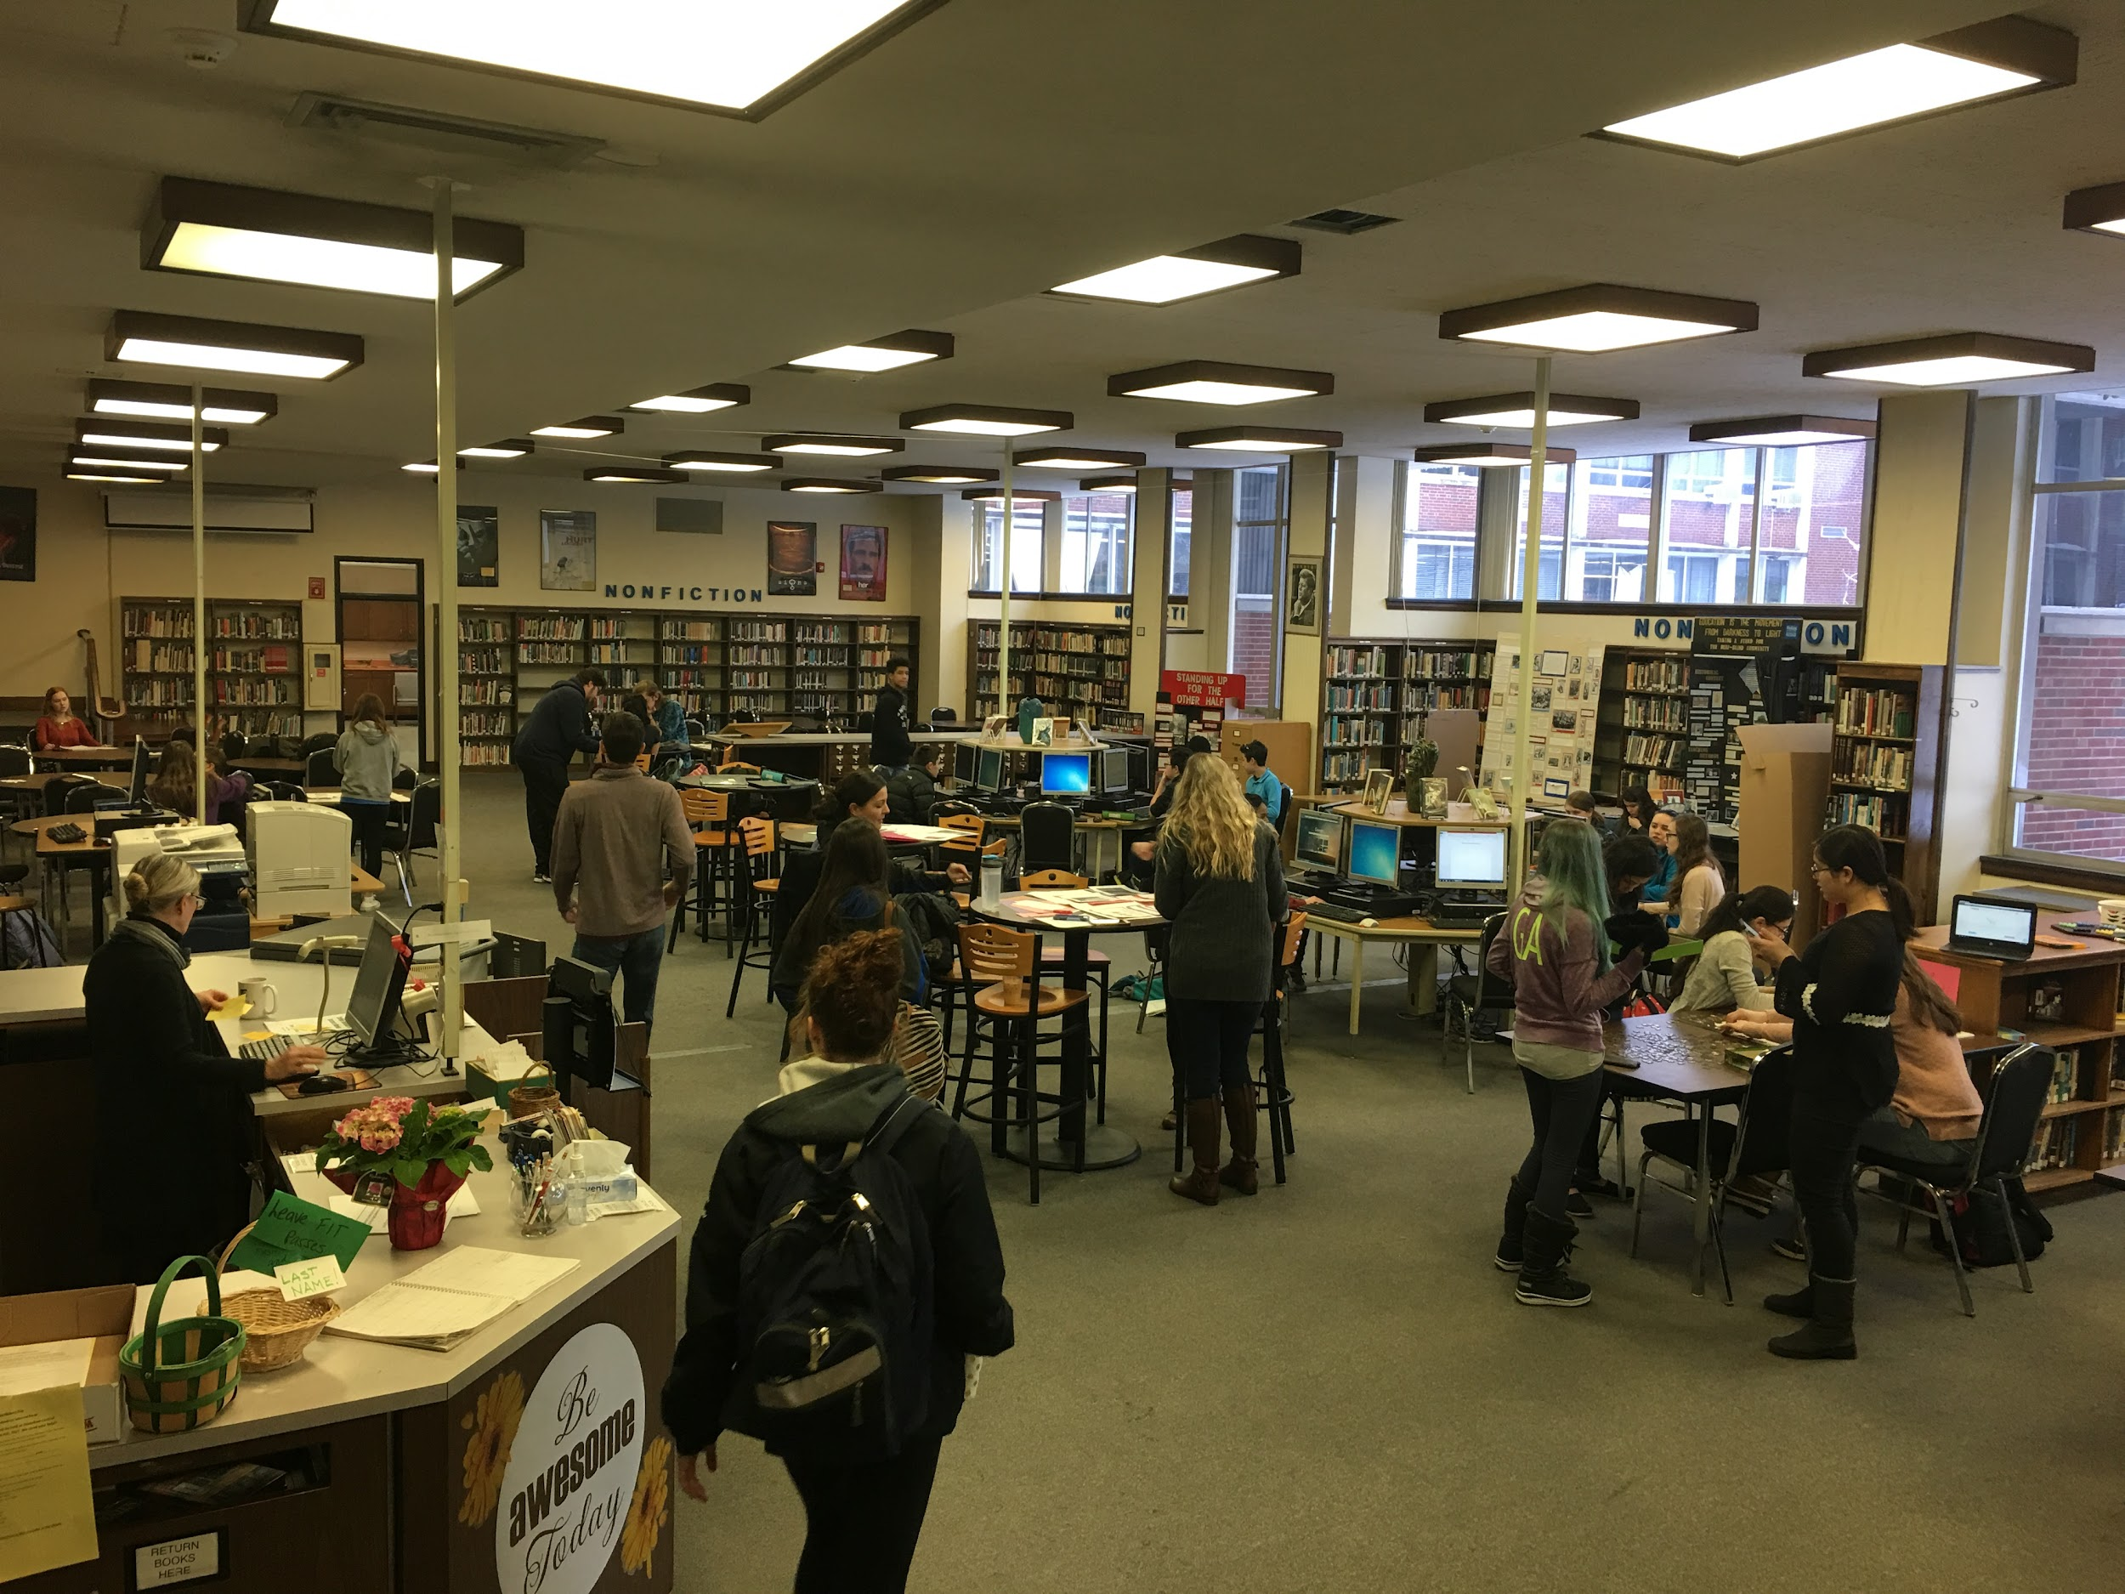
Make it Warm
New Paint and Rugs
Old Paint and Rugs

Slide 42
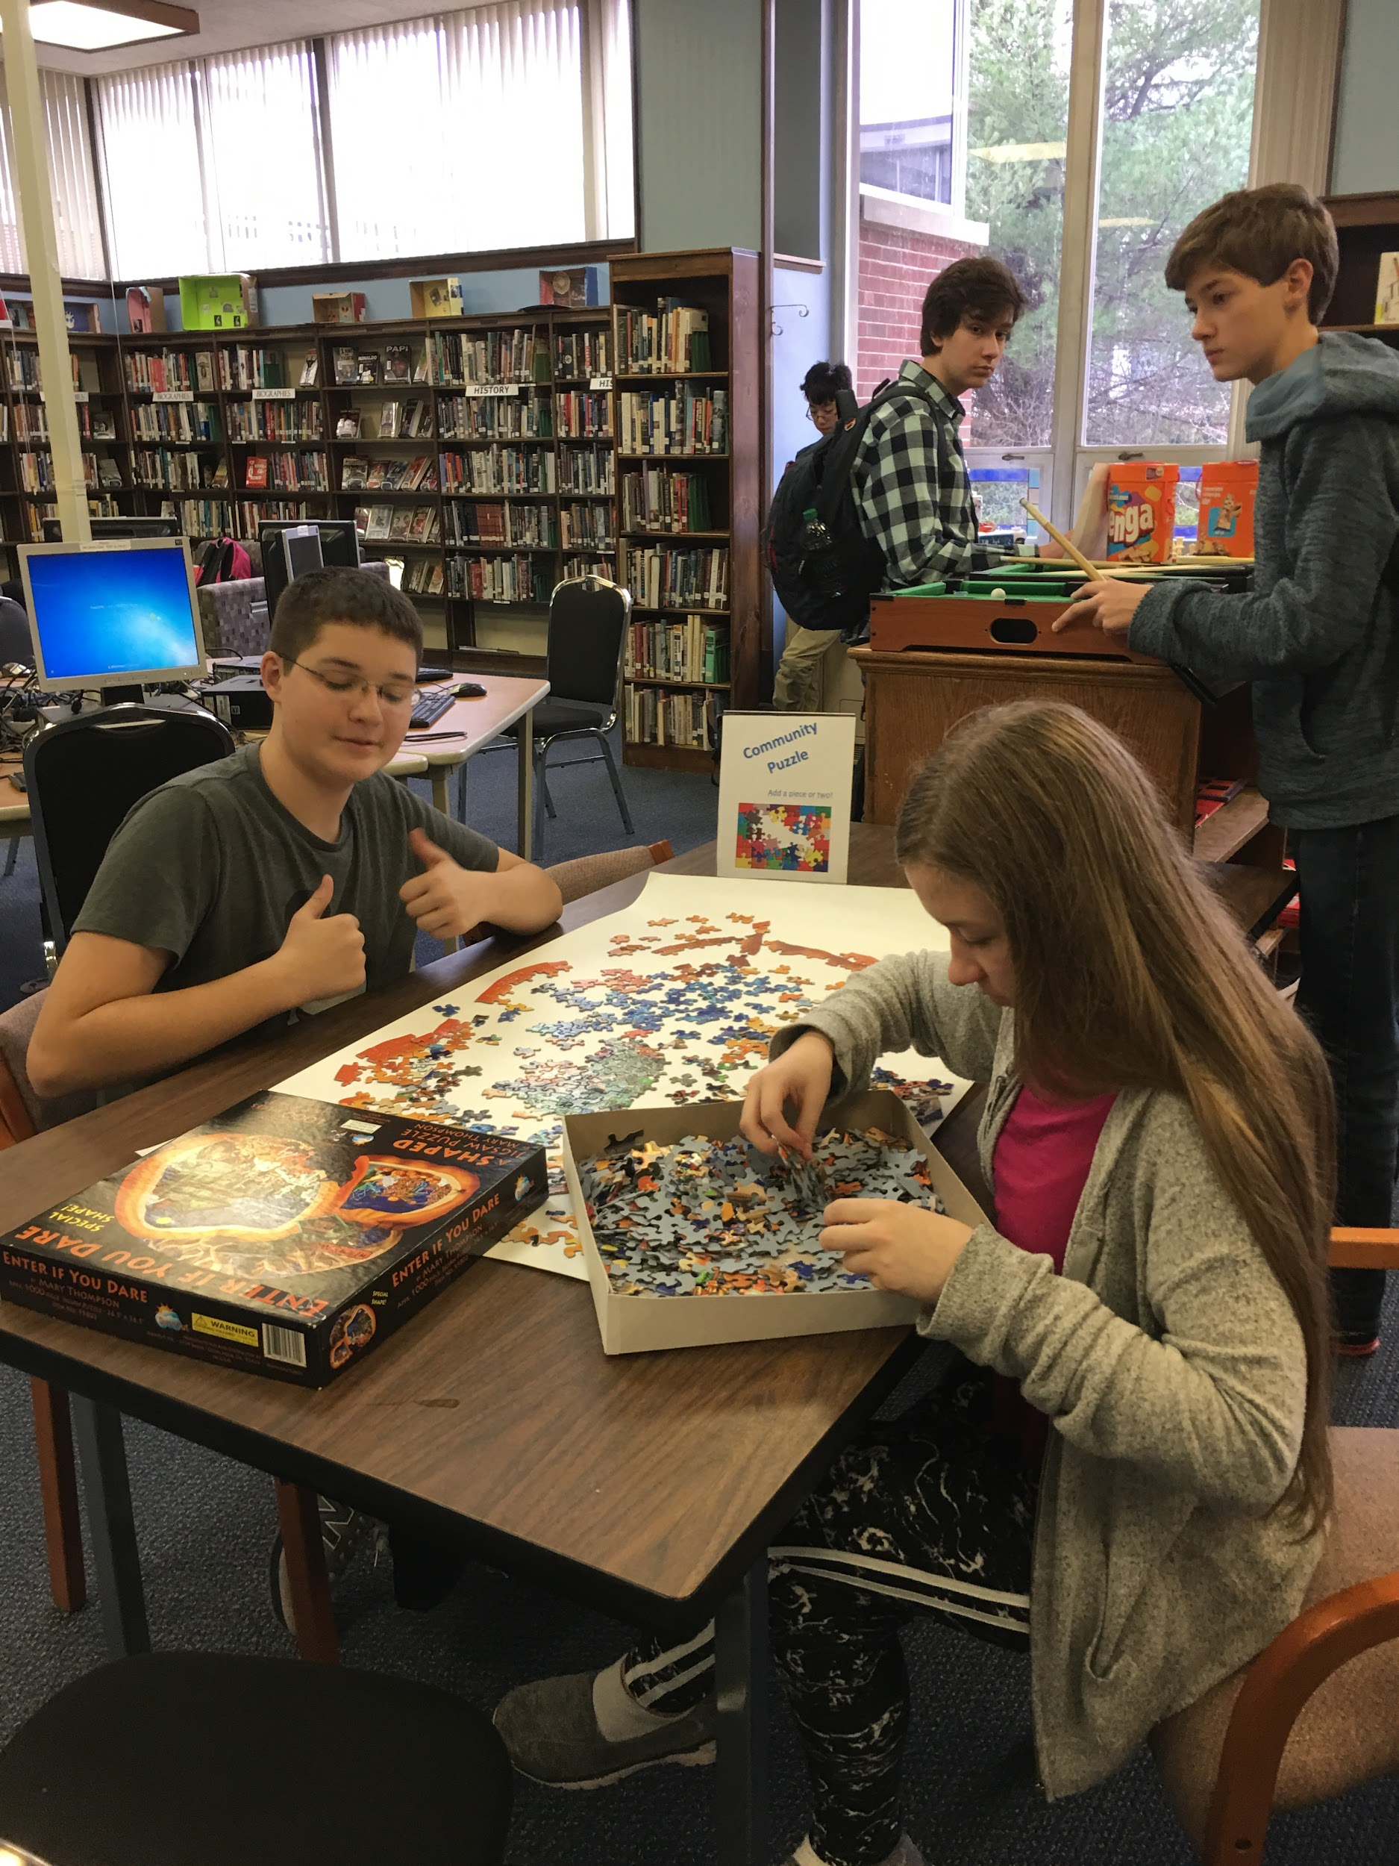
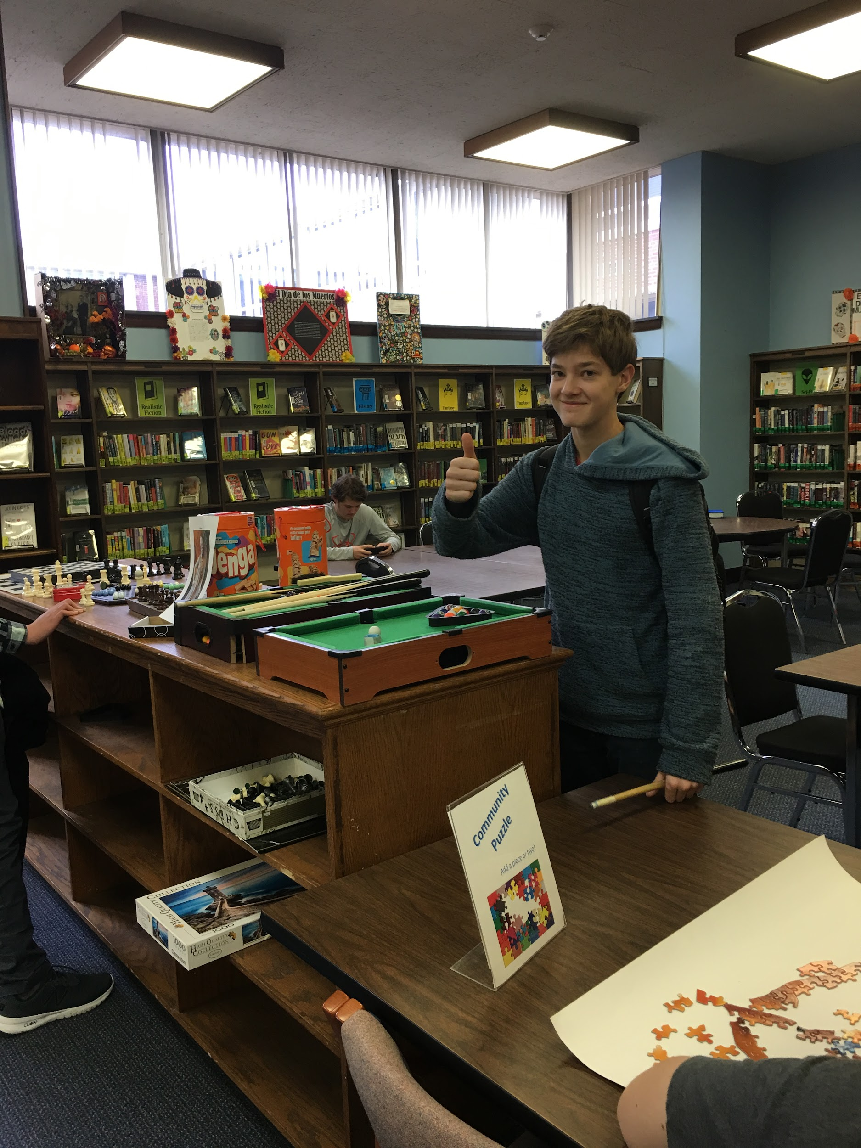
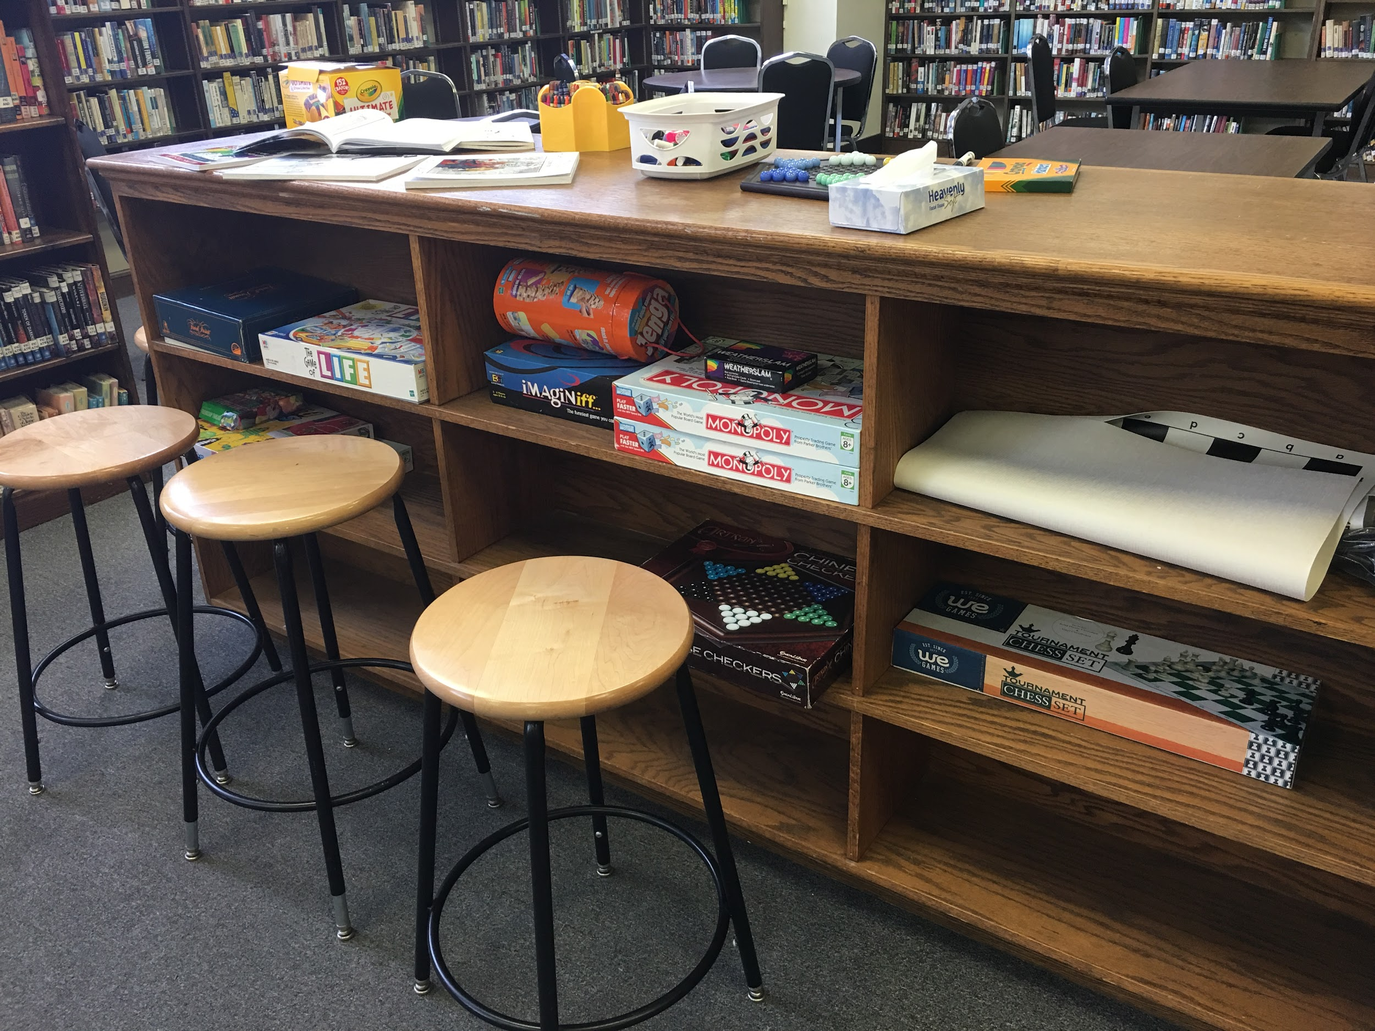
Make it Fun
Notes:
~3 minutes

Slide 43
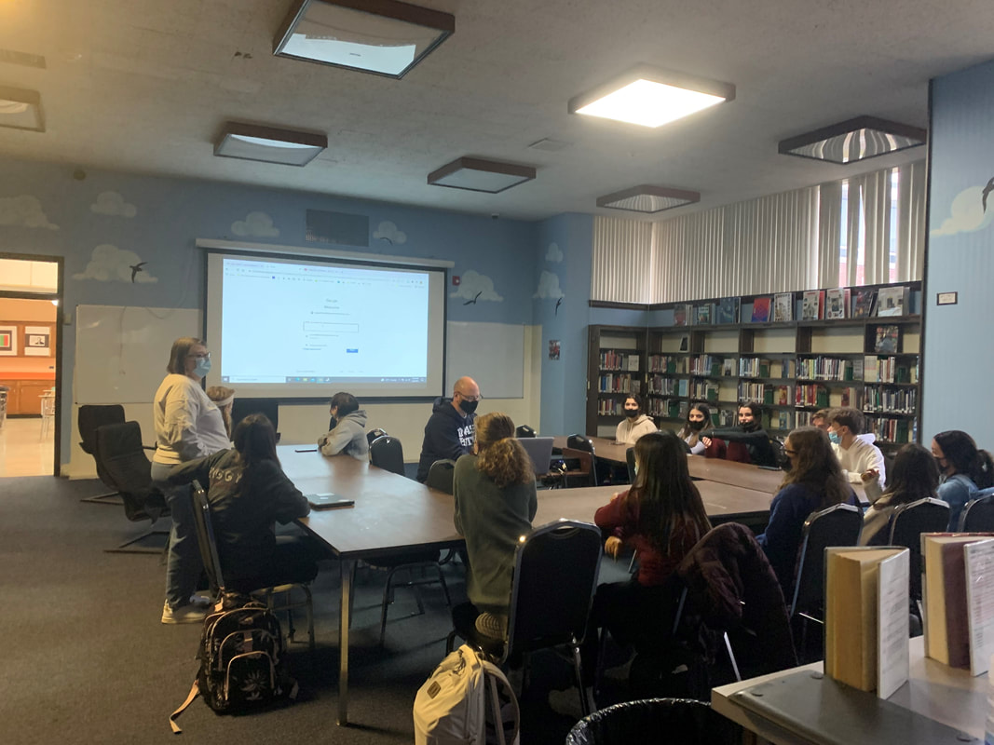
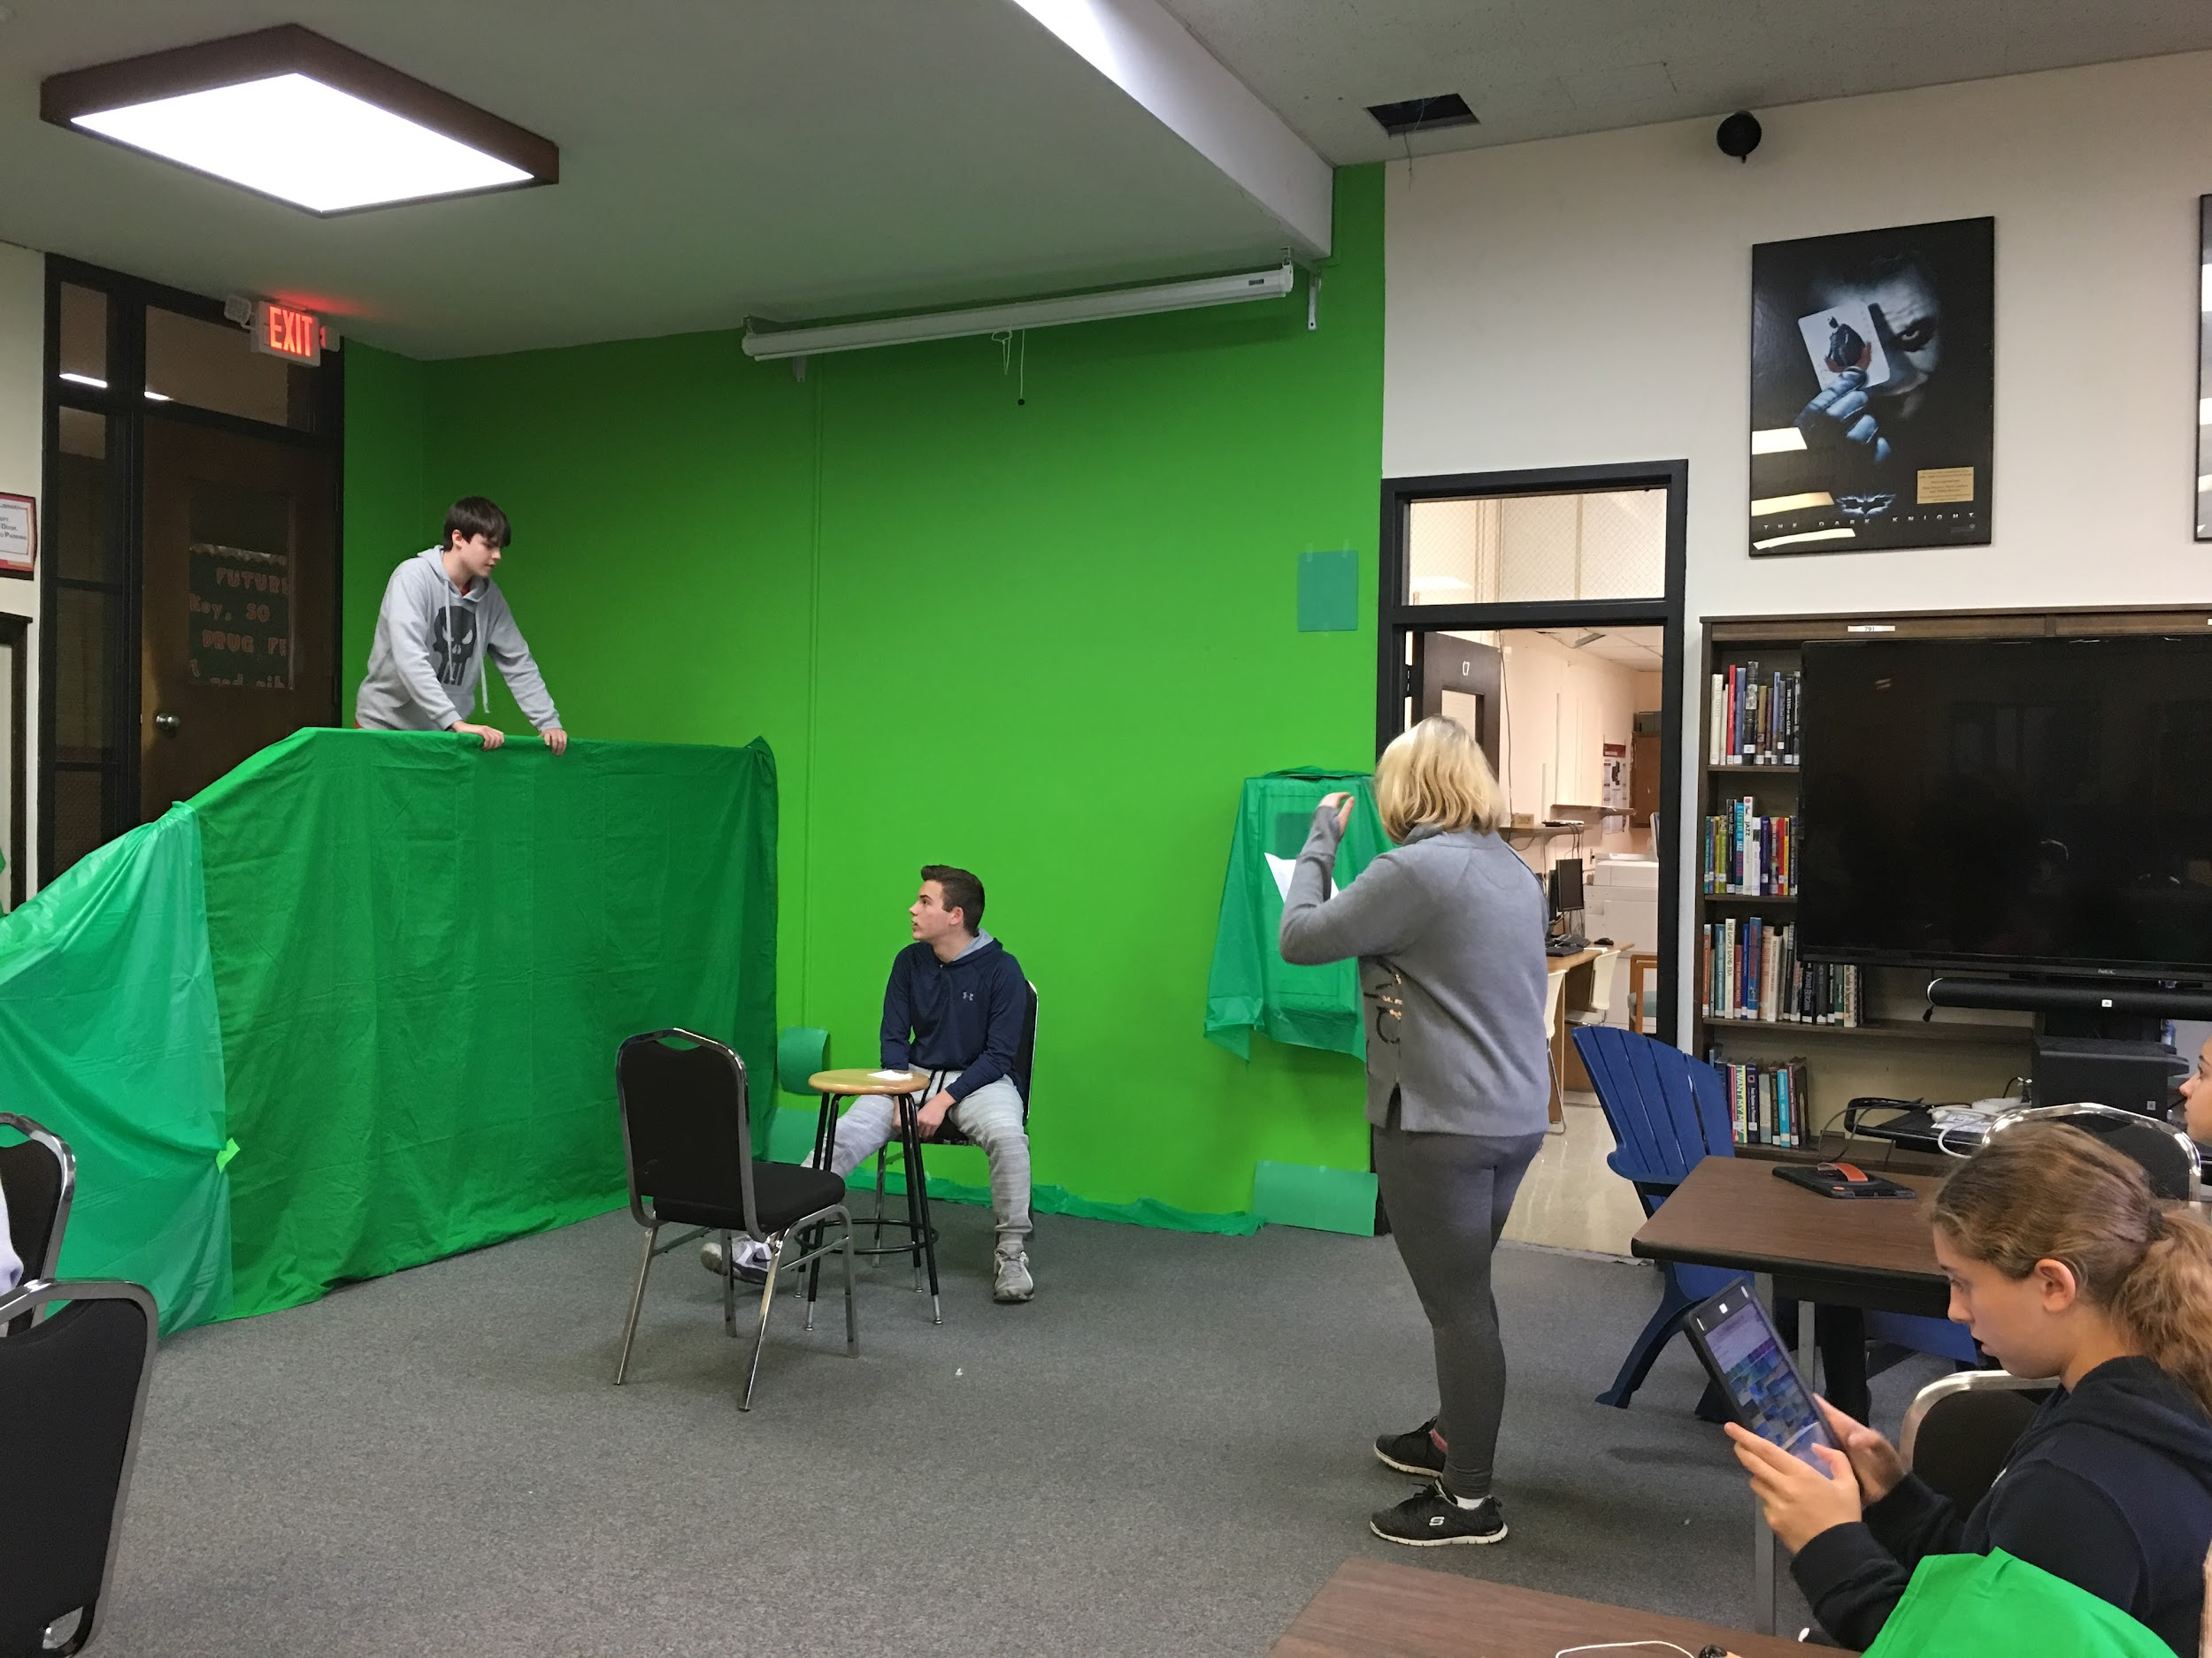
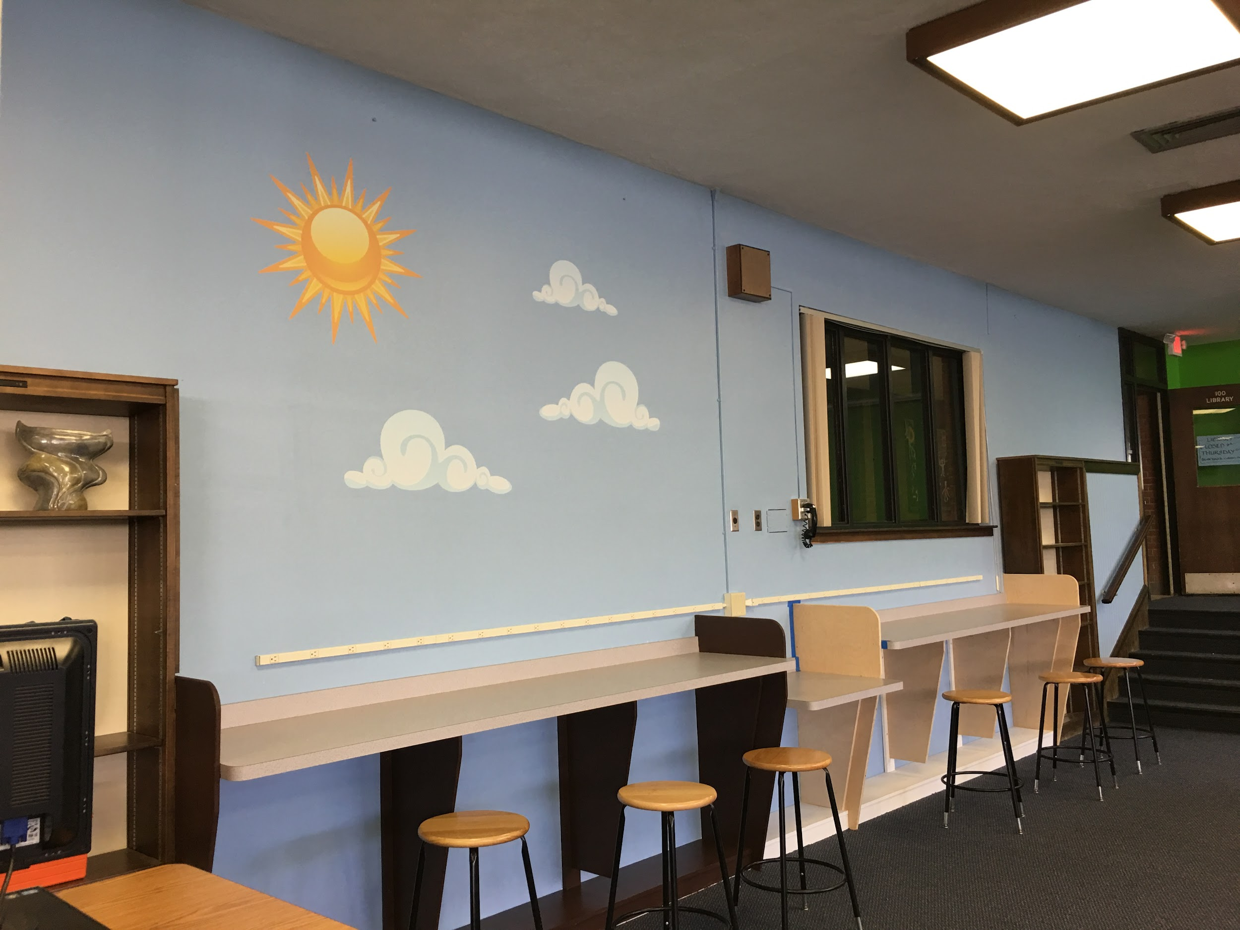
Make it an alternative teaching space to the traditional classroom
Notes:
~3 minutes

Slide 44
Introduction
Marla De La Cruz
Groton Dunstable Regional School District
District Coordinator of Behavioral and Mental Health
Notes:
Slide should take no more than 1 minue to present

Slide 45
Highlights
Restructuring roles and responsibilities
Refining systems and structures for procedures and data collection
Increasing and expanding professional development/professional learning opportunities
Rethinking and redoing mindfulness and instructional spaces
Notes:
~3 minutes

Slide 46
Implementation
Primary challenges:
Limited room options for mindfulness spaces and instructional spaces allowing for more proactive measures
Hiring and retaining staff
Extent of time and resources available to promote unlearning and new learning for staff with so many competing priorities

Slide 47
Implementation
Implementation highlights/What’s working:
Development of positions focused on behavioral and mental health, and coordination of supports and services
Establishment of district-wide Call for Support data collection and review system, ongoing cycles of review
Multi-tiered Professional Development/Learning requirements and offerings
Mindfulness spaces, sensory seating options, materials to promote interactive play and self-regulation
Notes:
~3 minutes

Slide 48
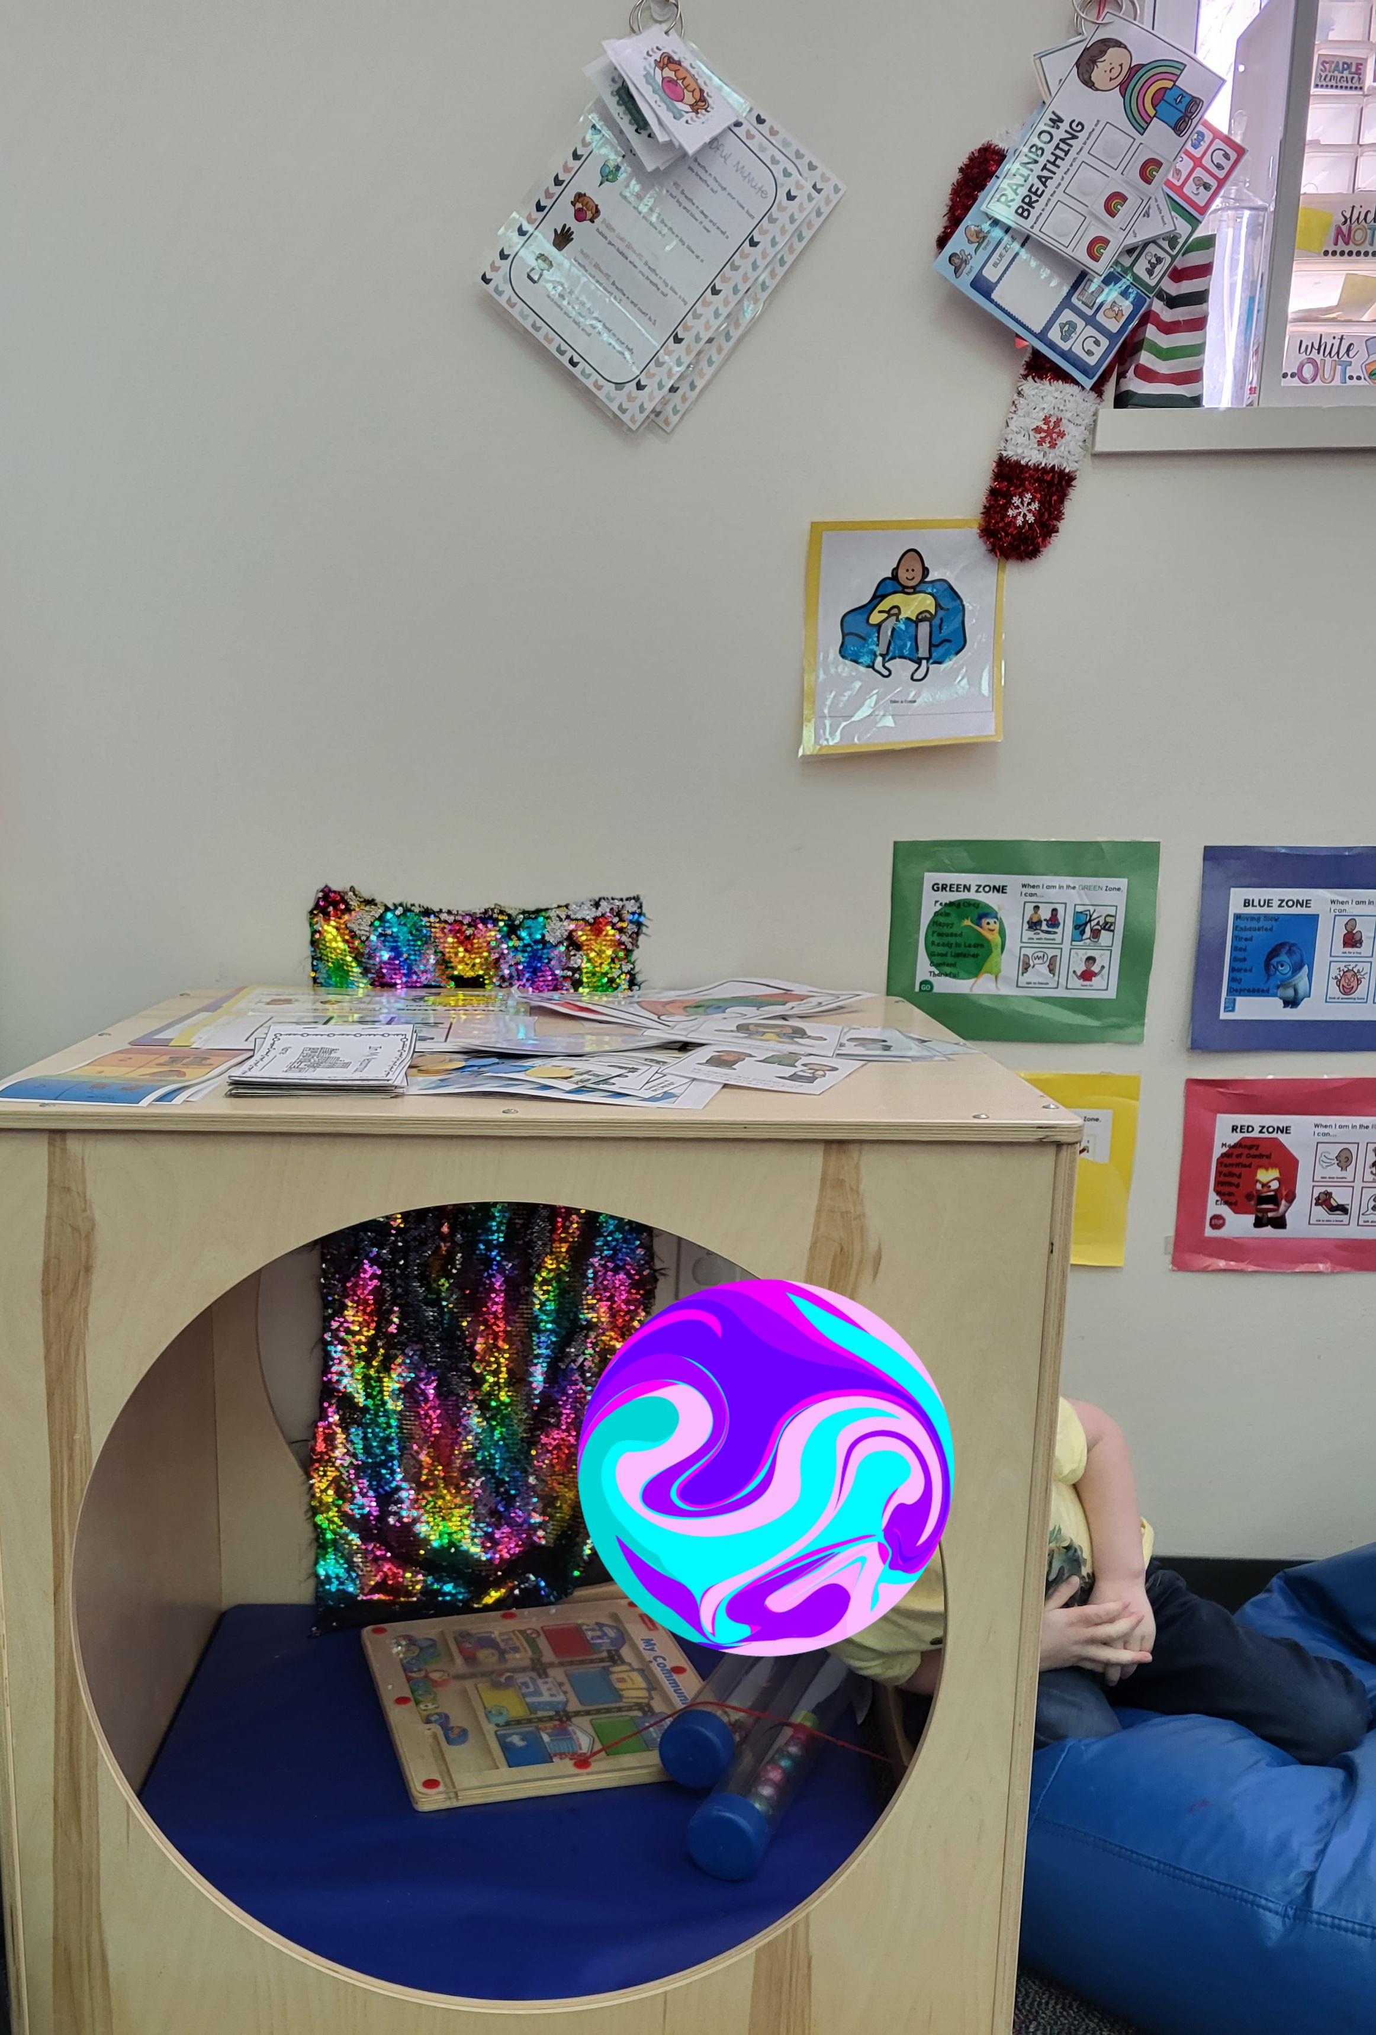
Student in Groton Dunstable

Slide 49
Wrap-up and Q&A

