Slide 1
Special Education Leaders Meeting
Friday, June 23, 2023

Slide 2
Today’s Agenda
From DESE's Educational Vision:
DESE works with districts, schools, and educators to promote teaching and learning that is antiracist, inclusive, multilingual, and multicultural; that values and affirms each and every student and their families; and that creates equitable opportunities and experiences for all students, particularly those who have been historically underserved.
Special Education Updates
MCAS Alternate Assessment Update
New Early Literacy Screening Guidance
Q&A

Slide 3
DESE's Educational Vision
What principles guide our work?
What does that look like in a classroom?
All students in Massachusetts, particularly students from historically underserved groups and communities
Culturally and linguistically sustaining classroom and school practices
High expectations with targeted support
Learning experiences
Individualized supports
Enable students to excel at grade level and beyond
Are relevant, real-world and interactive
Are known and valued
All students
Hyperlink to Ed Vision

Slide 4
Special Education Updates

Slide 5
Resolution funds Year 3
Resolution funds allocations for FY24 were sent on May 23, 2023. If you have not received your letter, please email us at IDEAequitableservices@mass.gov.
A list of LEAs receiving resolution funds for FY24 can be found here.
Written affirmations that reflect consultation regarding these funds are to be submitted with your IDEA application (through the GEMS system).
A sample affirmation that includes Resolution Funds can be found at https://www.doe.mass.edu/sped/proshare/ in the Sample Documents section.

Slide 6
What are Coordinated Pandemic-Related Transition Services?
Chapter 42 of the Acts of 2022
To address the needs of individuals with IEPs who reached or will reach age 22 during the COVID-19 pandemic
The Commonwealth allocated $10 million for transition “services for individuals with disabilities that reached age 22 between March 10, 2020, and September 1, 2023, and were entitled to special education services up to age 22.”

Slide 7
Agencies Providing Services
The Department is collaborating with these agencies to expand their adult services to eligible young adults.
Department of Developmental Services (DDS)​
Massachusetts Rehabilitation Commission (MRC)​
Massachusetts Commission for the Blind (MCB)​
Massachusetts Inclusive Concurrent Enrollment Initiative (MAICEI)

Slide 8
We need your help!
Check the Security Portal for a list of eligible young adults
Go to DropBox Central – State Performance Plan
Contact those eligible and their families to share the link about the services
Flyers are available in multiple languages
Share the link with local community organizations and ask them to post it, such as at….
Your social media platforms
Towns social media platforms
Parks and Recreation department
YMCA/YWCA
Community Action
Faith-based organizations
Other organizations in your community
Questions: contact Martha at martha.s.daigle@mass.gov

Slide 9
Next Steps for Families?
Families who are interested:
Should contact the Federation for Children with Special Needs (FCSN)
Can use this link, or the flyers’ QR code to submit their contact information
FCSN will reach out to each family
Can call FCSN to get more information at (617) 236-7210, (800) 331-0688

Slide 10
Indicator 7 – Due August 31, 2023
ECOS database is open with latest SIMS certification
All pre-K students coded as receiving special education listed
Every district is required to submit entry data for students who started services during the 2022-2023 school year
Every district is required to submit exit data for students with existing entry data
Exit Data MUST be collected for:
Students who progress to Kindergarten
Students who move out of the district or state
Students who are no longer eligible for special education services

Slide 11
Indicator 7 Resources
If you do not see a student in the ECOS database, contact your district’s directory administrator
You will need access to the Indicator 7 Security Portal AND the Special Education State Performance Plan app
Please do NOT email student information – use the DropBox
Resources:
District User Guide for Indicator 7 Data Submission
School User Guide for Indicator 7 Data Submission
Indicator 7 Data webinar
Contact Taletha Derrington (tderrington@air.org) OR Zach Weingarten (zweingarten@air.org)

Slide 12
IEP Improvement Project
Check out the updated website!
Training of Trainers Symposium May 31 and June 1
Vendor Office Hours Session June 8
IEP Office Hours June 15

Slide 13
IEP Improvement - Upcoming Supports
Monthly Office Hours will happen throughout the 2023-2024 school year
Training of Trainers Sessions, Fall 2023
Full Day
In Person
Regional
Process Guide
Sample IEPs
Crosswalk

Slide 14
Additional Informational Sessions/Trainings
Internal DESE staff​
State agency partners​
BSEA​
Advocacy organizations​
Professional organizations (e.g., MASC, MASS)

Slide 15
Confronting Racial Discrimination in Student Discipline
Joint US Departments of Education and Justice guidance
Issued on May 26, 2023
Describes how the Departments resolved investigations of 14 school districts in 10 states nationwide
Supporting Students' Social, Emotional, Behavioral, and Academic Well-Being and Success fact sheets and webinars

Slide 16
Next Special Education Leaders’ Meeting:
August 18, 2023
12:00-1:00

Slide 17
Update:
MCAS-Alt
Eligibility Guidelines

Slide 18
Robert Pelychaty
Manager of Inclusive Assessment
Massachusetts Department of Elementary and Secondary Education (DESE)

Slide 19
Background
The Every Students Succeeds Act (ESSA) has made significant changes regarding student participation rates in the alternate assessment.
The number of students who may take the alternate assessment is limited to no more than 1.0 percent of the total number of all students in the State who are assessed in any of the given subjects.
ESSA further requires that a school district exceeding the 1.0 percent cap in any subject must submit a verification to the department, and the department must provide appropriate guidance to that district. Previously, there was no cap on participation rates.

Slide 20
References for Alternative Assessment
A Dear Colleague Letter from the Office of Special Education stated that, States that adopt Alternate Assessment based on Alternate Achievement Standards must create a definition for students with the most significant cognitive disabilities.
Further in 34 CFR § 200.6 - Inclusion of all students ….
“consistent with section 612(a)(16)(C) of the IDEA, [States must]… monitor implementation of clear and appropriate guidelines for IEP teams to apply in determining, on a case-by-case basis, which students with the most significant cognitive disabilities will be assessed based on alternate academic achievement standards. Such guidelines must include a State definition of students with the most significant cognitive disabilities that addresses factors related to cognitive functioning and adaptive behavior…”
References for additional information
NCEO Reports: Alternate Assessments for Students with Significant Cognitive Disabilities: Participation Guidelines and Definitions (#406) Thurlow, M. L., Lazarus, S. S., Larson, E. D., Albus, D. A., Liu, K. K., & Kwong, E. (2017). Alternate assessments for students with significant cognitive disabilities: Participation guidelines and definitions (NCEO Report 406). Minneapolis, MN: University of Minnesota, National Center on Educational Outcomes.
NCEO Reports: 2018-19 Participation Guidelines and Definitions for Alternate Assessments based on Alternate Academic Achievement Standards (#415) Thurlow, M. L., Lazarus, S. S., Albus, D. A., Larson, E. D., & Liu, K. K. (2019). 2018-19 participation guidelines and definitions for alternate assessments based on alternate academic achievement standards (NCEO Report 415). Minneapolis, MN: University of Minnesota, National Center on Educational Outcomes.)

Slide 21
Definition for Students with the Most Significant Cognitive Disabilities
Massachusetts defines “students with the most significant cognitive disabilities” as students who:
have cognitive disabilities evidenced by significant delays in attaining age-level academic achievement standards, even with systematic, extensive individually designed instruction, related services, and modifications; and
have cognitive disabilities that significantly impact their educational performance and ability to apply learning from one setting to another; and
require extensive, direct individualized instruction and substantial supports to achieve measurable gains on the challenging State academic content standards for the grade in which the student is enrolled; and
perform significantly below average in general cognitive functioning and adaptive behavior. This is defined as a student functioning two or more standard deviations below the mean on commonly accepted norm-referenced assessments in both cognitive functioning and adaptive behavior (e.g., two or more adaptive skill areas such as daily living skills, communication, self-care, social skills, and academic skills).

Slide 22
Consideration for Schools
Resources and Guidance
For the spring 2024 MCAS-Alt decisions, Teams should evaluate student’s eligibility for the alternate assessment (MCAS-Alt) based on the definition for Students with the Most Significant Disabilities.
We anticipate this to be a transition year for schools and Teams to review MCAS-Alt eligibility decisions using the new definition.
The Educator’s Manual for the MCAS-Alt will include important resources and guidance for Teams to consider (Available Aug. 2023).
The MCAS Accessibility and Accommodations Manual will also describe guidance for Teams (Available Aug. 2023).
Trainings and Materials:
MCAS-Alt web pages will include an FAQ and provide training opportunities for educators (Aug. 2023)

Slide 23
Early Literacy Screening Guidance

Slide 24
Early Screening Regulation
Assessment | Instructional Response | Family Communication
All students Grades K-3 At least 2x per year Use a screening instrument approved by the Department | For students scoring significantly below benchmarks, schools: Plan instruction to meet students’ needs Determine need for progress monitoring | Within 30 school days of a screening result that is significantly below benchmarks, schools: Inform the student’s family of result Offer follow-up discussion

Slide 25
Importance of Early Literacy Screening
Allows educators to intervene with targeted evidence-based instruction at the first indication that additional support is needed.
Proactively designed to gather information on the most predictive literacy skills to identify each student’s risk of experiencing reading difficulties.
Early Screening examines all students’ early literacy skills as a part of an equitable, culturally and linguistically sustaining literacy plan.

Slide 26
DESE-approved screening assessments
Approved: Meets Expectations DIBELS 8th Edition by the University of Oregon EarlyBird by EarlyBird Education (Kindergarten) mClass by Amplify Education | Approved: Partially Meets Expectations Acadience by Voyager Sopris Learning Fastbridge by Illuminate i-Ready by Curriculum Associates MAP Reading Fluency by NWEA STAR by Renaissance

Slide 27
Significantly below benchmarks
25th percentile or below
Approved screening assessment | Suggested designation to determine “significantly below relevant benchmarks”
DIBELS 8th edition (paper) | At Risk
EarlyBird | Flag icon
mCLASS DIBELS 8th edition (digital) | Well Below Benchmark / Intensive Intervention
Acadience | Well Below Benchmark
Fastbridge | High Risk
i-Ready | At Risk
MAP Reading Fluency | Flag and/or Below Grade Level Expectations
STAR | Intervention or Urgent Intervention

Slide 28
What information must be shared with families?
Within 30 school days of a screening result that is significantly below relevant benchmarks, schools must: Inform the student’s parent or guardian of the screening results Inform the student’s parent or guardian of the school’s instructional response Offer the student’s parent or guardian the opportunity for a follow-up discussion
DESE recommends that schools inform all families of students' screening results.

Slide 29
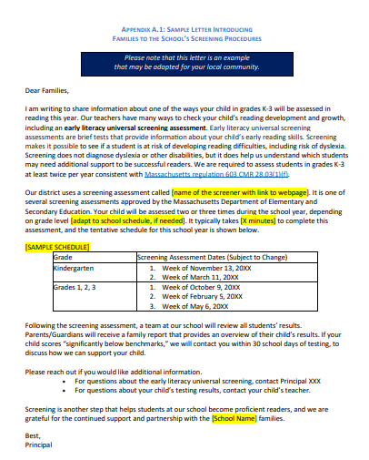
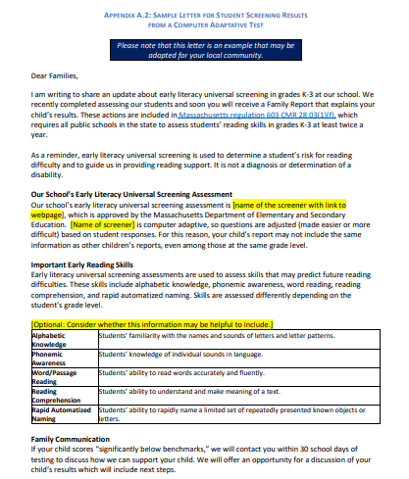
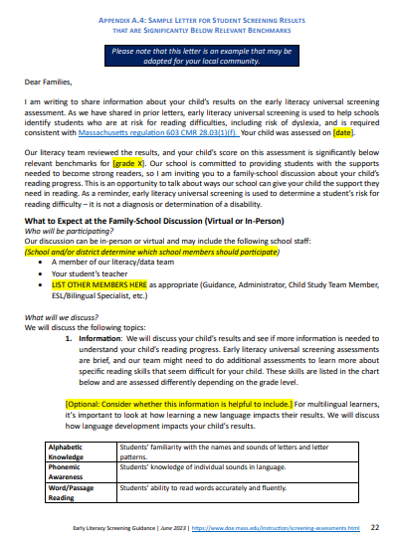
Sample family letters are provided
Introduce Screening
Share Screening Family Report
Share Screening Result that is Significantly Below Benchmark

Slide 30
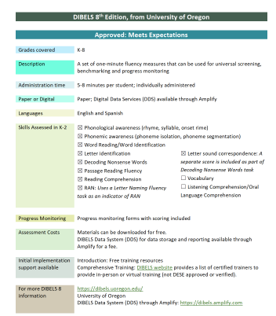
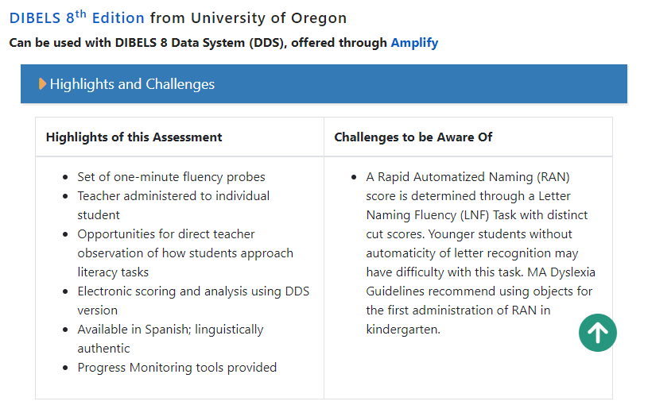
Resources for selecting a screening assessment
Early Literacy Universal Screening Website:
Highlights and Challenges
Early Literacy Screeners
At-A-Glance
www.doe.mass.edu/instruction/screening-assessments.html

Slide 31
How can I get more support?
Screening Office Hours | Screening Plug and Play Resources (Coming soon!)

Slide 32
Q&A

