Slide 1
Special Education Leaders Meeting
Friday, September 15, 2023

Slide 2
Today’s Agenda
From DESE's Educational Vision:
DESE works with districts, schools, and educators to promote teaching and learning that is antiracist, inclusive, multilingual, and multicultural; that values and affirms each and every student and their families; and that creates equitable opportunities and experiences for all students, particularly those who have been historically underserved.
Special Education Updates and Reminders
New IEP Updates
General Supervision Updates

Slide 3

DESE's Educational Vision
What principles guide our work?
What does that look like in a classroom?
All students in Massachusetts, particularly students from historically underserved groups and communities
Culturally and linguistically sustaining classroom and school practices
High expectations with targeted support
Learning experiences
Individualized supports
Enable students to excel at grade level and beyond
Are relevant, real-world and interactive
Are known and valued
All students
Hyperlink to Ed Vision

Slide 4
Special Education Updates

Slide 5

Special Education in Institutional Settings (SEIS)
Who we are
  Providing services in four host agencies
How we partner with you, the local school districts
IEP Reconvene/SIEM meetings

Slide 6
If you have more questions, please contact:
Teresa Poteat, SEIS Contract Administrator TPOTEAT@collaborative.org 413-320-3858
Antonio Fazio, Associate Director of Program Coordination AFAZIO@collaborative.org 413-727-5738
Kate Firlings, School District Liaison Coordinator KFIRLINGS@collaborative.org 508-439-0986

Slide 7
Reminders: Special Education Leaders
Regular Updates and Information
  Special Education Bulletin
  Special Education Website (Announcements)
Update Information in the Directory Administration
  Special Education Leaders Meeting Invites and Memos
IDEA Applications and Budgets (Fund Codes 240 & 262)
  Resolution Funds/Equitable Services, M3 (NI Districts from 2022-2023), and CCEIS/CEIS
Equitable Services
  Consultation Meetings, Provision of Services, and Resolution Funds
Data Collection
  Indicator 7- Planning for November, April, and August Submissions
  FY2024 Data Collection
ESY Planning (Transportation)

Slide 8
Important Dates: Special Education Leaders
9/15/2023- Indicator 7 Data Collection Closes
9/29/2023- Indicator 14 Data Collection Closes
9/30/2023- FY22 IDEA Funds Expire
10/1/2023- Child Count for Parentally Placed and Homeschooled Children
10/2/2023- IDEA Applications (Fund Codes 240 & 262) Due
11/2023- Indicator 7 Entry/Exit Data Submission

Slide 9
MCAS-Alt Administrator’s Overview Sessions (webinar)

Slide 10
Special Education Leaders Meetings
2023-2024
  October 2023 – No Meeting (Due to ToT Sessions)
  Friday, November 17, 2023 – noon to 1pm
  Friday, December 15, 2023 – noon to 1pm
  Friday, January 26, 2024 – 11am to noon
  Friday, February 9, 2024 – noon to 1pm
  Friday, March 29, 2024 – noon to 1pm
  April 2024 – TBA
  May 17, 2024 – noon to 1pm
  June 21, 2024 – noon to 1pm
  Reminder that if you are not able to attend, we post slides and recordings of these meetings here

Slide 11
MCAS-Alt Administrator’s Overview Sessions (webinar)

Slide 12
Registration information for this and all the educator trainings available will be emailed via flyer to all schools and publicized in the MCAS-Alt Newsletter, SAS Update, and the MCAS-Alt website
2023 Fall Administrator’s Overview for the MCAS-Alt
Administrators Overview (choose one date)
Date Time
Tuesday, September 26 1:30- 3:00 p.m.
Thursday, October 12 9:30- 11:00 a.m.

Slide 13
MCAS Competency and Grade-Level Portfolios Sessions
For students with complex disabilities that have grade level skills but cannot demonstrate their knowledge on the standard MCAS tests. Special educators are encouraged to bring their general education colleagues to attend this session.
MCAS Competency and Grade-Level Portfolios (choose one date)
Date Time
Tuesday, September 26 9:30- 10:30 a.m.
Tuesday, October 10 1:00- 2:00 p.m.

Slide 14
What are Coordinated Pandemic-Related Transition Services?
Chapter 42 of the Acts of 2022:
To address the needs of individuals with IEPs who reached or will reach age 22 during the COVID-19 pandemic
The Commonwealth allocated $10 million for transition “services for individuals with disabilities that reached age 22 between March 10, 2020, and September 1, 2023, and were entitled to special education services up to age 22.”

Slide 15
Agencies Providing Services
The Department is collaborating with these agencies to expand their adult services to eligible young adults.
  Department of Developmental Services (DDS)​
  Massachusetts Rehabilitation Commission (MRC)​
  Massachusetts Commission for the Blind (MCB)​
  Massachusetts Inclusive Concurrent Enrollment Initiative (MAICEI)

Slide 16

Of the 2,162 eligible young adults
…we want more to receive these services

Slide 17
We need your help!
Check the Security Portal for a list of eligible young adults
    Go to DropBox Central – State Performance Plan
Contact those eligible and their families to share the link about the services
    Flyers are available in multiple languages
Share the link with local community organizations and ask them to post it, such as at….
    Your social media platforms
    Town's social media platforms
    Parks and Recreation department
    YMCA/YWCA
    Community organizations
Questions: contact Martha at martha.s.daigle@mass.gov

Slide 18
Next Steps for Families
Families who are interested:
Need to contact the Federation for Children with Special Needs (FCSN)
Use this link, or the flyers’
QR code to submit their contact information
  FCSN will reach out to each family
  OR
Call FCSN to get more information at
(617) 236-7210, (800) 331-0688

Slide 19
New IEP Updates

Slide 20
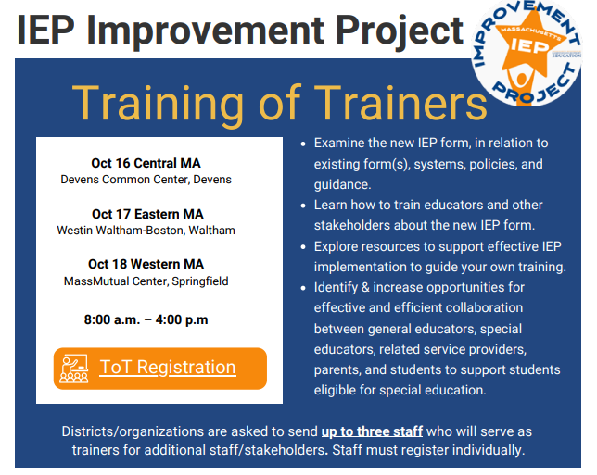
Training of Trainers for IEP Improvement Project
Click HERE to Register!
Registration closes today,
Sept. 15!

Slide 21
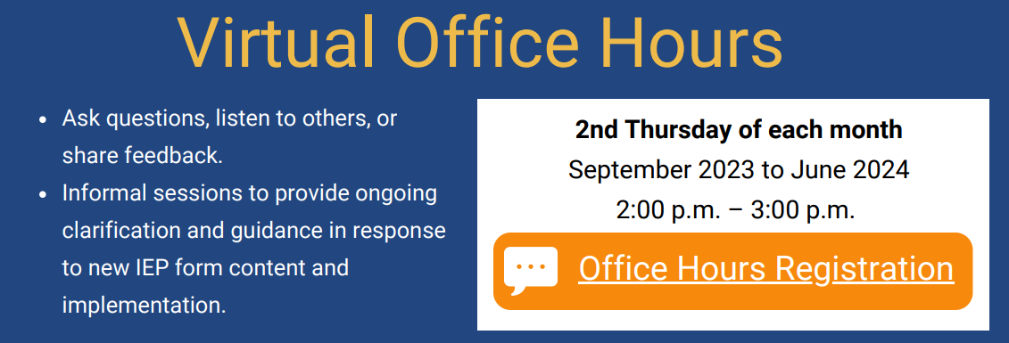
Virtual Office Hours
Click HERE to Register!

Slide 22
IEP Technical Guide—Released in Two Sections
Section 1
Released on Aug. 3
Includes Vision Statement, Present Levels, Accommodations and Modifications, etc.
Section 2
To be released in early Sept.
Will include English Learners, Service Delivery, Transportation, etc.

Slide 23
IEP Technical Guide
Section 1 of updated guide form is posted for stakeholder review.
Section 2 will be posted in early September!
A survey has been developed and posted to collect stakeholder feedback on Section 1.
The feedback survey for Section 1 will close on September 1, 2023.
The final full version will be posted in October.

Slide 24
Additional Resources Coming Soon
Topic-Specific Training Resources
Transition Planning
Dually Identified Learners
Preparing for a Team Meeting
Other Resources
Family Guide
Playbook
Sample Family Letter

Slide 25
IEP Implementation Grant Update
Name of Grant Program: Individuals with Disabilities Education Act Part B (IDEA)
Federal Targeted - IEP Implementation Project Grant
Fund Code: 274
*Grant funding is subject to the availability of federal funds. The above information is currently proposed and is subject to change before posting.

Slide 26
General Supervision Update

Slide 27
States must have a system of general supervision – an accountability and support system – that monitors local education agencies (LEAs) and assists LEAs to implement the Individuals with Disabilities Education Act (IDEA).
Primary focus:
Educational Results
Functional Outcomes

Slide 28
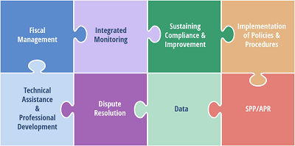
General Supervision Systems
A general supervision system consists of the many mechanisms by which states facilitate LEA adherence to IDEA and improved outcomes for children with disabilities.

Slide 29
New OSEP Guidance Released July 24, 2023
State General Supervision Responsibilities under Parts B and C of the IDEA: Monitoring, Technical Assistance and Enforcement
“Dear Colleague” Letter that adds context to the above guidance

Slide 30
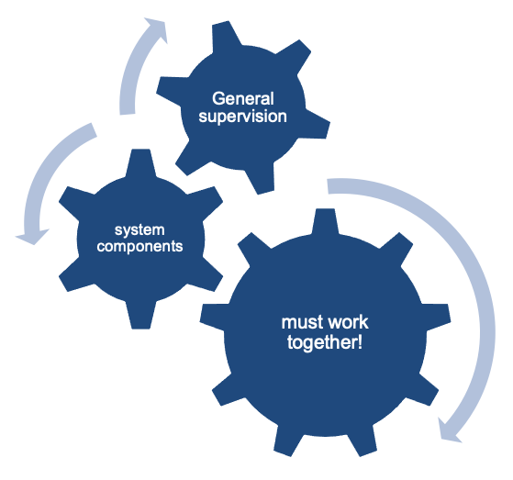
Coherence Matters!
Imagine a general supervision system as a sophisticated machine comprised of many interlocking gears that all must operate in concert to produce the desired outcomes.

Slide 31
LEA Determinations
General Supervision Opportunity
By improving the connection between the LEA Determinations, Department provided TA, PD, and special education improvement planning, schools and districts will be able to better align policies, procedures, practices, and systems to improve outcomes and opportunities for students with disabilities.

Slide 32
Update LEA Determinations
Current | Future
Special Education Data Driven Rubric | Aligned Rubric (Compliance and Outcomes)
General- Improvement Planning TA, PD, and Support for Districts | Aligned Improvement Planning Aligned TA, PD, and Support (Tiered/Targeted)

Slide 33
Approved Special Education Schools Monitoring
General Supervision Opportunity
By using CHAMP as our monitoring platform, we can develop a more streamlined, timely and collaborative process of data collection. This new and efficient process improves outcomes for children by ensuring successful implementation of policies, procedures, and practices.

Slide 34
Approved Special Education Schools
Current | Future
CHAMP- new comprehensive monitoring platform | On-going analysis of Program and Mid-Cycle Review timelines
Training in cohorts; self-assessment due dates based on-site visit date | Update website- documents, technical assistance, and procedures

Slide 35
Public School Monitoring
General Supervision Opportunity -
Further integration of data in our monitoring leading to improved educational results and functional outcomes for students.

Slide 36
Public School Monitoring
For LEAs Undergoing a Tiered Focused Monitoring Review
Current | Future
No longer tiering | Monitoring will move from the current system into CHAMP
Noncompliance addressed through Corrective Action Plans | Onsite will be based on key data elements

Slide 37
Problem Resolution System
General Supervision Opportunity
Clarify the existing alignments of policy between PRS and other DESE units, and with the BSEA to enhance information sharing and reporting.

Slide 38
Problem Resolution System
Current | Future
Update PRS Procedures Guide | Implement new procedures after stakeholder engagement and internal training
Update PRS Intake Form

Slide 39
Next steps—Areas of Focus
Alignment
Stakeholder Engagement
Data

Slide 40
Q&A

