Slide 1
Special Education Leaders Meeting
Friday, November 17, 2023

Slide 2
Today’s Agenda
From DESE's Educational Vision:
DESE works with districts, schools, and educators to promote teaching and learning that is antiracist, inclusive, multilingual, and multicultural; that values and affirms each and every student and their families; and that creates equitable opportunities and experiences for all students, particularly those who have been historically underserved.
Special Education Updates and Reminders
688 Referrals for Students with ASD
General Supervision Updates
New IEP Updates

Slide 3
DESE's Educational Vision
What principles guide our work?
What does that look like in a classroom?
All students in Massachusetts, particularly students from historically underserved groups and communities
Culturally and linguistically sustaining classroom and school practices
High expectations with targeted support
Learning experiences
Individualized supports
Enable students to excel at grade level and beyond
Are relevant, real-world and interactive
Are known and valued
All students
Hyperlink to Ed Vision

Slide 4
Special Education Updates

Slide 5
Introducing Kelsey LoDuca-Towne Assistant Director, Problem Resolution System

Slide 6
2023 ELA MCAS Results

Slide 7
2023 MCAS Math Results

Slide 8
2023 Chronic Absenteeism Rates

Slide 9
2023 Student Discipline – All Categories

Slide 10
Equitable Services Reminders
Reminders for Year 3 of the Resolution Funds (FY2024)
Timely and Meaningful Consultation (written affirmations must include the Resolution Funds)
Midyear Self-Assessment (amount of funds expended to date and use of funds)
Evidence of Expenditures (may be requested by the Department)
Summer Summative Survey (confirm funds expended and use of funds)
General Reminders- Equitable Services
Carryover Questionnaire (must completed and be approved before funds can be used for general IDEA expenditures)
Child Count (October 1st count used to determine proportionate share for the following fiscal year)

Slide 11
Updated Dyslexia Guidance
Chapter 9 updated with more robust information to center the unique assets of multilingual learners who are at risk for dyslexia.
School and district leaders are encouraged to use the recommendations and considerations outlined to approach assessment and instruction through a culturally and linguistically sustaining lens.
Updated guidance is located here.

Slide 12
Reminder from OSEP: Tiered Systems of Support
Multi-Tiered System of Supports (MTSS)/Response to Intervention (RTI) Process Cannot Be Used to Delay/Deny an Initial Evaluation (April 10, 2023)
OSEP Memorandum 11-07- RTI Process Cannot Be Used to Delay-Deny an Evaluation for Eligibility under the Individuals with Disabilities Education Act (IDEA) (January 21, 2011)
OSEP Memorandum 16-07- A Response to Intervention Process Cannot be Used to Delay-Deny an Evaluation for Preschool Education Services under IDEA (April 29, 2016)
* The memos apply to tiered systems of support including MTSS.

Slide 13
Key Takeaways from the OSEP Memos
LEAs must ensure there are systems in place for meeting the child find requirements as a condition for funding.
IDEA Part B regulations at 34 C.F.R. §300.301(b) allow a parent to request an initial evaluation at any time to determine if a child is a child with a disability under IDEA.
MTSS may not be used to delay or deny a full and individual evaluation under 34 C.F.R. §§300.304-300.311 for a child suspected of having a disability.
IDEA does not require or encourage a local or preschool program to use an MTSS approach prior to referral for evaluation or as part of determining whether a 3-, 4-, or 5-year-old is eligible for special education and related services.
Once an LEA receives a referral from a preschool program, the LEA must initiate an evaluation process to determine if the child is a child with a disability.

Slide 14
Reminder: Requirement to Monitor Provision of Services and Programs to Students
The school district is required to monitor the provision of services to and the programs of individual students placed out-of-district. Documentation of monitoring plans and all actual monitoring shall be placed in the files of every eligible student who has been placed out-of-district. To the extent that this monitoring requires site visits, such site visits shall be documented and placed in the students' files for review. The duty to monitor out-of-district placements cannot be delegated to parents or their agents, to the Department, or to the out-of-district placement. The school district may, however, contract directly with a person to conduct such monitoring. 603 CMR 28.06(3)(b).

Slide 15
Reminder: Students Placed in Private Schools by School Districts
A child with a disability who is placed in or referred to a private school or facility by a public agency must be:
(a) provided special education and related services—
In conformance with an IEP that meets the requirements of §§ 300.320 through 300.325; and
At no cost to the parents;
(b) Is provided an education that meets the standards that apply to education provided by the SEA and LEAs including the requirements of this part, except for § 300.156(c); and
(c) Has all of the rights of a child with a disability who is served by a public agency. See 34 C.F.R. § 300.146.

Slide 16
Reminder of Requirements
The out-of-district placement shall afford publicly-funded students all the substantive and procedural rights held by eligible students, including but not limited to those specified in 603 CMR 28.09, and shall comply with all other applicable requirements of 603 CMR 28.00 and applicable policy statements and directives issued by the Department. 603 CMR 28.06(3)(f)(4).

Slide 17
Mileage Reimbursement Reminder
Effective July 17, 2022, state employees became eligible to receive reimbursement for transportation at the rate of $0.62 per mile.
Therefore, if a parent provides transportation to an eligible student requiring special transportation consistent with the requirements of 603 CMR 28.05(5)(b), the school district shall reimburse such parent the prevailing rate per mile for state employees.
No parent shall be obligated to provide such transportation.
DESE’s July 2022 Mileage Reimbursement Advisory can be found here

Slide 18
Special Education Leaders Meetings 2023-2024
Friday, December 15, 2023 – noon to 1pm
Friday, January 26, 2024 – 11am to noon
Friday, February 9, 2024 – noon to 1pm
Friday, March 29, 2024 – noon to 1pm
April 2024 – TBA
May 17, 2024 – noon to 1pm
June 21, 2024 – noon to 1pm
Reminder that if you are not able to attend, we post slides and recordings of these meetings here

Slide 19
688 Referrals for Students with ASD
Chris Peltier
DDS Director of Adult Autism Supports
christopher.j.peltier@mass.gov

Slide 20
A Little History
DDS has always served people with autism and intellectual disabilities
Beginning in 2014 with the passage of the Autism Omnibus Bill, our eligibility standards changed and DDS became the lead agency for autistic individuals in the Commonwealth without an accompanying ID diagnosis as well
We currently serve almost 5,000 adults with ASD without cognitive challenges, and the number of these eligible adults is growing rapidly

Slide 21
The Message for IEP Teams
Every student identified with ASD - primary, secondary or tertiary – should be referred to DDS through the 688 process with the student’s/parent’s consent 2 years prior to their anticipated graduation date
This is true regardless of IQ or academic performance – autistic students with average or even above average academic skills may require significant supports in other domains to make a successful transition into adult life
Students & families should be encouraged to apply for DDS adult eligibility when students turn 17. A DDS eligibility determination will be made based on the IEP and evaluations submitted during the application process

Slide 22
Why is 688 so Important for Students with ASD?
Connection to an adult service agency and to a Transition or ASD Service Coordinator can make the transition process smoother and less chaotic for schools, families and DDS
Planning time for ISP teams to work together to identify a post secondary vision and look at available community supports
Funding for adult services is triggered by the 688 process – students who come to us without a 688 are still eligible, but it will be much more difficult for DDS to serve them adequately

Slide 23
Examples of Available DDS ASD-Only Services
Employment Supports
Coaching & College Navigation
Flexible Funding
Community Access & Social Recreation
Clinical Supports
Service Coordination
Self-advocacy and Peer Support Groups

Slide 24
Working Together
DDS wants to partner well with public schools in this transition process. We recognize that schools have a lot on their plates currently, and that staffing shortages and turn-over complicate the 688 process and transition in general.
DDS Area & Regional staff are available for training and consultation for ETL’s and other school leaders on 688, adult service options and available service providers in your area

Slide 25
New IEP Updates

Slide 26
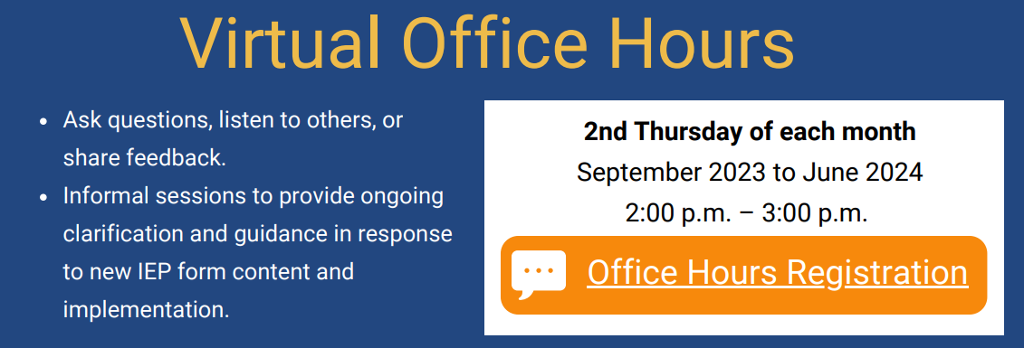
Virtual Office Hours
Registration Link for School Personnel: https://airtable.com/appZBV9AbaI0sTuS4/shrYP9ZunhL9yk980

Slide 27
IEP Implementation Grant Update
Name of Grant Program: Individuals with Disabilities Education Act Part B (IDEA) Targeted Improvement Grant
Federal Targeted - IEP Implementation Project Grant
Fund Code: 274

Slide 28
IEP Resources
IEP Technical Guide
Two sample IEPs
Training of trainer materials
Parent letter (translated)
All available at this link
IEP Improvement Playbook
Available at this link

Slide 29
Resources in Development
Resource guides
Parent guide to the new IEP process
Transition
Dually identified students (English learners and students with disabilities)
Additional Forms, such as:
Eligibility flowchart
Notice of procedural actions
Placement pages

Slide 30
IEP Playbook: Sample promising practices
Family Engagement

Slide 31
Where does family engagement come up in the new IEP forms?
Gathering information on student and family concerns

Slide 32
Where does family engagement come up in the new IEP forms? (continued)
Highlighting the student’s vision for the future and incorporating family perspectives into the team vision statement
And throughout the IEP, where teams should be attentive to family questions, suggestions, and concerns

Slide 33
What are some promising practices that can help in this process?
Structure IEP meetings thoughtfully so family members feel welcomed and included rather than overwhelmed
Staff at School F are intentional about how they enter the IEP meeting so families don’t feel overwhelmed. The special education teacher leading the meeting brings staff in gradually so that they can introduce themselves to the family one at a time—typically beginning with the school psychologist, then specialists, then the student’s general education teacher, and ending with the adjustment counselor, who most families already know.

Slide 34
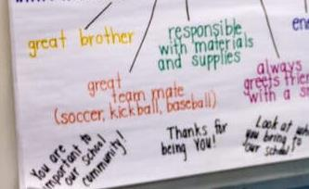
What are some promising practices that can help in this process? page2
Center student strengths by “strength mapping” during IEP meetings
School F has implemented “strength mapping” in every IEP meeting. The meeting begins with each attendee stating one strength that the student possesses. They record strengths on a poster as a web of attributes surrounding the student’s name and hang the poster on the wall throughout the meeting. They have found that the exercise empowers families at the onset to be active participants throughout the meeting. Families and students love having the strength map to take home, and many students choose to display it in their bedrooms.

Slide 35
What are some promising practices that can help in this process? Page 3
If possible, offer pre- and post-IEP meetings to ensure families are comfortable with the process and result
School F holds pre- and post-IEP meetings for families. The pre-meetings run for approximately 15-20 minutes and cover what to expect during the IEP meeting. Post-meetings are longer (generally 30-45 minutes) and include a section-by-section discussion of the student’s IEP so that the family fully understands the services that will be provided. As a result of these meetings, the school has had very few IEPs rejected by families.

Slide 36
What are some promising practices that can help in this process? Page 4
Think proactively about how to build relationships with families and convey critical information—including before the evaluation process begins.
School F partnered with their local food pantry. School personnel staffed a table and distributed supplies to families as a means to initiate conversation. The school also established a presence at dinners hosted by their local Boys and Girls Club. This work fostered trust and camaraderie with families.
District E developed a website containing resources informing families about the special education referral process, tiered interventions, and the District Curriculum Accommodation Plan, centralizing resources in one place.

Slide 37
General Supervision Update

Slide 38
States must have a system of general supervision – an accountability and support system – that monitors local education agencies (LEAs) and assists LEAs to implement the Individuals with Disabilities Education Act (IDEA). Primary focus: Educational Results Functional Outcomes

Slide 39
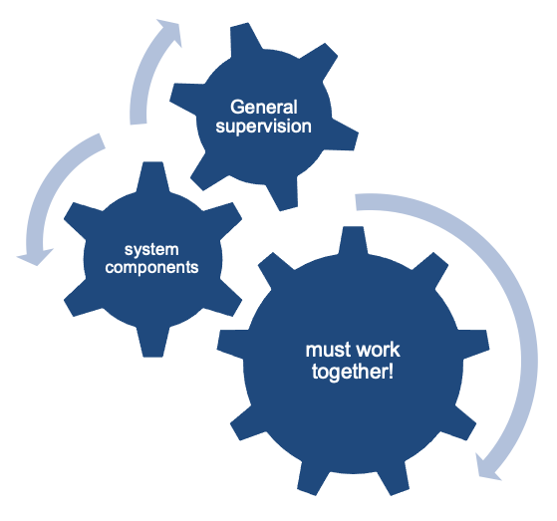
Coherence Matters!
Imagine a general supervision system as a sophisticated machine comprised of many interlocking gears that all must operate in concert to produce the desired outcomes.

Slide 40
Components of General Supervision

Slide 41
Cycle for Racial Equity Decision Making Tool
Define the Initiative
What is the problem or opportunity we are seeking to address and what would be the desired outcome on equity, particularly racial equity?
Accountability Process
Analyze Data and Historical Context
How will we evaluate and communicate results?
What data are we using to inform our initiative? Are there data gaps?
Implementation and Viability
Engage Stakeholders
Who are the most affected stakeholders and how will they been involved in the development of this initiative?
Is the initiative realistic, adequately funded, and resourced?
Identify Racial Equity Strategies and Impact
Based on data analysis & stakeholder input, what strategies will advance diversity, equity, and inclusion, particularly racial equity?

Slide 42
2023-24 DESE/BSEA General Supervision Related Updates and Initiatives
OASES Procedures
PRS Procedures
PSM Procedures
Dispute Resolution and Mediation Procedures
Fiscal Monitoring Procedures
LEA Determinations
Policies and Procedures Manual
Conditions for Assistance
Data Protocols
Technical Assistance

Slide 43
Fall and Winter Deliverables
LEA Determinations (December)
Technical Assistance (January)
SPP/APR (February)

Slide 44
Fall and Winter Deliverables—Beginning of Public Comment Period
OASES Procedures (December)
PRS Procedures (December)
PSM Procedures (December)
Dispute Resolution and Mediation Procedures (February)

Slide 45
Updated Procedures Stakeholder Engagement
Extended public comment period with emphasis on input from diverse stakeholders
Special Education Advisory Panel Meeting (OASES, PRS and PSM Procedures)
BSEA Advisory Council Meeting (Dispute Resolution and Mediation Procedures)

Slide 46
Q&A

