Slide 1
Special Education Leaders Meeting
Friday, December 15, 2023

Slide 2
Today’s Agenda
From DESE's Educational Vision:
DESE works with districts, schools, and educators to promote teaching and learning that is antiracist, inclusive, multilingual, and multicultural; that values and affirms each and every student and their families; and that creates equitable opportunities and experiences for all students, particularly those who have been historically underserved.
Special Education Updates
New IEP Updates
General Supervision Updates

Slide 3
Special Education Updates

Slide 4
MCAS-Alt Update
All LEAs with an MCAS-Alt rate above 1% will be required to complete a statement of assurances by January 31, 2024
If you receive this notification and have questions, please contact:
Email Robert.pelychaty@mass.gov
Phone: 781-338-3627
Email: Debra.d.hand@mass.gov
Phone: 781-338-3612
Student assessment email updates will include information about office hours

Slide 5
Special Education Grant Updates
IEP Improvement Implementation Assistance Grant – FC 274
Extended until December 21, 2023
Coming Soon!
Implementing Strategies to Reduce or Eliminate the Use of Exclusionary Time-Out Rooms Federal Competitive Special Education Program Grant
Notes:
There is a large percentage of Local Education Agencies who have yet to apply for the IEP Implementation Grant – so its submission date has been extended to December 21. We urge you to apply.

Slide 6
Indicator 7 data collection
SIMS data have been imported into the ECOS database.
All students coded as receiving preschool special education services (including related services) are in the ECOS database (found in the Security Portal).
All LEAs are required to submit Indicator 7 data on an annual basis. DESE is no longer using a cohort model for Indicator 7 data collection.
An email with more details is coming soon. It will be sent to Special Education Administrators and Early Childhood Coordinators.
Notes:
Important to note that all districts are reporting data for Indicator 7

Slide 7
Resources to help you submit your Indicator 7 data
User guides and resources for Indicator 7 data submission:
District User Guide for Indicator 7 Data Submission
School User Guide for Indicator 7 Data Submission
Indicator 7 Data Webinar: October 12, 2022
Notes:
All data is submitted using ECOS. This is found in the Security Portal. You will find more detailed instructions in the resources here.

Slide 8
Special Education Leaders Meetings 2023-2024
Friday, January 26, 2024 – 11am to noon
Friday, February 9, 2024 – noon to 1pm
Friday, March 29, 2024 – noon to 1pm
April 2024 – TBA
May 17, 2024 – noon to 1pm
June 21, 2024 – noon to 1pm
Reminder that if you are not able to attend, we post slides and recordings of these meetings here

Slide 9
New IEP Updates

Slide 10
Virtual Training of Trainer Session
January 31 and February 1, 2024 (from 12:00 to 3:00 p.m. each day)
One virtual session divided between two days
Up to five participants from each LEA, education collaborative or approved special education school
Each person will be asked to register individually regardless of whether they attend as part of a team
Save the date and register here by January 15, 2024
We hope to see you there!

Slide 11
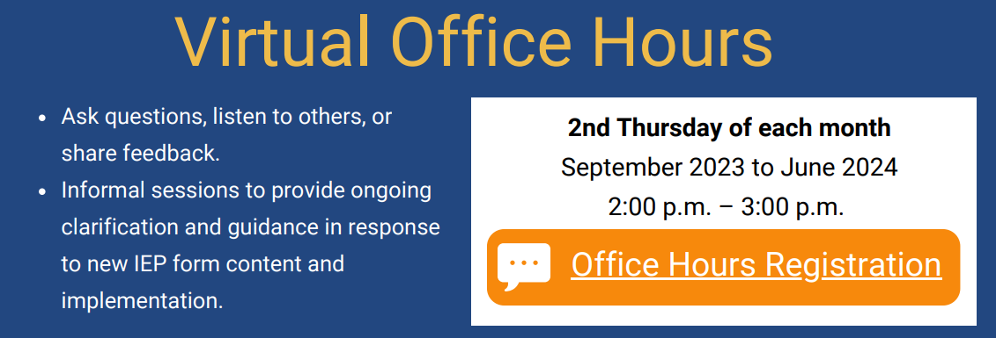
Virtual Office Hours
Registration Link for School Personnel: https://airtable.com/appZBV9AbaI0sTuS4/shrYP9ZunhL9yk980

Slide 12
IEP Resources
IEP Technical Guide
Two sample IEPs
Training of trainer materials
Parent letter (translated)
All available at this link
IEP Improvement Playbook
Available at this link

Slide 13
Resources in Development
Resource guides
Parent guide to the new IEP process
Transition
Dually identified students (English learners and students with disabilities)
Additional Forms, such as:
Eligibility flowchart
Notice of procedural actions
Placement pages

Slide 14
General Supervision Update

Slide 15
Components of General Supervision

Slide 16
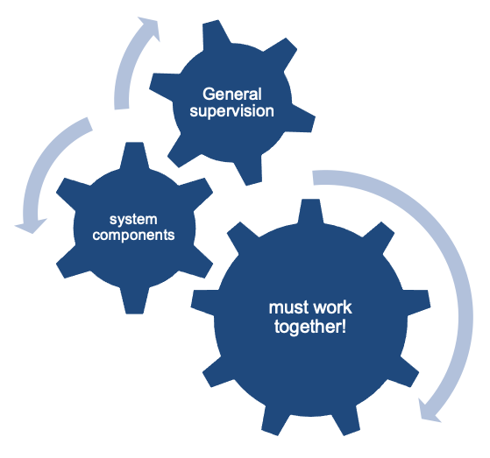
Coherence Matters!
Imagine a general supervision system as a sophisticated machine comprised of many interlocking gears that all must operate in concert to produce the desired outcomes.

Slide 17
Cycle for Racial Equity Decision Making Tool
Define the Initiative
What is the problem or opportunity we are seeking to address and what would be the desired outcome on equity, particularly racial equity?
Accountability Process
Analyze Data and Historical Context
How will we evaluate and communicate results?
What data are we using to inform our initiative? Are there data gaps?
Implementation and Viability
Engage Stakeholders
Who are the most affected stakeholders and how will they been involved in the development of this initiative?
Is the initiative realistic, adequately funded, and resourced?
Identify Racial Equity Strategies and Impact
Based on data analysis & stakeholder input, what strategies will advance diversity, equity, and inclusion, particularly racial equity?

Slide 18
2023-24 DESE/BSEA General Supervision Related Updates and Initiatives
OASES Procedures
PRS Procedures
PSM Procedures
Dispute Resolution and Mediation Procedures
Fiscal Monitoring Procedures
LEA Determinations
Policies and Procedures Manual
Conditions for Assistance
Data Protocols
Technical Assistance

Slide 19
Fall and Winter Deliverables
LEA Determinations (December)
Technical Assistance (January)
SPP/APR (February)

Slide 20
Current LEA Determination Rubric Categories
Points | Annual Dropout Rate (2021) | 5-Year Cohort Graduation Rate (2020) Points x1.5 | Public School Monitoring Compliance (SY2021-2022) | Problem Resolution System Complaints per 1000 SWD (SY2021-2022) | Special Education State Performance Plan/Annual Performance Report (SPP/APR) Compliance Indicators (4B, 9, & 10) (SY2020-2021) | Special Education State Performance Plan/Annual Performance Report (SPP/APR) Performance Indicators (5 & 6) (SY2021-2022) Points x2 | Significant Disproportionality Data (SY2021-2022 & SY2022-2023)

Slide 21
Revised LEA Determination Rubric Headings
Notes:
You’ll notice that we have revised the categories included in the LEA Determination Rubric.
The highlighted categories are new or revised from last year.
Of note- we have removed Significant Disproportionality completely from the Rubric.

Slide 22
Notable Changes
Clearly distinguished between Performance and Compliance Data
New Categories:
Performance Indicator – 3D Gap In Proficiency Rate between Students with Disabilities and All Students on MCAS
Indicators 11-13
Public School Monitoring and Problem Resolution Systems combined into:
Identification of Noncompliance (Number of Findings)
Timely Submission of Data/Verified Correction of Non-Compliance
Notes:
Changes this year include a reorganization and clear distinction between Performance and Compliance Categories.
Per OSEP’s longstanding requirements, States are required to consider: performance on compliance Indicators, valid, reliable and timely data, correction of identified noncompliance, and other data available to the State about an LEAs programs compliance with IDEA. They additionally recommend that State’s should also consider results or functional outcomes in their Determinations. The changes in the reorganization and revision of the rubric are the first step in ensuring that DESE is meeting the expectations set forth by OSEP.
Additionally, we have added a new Performance Indicator in Indicator 3D- Gap in Proficiency Rates on Grade Level Academic Achievement Standards between children with IEPs and all students. Indicator 3 includes six different data groups, students in Grade 4, 8, and HS in both Reading and Math. For this year, we will be including data from the Grade 8 Reading assessment group in this category. Upon further review we may adjust the groups included in this category in the future.
Another revised category is Indicators 11-13 compliance percentages for schools and districts that went through Tiered Focus Monitoring with Public School Monitoring during the 2022/2023 school year. This category is required to be considered in a State’s determination for LEAs.
Lastly, we have combined the remaining Public School Monitoring data and Problem Resolution Systems data into two categories: the Identification of Noncompliance (a total number of findings during the previous school year and whether or not schools and districts submitted data and information in a timely manner and corrected any identified non-compliance. For both of these categories, the number of findings of non-compliance, or those which were not corrected within one year/not submitted in a timely manner, are both per 1,000 SwD.
Again, these changes are the first step into ensuring that our LEA Determinations not only meet the requirements set forth by OSEP, but also to ensure that we are identifying the most important areas for schools and districts so that the Department can continue to provide targeted assistance for identified areas of need by using current data.

Slide 23
Fall and Winter Deliverables—Beginning of Public Comment Period
OASES Procedures (December)
PRS Procedures (December)
PSM Procedures (December)
Dispute Resolution and Mediation Procedures (February)

Slide 24
Public Feedback on Draft Procedures
DESE is seeking public comment on three draft procedure documents
Public comment is due by January 22, 2024
The next slides provide an overview of the draft documents to orient you to our proposed changes
More information about public feedback process at the end of this section

Slide 25
Problem Resolution System: Proposed Changes to the Procedures Guide

Slide 26
Noteworthy Updates to the Draft PRS Procedures Guide 1
Laws and regulations governing PRS complaints have not changed.
Our goal was to answer the most common questions about the PRS process in one document.

Slide 27
Noteworthy Updates to the Draft PRS Procedures Guide 2
New format
ONLY procedures for special education complaints
Not general education
Chronological
Clarifies the scope of PRS authority
Definition of special education complaint
Authority/jurisdiction of PRS
Outlines the steps of a PRS investigation

Slide 28
Noteworthy Updates to the Draft PRS Procedures Guide 3
Explains parties' access to information during an investigation
Expands upon Corrective Action
Permits limited requests for reconsideration of PRS determinations
Notes the Department's General Supervision
Internal collaboration

Slide 29
Office of Approved Special Education Schools: Proposed Changes SY ’25

Slide 30
What this will mean for Approved Special Education Schools and Collaboratives
3 Phases to Monitoring Review and Updated Timelines
Language Changes
Pre-Finding Corrections and Due Diligence

Slide 31
Review Phases
Discovery
Closeout
Program Data Collection - Onsite Activity Planning
Engagement
Seven (7) weeks post onsite visit through one year post onsite visit
Starts twenty weeks before the onsite visit date
Six weeks prior to onsite visit through onsite visit
Planning Meeting to Onsite Review - Reports
Reports - Follow Up
Reports that have non corrected pre-findings corrections will be issued two weeks post onsite visit
To ensure up-to-date data and to decrease duplicated work, programs will be trained in three cohorts throughout the year and data collection (previously known as self assessments) will be due 10 weeks prior to onsite visit.

Slide 32
An Example Schedule of a Review for OASES Schools
Discovery
Engagement
Closeout
May 29th
DESE provides training
August 7th
Program submits Data Collection to DESE
September 11th
DESE and Agency meeting for Onsite Planning
October 16th & 17th
Onsite Visit
October 23rd – November 27th
Draft Reports
Before November 27th of Following Year
Final Report
CAP’s Issued
Compliance Visit
OASES provides feedback and required follow up from Data Review

Slide 33
Software and Language Updates
All Monitoring Reviews will occur in the updated software CHAMP
What was the Self-Assessment is transitioning to Data Collection
What was the Orientation Meeting is transitioning to an Onsite Planning Meeting

Slide 34
Pre-Finding Corrections and Due Diligence
A pre-finding correction is an area of non-compliance in which the Program has the opportunity to provide additional data. This will occur between the onsite planning meeting and onsite visit. The liaison will verify correct implementation of the applicable requirements for each pre-finding correction area.
Some criteria may need further data review during the onsite review to confirm compliance or non-compliance with the applicable requirements.
If DESE verifies that any criterion identified for pre-finding correction has been fully corrected within the required timeframe, no finding of non-compliance will be issued to the Program on that specific criterion.

Slide 35
Public School Monitoring: Integrated Monitoring Review Proposed Changes SY ’25

Slide 36
New Terminology: Discovery, Engagement & Close-out
Integrated Monitoring Is Organized into Three Stages:
Discovery: Prior to onsite; review system-wide data to develop the plan for onsite monitoring and to determine whether to target additional areas of monitoring.
Engagement: All activities that occur onsite and/or virtually through the issuance of the report, including interviews, review of student records, and observations.
Close-out: Corrective action and progress reporting.
Notes:
Amy
There are new terms we will be using moving forward, including discovery, engagement and close-out. This is how we break out the review process. [read through the terms]

Slide 37
PSM: What Is Changing and What Is Staying the Same?
Same
Onsite Every Three Years Alternating Group A and Group B Reviews
Indicators 11, 12, 13
Civil Rights Self-Assessment
Interviews
Record Review
Observations
Orientations and Exit/Debrief
Corrective Action Plans
Internal Cross-office Collaboration
Proposed Changes
No Special Education Self-Assessment
PSM Internal Data Gathering Protocol
No Tiering
No Continuous Improvement and Monitoring Plans (CIMPs)
Rolling Submissions and New Timelines for Monitoring Special Education
Pre-finding Correction
CHAMP Web-Based Monitoring System

Slide 38
PSM Data Gathering Protocol (Discovery Phase)
CHAMP Data Dashboard
Online
Information from LEA

Slide 39
PSM Data Gathering Protocol Data Dashboard
CHAMP Data Dashboard
School and district data, including data by subgroups.

Slide 40
PSM Data Gathering Protocol Online
Online
Published district resources available for families, students, educators, and all external stakeholders.

Slide 41
PSM Data Gathering Protocol LEA
Information from LEA
Information that is not available through data systems or online.

Slide 42
PSM Data Gathering Protocol Review
When reviewing the PSM Data Gathering Protocols, please consider the following:
During integrated monitoring reviews, monitoring teams look at data disaggregated by student groups. As you learn about these data, note if there are relevant data points missing and what should be included to assist in giving a complete picture of your LEA.

Slide 43
Public Feedback Options—due by Jan. 22, 2024
Survey | https://survey.alchemer.com/s3/7651351/Draft-OASES-PRS-PSM-Procedures-Public-Comment-12-23
Mail (after 12/31/23 due to a pending relocation of DESE offices) | Massachusetts Department of Elementary and Secondary Education Office of Special Education Planning and Policy 135 Santilli Highway Everett, MA 02149
Fax | 781-338-3371
Email | SpecialEducation@doe.mass.edu

Slide 44
Q&A

