Slide 1
Special Education Leaders Meeting
Friday, January 26, 2024

Slide 2
Today’s Agenda
From DESE's Educational Vision:
DESE works with districts, schools, and educators to promote teaching and learning that is antiracist, inclusive, multilingual, and multicultural; that values and affirms each and every student and their families; and that creates equitable opportunities and experiences for all students, particularly those who have been historically underserved.
Special education updates
New IEP update
General Supervision updates
  LEA Determinations
  Update on draft procedures for special education complaints and monitoring

Slide 3
Special Education Updates

Slide 4
Comprehensive Assistive Technology Guidance
This week, the U.S. Department of Education’s Office of Educational Technology and the Office of Special Education Programs released a comprehensive guidance package designed to:​
  increase understanding of the Individuals with Disabilities Education Act’s (IDEA’s) assistive technology (AT) requirements, ​
  dispel common misconceptions regarding AT, and ​
  provide examples of the use of AT devices and services for children with disabilities, as well as to highlight the different AT requirements under Part C and Part B of IDEA.

Slide 5
AT Guidance in Two Parts
A joint Dear Colleague Letter from the Office of Special Education and Rehabilitative Services and the Office of Planning, Evaluation, and Policy Development announcing the release of the guidance package, and
A guidance document dispelling common misconceptions regarding AT titled, Myths and Facts Surrounding Assistive Technology Devices and Services.

Slide 6
Referral and Evaluation for Students Experiencing Homelessness
U.S. Department of Education’s Office of Special Education and Rehabilitative Services and Office of Elementary and Secondary Education
February 2008 Questions and Answers on Special Education and Homelessness

Slide 7
Referral and Evaluation for Students Experiencing Homelessness
Homeless children may be at greater risk of having undiagnosed disabilities.
Local educational agencies (LEA) should coordinate with staff of emergency shelters, transitional shelters, independent living programs, street outreach programs, and other advocacy organizations to assist in identifying the warning signs of a disability as quickly as possible so that homeless children suspected of having disabilities can be evaluated, and if found eligible, receive required special education and related services.

Slide 8
Referral and Evaluation for Students Experiencing Homelessness
All children who are suspected of having disabilities and who are in need of special education and related services, including homeless children, must be evaluated in a timely manner and without undue delay before the initial provision of special education and related services.
A parent or any person in a caregiving or professional position may initiate a request for an initial evaluation.
The evaluation assessments must be completed within 30 school working days after receipt of parental consent for evaluation.

Slide 9
Referral and Evaluation for Students Experiencing Homelessness
The requirement for timely initial evaluations applies to homeless children who transfer to a new LEA.
Assessments of children with disabilities who transfer from one LEA to another LEA in the same school year must be coordinated with those children’s prior and subsequent LEAs, as necessary and as expeditiously as possible to ensure prompt completion of full evaluations.

Slide 10
Referral and Evaluation for Students Experiencing Homelessness
The initial evaluation timeframe (30 school working days) does not apply if (1) the parent of a child repeatedly fails or refuses to produce the child for the evaluation; or (2) a child enrolled in a school of another LEA after the relevant timeframe has begun and prior to a determination by the child’s previous public agency or school district whether the child is a child with a disability.

Slide 11
Referral and Evaluation for Students Experiencing Homelessness
In the latter situation, the new LEA may extend the 30-day or State-established timeframe only if: (1) it is making sufficient progress to ensure prompt completion of the evaluation; and (2) the parent and the new public agency agree to a specific time when the evaluation will be completed.

Slide 12
Grant Opportunity:
Implementing Strategies to Reduce or Eliminate the Use of Time-Out Rooms Federal Competitive Special Education Program Grant
The purpose of this federally funded competitive grant program is to support schools and districts as they implement strategies, interventions, and supports to reduce or eliminate the use of time-out rooms and increase the amount of time that students spend learning alongside their peers. Strategies, interventions, and supports to promote the social emotional wellbeing of students and reduce exclusionary practices are outlined in the memorandum sent on September 10, 2021 and reposted in May of 2023.
Any Massachusetts public school district, public school, collaborative, approved special education program, or charter district/school that currently employs the use of one or more time-out rooms are eligible to apply.
Competitive priority will be given to Approved Special Education Schools or Collaboratives with a finding under 9.1a and LEAs that have a finding under SE 55 or have received a written summary indicating concerns or a PRS finding related to use of time-out rooms. The final group of successful applicants will represent a geographically diverse group of grantees as well as varying types (large districts/schools, small districts/schools, charter districts/schools, collaboratives, and approved special education schools).
https://www.doe.mass.edu/grants/2024/0213/
Expected outcomes:
A significant reduction in the use of time-out rooms and an increase in the amount of time students spend learning alongside peers.
Improved student emotional and behavioral regulation (self- and/or co-regulation) and overall school climate.
Increased collaboration and communication among school staff, parents, and the community.
Apply by Tuesday, February 20, 2024

Slide 13
LEA Policies and Procedures
LEAs are required to keep on file current documentation at the local level that demonstrates its compliance with federal and state special education laws and regulations for the SEA’s review.
The Conditions of Assistance:
IDEA Part B Funding Certifications, and any policies, procedures related documents need to be available for the public upon request if it is not published on a website or any public platform.

Slide 14
What are Coordinated Pandemic-Related Transition Services?
Chapter 42 of the Acts of 2022
To address the needs of individuals with IEPs who reached or will reach age 22 during the COVID-19 pandemic.
MA allocated $10 million for transition “services for individuals with disabilities that reached age 22 between March 10, 2020, and September 1, 2023, and were entitled to special education services up to age 22.”

Slide 15
There is strong evidence that families need three (3) contacts to effectively engage
All Schools and Districts Can Help!
An updated list of eligible young adults will be uploaded to each LEAs Security Portal
    Go to DropBox Central – State Performance Plan – Download
    Enter last known contact information – Re-upload
Contact those eligible and their families to share the link about the services
Share the link with local community organizations and ask them to post information
Questions: contact Holly at holly-anne.neal@mass.gov

Slide 16
Next Steps for Families?
Families who are interested need to contact the Federation for Children with Special Needs (FCSN)
Use this link to submit their contact information
  FCSN will reach out to each family
  OR
Call FCSN to get more information at
(617) 236-7210, (800) 331-0688

Slide 17
Special Education Leaders Meetings
2023-2024
  Friday, February 9, 2024 – noon to 1pm
  Friday, March 29, 2024 – noon to 1pm
  Friday, April 26 – 11:00am to noon – NEW!
  May 17, 2024 – noon to 1pm
  June 21, 2024 – noon to 1pm
  Reminder that if you are not able to attend, we post slides and recordings of these meetings here

Slide 18
New IEP Updates

Slide 19
Minor Changes to New IEP
Student information added on first page
  Name
  Student ID
  IEP dates
Extended School Year language
Business rules document also updated accordingly

Slide 20
Virtual Training of Trainer Session
January 31 and February 1, 2024 (from 12:00 to 3:00 p.m. each day)
One virtual session divided between two days
Up to five participants from each LEA, education collaborative or approved special education school
Each person will be asked to register individually regardless of whether they attend as part of a team
Register here. Registration open until Jan. 31
We hope to see you there!

Slide 21
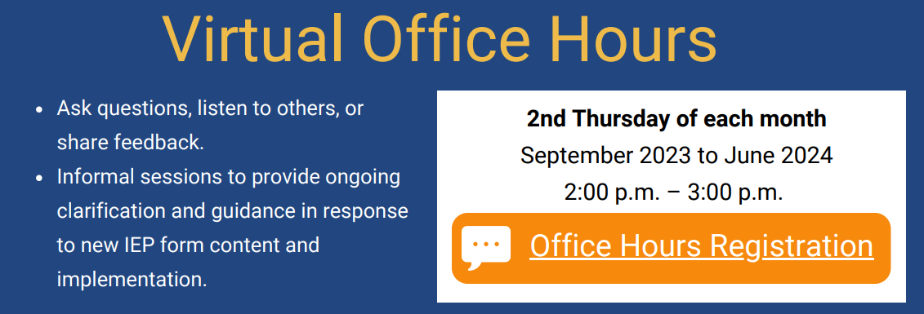
Virtual Office Hours
Registration Link for School Personnel: https://airtable.com/appZBV9AbaI0sTuS4/shrYP9ZunhL9yk980

Slide 22
IEP Resources
IEP Technical Guide
Two sample IEPs
Training of trainer materials
Parent letter (translated)
All available at this link
IEP Improvement Playbook
Available at this link

Slide 23
Resources in Development
Resource guides
  Parent guide to the new IEP process
  Transition
  Dually identified students (English learners and students with disabilities)
Additional forms (targeted release date—Feb. 2024):
  Eligibility flowchart
  Notice of procedural actions
  Placement pages

Slide 24
General Supervision Update

Slide 25
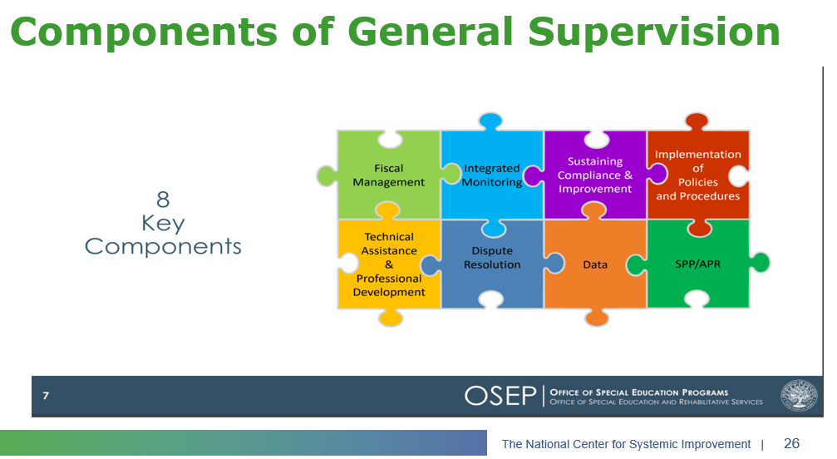
Components of General Supervision

Slide 26
2023-24 DESE/BSEA General Supervision Related Updates and Initiatives
OASES Procedures
PRS Procedures
PSM Procedures
Dispute Resolution and Mediation Procedures
Fiscal Monitoring Procedures
LEA Determinations
Policies and Procedures Manual
Conditions for Assistance
Data Protocols
Technical Assistance

Slide 27
Differentiated Monitoring and Support (DMS)
OSEP conducts DMS reviews of states on a regular cycle
OSEP has provided states with resources to support General Supervision and DMS preparation
  General Supervision Guidance
  DMS Protocols

Slide 28
DMS 2.0 Timeline
SY24
Update Procedures
SY25
Implement Procedures
December 2025
DMS 2.0 Visit

Slide 29
Fall and Winter Deliverables
LEA Determinations (January)
Technical Assistance (February)
SPP/APR (February)

Slide 30
LEA Determinations SY23/24

Slide 31
LEA Determinations
Under the federal Individuals with Disabilities Education Act (IDEA), the Department must make annual determinations regarding LEA’s specific needs for technical assistance or intervention in special education. Massachusetts does so based on four categories:
Meets Requirements (MR)
Needs Assistance (NA)
Needs Intervention (NI)
Needs Substantial Intervention (NSI)

Slide 32
How did the Department Make the 2023-2024 Determinations?
Assessed LEAs’ performance and compliance data, including data from the general Accountability and Assistance System, Tiered Focused Monitoring process, State complaints, State Performance Plan/Annual Performance Reports, and other data available to the State about the LEA’s compliance with IDEA.
Changes were made to the rubric this year to align it with the U.S. Department of Education’s Office of Special Education and Rehabilitative Services Memo 23-01: State General Supervision Responsibilities Under Parts B and C of the IDEA.

Slide 33
LEA Determination Rubric Categories
 | Performance |  |  |  | Compliance
Points | Annual Dropout Rate (2022) | 5-Year Cohort Graduation Rate (2021) Points x1.5 | Special Education State Performance Plan/Annual Performance Report (SPP/APR) Indicator 3 (2023) | Special Education State Performance Plan/Annual Performance Report (SPP/APR) Indicators 5 & 6 (SY2022-2023) Points x2 | Special Education State Performance Plan/Annual Performance Report (SPP/APR) Indicators 4B, 9, & 10 (SY2021-2022) | Special Education State Performance Plan/Annual Performance Report (SPP/APR) Indicators 11, 12, & 13 (SY2022-2023) | Identification of Noncompliance # of Findings (PSM/PRS) (SY2022-2023) | Timely Submission/ Verified Correction of Non-Compliance (SY2022-2023)

Slide 34
Districts Assigned as NA, NI, or NSI
Targeted and technical assistance related to special education
Coordinated assistance and intervention are available from multiple offices including, the Special Education Planning and Policy office, Office of Public School Monitoring, Statewide System of Support, Office of Strategic Support, and Office of Charter Schools & School Redesign
Assistance is tailored to meet an LEA’s needs, depending on the reasons for which an LEA was identified as needing technical assistance or intervention
The Department will communicate directly with LEAs about this assistance and intervention

Slide 35
Requirements for NA Districts
Engagement with SSOS, OST, or CSSRD; and/or
Engagement with PSM to address identified noncompliance or as part of Tiered Focused Monitoring activities; and/or
Engagement with SEPP and/or other Department offices to address other special education compliance and performance issues; and/or
Prohibited from using the flexibility available under the Maintenance of Effort provisions of IDEA.
Note- LEAs with this determination are encouraged to engage in improvement activities to address areas of need as identified by the data used in the determination.

Slide 36
Requirements for NI Districts
Engagement with SSOS, OST, or CSSRD; and/or PSM and SEPP.
Prohibited from using the flexibility available under the Maintenance of Effort provisions of IDEA
Participation in required technical assistance activities (webinar)
Use of a portion of IDEA funds for the improvement of performance issues identified through the LEA determination system, i.e., Making Money Matter (M³)
Improvement activities coordinated by a LEA determination liaison including:
  Reviewing the district’s special education related data
  Development of a plan for providing targeted and technical assistance for special education
  Development of an improvement plan that includes root cause analysis
  Regular meetings/contact with a LEA determination liaison

Slide 37
Significant Disproportionality

Slide 38
Identification of Significant Disproportionality
2023-2024
Initial notification sent out to all Superintendents/Charter School Leaders, Special Education Directors, Curriculum Coordinators, and School Business Officers
  Data is available in Edwin – SP301 Significant Disproportionality in Special Education
Follow Up Communications to all Identified and At-Risk Districts
  Sent from Special Education Planning and Policy Office
  Required Actions and Submissions to SEPP will be due in April

Slide 39
Fall and Winter Deliverables
OASES Procedures (December)
PRS Procedures (December)
PSM Procedures (December)
Dispute Resolution and Mediation Procedures (February)

Slide 40
Next Steps on New Procedures
Analyze and synthesize public comment feedback
Finalize and publicize updated DESE procedures
BSEA to share draft procedures for public comment
DESE to share draft general education complaint resolution procedures for public comment

Slide 41
Public Feedback Options—due today Jan. 26, 2024
Survey | https://survey.alchemer.com/s3/7651351/Draft-OASES-PRS-PSM-Procedures-Public-Comment-12-23
Mail | Massachusetts Department of Elementary and Secondary Education Office of Special Education Planning and Policy 135 Santilli Highway Everett, MA 02149
Fax | 781-338-3371
Email | SpecialEducation@doe.mass.edu

Slide 42
Q&A

