Slide 1
Special Education Leaders Meeting
February 9, 2024

Slide 2
Our Educational Vision
From DESE's Educational Vision:
DESE works with districts, schools, and educators to promote teaching and learning that is antiracist, inclusive, multilingual, and multicultural; that values and affirms each and every student and their families; and that creates equitable opportunities and experiences for all students, particularly those who have been historically underserved.

Slide 3
Today’s
Agenda
DESE/DDS Residential Prevention Program
Special Education Updates
New IEP Update
General Supervision Updates

Slide 4

DESE/DDS Residential Prevention Program
Annual Open Interest 2024
February 9, 2024

Slide 5
What it is and who we support
DESE/DDS Residential Prevention Program
Wrap Around Program
  In home and community supports
  Committed to preventing Residential Programming
Our Participants
  6-21 years old
  DDS Child Eligible
  Served by an IEP
  Living in a family or caregiver’s home
    No group homes
  https://www.mass.gov/dese-dds-program

Slide 6
Components of the program
DESE/DDS Residential Prevention Program
Travel experience
Safety in the community
Routine interactions with community members
Skill Building
Independence
Community Integration
Chores
Self-Regulation
Individually determined therapies
Self-determination model
ADL and IADL practice
Family confidence and capacity in supporting their child

Slide 7
Benefits for Participants
DESE/DDS Residential Prevention Program
Dedicated Family Navigator
Comprehensive support plan developed in collaboration with family
Schedule works around family availability
The 55/45 Guide
  Skills Training, Senior Level Therapists, Alternative Therapies (music/art), Peer Mentors, Respite
  Community Activities, Outing Costs, Family Training, Specialized Nutrition, Safety Equipment, Uncovered Medical
https://www.mass.gov/dese-dds-program

Slide 8
Annual Open Interest Period
DESE/DDS Residential Prevention Program
March 1 – March 31, 2024
Electronic Submissions (English only)
Email Submissions (12 Languages available)
Mailed Submissions (12 Languages available)
https://www.mass.gov/dese-dds-program
OPEN INTEREST
MAR 1 to Mar 31

Slide 9
DESE/DDS Residential Prevention Program
Thank You
Beth Doyle
Education Program Manager
Department of Developmental Services
Beth.Doyle@mass.gov
DESEDDSProgram@mass.gov
https://www.mass.gov/dese-dds-program

Slide 10
Special Education Updates

Slide 11
Responsibilities for Private School Placements by Public Agencies
603 CMR 28.06: Placement and Service Options
(3) General requirements for out-of-district placements. For the duration of any student's placement in an out-of-district setting in Massachusetts, the Administrator of Special Education shall make a good faith effort, to ensure that the student's IEP is being appropriately implemented and that service delivery in the out-of-district setting is aimed at assisting the student to meet the goals identified on the student's IEP.
(b) Individual student program oversight: The school district is required to monitor the provision of services to and the programs of individual students placed out-of-district. Documentation of monitoring plans and all actual monitoring shall be placed in the files of every eligible student who has been placed out-of-district. To the extent that this monitoring requires site visits, such site visits shall be documented and placed in the students' files for review. The duty to monitor out-of-district placements cannot be delegated to parents or their agents, to the Department, or to the out-of-district placement. The school district may, however, contract directly with a person to conduct such monitoring.
(c) Student right to full procedural protections: School districts that place eligible students in out-of-district programs retain full responsibility for ensuring that the student is receiving all special education and related services in the student's IEP, as well as all procedural protections of law and regulation, including but not limited to those specified in 603 CMR 28.09. Any Team meetings conducted during the time that a student is enrolled in the out-of-district program shall be initiated by the school district in coordination with the out-of-district placement.

Slide 12
Responsibilities for Private School Placements by Public Agencies 2
603 CMR 28.09: Approval of Public and Private Day and Residential Special Education School Programs
(7) Educational staffing requirements.
(a) At least one staff member shall be designated as the educational administrator for the program. The educational administrator shall either possess licensure as a special education administrator or as a special educator and shall have a minimum of a master's degree in special education or a related field; and shall have a minimum of one year of administrative experience. Such person shall be assigned to supervise the provision of special education services in the school and ensure that the services specified in each student's IEP are delivered. The educational administrator shall be relicensed pursuant to the requirements of 603 CMR 44.00 and shall be required to obtain supervisor approval of his/her Professional Development Plan pursuant to 603 CMR 44.04.

Slide 13

Assistive Technology Grant Opportunity
Allison Keller Education Technology Program
To help fill the financial and technological gap for schools and organizations that assist individuals with autism.
Since 2012, the Flutie Foundation has granted over $735,000 to 157 schools and organizations for programs specifically serving individuals with autism that have an established technology program in place or have expressed an interest in starting a program using the iPad or other technology tools.
Applications will be considered for any technology tools and/or training that improve learning outcomes or performance. Maximum request is $7,500.00. Examples include but are not limited to:
  Tablets & Accessories
  Apps
  Smartboards
  Laptops
  Technology Training
  Science, Technology, Engineering, and Mathematics (STEM) educational activities & access to STEM studies
For more information or to apply, please see: https://flutiefoundation.org/helping-communities/assistive-technology-grants/

Slide 14
Commonwealth Preschool Partnership Planning Initiative (CPPI)
The CPPI grant will:
support districts in expanding local access to preschool by working with local private providers to create more affordable opportunities for 3- and 4-year old children,
align quality across the local system of preschool providers, and
ensure equitable special education access for children with IEPs, regardless of their program of choice

Slide 15
More Info on the CPPI Grant
There are two opportunities built within this competitive opportunity:
  Early Planning – This selection is for communities who are interested in the CPPI model for PreK expansion but have not begun a Needs Assessment.
  Planning to Implementation - This selection is for communities that have already developed strong partnerships with local EEC-Licensed Community-Based Organizations and have conducted a Needs Assessment.
The initial time frame for the grant is:
  March 1, 2024 through June 30, 2024 and
  July 1, 2024 through August 31, 2024; renewal options are available for FY25.
Lead agents for the grant must be school districts and school district applicants are required to partner with at least two community-based organizations during the planning and implementation phase.
Currently posted in Commbuys. Submissions are due by Friday, February 16th at 4:00.

Slide 16
Implementing Strategies to Reduce or Eliminate the Use of Time-Out Rooms Federal Competitive Special Education Program Grant
The purpose of this federally funded competitive grant program is to support schools and districts as they implement strategies, interventions, and supports to reduce or eliminate the use of time-out rooms and increase the amount of time that students spend learning alongside their peers. Strategies, interventions, and supports to promote the social emotional wellbeing of students and reduce exclusionary practices are outlined in the memorandum sent on September 10, 2021 and reposted in May of 2023.
Any Massachusetts public school district, public school, collaborative, approved special education program, or charter district/school that currently employs the use of one or more time-out rooms are eligible to apply.
Competitive priority will be given to Approved Special Education Schools or Collaboratives with a finding under 9.1a and LEAs that have a finding under SE 55 or have received a written summary indicating concerns or a PRS finding related to use of time-out rooms. The final group of successful applicants will represent a geographically diverse group of grantees as well as varying types (large districts/schools, small districts/schools, charter districts/schools, collaboratives, and approved special education schools).
https://www.doe.mass.edu/grants/2024/0213/
Expected outcomes:
A significant reduction in the use of time-out rooms and an increase in the amount of time students spend learning alongside peers.
Improved student emotional and behavioral regulation (self- and/or co-regulation) and overall school climate.
Increased collaboration and communication among school staff, parents, and the community.
Apply by Tuesday, February 20, 2024

Slide 17
What are Coordinated Pandemic-Related Transition Services?
Chapter 42 of the Acts of 2022
To address the needs of individuals with IEPs who reached or will reach age 22 during the COVID-19 pandemic.
MA allocated $10 million for transition “services for individuals with disabilities that reached age 22 between March 10, 2020, and September 1, 2023, and were entitled to special education services up to age 22.”

Slide 18
There is strong evidence that families need three (3) contacts to effectively engage
All Schools and Districts Can Help!
An updated list of eligible young adults will be uploaded to each LEAs Security Portal
    Go to DropBox Central – State Performance Plan – Download
    Enter last known contact information – Re-upload
Contact those eligible and their families to share the link about the services
Share the link with local community organizations and ask them to post information
Questions: contact Holly at holly-anne.neal@mass.gov

Slide 19
Next Steps for Families?
Families who are interested need to contact the Federation for Children with Special Needs (FCSN)
Use this link to submit their contact information
  FCSN will reach out to each family
  OR
Call FCSN to get more information at
(617) 236-7210, (800) 331-0688

Slide 20
Special Education Leaders Meetings
2023-2024
  Friday, March 29, 2024 – noon to 1pm
  Friday, April 26 – 11:00am to noon
  May 17, 2024 – noon to 1pm
  June 21, 2024 – noon to 1pm
  Reminder that if you are not able to attend, we post slides and recordings of these meetings here

Slide 21
New IEP Update

Slide 22
IEP Support Survey
We want your input on additional supports you recommend we provide to enhance your implementation of the new IEP
Please complete this survey by February 16, 2024
Thank you for your input

Slide 23
Upcoming IEP Vendor Meeting
The Department is committed to ensuring that our schools and districts are able to make an effective transition to the updated IEP forms and process.
Please encourage your vendors to join us at an IEP Software Vendor Meeting at noon on Tuesday, March 5th, 2024.
Vendors interested in joining should email the special education inbox at specialeducation@doe.mass.edu.

Slide 24
12 Updated IEP Forms
Attendance Sheet
Educational Environment and Placement (Ages 3-5)
Educational Environment and Placement (K-age 21)
Evaluation Consent Form
Extended Evaluation Form
IEP Amendment
Level of Need
Notice of Proposed School District Action
Notice of School District Refusal
Placement Consent Form (Ages 3-5)
Placement Consent (K-Age 21)
Special Education Eligibility Determination

Slide 25
General Supervision Update

Slide 26
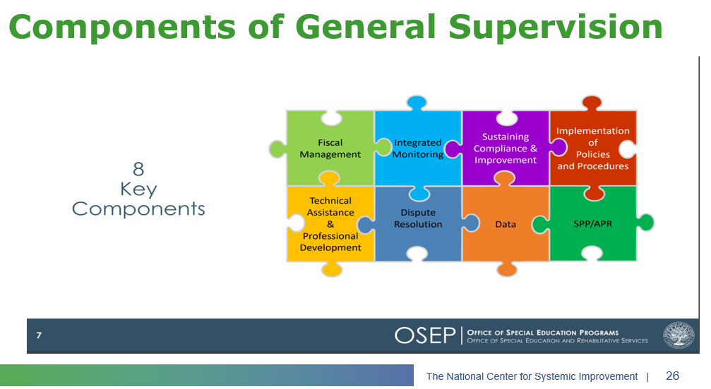
Components of General Supervision

Slide 27
2023-24 DESE/BSEA General Supervision Related Updates and Initiatives
OASES Procedures
PRS Procedures
PSM Procedures
Dispute Resolution and Mediation Procedures
Fiscal Monitoring Procedures
LEA Determinations
Policies and Procedures Manual
Conditions for Assistance
Data Protocols
Technical Assistance

Slide 28
Q&A

