Slide 1
Special Education Leaders Meeting
April 2024

Slide 2
Our Educational Vision
From DESE's Educational Vision:
DESE works with districts, schools, and educators to promote teaching and learning that is antiracist, inclusive, multilingual, and multicultural; that values and affirms each and every student and their families; and that creates equitable opportunities and experiences for all students, particularly those who have been historically underserved.

Slide 3
Today’s
Agenda
General Supervision Updates
New IEP Update
Special Education Updates
DDS- 688 Referrals

Slide 4
Special Education Leadership
Iraida J. Alvarez, Acting Executive Director of Special Education
Jamie Camacho, Acting State Director of Special Education & Director, Office of Special Education Planning and Policy Development
Vani-Rastogi Kelly, Director, Office of Public School Monitoring
Barry Barnett, Director, Office of Problem Resolution System
Jannelle Roberts, Acting Director, Office of Approved Special Education Schools

Slide 5
General Supervision Update

Slide 6
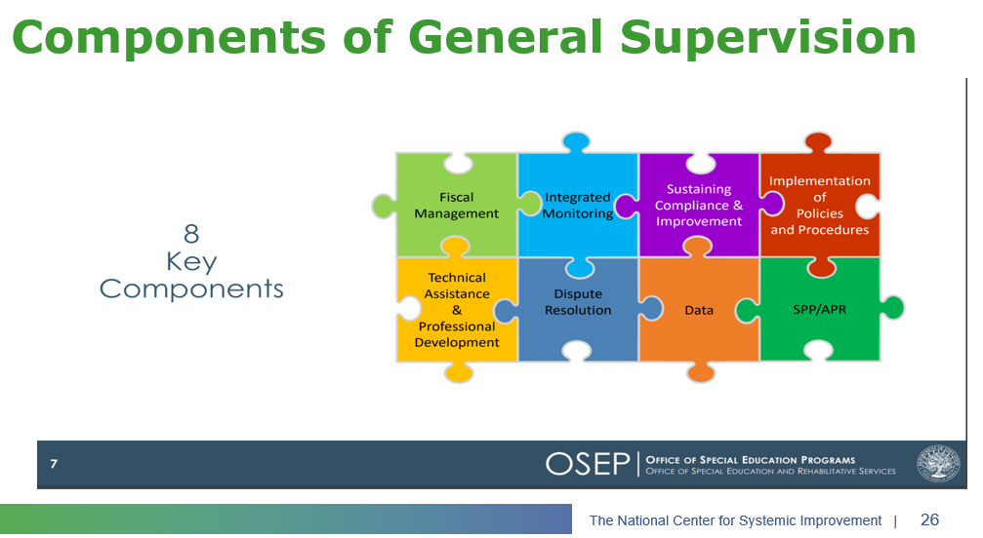
Components of General Supervision

Slide 7
2023-24 DESE/BSEA General Supervision Related Updates and Initiatives
OASES Procedures
PRS Procedures
PSM Procedures
Dispute Resolution and Mediation Procedures
Fiscal Monitoring Procedures
LEA Determinations
Policies and Procedures Manual
Conditions for Assistance
Data Protocols
Technical Assistance

Slide 8
Public School Monitoring Updates
Integrated Monitoring Review Procedures
Based on feedback, revised to include the following:
  Glossary of Terms
  Enhanced description of family engagement
    Parent Orientation
    Parent Survey
    Parent Interviews
    Focus Groups
  Monitoring of English learner students with disabilities.
  Noting any pre-finding corrections in the Integrated Monitoring Review report.

Slide 9
Problem Resolution System Updates
PRS Special Education Procedures Guide
Key Changes:
  Updated Glossary of Terms section for clarity and comprehensiveness + relocated the glossary to the end of the guide. (pg 19)
  Authority/Jurisdiction of PRS includes a link to USDOE guidance (pg 7)
  Complainant's rebuttal period is now seven (7) calendar days (previously 10 calendar days). (pg 11)
  New requirements for requests for factual correction of PRS determinations. (pg 14)

Slide 10
Problem Resolution System Updates (cont'd)
PRS Team Restructuring
  3 Special Education Teams
    Note: Special education cases are assigned within regional teams on a rotation basis. LEAs will not have an assigned PRS Specialist.
  1 General Education Team (State-wide with exception)
  1 Corrective Action Team (State-wide with exception)
Updating PRS letter templates to clarify requirements and align with new procedures.
PRS Compliance inbox address updated.
  DESECompliance@mass.gov - Emails sent to the prior compliance inbox addresses will forward to this address.

Slide 11
Department of Developmental Services

Slide 12

DDS: Department of Developmental Services
DDS, T22 and the 688 Process
A Review of the Importance of the 688 Referral
April 26, 2024

Slide 13
DDS Slide 2
DDS, T22 and the 688 Process
Agenda
  The Why, How and What of the 688 Process
  504 Plans and Turning 22 Funding

Slide 14
DDS Slide 3
DDS, T22 and the 688 Process
Why does the 688 Process matter?
  Entitles a young adult to an Individual Transition Plan
  Planning for Life-long Adult Services
    Fiscal and Programmatic
    Day Programming
    Supportive Technology
    Housing
    22 years old – 79.0 years old (average life expectancy in MA according to CDC)
  Specific T22 funding

Slide 15
DDS continues to see an increase with those turning 22 (1,395 in FY24)

Slide 16
DDS Slide 5
DDS, T22 and the 688 Process
How does the 688 Process work?
  LEA Submits 688 Referral (16-20 years old)
    17.5 years old is the ideal
    To initiate DDS adult eligibility determination process
  DDS Engages in Planning for Adult Services (6-21 years old)
    Transition Coordinators in each Area Office
    Apply for adult eligibility
    Coordination with other Adult Service Agencies
    Budget internally for community and residential supports
    Engage with legislature and governor to ensure appropriate funding
    Individual Transition Plan development
  Adult Eligibility Begins on 22nd Birthday
    Turning 22 Funding

Slide 17
DDS continues to benefit from the turning 22 budgetary support from the Governor and Legislature.

Slide 18
DDS Slide 7
DDS, T22 and the 688 Process
What does DDS need for planning?
  LEAs submit the 688 in the Virtual Gateway when student is 17.5 years old
    DDS Children’s and Transition Coordinators can assist in getting family consent for 688 submission
  All 688s are submitted to Virtual Gateway
    Bureau of Transitional Planning can assist with Virtual Gateway access issues

Slide 19
DDS Slide 8
DDS, T22 and the 688 Process
Students with Autism on a 504 Plan
  Eligible for Turning 22 Funding if DDS Adult Eligible
  Not eligible for a 688 submitted to Virtual Gateway

Slide 20
Internal/External Meetings
DDS Central Office meets on a regular basis with the transition and autism service coordinators to discuss Turning 22 issues and identify alternative support models.
DDS works collaboratively with DESE and the other EOHHS agencies to address the unique needs of the individuals as they enter the DDS adult services.

Slide 21
DDS Slide 10
DDS, T22 and the 688 Process
Questions and Contacts
  Questions about the 688 Process can be directed to
  Victor Hernandez
  Deputy Assistant Commissioner
  Victor.Hernandez@mass.gov
  Questions about the Virtual Gateway can be directed to
  The Bureau of Transitional Planning
  T22UserAssistance@mass.gov

Slide 22
Special Education Updates

Slide 23
Child Count Reporting Deadline
IDEA Equitable Services Child Count Reporting is due:
Reminder: Districts are required under IDEA to submit annual child count data as soon as possible.
Child counts for SY2023-2024 must be as of October 1, 2023.
Districts will be using the new IDEA Equitable Services Annual Child Count application located in the Security Portal.

Slide 24
New Resources on Section 504 Civil Rights
On February 20th, the U.S. Department of Education’s Office for Civil Rights (OCR) released four (4) new resources with information for students, parents and families, and schools addressing civil rights of students with disabilities, as well as a data snapshot about education access for students with disabilities drawn from OCR’s 2020-21 Civil Rights Data Collection (CRDC).
The four (4) new resources address common medical conditions that can be disabilities for purposes of Section 504 and are available on the OCR website:
  asthma,
  diabetes,
  food allergies, and
  GERD
  These resources, which are applicable to all levels of education, explain when these medical conditions trigger protections under Section 504, what kind of modifications an educational institution may need to take to avoid unlawful discrimination, and what an institution may need to do to remedy past discrimination.

Slide 25
Update on Implementing Strategies to Reduce or Eliminate the Use of Time-Out Rooms Federal Competitive Special Education Program Grant
69 applications
  16 approved special education programs
  3 charter schools
  7 educational collaboratives
  43 public school districts
We expect to award funds to 19 applicants, representative from multiple types of entities and regions across the state.
Due to the overwhelming interest, we are considering offering another grant in FY25. Stay tuned for more information.

Slide 26
New IEP Update

Slide 27
New IEP Implementation Support Survey
447 Responses

Slide 28
Survey Participants

Slide 29
Which topics are your priority for additional professional learning supports to promote successful implementation of the new IEP?
All 447 Responses

Slide 30
Administrators (131) and Educators (84) : 215

Slide 31
Advocates (133)

Slide 32
Side by side – Admin/Educators vs. Advocate

Slide 33
What is your preferred format for professional learning?

Slide 34
Continued Support for IEP Implementation
Training (educators, students, families, advocates)
Resources
  Quick Reference Guide for Supporting English Learners with Disabilities
  Quick Reference Guide for Transition Planning
  Discussion Questions for Getting Ready for My Yearly IEP Meeting
  Quick Reference Guide for Parents
  Quick Reference Guide for Students (new information)
  Updated High School Sample IEP
  Assessment of all remaining IEP forms to determine next steps

Slide 35
12 Updated IEP Forms
Attendance Sheet
Educational Environment and Placement (Ages 3-5)
Educational Environment and Placement (K-age 21)
Evaluation Consent Form
Extended Evaluation Form
IEP Amendment
Level of Need
Notice of Proposed School District Action
Notice of School District Refusal
Placement Consent Form (Ages 3-5)
Placement Consent (K-Age 21)
Special Education Eligibility Determination

Slide 36
Upcoming Meetings

Slide 37
Special Education Leaders Meetings
2023-2024
  May 24, 2024 – 12 noon to 1pm
  change from May 17, 2024
  June 21, 2024 – 12 noon to 1pm
  Reminder that if you are not able to attend, we post slides and recordings of these meetings here

Slide 38
Q&A

