Slide 1
Special Education Leaders Meeting
May 2024

Slide 2
Today’s
Agenda
Special Education Updates
New IEP Update
General Supervision Updates

Slide 3
Special Education Updates

Slide 4
Special Education Leadership
Iraida J. Alvarez, Acting Executive Director of Special Education
Jamie Camacho, Acting State Director of Special Education
Office of Approved Special Education Schools
Jannelle Roberts, Acting Director
Special Education Planning and Policy Development
Jamie Camacho, Director
Patrick Fitzgerald, Assistant Director
Theresa Senio, Assistant Director
Office of Public School Monitoring
Vani Rastogi-Kelly, Director
Amy Paulin, Assistant Director
Office of Problem Resolution System
Barry Barnett, Director
Kelsey LoDuca-Towne, Assistant Director
Special Education in Institutional Settings
Shawn Connelly, Director

Slide 5
Extended School Year (ESY)
“An extended year program may be identified if the student has demonstrated or is likely to demonstrate substantial regression in learning skills and/or substantial difficulty in relearning such skills if an extended program is not provided.” 603 CMR 28.05(4)(d).
ESY services described on an IEP must be provided at no cost to the child's parent(s).
As in regular school year placements, the principles of LRE apply to the provision of ESY services.
Students who receive ESY services are entitled to transportation if they need it to benefit from special education ESY services.
A student may need transportation to benefit from special education ESY services even if they don't receive "special" or "specialized" transportation during the regular school year.
More information can be found in the ESY Question and Answer Guide

Slide 6
Extension of Early Intervention Services
The Department of Public Health wants to make you aware of an extension to an existing General Early Intervention Services contract to continue operation through September 2024. The Department of Public Health has decided to extend the contract to provide continuity of care.
The providers impacted are:
  People Incorporated,
  Northeast Arc,
  Town of Billerica,
  The May Center for Early Intervention,
  Dimock Community Health, and
  Center for Human Development.
If you have any questions, please contact your Early Intervention Services provider.

Slide 7
Planning for the FY 2025 Federal Grant Application
For the second year, applications for IDEA Part B funds Fund Codes 240 and 262 will be made available, completed, and submitted via the GEM$ system.
Applications for FY 2025 funding will be available to LEAs soon!

Slide 8
Planning for the FY 2025 Federal Grant Application: Conditions of Assistance
Conditions of Assistance: IDEA Part B Funding
  As part of the application process, each LEA must submit a completed Conditions of Assistance: Individuals with Disabilities Education Act (IDEA) Part B form. This is updated annually and will be posted and available SOON.
  Please be sure to use the FY2024-2025 form. The entire executed document must be updated and uploaded to GEM$.
  Certification Section – Signed by the Superintendent (or school leader), Special Education Administrator, School Business Official, and School Committee Chairperson/Board of Trustees Chairperson.

Slide 9
Planning for the FY 2025 Federal Grant Application:
MOE and M3
Maintenance of Effort (MOE)
  Budget and student data for the upcoming school year
  Districts who were previously notified they have not met the FY2024 MOE Compliance Standard and are still out of compliance must contact IDEAfiscal@mass.gov immediately
  Non-compliance of your FY24 MOE could delay your ability to file and approval of your FY 2025 IDEA application
Making Money Matter (M3) Budget
  LEAs that were identified in the 2023-2024 LEA Determinations as Needing Intervention (NI)
  Required to dedicate at least 2% of IDEA (FC 240) Funds

Slide 10
Planning for the FY 2025 Federal Grant Application:
CCEIS and CEIS
Comprehensive Coordinated Early Intervening Services (CCEIS)
  LEAs identified as having significant disproportionality in school year 2023-2024 must reserve 15% of Part B funds (Fund Code 240 and 262) for coordinated early intervention services
Coordinated Early Intervening Services (CEIS)
  LEAs may opt to use up to 15% of Part B funds (Fund Code 240 and/or Fund Code 262) to develop and implement CEIS to improve results for students without disabilities in grades K-12.
Tracking the Use of Funds​
  Districts are required to track the use of the funds, as well as the total number of children serviced using the funds, and those who are eventually found eligible for special education or related services and maintain that data for submission to the Department.

Slide 11
Planning for the FY 2025 Federal Grant Application:
Proportionate Share
Equitable Services
  Proportionate Share (Fall 2023 Child Count informs FY 2025 Proportionate Share of IDEA Part B funds)
  Meaningful Consultation
  Written Affirmation
  FY 23 Carryover Questionnaire (expiring funds)

Slide 12
Federal Grant Application
GEPA
General Education Provision Act (GEPA) Statement
The Department’s GEPA Statement was filed with the IDEA State Application.
General GEPA Question
Describe how your entity’s existing mission, policies, or commitments ensure equitable access to, and equitable participation in, the proposed project or activity (in the general federal grant section to be answered once by the district).

Slide 13
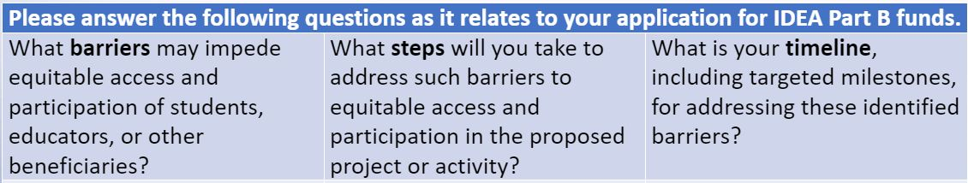
Federal Grant Application
IDEA Related Questions

Slide 14
Referral and Evaluation for Students Experiencing Homelessness
Homeless children may be at greater risk of having undiagnosed disabilities. ​
LEAs should coordinate with staff of emergency shelters, transitional shelters, independent living programs, street outreach programs, and other advocacy organizations to assist in identifying the signs of a disability so that homeless children suspected of having a disability can be evaluated, and if found eligible, receive required special education and related services as soon as possible.​
Districts with emergency shelters should have processes in place to facilitate appropriate and timely referral and evaluation and should document that process.

Slide 15
New IEP Update

Slide 16

IEP Improvement Process Timeline
Winter 2023
Spring 2023
SY 23-24
Fall 2023
Fall 2024
Finalize Forms and Tech Specs
Initial Training for Schools and Districts
Continued Training and Technical Assistance
Initial Adoption (at discretion of schools and districts)
Full Adoption Statewide
NEW!
Thanksgiving

Slide 17
Updated IEP Forms
Extended Evaluation Form — Revised 2/7/2024
Individualized Education Program (IEP) Amendment — Revised 2/7/2024
Level of Need: aged 3 through 21 — Revised 2/7/2024
Notice of Proposed School District Action — Revised 2/7/2024
Notice of School District Refusal to Act — Revised 2/7/2024
Placement Consent Form: aged 3 to 5 — Revised 2/7/2024
Placement Consent Form: aged 5 (enrolled in kindergarten) and aged 6 through 21 — Revised 2/7/2024
Special Education Eligibility—Initial and Reevaluation Determination — Revised 2/7/2024
Administrative Data Sheet — Revised 6/14/2023
Individualized Education Program (IEP) Form — Revised 1/23/2024
IEP Meeting Invitation — Revised 5/15/2023
Attendance Sheet—Special Education Team Meeting — Revised 2/7/2024
Educational Environment and Placement: aged 3 to 5 — Revised 2/7/2024
Educational Environment and Placement: aged 5 (enrolled in kindergarten) and aged 6 through 21 — Revised 2/7/2024
Evaluation Consent Form—Attachment to Notice of Proposed School District Action — Revised 2/7/2024

Slide 18
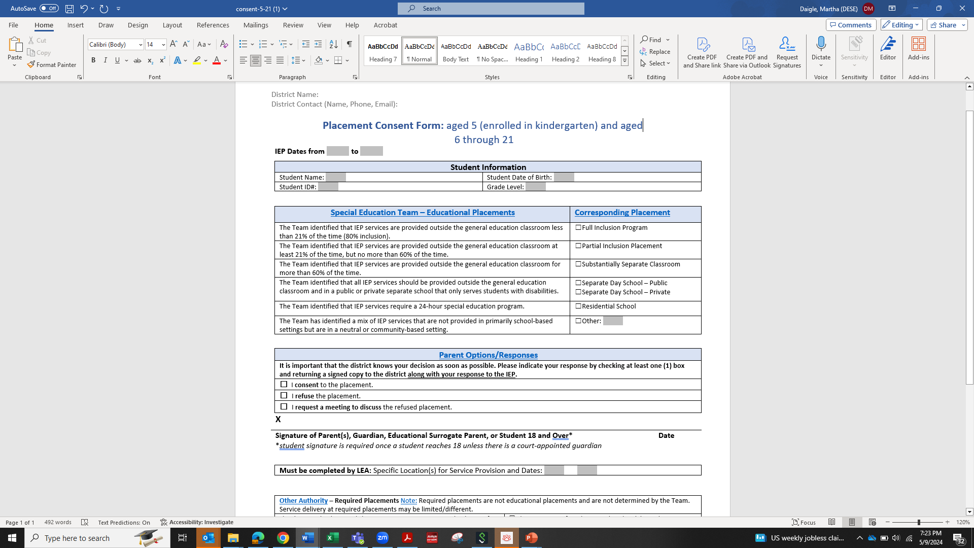
Placement Consent Form
https://www.doe.mass.edu/sped/ImproveIEP/consent-5-21/

Slide 19
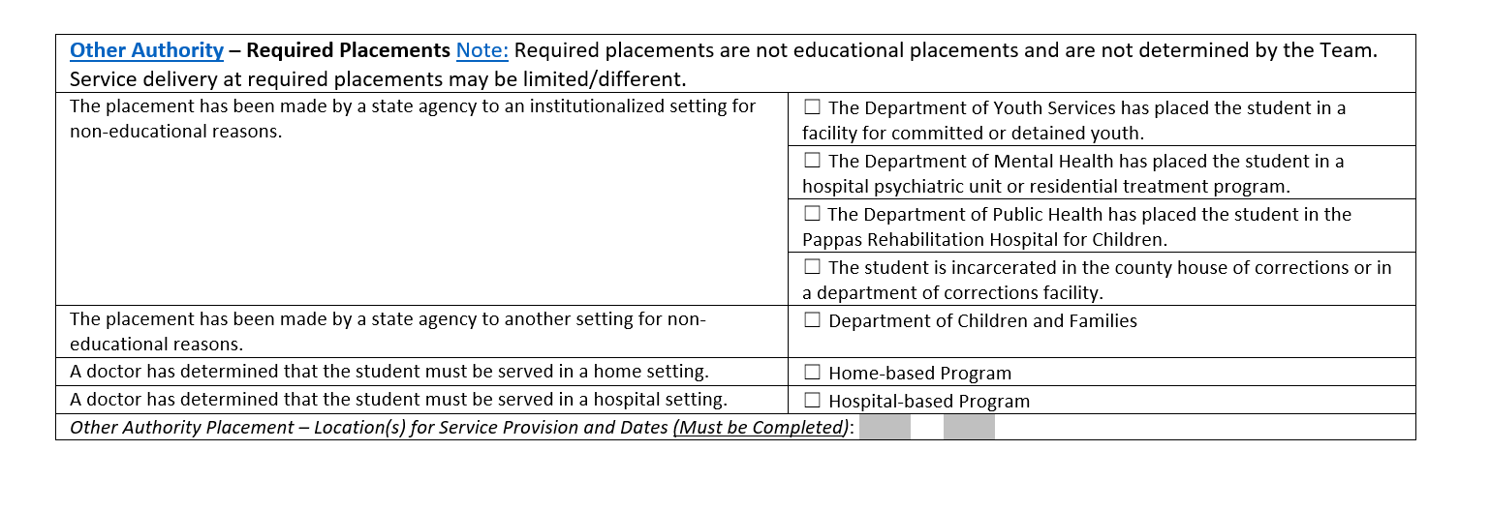
Placement Consent Form: Identifying Required Placements
https://www.doe.mass.edu/sped/ImproveIEP/consent-5-21/

Slide 20
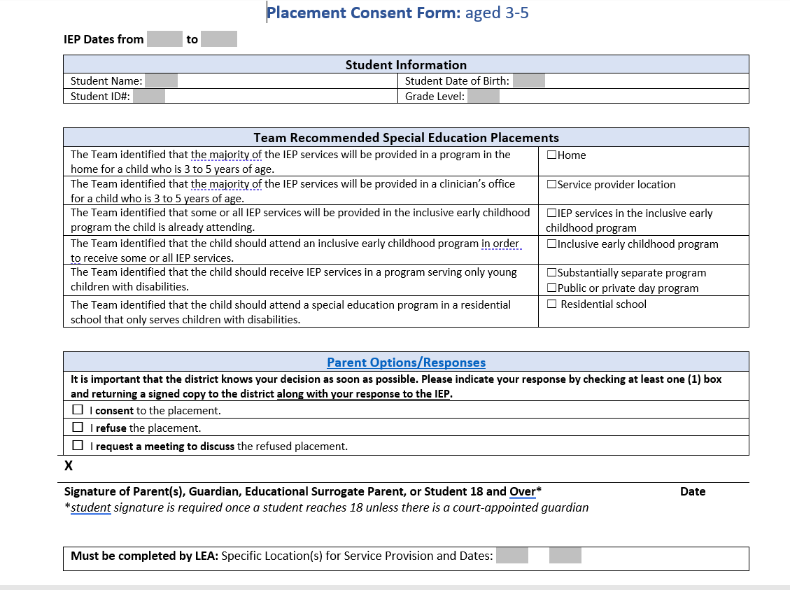
Placement Consent Form: Early Childhood
https://www.doe.mass.edu/sped/ImproveIEP/consent-3-5/

Slide 21
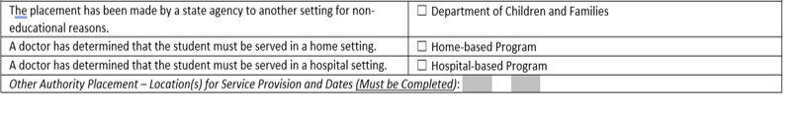
Placement Consent Form: Identifying Required Placements
Early Childhood
https://www.doe.mass.edu/sped/ImproveIEP/consent-3-5/

Slide 22
Continuing Support for the New IEP
Training (educators, students, families, advocates)
Resources
  Quick Reference Guide for Supporting English Learners with Disabilities
  Quick Reference Guide for Transition Planning
  Quick Reference Guide for Parents
  Discussion Questions for Getting Ready for My Yearly IEP Meeting
  Updated High School Sample IEP
Assessment of all remaining IEP forms to determine next steps

Slide 23
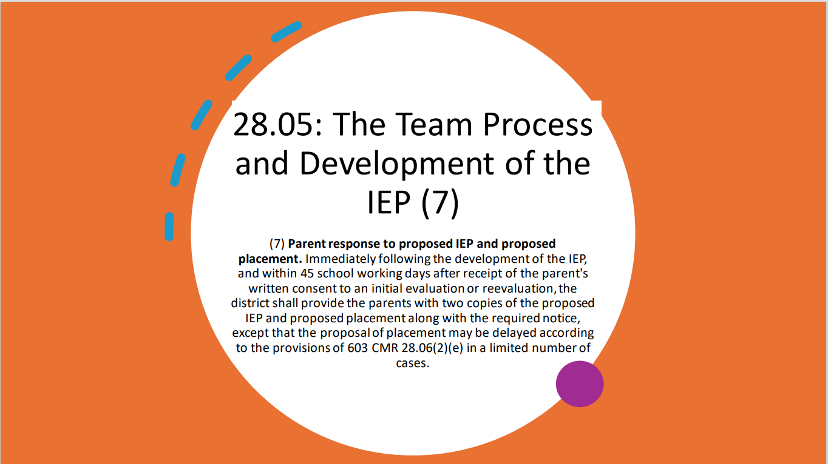
.
In the latter situation, the new LEA may extend the 30-day timeframe only if: (1) it is making sufficient progress to ensure prompt completion of the evaluation; and (2) the parent and the new public agency agree to a specific time when the evaluation will be completed.

Slide 24
Participation Cap for Alternate Assessments Based on Alternate Achievement Standards
"The total number of students assessed in a subject using an alternate assessment aligned with alternate academic achievement standards…may not exceed 1 percent of the total number of students in the state who are assessed in that subject.”
  Defines 1% based on total number of students assessed in a subject
  Districts may exceed 1% of all assessed students if justification is provided.
    Districts must address any disproportional representation of students from all subgroups taking the MCAS-Alt.
  States may exceed 1%, if a one-year waiver was granted based on assessing 95% of students and other factors.

Slide 25
Revised Participation Criteria
“States that adopt Alternate Assessment based on Alternate Achievement Standards must create a definition for students with the most significant cognitive disabilities.”
Further in 34 CFR § 200.6 - Inclusion of all students
  the State must . . . monitor implementation of clear and appropriate guidelines for IEP teams to apply in determining, on a case-by-case basis, which students with the most significant cognitive disabilities will be assessed based on alternate academic achievement standards. Such guidelines must include a State definition of students with the most significant cognitive disabilities that addresses factors related to cognitive functioning and adaptive behavior . . .
References for additional information
    NCEO Reports: Alternate Assessments for Students with Significant Cognitive Disabilities: Participation Guidelines and Definitions (#406)
    NCEO Reports: 2018-19 Participation Guidelines and Definitions for Alternate Assessments based on Alternate Academic Achievement Standards (#415)

Slide 26
Definition of “Students with the Most Significant Cognitive Disabilities” for Assessment Purposes
Massachusetts defines “students with the most significant cognitive disabilities” as students who:
  have cognitive disabilities evidenced by significant delays in attaining age-level academic achievement standards, even with systematic, extensive individually designed instruction, related services, and modifications; and
  have cognitive disabilities that significantly impact their educational performance and ability to apply learning from one setting to another; and
  require extensive, direct individualized instruction and substantial supports to achieve measurable gains on the challenging State academic content standards for the grade in which the student is enrolled; and
  perform significantly below average in general cognitive functioning and adaptive behavior. This is defined as a student functioning two or more standard deviations below the mean on commonly accepted norm-referenced assessments in both cognitive functioning and adaptive behavior (e.g., two or more adaptive skill areas such as daily living skills, communication, self-care, social skills, and academic skills).

Slide 27
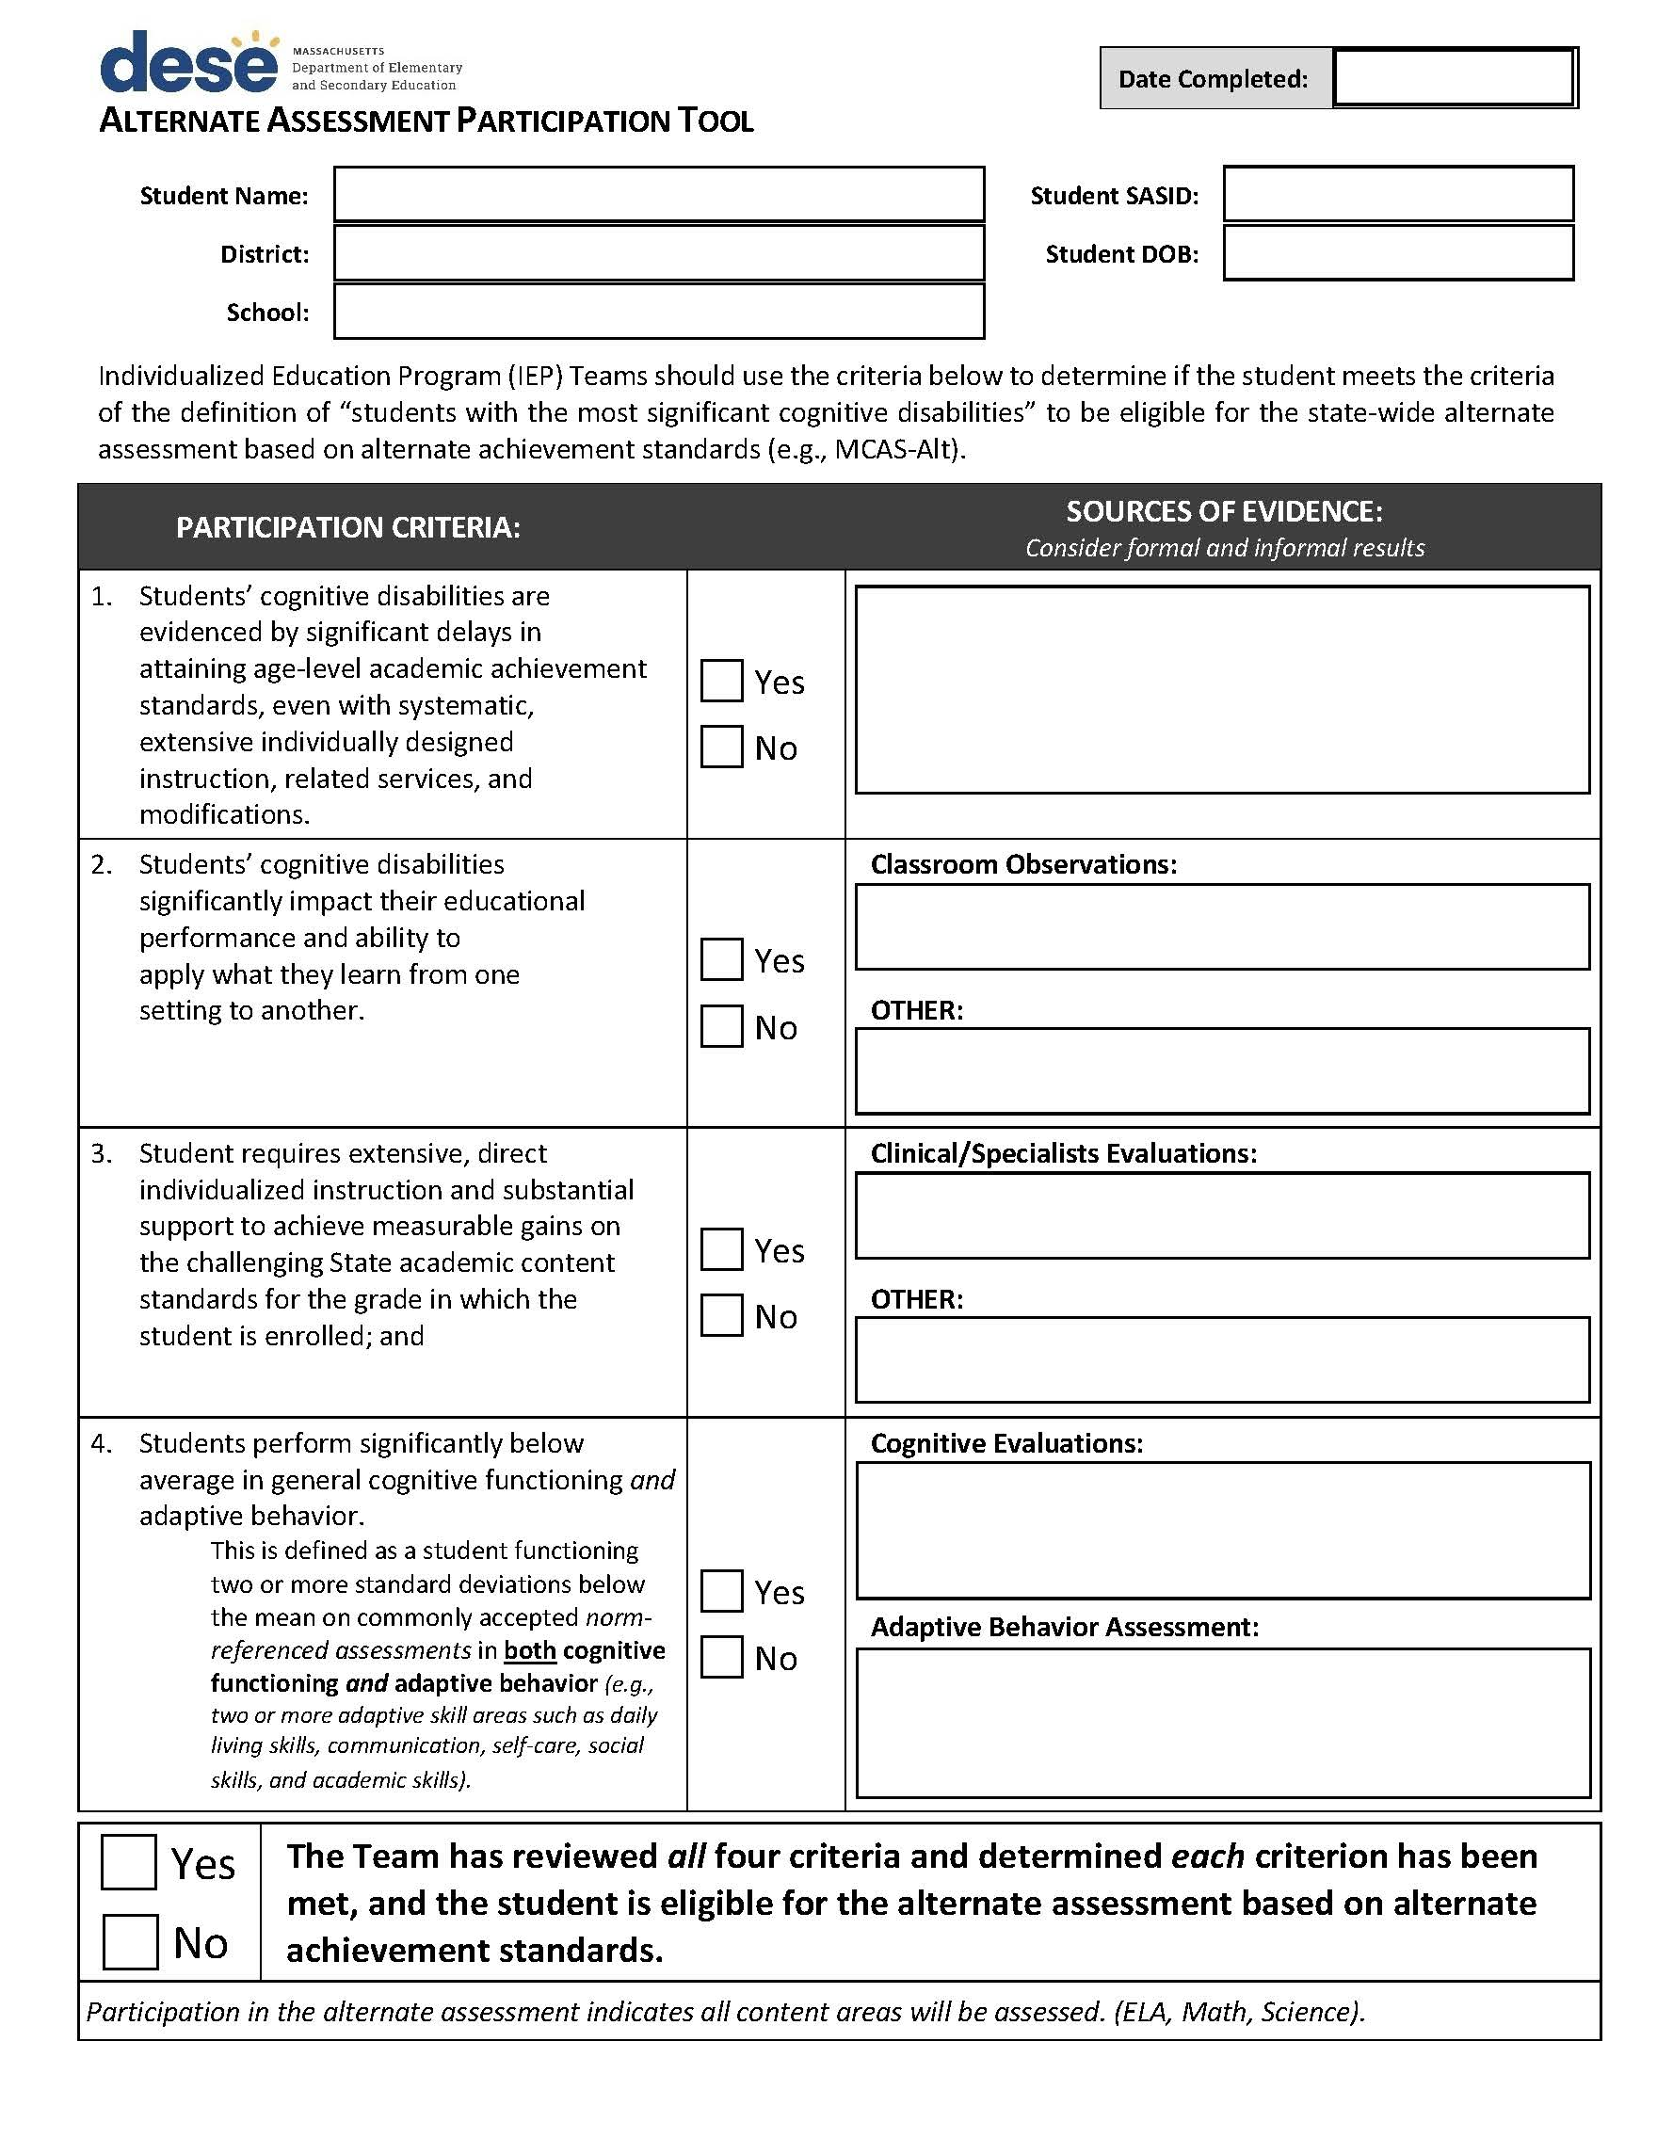
The Alternate Assessment Participation Tool is a companion document to assist IEP teams when deciding if a student may be eligible to participate in the MCAS-Alt.
If eligible, the student will participate in the assessment in all content areas required for their grade.

Slide 28
General Supervision Update

Slide 29
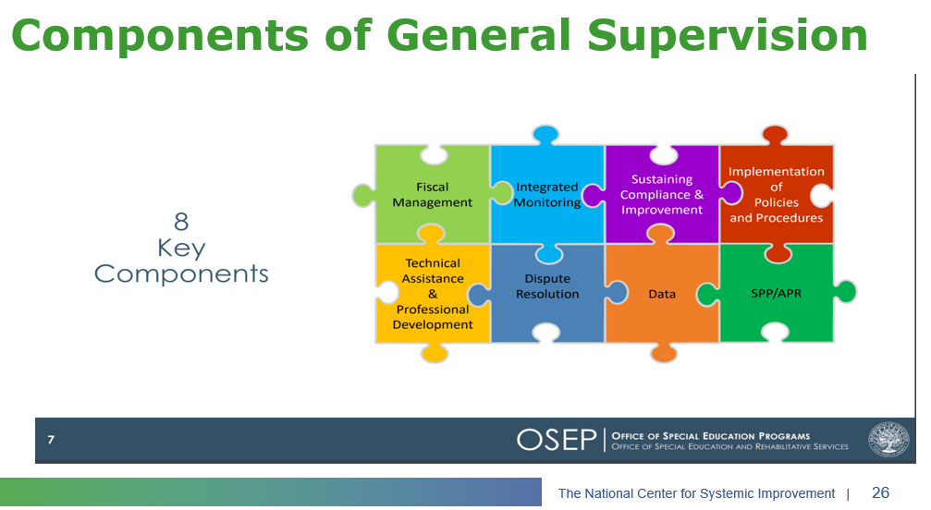
Components of General Supervision

Slide 30
2023-24 DESE/BSEA General Supervision Related Updates and Initiatives
OASES Procedures
PRS Procedures
PSM Procedures
Dispute Resolution and Mediation Procedures
Fiscal Monitoring Procedures
LEA Determinations
Policies and Procedures Manual
Conditions for Assistance
Data Protocols
Technical Assistance

Slide 31
Special Education Leaders Meetings
  2023-2024
  June 21, 2024 – 12 noon to 1pm
  2024-2025 Tentative Schedule
  September 13, 2024
  October 18, 2024
  November 15, 2024
  December 13, 2024
  January 17, 2025
  February 14, 2025
  March 14, 2025
  April 18, 2025
  May 16, 2025
  June 13, 2025
  Reminder that if you are not able to attend, we post slides and recordings of these meetings here

Slide 32
Q&A

