Slide 1
Update on K-12 testing program
September 1, 2021

Slide 2
Today’s presentation
Department of Elementary and Secondary Education
Shah Foundation
COVID-19 Command Center
Russell Johnston, Senior Associate Commissioner
Lauren Woo, Strategic Transformation Director
Ross Wilson, Executive Director
Eliza Novick, Project Manager
Michael Madigan, Project Associate
Lizzie Gordon, Project Associate
Jeremiah Hay, Deputy Strategy Director, COVID-19 Command Center
Sean Burpoe, Strategy Manager, COVID-19 Command Center
Amar Parikh, Strategy Analyst, COVID-19 Command Center
Notes:
Russell

Slide 3
CONTENTS
01
Resources for contact tracing
02
Further info on eMed at home tests
03
Review of FAQs and Protocols
04
Shah Family Foundation resources
Notes:
Lauren

Slide 4
Resources for contact tracing
01

Slide 5
Andrea Ciaranello, MD
Infectious Diseases
Massachusetts General Hospital

Slide 6
Standardized spreadsheet
In spring 2021, physicians from MGH studied the prevalence and risk factors for in-school transmission of COVID-19 in MA K-12 public schools. (Publish date TBD)
Results of the study demonstrated the secondary attack rate among students and staff exposed in school to people with COVID-19 during the infectious period was low (2.2%) and similar to other studies of public schools.
8 districts participated and compiled data using a standardized spreadsheet for reporting de-identified information about COVID-19 cases in schools and their school-based close contacts.
This spreadsheet is being shared as a resource for districts and schools to use during the 2021-22 school year.

Slide 7
Further info on eMed at home tests
02

Slide 8
Uses for the eMed tests
EMed tests should be used if an individual who is currently in the Test and Stay protocol is participating in an athletic or extracurricular activity on a weekend or non-school day.
In this case, the individual should receive one eMed test kit to take home on the last day of school prior to the non-school day activity, and take the test on the same day as, but prior to arriving at, the event.
If the test is negative the individual should show the negative result to school staff (coaches, etc) and is cleared to participate. The individual should remain masked.
If the test is positive, the individual should be treated as a positive case.

Slide 9
Requesting eMed tests
This afternoon, CIC Health will circulate a link to a survey where districts can request eMed tests.
Schools/districts will receive a fixed supply of tests based on the size of their school population.
If a school needs additional tests in the future, they should work with their CIC program coordinator to order more tests.
For school districts: tests should be ordered at the district level and each application must identify a single “hub” to where the tests will be delivered.
Please note this is the same processed followed for traditional BinaxNOW tests.
Frequently asked questions regarding the eMed test may be found on the DESE testing website: https://www.doe.mass.edu/covid19/testing/

Slide 10
Review of FAQs on testing and protocols
03

Slide 11
Level 2 Support Services
When will I receive my on-site support services from CIC Health?
To date, DESE/EHS have received over 530 applications to participate in a component of the Testing program, totaling over 2,000 schools enrolling over 800,000 students
If you have applied to the program, you will hear from CIC Health within 48 hours with a welcome email. The email will include instructions on how to begin training and order BinaxNOW/eMed tests
CIC Health is working hard to get all necessary supports in place to support districts/schools in their testing efforts.
In rare cases, on-site support services (e.g., specimen collectors) may be delayed to start the school year. All schools that requested these services will receive them in the coming weeks.
In cases where on-site services are delayed, districts/schools will have the tools – BinaxNOW tests, technology platform, pooled testing kits, and courier services – to conduct some testing if they wish to do so.
If a school does not wish to begin testing until all on-site support services are in place, they may use the intervening time to build family buy-in and gather consents for the testing program.

Slide 12
Shah Family Foundation resources
04

Slide 13
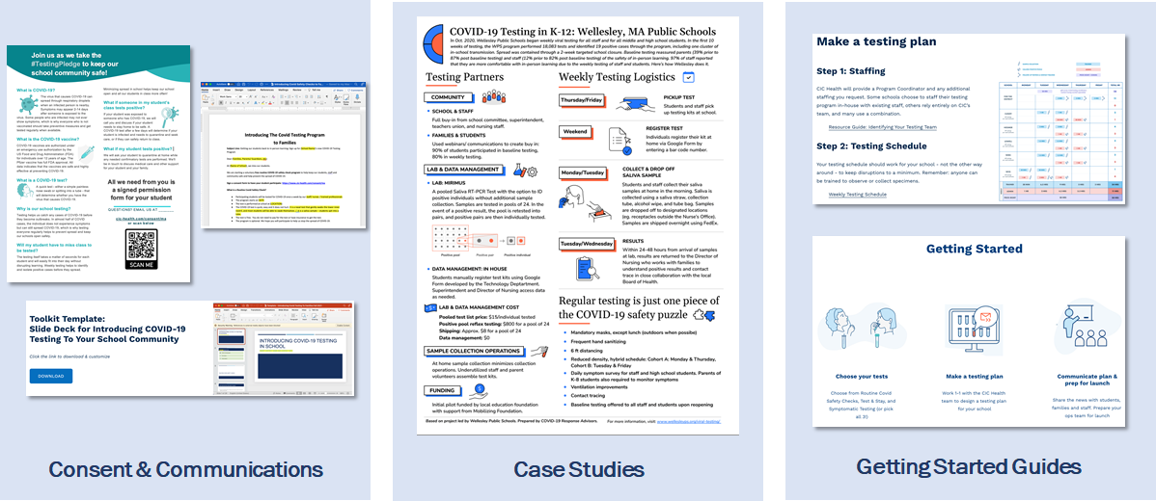
CovidEdTesting.com
Testing 101, comms guides, examples, templates

Slide 14
Next steps
05

Slide 15
Next steps
Complete the Authorized School Application and Statement of Assurances
https://survey.alchemer.com/s3/6473918/SY22-Authorized-School-Application-COVID-19-Testing-Program
If needed, request eMed at home tests or BinaxNOW through the forms provided by CIC Health.
The BinaxNOW order form was provided in the welcome email you received from CIC Health.
The eMed form will be circulated by CIC Health in an email this afternoon.
CIC will circulate both forms periodically to ensure that districts have access to them.

