Slide 1
Update on Reporting Positive Cases and K-12 Testing Program
September 9, 2021

Slide 2
Today’s presentation
Department of Elementary and Secondary Education
Shah Foundation
COVID-19 Command Center
Rob Curtin, Chief Officer for Data, Assessment and Accountability
Russell Johnston, Deputy Commissioner
Lauren Woo, Strategic Transformation Director
Ross Wilson, Executive Director
Eliza Novick, Project Manager
Marisa Meldonian, Associate Director
Lizzie Gordon, Project Associate
Jeremiah Hay, Deputy Strategy Director, COVID-19 Command Center
Sean Burpoe, Strategy Manager, COVID-19 Command Center
Notes:
Russell

Slide 3
CONTENTS
01
Reporting positive cases
02
Update and frequently asked questions
03
Shah Family Foundation resources
04
Next steps
Notes:
Lauren

Slide 4
Reporting positive cases
01

Slide 5
Collecting positive COVID-19 case data
DESE will begin to collect positive case data beginning on Monday, September 13th from districts, education collaboratives and approved special education schools
Any positive COVID-19 case for students enrolled or staff employed must be reported to DESE
At this time, no differentiation between in-school, remote, when last in school etc.

Slide 6
Case reporting application
Districts will no longer call DESE to report positive case results and instead report cases through a Security Portal application
Call center is not being staffed for logging cases
Amount of information required has been decreased
Name of school
Number of student cases
Number of staff cases

Slide 7
Case reporting application
Access to the case reporting application is provided through the Covid Lead security role in Directory Administration
Assignment of access to the application is a district responsibility and DESE will not assign on behalf of a district
District-level Directory Administrators can assign access for staff

Slide 8
Case reporting schedule
DESE will publicly report case data on Thursday evenings along with pooled testing data
Reporting week will run from Thursday to Wednesday
All cases for the reporting week must be submitted into the Security Portal collection application by Wednesday at 5:00 of each week
Reporting can be done as frequently as the district chooses (daily, weekly etc.) but all cases must be in by Wednesday at 5:00

Slide 9
K-12 Testing Update and Frequently Asked Questions
02

Slide 10
COVID-19 testing program update
Staffing solutions
Survey
New Parent letters posted to: https://www.doe.mass.edu/covid19/testing/
Rapid Test Result letter (New!)
Positive Case letter – All Families (New!)
Positive Case letter – Close Contact (New!)
COVID-19 Testing Program letter
Updated gender options on consent form (forthcoming)

Slide 11
MGH Infectious Disease Department contact tracing resource
Standardized spreadsheet for reporting de-identified information about COVID-19 cases in schools and their school-based close contacts
A link to the spreadsheet is available: https://www.doe.mass.edu/covid19/testing/ (“Contact Tracing – District Data Template”)
Ongoing study using data from the spreadsheet to further understand COVID transmission in schools
If interested in participating, please contact aciaranello@mgh.harvard.edu or sbnelson@mgh.harvard.edu

Slide 12
Support for contact tracing spreadsheet
Mary Ellen Duggan Northborough/Southborough mduggan@nsboro.k12.ma.us
Noelle Freeman Shrewsbury nfreeman@shrewsbury.k12.ma.us

Slide 13
Ordering BinaxNOW tests
How do I order BinaxNOW tests, and when should I receive them by?
Nearly all districts have either placed orders or have orders placed for them centrally. If you are unsure about whether you need tests or whether they have been ordered for you, contact your PC or K12COVID19testing@mass.gov
By the end of this week or early next week, nearly all participating schools/districts) will have received the tests that they ordered.
Any district that needs more tests should request tests through this form: https://cic.jotform.com/212167979269977
The typical turnaround time for test delivery is 5-7 days from the order being placed with DPH.

Slide 14
BinaxNOW expiration
When will my BinaxNOW tests expire?
Any tests shipped this summer/fall will not expire until December. (Because of past extensions, printed expiration dates are not accurate.) However, there are a small number of tests, shipped in the spring, that will expire soon.
To determine when your tests will expire:
Locate the “lot number” on the BinaxNOW box
Determine if the “lot number” appears in the form here.
If it does appear, the updated expiration date is the date in the column “New Expiry.”
If it does not appear, the expiration date is the original date that appears on the box.

Slide 15
Antigen tests for test and stay
Can other rapid antigen (non-BinaxNOW) tests be used for test and stay?
No. BinaxNOW tests are the only tests that schools/districts may used for test and stay.
BinaxNOW tests are available from the state to all schools/districts free of charge and may be requested through the survey distributed by CIC Health.
A district should never be instructed to purchase tests on their own (e.g., pharmacy OTC tests).
If this occurs, please contact the DESE testing inbox: K12COVID19testing@mass.gov.

Slide 16
Remote learning
Under what circumstances may remote learning be implemented?
As described in DESE's August 20, 2021 FAQ, during the 2021-22 school year, full-time remote learning programs will not count toward structured learning time hours unless specifically previously authorized by DESE.
Only in the limited instance where students are isolating and/or quarantining, if schools have the ability to allow students to join their schedule remotely, then they may do so.
Consistent with DESE’s guidance on student attendance, quarantining students who participate in at least half of the school day activities can be marked present.

Slide 17
Definition of close contact
What is a close contact?
A close contact in the school setting is defined as only those who have been within (less than) 6 feet of distance of the COVID-19 positive individual while INDOORS, for at least fifteen minutes during a 24-hour period.
The period of time that students or staff are outside does not count as a close contact.
In a classroom setting, it would be rare for an entire classroom to be considered a close contact of an infectious person.
Districts should focus on this definition when determining which students need to participate in the test and stay program.
Resources are finite and over-identifying close contacts has a tangible impact on support time and test supply.

Slide 18
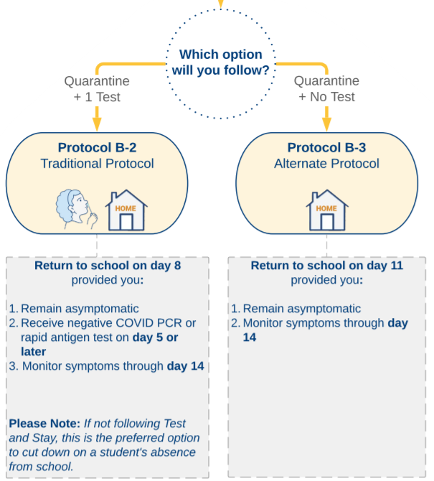
Test and Stay participation for non-school based close contacts
Can individuals identified as a close contact while at home (i.e., non-school based close contact) return to school and participate in the Test and Stay program?
No. The Test and Stay program is intended for school-based close contacts, only.
This includes close contacts identified in after-school/weekend school-sponsored extracurricular activities and sports.
Individuals identified as a close contact of an individual outside of school should follow Protocol B-2 or B-3 in the SY22 DESE/DPH Protocols for Responding to COVID-19 Scenarios (see flow chart)

Slide 19
Shah Family Foundation resources
03

Slide 20
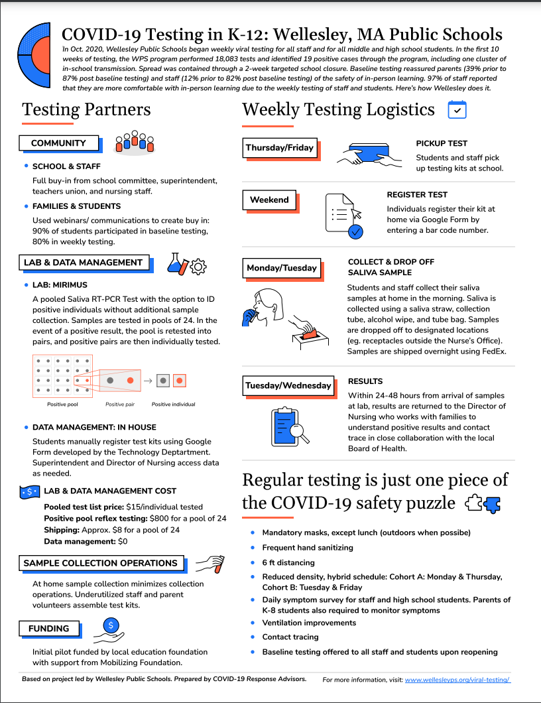
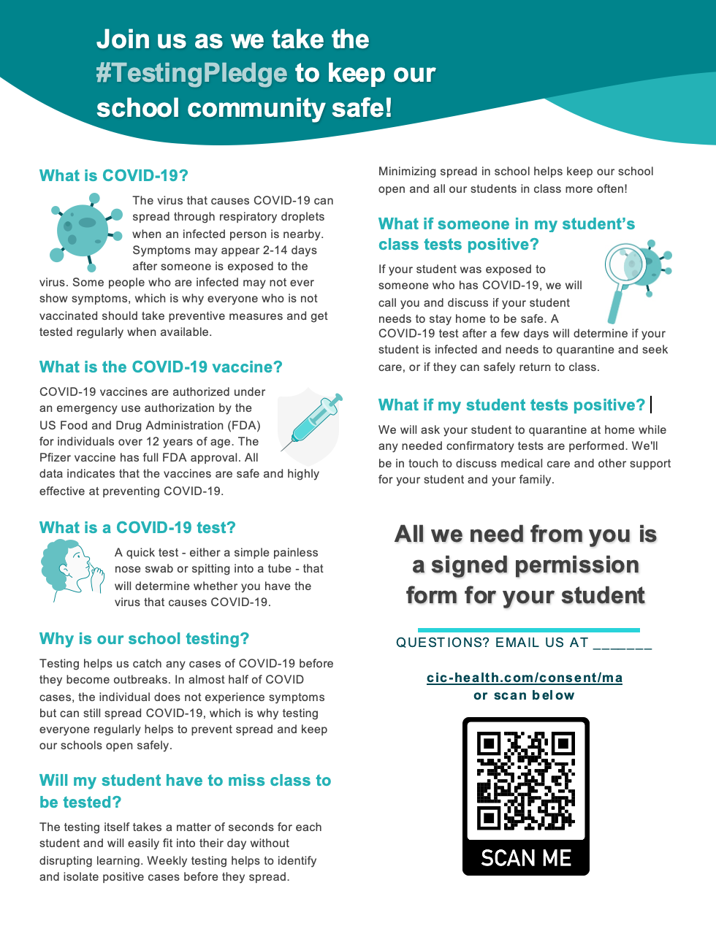
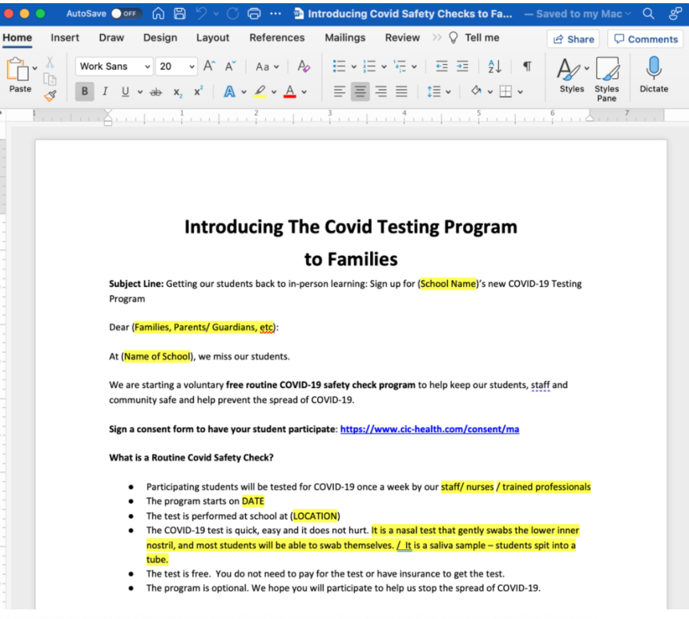
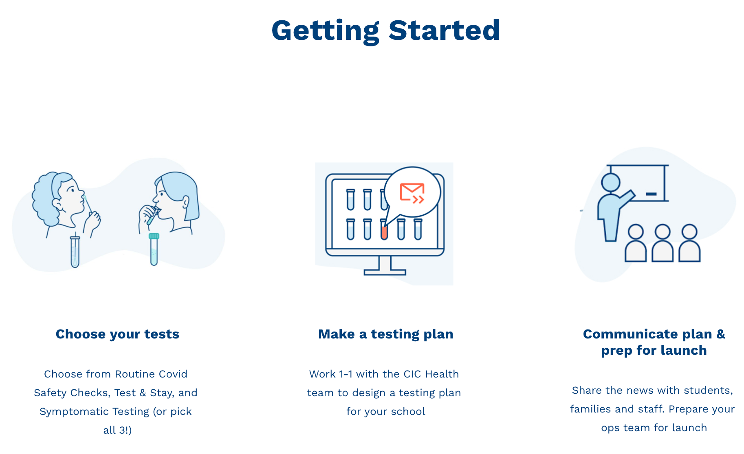
CovidEdTesting.com
Testing 101, comms guides, examples, templates
Consent & Communications
Case Studies
Getting Started Guides

Slide 21
Next steps
04

Slide 22
Important links on DESE website
COVID-19 Testing Program: https://www.doe.mass.edu/covid19/testing/
Authorized School Application
COVID-19 Testing and eMed FAQs
Webinar recordings and slides
Consent forms and parent letters
On the Desktop: https://www.doe.mass.edu/covid19/on-desktop.html
Protocols for Responding to COVID-19 Scenarios
Protocols Flowcharts
FAQs: https://www.doe.mass.edu/covid19/faq/
Protocols and other reopening FAQs (also sent out in the Commissioner’s Weekly Update)

Slide 23
Next steps
Complete the Authorized School Application and Statement of Assurances
https://survey.alchemer.com/s3/6473918/SY22-Authorized-School-Application-COVID-19-Testing-Program
If needed, request eMed at home tests or BinaxNOW through the forms provided by CIC Health.
The BinaxNOW order form can be found here: BinaxNOW Order Form
The eMed form will be can be found here: eMed Order Form

Slide 24
Have a question? Need help?
Here’s how to get in touch:
First, contact your Program Coordinator
They are your best first line of defense.
If you don’t hear back, contact CIC support
support@cic-health.com
Please allow a few hours for a response during the next few weeks
Still don’t have what you need? Send us a note!
DESE: k12covid19testing@mass.gov
Shah Foundation: CovidEdTesting@ShahFoundation.org
Please note:
If you need help, please reach out as early as possible. All teams are experiencing a high volume and the sooner we hear from you the better.

