Slide 1
Update on K-12 Testing Program
October 1, 2021

Slide 2
Today’s Presentation
Department of Elementary and Secondary Education
Shah Foundation
COVID-19 Command Center
Russell Johnston, Senior Associate Commissioner
Lauren Woo, Strategic Transformation Director
Ross Wilson, Executive Director
Eliza Novick, Project Manager
Marisa Meldonian, Associate Director
Lizzie Gordon, Project Associate
Jeremiah Hay, Deputy Strategy Director, COVID-19 Command Center
Sean Burpoe, Strategy Manager, COVID-19 Command Center
Amar Parikh, Strategy Analyst, COVID-19 Command Center
Notes:
Russell

Slide 3
CONTENTS
01
Recommendations for alleviating staffing constraints
02
Extension of the DESE mask requirement and key reminders on close contacts
03
Shah Family Foundation resources
04
Next Steps
Notes:
Lauren

Slide 4
Recommendations for alleviating staffing constraints
01

Slide 5
Staffing solutions
We understand that on-site staffing support has been slow to materialize for many districts.
All parties – CIC Health, DESE, and EHS – are actively working to fill the on-site support gap for all districts.
Aggressively adding more partners to double the number of subcontractors.
If you are struggling with the launch of your testing program, please reach out to k12covid19testing@mass.gov ASAP.
CIC has been proactively reaching out to every participating district to schedule direct conversations this week.

Slide 6
Subcontracting with CIC to cover costs of school-identified support
Some districts have used part-time school-affiliated staff members – such as after school program staff – to assist with launching their testing program, and others have found community members/caregivers willing to volunteer.
Please note: individuals do not need to be a healthcare provider. They will receive all necessary training on administering tests.
Districts may handle compensation for these individuals by adding them as subcontractors to CIC Health.
Contact your program coordinator if you have a hiring recommendation to make. They can provide guidance on the pay rates that would apply.
Advertise locally for these positions using sample job descriptions.
Email K12COVID19testing@mass.gov for the template.
Project Coordinator
Sample Collector
Site Observer

Slide 7
Additional staffing options
Districts may also apply for reimbursement from FEMA (see question 12 of the updated FAQ) to cover the costs associated with compensating this individual(s).
For more information regarding FEMA reimbursement, districts may direct questions to Disaster.recovery@mass.gov
This is not mutually exclusive to receiving other support.
CIC has been in touch with some Medical Reserve Corps units, some of which have had capacity to provide temporary help. This outreach is ongoing.

Slide 8
Double swab versus single swab – pooled testing
Some schools have successfully implemented double swab pooled testing, and we encourage those districts to maintain their current practices.
Other districts have encountered challenges with the double swab methodology, particularly the collection of the second swab (to determine the positive individual in the pool).
Some of these districts have switched to single swab with BinaxNOW for positive pool deconvolution (follow-up testing) and have found this approach logistically more feasible and efficient.
If your district is finding challenges with the double swab collection, switching to single swab may be a viable option.
This may be coordinated through your CIC program coordinator.

Slide 9
Entering BinaxNOW results in bulk in Crush the Curve
Link to explanatory video from CIC

Slide 10
Extension of the DESE mask requirement and key reminders on close contacts
02

Slide 11
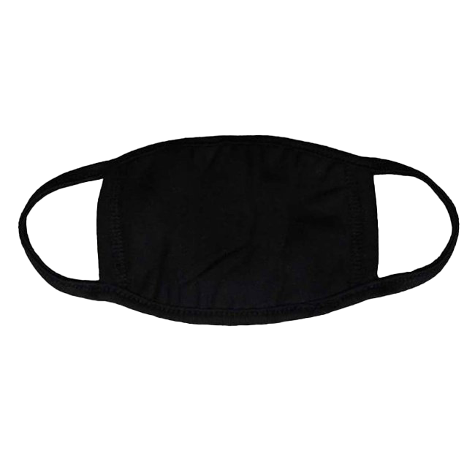
DESE Mask Mandate Extended
On August 24, 2021, the Board of Elementary and Secondary Education (Board) authorized the Commissioner of Elementary and Secondary Education to require masks for public school students (age 5 and above) and staff in all grades through at least October 1, 2021.
Consistent with the authority provided by the Board, and after consulting with medical experts and state health officials, the Commissioner is extending the mask requirement through at least November 1, 2021.
https://www.doe.mass.edu/covid19/on-desktop/mask-requirement-extension/mask-requirement-extension.pdf

Slide 12
The following requirements remain in effect:
Public school students (age 5 and above) and staff in all grades are required to wear masks indoors in schools, with few exceptions. All visitors are also expected to wear a mask in school buildings.
The mask requirement will be in place until at least November 1, 2021. The Commissioner will revisit the requirement in the near future to revise it as warranted by public health data.
Masks should cover an individual’s nose and mouth
It is strongly recommended that students younger than age 5 also wear a mask in school.
Students and staff who cannot wear a mask for medical reasons, and students who cannot wear a mask for behavioral reasons, are exempted from the requirement. The mask requirement applies when students and staff are indoors at school, except when eating, drinking, or during mask breaks.
Mask breaks may occur throughout the day. If feasible, breaks should occur when the windows are open or students are outdoors
Masks may also be removed indoors when necessary to participate in elective classes, such as the use of wind instruments in band.

Slide 13
Sports, Buses and Discipline
Masks are required for any sports-related activity for student-athletes and coaches when indoors
By federal public health order, all students and staff are required to wear a mask on school buses.
It is recommended windows on buses remain cracked, even as temperatures decline. Students should be encouraged to dress in appropriate outerwear layers while riding the bus.
Whether and when a student should be disciplined for failure to wear a mask is a local decision, guided by the district’s student discipline policy and the particular facts. Districts should provide written notice to students and families about expectations and potential consequences and are encouraged to use a progressive discipline approach.
The mask requirement includes an exemption for students who cannot wear a mask due to medical conditions or behavioral needs. Further, some students with disabilities may need additional supports to wear masks and may need to be accommodated.

Slide 14
Vaccine Rate Threshold
As of October 15, 2021, if a school demonstrates a vaccination rate of 80 percent or more of all students and staff in the school through an attestation form submitted to DESE, then vaccinated individuals in that school would no longer be subject to the mask requirement.
Unvaccinated students and staff would be required to continue wearing masks.
DESE will continue to work with medical experts and state health officials to review and consider additional metrics to determine when individuals in schools would no longer be subject to the mask requirement

Slide 15
Identifying Close Contacts in School Settings
Definition of a close contact:
Individuals who have been within 6 feet of a COVID-19 positive individual while indoors, for at least 15 minutes during a 24-hour period.
At-risk exposure time begins 48 hours prior to symptom onset (or time of positive test if asymptomatic) and continues until the time the COVID-19 positive individual is isolated.
Multiple brief or transitory interactions, such as in a hallway or when entering or exiting a classroom, are unlikely to result in 15 minutes and do not meet the definition of close contact.
The definition of a close contact also specifies time spent indoors only.
Interactions that occur outdoors, whether masked or unmasked, do not count toward the definition of a close contact.

Slide 16
Exemptions to close contact quarantine and testing protocols:
While all individuals who meet the close contact definition are considered close contacts, there are individuals who may be exempt from any quarantine or testing protocols in school.
Asymptomatic, fully vaccinated close contacts
Classroom close contacts spaced at least 3 feet apart
Bus close contacts
Close contacts who have had COVID-19 within the past 90 days
Schools are strongly encouraged to work with students and teachers to identify which individuals are known to be close contacts. If it is not known that an individual meets the definition of a close contact, they should not be identified as a close contact. Schools can also use the linked decision-tree to help correctly identify close contacts, available here.

Slide 17
Shah Family Foundation resources
03

Slide 18
Software Platform Cheat Sheet
Platform | What It’s Used For | Link
CIC Electronic Consent | Consent Forms, Logging Paper Forms | https://www.cic-health.com/consent/ma *each district/school can send an individualized link
CIC Zendesk Portal | How-To Materials, Re-Ordering Supplies, Student Consent & Database Portal | https://cich-ma.zendesk.com/hc/en-us
Crush the Curve | Recording Tests: single/double swab, BinaxNOW | https://covid.cic-health.com/s/login/
Veritas | Recording Tests: Saliva and swab | https://secure.veritasgenetics.com/user/login
Project Beacon | Recording Tests: LEGACY CLIENTS ONLY (single/double swab, BinaxNOW) | https://app.beacontesting.com/login
The Shah Foundation has also created cheat sheets that district personnel can use to keep track of usernames and passwords for Crush the Curve, Veritas Genetics, and Project Beacon.

Slide 19
Next steps
04

Slide 20
Important links on DESE website
COVID-19 Testing Program: https://www.doe.mass.edu/covid19/testing/
Authorized School Application
COVID-19 Testing FAQs (updated/new FAQs dated 9/22/2021)
Webinar recordings and slides
Consent forms and parent letters
On the Desktop: https://www.doe.mass.edu/covid19/on-desktop.html
Extension of Mask Mandate
Policy on Vaccination Rate Threshold & Attestation Form
Reminders for Identifying Close Contacts and Close Contact Decision Tree
Protocols for Responding to COVID-19 Scenarios
Protocols Flowcharts
General FAQs: https://www.doe.mass.edu/covid19/faq/
Protocols and other reopening FAQs (also sent out in the Commissioner’s Weekly Update)

Slide 21
Next steps
Complete the Authorized School Application and Statement of Assurances
https://survey.alchemer.com/s3/6473918/SY22-Authorized-School-Application-COVID-19-Testing-Program
If needed, request eMed at home tests or BinaxNOW through the forms provided by CIC Health.
The BinaxNOW order form can be found here: BinaxNOW Order Form
The eMed form will be can be found here: eMed Order Form

Slide 22
Have a question? Need help?
Here’s how to get in touch:
First, contact your Program Coordinator
They are your best first line of defense.
If you don’t hear back, contact CIC support
support@cic-health.com
Please allow a few hours for a response during the next few weeks
Still don’t have what you need? Send us a note!
DESE: k12covid19testing@mass.gov
Shah Foundation: CovidEdTesting@ShahFoundation.org
Please note:
If you need help, please reach out as early as possible. All teams are experiencing a high volume and the sooner we hear from you the better.

Slide 23
Next Week
Likely update on involving Out-of-School-Time Programs in Test and Stay
Webinar likely to be announced on Monday
Consider having OST program coordinator join you for that meeting

