Slide 1
Update on K-12 Testing Program
November 4, 2021

Slide 2
Today’s Presentation
Department of Elementary and Secondary Education
Shah Foundation
COVID-19 Command Center
Russell Johnston, Deputy Commissioner
Lauren Woo, Strategic Transformation Director
Ross Wilson, Executive Director
Eliza Novick, Project Manager
Marisa Meldonian, Associate Director
Lizzie Gordon, Project Associate
Jeremiah Hay, Deputy Strategy Director, COVID-19 Command Center
Sean Burpoe, Strategy Manager, COVID-19 Command Center
Amar Parikh, Strategy Analyst, COVID-19 Command Center
Notes:
Russell

Slide 3
CONTENTS
01
Scheduling vaccine clinics
02
Community Tracing Collaborative Transition
03
Program updates and FAQs
04
Shah Family Foundation resources
05
Next Steps
Notes:
Lauren

Slide 4
Scheduling vaccine clinics
01
Eleni Kacher, Strategy Manager, Executive Office of Health and Human Services

Slide 5
Mobile Vaccination Program – Process
We are accepting mobile vaccination clinic requests, with priority given to clinics for 5-11 year-olds
Mobile vaccination clinic requests must be submitted:
  Through the online form (mass.gov/mobilevaccineform), and
  At least 14 business days before the desired clinic date
If a clinic request can be accommodated, an approval notification email will be sent to introduce the clinic requestor to the designated vaccination provider
If you previously worked with a provider and enjoyed that experience, please note that in the request
Once you are connected with a provider, they will provide consent forms and a scheduling platform. We encourage as much pre-registration as possible to streamline the process

Slide 6
Mobile Vaccination Program – Other Notes
Clinics that serve 5-11 year-olds at public schools will be prioritized at this time
We ask that clinics be coordinated on a district-level and schools consolidate clinics as possible
Clinics can also be coordinated on a cross district-level
Clinics will offer the pediatric Pfizer vaccine and the Pfizer vaccine to reach all students, ages 5+.
  If available, J&J and Moderna may be requested for staff and other adults
Clinics will be tailored to the community:
  Language translation support is available. Please note any needs in your request
  The vaccination providers have received training in administering pediatric vaccinations and can be flexible in adjusting to the needs of the population
We welcome the support of your staff to make the students as comfortable as possible
More details can be found on the mobile vaccination webpage.

Slide 7
Community Tracing Collaborative Transition
02
Jana Ferguson, Assistant Commissioner,
MA Department of Public Health

Slide 8
Community Tracing Collaborative - Background
The MA Community Tracing Collaborative (CTC) was created in the earliest days of the pandemic to respond to the surge in COVID-19 positive cases and to assist local health departments
The CTC was established by the Commonwealth’s COVID-19 Command Response Center in April 2020 and is a collaboration of the Department of Public Health and Partners in Health. The Health Connector has been the contract administrator on behalf of the state
When the CTC was established, there was limited testing capability, minimal therapeutic interventions, and no vaccines. Today, Massachusetts is a national leader in vaccine administration and free testing, with the second lowest COVID-19 hospitalization rate and case positivity rate. The state’s declared public health emergency ended in May 2021
Since April 2020, more than 1.1 million cases and contacts have been identified for follow-up conducted by local health departments and the CTC, and over 2.6 million phone calls to cases and contacts have occurred.

Slide 9
Local Funding, Training and Technical Support
  Recent awards of over $15M in federal and state resources to LBOHs specifically to build local capacity to investigate cases, trace contacts, investigate clusters and identify support services for COVID cases and contacts needing to isolate and quarantine
    DPH is preparing to award an additional ~$4M to build LBOH contact tracing and case investigation capacity.
  The Academic Public Health Corps, coordinated by DPH and the MA Health Officers Association, has placed hundreds of volunteers and interns with LBOH to meet short term needs and to create training and development for a new public health workforce.
  DPH provides weekly education and training by DPH senior epidemiologists and weekly all-towns webinars, on-demand technical assistance to local health departments to use MAVEN.
  Local health departments can advertise job opportunities with outgoing CTC staff in order to attract experienced job applicants.

Slide 10
Community Tracing Collaborative Transition
Local health departments and the Department of Public Health will resume responsibility for case investigations and any appropriate contact tracing activity.
  The CTC will cease taking new case referrals on November 30, 2020.
  CTC case work will be completed for referred cases by December 17.
  Local Health Liaisons are available to communities until December 30.
The CTC also supported the initial deployment of the MassNotify, to let users anonymously report positive test results to other users.
MassNotify is a smartphone service developed with Apple and Google and works by exchanging anonymous codes with other nearby users and is another way to stay alert about possible exposures.
Since launching in June, MassNotify has been enabled by 1.59 million users, 23 percent of the state’s population. The Commonwealth will continue to support and promote this electronic notification system.

Slide 11
Program updates and FAQs
02

Slide 12
Program results to date

Slide 13
Reporting BinaxNOW results
All results – both positive and negative – must be reported in a timely fashion through either Crush the Curve or Project Beacon.
  This includes historical results that a district has yet to record.
While we understand that the lack of on-site support may have contributed to these delays, reporting results is important, especially for:
  Complying with Department of Public Health regulations regarding the reporting of COVID-19 cases.
  Tracking positive cases/clusters in schools
  Determining the efficacy of test and stay as a mechanism for preserving in-person student learning
In the next week, DESE/EHS will reach out to districts that have received a large supply of BinaxNOW tests but have not reported sufficient results.
  Failure to report tests may result in reduced BinaxNOW supply for a school/district

Slide 14
BinaxNOW expirations
A significant number of BinaxNOW kits currently on-hand at schools will expire within the next 45-60 days.
As of today, Abbott has not issued a further extension of the expiration date.
However, schools should keep expired tests on hand until the end of the year if a further expiration extension is granted.

Slide 15
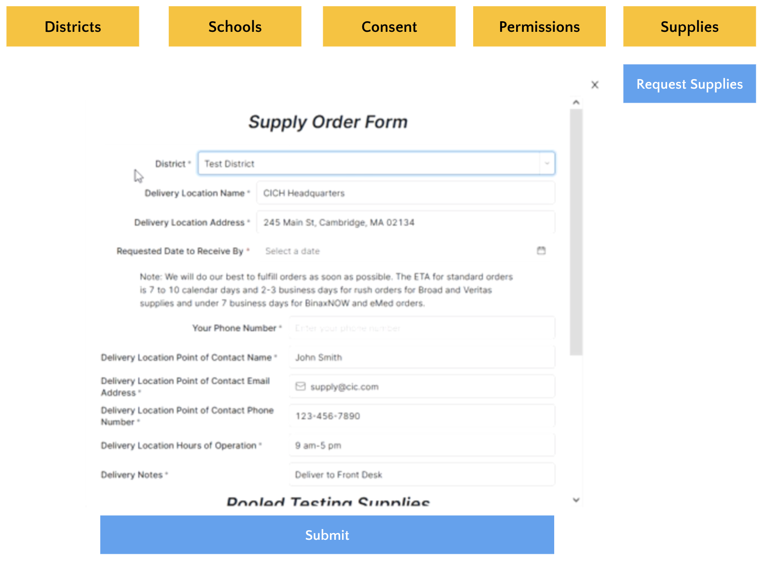
New process for ordering tests & supplies
Effective Friday 11/5 all districts will place orders directly through the CIC Health Portal
How To:
Log in to CIC Health Portal: cich-ma.zendesk.com
Go to School & Consent Database
Click “Supplies” tab → click “Request Supplies”
Fill out form and submit
Previously, districts ordered tests and supplies using separate forms: Veritas, Broad, BinaxNOW, and eMed
Now, there is one order form for all tests / supplies – found in the School & Consent Database
Can I view my orders? Yes, view your district’s submitted orders and order status in the “Supplies” tab
Who can order? Any individual with a CIC Health portal account may place and view orders.

Slide 16
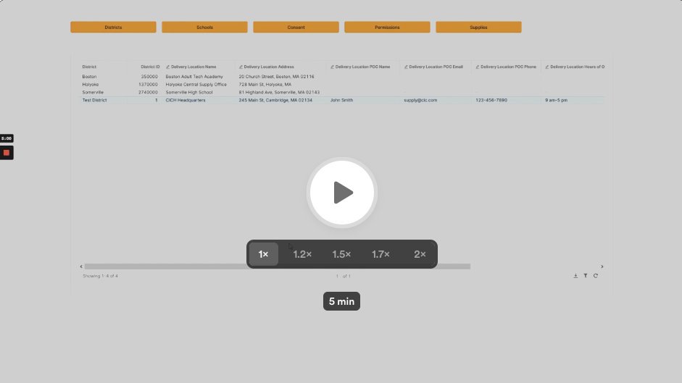
How-to video: New process for ordering tests & supplies
Instructions
Go to CIC Portal
Go to "School & Consent Database"
Click on "Supplies" tab, then "Request Supplies" blue button
Fill out the order form:
  Confirm your delivery address & info
  Request supplies:
    Pooled testing supplies
    Cryoboxes, bags, scanners, extra swabs
    BinaxNOW
    eMed
Click blue “submit” button at the bottom of the form
View your orders in the "Supplies" tab to track processing, fulfillment, and delivery status
Click the image to open the video

Slide 17
Appropriate close contact identification
Definition of a close contact:
Individuals who have been within 6 feet of a COVID-19 positive individual while indoors, for at least 15 minutes during a 24-hour period.
At-risk exposure time begins 48 hours prior to symptom onset (or time of positive test if asymptomatic) and continues until the time the COVID-19 positive individual is isolated.
Multiple brief or transitory interactions, such as in a hallway or when entering or exiting a classroom, are unlikely to result in 15 minutes and do not meet the definition of close contact.
The definition of a close contact also specifies time spent indoors only.
Interactions that occur outdoors, whether masked or unmasked, do not count toward the definition of a close contact.

Slide 18
Exemptions to close contact quarantine and testing protocols:
While all individuals who meet the close contact definition are considered close contacts, there are individuals who may be exempt from any quarantine or testing protocols in school:
    Asymptomatic, fully vaccinated close contacts
    Classroom close contacts spaced at least 3 feet apart
    Bus close contacts
    Close contacts who have had COVID-19 within the past 90 days
Under no circumstance is it appropriate to pressure nursing staff or testing program supervisors into testing individuals that meet one of these exemptions.
  Reports regarding inappropriate use of Test and Stay will result in DESE intervention.

Slide 19
Potential extension of Test and Stay to Out of School Time (OST) Programs
DESE, EEC and DPH have collaborated to determine how students attending EEC-affiliated before and after school programs could participate in Test and Stay.
Student participation will require adult consent for information sharing between the district and OST programs.
If interested in learning more about this potential development, please take this brief survey so we can invite you to a follow up webinar next week, likely on Fri.

Slide 20
Pooled testing during shortened weeks
During short school weeks, such as Thanksgiving week, should schools still provide pooled testing programs?
DESE recommends that pooled testing programs are only run when the school can complete the entire pooled testing process from the initial pooled test through the completion of all needed follow-up tests. Schools are encouraged to work with their project coordinator to develop a schedule that will work for your school community and can be supported by your CIC staff during shorter school weeks.

Slide 21

“Trial balloon phase” when changing testing modalities
If you are changing testing modalities (single swab to double swab, etc.), please build in a “trial balloon phase” to work out any issues before you fully launch the new modality.

Slide 22
Shah Family Foundation resources
03

Slide 23
Software Platform Cheat Sheet
Platform | What It’s Used For | Link
CIC Electronic Consent | Consent Forms, Logging Paper Forms | https://www.cic-health.com/consent/ma *each district/school can send an individualized link
CIC Zendesk Portal | How-To Materials, Re-Ordering Supplies, Student Consent & Database Portal | https://cich-ma.zendesk.com/hc/en-us
Crush the Curve | Recording Tests: single/double swab, BinaxNOW | https://covid.cic-health.com/s/login/
Veritas | Recording Tests: Saliva | https://secure.veritasgenetics.com/user/login
Project Beacon | Recording Tests: LEGACY CLIENTS ONLY (single/double swab, BinaxNOW) | https://app.beacontesting.com/login
The Shah Foundation has also created cheat sheets that district personnel can use to keep track of usernames and passwords for Crush the Cuve, Veritas Genetics, and Project Beacon.

Slide 24
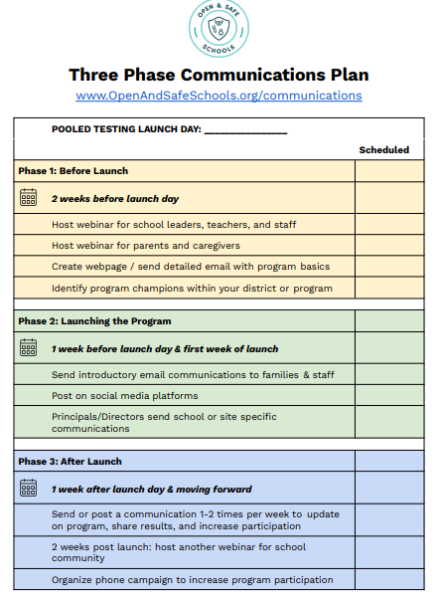
Open and Safe Schools website
www.openandsafeschools.org has vital information for schools that are launching/have launched their school testing program, including:
  Sample communication plans that highlight key messages for students, families, educators and school staff
  Template program FAQs
  Example webinars
  Peer-to-peer sharing resources

Slide 25
Next steps
04

Slide 26
Important links on DESE website
COVID-19 Testing Program: https://www.doe.mass.edu/covid19/testing/
  Authorized School Application
  COVID-19 Testing FAQs
  Webinar recordings and slides
  Consent forms and parent letters
On Desktop: https://www.doe.mass.edu/covid19/on-desktop.html
  Vaccination clinic information
  Mask extension
  80% vaccination threshold information
  Protocols for Responding to COVID-19 Scenarios
  Protocols Flowcharts
General FAQs: https://www.doe.mass.edu/covid19/faq/
  Protocols and other reopening FAQs (also sent out in the Commissioner’s Weekly Update)

Slide 27
Have a question? Need help?
Here’s how to get in touch:
  First, contact your Program Coordinator
    They are your best first line of defense.
  If you don’t hear back, contact CIC support
    support@cic-health.com
    Please allow a few hours for a response during the next few weeks
  Still don’t have what you need? Send us a note!
    DESE: k12covid19testing@mass.gov
    Shah Foundation: CovidEdTesting@ShahFoundation.org
Please note:
If you need help, please reach out as early as possible. All teams are experiencing a high volume and the sooner we hear from you the better.

