Slide 1
K-12 COVID Response Update
December 21, 2021

Slide 2
Today’s Presentation
Department of Elementary and Secondary Education
Shah Foundation
COVID-19 Command Center
Russell Johnston, Deputy Commissioner
Lauren Woo, Strategic Transformation Director
Ross Wilson, Executive Director
Eliza Novick, Project Manager
Marisa Meldonian, Associate Director
Lizzie Gordon, Project Associate
Jeremiah Hay, Deputy Strategy Director, COVID-19 Command Center
Sean Burpoe, Strategy Manager, COVID-19 Command Center
Amar Parikh, Strategy Analyst, COVID-19 Command Center
Notes:
Russell

Slide 3
CONTENTS
01
Holiday planning and program updates
02
Scheduling vaccine clinics
03
Contact tracing
04
Shah Family Foundation resources
05
Next Steps
Notes:
Lauren

Slide 4
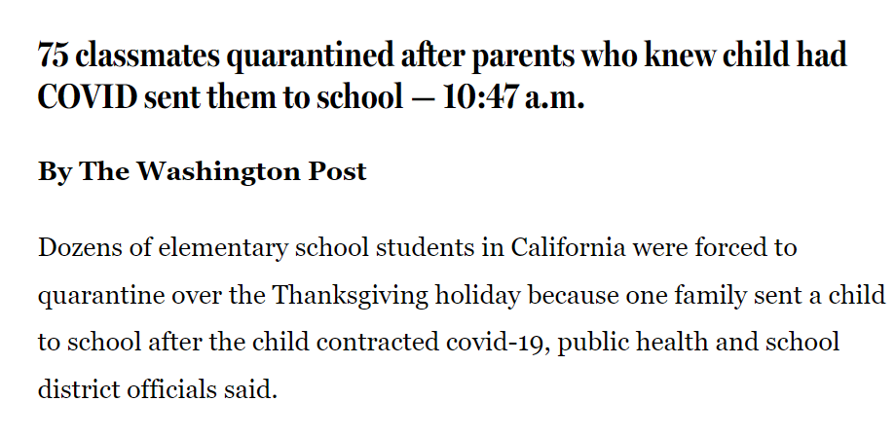
The Washington Post

Slide 5
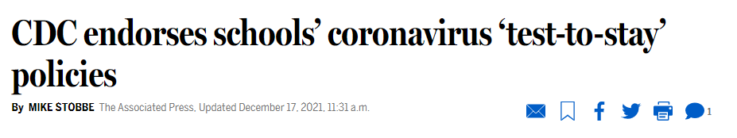
CDC endorsement of Test and Stay
On Friday (12/17), the CDC endorsed the test and stay policy after research of such policies in the Chicago and Los Angeles areas found COVID-19 infections did not increase when using the approach.
Massachusetts has been a national leader in Test and Stay, and the program has saved over 325,000 days of learning to date.
The CDC endorsement affords further credibility to the work being done at schools by administrators, nursing staff, and others to keep students in school.

Slide 6
Program results to date

Slide 7
Holiday planning and program updates
01

Slide 8
Multiple supports to respond to a potential surge
MA National Guard support
Mobile testing unit
Additional staffing
Follow up consultation and support
DESE, HHS, CIC data monitoring

Slide 9
Post-holiday preparation
Ensure that there is sufficient BinaxNOW within the district to conduct test and stay, reflex, and symptomatic testing upon returning from the break.
  Link to order more testing supplies: cich-ma.zendesk.com
  If the 7th day of Test and Stay falls over an extended break (e.g., long weekend, vacation, holiday break), the individual must be tested on the morning of their return to school so long as the first day back is within 10 days of the date of exposure. If the first day back to school following an extended break is day 11 or later from the date of exposure, the individual does not need to be tested upon return to school if they have not experienced any symptoms, as aligned to Protocol B-3.
Remind students/caregivers of COVID-19 protocols over the holiday break:
  Students experiencing COVID-19 symptoms over the break should follow Protocol C of the DESE protocols.

Slide 10
Post-holiday preparation
BinaxNOW tests may be administered by a trained professional.
  Individuals in your school community may be trained to support the administration of these tests. For example, afterschool staff, community members/volunteers, other part-time staff.
  Testers do not need to be health professionals.
Testers must complete the online training modules from Abbott prior to test administration.
  Testers must complete modules 1, 2, 3, and 4 found here.
  Complete guidance can be found in our SY22 COVID-19 Testing Memo (pgs. 6-7) on the DESE COVID-19 website.

Slide 11
Testing options over holiday break
Testing cannot be required for a student’s return to school after holidays or vacations.
  Please see the relevant FAQ here.
  Individuals are encouraged to follow the recommended travel guidelines set by the CDC.
If a student requires testing over the break, there are several options:
  102 municipalities recently received iHealth rapid tests; districts should coordinate with local leadership to understand how these tests will be used.
  A list of free local testing sites may be found here.
  Rapid tests with EUA’s from the FDA are available in many pharmacies and online.

Slide 12
Spring 2022 K-12 testing program
The program will continue to function similarly in January 2022.
However, we encourage schools to think of ways to “enhance” their program, if needed. For example:
  Generating a more efficient testing schedule, based on lessons learned in the fall
  Understanding program pain points (e.g., reflex testing) and identifying potential solutions (central location for reflex testing, automatic pool deconvolution, reducing pool size)
  Using ESSER funds to hire additional staff to support testing operations
We encourage you to discuss any potential program improvements with your CIC Health program coordinator.

Slide 13
BinaxNOW expiration dates
All BinaxNOW tests that have been shipped since the beginning of December do not expire until 2022.
The relevant expiration date (and lot number) is the one found on the outside of the box of 40 tests – not the one on each individual test
  If the current date is within the expiration date found on the outside of the box, all contents within the box – reagent, individual tests – may be used.
If you think your tests are expired, please take the following steps:
  Attempt to locate the lot number for the box of tests on the expiration extension list provided by Abbott.
    This list is also found in the BinaxNOW section of the COVID-19 testing webpage
  If they are not on this list, but you received the tests recently, identify the manufactured date on the box. If the manufactured date is less than twelve months from the current date, the tests may still be used.

Slide 14
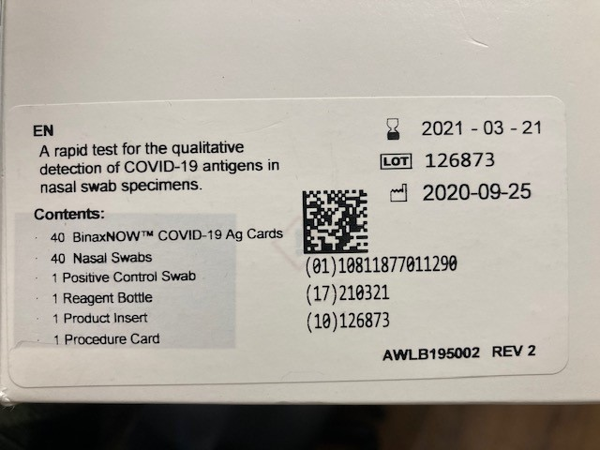
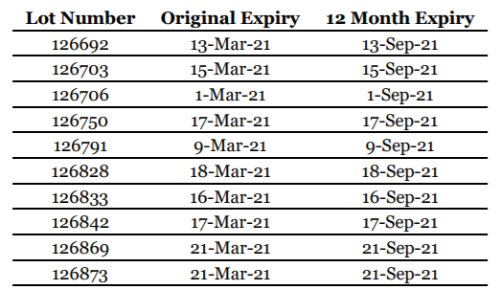
Locating BinaxNOW expiration dates (example)
Example of the label on the outside of the box of 40 tests:
Original expiration date: March 21, 2021
  However – this lot number was extended by Abbott, as seen below
Lot number: 126873
Manufactured date: September 25, 2020

Slide 15
eMed expiration dates
The relevant expiration date (and lot number) is the one found on each individual eMed test (note: this is different than the BinaxNOW tests!)
  If the current date is within the expiration date found on the individual test, all contents within the test box – such as the reagent– may be used.
If you think your tests are expired, please take the following steps:
  Attempt to locate the lot number for the individual test on the expiration extension list provided by Abbott.
    This list is also found in the BinaxNOW section of the COVID-19 testing webpage
  If they are not on this list, but you received the tests recently, identify the original expiration date on the box and add three months. If this date is in the future, the tests may still be used.

Slide 16
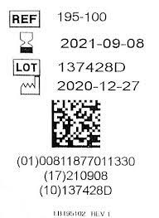

Locating eMed expiration dates (example)
Example of the label on the outside of the individual test:
Original expiration date: September 8, 2021
  However – this lot number was extended by Abbott, as seen below.
Lot number: 137428D
Manufactured date: September 25, 2020

Slide 17
Scheduling vaccine clinics
02

Slide 18
Reminder: Mobile Vaccination Program Process
We are accepting mobile vaccination clinic requests, with priority given to clinics for 5-11 year-olds
Mobile vaccination clinic requests must be submitted:
  Through the online form (mass.gov/mobilevaccineform), and
  At least 14 business days before the desired clinic date
If a clinic request can be accommodated, an approval notification email will be sent to introduce the clinic requestor to the designated vaccination provider
If you previously worked with a provider and enjoyed that experience, please note that in the request
Once you are connected with a provider, they will provide consent forms and a scheduling platform. We encourage as much pre-registration as possible to streamline the process

Slide 19
Contact tracing
03

Slide 20
Larry Madoff, MD
Larry Madoff, MD
Medical Director
Bureau of Infectious Disease and Laboratory Sciences
Massachusetts Department of Public Health

Slide 21
Reminders and tips for contact tracing
Reminder: any positive test should prompt isolation and contact tracing
  Only need to quarantine those not fully vaccinated
  Quarantining and testing in the school setting may be required when individuals are within 3 ft distance of an individual that tested positive for greater than 15 minutes when masked.
    When a student is not masked, this may extend to those within 3-6 feet of distance.
  In schools, individuals must either quarantine or test-and-stay (which is a modified quarantine)
Tips for conducting contact tracing
  Consider general notification for awareness to classrooms when not a close contact to decrease anxiety relating to cases
  Contact tracing can be performed by non-clinical personnel – it does not need to be conducted by a healthcare professional
  School staff only needs to conduct contact tracing for school close contacts. Household and non-school contact tracing is the responsibility of the LBOH
  As always, emphasize staying home and testing if symptomatic

Slide 22
Shah Family Foundation resources
04

Slide 23
Software Platform Cheat Sheet
Platform | What It’s Used For | Link
CIC Electronic Consent | Consent Forms, Logging Paper Forms | https://www.cic-health.com/consent/ma *each district/school can send an individualized link
CIC Zendesk Portal | How-To Materials, Re-Ordering Supplies, Student Consent & Database Portal | https://cich-ma.zendesk.com/hc/en-us
Crush the Curve | Recording Tests: single/double swab, BinaxNOW | https://covid.cic-health.com/s/login/
Veritas | Recording Tests: Saliva | https://secure.veritasgenetics.com/user/login
Project Beacon | Recording Tests: LEGACY CLIENTS ONLY (single/double swab, BinaxNOW) | https://app.beacontesting.com/login
The Shah Foundation has also created cheat sheets that district personnel can use to keep track of usernames and passwords for Crush the Curve, Veritas Genetics, and Project Beacon.

Slide 24
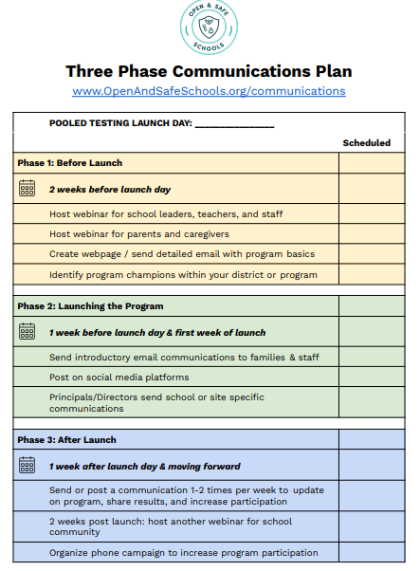
Open and Safe Schools website
www.openandsafeschools.org has vital information for schools that are launching/have launched their school testing program, including:
  Sample communication plans that highlight key messages for students, families, educators and school staff
  Template program FAQs
  Example webinars
  Peer-to-peer sharing resources

Slide 25
Next steps
06

Slide 26
Important links on DESE website
Order supplies: cich-ma.zendesk.com
COVID-19 Testing Program: https://www.doe.mass.edu/covid19/testing/
  Authorized School Application
  COVID-19 Testing FAQs
  Webinar recordings and slides
  Consent forms and parent letters
On the Desktop: https://www.doe.mass.edu/covid19/on-desktop.html
  Protocols for Responding to COVID-19 Scenarios
  Protocols Flowcharts
General FAQs: https://www.doe.mass.edu/covid19/faq/
  Protocols and other reopening FAQs (also sent out in the Commissioner’s Weekly Update)

Slide 27
Have a question? Need help?
Here’s how to get in touch:
  First, contact your Program Coordinator
    They are your best first line of defense.
  If you don’t hear back, contact CIC support
    support@cic-health.com
    Please allow a few hours for a response during the next few weeks
  Still don’t have what you need? Send us a note!
    DESE: k12covid19testing@mass.gov
    Shah Foundation: CovidEdTesting@ShahFoundation.org
Please note:
If you need help, please reach out as early as possible. All teams are experiencing a high volume and the sooner we hear from you the better.

